Slide 1


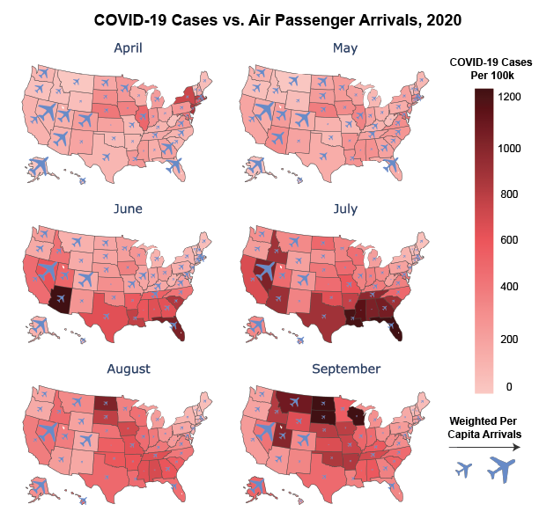
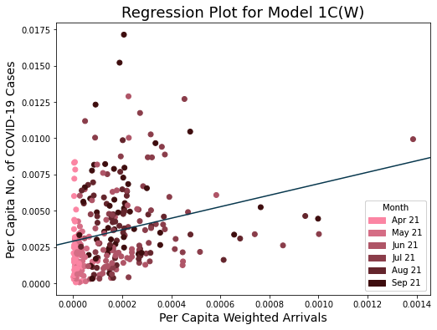
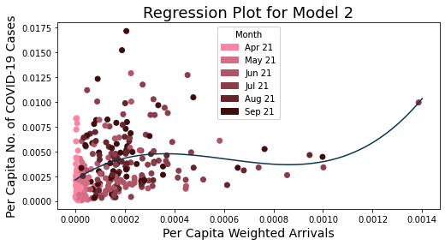
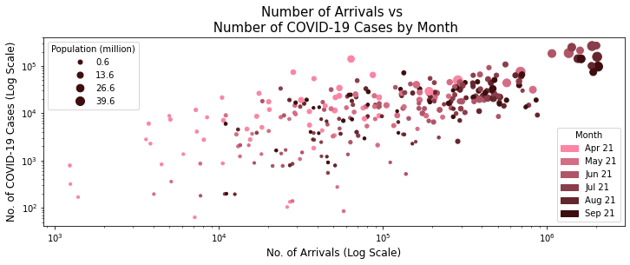
PandAIRmic
An analysis of the impacts of air travel on the spread of COVID-19
Jian Cong Loh, Joshua Neronha, Stephen Sun, Tzuhwan Seet
DNA 20
Cure 100%
Hypothesis
Simple Linear Regression
Map Visualization
We hypothesize that the number of domestic air passenger arrivals in a US state is positively correlated with the number of new COVID-19 cases in that state.
All simple linear regression models except Model 1B showed a significant positive correlation between the independent and dependent variables at the 5% significance level.
While Model 1A had the highest R², this likely reflects a spurious correlation as population is a confounding factor that influences both variables.
Model | P-Value | Coef | R²
1A | 0.000 | 0.083 | 0.611
1B | 0.208 | -0.095 | 0.005
1C | 0.000 | 0.016 | 0.047
1C(W) | 0.000 | 3.96 | 0.065
Data
Our COVID-19 data is obtained from The Atlantic’s The COVID Tracking Project. It gives the daily number of positive cases for each of the 50 states, five territories and D.C., and our data spans Jan 20 and Feb 21.
Our air passenger arrival data is compiled from two datasets from the USDOT. The DB1B gives a 10% sample of all itineraries by quarter, and covers Q1 to Q3 2020. The T100 breaks down the number of passengers flying between two airports (including layovers) by month, and covers Jan to Nov 2020. We combined the two datasets to estimate the number of passengers travelling between every pair of states per month, excluding layovers.
Our policy data comes from the COVID-19 US State Policy Database developed by the Boston University School of Public Health. It tracks the dates when each US state implemented COVID-19-related social safety net, economic, and social distancing policies.
To control for population, we experimented with the percentage change (Model 1B) and per capita values (Model 1C) of both variables.
A possible reason for Model 1B’s poor performance is that taking the percentage change of the variables violates the i.i.d. assumption.
We extended Model 1C by weighing the number of arrivals by the origin states’ per capita number of cases. Model 1C(W) gave the best R², and serves as the base model for our subsequent analyses.
Polynomial Regression
Given the geographical nature of the data, a map provides a useful visualization that allows us to compare across different states at one glance and more intuitively understand the relationship between arrivals and COVID-19 cases. The map supports the results of our statistical tests by showing that there is some positive correlation between the independent and dependent variables, but it is limited.
We used a third degree polynomial model, as fitting the examples to polynomial curves of increasing degrees resulted in an increase in R², but this improvement plateaus for degrees > 3.
All polynomial terms have significant correlation with p.c. number of cases at the 5% confidence level.
The R² is 0.118, which is higher than that for simple linear regression. The relationship between weighted p.c. arrivals and p.c. COVID-19 cases is therefore likely to be polynomial rather than linear.
Methodology
To match the monthly arrivals data, we aggregated cases from the 15th of each month to the 14th of the next, considering the 2-week COVID-19 incubation period. This gave us 294 data points from 49 states (excl. DE) and 6 months (Apr – Sep 20).
Our exploratory data analysis (see below) gave us the following insights:
States with large pop. had more arrivals and cases – pop. is a possible confounding variable that affects both
Linear r/s in log-log plot – possible polynomial r/s
Cases increased over time – possible time-fixed effects
Conclusions
Regressor | P-Value | Coef
X | 0.002 | 16.9
X² | 0.000 | -3.30 x 10⁴
X³ | 0.001 | -1.80 x 10⁷
There is a statistically-significant positive correlation between air passenger arrivals and new COVID-19 cases, although the independent variable explains only a small proportion of the variance in the independent variable.
The relationship between domestic air passenger arrivals and new COVID-19 cases is likely polynomial and not linear.
Social distancing policies are negatively correlated with COVID-19 cases, but are not the only omitted variables that vary across states.
More variables that are neither entity- nor time-fixed are needed as controls to understand the true relationship between air passenger arrivals and COVID-19 cases.
Multiple Linear Regression
Regressor | P-Value | Coef
Weighted p.c. Arrivals | 0.033 | 1.99
Stay at Home | 0.032 | -0.001
Business Closure | 0.067 | -0.001
Facemask Mandate | 0.088 | -0.001
Quarantine Mandate | 0.000 | -0.002
All policy variables are negatively correlated with weighted p.c. number of cases, with the relationship being significant at the 5% level for Stay at Home and Quarantine Mandate.
The R² is 0.211, which is higher than that for simple linear regression. Adding states’ COVID-19-related policy to the model reduces omitted variable bias.
Limitations / Future Directions
We ran simple linear regression with different versions of our variables:
Model 1A – No. of arrivals vs no. of cases
Model 1B – Change in arrivals vs change in cases
Model 1C – Per capita (p.c.) arrivals vs per capita cases
Model 1C(W) – Weighted p.c. arrivals vs p.c. cases
Using Model 1C(W) as the base, we ran several more complex regression models:
Model 2 – Polynomial regression
Model 3 – Multiple linear regression (w/ policy as controls)
Model 4 – Fixed effects model (entity & time)
Due to its proprietary nature, data from the USDOT is available only by month or quarter, limiting the resolution of our analysis. More granular data will allow for a more precise analysis of the relationship.
There is likely simultaneous causality where air passenger arrivals affect COVID-19 cases, and vice versa. Instrumental variable regression can allow us to eliminate the bias.
As an extension, the relationship between international flight volumes and COVID-19 cases can be explored. Stricter international travel restrictions may mean that flights have a greater impact on the cross border spread of COVID-19.
Fixed Effects Model
A fixed effect model controls omitted variables in panel data that vary across entities/states (e.g. public health systems, political attitudes) or time (e.g. federal COVID-19 policy).
Including entity-fixed effects to Model 3 gives an R² of 0.274, but weighted p.c. arrivals is no longer significantly correlated with p.c. cases (p-value 0.469). Adding time-fixed effects too does not change the variables’ coefficients or p-values, but gives a lower R² of 0.0343.
The results indicate that there is omitted variable bias from unobserved variables that vary across states but not time, but not from those constant across states that change with time.

