Slide 1
Mechanical Parts
BOM and material description

Slide 2

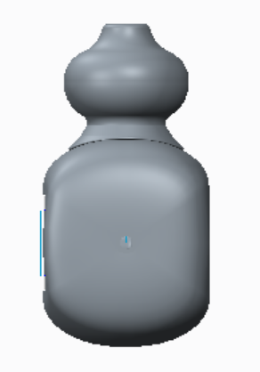
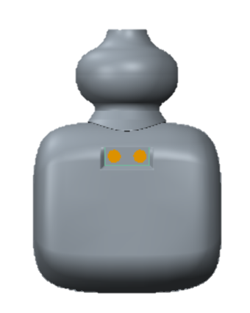

Slide 3
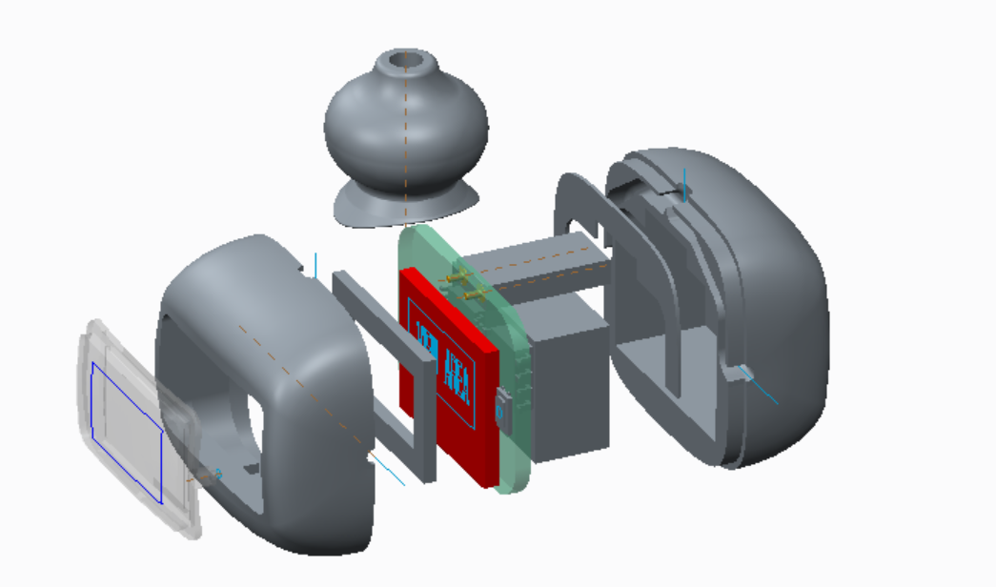
Counter head
金屬皇冠
0.3 mm Film with adhesive
0.3 薄片含背膠
Back cover
金屬背蓋
EE components
電子零件
Sponge
1.0mm 泡棉
Front cover
金屬前框
** 前後蓋點膠黏死完成組裝
PC Lens with Switch
PC 面板含按鍵功能

Slide 4
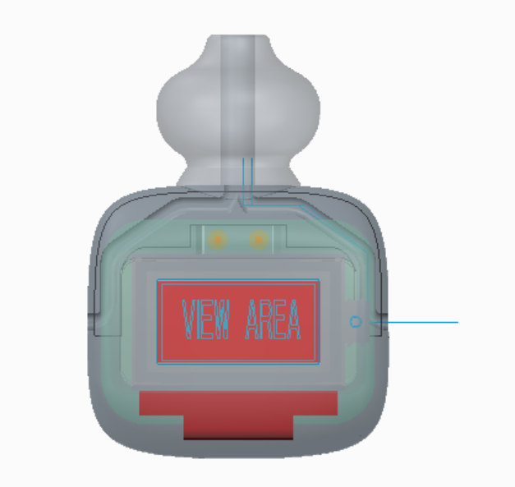
** 穿線路徑

Slide 5
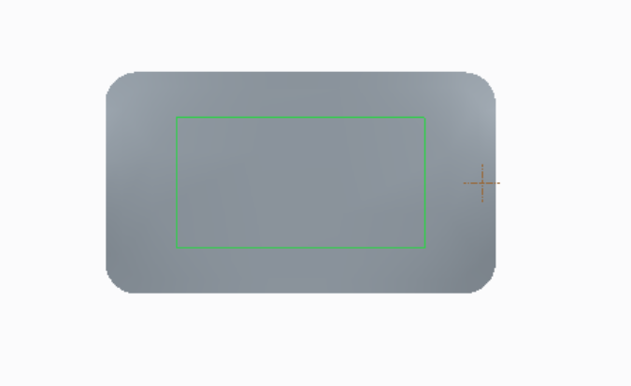
PC Lens with Switch
PC 面板含按鍵功能
11.78 mm
3.6 mm
2.48 mm
6.18 mm
印刷黑色
透光區域

Slide 6
Product Overview
And
EE components description

Slide 7
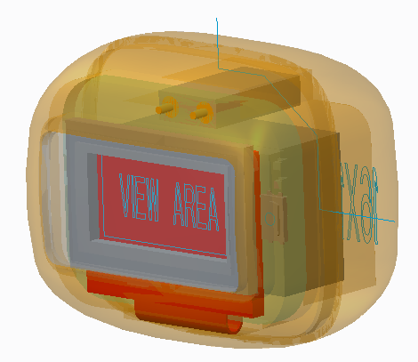
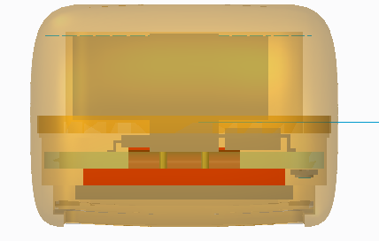
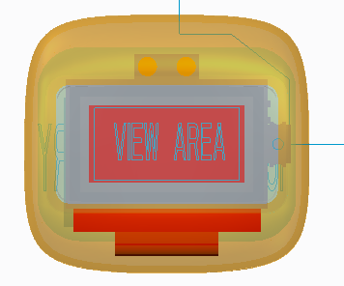
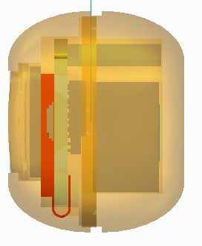
16mm
20mm
22mm

Slide 8
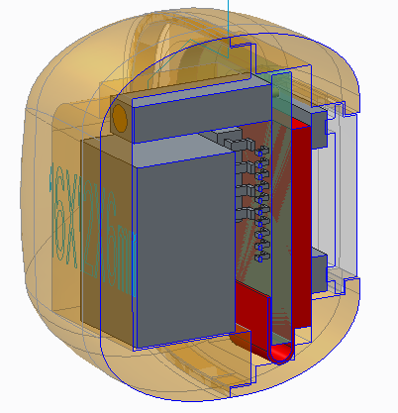
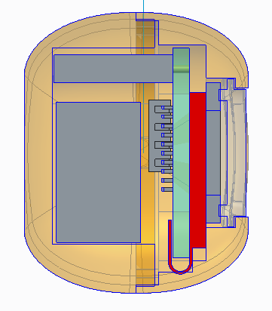
Charge connector
Side section
battery
lens
sponge
OLED
Space
2.3mm
PCB T1.2mm

Slide 9
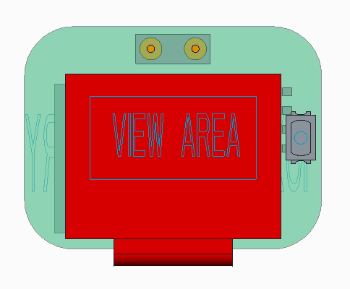

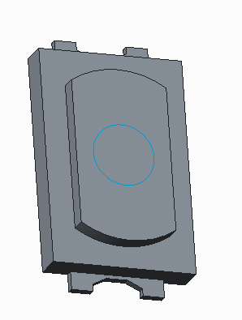
R3.3
FRONT side
15mm
PCB T1.2mm
20 mm
Switch
11.1mm
OLED 0.49inch
T1.2mm
E-switch TL3780
www.e-switch.com
14.5mm

Slide 10
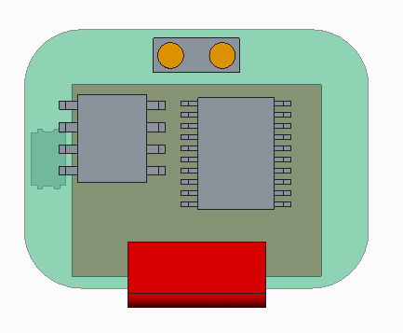
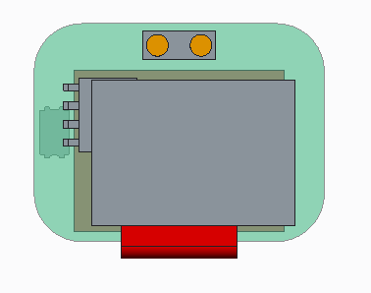

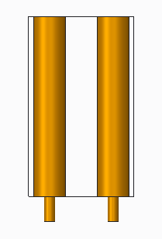
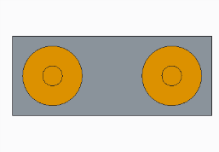
BACK side
Charge connector
N76E003
TP4056
ZIF connector
Battery
Battery cable
D 1.5 mm
10mm
10mm
Charge conn.
10mm
1.2mm
14.mm
2mm
D 0.5mm
Battery H 6.0mm
Max 7.0 mm
5mm
Pitch 3.0mm

