Slide 1

HOW TO DO
GREAT RESEARCH
Samira Khan

Slide 2
AGENDA
Good advices on doing great research
Maximizing Impact by Bill Dally
You and Your Research by Richard Hamming
The Structure of Scientific Revolutions by Thomas Kuhn

Slide 3
WHAT IS THE GOAL OF RESEARCH?
To generate new insight
that can enable what previously did not exist
Research (in engineering) is a hunt for insight that can eventually impact the world
*Thanks to Onur Mutlu for the next few slides

Slide 4

TALK BY BILL DALLY
Moving the needle: Effective Computer Architecture Research in Academy and Industry
by Bill Dally, ISCA 2010 Keynote Talk
Professor at Stanford
Chief Scientist at NVidia
Founder and chairman of Stream Processors, Inc
Acknowledgment: Next few slides are from this talk

Slide 5
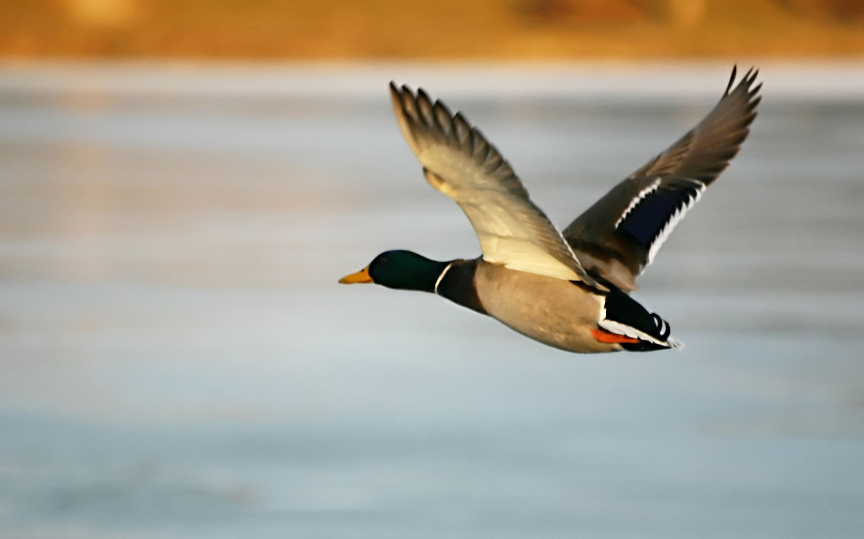
Current Architecture Practice

Slide 7
Aim Here
5-10 years

Slide 8
Enable this point
5-10 years

Slide 9
The Research Formula

Slide 10
Reward
If you are wildly successful, what difference will it make?

Slide 11
Effort
Learn as much as possible with as little work as possible

Slide 12
Effort
Do the minimum analysis and experimentation necessary to make a point

Slide 13
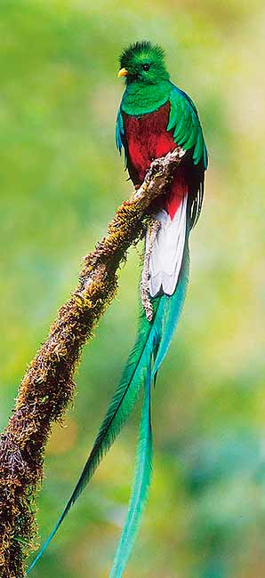
Research is a
hunt for insight
Need to get off the beaten path to find new insights

Slide 14
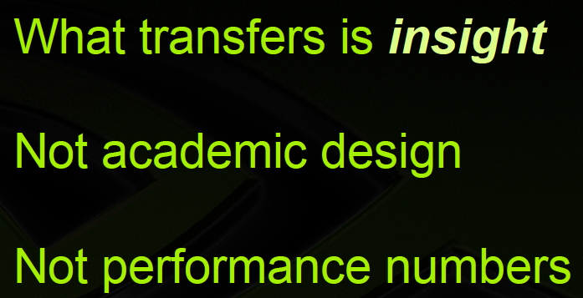

Slide 15
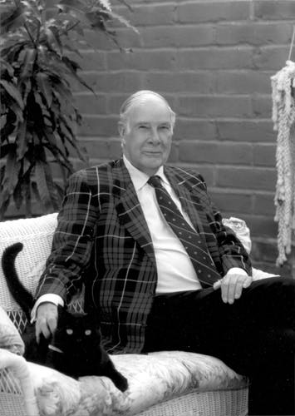
RICHARD HAMMING
“The purpose of computing is insight, not numbers”

Slide 16
RICHARD HAMMING
Best known for Hamming Code
Won Turing Award in 1968
Was part of the Manhattan Project
Worked in Bell Labs for 30 years
You and Your Research
Mainly his advice to other researchers
Had given the talk many times during his life time
A video is available if you are interested
http://www.youtube.com/watch?v=a1zDuOPkMSw

Slide 17
Why do so few scientists make
significant contributions and
so many are forgotten in the long run?

Slide 18
How to do Outstanding (Nobel Prize Quality) Research
Hamming wanted to answer this question
Luckily he knew a number of famous people
He and Shannon shared an office
He tried to compile the characteristics
So what are the components?

Slide 19
HOW TO DO GREAT RESEARCH
IMPORTANCE OF THE PROBLEM
LUCK?
BEING SMART?
COURAGE
HARD WORK
EMOTIONAL COMMITMENT
COMMUNICATION SKILL

Slide 20

Importance of the Problem
What imp problem are you working on?
What are the imp problems in your field?
Hamming used to have lunch with physicists
but they got Nobel prize and left, Hamming started having lunch with chemists
He asked them these questions
“What are the important problems of your field?”
“What important problems are you working on?”
“If what you are doing is not important, and if you don't think it is going to lead to something important, why are you working on it?”
He was not welcomed in the table; none of them did anything in the future
Other than one person who gave some thought

Slide 21
Importance of the Problem
IMPORTANT PROBLEM
IMPORTANT CONTRIBUTION
If you do not work on an important problem, it's unlikely you'll do important work
Sign of an average scientist
spends time working on problems which he believes will not be important
doesn't believe that they will lead to important problems

Slide 22
Importance of the Problem
Each Friday Hamming will think about these high-level research questions:
What will be the role of computers in all of AT&T?
How will computers change science?
What will be the impact of computers and how can I change it?
THINK ABOUT HOW COMPUTERS HAVE CHANGED THE WORLD IN 50 YEARS

Slide 23
HEILMEIER’S CATECHISM
Heilmeier invented liquid crystal displays (LCDs)
What is the problem?
Why is it hard?
How is it solved today?
What is the new technical idea?
Why can we succeed now?
What is the impact if successful?

Slide 24
HOW TO DO GREAT RESEARCH
IMPORTANCE OF THE PROBLEM
LUCK?
BEING SMART?
COURAGE
HARD WORK
EMOTIONAL COMMITMENT
COMMUNICATION SKILL

Slide 25
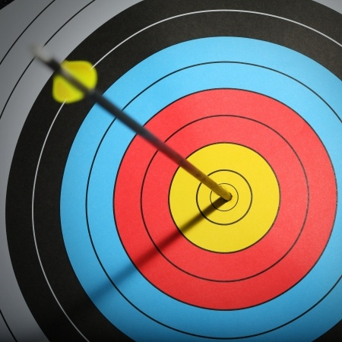
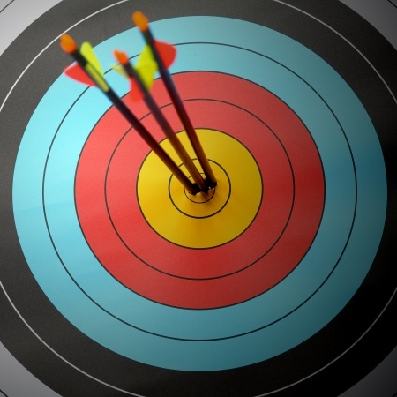
Luck?
Can you get lucky multiple times?
Einstein made multiple contributions
Why?
Luck favors the prepared mind
“Yes, it is partly luck, and partly it is the prepared mind”
Newton said, “If others would think as hard as I did, then they would get similar results”

Slide 26
HOW TO DO GREAT RESEARCH
IMPORTANCE OF THE PROBLEM
LUCK?
BEING SMART?
COURAGE
HARD WORK
EMOTIONAL COMMITMENT
COMMUNICATION SKILL

Slide 27
How about having lots of `brains?'
Not enough
Need to be courageous, hard working, articulate, confident
Hamming met Clogston and thought he should be fired
“Clogston finally did the Clogston cable*. After that there was a steady stream of good ideas. One success brought him confidence and courage.”
*laminated central conductor that reduced microwave system losses

Slide 28
HOW TO DO GREAT RESEARCH
IMPORTANCE OF THE PROBLEM
LUCK?
BEING SMART?
COURAGE
HARD WORK
EMOTIONAL COMMITMENT
COMMUNICATION SKILL

Slide 29

Courage
“Once you get your courage up and
believe that you can do
important problems, then you can.
If you think you can't,
almost surely you are not going to.”
Hamming gave example of Shannon’s courage
Courage to ask difficult questions
Shannon asked the impossible question, “What would the average random code do?” He then proves that the average code is arbitrarily good

Slide 30
HOW TO DO GREAT RESEARCH
IMPORTANCE OF THE PROBLEM
LUCK?
BEING SMART?
COURAGE
HARD WORK
EMOTIONAL COMMITMENT
COMMUNICATION SKILL

Slide 31
Hard Work
Hamming mentions John Tukey, who was younger than Hamming but yet more knowledgeable than him
“You would be surprised Hamming, how much you would know if you worked as hard as he did that many years.”
The more you know → the more you learn;
The more you learn → the more you can do;
The more you can do → the more the opportunity;
Given two people with exactly the same ability
If one person manages even one more hour day in and day out
Will be tremendously more productive over a lifetime

Slide 32
HOW TO DO GREAT RESEARCH
IMPORTANCE OF THE PROBLEM
LUCK?
BEING SMART?
COURAGE
HARD WORK
EMOTIONAL COMMITMENT
COMMUNICATION SKILL

Slide 33
Emotional Commitment
Need to emotionally commit to the problem
Creativity comes from subconscious mind
Need to deeply immersed and committed to a topic day after day
Even when not working, still thinking about the problem
Waiting for the bus or taking a walk --> your mind should still be busy
Let your subconscious mind work on your problem
Eureka moment

Slide 34
HOW TO DO GREAT RESEARCH
IMPORTANCE OF THE PROBLEM
LUCK?
BEING SMART?
COURAGE
HARD WORK
EMOTIONAL COMMITMENT
COMMUNICATION SKILL

Slide 35
Last Attribute: Communicating Clearly
You have to learn to write clearly
So that people can understand the contribution
You must learn to give reasonably formal talks
So that you can communicate your ideas
You must learn to give informal talks
So that you can engage other people and discuss your contributions
Practice, practice, practice

Slide 36
Why do so many talented people fail?
Don't work on important problems
Don't become emotionally involved
Don't try and change what is difficult
Fight the system instead of doing great work
Self-delusion: keep giving themselves alibis why they don't have contribution

Slide 37
MY SUMMARY
Pick your problem wisely, have a high-level vision
This is the most important part
Be passionate about your problem
Will let you drive yourself
Work hard
Push yourself to limit
Be clear and articulate
Have to be able to convince others
Writing and presenting well is a significant part of research

Slide 38
So far we have seen how to do great research
Let’s get one more layer up
Where does your research fit in the history of science?

Slide 39
The Structure of Scientific Revolutions
Thomas S Kuhn

Slide 40
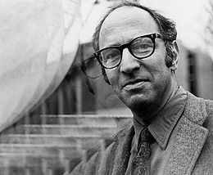
Thomas S Kuhn
PhD in Physics from Harvard in 1949
During his PhD switched from physics to the History and Philosophy of Science
Joined University of California Berkeley as a professor of the History of Science in 1961
Wrote the book “Structure of the Scientific Revolutions” in 1962

Slide 41
Some Information about the Book
650,000 copies in 25 years (1987)
It changed “the image of science by which we are now possessed”
Times Literary Supplement labeled it one of "The Hundred Most Influential Books Since the Second World War.”
Kuhn made the words “Paradigm shift”, “Anomaly”, “Normal science as puzzle-solving” popular
The book is heavily focused on basic science (physics), but can be applicable to technology, too

Slide 42
The Structure of Scientific Revolutions
The Structure of Scientific Revolutions
Revolution is usually used in political context
Everything old is overthrown and a new world order begins
Not only there is revolution in science, there is a structure of the revolutions
Copernicus’s Revolution or Newton’s Principia
Used the word “Paradigm Shift”
"sufficiently unprecedented to attract an enduring group of adherents away from competing modes of scientific activity,"
"sufficiently open-ended to leave all sorts of problems for the redefined group of practitioners to resolve.”

Slide 43
So What is the Structure of Scientific Revolutions?
Step 2:
Normal Science
Step 3:
Anomaly
Step 4:
Crisis and Emergence
of Scientific Theory
Step 5:
Scientific
Revolution
Step 1:
Pre-paradigm
History of Science

Slide 44
Pre-paradigm
No accepted scientific facts and rules
Exists many competing school of thoughts
Example: History of physical optics
Current Status: Photon has characteristics of waves and particles
Nineteenth century: wave (Young and Fresnel)
Eighteenth century: material corpuscles (Newton)
corpuscles → small discrete particles called
Light made of corpuscles that travel in a straight line with a finite velocity
Pre-paradigm: particles emanating from bodies, modification of medium that intervened between body and eye, etc.
Ends with triumph of one pre-paradigm school and emergence of a paradigm

Slide 45
Normal Science
Established set of rules defines the field
Given the basic rules, scientists focus on details
“Puzzle solving”
Determination of significant facts
Matching of facts to theory
Articulation of the theory
Normal science is cumulative, adds to scope and precision of scientific knowledge
Normal Science does not aim at significant novelty

Slide 46
Anomaly
Discoveries are rare in normal science
expectations obscure the vision
But occasionally anomalies occur
Paradigm theory cannot explain the facts/experiments
“Copernicus saw as counter instances what most of Ptolemy’s other successors had seen as puzzles in the match between observation and theory.”
Sun rather than the Earth is at the center of the universe
in his day astronomers were "so inconsistent in these [astronomical] investigations ... that they cannot even explain or observe the constant length of the seasonal year.”
Anomalies are precondition for discovery

Slide 47
Crisis
Only anomaly is not enough for the emergence of new scientific theory
A crisis involves a period of extra-ordinary research
“To reject one paradigm without simultaneously substituting another is to reject science itself.”
“proliferation of competing articulations, the willingness to try anything, the expression of explicit discontent, the recourse to philosophy and to debate over fundamentals.”
Food for thought: Why do we have so many competing memory technologies now? Why so many computing models?

Slide 48
Scientific Revolution
Crisis gradually changes the nature of scientific activity
The competing schools disagree and debate on their perspective paradigms
Eventually more promising paradigm gets accepted by all and those who do not accept the paradigm vanishes
Two characteristics of revolution:
"First, the new candidate must seem to resolve some outstanding and generally recognized problem that can be met in no other way.
“Second, the new paradigm must promise to preserve a relatively large part of the concrete problem solving activity that has accrued to science through its predecessors.”
Food for thought: Vacuum tubes vs. transistors

Slide 49
Paradigms Transform Scientists’ View of the World
“New paradigms place new relations amongst the data.”
“When the transition is complete, the profession will have changed its view of the field, its methods, and its goals.”
A process that involves "handling the same bundle of data as before, but placing them in a new system of relations with one another by giving them a different framework.”

Slide 50
Paradigms Transform Scientists’ View of the World
Example: Discovery of Uranus (planet)
Atleast seventeen occasions where astronomers mentioned a star in the position of Uranus
They did not notice the anomaly in motion
Once Herschel discovered Uranus, that prepared the mind of the astronomers to the possibility of new planets
Twenty of them found in next fifty years
Food for thought: What did cell phones enable? Computers were used for calculation. Now we have self-driving cars, smart watches, smart TVs, etc

Slide 51
Science is Non-Cumulative
Kuhn attacks the common idea that scientific knowledge is accumulative
Science progresses through revolutions
Scientific revolutions are non-cumulative
An older paradigm is replaced
In whole or in part by an incompatible new one

Slide 52
Thoughts?
Let’s do great research then …

Slide 53
HOW TO DO
GREAT RESEARCH
Samira Khan

