Slide 1
HOW TO
do good systems research
and publish papers
Changwoo Min
ECE @ Virginia Tech
Oct 23rd, 2018
Notes:
Today I am going to talk about manycore scalability of file systems.
This work is a joint work with my colleagues at Georgia Tech: Sanidhya Kashyap, Steffen Maass, Woonhak Kang, and Professor Tasesoo Kim.
In this work, we introduce a new file system benchmark, named FxMark,
and analyzed the manycore scalability of five-widely used file systems using FxMark.

Slide 2
Executive Summary
No magic wand
  Read papers; think critically; build systems; measure performance; write papers
But there are anti-patterns and best practices
Following are some thoughts and suggestions that I learned from my advisers, collaborators, and colleagues.

Slide 3
Three most important things in doing systems research
Problem selection
Problem selection
Problem selection

Slide 4
How to find a good problem
What is a good problem?
  Important problem
  Unsolved problem (or problem that needs more solutions)
  New problem
What should I do?
  Read papers; think critically; build systems; measure performance; write papers
Where should I take a look?
  Emerging new technologies (manycore, accelerator, RDMA, non-volatile memory)
  Boundaries between layers (SSD vs. file system)
  New aspects of a system (security, energy consumption)
  New applications (IoT, Mobile, Cloud)
  Interactions between subfields (OS, concurrency, database)

Slide 5
Why finding a good problem is not easy as a gradstudent?
You should change your role in learning
  Undergrad: knowledge consumer
  Grad: knowledge producer
Are you ready to find an important problem?
  Student: I have a cool idea, which is …
  Adviser: Sounds great! The similar idea was published at 197x by someone who won the Turing award.
  /* a month later */
  Student: I have another cool idea, which is …
  Adviser: Sounds great! The similar idea was published at 198x by someone who won the Turing award.
  /* a month later */
  … 199x …
  /* a month later */
  … 200x ...`

Slide 6
Develop a good intuition
How to approach the problem
  What’s the fundamental limitation of existing approaches?
  Why do you think your approach would be better?
  E.g., MV-RLU: two threads accessing different memory locations should run in parallel.
Elevator pitch to your adviser, colleagues, senior meet in conferences
  What are their first questions?
  Why they are not enthusiastic to your idea?
Improve your intuition/idea/algorithm
Repeat
Do you still think your approach is good?

Slide 7
Is your idea publishable? (1/2)
Is your system better?
  Better performance
  Short tail latency
  Save energy
  Enable new types of applications
  Secure by design
  Etc.
How much better is “better”?
  100x, 10x
  30%
  10%, 5%

Slide 8

Is your idea publishable? (2/2)
Is your idea novel?
New technique
New combination
of old technique
Old technique
Not-important problem
Old problem
New problem

Slide 9
My rule of thumb to find an important problem and a good solution
: 30-20 rule
First read 30 papers
  Understand the problem space more deeply
  Know the details of common techniques and the big ideas behind them
  Know how to evaluate and what to compare
  Find out the fundamental limitations of the 30 papers
  Come up with your tentative solution to overcome the fundamental limitations
Then read another 20 papers
  Understand techniques proposed in 20 more papers
  Test if your idea is competitive over the 20 papers at least one or two aspects (e.g., performance, energy, programmability, etc)

Slide 10
Is it doable?
Can you develop the first prototype within a semester?
  If no, ...
    Learn necessary skills
    Find good team mates
    Limit the scope → Is your idea still competitive?
Know your competition
  What is the baseline?
  What is the state-of-the-art?

Slide 11
Design / Implementation / Evaluation
This is an iterative process.
  Start the minimal design and implementation
  Gradually add features
  Or periodically rewrite the code
Plan evaluation ahead
  Write unit testcases
  Integrate your benchmark and automate evaluation

Slide 12

Papers in systems research
Romantic comedies

Slide 13
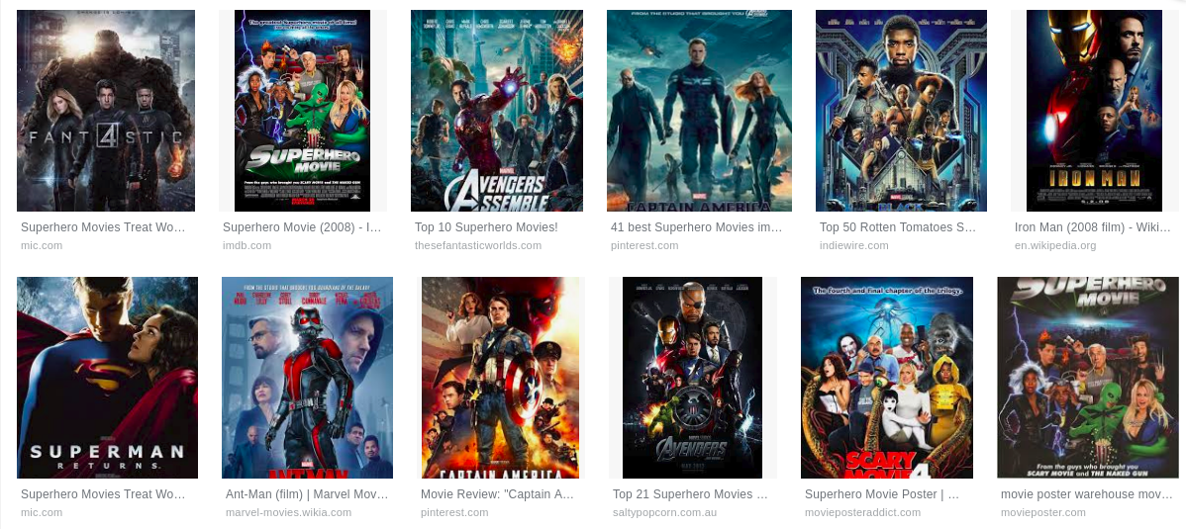
Papers in security research
Superhero

Slide 14
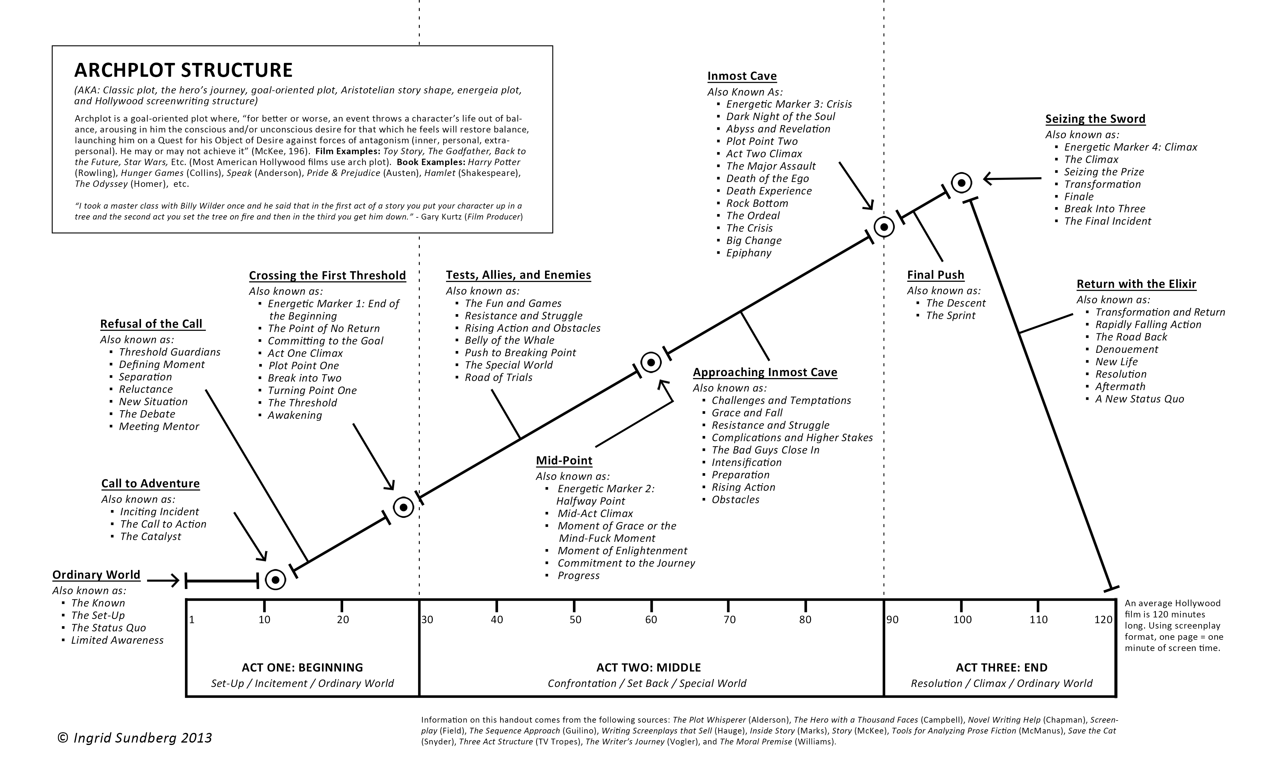
The Law of Genre

Slide 15
Archplot of a systems paper
Contribution
Evaluation
Challenges
Benefits
Problem
Conclusion

Slide 16
Before writing a paper
Know your strength and weakness
  Read all related papers: 30 – 50
  What is the real strength of my approach?
  How will you defend your weakness?
Does your evaluation results support your claim?
  Get baseline numbers first
  Run core evaluation results
Is your system better? Really?

Slide 17
Typical outline of a systems paper
Introduction
Background and Motivation
Design
Implementation
Evaluation
Discussion and Limitation
Related work
Conclusion

Slide 18
Outlining your paper
Top-down approach
Find 2-3 most similar paper in style
  Copy the style of the paper!
Quickly outline the paper (within one day)
  Decide section title
  For each section
    Key message of each paragraph
  Evaluation
    What to show? What to compare?
Present the first version of outline to co-authors
  What’s their questions?
Rewrite the outline from scratch (withing five hours)
  Don’t try to modify the first version
Revise the outline
  By co-authors

Slide 19
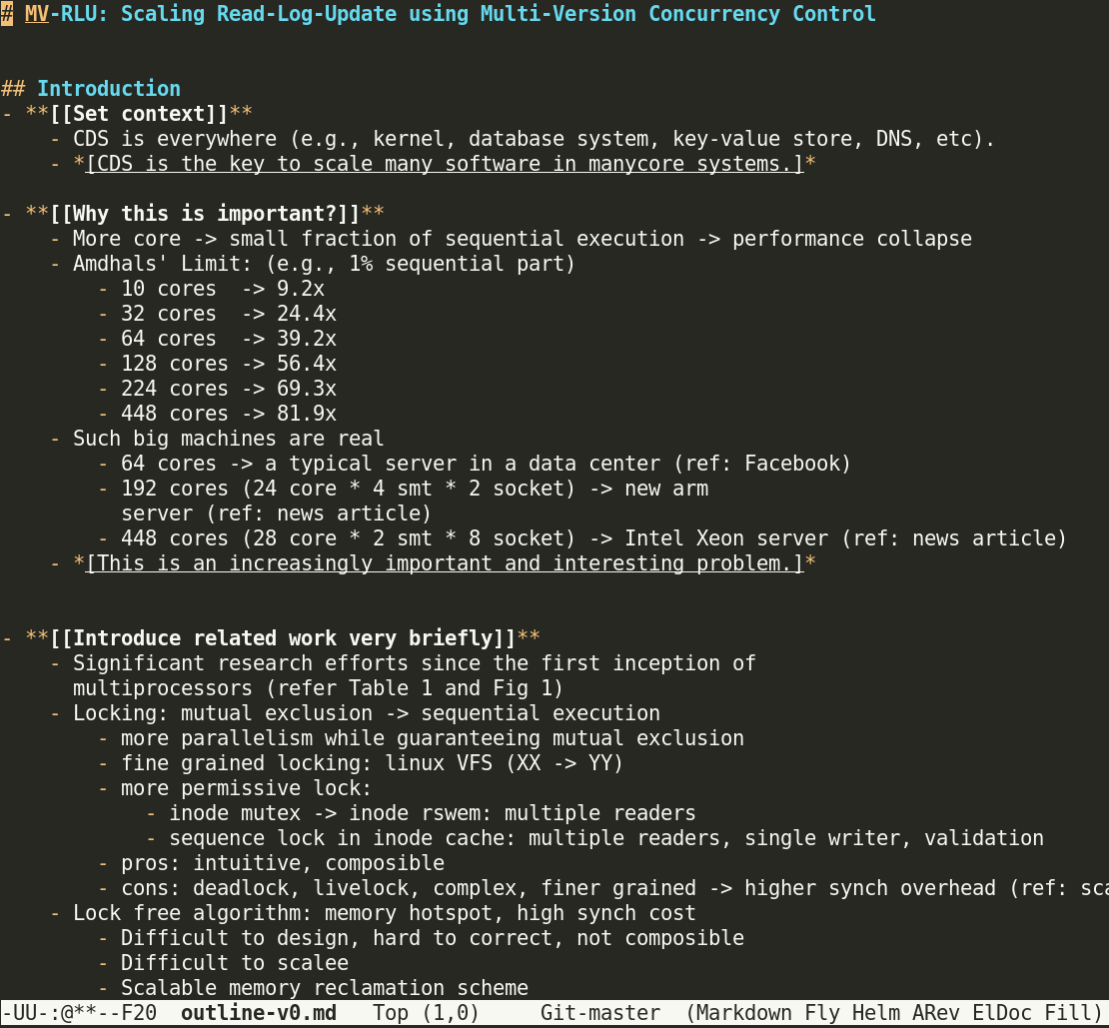
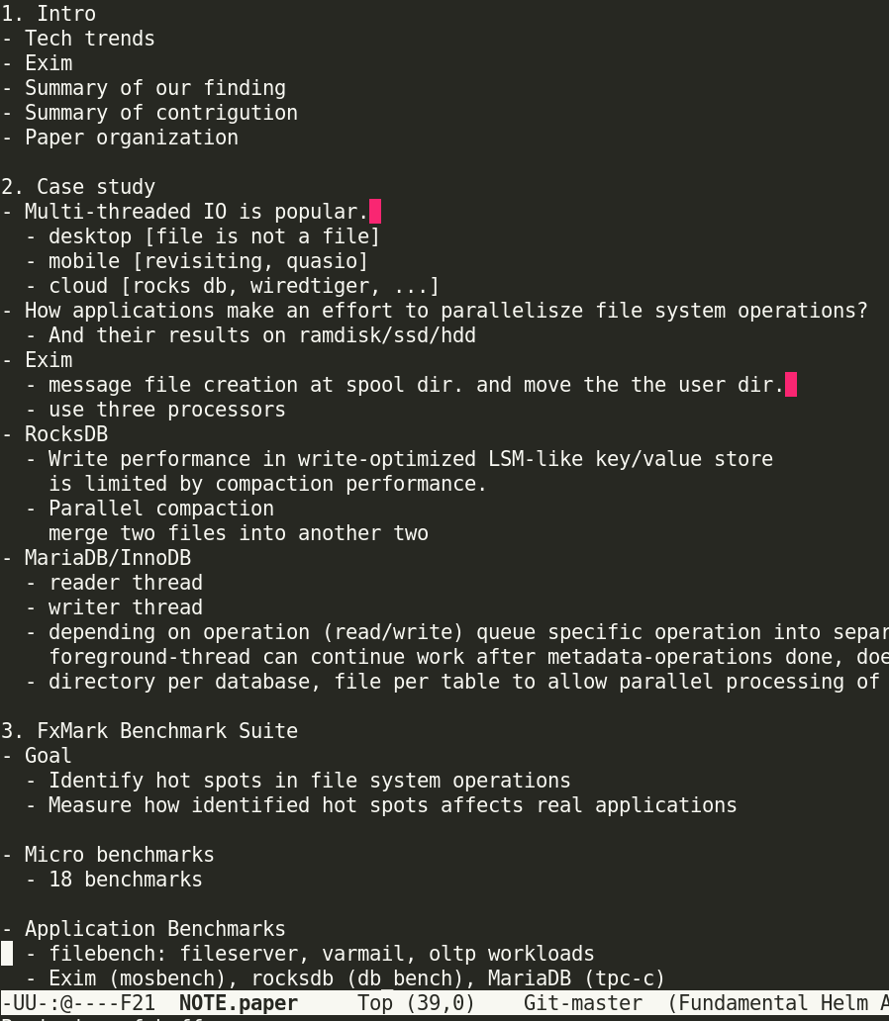
Outline examples

Slide 20
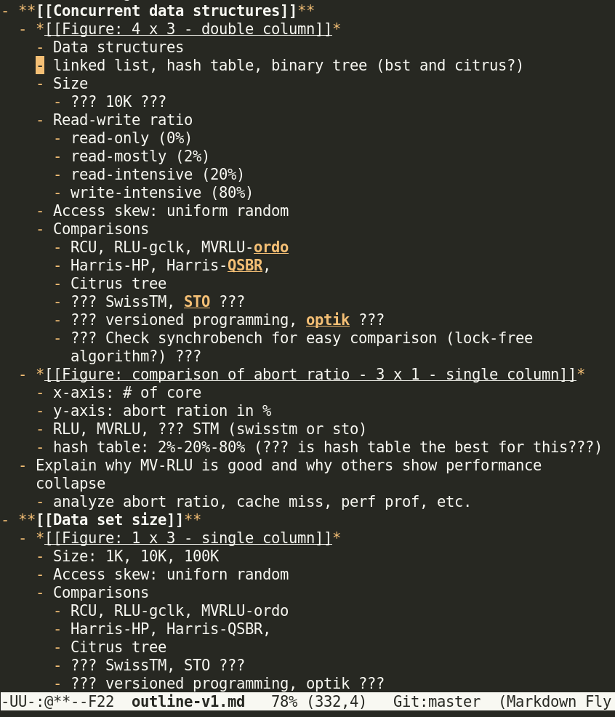
Fix evaluation scenarios
Decide graphs and tables in the evaluation section
  X-axes, y-axes
Get baseline number first
Then get your numbers
Automate everything

Slide 21
Writing in bottom-up order
Abstract
Introduction
Background and Motivation
Design
Implementation
Evaluation
Discussion and Limitation
Related work
Conclusion
Evaluation
Design
Implementation
Background and Motivation
Related work
Discussion and Limitation
Introduction
Conclusion
Abstract

Slide 22
Writing a section
Design the logical flow between paragraph
Writing a paragraph
  Conclusion first
  Why? Provide supporting data

Slide 23
Evaluation Section
Show you achieved all you promised
  Benefit? Design decision?
List up evaluation questions
  Show your evaluation is complete
Show benefit of your system first
  then explain how your design decisions affects
  X: micro-benchmark → application benchmark
  O: application benchmark → micro-benchmark
Draw graphs and tables

Slide 24
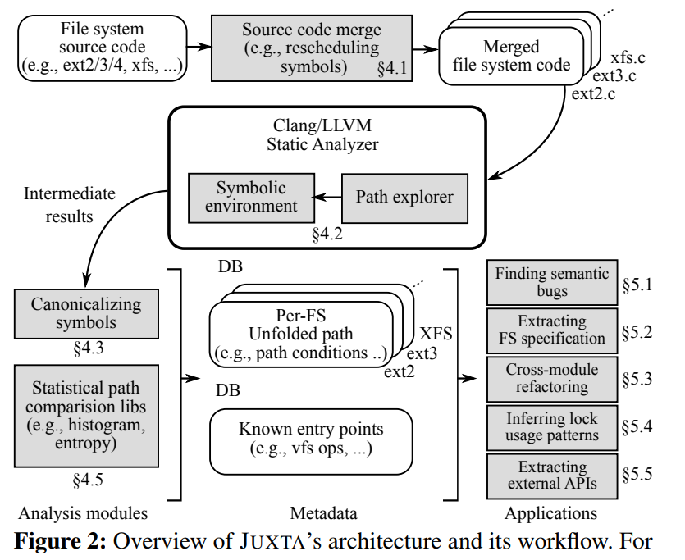
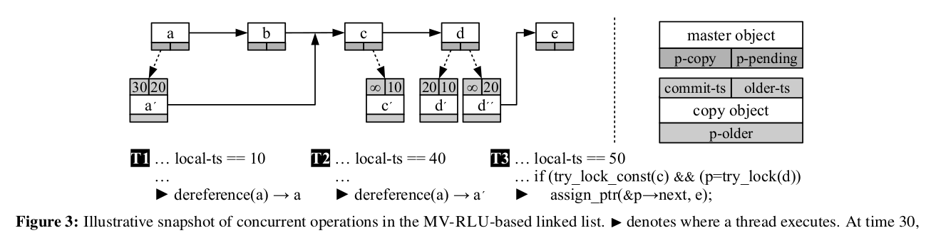
Design Section
Make sure non-expert reviewers can easily understand
Draw a self-contained, illustrative example of your system
  In most cases, layered diagram is useless
  Introduce key components and their interactions of your system
  Define terms in your system
Explain the diagram
Emphasize your new, cool stuff

Slide 25
Implementation Section
Clearly separate your reusable idea and implementation artifacts
Design section
  reusable idea which will be usable in 20 years later
Implementation section
  Implementation-specific optimization
    Show off your implementation is solid
  Limitation in implementation
    != limitation in design

Slide 26
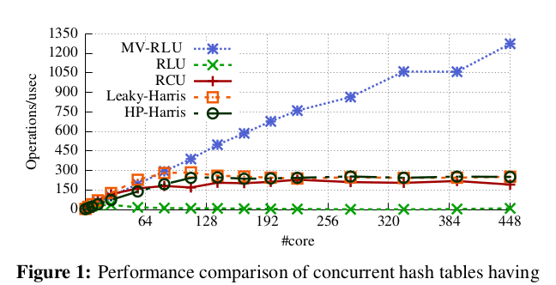
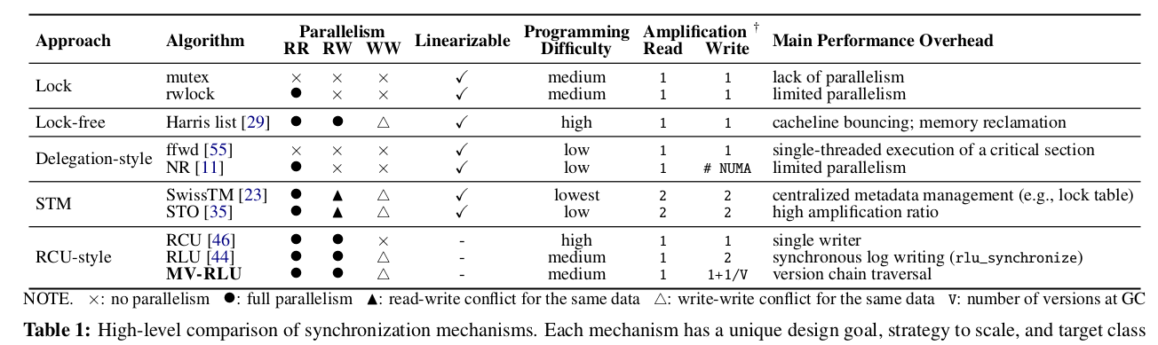
Background and Motivation
Background
  Provide enough background for non-expert reviewers to understand this paper without reading other paper
Motivation
  Show fundamental limitations of existing approaches
    Compare performance and design decisions

Slide 27
Related Work
Show you considered all related work
Categorize related papers in a few groups
  E.g., 1) In-memory database system, 2) Software transactional memory, 3) Synchronization framework for CDS
Don’t fight against each paper
  The authors will review your paper. ;-(
Instead appreciate what you inherit from previous work and emphasize you enhanced
Be precise
Double check if there are missing related work
  Especially, PC member’s work

Slide 28
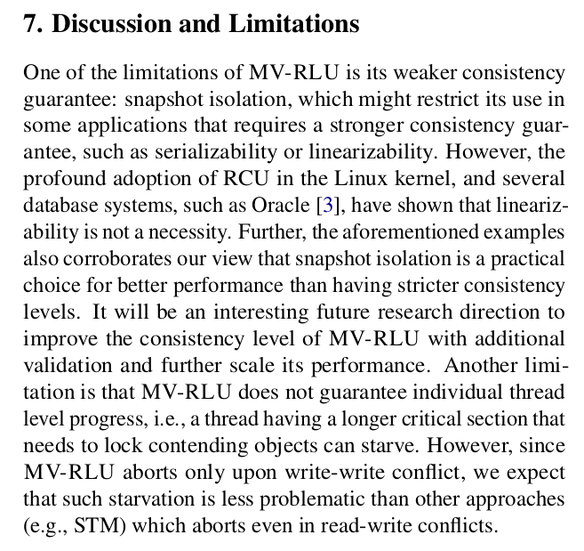
Discussion and Limitation
There is no such perfect system.
Show you made a informed decision even knowing your limitation.
  If you do not tell your limitation, reviewers will make their best efforts to figure out your limitation anyway. ;-)
Explain why you made such decision even if you knew limitations

Slide 29
Introduction
How important it is
  First 15 minutes of a movie
  First 30 seconds of a pop song
You SHOULD make your reviewer excited and jealous
  “I wish I was working on this area”
  “If I were working in that area, I wish I was working on this problem”
  “I wish I was him/her”
Show your enthusiasm
  Why this is an important problem
  Why your solution is good
  Motivating example
Articulate technical challenges and your contribution
  Help review writing

Slide 30
Conclusion and Abstract
Conclusion
  Focus on what you achieved and its implication in the future
Abstract
  Focus on the problem
  Introduce your cool, key idea

Slide 31
Revising a paper
Ask a non-expert colleague to read
  Ask him/her to read for an hour
  Understand why they could not understand
  Understand what aspects of your paper they like
Revise the paper
Ask an expect colleague to read
  Ask him/her to read for 2-3 hours
  Ask which parts are misleading
  Understand why they could not understand
  Understand what aspects of your paper they like
Do not ask check grammar or spelling

Slide 32
Before submitting a paper
Title! Title! Title!
  Reviewer will choose paper only seeing the paper title
  Misleading title → wrong reviewer assignment → bad review
Check if every is PERFECT
  Spelling, grammar, graphic, citations
  Sloppiness undermines reader’s trust
Revise abstract, introduction, and conclusion

Slide 33
If your paper is rejected
Paper rejection is a part of research process
  You just got feedback from research community
Don’t blame reviewers. It’s your fault.
  If they didn’t understand, it was your fault for them to misunderstand.
  If they found flaws of your system, you should thank.
  Check if reviewers read the paper as you intended
Finish your homework before next submission
  Top conferences NEVER accept a paper having clear flaws.

Slide 34
Final thoughts
Ask a bold question and find a simple solution
People remember only what you finish
Find colleagues and mentors
Help each other
Keep trying
Enjoy!

