Slide 1
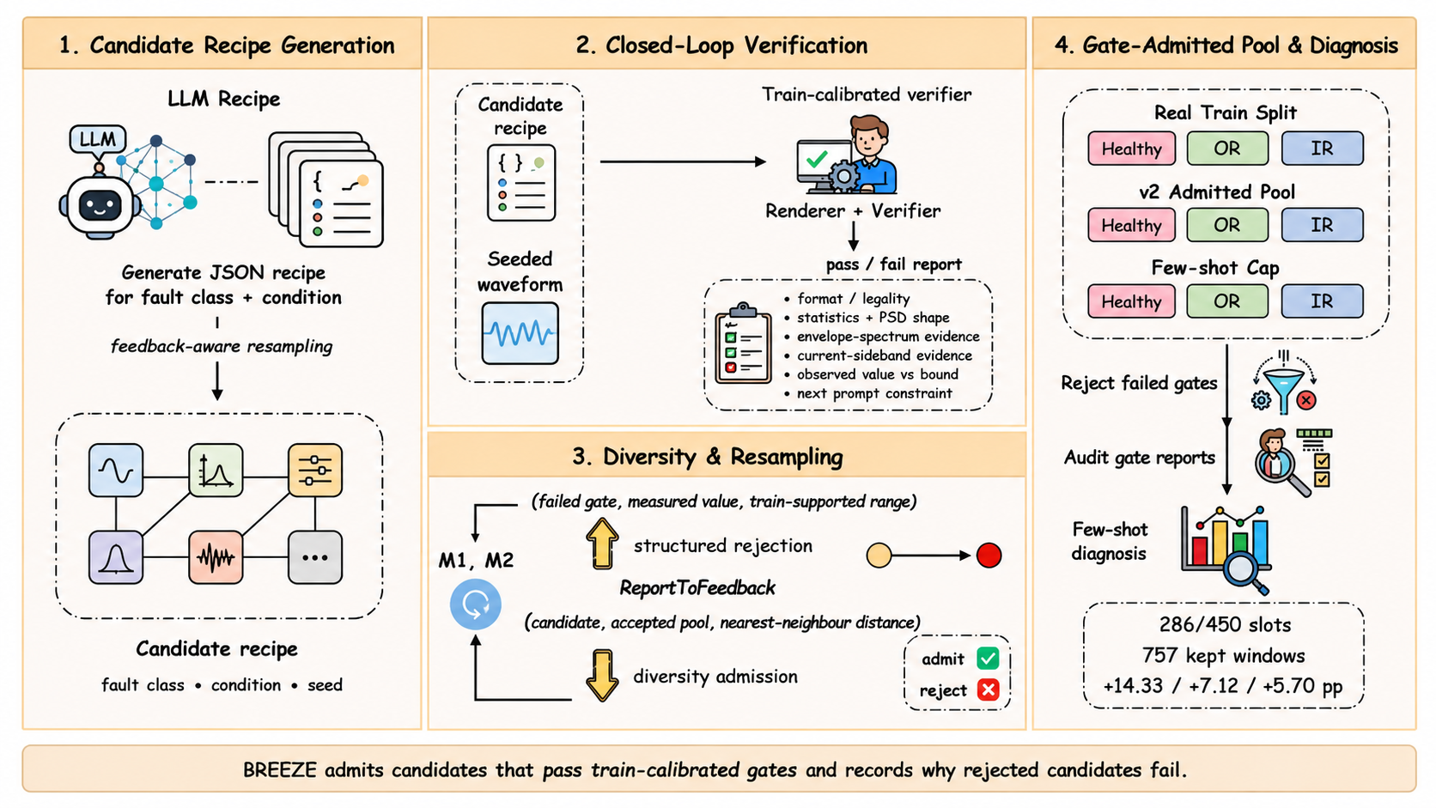
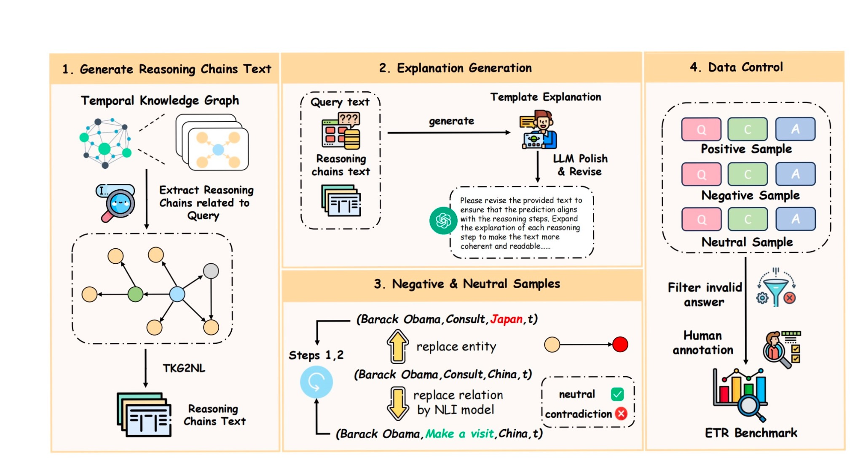
v
v
v
4.Gata-Admitted Pool & Diagnosis
Real Train Split
Healthy
OR
IR
Healthy
OR
IR
v

