Slide 1

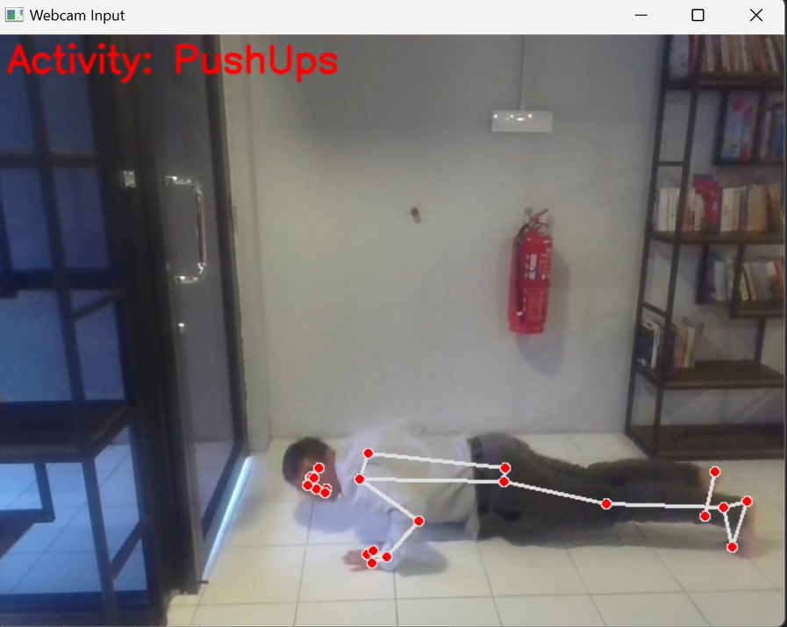
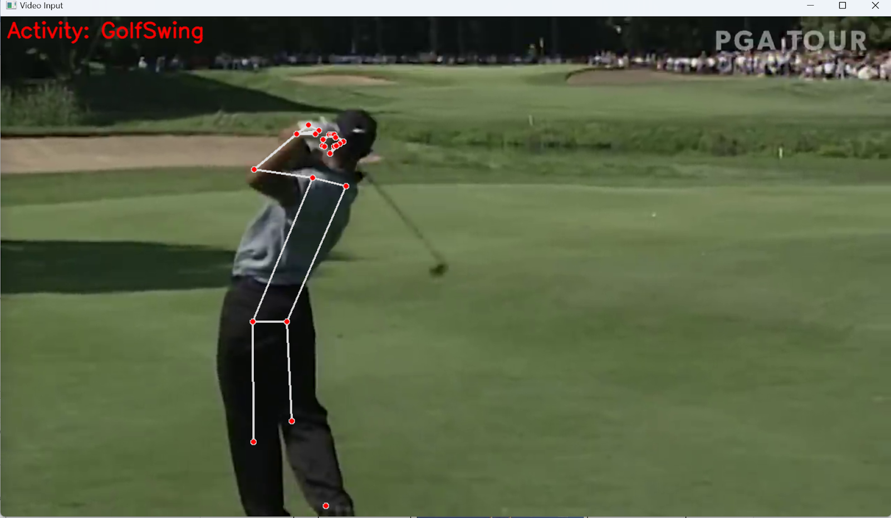
Human Activity Recognition System
Koh Jian Yong
BIT(Hons) in Data Science
Supervisor: Ts. Dr. Tan Chi Wee
The research aims to develop a real-time system for recognizing human activities from videos. It uses the UCF50 dataset and employs MediaPipe and LSTM for pose extraction and deep learning. The system can be used with uploaded videos or real-time camera feeds. Potential applications include security, healthcare, and human-computer interaction.
Abstract
Human movements are diverse and complex, making it challenging for Human Activity Recognition (HAR) systems to accurately classify behaviors in video data.
The quality of visual data used for HAR directly impacts the system’s recognition performance.
Real-time recognition presents significant challenges due to the computational complexity of processing video data.
Construction and Testing
Problem Statement
The accuracy of the system: 51.53%
Since there are 50 actions in total and we are not able to test one by one, 10 actions are randomly selected for test case.
Table 1: Results of Test Case
Figure 1: Performing Real Time Activity Recognition
Figure 2: Performing Activity Recognition from Uploaded Video
ID | Activity | Method | Result
1 | Push Ups | Real Time | Pass
2 | Lunges | Real Time | Pass
3 | Jumping Jack | Real Time | Pass
4 | Breast and Stroke | Video | Fail
5 | Playing Piano | Video | Pass
6 | Taichi | Video | Pass
7 | Clean and Jerk | Video | Pass
8 | Golf Swing | Video | Pass
9 | Fencing | Video | Pass
10 | Basketball | Video | Fail
1. To develop a robust Human Activity Recognition (HAR) system capable of accurately recognizing and classifying a diverse range of human behaviours, despite variations in human mobility with at least 70% accuracy.
2. To enhance the performance of a Human Activity Recognition (HAR) system by incorporating at least 720p video data
3. To improve the computational efficiency and responsiveness of a Human Activity Recognition (HAR) system, enabling real-time recognition and classification of human behaviours in various applications
Objectives
Dataset
The dataset used in this research is UCF50 dataset. This dataset contains50 action categories made up of real YouTube videos.
Pose Extraction
The pose extraction tools used in this research is MediaPipe. The MediaPipe posture estimation approach is very good for recognising human activities. To categorise motions, it can identify key body areas and analyse posture. Body posture markers are produced by the model in both image coordinates and 3-dimensional world coordinates.
Deep Learning Model
LSTM is chosen as the deep learning model because human activity recognition involves time series data that contain temporal dependencies. LSTM can capture the sequential patterns and dynamics of human activities by using its memory cells and gates.
Human Activity Recognition system
The system can perform human activity recognition from video uploaded by users and also real time recognition which use webcam as video input. The recognised action will be labelled in the video.
Design and Methodology
Despite not reaching the 70% accuracy goal (51.53%), the research extends the frontiers of HAR capabilities by tackling the issues connected with the video data quality, algorithm selection, and real-time processing. This not only improves the accuracy and efficacy of existing HAR systems, but also prepares the way for future advancements and applications in a variety of fields.
Contribution
The proposed Human Activity Recognition (HAR) system that can recognize human actions from webcam and video input achieved an accuracy of 51.53%, which is below the initial goal of 70%, but still showcases its potential for real-time applications. The system also processed most test videos successfully, meeting the resolution requirement and demonstrating its robustness. There are few limitations in the system, such as occlusion, multi-person scenarios, and overfitting, and future improvement can be made to improve its accuracy and generalizability.
Conclusion

