Slide 1
Writing your Final Report

Slide 2
NOTE:
Some of your lecturers use the term “manual” to refer to your dissertation.
That’s OK, they are just using it in a broad way, but your dissertation is definitely NOT a manual, it is a scientific report that describes what you did, why you did it, how you did it, and when you did it.

Slide 3
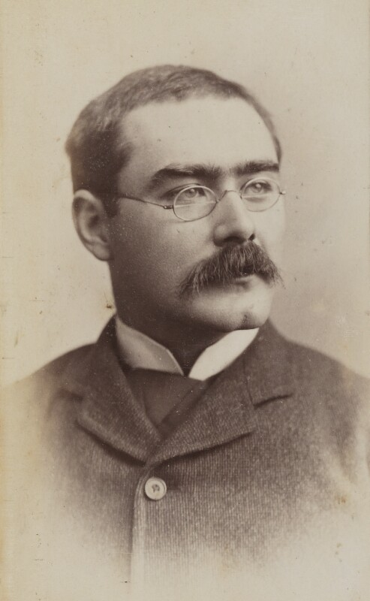
"I Keep Six Honest Serving Men ..."
I keep six honest serving-men
(They taught me all I knew);
Their names are What and Why and When
And How and Where and Who.
I send them over land and sea,
I send them east and west;
But after they have worked for me,
I give them all a rest.

Slide 4
Structure
Title Page
Declaration
Abstract
Table of Contents
List of Tables
List of Figures
Acknowledgments
1. Introduction
2. Background
3. Design
4. Development
5. Testing & Evaluation
6. Conclusions & Future Work
Appendices

Slide 5
Structure
Title Page
Declaration
Abstract
Table of Contents
List of Tables
List of Figures
Acknowledgments
1. Introduction
2. Background
3. Design
4. Development
5. Testing & Evaluation
6. Conclusions & Future Work
Appendices

Slide 6
The ABSTRACT

Slide 7
Questions
What is the area of study?
What is the problem being tackled?
What does the literature say?
How did you tackle the problem?
How did you implement the solution?
What results have you gotten?

Slide 8
Sample Answers
“This research investigates the area of knowledge capture in the domain of knowledge management.”
“By introducing a new technology into my work place the staff will be able to record their ideas.”
“Existing research indicates that their may be benefits to capturing the organisational knowledge.”
“In this work a Wiki server was be introduced into the workplace, and logins provided to staff.”
“The Wiki has a range of templates to support the range of approaches to ideas generation.”
“Results suggest that the use of this Wiki has aided in capturing key organisational knowledge.”

Slide 9
Merge into abstract
This research investigates the area of knowledge capture in the domain of knowledge management. By introducing a new technology into my work place the staff will be able to record their ideas. Existing research indicates that their may be benefits to capturing the organizational knowledge. In this work a Wiki server was be introduced into the workplace, and logins provided to staff. The Wiki has a range of templates to support the range of approaches to ideas generation. Results suggest that the use of this Wiki has aided in capturing key organisational knowledge.

Slide 10
Introduction Chapter

Slide 11

Introductory Chapter
Topic?
Importance?
Background?
Arrangement?
Introduction
Notes:
This slide shows the questions that should be answered for the readers once they finish reading the “Introduction.” In showing this slide, I begin by asking the students what questions they have about a topic when they are first introduced to it. The analogy I use is that an introduction section is like a car or bus ride to a place where the readers will learn something. I ask the students to imagine that I am leading them out the door to a parked car or bus that will take them someplace where they will learn something. I then ask what questions they have as they are walking out the door. The students will guess the first two questions right off (“what topic are we going to learn about?” and “why is that topic important?”) and after prodding will get the fourth one (“how long will this trip take?” or “will we come back in time for our next class?”). Although they rarely guess the third question (“what information do I need to know to understand this subject?”), the third question makes sense to them because they usually associate “background” with “introduction.” I usually remind them that in this section, the document is referred to in the present tense (“This report presents…”). (Pages 27-33)

Slide 12
Introductory Chapter
Possible sections in this chapter :
  1. Project Background
  2. Project Description
  4. Project Aims and Objectives
  5. Project Scope
  6. Thesis roadmap

Slide 13
Background

Slide 14
Background
This chapter outlines some reading you have done in this field, organised by ideas, research trends NOT chronologically or by author.
Also have you found any existing software similar to yours, or any software/webpages/etc. that inspires your system.
The objective of this chapter is to tell the reader that this is an important and interesting problem, other people have done work on it before, and this is inspiring your development.

Slide 15
Design (and Methodology)

Slide 16
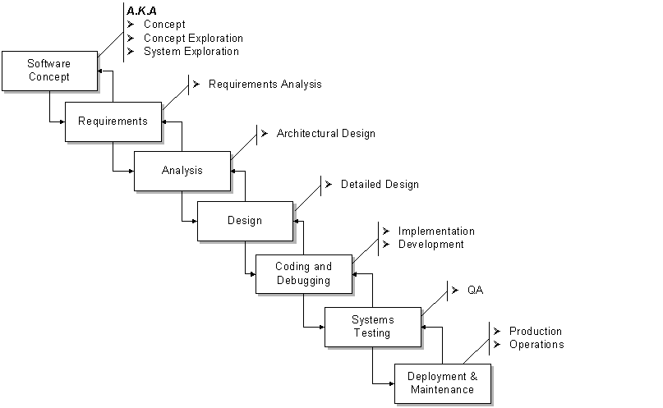
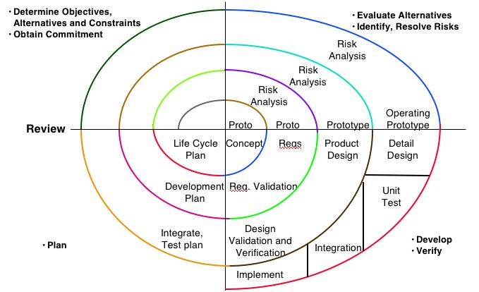
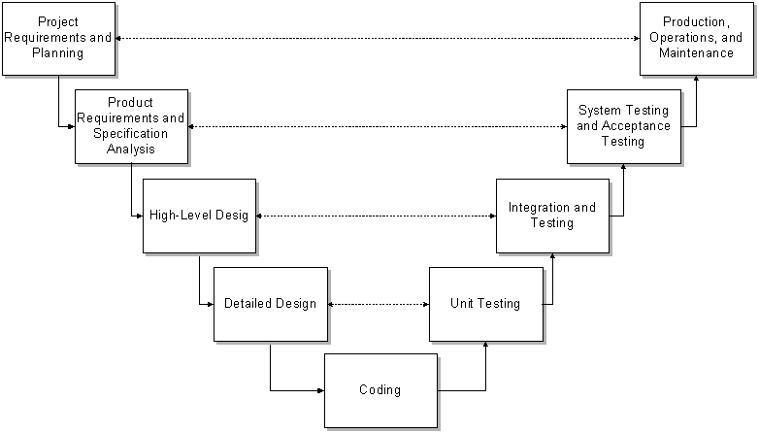
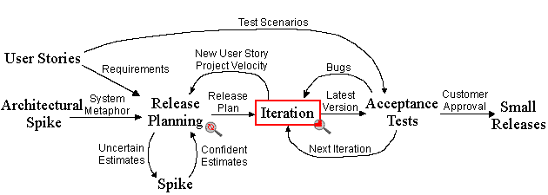
Design and Methodology

Slide 17

Design and Methodology

Slide 18
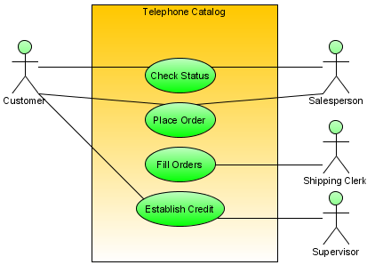
Design and Methodology
Notes:
Dashed oval : collaboration , rectangular : instances of any type of classifier, including classes, objects, or interfaces

Slide 19
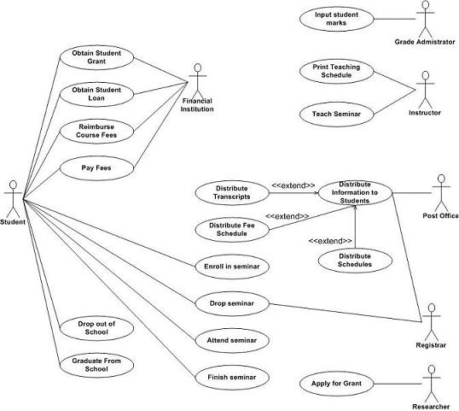
Design and Methodology

Slide 20
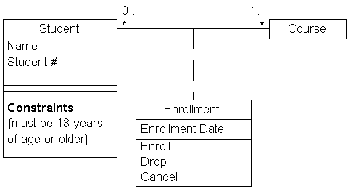
Design and Methodology

Slide 21
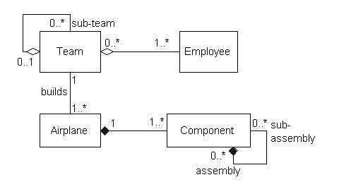
Design and Methodology

Slide 22
Design and Methodology
In this chapter you design comes from two places;
  What the background reading suggests to you
  What the research question is about

Slide 23
Development

Slide 24
Development chapter
Explain the basic structure of your code
How does it differ from your design?
Show some interfaces (if relevant)

Slide 25
Development chapter
Show some code snippets
Discuss problems you had and how you got around them
Discuss what blind alleys you went down

Slide 26
Testing & Evaluation

Slide 27
Testing & Evaluation chapter
Testing is to determine if there are any bugs in the code.
A fully tested system may still have bugs in it.
  Testing shows the presence, not the absence, of bugs - Edsger W. Dijkstra
You don’t want to find out if there are bugs in your code at the demo.

Slide 28
Testing & Evaluation chapter
Testing will tell you if the code works, evaluation tell you how well it works.
Think about ways to evaluate your system.
How usable is the system?

Slide 29
Conclusions & Future Work

Slide 30
Conclusions & Future Work
Conclusions tell use what you discovered from your project, but not just a summary of your findings, but a bit of context as well – the “because” bit.
CONCLUSION = SUMMARY + CONTEXT;
The Future Work might inspire other students to continue of your work so try to go beyond the obvious ones.

Slide 31
Linking it all together

Slide 32
Link chapters together
Chapter N
Introduction N.1
As has been discussed in the previous chapter ...
Conclusion N.X
In this chapter, the following topics were discussed...equipped with this information, in the next chapter it will be investigated how to apply this in ...

Slide 33
Mirroring of chapters :
Chapter 1 = Chapter 6
Chapter 2 = Chapter 5
Chapter 3 = Chapter 4
Chap 1
Chap 6
Chap 2
Chap 5
Chap 3
Chap 4

Slide 34
Mirroring of chapters :
All themes raised in the Introduction chapter should be addressed in the Conclusions.
All themes in the Design chapter should appear in the Implementation chapter.
All Background Reading themes should be re-discussed in the Testing and Evaluation chapter

