Slide 1

Space Checker
DT228/4
Computer Science
Jianyu HE
Supervisors: Dr. Martin Mchugh

Slide 2
Project Overview
This project is about check how many car space and free space in the car park, and display the space status using CCTV, it also show location of car park and allow user to update feedback to developer.

Slide 3
Introduction
The car parking video of project is from Elmhurst Public Library, parking in this lot is for Library users.
My project is base on image processing and machine learning.

Slide 4
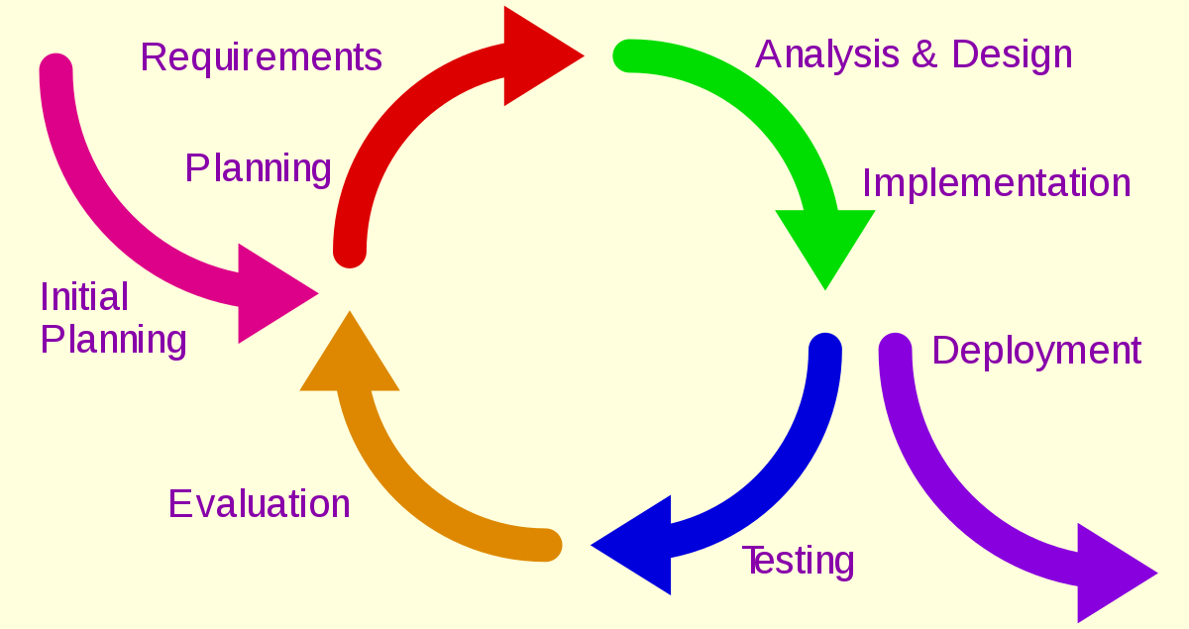
Methodology
Iterative Methodology used:

Slide 5
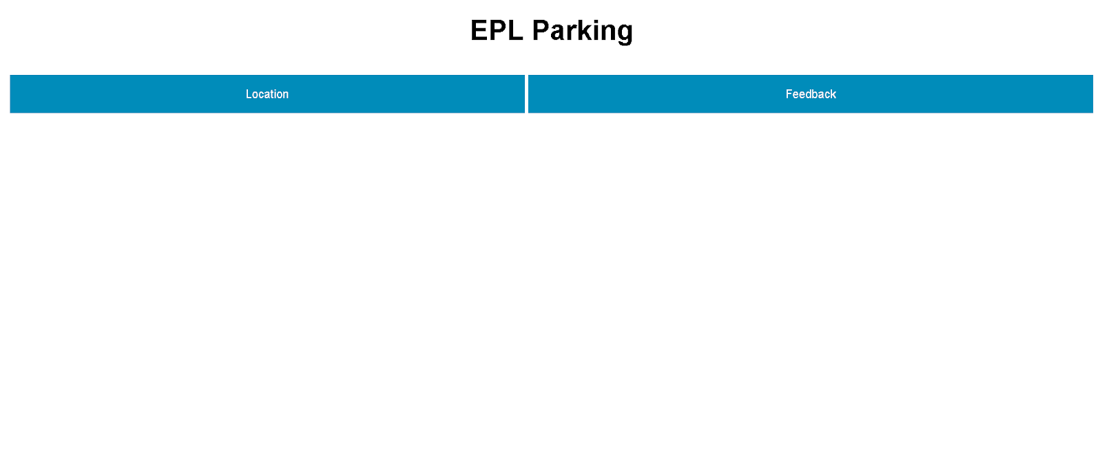
Design - Frontend
Video Screen:

Slide 6
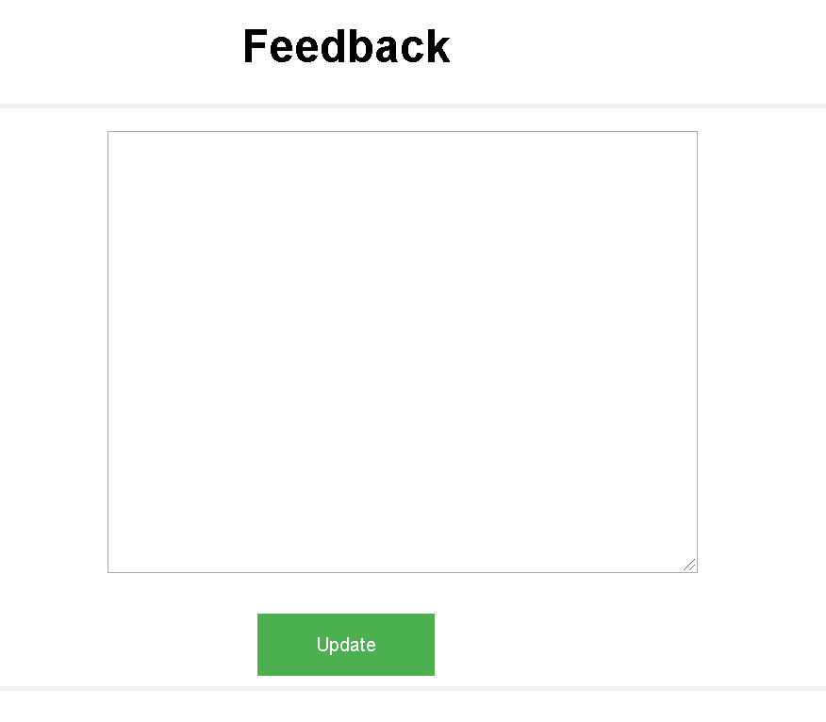
Design - Frontend
Feedback Screen:

Slide 7
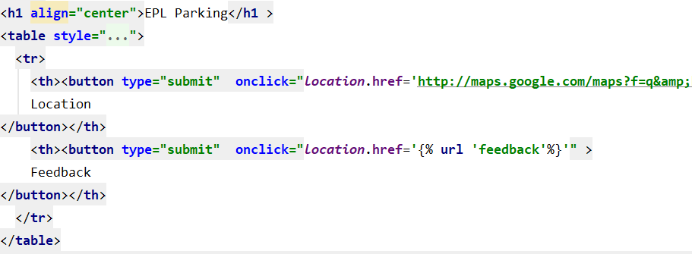
Design Back-End
Video screen HTML

Slide 8
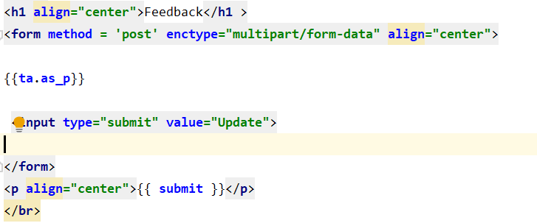
Design Back-End
Feedback screen

Slide 9
Development
Technologies
  Operating System(s): Linux , Windows
  Programming Language(s): Python
  Scripting Languages: JavaScript, HTML ,CSS
  Web Servers: Amazon Lightsail
  Tool(s): Pycharm, jupyter notebook, django
  Library: opencv, tensorflow, keras
  Classifier: VGG16

Slide 10
Development
Present main code for video processing

Slide 11
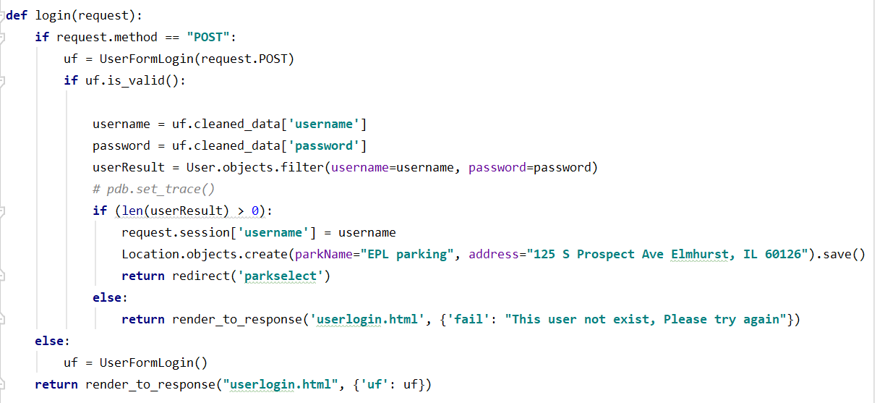
Development
Login

Slide 12
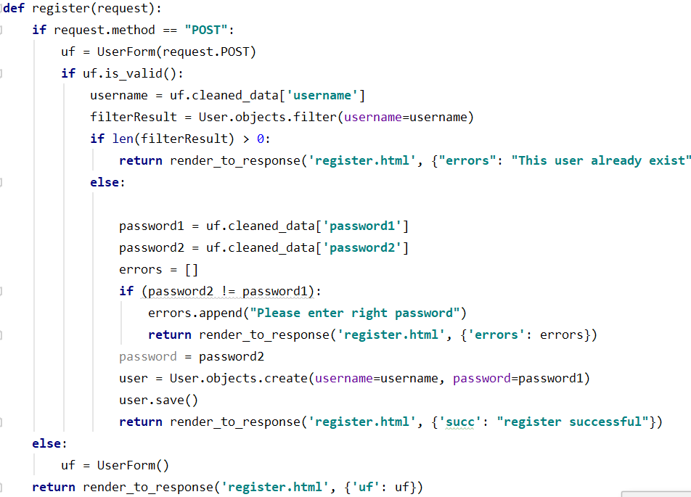
Development
Register Page

Slide 13
Development
Set static video

Slide 14
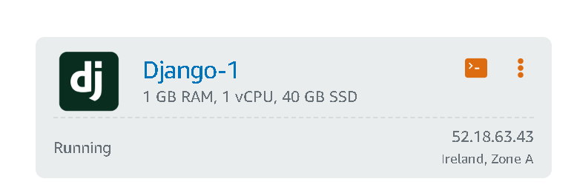
Development
Deployed web application using Amazon Lightsail.

Slide 15
Testing
White-box tests
Unit tests
Black Box Testing
Integration tests

Slide 16
Conclusions
Achieve most required of project design
Learning knowledge
It is a big challenge
Benefit future

Slide 17
Future Work
Try to use in a live stream
Improve user interface.
Try to use some method to process other car parking.

Slide 18
DEMO

Slide 19
Thank You and
Questions

