Slide 1
FYP Interim Presentation Space Checker
Jianyu He
D17124591
DT228

Slide 2
Project Idea
The main idea of this project is to create a online website to show free space of car park.
The main purpose of this web application is allowed user easy to understand where is free car space of the car park
The domain area for this project is base on image processing to process each frames of video of car park.

Slide 3
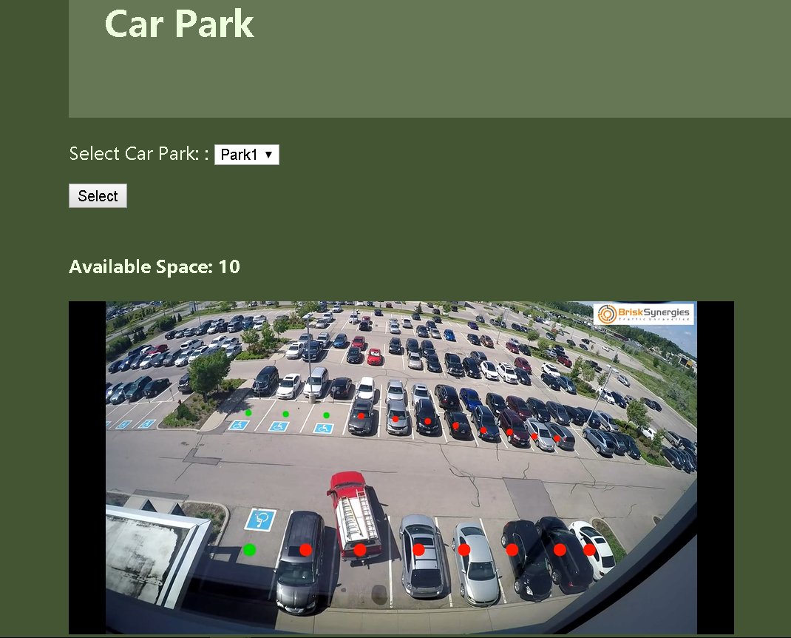
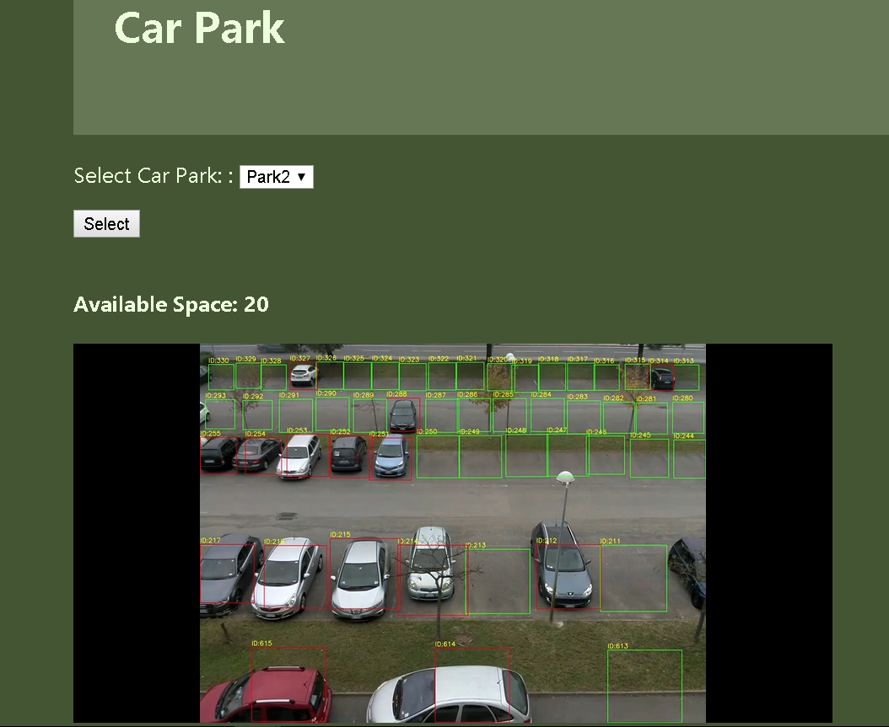
Car Park

Slide 4
System Design
The project document has a comprehensive system design with a detailed textual description of the system and the UML diagrams.
The main development focus on space and cars detection from images, then set id for each car space, after draw red points for occupy space and draw green point for free space on the image.
The OpenCV will be used to process the operation of the developed solution.

Slide 5
Technologies Used
OpenCV : is a library of programming functions mainly aimed at real-time computer vision.
Django: is a high-level Python Web framework.
PostgreSQL: is a open source relational database.
Mask R-CNN: is a open source library can use to find mask of car.
Git: is a version controller.

Slide 6
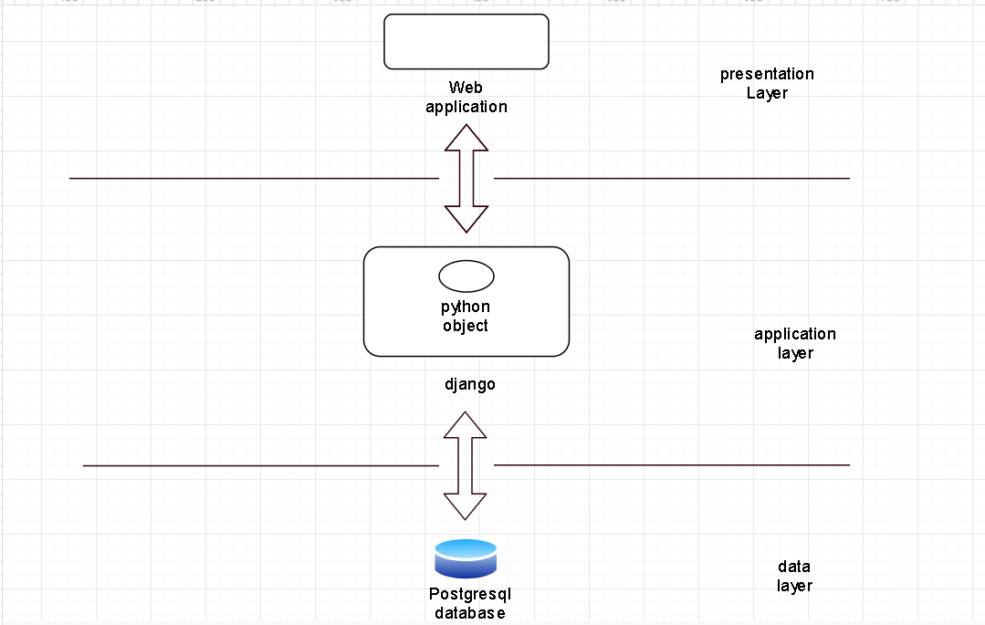
System Overview

Slide 7
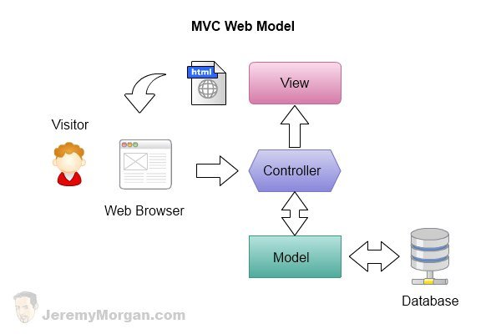
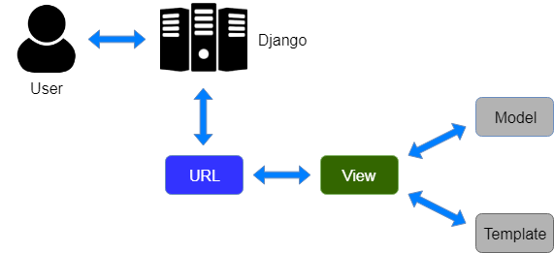
System Architecture

Slide 8
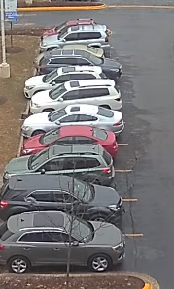
Project Complexity
Method 1
Find position of car – Mask CNN
Find position of car space – Mask CNN
Solve cars overlap on the video - Intersection Over Union

Slide 9
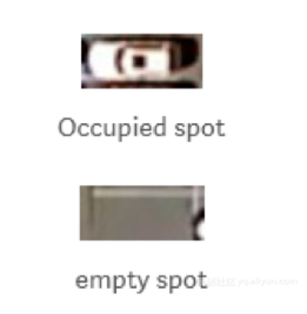
Project Complexity
Method
1. Find position of car space – Hough Transformation
2. create classifier for each car space - Convolutional neural network
3. compare current car space

Slide 10
Demo
The demonstration will be presented now….
The prototype solution have login and register system, the login system allow user directly go to homepage and show car park which user watched last time. After user login successful will go to homepage, the homepage shows number of available free space and a live video shows status of space.

Slide 11
Test
White-box tests
Unit tests
Black Box Testing
Integration tests
Jakob Nielsen's heuristics

Slide 12
Future Work
Follow the GANTT Chart and project plan
Research on relevant topics such how classifier
Continually work on the project report
Deploy my project on cloud server.

Slide 13

Question

