Slide 1
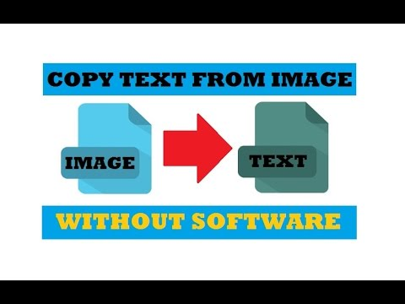
Extract Text From Image

Slide 2
Original Method Overview
The original idea is first rectangle each letters from whatsapp image, then type a-z, A-Z and 0-9 on whatsapp app, after crop as a image, then rectangle each letters and numbers use to create image of each rectangle save into template folder, after we compare histogram of both rectangle one from whatsapp other one from template, if both histogram of rectangle is same, that we can knows what letter of the rect. final we can print all letters from whatsapp image without space. for create space for letters: we know position of each rectangle, then we can find length of space is more longer with length of each letters. that we can know position of space. we can create space for each letters.

Slide 3
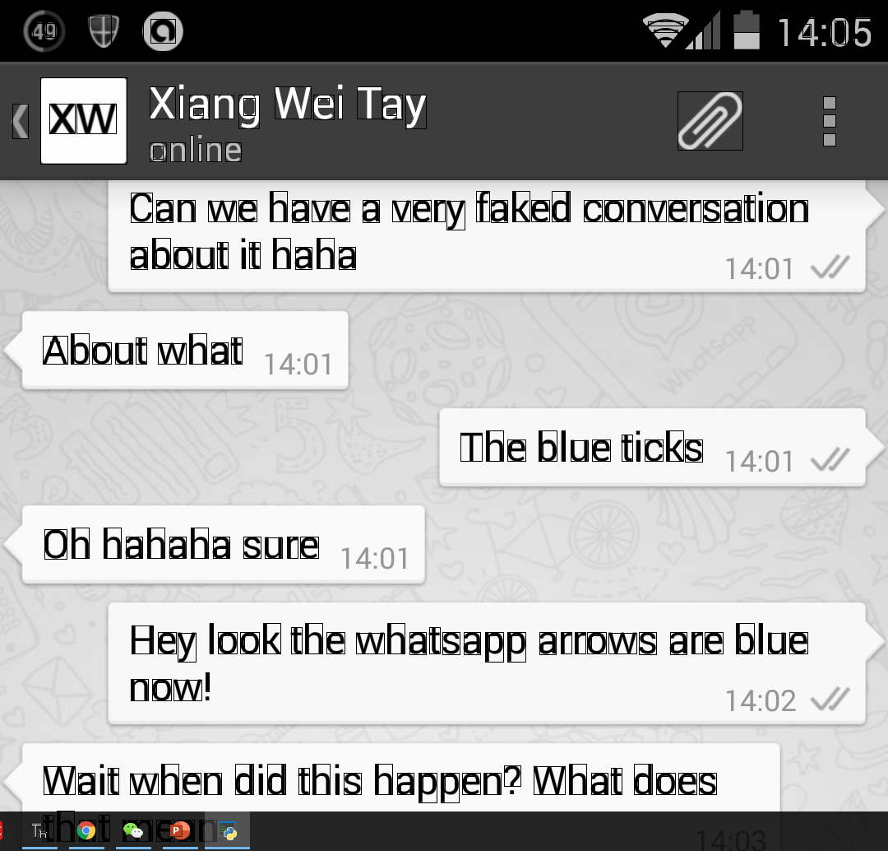
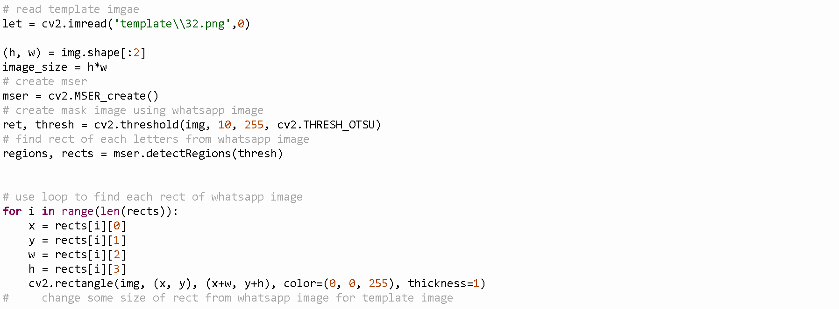
Draw rectangular for each letters

Slide 4
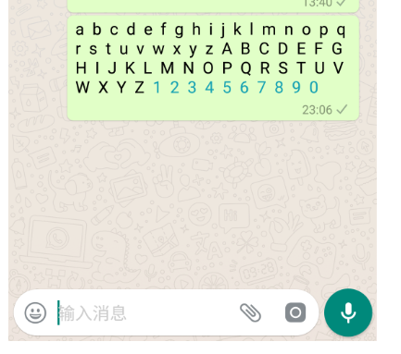
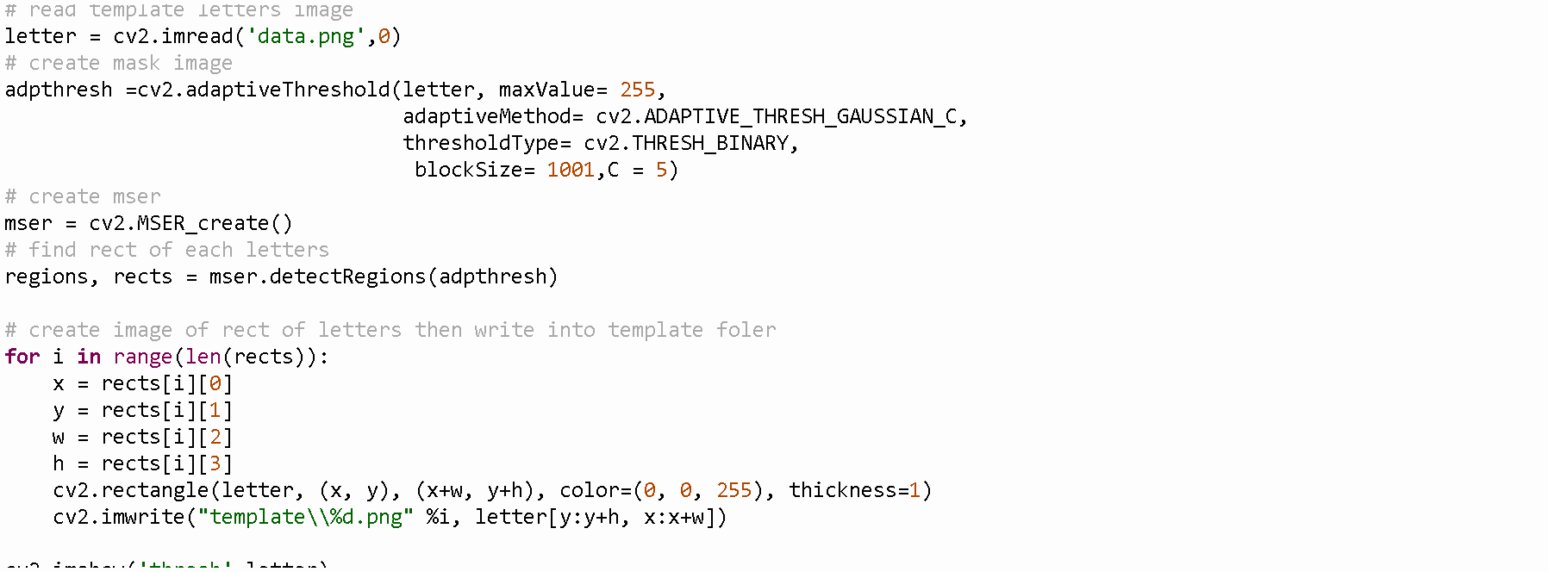
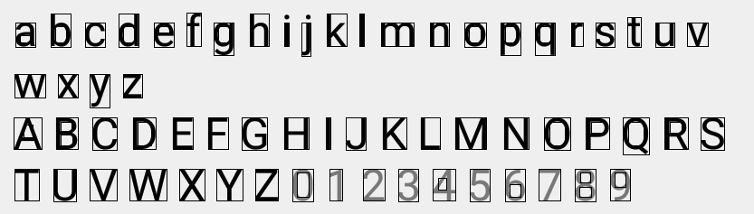
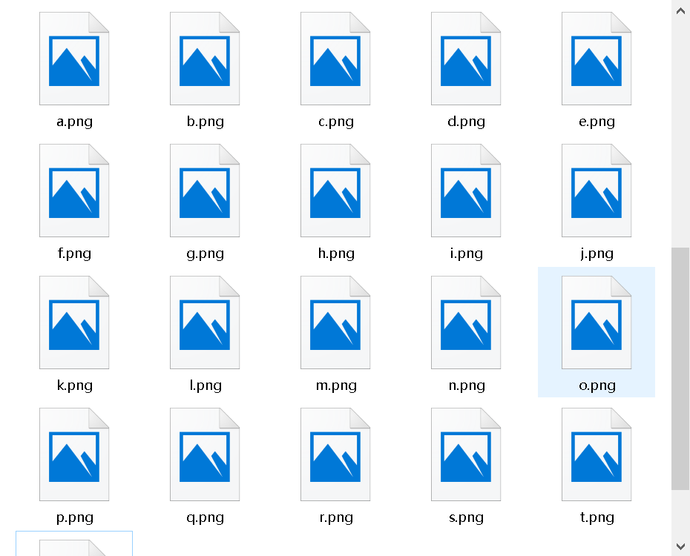
Create template letters

Slide 5
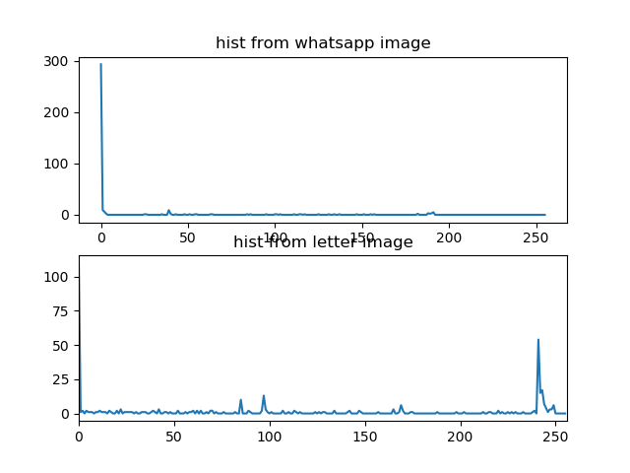
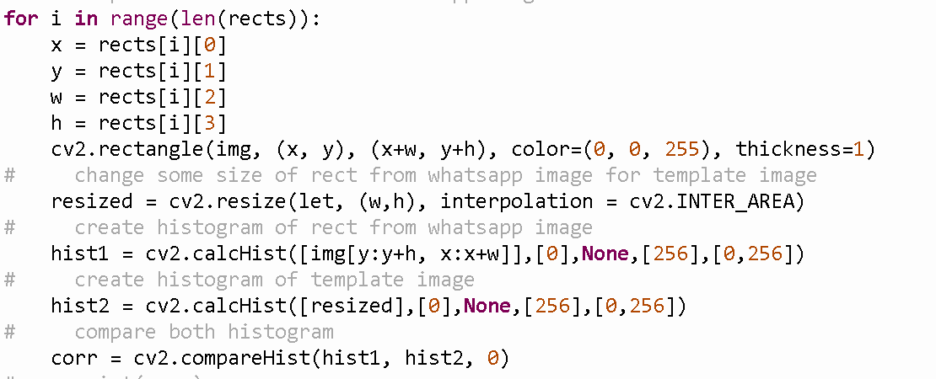
Compare histogram

Slide 6
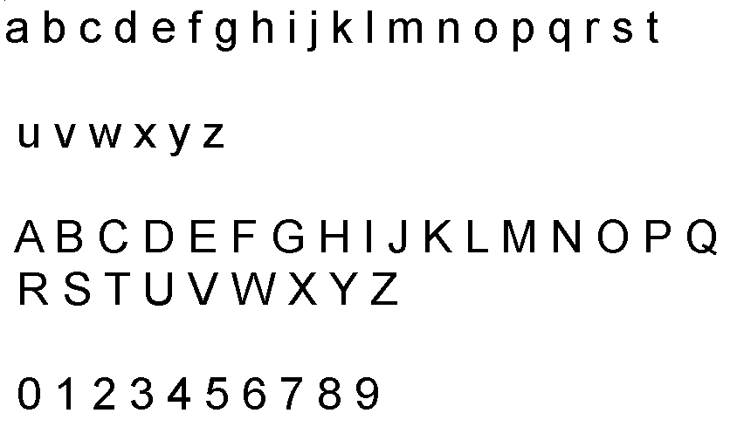
Give Up this method

