Slide 1
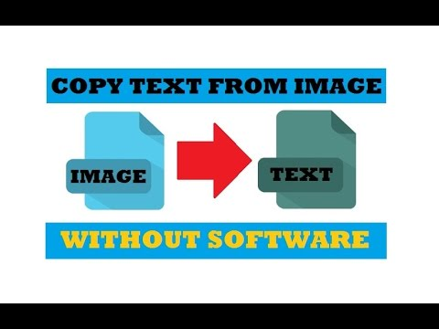
Extract Text From Image

Slide 2
Original Method Overview
The original idea is first rectangle each letters from whatsapp image, then type a-z, A-Z and 0-9 on whatsapp app, after crop as a image, then rectangle each letters and numbers use to create image of each rectangle save into template folder, after we compare histogram of both rectangle one from whatsapp other one from template, if both histogram of rectangle is same, that we can knows what letter of the rect. final we can print all letters from whatsapp image without space. for create space for letters: we know position of each rectangle, then we can find length of space is more longer with length of each letters. that we can know position of space. we can create space for each letters.

Slide 3
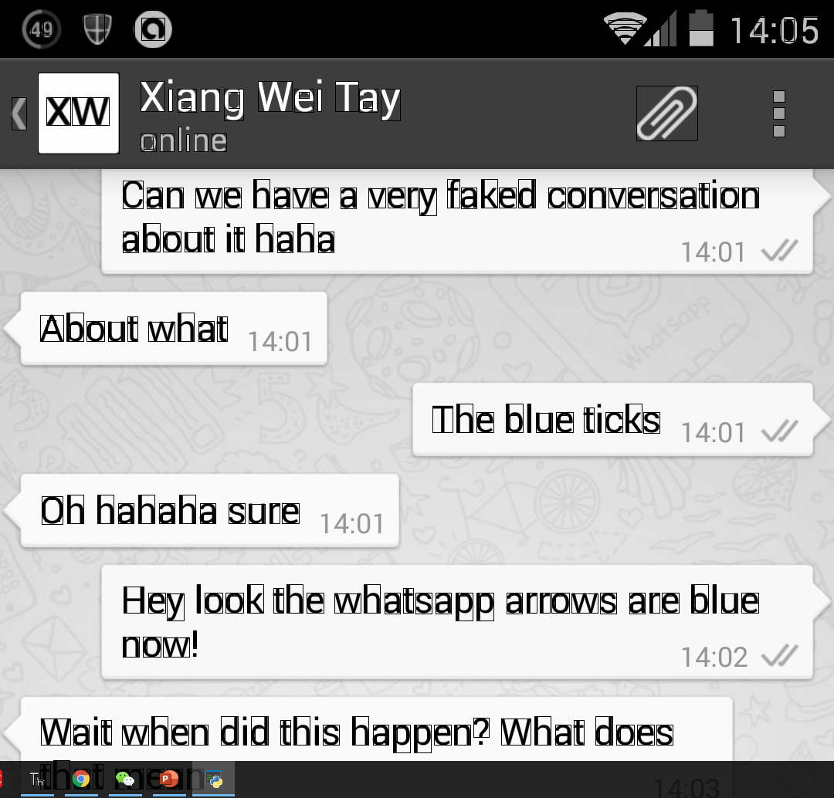
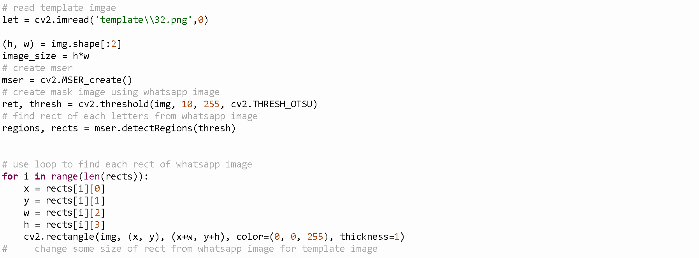
Draw rectangular for each letters

Slide 4
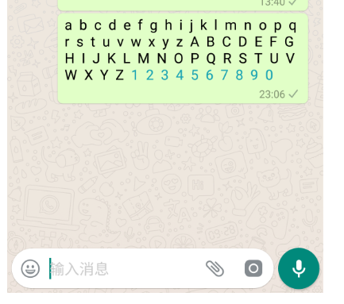
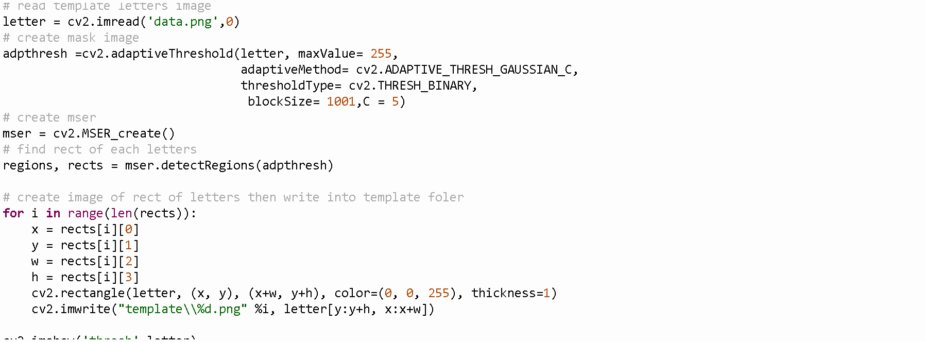
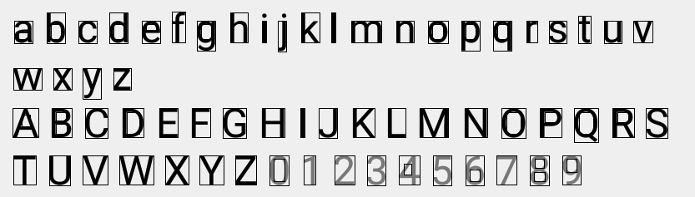
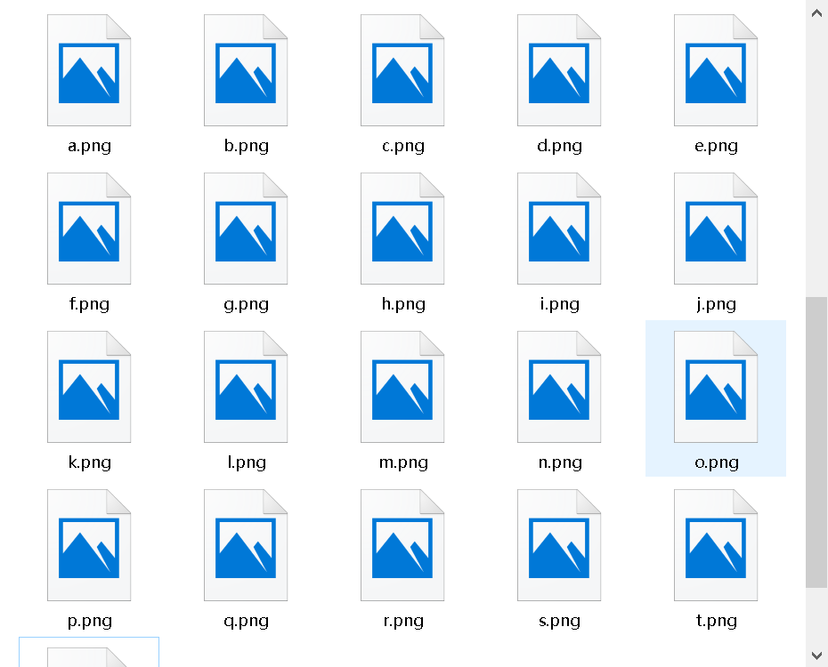
Create template letters

Slide 5
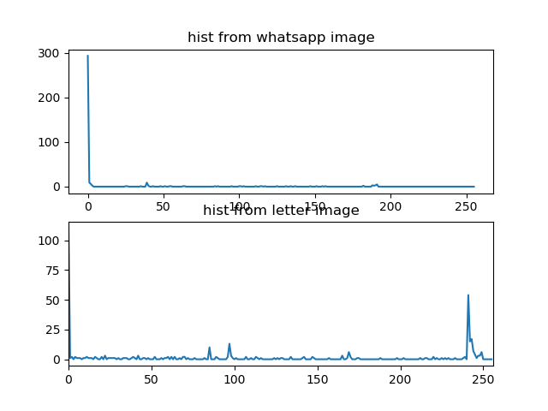
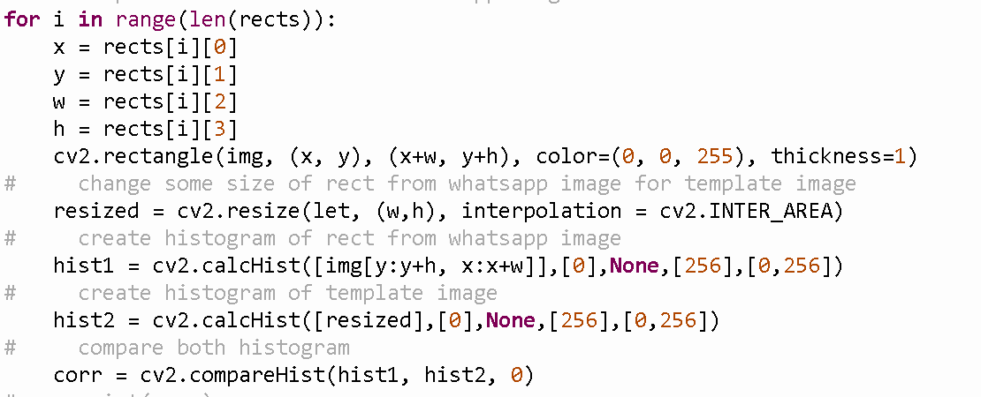
Compare histogram

Slide 6
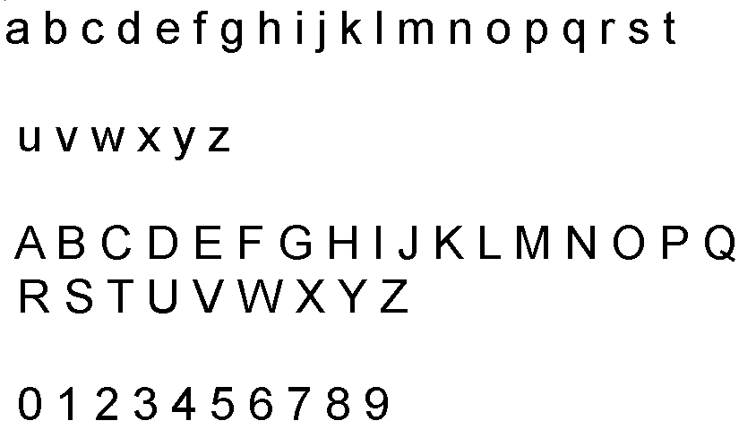
Give Up this method can not compare different font

Slide 7
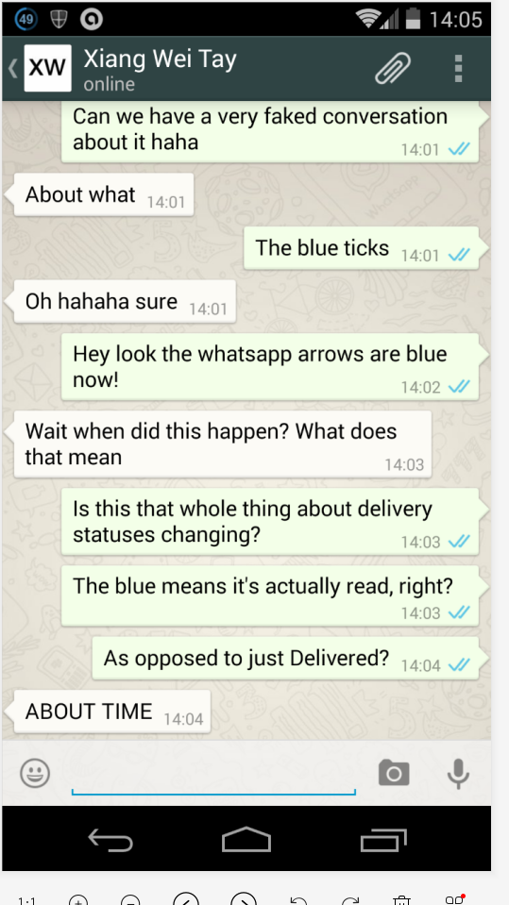
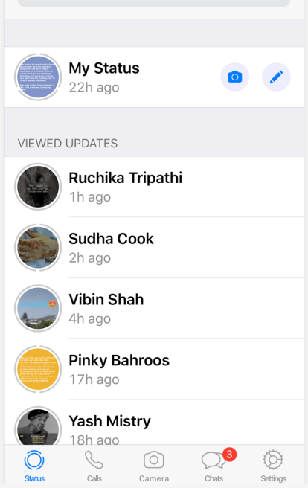
Extract text from text image

Slide 8
Step1:Extract text region by morphology method and threshold function.(usually one sentence as one text region)
Step2:For some tilted text regions, turn them back.
Step3:Get text string from turned text regions by pytesseract.image_to_string( )
Step4:Store text into text file
Step5:Read text from text file and print them on screen

Slide 9
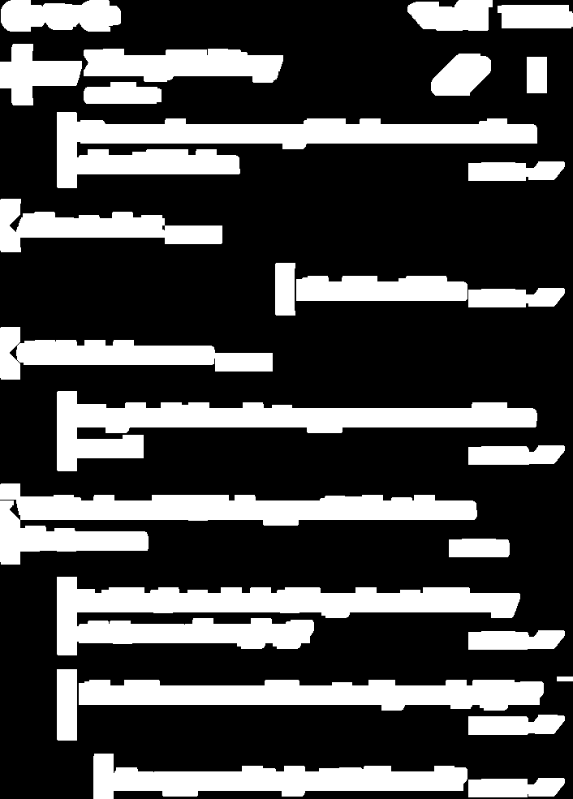
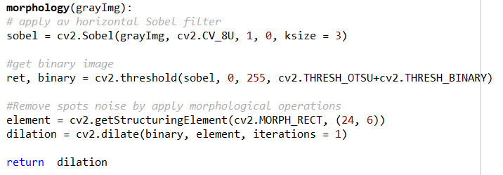
Step1: Extract text region by morphology method and threshold function.(usually one sentence as one text region)

Slide 10
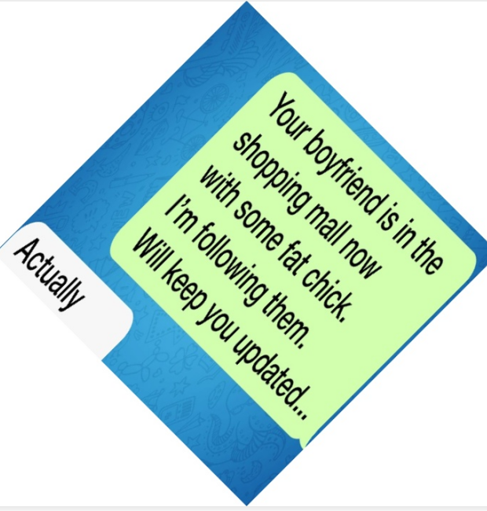
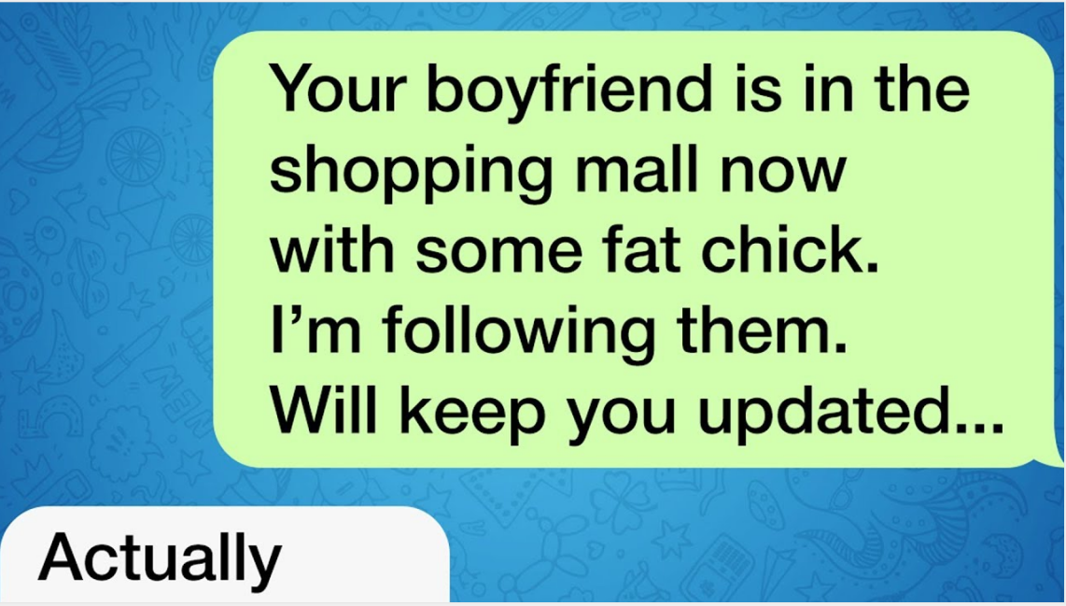
Step2:For some tilted text regions, turn them back.
----->

Slide 11

Step2:For some tilted text regions, turn them back.

Slide 12
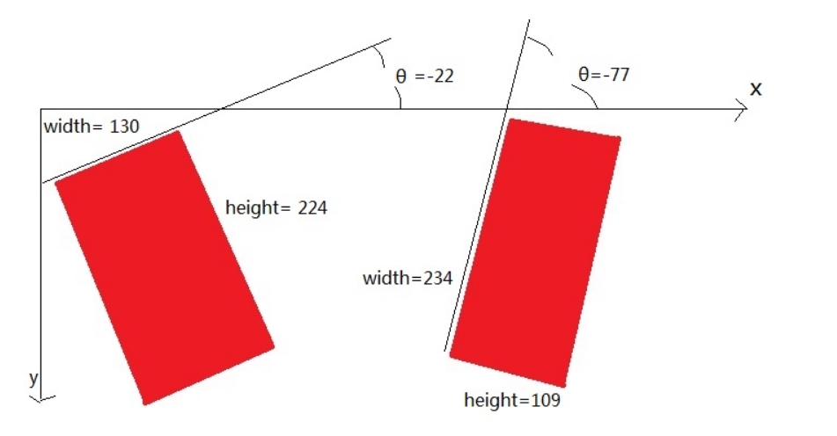

Slide 13
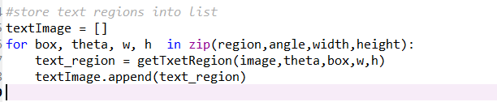


Step3:Get text string from turned text regions by pytesseract.image_to_string( )

Slide 14
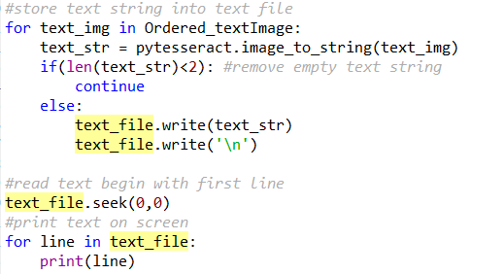
Step4:Store text into text file & Step5:Read text from text file and print them on screen

Slide 15
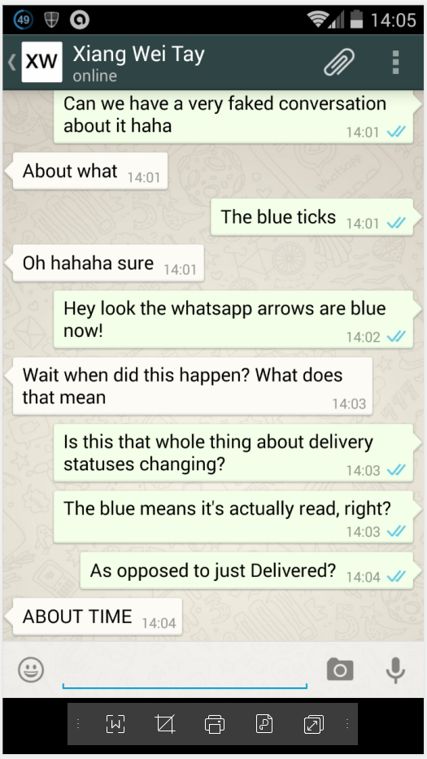
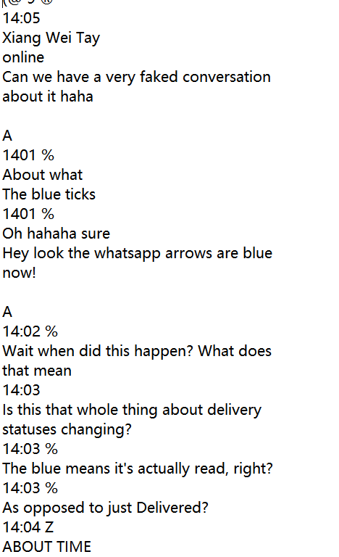
Result

Slide 16
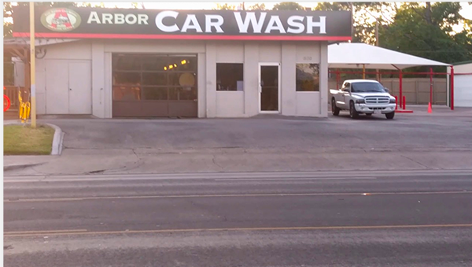
Natural Scene Image
Difficulty for extract text from natural scene image
Image/sensor noise
Viewing angles
Light conditions
Non-paper objects
Unknown layout
Resolution
Blurring

Slide 17
EAST, Non-max Suppression, Tesseract
EAST: it is a deep learn model, it can be use to detect the text region in natural scene image.
Non-max Suppression: usually used to the object detection algorithm, can use to remove the repetitions bounding box. Only keep the most likely bounding box.
Tesseract: It is an OCR engine, can use to recognize the text.

Slide 18
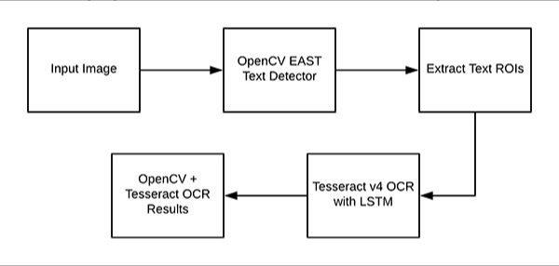
Flow chart

Slide 19
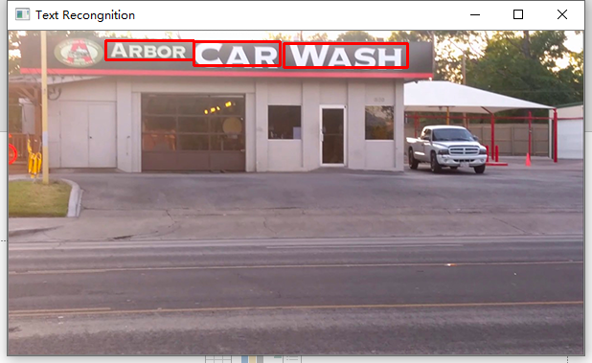

Sample

Slide 20


