Slide 1

Image Inpainting
Based on the Fast Marching Method
YUAN GAO
JIAN ZHANG

Slide 2
Introduction
Introduction of Image Inpainting
Problem Statement
Proposed Solution
Implementaion Details
Results

Slide 3
Image Inpainting
Image inpainting is the technique of
reconstructing small damaged portions of an image
Image inpainting is usually used in
removing text and logos from images
reconstructing scans of deteriorated images by removing scratches or stains
creating artistic effects

Slide 4
Problem Statement
Input:
"Demaged" image: covered by some texts or stains.
Same size mask: shows the portions to be inpainted.
Output:
Inpainted result: image which removed the texts or stains.

Slide 5
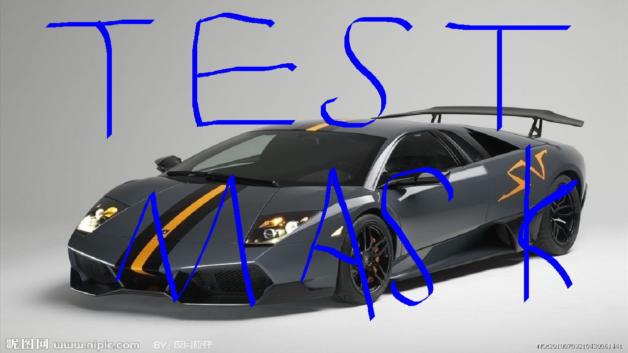

Problem Statement.cont

Slide 6
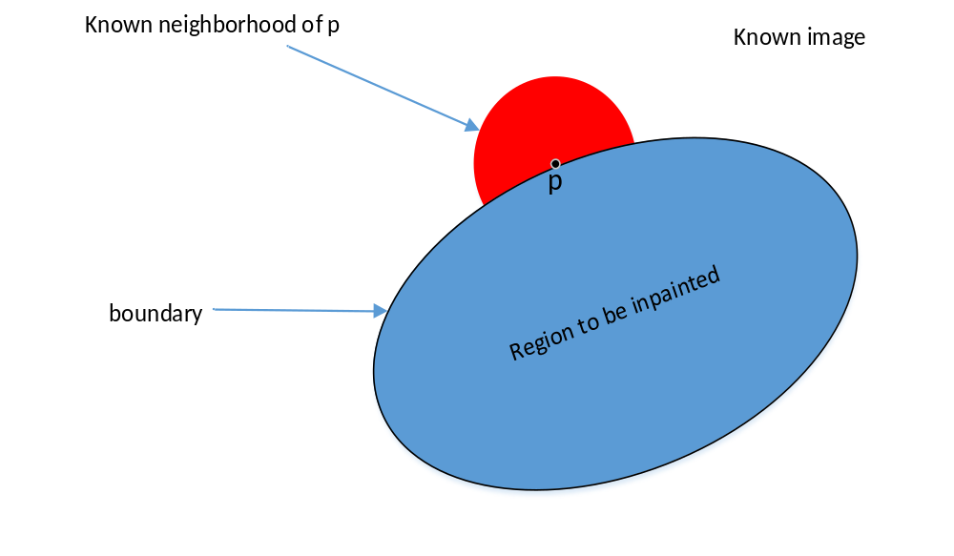
Proposed Solution

Slide 7
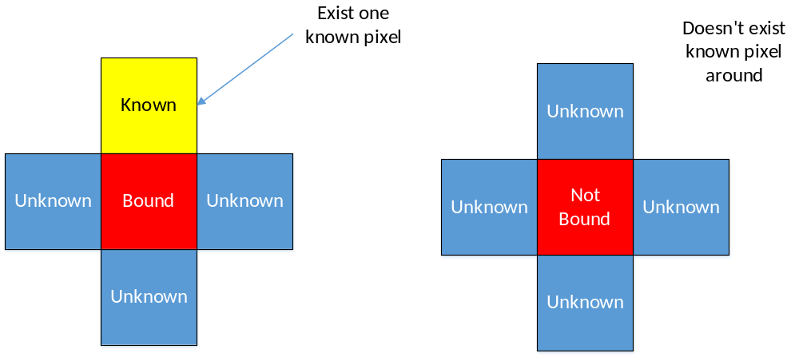
Determination of the Bound

Slide 8
Determination of the Inpainting Order
We use the Fast Marching Method (FMM) to
specify which pixel is the next pixel to inpaint.
The FMM will:
calculate priority values (T) of bound pixels we found
maintains a heap which stores the bound pixels based on their priority values(T)

Slide 9

Fast Marching Method
Step 1: Initialize the T to 0 for known parts and bound.
Initialize the T to for inside parts.
Step 2: Insert the all bound pixels into the heap,
and extract the bound pixels with the smallest T.
Step 3: Inpaint the pixel we get and this pixel will be known.

Slide 10




Fast Marching Method
Step 4: Calculate the T for the inside pixels (k,l) which are the neighbors of the new known pixel (i,j) by solving the equation below.
Step 5: Insert these pixels into heap with new T and change them to be bound.

Slide 11
Implementation Details
Step 1: Change the mask to binary image.
Step 2: Seperate the known area, unknown area and the bound of the unknown area.
Step 3: Calculate the priority value of each bound pixel.
Step 4: Insert bound pixels in a heap sorted in the ascending order of their priority values.

Slide 12
Implementation Details.cont
Step 5: Extract the bound pixels with the smallest priority. Inpaint that pixel using its adjacent known pixels’ data.
Step 6: Change that pixel to the known part and remove it from the heap. Then change its adjacent unknown pixel(s) to the bound pixel(s) and calculate the priority.
Step 7: Insert new bound pixels into the heap.
Step 8: Repeat step 5, 6 and 7 until the heap becomes empty. Inpainting of the damged image is completed.

Slide 13

Result

Slide 14

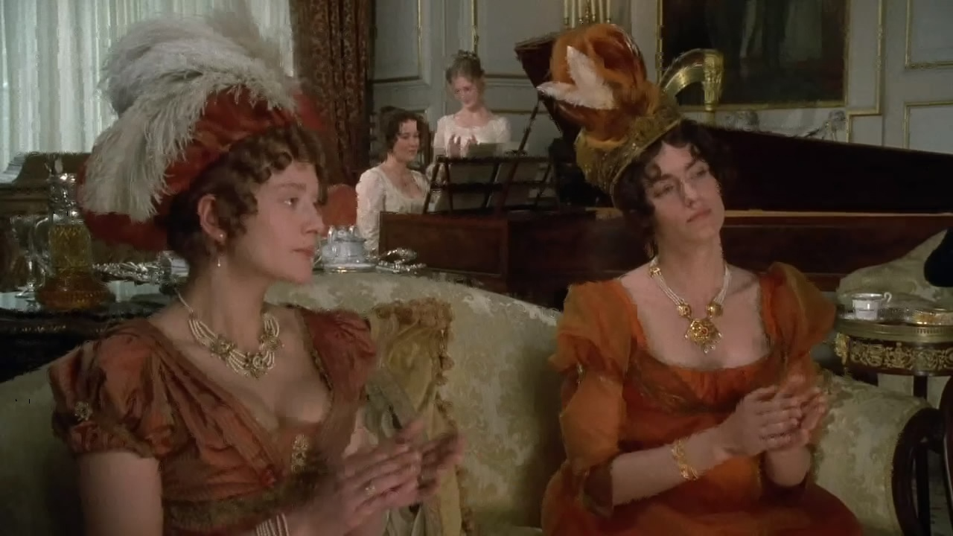

Result

Slide 15
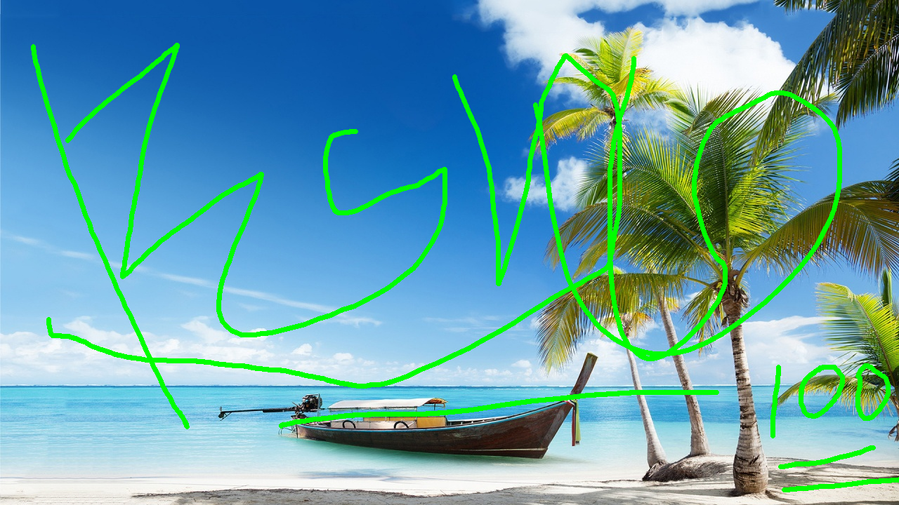


Result

