Slide 1
Kaggle | Housing Prices: Advanced Regression Techniques
By Jenny

Slide 2
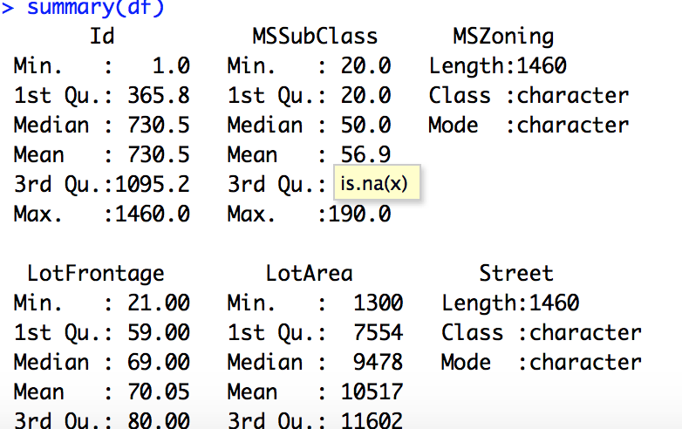
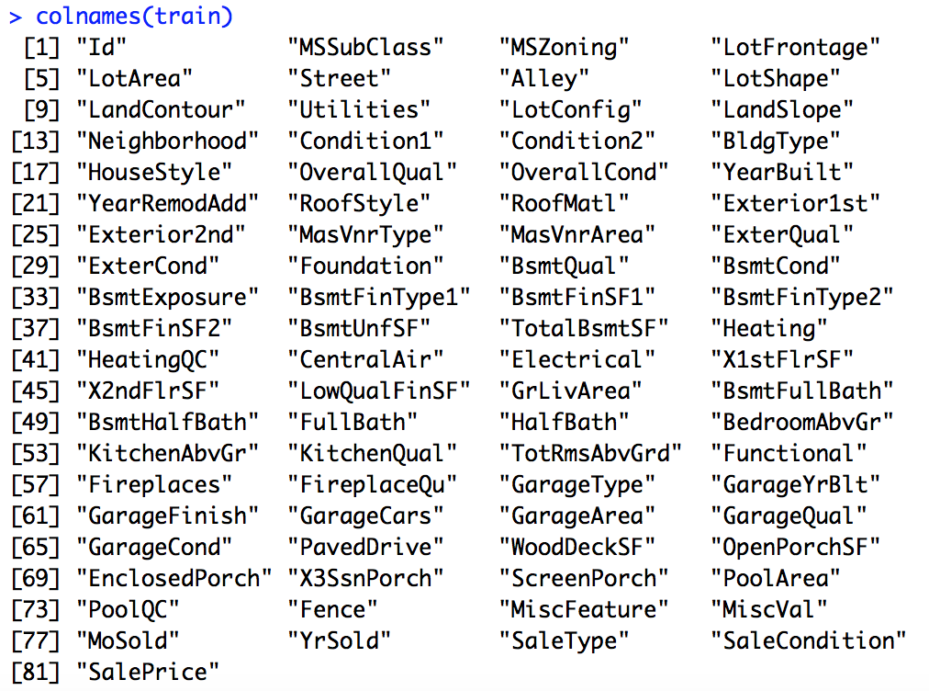
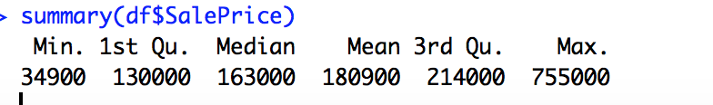
Data Overview

Slide 3
Methodology
1. Read data
2. Check and replace missing values
Some NA have meanings ( ie. NA in Fence mean no fence) => replace these with ‘None’
Some NA are true missing values => replace them using MICE library
3. Feature engineering:
Log transform higher skewed feature (|skewness| > 0.75)
simplify features
create new feature by combining features
5. Train with different ML models :
Linear regression
Decision tree
Random forest
XGBoost
6. Predictions and Evaluation

Slide 4
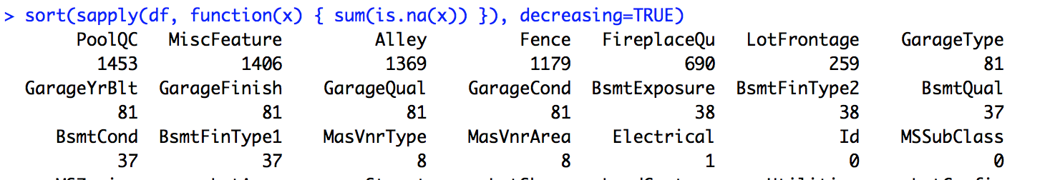

Missing Value
Missing value percentage:
NA : no garage => replace with ‘None’
GarageYrBlt: Year garage was built
GarageFinish: Interior finish of garage
GarageQuality: Garage quality
GarageCond: Garage condition
GarageType: Garage location
NA : no basement = > replace with ‘None’
BsmtCond: Basement condition
BsmtExposure : Refers to walkout or garden level
BsmtQual : evaluate the height of basement
BsmtFinType2: Rating of basement finished area
BsmtFinType1 : : Rating of basement finished area
PoolQC: Pool Quality
NA : no pool => replace with ‘None’
MiscFeature: Miscellaneous features
Alley: Indicate the type of alley access
NA : no alley access => replace with ‘None’
Fence: Fence quality
NA : no fence => replace with ‘None’
FirePlaceQu:FirePlace Quality
NA : no fire place => replace with ‘None’
LotFrontage:Linear feet of street connected to property

Slide 5
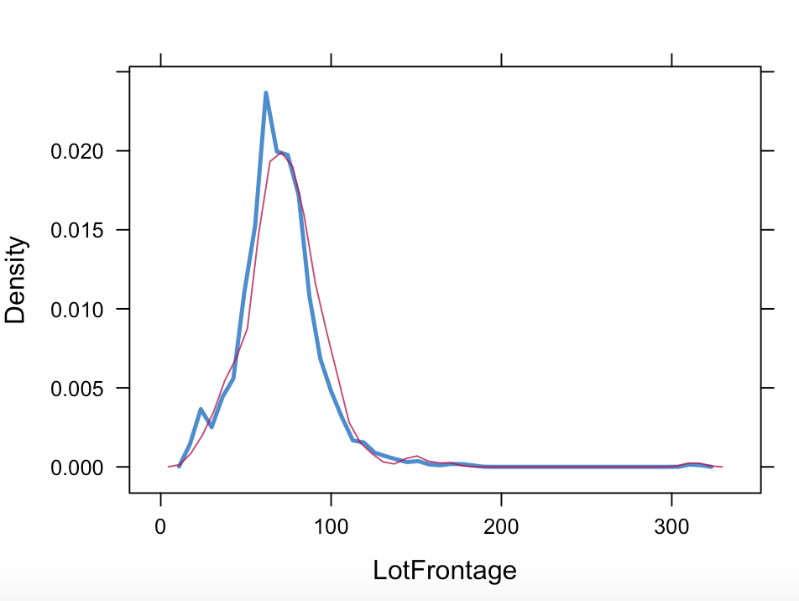
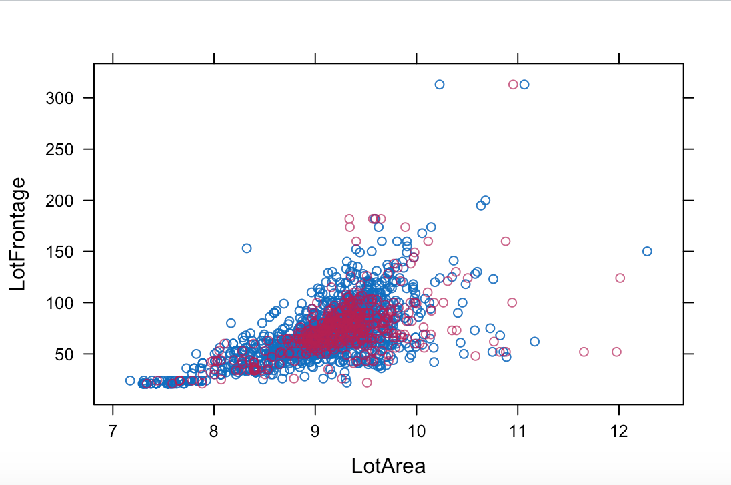
Check distribution of imputed data Ex. LotFrontage on LotArea
LotFrontage has the largest missing numerical values.
Red dots/line are imputed data
Blue dots/line are actual data
The density plot looks very similar for LotFrontage between the imputed data and actual data
The pattern of distribution of LogFrontage on LotArea are similar for imputed data and actual data.
MICE library does a good job on imputing the missing data

Slide 6
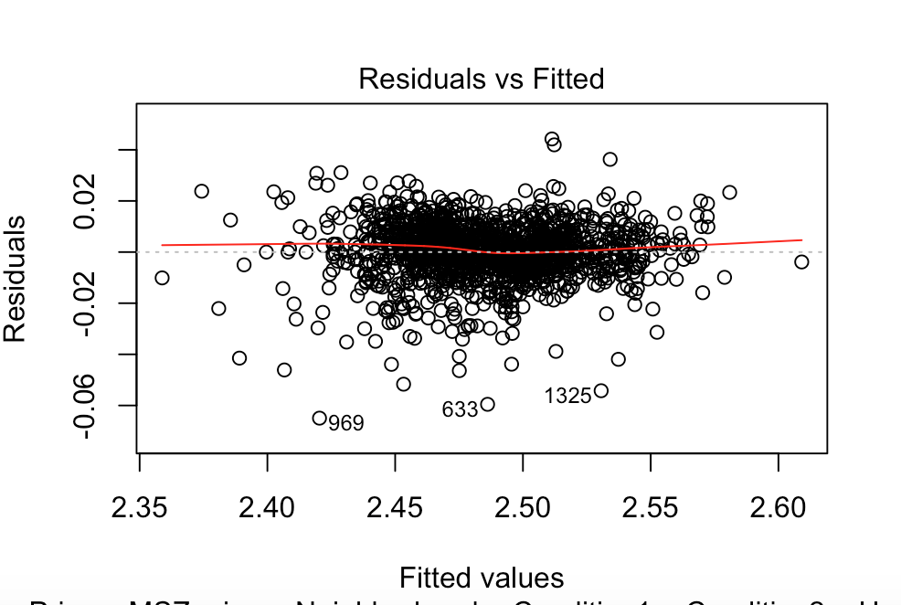
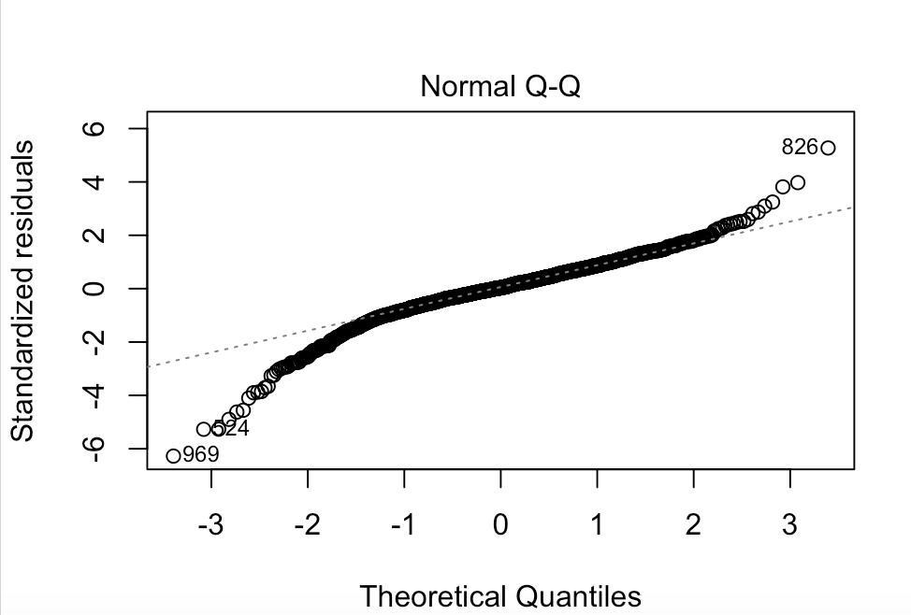
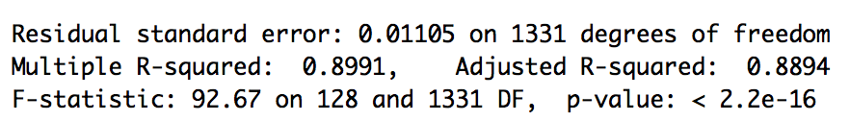
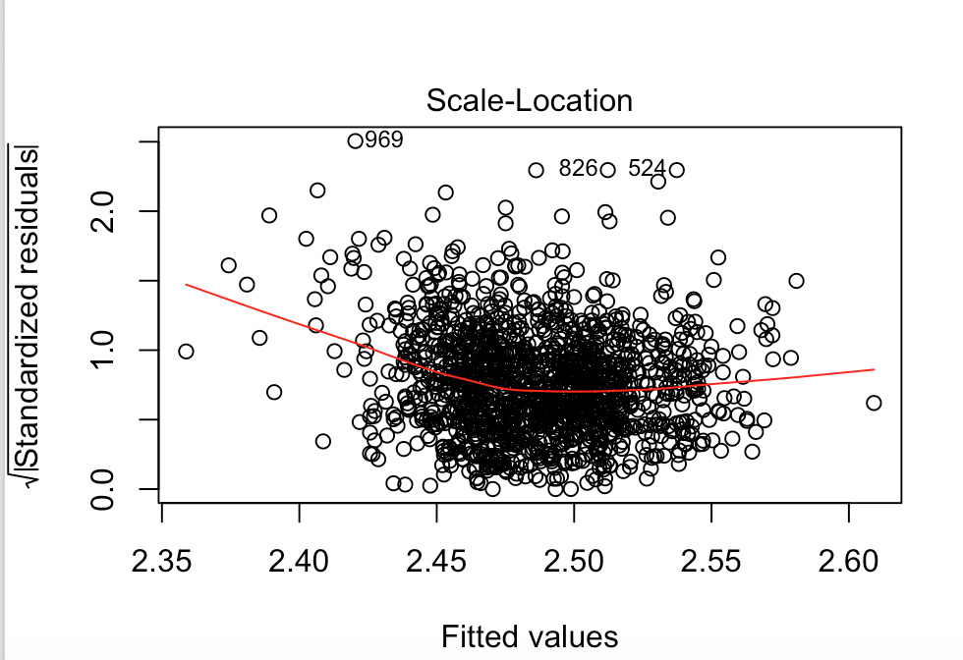
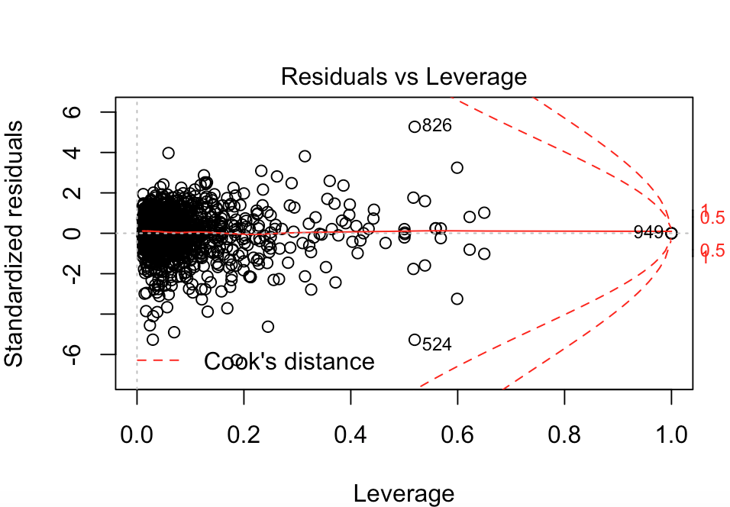
Linear Regression
Fit linear regression on all features
Select 5% significant features
Fit linear regression on selected features
89% of variation in outcome is explained
using this linear model
Good residual plot
Good normal qq plot, it follows the straight
line well, except little deviated in the ends
The Scale-location plot is little off at the
first part, but the second part is good, overall
is not bad. Residuals appear randomly spread.
Very small Cook’s distance
Small cook’s distance, low residual and leverage

Slide 7
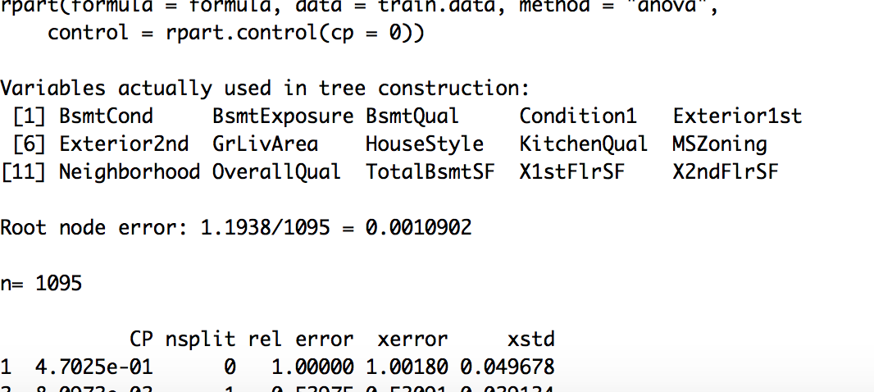
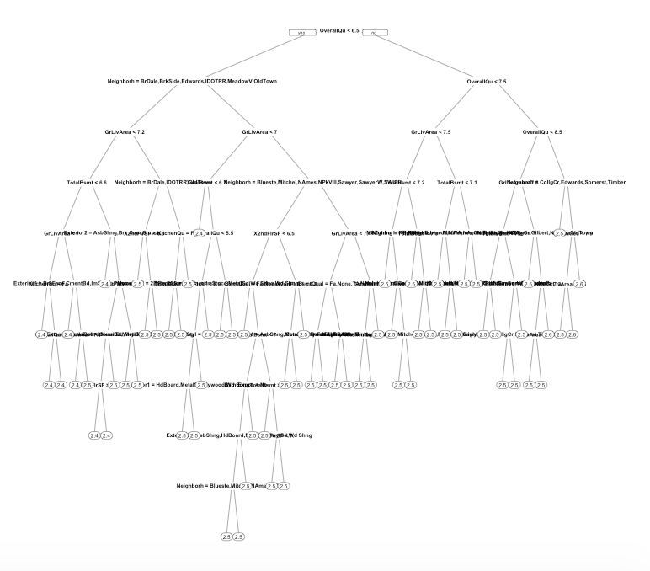
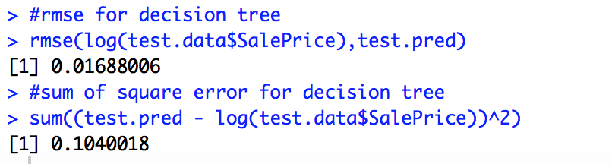
Decision Tree
1. Start with small cp=0
2. Pick the tree size that minimizes xerror
3. Prune the tree using the best cp.
4. Predict with test data
5. Evaluate the error

Slide 8
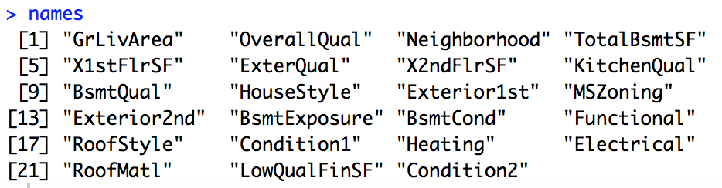
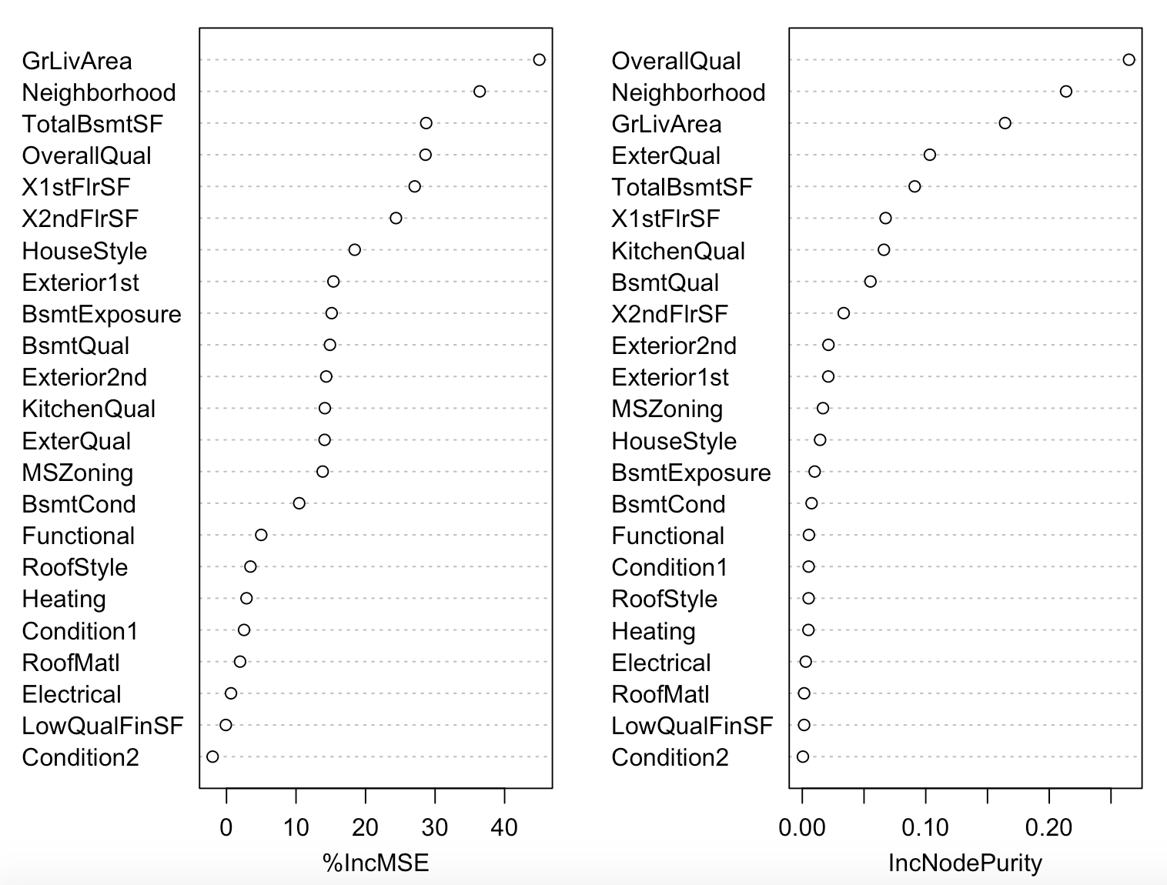
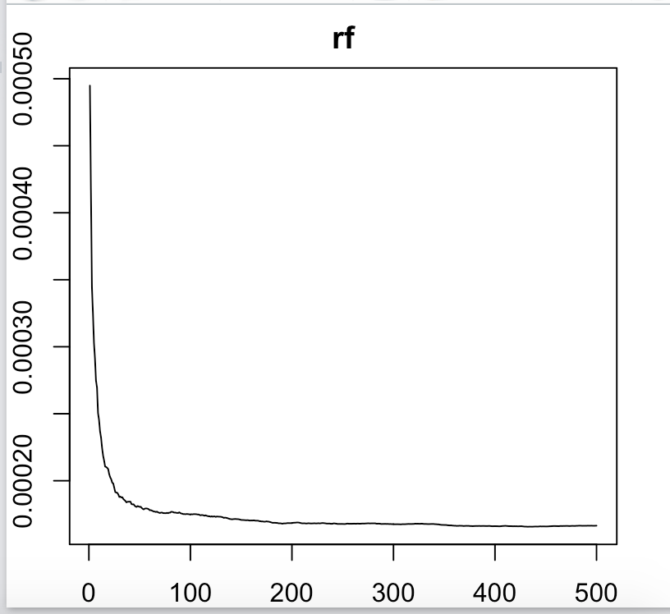
Random Forest
Feature importance

Slide 9
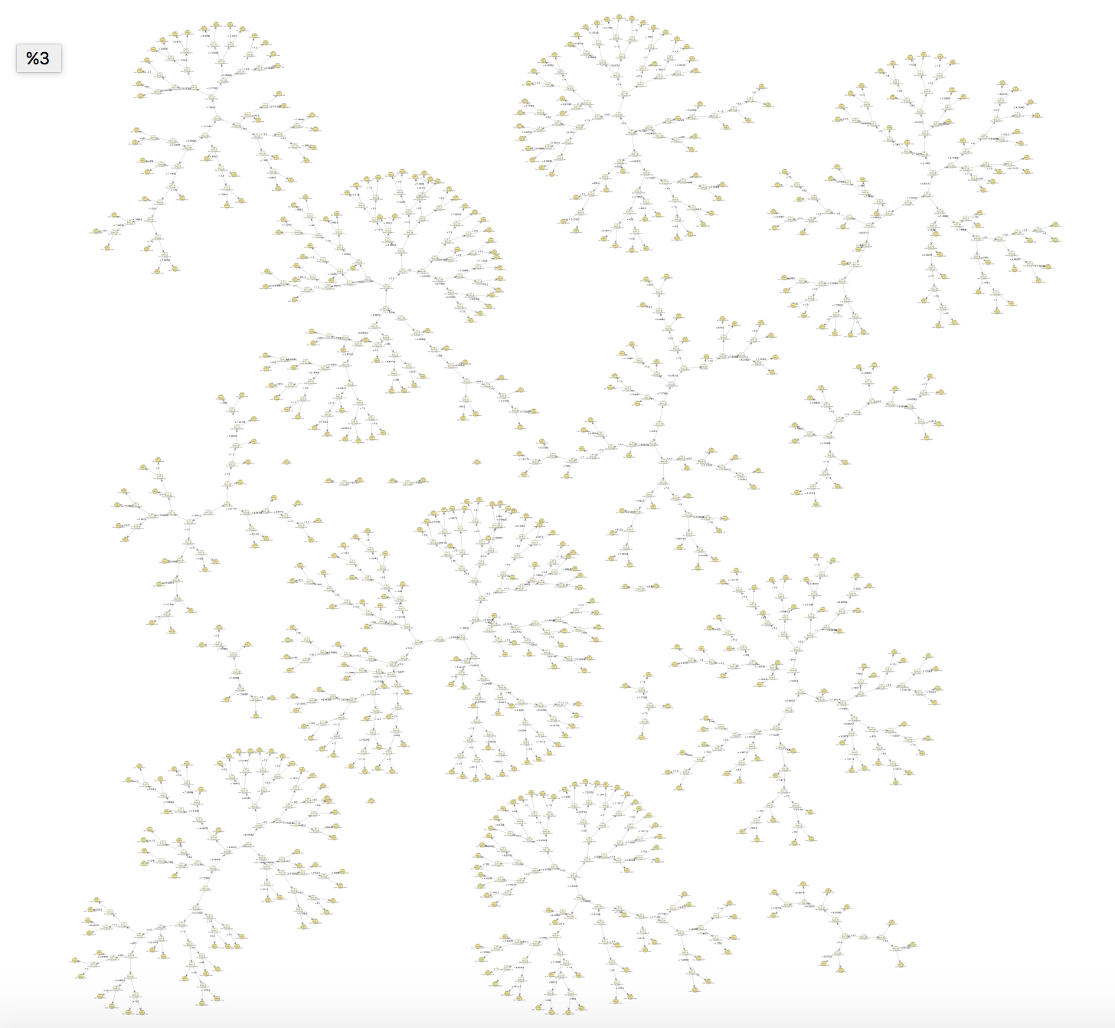
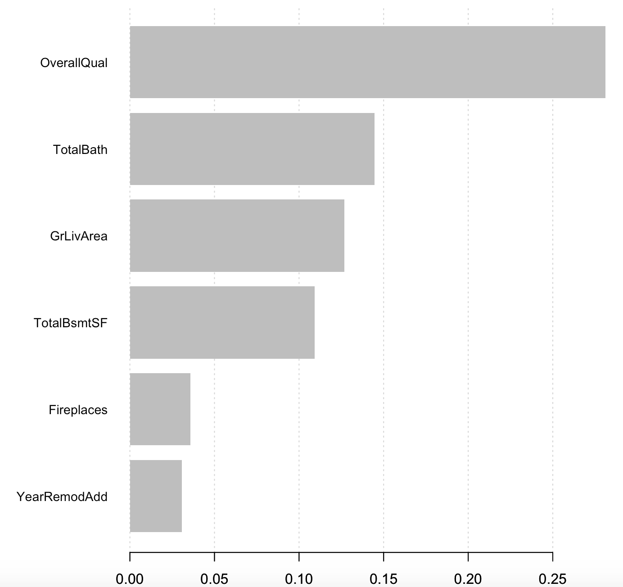
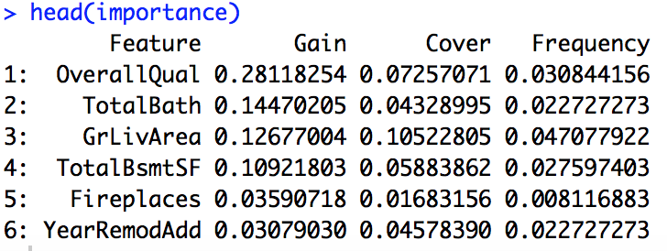
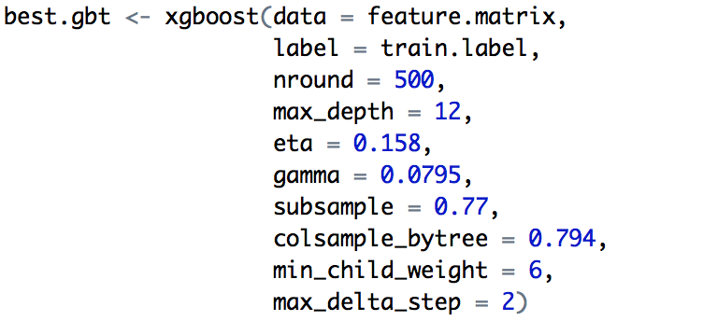
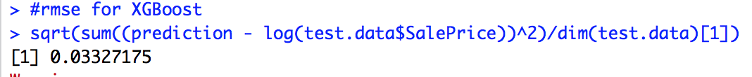
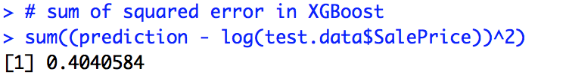
XGBoost
Importance features
Grid Search to tune the parameter
Error

Slide 10
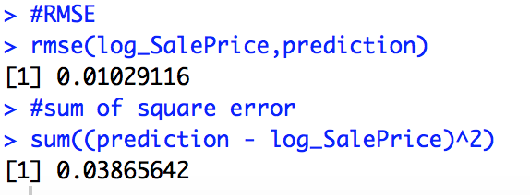
Results
Linear Regression
Decision Tree
XGBoost

