Slide 1
Prototype-initialized adaptation of ViT-B/16 for 10,000-class fine-grained classification
CS604 COURSE PROJECT · TEAM 06
Full fine-tuning reaches 76.22% and LoRA 71.90% top-1 on CodaBench val, inside a 2-hour, 48 GB training budget
[Member names] · 7 November 2026
Notes:
Good afternoon. We are Team 06. Our task was to adapt one pretrained Vision Transformer, ViT-B/16, to a 10,000-class fine-grained dataset under a fixed compute budget, with both full fine-tuning and parameter-efficient methods.
The headline: our final full fine-tuning model reaches 76.22% top-1 on the CodaBench validation set, and our LoRA model reaches 71.90% while training only 1.375% of the backbone. The single change that mattered most was how we initialize the 10,000-class classifier head.

Slide 2
One ViT, 10,000 classes, a fixed budget
THE TASK
10,000
45
1.2 h
< 5%
fine-grained classes in an anonymized dataset
training images per class, 450,000 in total
per training run on one A100-80GB (the 2 h × 48 GB budget)
trainable parameters for the parameter-efficient track
Base model: ViT-B/16, pretrained on ImageNet-21k and fine-tuned on ImageNet-1k (timm). Graded on top-1 accuracy, trainable parameters, inference latency and training GPU-hours.
CS604 · Team 06
2
Notes:
The dataset has 10,000 fine-grained classes but only 45 training images per class, 450,000 images in total. So per class this is close to a few-shot problem.
The backbone is fixed: ViT-B/16, pretrained on ImageNet-21k and fine-tuned on ImageNet-1k. Every training run must fit in 2 hours on 48 GB of GPU memory. We trained on one A100 with 80 GB, so we converted the budget to 96 GB-hours divided by 80 GB, which is 1.2 hours per run, counting head initialization, training and per-epoch evaluation.
The parameter-efficient track should train less than 5% of the parameters. We report all four metrics the brief asks for: top-1 accuracy, trainable parameters, inference latency and training GPU-hours.

Slide 3
We first reproduced the reference baselines
STARTING POINT
Method | Trainable params | Reference | Ours (holdout)
Zero-shot: prototype head, no training | 0% | 43.7% | 43.95%
Full fine-tuning, 3 epochs | 100% | 70.8% | 70.88%
LoRA r = 8 on qkv, 3 epochs | 0.34% | 68.3% | 68.57%
Holdout protocol. We set aside 2 training images per class (20,000 images) as a local validation set. It tracks CodaBench val within 0.3 points (72.31% vs 72.57%; 71.98% vs 71.90%), so we judged every ablation on holdout and saved CodaBench submissions.
CS604 · Team 06 · Reference = numbers reported by a PhD student in the project brief
3
Notes:
Before trying anything new, we reproduced the three reference numbers from the brief. The zero-shot prototype head gives 43.95% against 43.7%, full fine-tuning for 3 epochs gives 70.88% against 70.8%, and LoRA with rank 8 on the attention qkv projection gives 68.57% against 68.3%. So our pipeline matches the reference.
The validation labels are hidden, so we held out 2 training images per class, 20,000 images, as a local validation set. Holdout and CodaBench agree within 0.3 points on the two models we checked, so the ablations that follow are on holdout.

Slide 4
Our pipeline: prototype head, fine-tune, flip TTA
OUR METHOD
1
2
3
4
Extract features
Prototype head
Fine-tune
Predict
Run the frozen ViT-B/16 once over all training images and keep the 768-d CLS features.
Class weight = L2-normalized mean feature of the class × temperature 40. No gradient steps.
Full fine-tuning, or LoRA r = 8 on qkv, proj, fc1 and fc2 (1.375% of the backbone).
Average the logits of each image and its horizontal flip (test-time augmentation).
Every run is budget-aware: after 120 steps the measured speed sets how many steps fit in 1.2 GPU-hours, and the cosine learning-rate schedule is compressed to fit.
CS604 · Team 06
4
Notes:
Here is the whole pipeline. Step one: we run the frozen backbone once over all training images and keep the 768-dimensional CLS features. Step two, the key design choice: each class's weight in the new 10,000-class head is the L2-normalized mean of its features, scaled by a temperature of 40. That takes no gradient steps at all. Step three: we fine-tune, either the whole network or LoRA with rank 8 on every linear layer of every block, which is 1.375% of the backbone. Step four: at prediction time we average the logits of the image and its horizontal flip.
Every run is also budget-aware. After 120 steps we measure the speed, compute how many steps fit into 1.2 GPU-hours, and compress the cosine schedule if needed, so no run can exceed the budget.

Slide 5
Three ways to start the 10,000-class head
KEY DESIGN CHOICE
Random
Prototype (ours)
Linear probe
≈ 0%
44.0%
62.1%
head-only accuracy before training
head-only accuracy before training
head-only accuracy before training
Small random weights (the timm default). The head starts with no class knowledge.
Normalized class-mean features × temperature. No training, about 6 minutes of feature extraction.
The prototype head, then 10 epochs of training on the frozen features of the same training images.
Intuition says: start from the strongest head, the linear probe. The experiments say otherwise.
CS604 · Team 06
5
Notes:
The new head has 10,000 classes and 7.69 million parameters, so how we start it matters. We compared three options.
Random: the timm default, small random weights, so the head knows nothing at the start.
Prototype, our choice: each class weight is the normalized mean feature of that class, times a temperature. It needs no training and already gives 44% before any fine-tuning.
Linear probe: we start from the prototypes and train only the head for 10 epochs on frozen features. It starts strongest, at 62%. This is the classic linear-probe-then-fine-tune recipe, and it was our first design. Intuition says the strongest starting head should win. The next slide shows it does not.

Slide 6
Prototype heads beat linear-probe heads by 2.5 to 3.1 points
FINDING 1
+2.5
+2.5
+3.1
Full fine-tuning, 3 epochs
LoRA on all linear layers, 3 epochs
Full fine-tuning, 8 epochs, all data, flip TTA
lp 70.88% → proto 73.38% (holdout)
lp 69.45% → proto 71.98% (holdout)
lp 73.10% → proto 76.22% (CodaBench val)
Everything else is identical within each pair. A random head ends level with the prototype head (71.95% vs 72.00%, LoRA, 3 epochs) but converges more slowly, so only the linear-probe head hurts.
CS604 · Team 06 · lp = linear-probe head, proto = prototype head
6
Notes:
This is our main finding. In every pair, with everything else identical, the prototype head beats the linear-probe head. Full fine-tuning for 3 epochs: plus 2.5 points on holdout. LoRA on all linear layers for 3 epochs: plus 2.5 points. And our final setting, full fine-tuning for 8 epochs on all data with flip TTA: plus 3.1 points on CodaBench, from 73.10% to 76.22%.
We also tried a random head. It ends level with the prototype head, 71.95% against 72.00%, but learns more slowly in the first epochs. So the problem is specifically the linear-probe head.

Slide 7
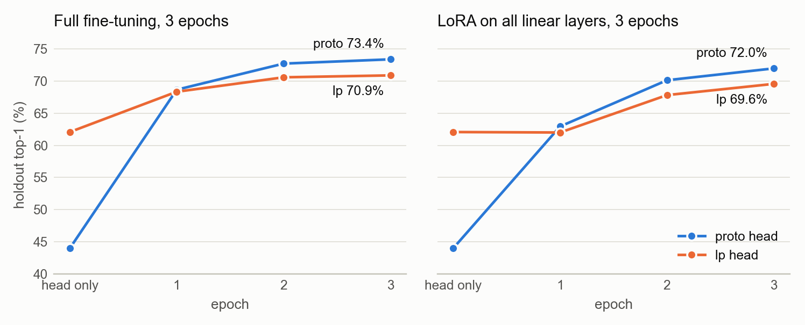
Linear-probe heads start high, finish low
FINDING 1 · EVIDENCE
Holdout top-1 after each epoch; “head only” is the accuracy before any training. Left: full fine-tuning. Right: LoRA on all linear layers. Blue = prototype head, orange = linear-probe head.
CS604 · Team 06
7
Notes:
Here are the learning curves behind that finding. The leftmost point is the head on its own, before any training: the linear-probe head, in orange, starts at 62%, far above the prototype head, in blue, at 44%.
But after the first epoch the prototype run has caught up, and from then on it stays ahead. After 3 epochs it finishes 2.5 points higher for full fine-tuning on the left, and 2.5 points higher for LoRA on the right. With LoRA the linear-probe run even stalls in the first epoch: holdout stays at 62%.

Slide 8
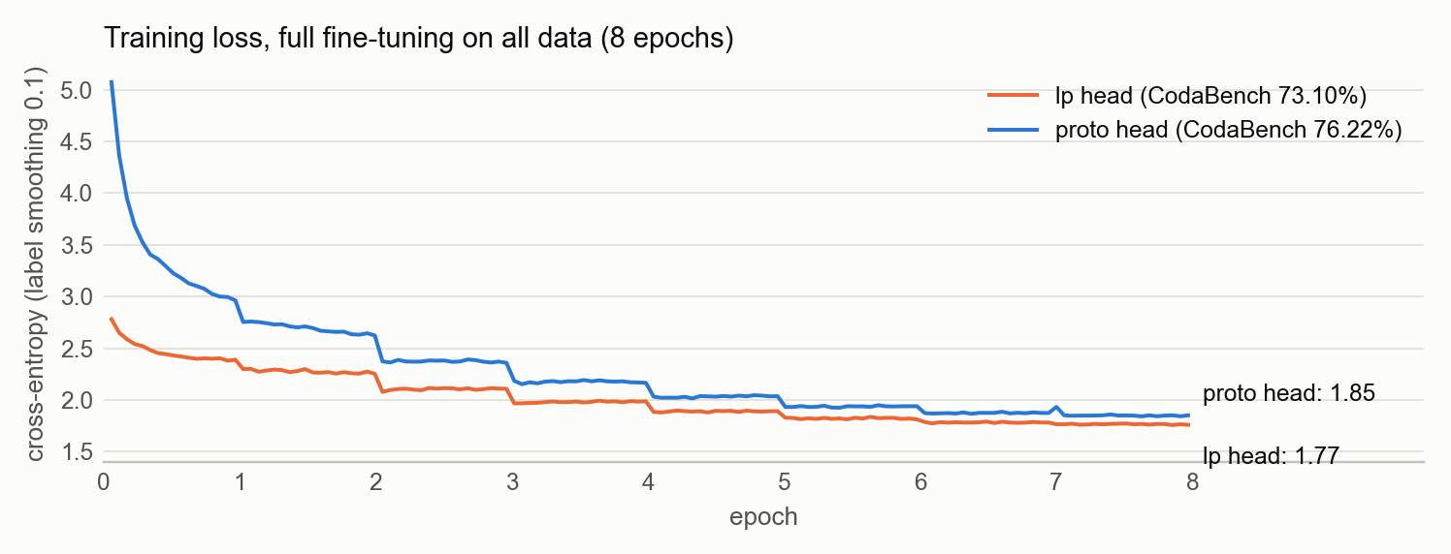
The linear-probe head has already fit the training set
FINDING 1 · WHY
Weak signal. It was trained on frozen features of the same training images, so the first training loss is low (2.29 vs 4.39 with prototypes, LoRA) and little gradient reaches the backbone.
Then a mismatch. Once the features move, the fitted head no longer fits: with LoRA the training loss rose from 2.22 to 2.69 in epoch 1.
Prototypes generalize. Higher training loss (1.85 vs 1.77), yet +3.1 points on CodaBench.
CS604 · Team 06 · Chart: full fine-tuning, all data, 8 epochs
8
Notes:
Why does the stronger start lose? Our explanation, consistent with the logs: the linear-probe head was trained on frozen features of the very same training images, so it already fits the training set. The training loss starts low, 2.29 against 4.39 for the prototype head in the LoRA runs, so only a weak gradient reaches the backbone and it learns less.
Then, as soon as the backbone features move, the fitted head no longer matches them. With LoRA the training loss actually rose from 2.22 to 2.69 during the first epoch, and the holdout accuracy stalled.
The chart shows full fine-tuning on all data. The prototype run keeps a higher training loss all the way, 1.85 against 1.77 in the last epoch, but it is 3.1 points better on CodaBench, so the linear-probe run is fitting the training images rather than learning general features. The step at every epoch boundary is the same memorization effect.

Slide 9
For PEFT, capacity matters more than learning rate
FINDING 2
Setting (lp head, 3 epochs) | Trainable | Holdout | Train speed | Peak VRAM | Latency bs1
LoRA on qkv (baseline) | 0.344% | 68.57% | 1,341 img/s | 13.5 GB | 7.22 ms
LoRA on qkv, LR 1e-3 → 5e-4 | 0.344% | 68.45% | 1,353 img/s | 13.5 GB | 7.15 ms
LoRA on qkv, proj, fc1, fc2 | 1.375% | 69.45% | 885 img/s | 19.9 GB | 7.03 ms
AdaptFormer (parallel to the MLP) | 1.387% | 69.05% | 1,437 img/s | 12.8 GB | 9.89 ms
Full fine-tuning (reference) | 100% | 70.88% | 1,131 img/s | 18.9 GB | 7.31 ms
Letting LoRA adapt the MLP adds 0.88 points; halving the learning rate changes nothing (−0.12, within noise). AdaptFormer comes close, but it cannot be merged into the backbone, so it is about 35% slower at batch size 1.
CS604 · Team 06 · All on an A100-80GB, bf16
9
Notes:
The second question: how should the parameter-efficient model spend its budget? All runs here use the same linear-probe head and 3 epochs, so only the PEFT design changes.
Halving the LoRA learning rate did nothing: minus 0.12, which is within noise. Putting LoRA on every linear layer, so that it also adapts the MLP, gained 0.88 points, at 1.375% of the backbone, still far below the 5% limit. So the bottleneck is capacity, not the learning rate.
AdaptFormer, the adapter in parallel to the MLP, is close in accuracy and the fastest to train, but its modules cannot be merged into the backbone, so inference at batch size 1 is about 35% slower than a merged LoRA.

Slide 10
More epochs help full fine-tuning, not LoRA
FINDING 3
Setting | Shorter | Longer | Change
Full fine-tuning, lp head (holdout) | 3 ep: 70.88% | 8 ep: 72.31% | +1.43
Full fine-tuning, proto head, all data, flip TTA (CodaBench) | 3 ep: 74.01% | 8 ep: 76.22% | +2.21
LoRA on qkv, lp head (holdout) * | 3 ep: 68.57% | 10 ep: 68.69% | +0.12
LoRA on all linear layers, lp head (holdout) | 3 ep: 69.45% | 6 ep: 69.87% | +0.42
LoRA on all linear layers, proto head (holdout) | 3 ep: 71.98% | 6 ep: 71.52% | −0.46
Full fine-tuning uses LR 1e-4 with layer-wise decay, so it moves gently and keeps improving. LoRA at LR 1e-3 starts to memorize after about 3 epochs.
CS604 · Team 06 · * this run also lowered the head LR to 2e-4
10
Notes:
Third finding: training length behaves in opposite ways for the two methods. Full fine-tuning keeps improving: 3 to 8 epochs adds 1.4 points with the linear-probe head and 2.2 points on CodaBench with the prototype head, which is how we got to 76.22%.
LoRA saturates after about 3 epochs. With the qkv-only LoRA, 10 epochs is no better than 3; with the prototype head, 6 epochs is even 0.46 points worse than 3. Our reading: full fine-tuning uses a small learning rate, 1e-4, with layer-wise decay, so it moves gently; LoRA uses 1e-3 and starts to memorize the training images. So we train full fine-tuning for the whole budget and stop LoRA at 3 epochs.

Slide 11
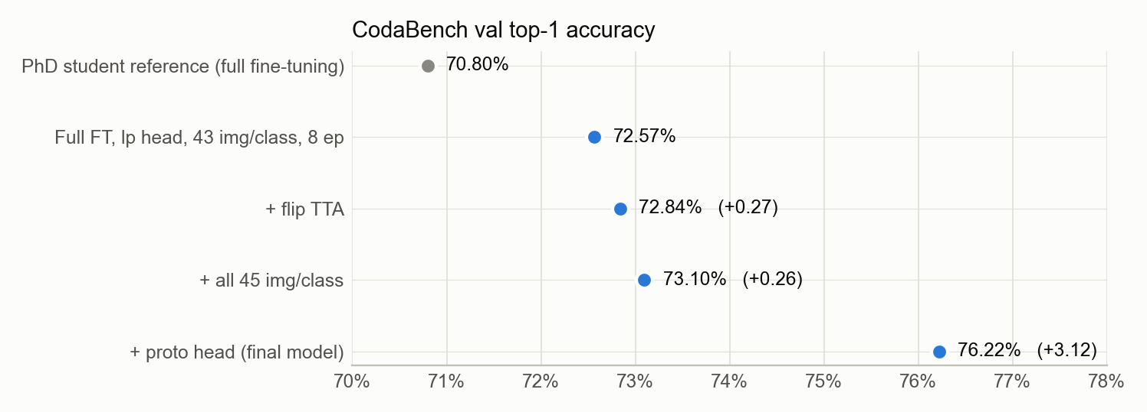
72.57% to 76.22%, one change at a time
RESULTS
CodaBench val top-1. Each step changes one setting; grey is the reference from the brief. The axis starts at 70% because the dots encode position, not length.
CS604 · Team 06
11
Notes:
This chart is the path to our final CodaBench score, one change per step, with the same model and 8 epochs throughout.
Our full fine-tuning with the linear-probe head scored 72.57%, already above the 70.8% reference. Flip test-time augmentation added 0.27 points. Training on all 45 images per class instead of holding out 2 added another 0.26. That one is at the edge of noise, but it points the expected way. Then switching only the head initialization to prototypes added 3.12 points, to 76.22%. That last step is bigger than everything before it combined.

Slide 12
Final results, all inside the compute budget
FINAL MODELS
Model | CodaBench val | Test | Trainable | Latency bs1 | GPU-hours | Peak VRAM
Reference: full fine-tuning | 70.8% | – | 100% | – | – | –
Reference: LoRA | 68.3% | – | 0.34% | – | – | –
Ours: full fine-tuning, proto head, 8 epochs, all data, flip TTA | 76.22% | [__%] | 100% | 14.95 ms * | 1.03 h | 18.9 GB
Ours: LoRA on all linear layers, proto head, 3 epochs | 71.90% | [__%] | 1.375% | 7.61 ms | 0.54 h | 19.9 GB
* Flip TTA runs two forward passes per image; without it the same model takes 7.35 ms. Budget per run: 1.2 GPU-hours on an A100-80GB (2 h × 48 GB) and 48 GB of memory. Latency: batch 1, bf16, forward pass only. Test accuracy is added after Phase 2 (6 November).
CS604 · Team 06 · Trainable = share of the 85.8M-parameter backbone; the 7.69M-parameter head is extra
12
Notes:
Here are the two final models side by side with the references, on all the metrics the brief asks for.
Full fine-tuning with the prototype head, 8 epochs, all data and flip TTA reaches 76.22% on CodaBench val, 5.4 points above the reference, using 1.03 of the 1.2 allowed GPU-hours and 18.9 GB of memory. Its latency is 14.95 ms per image because of the two TTA passes; without TTA it is 7.35 ms.
Our LoRA model trains only 1.375% of the backbone and reaches 71.90%, 3.6 points above the reference LoRA, in 0.54 GPU-hours. After merging, its latency equals the base model.
The test-set column will be filled in after Phase 2.

Slide 13
What PEFT saves, and what it does not
COST
Saves: parameters and storage
Does not save: training time or memory
Merging matters at inference
1.375%
885 img/s
+35%
of the backbone is trained. The checkpoint is about 36 MB (31 MB of it is the head), against 374 MB for full fine-tuning.
for LoRA on all linear layers, against 1,131 img/s for full fine-tuning; peak memory 19.9 GB against 18.9 GB.
batch-1 latency for AdaptFormer (9.89 ms), which cannot be merged. Merged LoRA adds nothing (about 7.3 ms).
CS604 · Team 06 · All measured on an A100-80GB, bf16
13
Notes:
A practical lesson about cost. What PEFT clearly saves is trainable parameters and storage: 1.375% of the backbone, and a checkpoint of about 36 MB, most of which is the 10,000-class head, against 374 MB for full fine-tuning.
What it did not save in our runs is training time or memory. Gradients still flow back through the whole frozen backbone, and the extra LoRA branches add work, so LoRA on all linear layers trained at 885 images per second against 1,131 for full fine-tuning, with slightly more peak memory.
At inference, merging is what matters. LoRA merges into the weights and costs nothing extra. AdaptFormer cannot be merged and is about 35% slower at batch size 1.

Slide 14
Takeaways
1
Start the 10,000-class head from class prototypes, not a linear probe: +2.5 to +3.1 points.
2
Give LoRA capacity in the MLP rather than a different learning rate: +0.88 points at 1.375% of the parameters.
3
Spend the whole budget on full fine-tuning; stop LoRA at about 3 epochs.
4
Result: 76.22% with full fine-tuning and 71.90% with LoRA on CodaBench val, both inside the budget.
CS604 · Team 06
14
Notes:
To sum up in four points. One: initialize the 10,000-class head from class prototypes, not from a linear probe; that alone is worth 2.5 to 3.1 points. Two: for LoRA, add capacity in the MLP rather than tuning the learning rate. Three: full fine-tuning should use the whole budget, while LoRA should stop at about 3 epochs. And four, the outcome: 76.22% with full fine-tuning and 71.90% with LoRA on CodaBench val, both well inside the compute budget.

Slide 15
Thank you
CS604 · TEAM 06
Questions are welcome.
[Member names]
Notes:
Thank you. We are happy to take questions. Likely questions: why prototypes beat the linear probe, whether the gains hold on the test set, and why LoRA was not faster to train. The backup slide has the exact hyperparameters and how we counted GPU time.

Slide 16
Implementation details and budget accounting
BACKUP
Training
Measurement
Backbone: timm vit_base_patch16_224.augreg2_in21k_ft_in1k (85.8M parameters); new 10,000-class head (7.69M)
AdamW, warmup then cosine decay, bf16, batch 256, label smoothing 0.1, gradient clipping at 1.0
Augmentation: RandomResizedCrop (area 0.25–1) and horizontal flip
Full fine-tuning: LR 1e-4, weight decay 0.05, layer-wise LR decay 0.75, drop path 0.1
LoRA: r = 8, α = 16, LR 1e-3, weight decay 1e-4, merged after training
AdaptFormer: bottleneck 64, scale 0.1, parallel to the MLP
Budget: 96 GB·h ÷ 80 GB = 1.2 h per run on an A100-80GB (±10% allowed)
Counted: head initialization with feature extraction, training, per-epoch holdout evaluation
Not counted: unpacking data, saving checkpoints, final prediction
Latency: random input, forward pass only, bf16, batch 1; about 3,850 img/s at batch 256
Software: torch 2.11.0 (CUDA 13.0), timm 1.0.30, peft 0.21.1
Hardware: A100-SXM4-80GB with 12 CPUs; one ablation batch ran on an RTX PRO 6000 and is used for accuracy only
CS604 · Team 06
16
Notes:
Backup slide for questions about implementation. Left: the training recipe for both methods. Right: how we measured. GPU time counts everything that uses the GPU for training, including the feature extraction for the prototype head, but not unpacking data, saving checkpoints or the final prediction. Latency is measured with random input, forward pass only, in bf16 at batch size 1. The software versions were logged from the later runs onward.

