Slide 1
Prototype-initialized adaptation of ViT-B/16 for 10,000-class fine-grained classification
CS604 COURSE PROJECT · TEAM 06
Seven adaptation methods, one budget, and the one choice that mattered most: how the new head starts.
Test top-1: 76.09% with full fine-tuning, 71.67% with LoRA.
[Name A] · [Name B] · [Name C] · [Name D] · 7 November 2026
Notes:
Speaker A.
Good afternoon, we are Team 06. Our task was to adapt one pretrained Vision Transformer, ViT-B/16, to 10,000 fine-grained classes within a fixed compute budget. We compared seven adaptation methods. Along the way, one design choice mattered more than the choice of method: how the new 10,000-class head starts. On the hidden test set we reach 76.09% with full fine-tuning and 71.67% with LoRA.

Slide 2
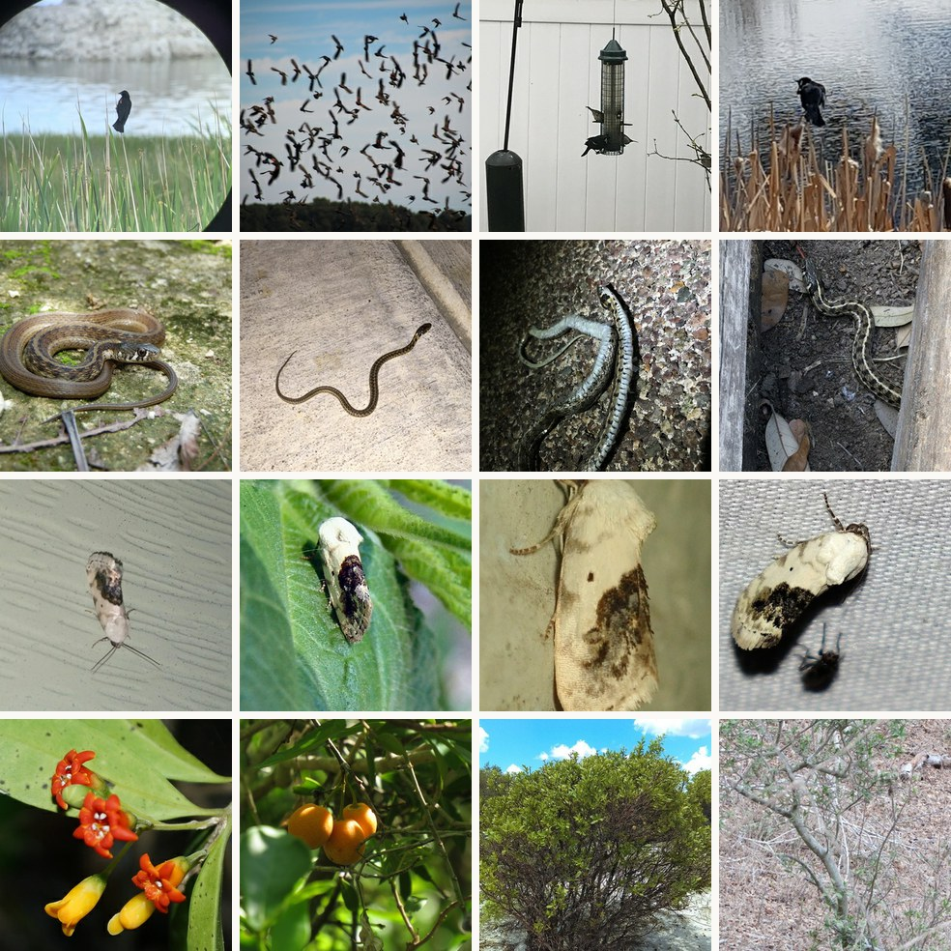
Many classes, few photos, one budget
PART 1 · THE PROBLEM
10,000
fine-grained classes; the class names are hidden
So: the features must adapt, not only the head
45
training photos per class, 450,000 in total
So: easy to memorize; judge on 20,000 held-out photos, not training loss
1.2 h
per run on one A100-80GB: 2 h × 48 GB of GPU memory, ±10%
So: every idea must fit one budget, and we count all GPU time
ViT-B/16
pretrained on ImageNet-21k, fine-tuned on ImageNet-1k; 85.8M parameters
So: the backbone the brief recommends; we keep it in every experiment
CS604 · Team 06
2
Notes:
Speaker A.
Before choosing any method, we asked what makes this problem hard, because each difficulty points to a design choice. First, 10,000 fine-grained classes with hidden names: the pretrained features were not made for these distinctions, so the backbone itself has to adapt, not only the classifier. Second, only 45 photos per class, and very different ones: on the left, each row is one class, from a single bird to a whole flock, from a flower to a whole shrub. A model can simply memorize them, so we never trust the training loss and always judge on held-out photos. That turned out to be the key risk. Validation, 50,000 photos, and test, 100,000, have hidden labels. Third, a fixed budget of 2 hours on 48 GB, which is 1.2 hours per run on our 80 GB A100. We count all GPU time: feature extraction for the head, training and evaluation during training.
The backbone is the one the brief recommends: ViT-B/16 pretrained on ImageNet-21k and fine-tuned on ImageNet-1k. We did not change it, and we checked that the ImageNet-21k-only versions give no better features.
Our yardstick: we hold out 2 training photos per class, 20,000 in total. It tracks CodaBench within about 0.3 points, so every comparison in this talk uses it.

Slide 3
Baselines first, then seven methods
PART 1 · STARTING POINT
Reference baseline (project brief) | Trainable | Reference | Ours (holdout)
Zero-shot: prototype head, no training | 0% | 43.7% | 43.95%
Full fine-tuning, 3 epochs | 100% | 70.8% | 70.88%
LoRA r = 8 on qkv, 3 epochs | 0.34% | 68.3% | 68.57%
Same backbone, same numbers: all three within 0.3 points of the reference.
TRAIN WHOLE BLOCKS, FROM THE TOP
Linear probe
Partial
Full fine-tuning
the head only
the last K of the 12 blocks
every weight
0 (0%)
7.1M–42.5M (8–50%)
85.8M (100%)
SMALL CHANGES IN EVERY BLOCK
BitFit
Adapter
AdaptFormer
LoRA
the bias terms only
a bottleneck after each MLP
a bottleneck beside each MLP
a low-rank update, merged after training
102,912 (0.12%)
1.19M (1.39%)
1.19M (1.39%)
1.18M (1.38%)
CS604 · Team 06
3
Notes:
Speaker A.
Before trying anything new, we reproduced the three reference numbers in the brief: zero-shot 43.95% against 43.7, full fine-tuning for 3 epochs 70.88 against 70.8, and LoRA on the attention qkv layer 68.57 against 68.3. So our pipeline matches the reference.
Then we compared seven ways to adapt the model, in two families. The first family trains whole blocks from the top: the linear probe trains only the head, partial fine-tuning trains the last K of the 12 blocks, and full fine-tuning trains every weight. The second family makes small changes in every block: BitFit trains only the biases, the Adapter and AdaptFormer add a small bottleneck after or beside each MLP, and LoRA learns a low-rank update that is merged back into the weights. They train 0.12 to 1.4% of the backbone.
All seven share one protocol: the same head, 3 epochs, the same holdout and the same GPU, so their numbers compare directly.
Handoff: [Name B] will show how we worked through these experiments, and how the seven compare.

Slide 4
How we iterated: one question at a time
PART 2 · OUR PROCESS
When | Question | What we tried | What we found (holdout top-1)
Sep 28 | Is our pipeline right? | Reproduce the three reference baselines | All three within 0.3 points
Sep 28 | Do longer runs help? | Full FT for 8 epochs, LoRA for 10 | Full +1.4; LoRA +0.1, and its loss rose in epoch 1
Oct 18 | Is LoRA's learning rate too high? | Halve it: 1e-3 → 5e-4 | Failed: −0.12, so not the cause
Oct 18 | Does LoRA lack capacity? | Also put LoRA on proj, fc1 and fc2 | Worked: +0.88
Oct 19 | Is the head the problem? | Linear-probe vs random vs prototype head | Worked: +2.5; the linear-probe head hurts
Oct 19 | What is the best final recipe? | Prototype head; full FT 8 epochs; LoRA 3 vs 6 | Val 76.22% and 71.90%; 6 LoRA epochs: −0.46
Nov 2 | Which method is best per weight? | Seven methods under one protocol | Where you train beats how much
Nov 5 | What limits us now? (after the deadline) | In21k-only backbones; larger input images | In21k-only backbones probe worse (61.05%, 51.07% vs 61.94%); resolution: +4.4
Failed ideas mattered too: each one ruled out an explanation and pointed to the next test.
CS604 · Team 06
4
Notes:
Speaker B.
Here is how we got there: one question per round, and each answer chose the next experiment. After reproducing the baselines, longer training helped full fine-tuning but not LoRA, and LoRA's training loss even rose in the first epoch. Our first guess, a too-high learning rate, failed: halving it changed nothing. Our second guess, missing capacity, helped: adding LoRA to the MLP gave 0.9 points. The third question, the head, was the big one: 2.5 points, as Part 3 explains. Then we fixed the final recipe, compared all seven methods under one protocol, and after the deadline asked what still limits us: not the backbone, but the input resolution. The failed ideas mattered as much as the successes: each one ruled out a wrong explanation.

Slide 5
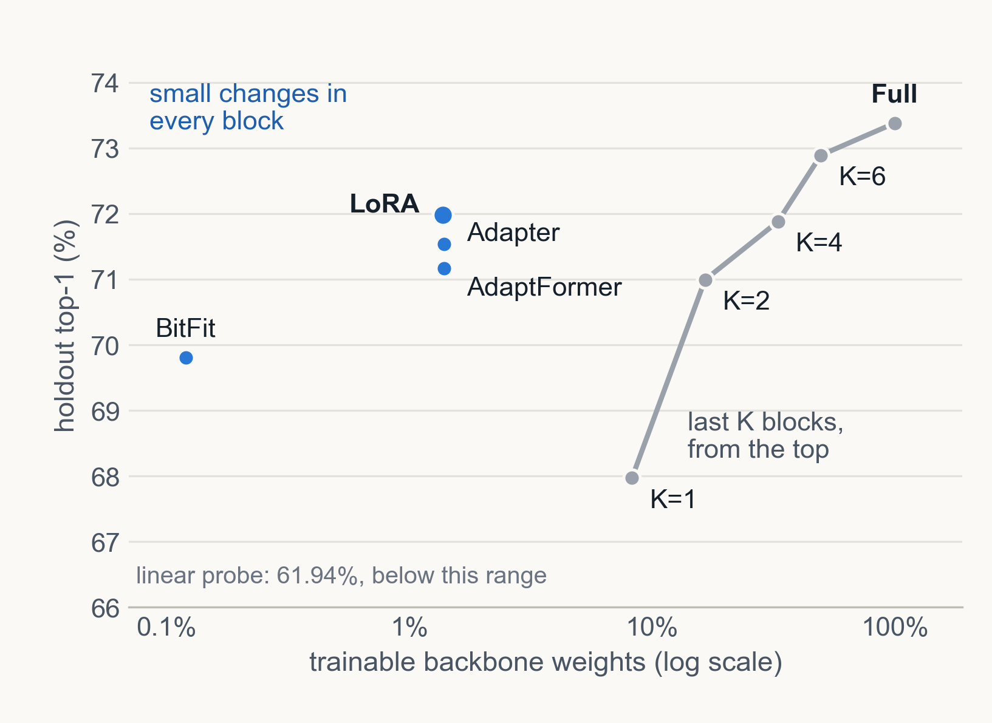
Spread small changes over every block
PART 2 · COMPARISON
Method | Trains | Holdout | Train memory | Latency, batch 1
Linear probe | 0% | 61.94% | 3.2 GB | 6.96 ms
Partial, K = 4 | 33% | 71.88% | 7.0 GB | 7.41 ms
Full fine-tuning | 100% | 73.38% | 18.9 GB | 7.78 ms
BitFit | 0.12% | 69.81% | 12.7 GB | 7.33 ms
Adapter | 1.39% | 71.54% | 12.8 GB | 9.74 ms
AdaptFormer | 1.39% | 71.17% | 12.8 GB | 10.23 ms
LoRA | 1.38% | 71.98% | 19.9 GB | 7.61 ms
Same protocol: LoRA (1.38%) matches partial K=4 (33%); BitFit (0.12%) beats K=1 (8%).
Memory follows how far gradients flow, not how many weights train: LoRA 19.9 GB, partial K=4 only 7.0 GB.
Full fine-tuning is the most accurate; LoRA is the best efficient method and merges, so no latency is added.
CS604 · Team 06
5
Notes:
Speaker B.
Here are all seven under the same protocol; the plot shows accuracy against the share of trained weights, on a log scale.
The grey line trains whole blocks from the top, and it climbs slowly: one block, 8% of the weights, gives 68%; six blocks give 72.9%; everything gives 73.4%. The blue points make small changes in every block, and they sit far to the left of the line. LoRA, with 1.38% of the weights, matches training the last four blocks, which is 33%. BitFit, with only the biases, beats training the last block. So where the trainable weights sit matters more than how many there are: a little capacity in every block beats a lot in a few.
Memory tells the same story. LoRA trains 1.38% of the weights yet needs 19.9 GB, more than full fine-tuning, while the last four blocks need only 7 GB. Memory follows how far back the gradients must flow, not how many weights are trained.
Full fine-tuning is still the most accurate. Among the efficient methods LoRA is best, and after training it merges into the weights, so it adds no latency, while the two adapters add 2 to 3 milliseconds per photo.

Slide 6
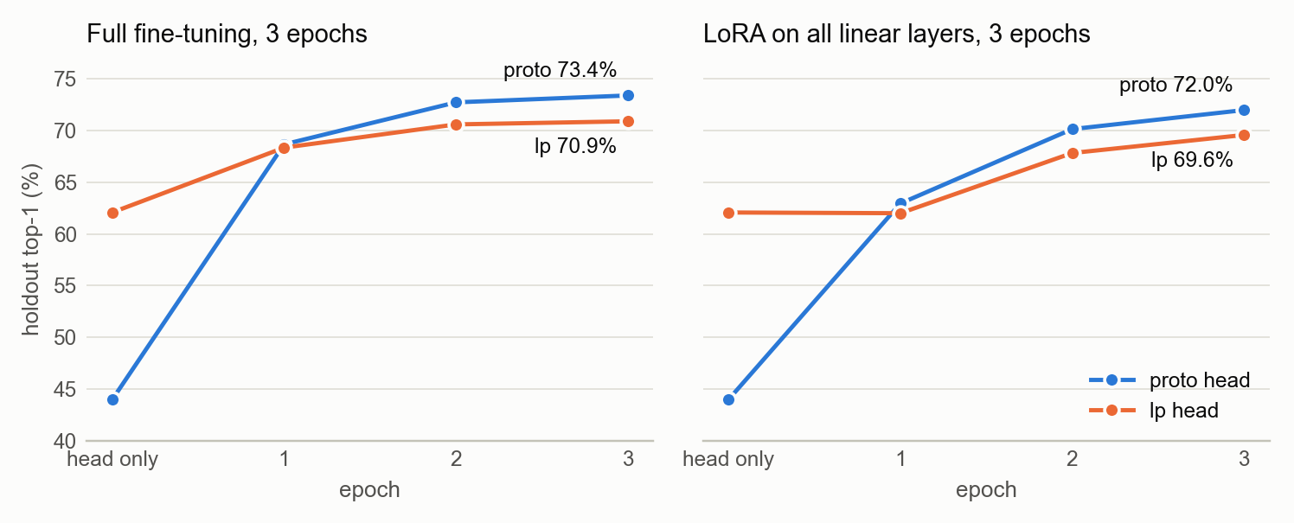
Linear-probe heads start high, finish low
PART 2 · A PROBLEM WE FOUND
Recommended recipe, LP-FT (Kumar et al., ICLR 2022): fit a linear-probe head on frozen features, then fine-tune.
Starts high, ends low: 18 points ahead before training, 2.5 points behind after it.
First suspect: LoRA's learning rate. Halving it changed nothing (−0.12), so we tested the head.
CS604 · Team 06
6
Notes:
Speaker B.
Now a closer look at the head question from the timeline. Our first runs used a recommended two-step recipe, LP-FT, from Kumar and colleagues at ICLR 2022: first fit a linear-probe head on frozen features, then fine-tune. The leftmost point of each panel is the head alone: the linear-probe head starts at 62%, far above the 44% of a prototype head. But after three epochs it is behind: 70.9 against 73.4 for full fine-tuning, and 69.6 against 72.0 for LoRA.
The first symptom was LoRA's training loss going up in the first epoch, so our first suspect was the learning rate. Halving it changed nothing, minus 0.12, which is noise. So we tested the head instead: a prototype head, and even a random head, beat the linear-probe head by about 2.5 points.
Handoff: [Name C] will explain our fix and why it works.

Slide 7
Our fix: start from class prototypes
PART 3 · OUR METHOD
1
2
3
4
Extract features
Prototype head
Fine-tune
Predict
Run the frozen ViT once over all 450,000 training photos (about 6 min).
Class weight = normalized mean feature × 40, as in weight imprinting (Qi et al., CVPR 2018).
Full fine-tuning or LoRA, starting from this head.
Full model: add the logits of each photo and its mirror image.
0
44%
4.39
gradient steps to build the head: it never fits a training photo, so it has nothing to memorize
holdout top-1 before any training, because each logit = 40 × cosine(photo, class mean)
starting loss, vs 2.29 for the linear-probe head: a strong signal that makes the backbone adapt
CS604 · Team 06
7
Notes:
Speaker C.
Our fix replaces the linear probe with class prototypes. Step one: run the frozen backbone once over all training photos and keep each 768-dimensional feature; this takes about six minutes and counts toward our GPU budget. Step two, the key step: the weight of each class is the normalized mean feature of its photos, times a temperature of 40. The idea itself is weight imprinting, from Qi and colleagues at CVPR 2018; what is new is our finding that it beats the LP-FT start here. There are no gradient steps, so the head never fits any training photo. Step three: fine-tune with any method; we keep full fine-tuning and LoRA. Step four: the full model adds the logits of each photo and its mirror image.
Why is this a good start? Each logit is about 40 times the cosine between a photo and its class mean, so the head already reaches 44% before any training, with calibrated scores. And its starting loss is 4.39, against 2.29 for the linear-probe head, so the backbone gets a strong learning signal from the first step. The next slide shows what that difference does during training.

Slide 8
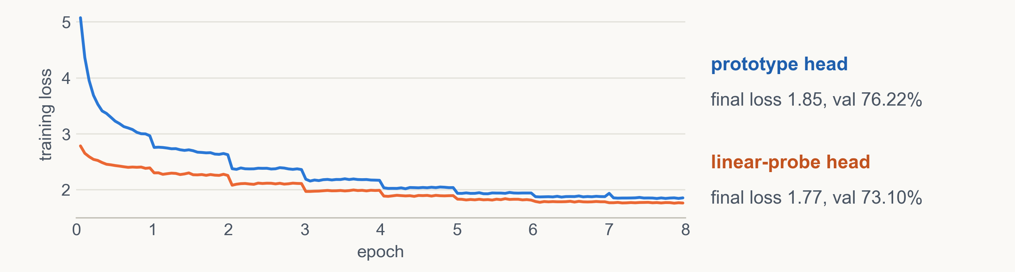
Lower training loss, yet lower accuracy
PART 3 · WHY IT WORKS
1
2
3
Fit on the same photos
Weak, then wrong signal
Memorization
The linear-probe head is trained on frozen features of the training photos.
Low starting loss; as features move, the head stops fitting (LoRA loss 2.2 → 2.7).
Lower training loss (1.77 vs 1.85), lower val (73.10% vs 76.22%).
Control: a random head ties the prototype head (71.95% vs 72.00%), so fitting the head on the training photos is what hurts.
CS604 · Team 06
8
Notes:
Speaker C.
Here is the evidence from two final-recipe runs: full fine-tuning on all data for 8 epochs, identical except for the head. The orange linear-probe run has the lower training loss the whole time and ends at 1.77, against 1.85 for the blue run. Yet on CodaBench val it scores 73.10, against 76.22. Lower training loss but lower accuracy: that is memorization.
Our explanation has three steps. One: the linear-probe head was fitted to frozen features of the very same training photos. Two: its starting loss is low, so the backbone gets a weak signal; and as the features start to move, the head no longer fits them, which is why LoRA's loss rose in the first epoch. Three: the model ends up fitting the 45 photos per class instead of features that generalize.
A control supports this: a random head ends level with the prototype head, 71.95 against 72.00. So prototypes are not magic; the harm comes from fitting the head on the training photos.

Slide 9
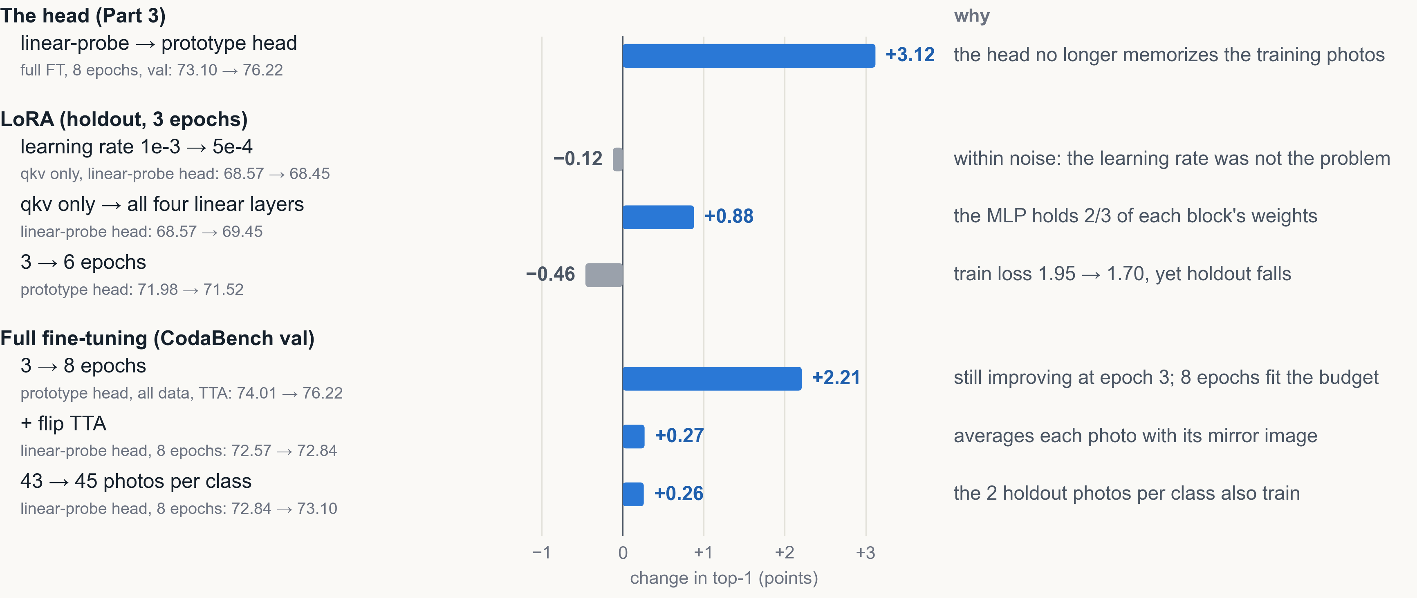
Each change, tested one at a time
PART 4 · ABLATIONS
CS604 · Team 06
9
Notes:
Speaker C.
Each row changes one setting of our final recipe and keeps the rest fixed; the right column gives the reason. The head is the biggest change, plus 3.1 points on val, as we just saw. For LoRA, halving the learning rate did nothing, while adding LoRA to all four linear layers gave plus 0.9: two thirds of each block's weights sit in the MLP. Training LoRA longer hurt: its training loss fell from 1.95 to 1.70 while the holdout fell, so it overfits, and we stop at 3 epochs. Full fine-tuning behaves the other way: 3 to 8 epochs gained 2.2 points, and 8 epochs fit our budget. Flip test-time augmentation and all 45 photos per class add about a quarter point each.
Handoff: [Name D] will show our two final models and their results.

Slide 10
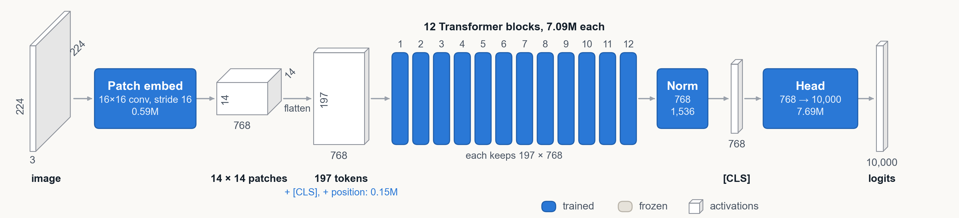
Full fine-tuning trains every weight
PART 4 · FINAL MODEL 1 OF 2
Model
Training
Cost and result
ViT-B/16: 85.8M weights, all trained
Head: 768 → 10,000, 7.69M weights
Head starts from class prototypes × 40
All 45 photos per class, 224 px
Random crop (25–100%) + flip
Loss: cross-entropy, label smoothing 0.1
AdamW, weight decay 0.05, clip 1.0
LR 1e-4, × 0.75 per block to the input
Drop path 0.1, bf16, batch 256
8 epochs: 1 warmup, then cosine to 0
1.03 GPU-hours on one A100
18.9 GB peak, 14,056 steps
Flip TTA: 14.95 ms, 1,919 photos/s
Val 76.22%, test 76.09%
CS604 · Team 06
10
Notes:
Speaker D.
Before the numbers, here are our two final models; blue means trained, grey frozen. The first is full fine-tuning of ViT-B/16: all 85.8 million weights plus the new 7.69 million head, which starts from the class prototypes. We train with cross-entropy and label smoothing 0.1, and AdamW at a learning rate of 1e-4 that shrinks by 0.75 per block toward the input, so the first block gets only 3% of it. Drop path 0.1, 8 epochs on all 45 photos per class, 1.03 GPU-hours.

Slide 11
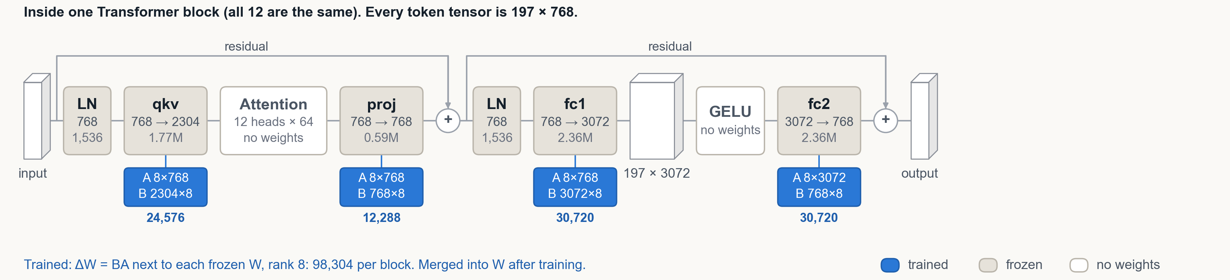
LoRA trains 1.38%, then merges
PART 4 · FINAL MODEL 2 OF 2
Model
Training
Cost and result
ViT-B/16: all 85.8M weights frozen
LoRA r = 8, α = 16 on qkv, proj, fc1, fc2
1,179,648 LoRA weights (1.375%)
Head: 7.69M, from prototypes × 40
43 photos per class (2 held out), 224 px
Loss: cross-entropy, label smoothing 0.1
AdamW, weight decay 1e-4, clip 1.0
LR 1e-3, no layer decay, no drop path
bf16, batch 256, random crop + flip
3 epochs: 0.3 warmup, then cosine to 0
0.54 GPU-hours on one A100
19.9 GB peak, 5,037 steps
Merged: 7.61 ms, 3,869 photos/s
Val 71.90%, test 71.67%
CS604 · Team 06
11
Notes:
Speaker D.
The second is LoRA, shown inside one block. The backbone stays frozen. Next to qkv, proj, fc1 and fc2 in every block, rank-8 matrices A and B learn the update, 1.18 million weights in total, and the head is trained too. Same loss; the learning rate is 1e-3 without layer decay, for 3 epochs, because longer training overfits. It took 0.54 GPU-hours, and after training the update is merged, so inference is as fast as the base model.

Slide 12
Final results on every metric
PART 4 · FINAL MODELS
Model | Trainable | Val | Test | GPU-hours | Peak memory | Latency, batch 1, A100
Project brief reference: full fine-tuning | 100% | 70.8% | – | – | – | –
Ours: full FT, prototype head, 8 epochs, all data, flip TTA | 85.8M (100%) | 76.22% | 76.09% | 1.03 | 18.9 GB | 14.95 ms (2 passes)
Project brief reference: LoRA r = 8 on qkv | 0.34% | 68.3% | – | – | – | –
Ours: LoRA on all linear layers, prototype head, 3 epochs | 1.18M (1.375%) | 71.90% | 71.67% | 0.54 | 19.9 GB | 7.61 ms (merged)
Held up on test: within 0.25 points of val for both models.
Inside the rules: both fit the 1.2-hour budget; both test files come from our Phase 1 models.
Recipe: AdamW, cosine, bf16, batch 256; full FT at LR 1e-4, layer decay 0.75; LoRA r = 8 at 1e-3.
Fair comparison: the like-for-like test is slide 5; here each model got its best setting.
CS604 · Team 06
12
Notes:
Speaker D.
Here are their results on every metric the brief asks for. Full fine-tuning reaches 76.22% on val and 76.09% on the hidden test set, 5.4 points above the reference, in 1.03 GPU-hours with 18.9 GB. LoRA trains 1.375% of the backbone and reaches 71.90% on val and 71.67% on test, 3.6 points above the reference LoRA, in 0.54 GPU-hours. For both, test is within 0.25 points of val, both fit the budget, and both test files come from our Phase 1 models. The like-for-like comparison is the one [Name B] showed, 73.38 against 71.98 under one protocol; here each model got its best setting.

Slide 13
Input resolution: the largest gain we found
PART 4 · AFTER THE DEADLINE
Optimized model: full fine-tuning of ViT-B/16 with the prototype head. The trained weights stay the same (85.8M backbone + 7.69M head); only the image size changes, and the position embeddings are interpolated, so no parameter is added.
Run | Train size | Test size | Top-1 | GPU-hours | Memory
3 epochs · holdout
Baseline | 224 px | 224 px | 73.38% | 0.48 | 18.9 GB
Same model, larger test images | 224 px | 288 px | 75.50% (+2.1) | 0.48 | 18.9 GB
Trained at 288 px | 288 px | 288 px | 77.23% (+3.9) | 0.68 | 30.2 GB
Trained at 288 px, best test size | 288 px | 320 px | 77.78% (+4.4) | 0.68 | 30.2 GB
8 epochs · all data · flip TTA
Our final model | 224 px | 224 px | val 76.22%, test 76.09% | 1.03 | 18.9 GB
Same recipe at 288 px | 288 px | 320 px | no test score | 1.61* | 30.2 GB
Why it helps: random crops enlarge objects in training, so larger test images match them (FixRes).
Not in our results: found after the deadline, and the 8-epoch run (1.61*) is over the 1.2-hour budget.
CS604 · Team 06
13
Notes:
Speaker D.
One more lesson from after the deadline, on the same full fine-tuning model with the prototype head: only the image size changes. With the 3-epoch protocol, simply testing our 224-pixel model at 288 pixels adds 2.1 points. Training at 288 as well and testing at 320 gives 77.78%, 4.4 points above the baseline, in 0.68 GPU-hours, inside the budget, but it needs 30 GB of memory instead of 19. The same final recipe at 288 pixels would take 1.61 GPU-hours, over the budget, so it is not part of our results and has no test score.

Slide 14
Takeaways
1
New finding: the usual linear-probe start (LP-FT) hurt all three methods we tested; class prototypes added 2.1 to 3.1 points.
2
Where you train beats how much: LoRA at 1.38% matches partial fine-tuning at 33%.
3
Failed ideas were useful: a lower learning rate changed nothing, and longer LoRA training hurt.
4
Limits: one run per setting (holdout noise about ±0.3 points); the efficient methods share one untuned learning rate.
5
After the deadline: larger input images added 4.4 holdout points. Next: trade epochs for image size within the budget.
CS604 · Team 06
14
Notes:
Speaker D.
To sum up. One, our main new finding: the usual recipe of starting from a linear probe hurt all three methods we tried, while a head built from class prototypes added 2 to 3 points. Two: where the trainable weights sit matters more than how many; LoRA at 1.4% matches training a third of the network. Three: the failed ideas were useful; each one ruled out an explanation. Four, our limits: each setting was trained once, and differences below about 0.3 points are within holdout noise; and the efficient methods share one learning rate that we did not tune per method. And five: after the deadline we found that larger input images add 4.4 points on the holdout; next, we would trade some epochs for larger images within the budget.

Slide 15
Thank you
CS604 · TEAM 06
Questions are welcome.
[Name A] · [Name B] · [Name C] · [Name D]
Notes:
Speaker D.
Thank you; we are happy to take questions.
Q&A routing (not spoken):
- Why prototype beats lp, and the evidence -> [Name C]. Slides 6 to 8: lp starts 62% but ends 2.5 lower; lower train loss (1.77 vs 1.85) but lower val (73.10 vs 76.22); random head ties proto (71.95 vs 72.00), so fitting the head on the training photos is what hurts. Is the prototype head new? No: it is weight imprinting (Qi et al., CVPR 2018); what is new is the finding that it beats the recommended LP-FT start (Kumar et al., ICLR 2022) with 10,000 classes and 45 photos each. Why 40? Chosen from 5, 10, 15, 20, 30, 40, 60, 80 by the cross-entropy on 10,000 training features; no gradient steps. Doesn't LP-FT say a random head distorts the features? It does, to protect robustness on new domains; here the features must change, and for LoRA a random head ties the prototype head. Slide 5 says 71.98 and slide 8 says 72.00: the same setting run twice, 72.00 on an RTX PRO 6000 and 71.98 on the A100.
- Why PEFT lost to full fine-tuning; fairness of the final comparison -> [Name D]. 450,000 photos in total is plenty for full fine-tuning (few per class, many overall); 10,000 fine-grained classes need changes in every layer; same protocol gap is 73.38 vs 71.98. LoRA got worse with more epochs (-0.46), full got better (+2.21), so each final model has its best setting; LR 1e-3 was not tuned per efficient method (limitation). LoRA final model: no TTA, 43 photos per class. Why does LoRA get worse after 3 epochs while full FT keeps improving? Our hypothesis, not yet tested: 7.69M of LoRA's 8.87M trainable weights are the head, and the LoRA recipe gives it LR 1e-3 (full FT: 1e-4), weight decay 1e-4 (full FT: 0.05) and no drop path (full FT: 0.1), so the head memorizes the 45 photos per class, as in Part 3. Next test: 6 LoRA epochs with a head LR of 1e-4 (notebook methods/10).
- Method details, parameters, latency, LoRA vs adapters -> [Name B]. Slides 3, 5, 10 and 11; backup slides 16 to 20 show the other five methods. LoRA 12 x 8 x (3,072 + 1,536 + 3,840 + 3,840) = 1,179,648; adapters 1,189,632. LoRA merges (no latency) but trains slowest (888 img/s, 19.9 GB); adapters train 1.6-1.7x faster with 36% less memory but add 2.4-2.9 ms at batch 1. Why LoRA needs more memory than full FT (19.9 vs 18.9 GB): to train its A matrices it must keep every linear layer's input, as full FT does, plus the activations of its 96 extra small matrix multiplications; the optimizer state that full FT adds is only about 1 GB. Partial K = 4 keeps activations for its 4 blocks only (7.0 GB). Other LoRA ranks? Not tried; r = 8 as in the brief, and we added capacity by placement instead (qkv only to all four linear layers: +0.88). Is LoRA really better than the Adapter (71.98 vs 71.54)? Only by 0.44, close to the noise; its clear advantage is merging (7.61 vs 9.74 ms at batch 1).
- Budget, GPU-hours, base model, data and holdout -> [Name A]. Slides 2, 4 and 12. 96 GB-h / 80 GB = 1.2 h (1.32 with 10%); counted: head features, training, holdout evaluation. Base model from page 1 of the brief; in21k-only checkpoints have a weaker linear probe (61.05% and 51.07% vs 61.94%), and our baselines match the reference within 0.3, so we kept the recommended backbone. Holdout: 2 per class, seed 0.
- Resolution over budget? -> [Name D]. Slide 13: the 3-epoch 288 px run (+4.4 holdout) used 0.68 GPU-hours, inside the budget; only the full 8-epoch recipe at 288 px (1.61 h) is over, and it has no test score.
- Limits on slide 14 -> [Name D]. One seed per setting. 0.3 points is about the standard error of accuracy on 20,000 holdout photos (0.32 at 72%), and the holdout matched CodaBench (72.31 vs 72.57 full, 71.98 vs 71.90 LoRA). The efficient methods all used LR 1e-3; only LoRA's was checked (5e-4: -0.12).

Slide 16
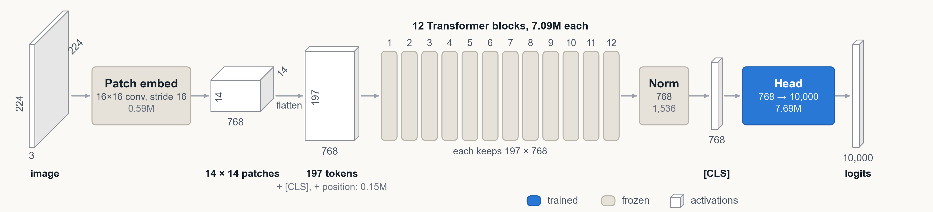
Linear probe: train only the head
LP
Partial
Full
BitFit
Adapter
AdaptFormer
LoRA
METHOD 1 OF 7
Idea: freeze the whole backbone and train only the new 10,000-class head.
Setting: the head starts from class prototypes; 10 epochs on cached features, LR 1e-3.
Parameters: 0 in the backbone. Head: 768 × 10,000 + 10,000 = 7.69M, trained in every method.
Result: 61.94% holdout in 0.10 GPU-hours. The untrained prototype head alone: 43.95%.
Problem: the features never adapt to the new classes. Next: unfreeze the top blocks.
CS604 · Team 06
16
Notes:
The diagram shows what each method trains in blue and what it freezes in grey. Read it like the classic AlexNet figure: the 3D boxes are tensors with their sizes, and the rounded boxes are layers with their shapes and parameter counts.
The linear probe freezes the whole backbone and trains only the new 10,000-class head on cached features. It needs no backbone gradients and takes 0.10 GPU-hours. It reaches 61.94%, up from 43.95% for the untrained prototype head. But the features never change, so this is a ceiling for frozen features. Next we unfreeze the top blocks.

Slide 17
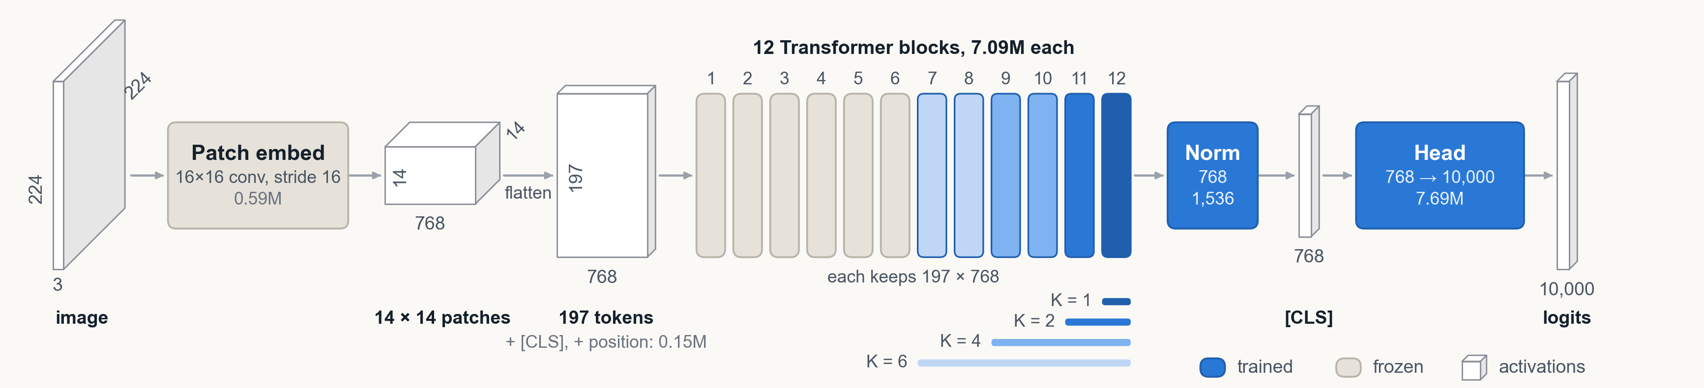
Partial fine-tuning: the last K blocks
LP
Partial
Full
BitFit
Adapter
AdaptFormer
LoRA
METHOD 2 OF 7
Idea: train the last K blocks and the final norm; freeze everything below them.
Setting: K = 1 and 2 at LR 3e-4; K = 4 and 6 use the full fine-tuning recipe.
Parameters: K × 7,087,872 + 1,536, so 8.26% (K = 1) to 49.6% (K = 6).
Result: 67.97%, 70.99%, 71.88%, 72.89% for K = 1, 2, 4, 6; memory 3.8 to 10.0 GB.
Problem: each extra block adds less, and the lower blocks never adapt. Next: train every block.
CS604 · Team 06
17
Notes:
Partial fine-tuning unfreezes the last K transformer blocks plus the final norm. We tried K equal to 1, 2, 4 and 6. Each block has about 7.09 million weights, so even one block is 8.3% of the backbone.
Accuracy rises from 67.97% with one block to 72.89% with six, but each extra block adds less: plus 6 points for the first block, plus 3 for the second, then about 1 point per two blocks. K equal to 4 and 6 also use the full fine-tuning recipe.
It is cheap to train, between 3.8 and 10 GB, because gradients only flow through the top blocks. But the lower blocks never adapt.

Slide 18
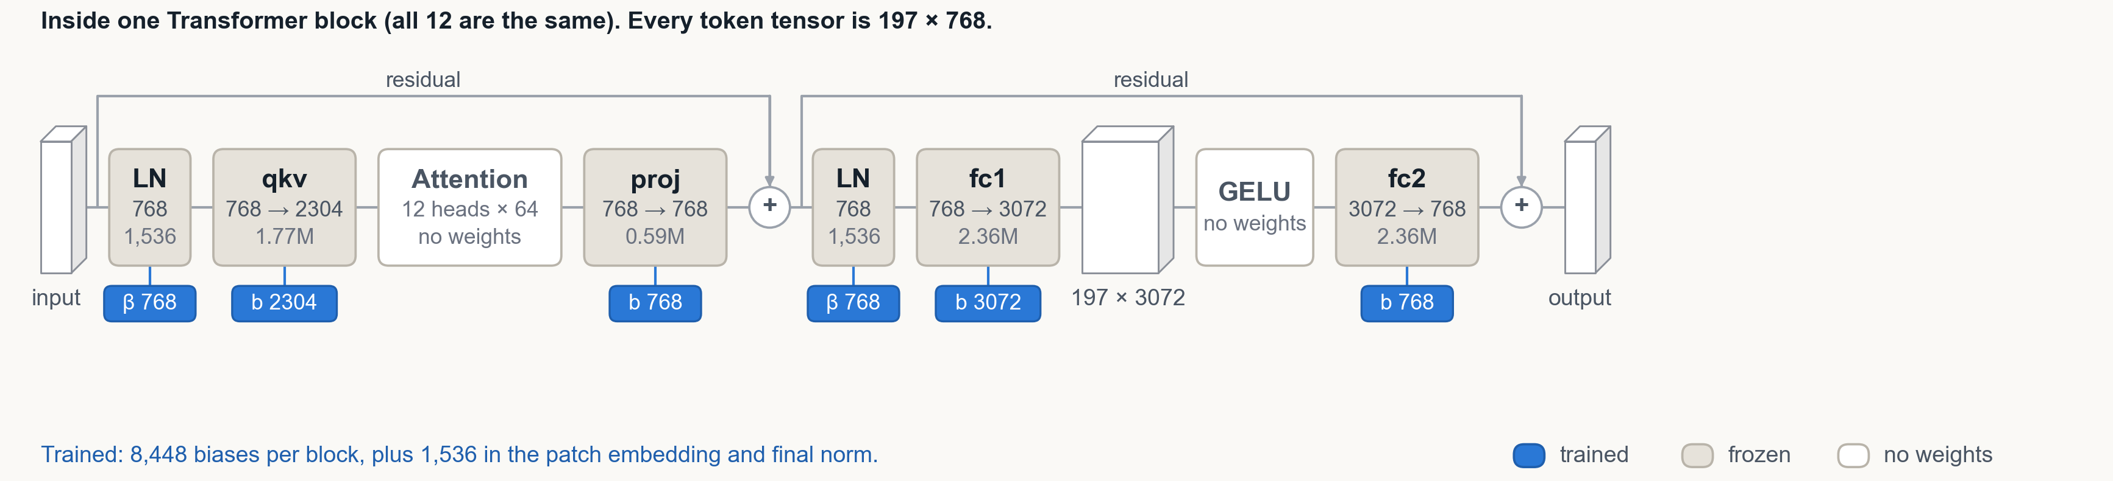
BitFit: train only the biases
LP
Partial
Full
BitFit
Adapter
AdaptFormer
LoRA
METHOD 4 OF 7
Idea: freeze every weight matrix; train only the bias terms and the head.
Setting: LR 1e-3, no weight decay.
Parameters: 12 × 8,448 + 1,536 = 102,912 biases, only 0.120% of the backbone.
Result: 69.81% holdout, 3.6 below full; no extra inference cost (7.33 ms).
Problem: too little capacity to close the gap. Next: add small trainable modules.
CS604 · Team 06
18
Notes:
Now the parameter-efficient methods. From here on the diagram zooms into one of the 12 identical transformer blocks.
BitFit is the most extreme: it freezes every weight matrix and trains only the bias vectors, the blue tags. Per block that is 8,448 numbers, plus the biases of the patch embedding and the final norm: 102,912 in total, 0.12% of the backbone.
With so little, it still reaches 69.81%, almost 8 points above the linear probe, and inference costs nothing extra. But it stays 3.6 points below full fine-tuning. So next we add small trainable modules.

Slide 19
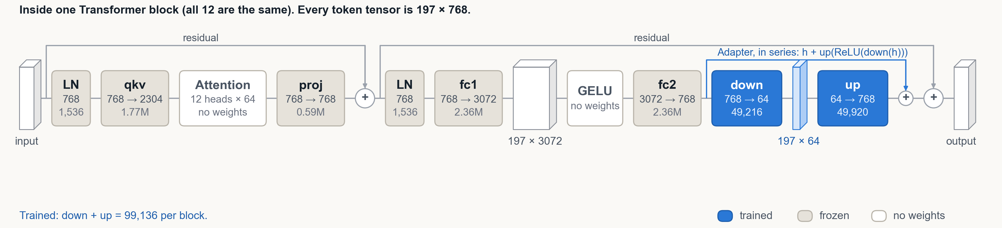
Adapter: a bottleneck after each MLP
LP
Partial
Full
BitFit
Adapter
AdaptFormer
LoRA
METHOD 5 OF 7
Idea: insert a small bottleneck, 768 → 64 → 768, after each MLP, in series.
Setting: bottleneck 64, scale 1.0, LR 1e-3; the up-projection starts at zero.
Parameters: 12 × (768 × 64 + 64 + 64 × 768 + 768) = 1,189,632 = 1.387%.
Result: 71.54% holdout; 12.8 GB; latency 9.74 ms vs 7.33 ms for the plain model.
Problem: it rewrites the MLP output in series. Next: a parallel, scaled branch.
CS604 · Team 06
19
Notes:
The Adapter adds a small bottleneck after the MLP of every block: down to 64 dimensions, a ReLU, and back up to 768, with its own skip connection. The up-projection starts at zero, so at the start the model is unchanged.
That is 1.39% of the backbone, and accuracy rises to 71.54%. The cost shows at inference: the adapter is an extra layer in the main path and cannot be folded into the frozen weights, so batch-1 latency goes from 7.33 to 9.74 ms. AdaptFormer, next, moves the same module to a side branch.

Slide 20
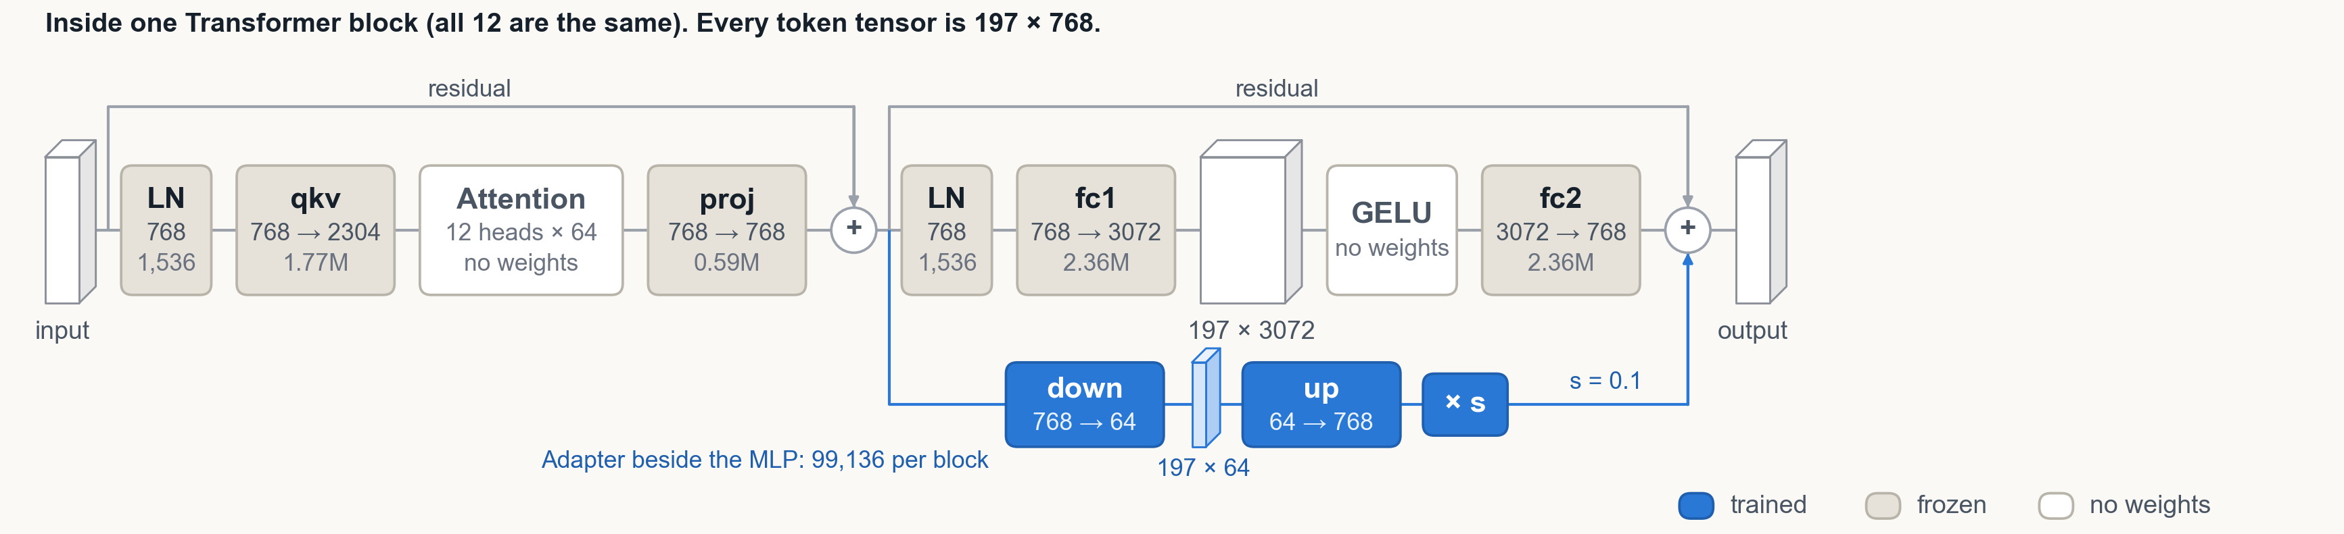
AdaptFormer: a scaled side branch
LP
Partial
Full
BitFit
Adapter
AdaptFormer
LoRA
METHOD 6 OF 7
Idea: run the same bottleneck beside the MLP and add its output, scaled by s.
Setting: bottleneck 64, s = 0.1, LR 1e-3.
Parameters: same as Adapter: 1,189,632 = 1.387% of the backbone.
Result: 71.17% holdout, close to Adapter (71.54%); latency 10.23 ms.
Problem: neither adapter merges into the weights, so inference stays slower. Next: a mergeable update.
CS604 · Team 06
20
Notes:
AdaptFormer uses the same bottleneck, but in parallel with the MLP, and adds its output with a small scale, s equal to 0.1, so the original MLP output stays intact.
Same parameter count, and 71.17% on holdout: 0.37 below the serial Adapter, about the size of our run-to-run noise. So in our setting the placement makes little difference.
Both adapters share one problem: they add layers at inference, about 30 to 40% more latency at batch size 1. We want an update that disappears after training. That is LoRA.

