Slide 1

Circuit Diagram Recognition and Beautification
Chu-Ching Hsu
Haito Ji
Hongyan Jiao
Xiangpeng Wang

Slide 2
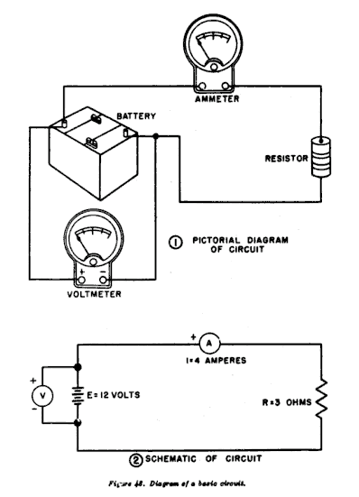
Circuit Diagram
graphical representation of an electrical circuit

Slide 3
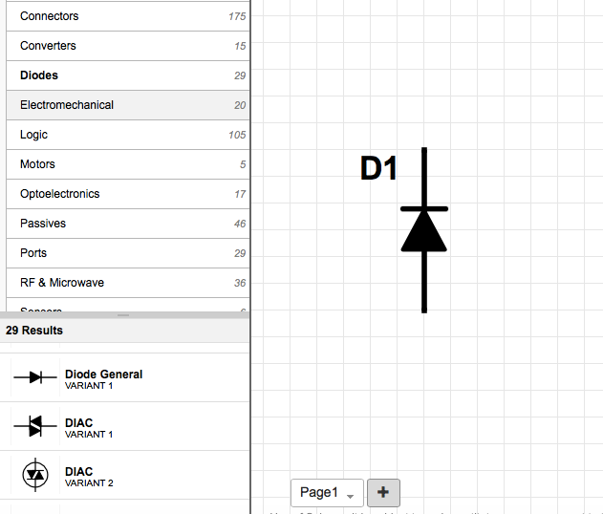
Current Problem
Few Circuit Diagram support hand drawing recognition
Common designing interfaces uses component dragging to implement.

Slide 4
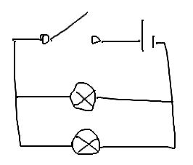
Our Goal
Allow Circuit Diagram beautification using sketch recognition

Slide 5
Our Strategy
Circuit unit recognition
$P Point-cloud recognition for circuit unit template
Beautification
Replace Circuit units for SVG graphs
Line segmentation and connection

Slide 6
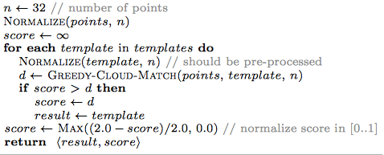
$P recognition
Like $1 recognition and $N recognition
Ignore points order as stroke
Represent point-clouds instead!

Slide 7
Demo

Slide 8
Future Work and Extend Application
More diagram circuit unit template
Combining circuit input output calculation
Current point-clouds segmentation: mouse right click/time out -> Real-time recognition

Slide 9

Question?
Thank you!

