Slide 1
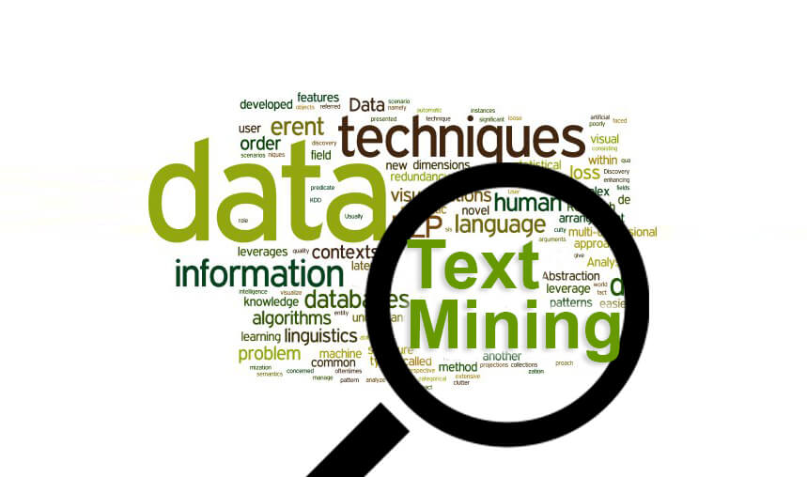
Text Mining MEDLINE
Rong Jiao
April. 25

Slide 2
Objective
Given a gene list of N human genes and several files of MEDLINE citation, testing the co-occurrence of two genes in the same abstract; build a gene network based on the test results.
To simplify the simulation, N is set as 6.

Slide 3
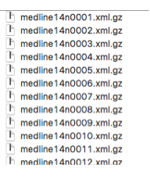
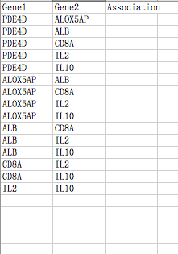

Objective
Medline Files
Gene Network
Gene List
Article Abstract

Slide 4
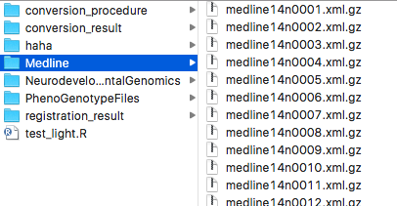
Step I: Extract PMID codes
"http://www.nlm.nih.gov/databases/dtd/nlmmedlinecitationset_140101.dtd">
<MedlineCitationSet>
<MedlineCitation Owner="NLM" Status="PubMed-not-MEDLINE">
<PMID Version="1">28432618</PMID>
<DateCreated>
<Year>2006</Year>
<Month>06</Month>
<Day>01</Day>
</DateCreated>
<DateCompleted>
…...

Slide 5
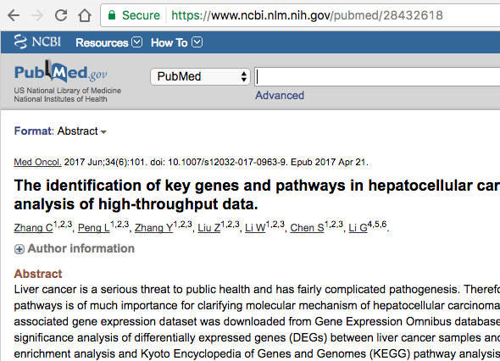
Step I: Extract PMID codes
Link PMID code to Article Abstract
Extracted PMID codes are saved in PMIDlist.txt
28432618
28421423
20896499
17239802
16691646
20896828

Slide 6
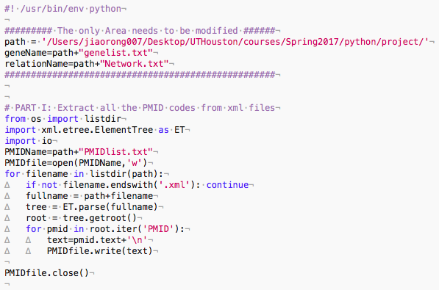
Step I: Extract PMID codes
Python Program

Slide 7
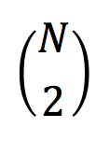
Step II: Get combinations

Slide 8
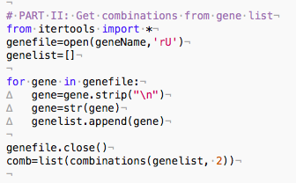
Step II: Get combinations from gene list
Python Program

Slide 9
Step III: Check Association
Gene A and Gene B in one pair
Co-occurrence in any article abstract?
YES
Association set as TRUE
NO
Association set as FALSE

Slide 10
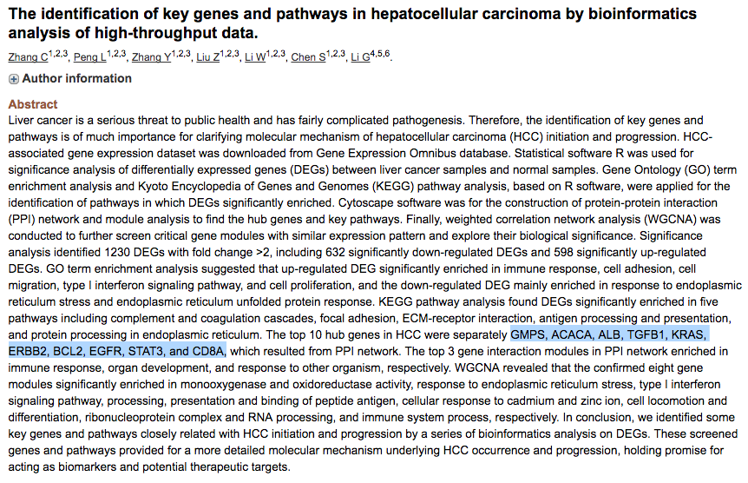
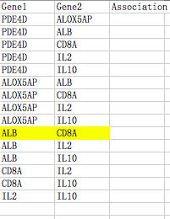
Step III: Check Associations

Slide 11
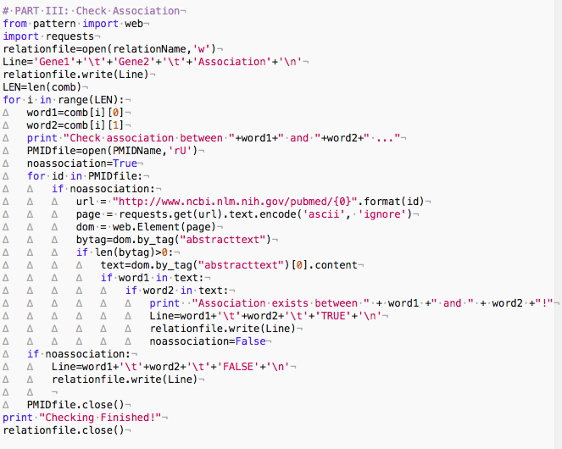
Step III: Check Associations
Python Program

Slide 12
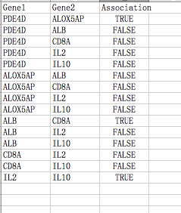
Results
The gene network is saved in Network.txt

Slide 13
Discussion
Three Minutes
How to reduce time consumption?
Six Human Genes
Six Medline Articles
20,000 Human Genes
Millions of Medline Articles

Slide 14
Thank you!

