Slide 1
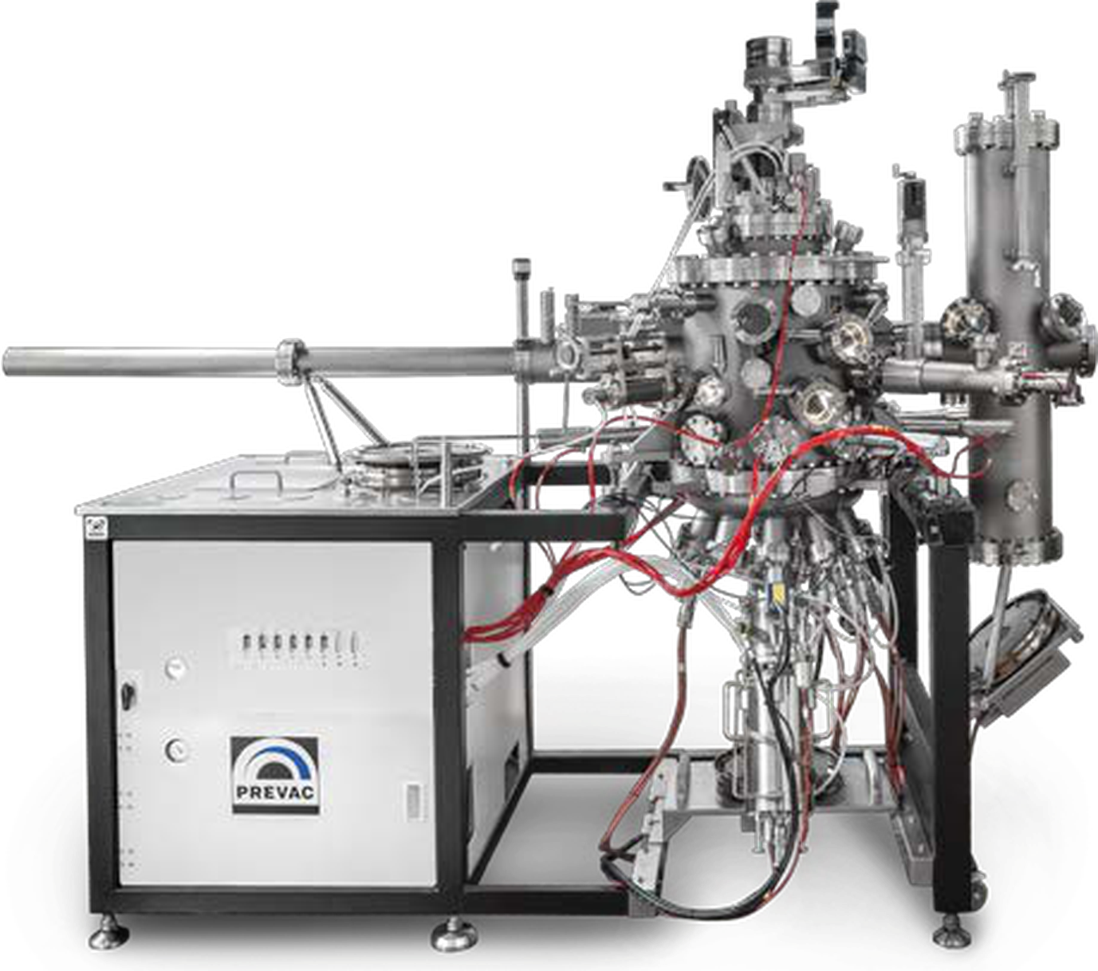

ITF PROJECT PROPOSAL · FOR REVIEW COMMITTEE
GaN Molecular Beam Epitaxy regrowth Platform
Phase 1 of the 8-12 inch domestic MBE cluster:
the MBE growth module and in-vacuum anneal module, built first.
HK$49.0M · 24 months within the HK$50M ITF platform-project envelope
Self-built MBE system class — in-house design, globally sourced components
August 2026 · Hong Kong SAR

Slide 2
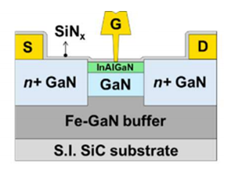
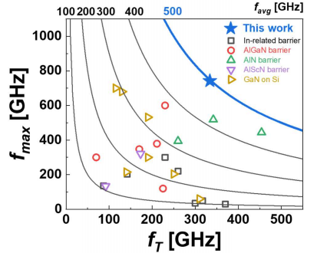
MBE PLATFORM PROPOSAL · TARGET PROCESS
The target process: selective-area regrowth (SAG)
GaN regrowth has been extensively studied in academia. Industry is going to follow.
Source/Drain regrowth
Ultra-low contact resistance
Son. First demonstration of fmax > 700 GHz in Lg = 45 nm In0.13Al0.83Ga0.04N/GaN HEMTs
for future 6G applications. 2026
02

Slide 3
MBE PLATFORM PROPOSAL · TARGET PROCESS
The target process: selective-area regrowth (SAG)
GaN regrowth has been extensively studied in academia. Industry is going to follow.
Gate regrowth
Decouple V_{T} and R_{ext}
SINANO. Normally-off HEMTs With Regrown p-GaN Gate and Low-Pressure Chemical Vapor Deposition SiNx Passivation by Using an AlN Pre-Layer.2019
03

Slide 4
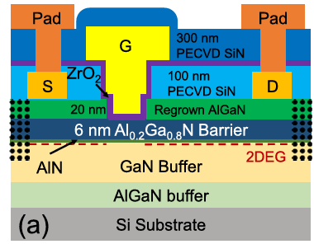
MBE PLATFORM PROPOSAL · TARGET PROCESS
The target process: selective-area regrowth (SAG)
GaN regrowth has been extensively studied in academia. Industry is going to follow.
Barrier regrowth
Etch-damage free
Jiang. Enhancement-Mode GaN MOS-HEMTs With Recess-Free Barrier Engineering and High-k ZrO2 Gate Dielectric. EDL.2018
04

Slide 5
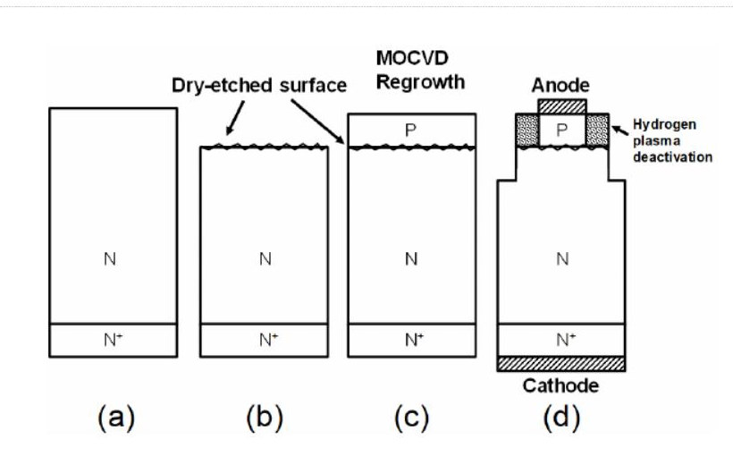
MBE PLATFORM PROPOSAL · WHY MBE
Why regrowth is hard — and advantages of MBE
WHY FEW LABS MASTER IT
WHY MBE ANSWERS ALL THREE
01 Interface contamination
Si and O pile up at the etched-then-regrown interface and form a parallel leakage channel — the documented bottleneck for regrown junctions (ASU 2019; Sandia 2021).
As low as 700°C
growth window, 200–300 °C below MOCVD — patterned surfaces, masks and existing junctions stay intact
02 Etch damage
Dry etch leaves lattice damage and roughness on the exposed surface; the regrown crystal inherits every defect — degrading breakdown and reverse leakage.
H-free UHV
no NH₃/H₂: p-GaN is active as grown, and the regrowth interface stays clean at 10⁻¹¹ mbar
03 Thermal budget on patterned wafers
In-vacuo clean
pre-regrowth anneal + interface preparation without air break — directly attacks the Si/O problem
Regrowth happens on a half-processed device: MOCVD's ~1,000 °C in NH₃/H₂ attacks masks and surfaces, and hydrogen passivates the p-GaN it touches.
Etch-then-regrow in practice: the dry-etched surface (damage) and the regrowth interface (contamination) are where devices are won or lost. Even record processes need UV-ozone + chemical + in-situ cleans to recover low leakage.
RHEED control
monolayer-abrupt n⁺ regions, monitored live on patterned wafers
Sources: ASU 2019 (etch-then-regrow p-n) · Sandia 2021 (interfacial Si) · NIST 2024 (regrowth-interface contaminants)
05

Slide 6
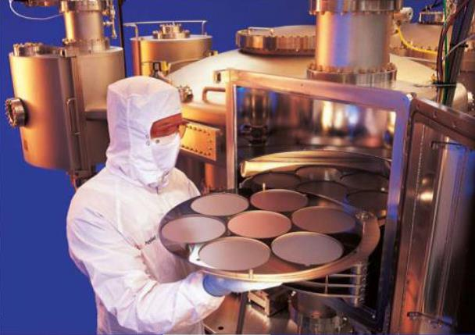
MBE PLATFORM PROPOSAL · STRATEGIC CONTEXT
Export control has turned MBE from a purchase into a capability gap
1979
1990s
2019
2025
CoCom embargo — CAS institutes answer with the first domestic MBE; National S&T Progress Award, 1985.
Ban lifted — the market is ceded to imports and the domestic UHV component chain stagnates.
Wassenaar re-ban — solid- and gas-source MBE systems and key components controlled for China.
Control reaches orders — RIBER discloses two licence rejections, ~€4M of orders lost.
THE GAP THIS PLATFORM CLOSES
~90%
0
8″+
of the global MBE market held by VEECO + RIBER — both licence-gated
domestic production-validated MBE tools above 4 inches
wafer sizes where AI optics, GaN RF/power and MicroLED demand sits
Every embargo in history has opened a substitution window — this one is open now.
Sources: Mota feasibility report (2022 vendor shares); RIBER 2025 interim disclosures; Wassenaar Arrangement 2019 listing.
Multi-wafer nitride MBE processing (Mota reference line)
06

Slide 7
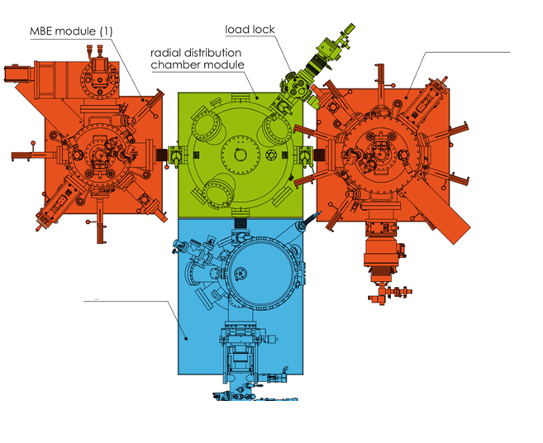
MBE PLATFORM PROPOSAL · EXECUTIVE SUMMARY
What to build — the growth engine first
PVD module
(potential expansion)
01 Strategic necessity
MBE has sat under Wassenaar export control since 2019; licence denials are now commercial reality. An 8-inch production tool can no longer simply be bought.
02 Phase 1 scope
Build the two chambers that create epitaxial quality — the 8″ MBE growth module (HK$19M) and the in-vacuum anneal module (HK$3.5M) — cluster-ready by design.
High temperature
anneal module
8″ MBE + High-temp anneal in 24 months
wafer size — beyond any domestic MBE in operation
Radial cluster architecture: growth, anneal and analysis modules attach to one UHV distribution hub — wafers move at 5×10⁻¹⁰ mbar, never seeing air.
07

Slide 8
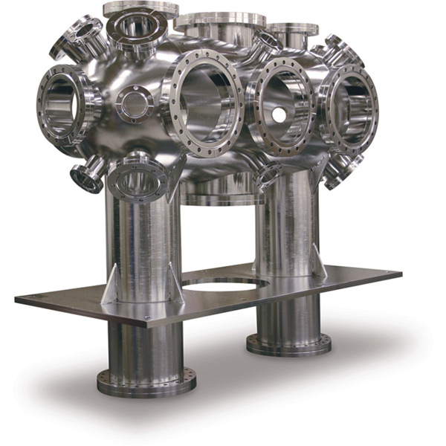
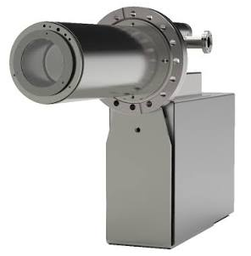
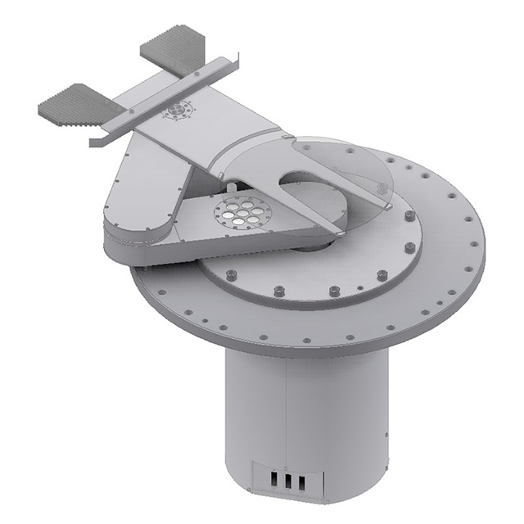
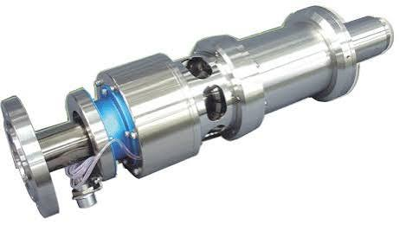
MBE PLATFORM PROPOSAL · EXECUTIVE SUMMARY
How can we build
03 Proven blueprint, complementary partners
Mota, Inc. (Jiangsu)
MRDI
system design based on their 4’’ self-built system
supply chain
nitride process heritage
8’’ System Integration
Pilot line process validation
nitride process heritage
Chamber set | Growth + buffer + load-lock · LN₂ shrouds · cluster frame
Nitrogen source | RF plasma, 600 W @ 13.56 MHz · all-ceramic discharge · ion-free flux
Substrate heater | Solid SiC, 1,200 °C in reactive gas — regrowth-grade
Effusion cells | 10 sources: 3×Ga, 3×Al, Si, Mg + spares · PBN crucibles · PID loops
Pumping | Maglev turbo ≥2,000 L/s · cryopumps · ion pump + Ti sublimation
In-situ diagnostics | 30 keV RHEED · band-edge pyrometer · beam-flux monitor · RGA
Wafer handling | UHV robot + platens to 12″ · heated viewports · cassette load-lock
Control | Open software stack · interlocks + logging · AI-ready (Level-5 roadmap)
UHV growth chamber
RF plasma source
30 keV RHEED gun
Wafer transfer robot
08

Slide 9
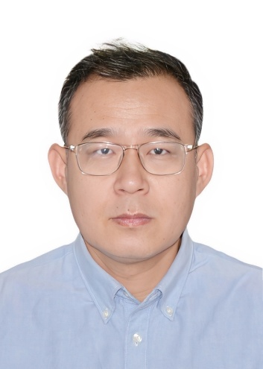

MBE PLATFORM PROPOSAL · SUPPLY CHAIN
Key supply chain considerations
Low risk of export restriction on buying parts vs buying a full MBE system
Almost all components can find domestic replacement. (key gap is reliability)
The project team can do parts customization, if needed.
THE TEAM BEHIND PARTS CUSTOMIZATION AND VALIDATION
Zhigang Wang
Dr. Zhuofei Gan
Head of Etch, Thin Film & Equipment Empowerment (EET), MRDI
R&D Lead Engineer, Equipment-Enabling Projects, MRDI
20 years in semiconductor equipment — 18 at Applied Materials, from 300 mm silicon process R&D (Santa Clara) to directing the Xi'an Demo Lab and leading the 200/300 mm etch engineering teams; Etch BD Lead at NAURA (2024–25).
Ph.D. (HKU); co-founder of InterLitho Technology; ~20 high-impact publications. Hands-on expertise in advanced lithography, precision bonding and 2.5D/3D packaging equipment — now leading co-development of next-generation equipment at MRDI.
09

Slide 10
MBE PLATFORM PROPOSAL · SUPPLY CHAIN
Import the best today — qualify domestic parts on the same tool
COMPONENT CATEGORY
PRIMARY SOURCE (GLOBAL)
DOMESTIC CANDIDATE
RF plasma / RF power
VEECO · OAR · AE / COMET
Hengyunchang 恒运昌
Turbomolecular pumps
Edwards · Leybold · ULVAC
SKY 中科科仪
Mass flow controllers
MKS · Bronkhorst
Sevenstar 七星华创
UHV valves
VAT · HVA · VACGEN
Kinglai / Jingsheng / Jiutian
Gauges & RGA
INFICON · MKS · Hiden
Hexin 禾信仪器
High-purity materials
UMC · DOWA · Plansee
Vital / GRINM 先导 / 有研
12
≥6
Imported baselines guarantee schedule; domestic parts are validated in parallel — never on the critical path. The tool itself becomes the qualification vehicle for the domestic UHV supply chain.
UHV component categories tracked in Mota's supplier programme
categories benchmarked on-tool during Phase 1
10

Slide 11
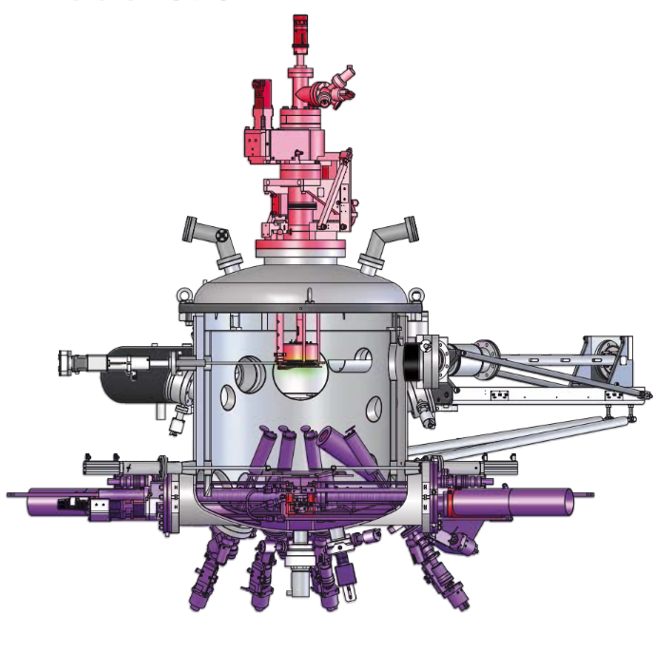
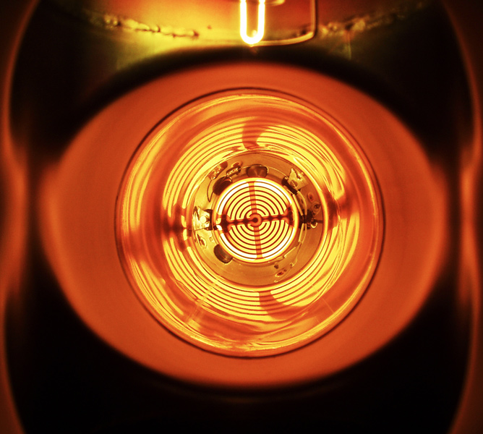
MBE PLATFORM PROPOSAL · EXECUTIVE SUMMARY
The innovations that make the system succeed
Multi-zone heat balancing with real-time closed-loop control during growth – enabler for 8″ production tool vs small diameter tools
PVD + MBE cluster tool integration — low cost, high throughput
Enhanced plasma source for high-throughput Ga(Al)N growth
11

Slide 12
MBE PLATFORM PROPOSAL · WORK PLAN
24 months, four phases, stage-gated
P1 · Design & procure M0–M6
P2 · Assemble & test M6–M12
P3 · Install & first epi M12–M18
P4 · Process & regrowth M18–M24
Design freeze · long-lead orders (chamber, pumps, sources, robotics) · MRDI site prep
Module assembly in Mota's Jiangsu class-10k cleanroom · leak-check, bake-out, pump-down · domestic bench tests
Installation and UHV integration at MRDI · commissioning + interlocks · first plasma → first GaN epitaxy on 8″
Device-grade MQW (M22) · selective-area regrowth flow · anneal-module DOE · user demos
G1 Design review passed; 100% long-lead on order
G2 Factory acceptance; ship to Hong Kong
G3 Site acceptance; first epitaxy reviewed
G4 Final review; platform enters shared service
M18
M22
Quarterly steering-committee gates · budget released per phase (40 / 25 / 20 / 15%) contingent on gate approval · monthly Jiangsu–Hong Kong technical sync.
first GaN regrowth epitaxy on 8″ wafers
device-grade MQW, XRD / PL verified
12

Slide 13
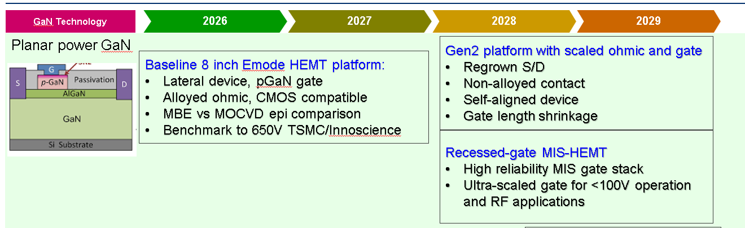
MBE PLATFORM PROPOSAL · ROADMAP ALIGNMENT
Relation to the GaN technology roadmap
MRDI planar power GaN roadmap
WHAT THE ROADMAP NEEDS Low-defectivity processes and scalable cost. Gen2 (2028) already schedules regrown S/D and scaled ohmic/gate
16

Slide 14
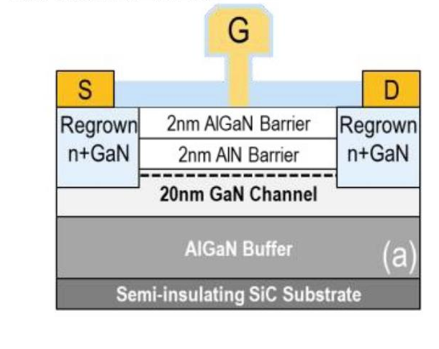

MBE PLATFORM PROPOSAL · APPLICATIONS
A standing user base before a single external sale
Selective-area regrowth process module as standard services
Nitride power & RF
MicroLED & future materials
Regrown ohmics and gates, buried heterostructures, PIC integration — turns a multi-week outsourced cycle into an in-house, days-long loop for MRDI users.
GaN HEMT stacks with MBE's abrupt interfaces and hydrogen-free p-doping — feeding MRDI's GaN pilot line and the GBA device chain directly.
High-indium InGaN and tunnel junctions where MBE beats MOCVD; 12″ BTO / oxide epitaxy as the platform's next programme.
DAY-ONE DEMAND MRDI's ~50 pilot runs per year · the GBA's merchant epi and device players — the platform qualifies into a market that already exists.
13

Slide 15
MBE PLATFORM PROPOSAL · RISKS
Named risks, engineered mitigations
RISK
LEVEL
MITIGATION
8″ scale-up of self-built design
Medium
Architecture follows proven production-MBE precedents; factory acceptance per module before shipment; G2/G3 hold points
Anneal-module crystal quality
Medium
Route anchored in published high-T anneal literature; dedicated DOE with XRD/TEM verification before device commitment
Long-lead component slip
Low–Med
All procurement in Phase 1; 10% hardware contingency inside module budgets; gate reviews can re-sequence without moving first-epi milestone
Talent recruitment in Hong Kong
Medium
Joint team from day one; Mota engineers seconded for build and training; MRDI hiring programme + GBA talent schemes
Domestic component shortfall
Low
Imported baseline guarantees performance — domestic parts validated in parallel, never on the critical path
Risk ownership: technical — joint chief engineer · procurement & licensing — MRDI with Mota support · site & operations — MRDI. Reviewed at every gate.
14

Slide 16
HK$49.0M and 24 months —
and the region's first 8″ MBE platform is built, not bought.
The MBE growth module and anneal module first — the quality core of the patented PVD + anneal + MBE cluster — designed jointly by MRDI and Mota, built from the best components the world still sells, and ready for Phase 2 to complete the 8–12″ cluster on the same interfaces.
HK$49.0M
M18
8″ → 8–12″
≥6
27.5 equipment · 10.0 manpower · 5.1 ODC · 6.4 overheads
first GaN epitaxy on 8″; device-grade MQW by M22
cluster-ready today; PVD + hub complete it in Phase 2
domestic component categories benchmarked on-tool
MRDI × JIANGSU MOTA — AUGUST 2026 · FOR REVIEW COMMITTEE EVALUATION
15

Slide 17
MBE PLATFORM PROPOSAL · BUDGET
HK$49.0M over 24 months — inside the HK$50M envelope
EQUIPMENT & INSTALLATION — HK$27.5M
ITF BUDGET STRUCTURE (HK$M)
01
8″ MBE growth module (including load lock)
19.0
Equipment & installation
chamber set · 10 sources · pumping · RHEED + diagnostics · handling
27.5
02
Anneal module
3.5
Manpower (6.2 FTE, 24 mo)
in-vacuo high-T recrystallisation chamber (nudged up from 2.5 for 8″ hot zone)
10.0
03
Facility & installation
2.0
Other direct costs
LN₂ distribution · 3-phase + UPS · chiller · bake-out · O₂ alarm
5.09
04
Freight, insurance & licences
2.0
Administrative overheads (15%)
EU→HK sea freight · rigging · customs · HK 3B001 import licence
6.39
05
Controls & software
1.0
TOTAL HK$49.0M
control PCs · DAQ · frame grabber · interlocks · open stack
Deferred to Phase 2: PVD module, 12″ hub & robotics, domestic validation sets (~HK$3.5M)
Industry contribution: Mota in-kind design IP + seconded engineers, ≥10% per ITF platform-project precedent.
MARKET BENCHMARK One RIBER MBE 49 production tool was quoted at €3.54M ≈ HK$30M — more than this entire Phase-1 hardware budget, with no IP, no process database, and licence risk.
17

Slide 18
MBE PLATFORM PROPOSAL · BUDGET DETAIL
Manpower and direct costs follow MRDI project precedents
MANPOWER — HK$10.03M (structure of prior MRDI ITF budgets)
OTHER DIRECT COSTS — HK$5.09M
Position / rank
FTE
Months
Rate (k)
Subtotal (k)
Source materials & first fill (7N Ga, Al, Si, Mg · PBN · gaskets)
1,000
Division Leader (PC)
0.2
24
150
720
Commissioning wafers & substrates
800
Senior Manager / Principal Engineer
1.5
24
100
3,600
LN₂, gases & utilities (commissioning)
600
Assoc. Principal / Lead Engineer
1.0
24
70
1,680
Wafer processing — regrowth validation short-loops (~60 wafers)
1,500
Senior Engineer / Engineer
3.5
24
48
4,032
Material & device characterisation (AFM · XRD · mapping)
500
Total
10,032
Domestic-component validation consumables
300
Travel & collaboration
200
Vacuum/mechanical · MBE process · controls software · electrical — one tightly integrated build team, trained on-tool for MRDI operations.
Publications & patent filings
150
Audit fee
40
Subtotal (HK$k)
5,090
CAN IT BE DONE INSIDE HK$50M? Yes — with HK$1.0M headroom. The collaborator plan's HK$30M hardware is trimmed to HK$27.5M by deferring the PVD module and hub to Phase 2; HK$2.0M of added ODC funds short-loop wafer processing to validate regrowth results; manpower and ODC follow the audited MRDI budget precedents.
18

Slide 19
MBE PLATFORM PROPOSAL · DELIVERABLES
Deliverables
D1
8″ MBE growth module + anneal module installed and commissioned at MRDI, cluster-ready
SUCCESS METRICS (TARGETS)
10⁻¹¹ mbar
D2
Open, jointly owned control software — Level-3+ automation
growth-module base pressure class after bake-out
M18 / M22
D3
Demo process flows: GaN epitaxy, MQW structures and selective-area regrowth on 8″
first GaN epitaxy on 8″ / device-grade MQW (XRD, PL)
≥5 patents
D4
Domestic component validation data — ≥6 categories benchmarked on-tool
invention filings; jointly owned design + process IP
≥12 FTE
D5
Application demos with MRDI pilot-line users + trained local engineering team
local engineers trained across vacuum, process, software
19

