Slide 1
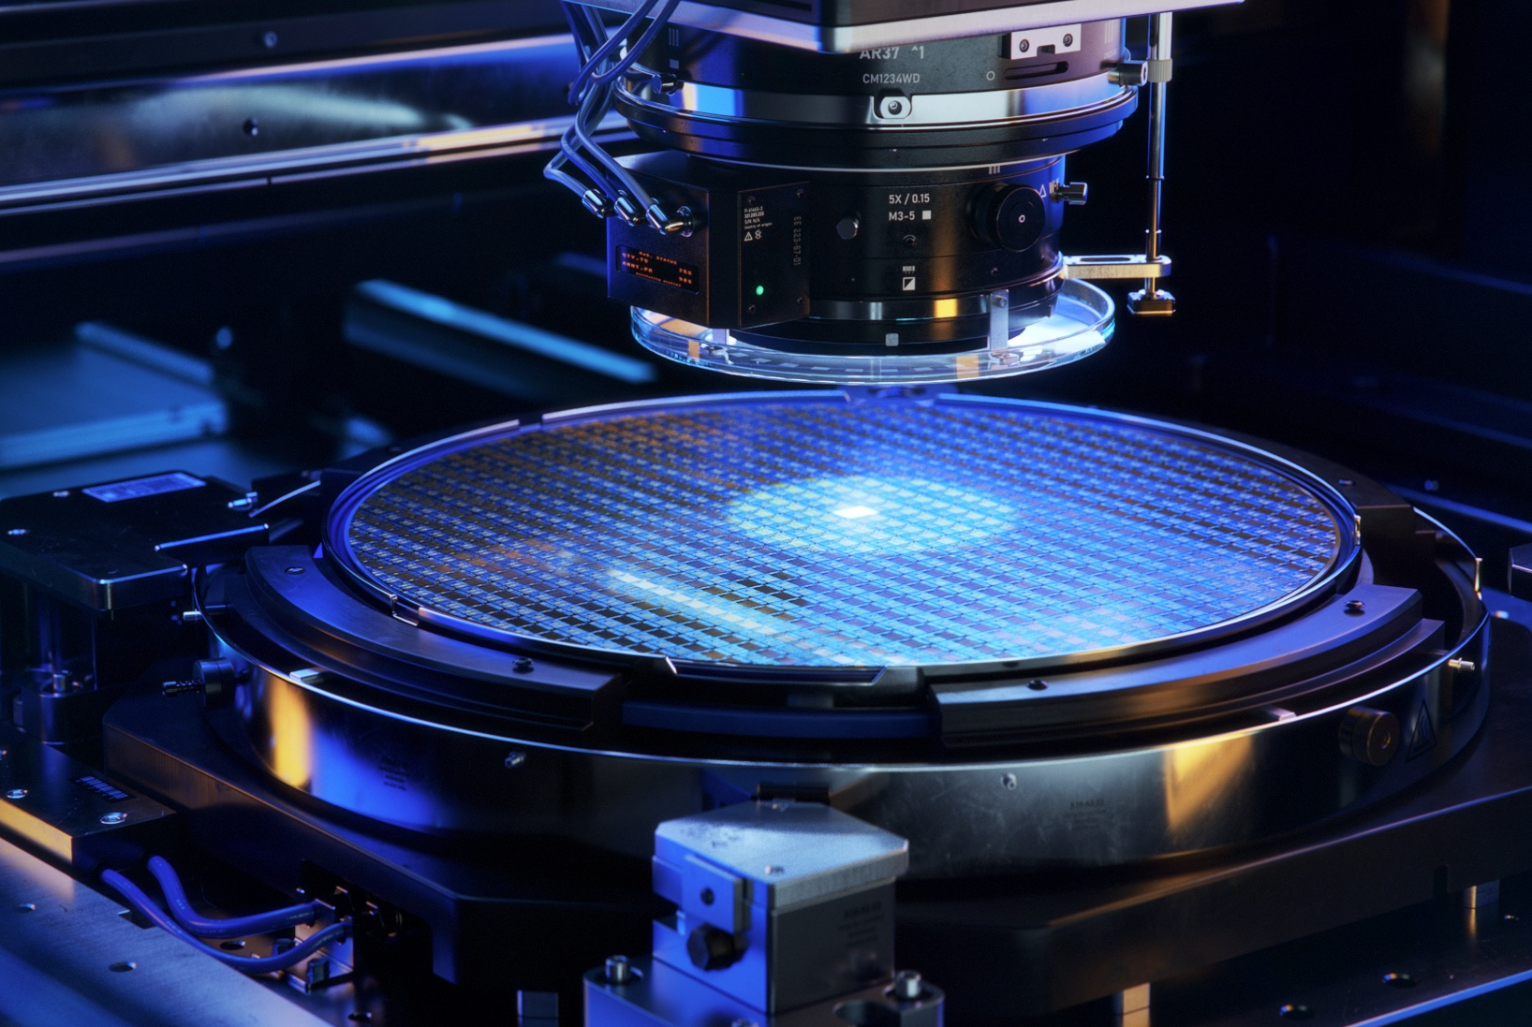
30 July 2026
Self-Built Nitride MBE System
Project proposal

Slide 2
NITRIDE MBE PROPOSAL · MOTIVATION
In-house built machine
01
Cost
02
Capability & Needs
03
In-Situ Control
Estimated US$1.0–1.6M for entire chamber; Depends on quotes; annual run cost ~US$60–120k
1200 °C substrate heater for selective-area regrowth
RHEED video output; Heater temperature knobs; Shutter & flux control
OBJECTIVE
MBE chamber + plasma source + heater + effusion cells + control software — one machine for epitaxy, selective area growth, and autonomous operation

Slide 3













NITRIDE MBE PROPOSAL · PARTS
MBE components
MBE chamber — Veeco GEN II / Riber 32 class
Growth, buffer and load-lock chambers · chamber frame · transfer system · liquid nitrogen shroud · load-lock cryopump · racks
RF N₂ plasma source
N₂ gas delivery system
1200 °C heater
600 W · 13.56 MHz ·RF coil. matching network
99.9999% pure supply · getter purifier · Mass flow controller
PBN-PG heater
Effusion cells ×6
Maglev turbomolecularpump
Ion pump + Titanium sublimation pump
Ga · cold-lip Al · Cu · Si · Mg · spare
≥2000 L/s N₂ + dry backing pump
Valved: base-pressure duty only
RHEED
Band-edge pyrometer
Residual gas analyzer + ion gauges
gun · phosphor screen · camera
true wafer temperature reading
incl. retractable beam-flux monitor
Power supply + Proportional integral derivative
LN₂ distribution
Bake-out heater · water-loop chiller · UPS
Maintenance & regulatory equipment
phase separator · vacuum-insulated lines
one DC supply + control loop per heater zone

Slide 4








NITRIDE MBE PROPOSAL · SUPPORTING PARTS
What the machine needs around it
Control PC + DAQ hardware
Substrate holders + platens
Heated viewport
computer · DAQ cards · RHEED frame grabber
per-wafer hardware · matching transfer forks
keeps the pyrometer window free of Ga coating
Helium leak detector
O₂ depletion alarm
Initial source charges
commissioning leak-hunt — buy or rent
LN₂ asphyxiation safety — code requirement
first Ga · Al · Cu · Si · Mg fill + spare PBN crucibles
Copper gaskets + spares kit
Mask patterning access
every flange opening consumes one
SiO₂ / Ti deposition · litho · etch — for SAG wafers

Slide 5
NITRIDE MBE PROPOSAL · BUDGET
Cost Estimate
US$M
01
GEN II / Riber 32 class, refurbished
used chassis
0.20–0.50
02
Plasma source · 1200 °C manipulator · effusion cells
nitride core
0.21–0.42
03
Maglev turbo · RHEED 30 keV · band-edge pyrometry · RGA
vacuum + diagnostics
0.19–0.32
04
Control PC · DAQ · software built in-house on commercial interlocks
controls + DAQ
0.05–0.10
05
Holders · heated viewport · leak detector · O₂ alarm · source charges · gaskets
supporting parts
0.05–0.12
06
LN₂ · 3-phase power + UPS · water · bake-out
facility
0.15–0.26
07
Leak-chase · calibration · spares
install + contingency
0.10–0.25
TOTAL
US$1.0–1.6M · run cost ~US$60–120k / yr
SAG mask patterning (cleanroom access or service) and ex-situ metrology are not budgeted here.

Slide 6
NITRIDE MBE PROPOSAL · RISKS
Three risks we manage from day one
01
Export control
02
Temperature spec
03
N₂ gas load
MBE growth equipment is a listed strategic commodity — a Hong Kong import licence (3B001(a)(3)) is required whatever the origin. US-origin parts additionally need a BIS licence, since the US has treated HK as mainland China since Dec 2020, and approval is not assured.
Selective-area growth only turns on above ~930–940 °C on-wafer, and AlN wants more. Used chassis come with ~900 °C GaAs manipulators — unusable — and retrofitting later means re-opening the chamber. Heater filaments also degrade in nitrogen plasma.
Nitride growth runs at ~10⁻⁵ Torr of continuous N₂. Ion pumps saturate and cryopumps need constant regeneration at this load — a mis-sized vacuum stack is usually discovered only at first plasma, after the rebuild is finished.
MITIGATION
MITIGATION
MITIGATION
classify every candidate part's ECCN before any PO; prefer EU sources (Riber, MBE-Komponenten, STAIB) or domestic builders as fallback; licence path confirmed = go / no-go gate P0
order the 1200 °C manipulator as the first long-lead item; specify a W or PBN/PG heater for the N-plasma environment; treat filaments as consumables and stock spares
maglev turbo ≥2000 L/s as the primary growth pump, sized up front — never retrofitted; valved ion pump + TSP kept for idle / base pressure; getter-purified N₂ protects film purity

