Slide 1
Chapter 2
Combinational Logic Design
Copyright © 2013 Elsevier Inc. All rights reserved.

Slide 2
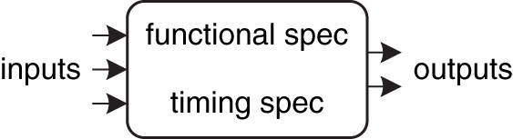
Figure 2.1 Circuit as a black box with inputs, outputs, and specifications
Copyright © 2013 Elsevier Inc. All rights reserved.

Slide 3
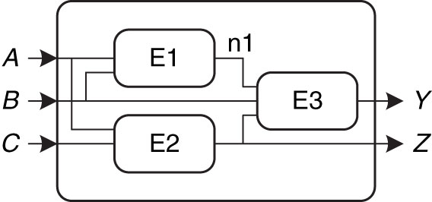
Figure 2.2 Elements and nodes
Copyright © 2013 Elsevier Inc. All rights reserved.

Slide 4
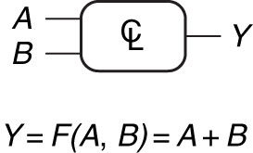
Figure 2.3 Combinational logic circuit
Copyright © 2013 Elsevier Inc. All rights reserved.

Slide 5
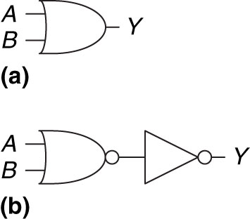
Figure 2.4 Two OR implementations
Copyright © 2013 Elsevier Inc. All rights reserved.

Slide 6
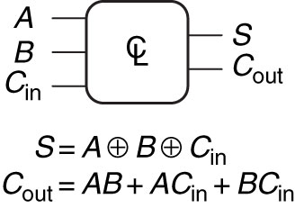
Figure 2.5 Multiple-output combinational circuit
Copyright © 2013 Elsevier Inc. All rights reserved.

Slide 7
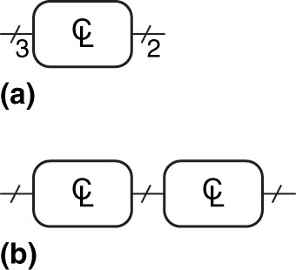
Figure 2.6 Slash notation for multiple signals
Copyright © 2013 Elsevier Inc. All rights reserved.

Slide 8
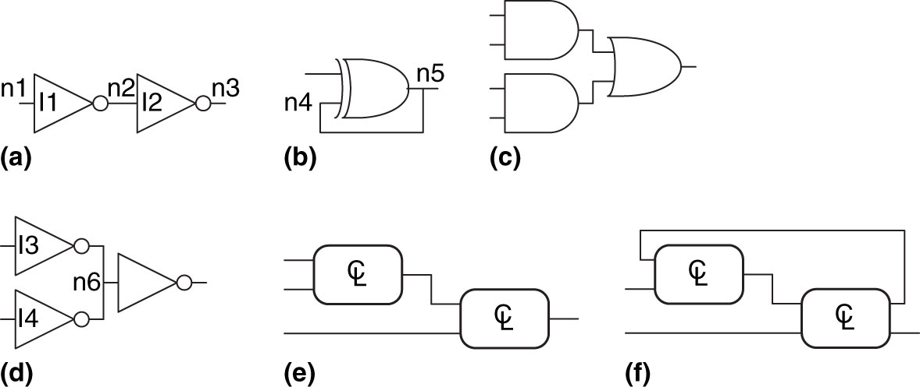
Figure 2.7 Example circuits
Copyright © 2013 Elsevier Inc. All rights reserved.

Slide 9
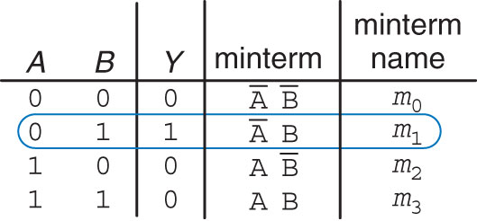
Figure 2.8 Truth table and minterms
Copyright © 2013 Elsevier Inc. All rights reserved.

Slide 10
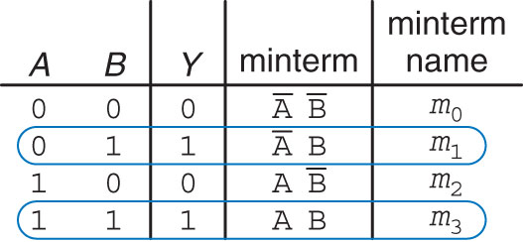
Figure 2.9 Truth table with multiple TRUE minterms
Copyright © 2013 Elsevier Inc. All rights reserved.

Slide 11
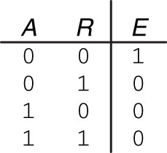
Figure 2.10 Ben’s truth table
Copyright © 2013 Elsevier Inc. All rights reserved.

Slide 12
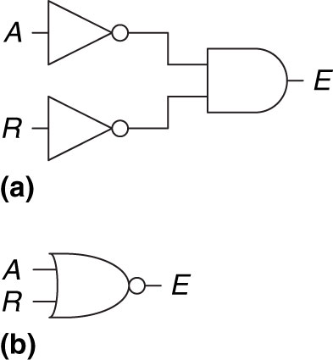
Figure 2.11 Ben’s circuit
Copyright © 2013 Elsevier Inc. All rights reserved.

Slide 13
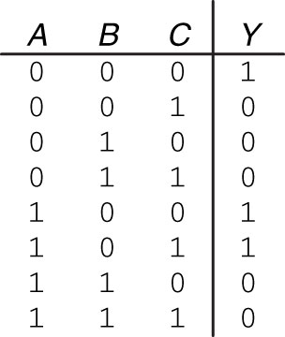
Figure 2.12 Random three-input truth table
Copyright © 2013 Elsevier Inc. All rights reserved.

Slide 14
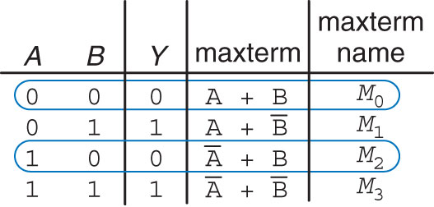
Figure 2.13 Truth table with multiple FALSE maxterms
Copyright © 2013 Elsevier Inc. All rights reserved.

Slide 15
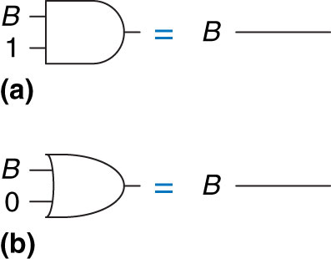
Figure 2.14 Identity theorem in hardware: (a) T1, (b) T1′
Copyright © 2013 Elsevier Inc. All rights reserved.

Slide 16
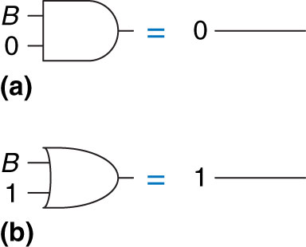
Figure 2.15 Null element theorem in hardware: (a) T2, (b) T2′
Copyright © 2013 Elsevier Inc. All rights reserved.

Slide 17
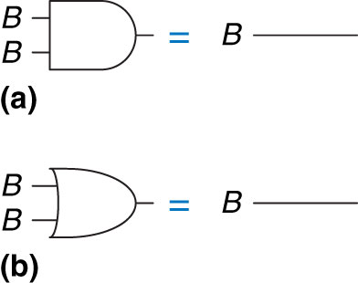
Figure 2.16 Idempotency theorem in hardware: (a) T3, (b) T3′
Copyright © 2013 Elsevier Inc. All rights reserved.

Slide 18

Figure 2.17 Involution theorem in hardware: T4
Copyright © 2013 Elsevier Inc. All rights reserved.

Slide 19
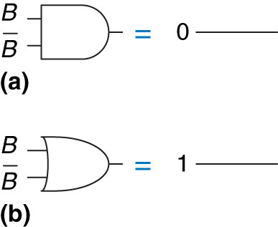
Figure 2.18 Complement theorem in hardware: (a) T5, (b) T5′
Copyright © 2013 Elsevier Inc. All rights reserved.

Slide 20
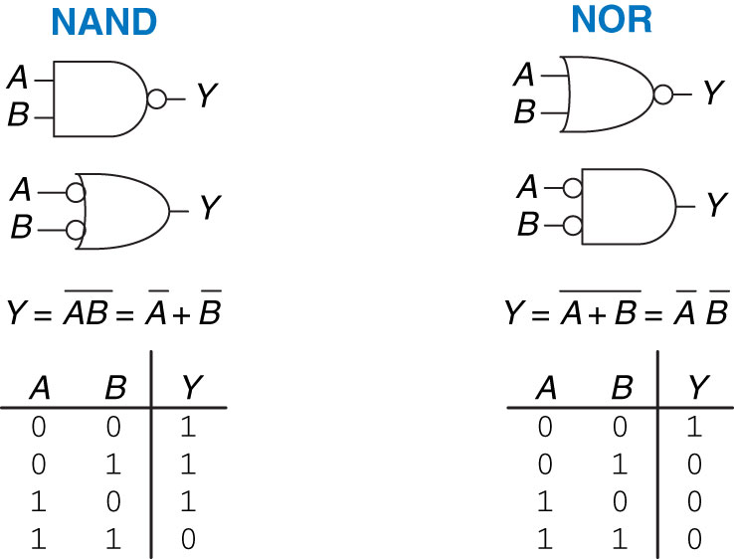
Figure 2.19 De Morgan equivalent gates
Copyright © 2013 Elsevier Inc. All rights reserved.

Slide 21
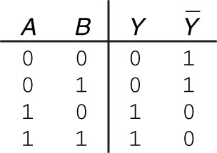
Figure 2.20 Truth table showing Y and
Copyright © 2013 Elsevier Inc. All rights reserved.

Slide 22
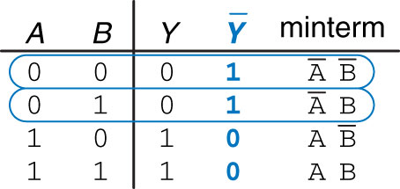
Figure 2.21 Truth table showing minterms for
Copyright © 2013 Elsevier Inc. All rights reserved.

Slide 23
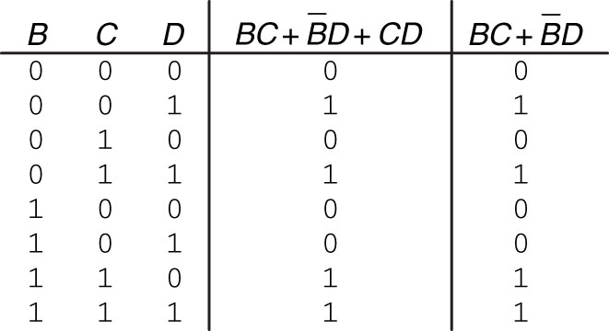
Figure 2.22 Truth table pr oving T11
Copyright © 2013 Elsevier Inc. All rights reserved.

Slide 24
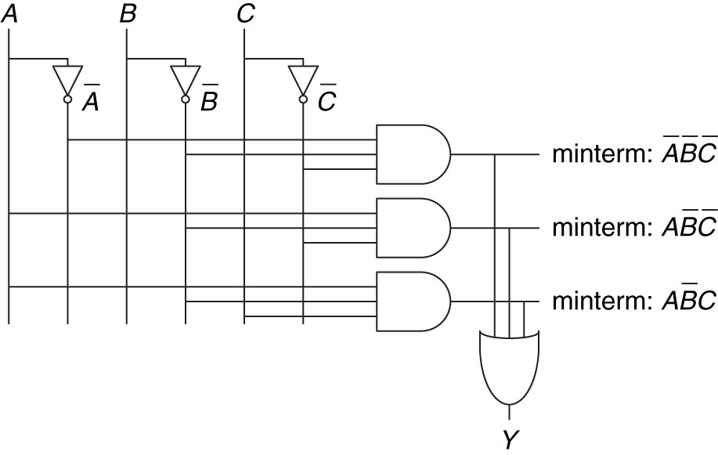
Figure 2.23 Schematic of
Copyright © 2013 Elsevier Inc. All rights reserved.

Slide 25
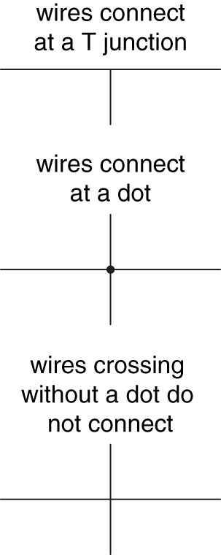
Figure 2.24 Wire connections
Copyright © 2013 Elsevier Inc. All rights reserved.

Slide 26
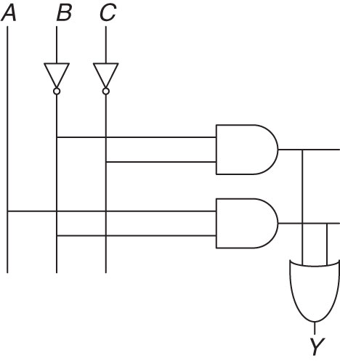
Figure 2.25 Schematic of
Copyright © 2013 Elsevier Inc. All rights reserved.

Slide 27
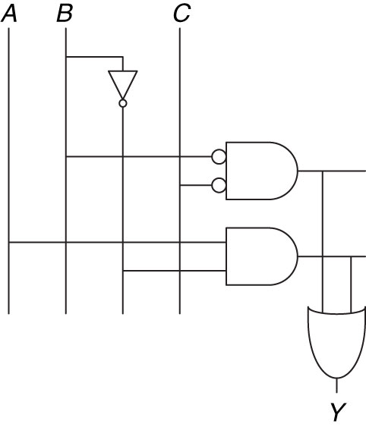
Figure 2.26 Schematic using fewer gates
Copyright © 2013 Elsevier Inc. All rights reserved.

Slide 28
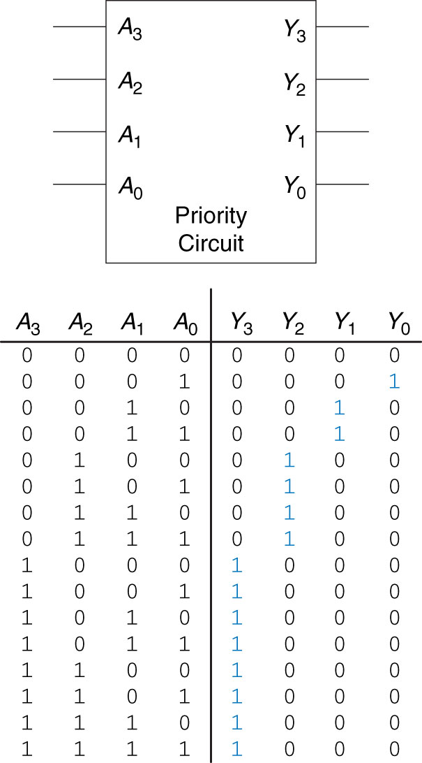
Figure 2.27 Priority circuit
Copyright © 2013 Elsevier Inc. All rights reserved.

Slide 29
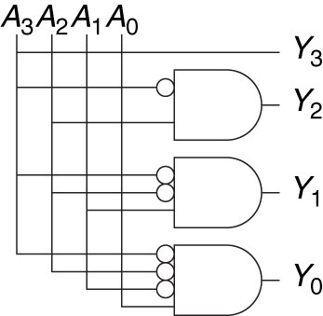
Figure 2.28 Priority circuit schematic
Copyright © 2013 Elsevier Inc. All rights reserved.

Slide 30
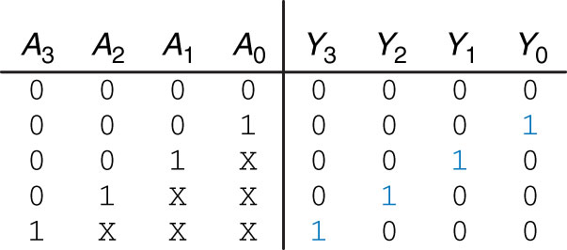
Figure 2.29 Priority circuit truth table with don’t cares (X’s)
Copyright © 2013 Elsevier Inc. All rights reserved.

Slide 31
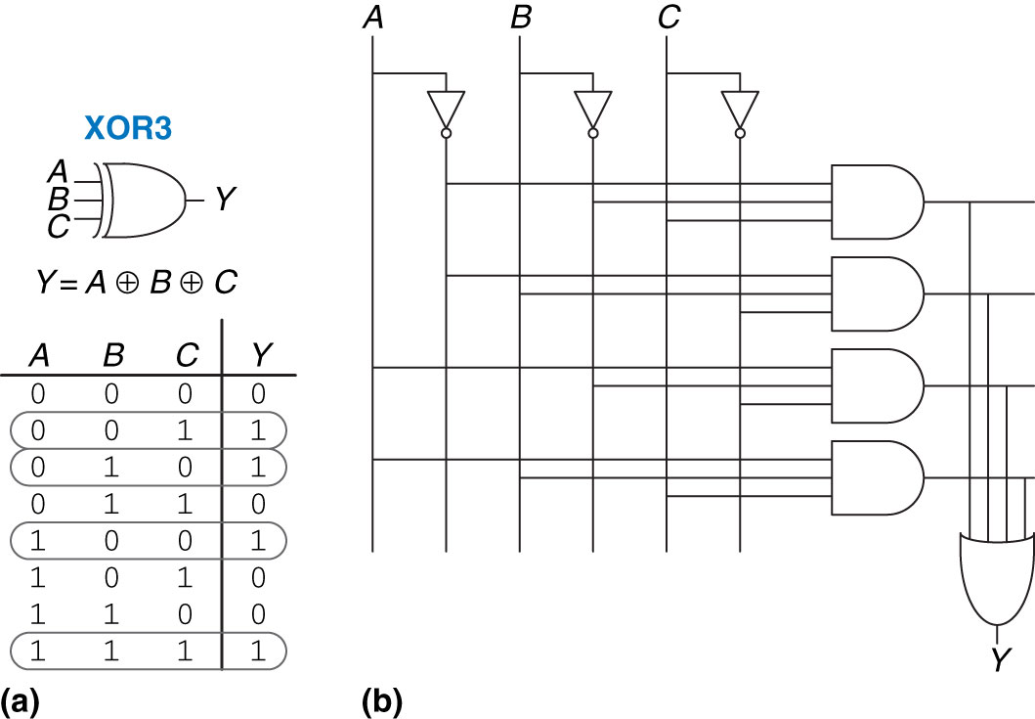
Figure 2.30 Three-input XOR: (a) functional specification and (b) two-level logic implementation
Copyright © 2013 Elsevier Inc. All rights reserved.

Slide 32
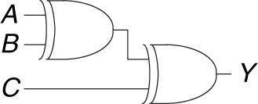
Figure 2.31 Three-input XOR using two-input XORs
Copyright © 2013 Elsevier Inc. All rights reserved.

Slide 33
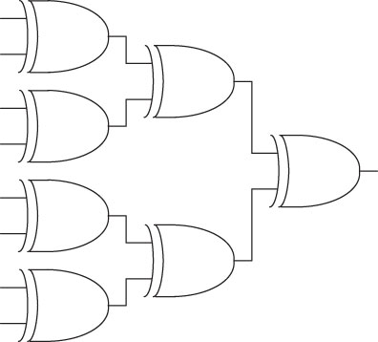
Figure 2.32 Eight-input XOR using seven two-input XORs
Copyright © 2013 Elsevier Inc. All rights reserved.

Slide 34
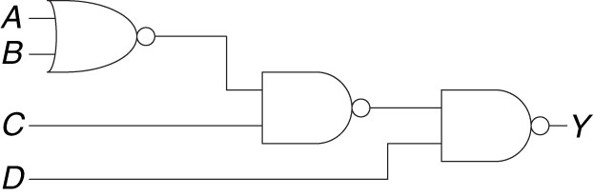
Figure 2.33 Multilevel circuit using NANDs and NORs
Copyright © 2013 Elsevier Inc. All rights reserved.

Slide 35
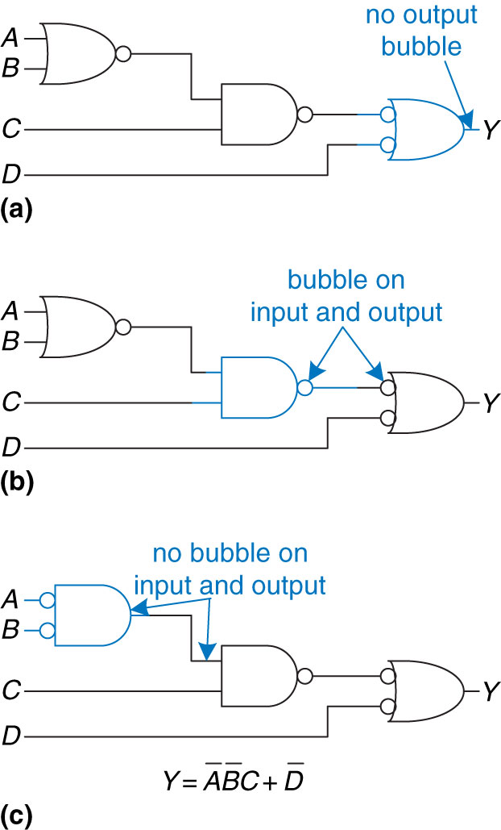
Figure 2.34 Bubble-pushed circuit
Copyright © 2013 Elsevier Inc. All rights reserved.

Slide 36
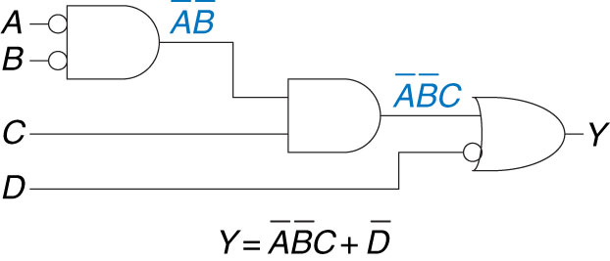
Figure 2.35 Logically equivalent bubble-pushed circuit
Copyright © 2013 Elsevier Inc. All rights reserved.

Slide 37
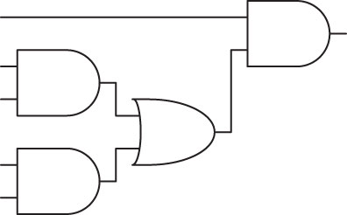
Figure 2.36 Circuit using ANDs and ORs
Copyright © 2013 Elsevier Inc. All rights reserved.

Slide 38
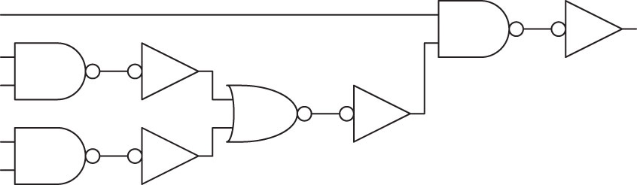
Figure 2.37 Poor circuit using NANDs and NORs
Copyright © 2013 Elsevier Inc. All rights reserved.

Slide 39
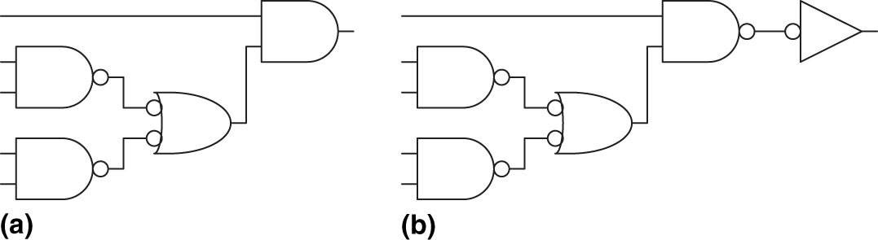
Figure 2.38 Better circuit using NANDs and NORs
Copyright © 2013 Elsevier Inc. All rights reserved.

Slide 40
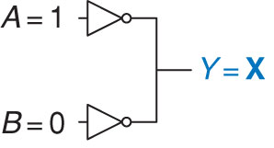
Figure 2.39 Circuit with contention
Copyright © 2013 Elsevier Inc. All rights reserved.

Slide 41
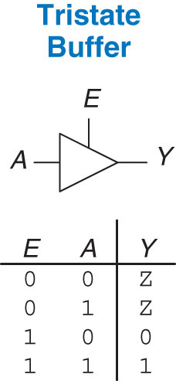
Figure 2.40 Tristate buffer
Copyright © 2013 Elsevier Inc. All rights reserved.

Slide 42
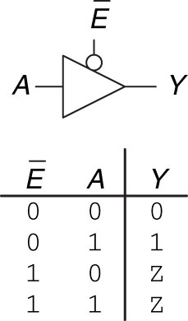
Figure 2.41 Tristate buffer with active low enable
Copyright © 2013 Elsevier Inc. All rights reserved.

Slide 43
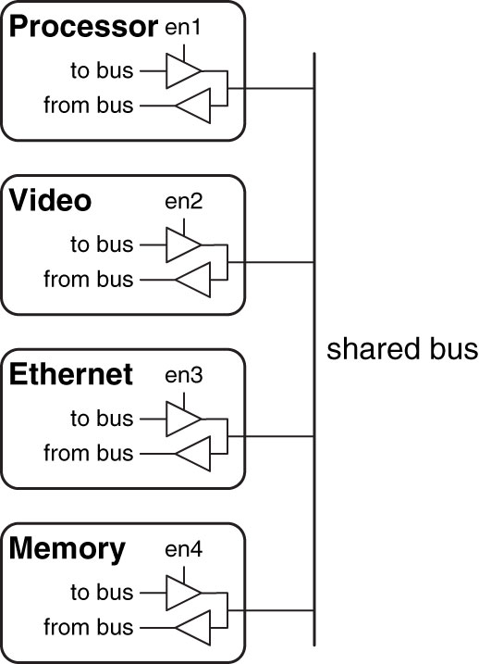
Figure 2.42 Tristate bus connecting multiple chips
Copyright © 2013 Elsevier Inc. All rights reserved.

Slide 44
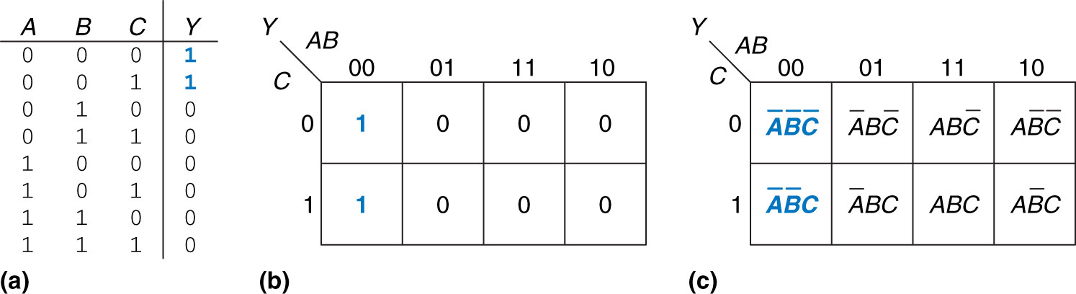
Figure 2.43 Three-input function: (a) truth table, (b) K-map, (c) K-map showing minterms
Copyright © 2013 Elsevier Inc. All rights reserved.

Slide 45
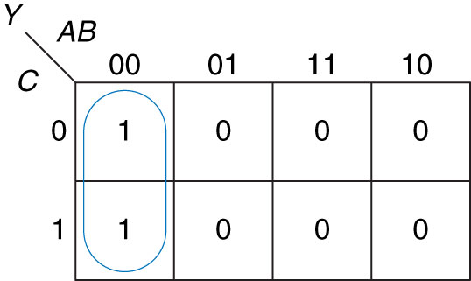
Figure 2.44 K-map minimization
Copyright © 2013 Elsevier Inc. All rights reserved.

Slide 46
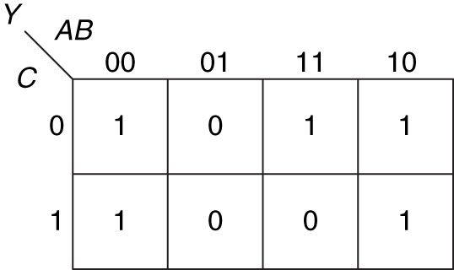
Figure 2.45 K-map for Example 2.9
Copyright © 2013 Elsevier Inc. All rights reserved.

Slide 47
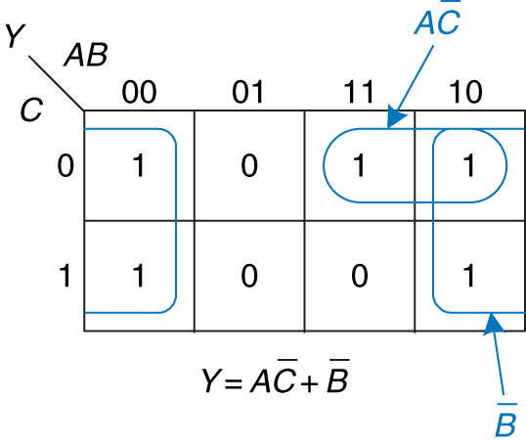
Figure 2.46 Solution for Example 2.9
Copyright © 2013 Elsevier Inc. All rights reserved.

Slide 48
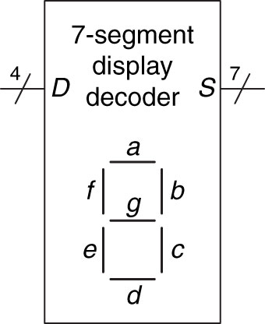
Figure 2.47 Seven-segment display decoder icon
Copyright © 2013 Elsevier Inc. All rights reserved.

Slide 49
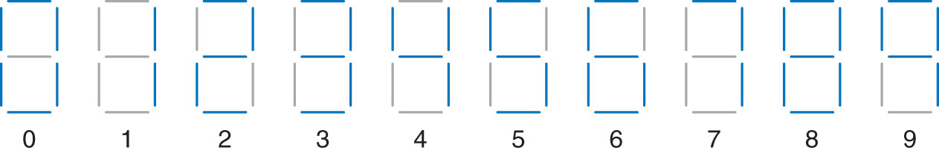
Figure 2.48 Seven-segment display digits
Copyright © 2013 Elsevier Inc. All rights reserved.

Slide 50
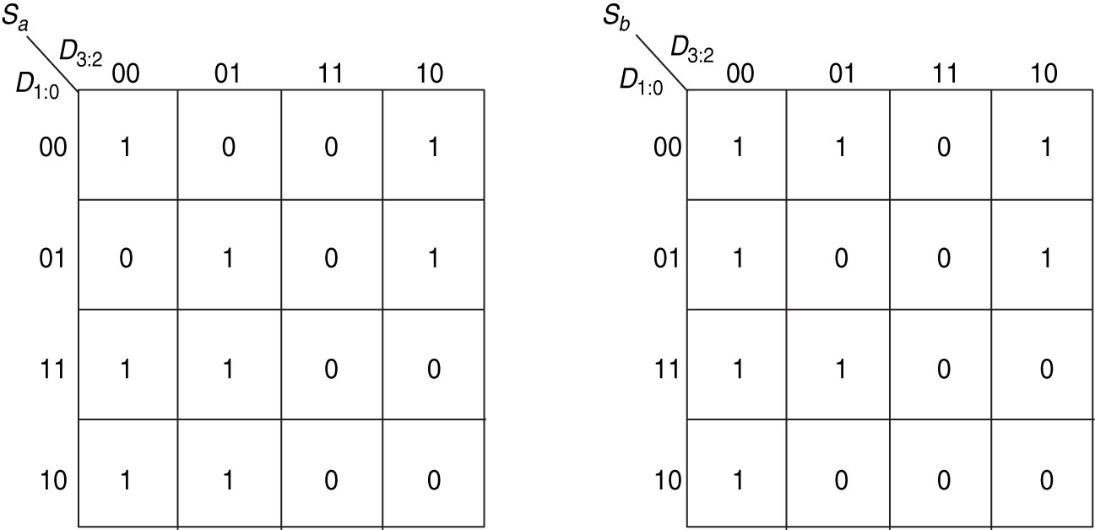
Figure 2.49 Karnaugh maps for S_{a} and S_{b}
Copyright © 2013 Elsevier Inc. All rights reserved.

Slide 51
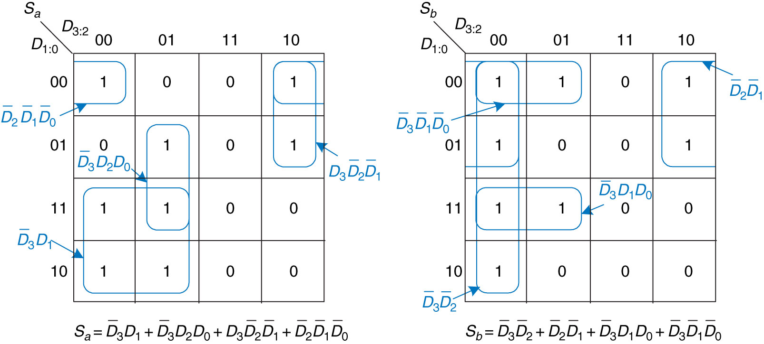
Figure 2.50 K-map solution for Example 2.10
Copyright © 2013 Elsevier Inc. All rights reserved.

Slide 52
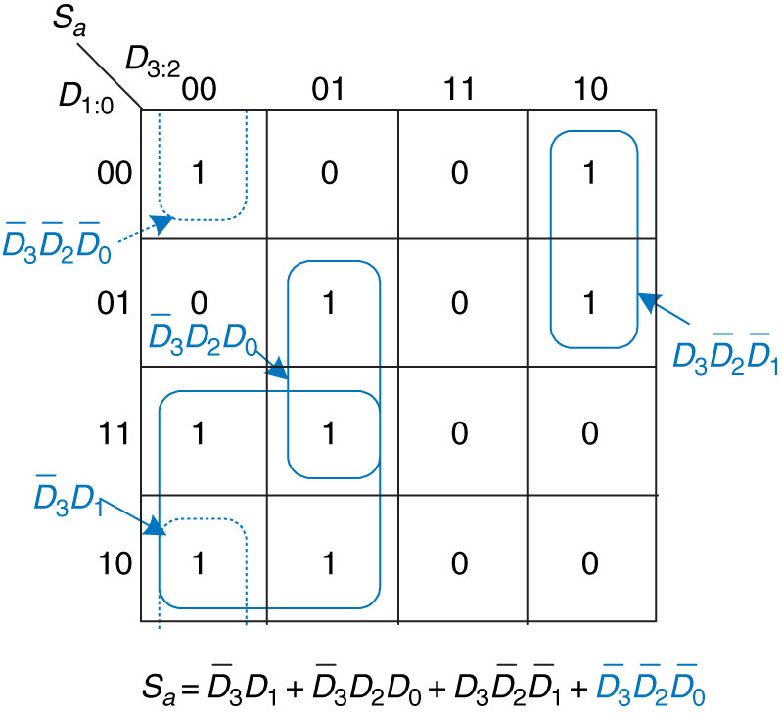
Figure 2.51 Alternative K-map for S_{a} showing different set of prime implicants
Copyright © 2013 Elsevier Inc. All rights reserved.

Slide 53

Figure 2.52 Alternative K-map for S_{a} showing incorrect nonprime implicant
Copyright © 2013 Elsevier Inc. All rights reserved.

Slide 54

Figure 2.53 K-map solution with don’t cares
Copyright © 2013 Elsevier Inc. All rights reserved.

Slide 55

Figure 2.54 2:1 multiplexer symbol and truth table
Copyright © 2013 Elsevier Inc. All rights reserved.

Slide 56

Figure 2.55 2:1 multiplexer implementation using two-level logic
Copyright © 2013 Elsevier Inc. All rights reserved.

Slide 57

Figure 2.56 Multiplexer using tristate buffers
Copyright © 2013 Elsevier Inc. All rights reserved.

Slide 58

Figure 2.57 4:1 multiplexer
Copyright © 2013 Elsevier Inc. All rights reserved.

Slide 59

Figure 2.58 4:1 multiplexer implementations: (a) two-level logic, (b) tristates, (c) hierarchical
Copyright © 2013 Elsevier Inc. All rights reserved.

Slide 60

Figure 2.59 4:1 multiplexer implementation of two-input AND function
Copyright © 2013 Elsevier Inc. All rights reserved.

Slide 61

Figure 2.60 Multiplexer logic using variable inputs
Copyright © 2013 Elsevier Inc. All rights reserved.

Slide 62

Figure 2.61 Alyssa’s circuit: (a) truth table, (b) 8:1 multiplexer implementation
Copyright © 2013 Elsevier Inc. All rights reserved.

Slide 63

Figure 2.62 Alyssa’s new circuit
Copyright © 2013 Elsevier Inc. All rights reserved.

Slide 64

Figure 2.63 2:4 decoder
Copyright © 2013 Elsevier Inc. All rights reserved.

Slide 65

Figure 2.64 2:4 decoder implementation
Copyright © 2013 Elsevier Inc. All rights reserved.

Slide 66

Figure 2.65 Logic function using decoder
Copyright © 2013 Elsevier Inc. All rights reserved.

Slide 67

Figure 2.66 Circuit delay
Copyright © 2013 Elsevier Inc. All rights reserved.

Slide 68

Figure 2.67 Propagation and contamination delay
Copyright © 2013 Elsevier Inc. All rights reserved.

Slide 69

Figure 2.68 Short path and critical path
Copyright © 2013 Elsevier Inc. All rights reserved.

Slide 70

Figure 2.69 Critical and short path waveforms
Copyright © 2013 Elsevier Inc. All rights reserved.

Slide 71

Figure 2.70 Ben’s circuit
Copyright © 2013 Elsevier Inc. All rights reserved.

Slide 72

Figure 2.71 Ben’s critical path
Copyright © 2013 Elsevier Inc. All rights reserved.

Slide 73

Figure 2.72 Ben’s shortest path
Copyright © 2013 Elsevier Inc. All rights reserved.

Slide 74

Figure 2.73 4:1 multiplexer propagation delays: (a) two-level logic, (b) tristate
Copyright © 2013 Elsevier Inc. All rights reserved.

Slide 75

Figure 2.74 4:1 multiplexer propagation delays: hierarchical using 2:1 multiplexers
Copyright © 2013 Elsevier Inc. All rights reserved.

Slide 76

Figure 2.75 Circuit with a glitch
Copyright © 2013 Elsevier Inc. All rights reserved.

Slide 77

Figure 2.76 Timing of a glitch
Copyright © 2013 Elsevier Inc. All rights reserved.

Slide 78

Figure 2.77 Input change crosses implicant boundary
Copyright © 2013 Elsevier Inc. All rights reserved.

Slide 79

Figure 2.78 K-map without glitch
Copyright © 2013 Elsevier Inc. All rights reserved.

Slide 80

Figure 2.79 Circuit without glitch
Copyright © 2013 Elsevier Inc. All rights reserved.

Slide 81

Figure 2.80 Truth tables for Exercises 2.1 and 2.3
Copyright © 2013 Elsevier Inc. All rights reserved.

Slide 82

Figure 2.81 Truth tables for Exercises 2.2 and 2.4
Copyright © 2013 Elsevier Inc. All rights reserved.

Slide 83

Figure 2.82 Circuit schematic
Copyright © 2013 Elsevier Inc. All rights reserved.

Slide 84

Figure 2.83 Circuit schematic
Copyright © 2013 Elsevier Inc. All rights reserved.

Slide 85

Figure 2.84 Circuit schematic
Copyright © 2013 Elsevier Inc. All rights reserved.

Slide 86

Figure 2.85 Truth table for Exercise 2.28
Copyright © 2013 Elsevier Inc. All rights reserved.

Slide 87

Figure 2.86 Truth table for Exercise 2.31
Copyright © 2013 Elsevier Inc. All rights reserved.

Slide 88

Figure 2.87 Multiplexer circuit
Copyright © 2013 Elsevier Inc. All rights reserved.

Slide 89

Figure 2.88 Multiplexer circuit
Copyright © 2013 Elsevier Inc. All rights reserved.

Slide 90

Figure M 01
Copyright © 2013 Elsevier Inc. All rights reserved.

Slide 91

Figure M 02
Copyright © 2013 Elsevier Inc. All rights reserved.

Slide 92

UNN Figure 1
Copyright © 2013 Elsevier Inc. All rights reserved.

