Slide 1
Chapter 6
Architecture
Copyright © 2013 Elsevier Inc. All rights reserved.

Slide 2
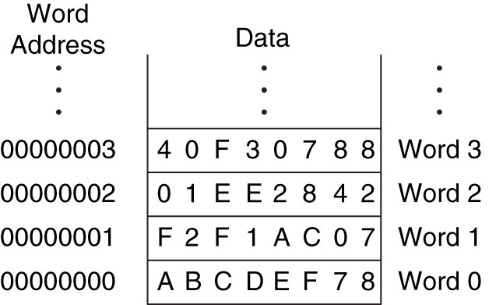
Figure 6.1 Word-addressable memory
Copyright © 2013 Elsevier Inc. All rights reserved.

Slide 3
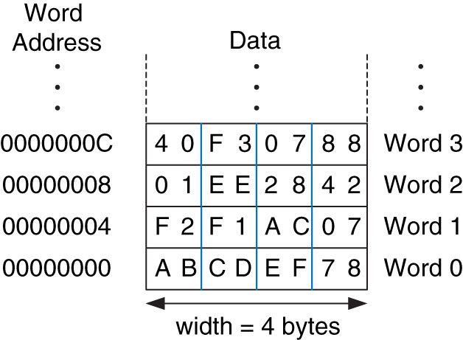
Figure 6.2 Byte-addressable memory
Copyright © 2013 Elsevier Inc. All rights reserved.

Slide 4
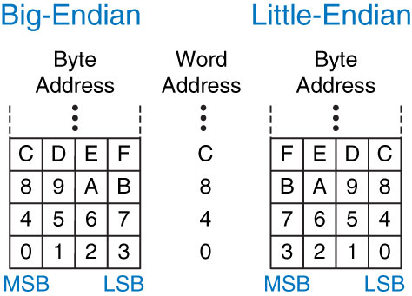
Figure 6.3 Big- and little-endian memory addressing
Copyright © 2013 Elsevier Inc. All rights reserved.

Slide 5
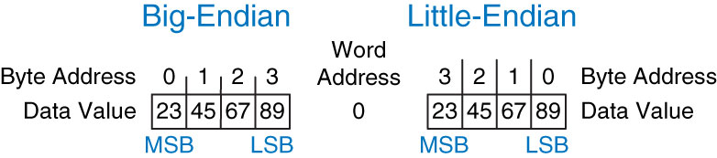
Figure 6.4 Big-endian and little-endian data storage
Copyright © 2013 Elsevier Inc. All rights reserved.

Slide 6
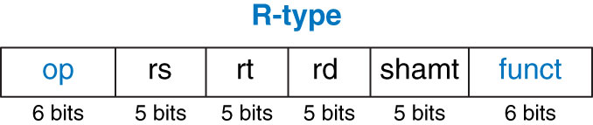
Figure 6.5 R-type machine instruction format
Copyright © 2013 Elsevier Inc. All rights reserved.

Slide 7
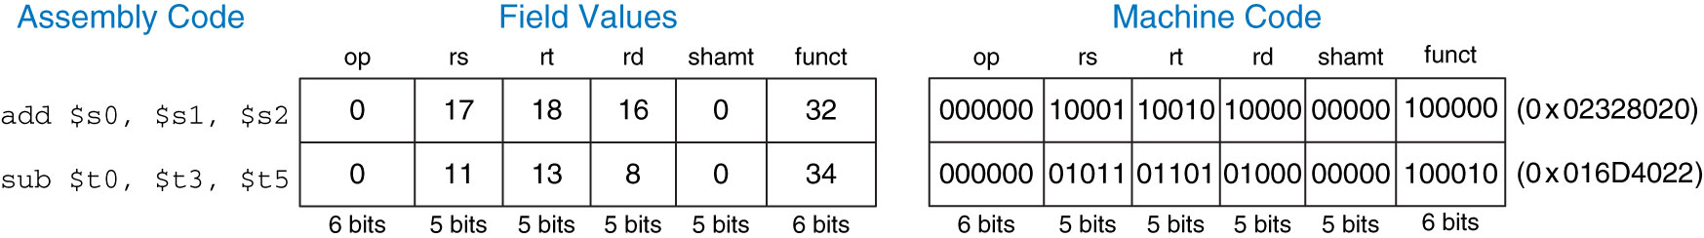
Figure 6.6 Machine code for R-type instructions
Copyright © 2013 Elsevier Inc. All rights reserved.

Slide 8
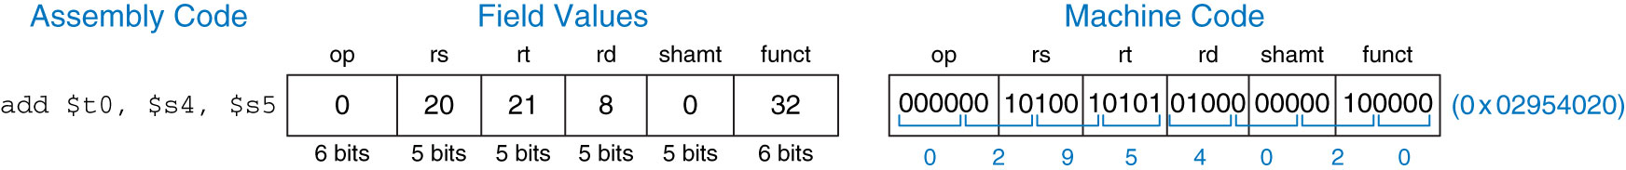
Figure 6.7 Machine code for the R-type instruction of Example 6.3
Copyright © 2013 Elsevier Inc. All rights reserved.

Slide 9
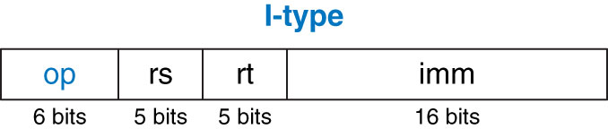
Figure 6.8 I-type instruction format
Copyright © 2013 Elsevier Inc. All rights reserved.

Slide 10
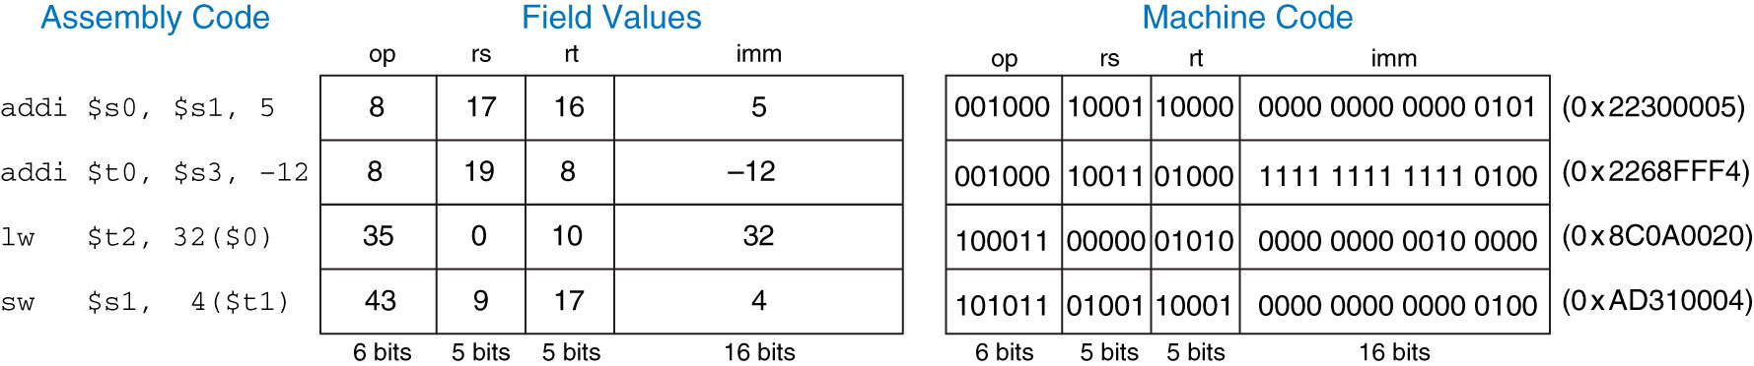
Figure 6.9 Machine code for I-type instructions
Copyright © 2013 Elsevier Inc. All rights reserved.

Slide 11
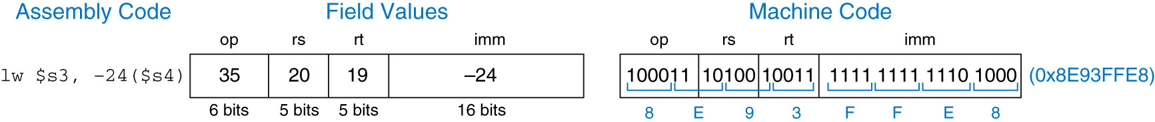
Figure 6.10 Machine code for an l-type instruction
Copyright © 2013 Elsevier Inc. All rights reserved.

Slide 12
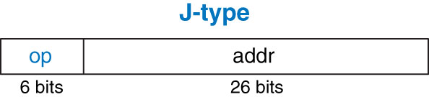
Figure 6.11 J-type instruction format
Copyright © 2013 Elsevier Inc. All rights reserved.

Slide 13
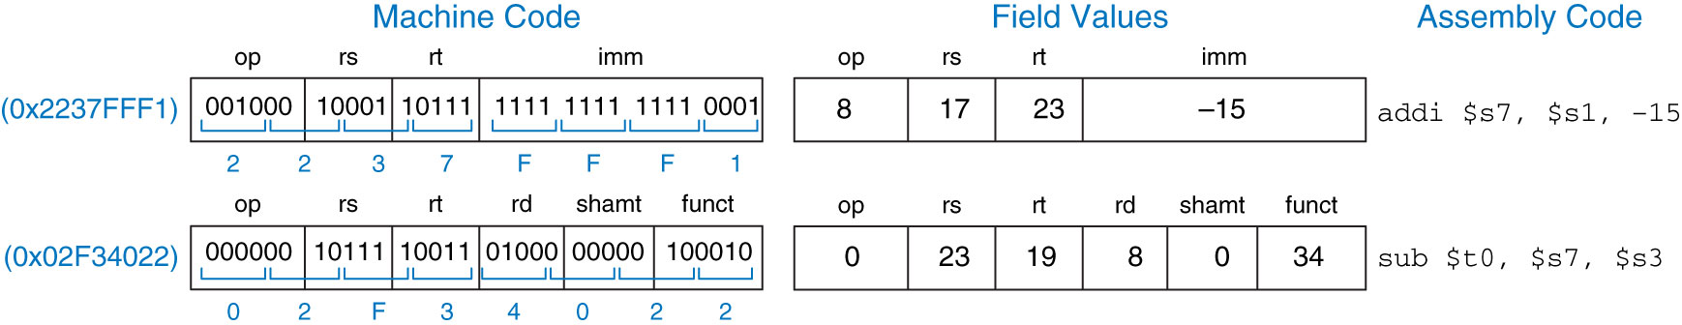
Figure 6.12 Machine code to assembly code translation
Copyright © 2013 Elsevier Inc. All rights reserved.

Slide 14
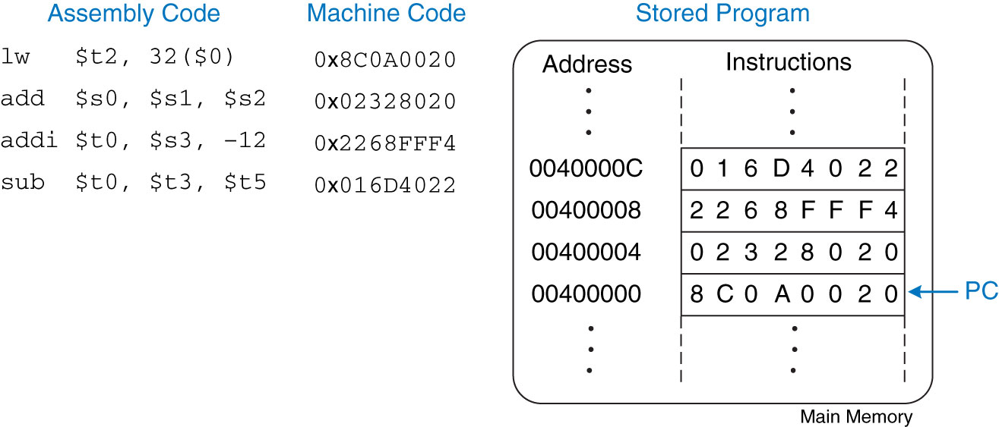
Figure 6.13 Stored program
Copyright © 2013 Elsevier Inc. All rights reserved.

Slide 15
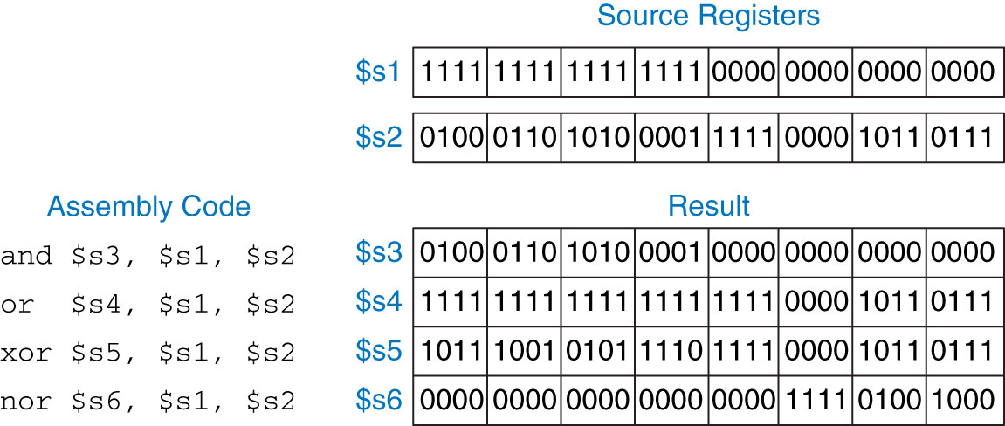
Figure 6.14 Logical operations
Copyright © 2013 Elsevier Inc. All rights reserved.

Slide 16
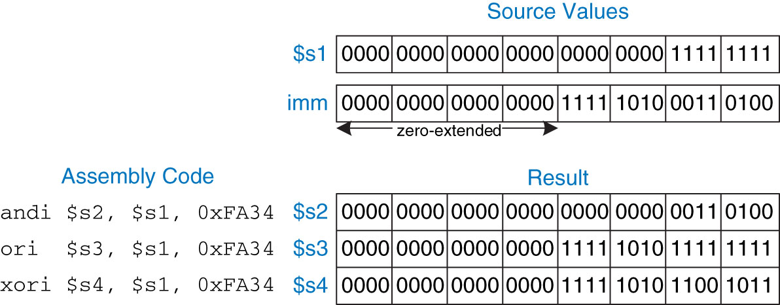
Figure 6.16 Shift instruction machine code
Copyright © 2013 Elsevier Inc. All rights reserved.

Slide 17
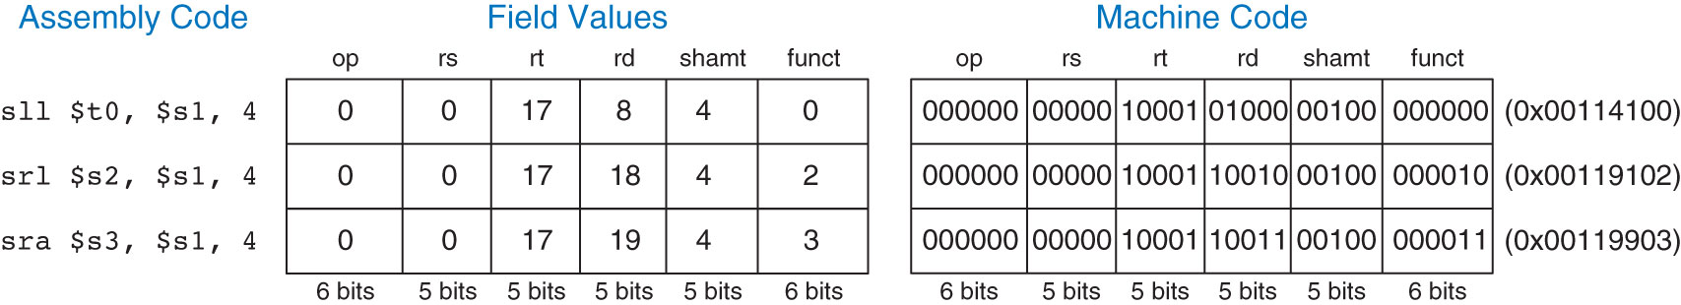
Figure 6.16 Shift instruction machine code
Copyright © 2013 Elsevier Inc. All rights reserved.

Slide 18
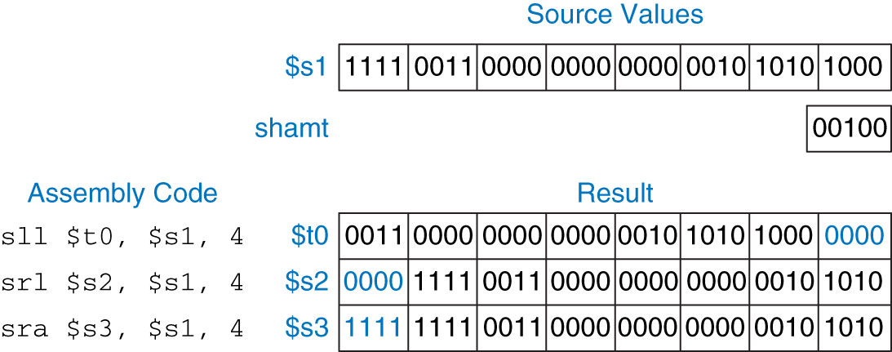
Figure 6.17 Shift operations
Copyright © 2013 Elsevier Inc. All rights reserved.

Slide 19
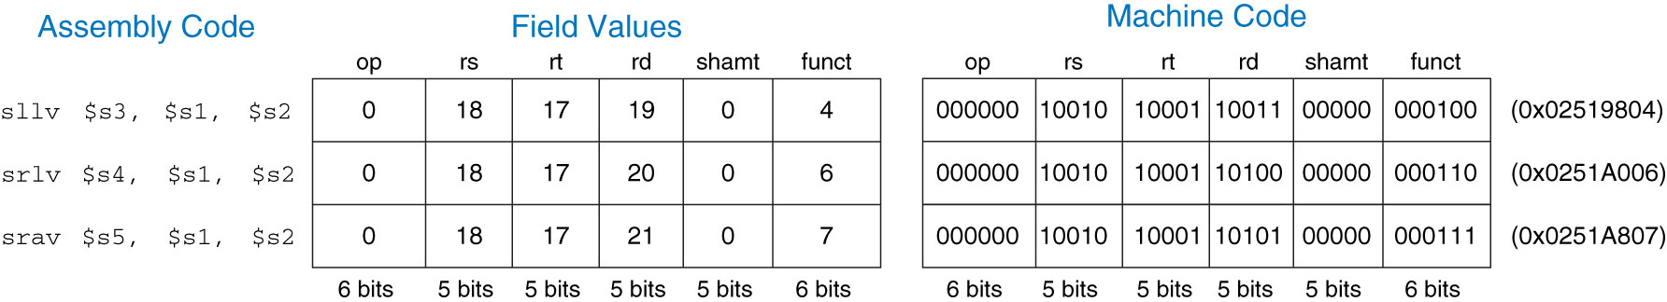
Figure 6.18 Variable-shift instruction machine code
Copyright © 2013 Elsevier Inc. All rights reserved.

Slide 20
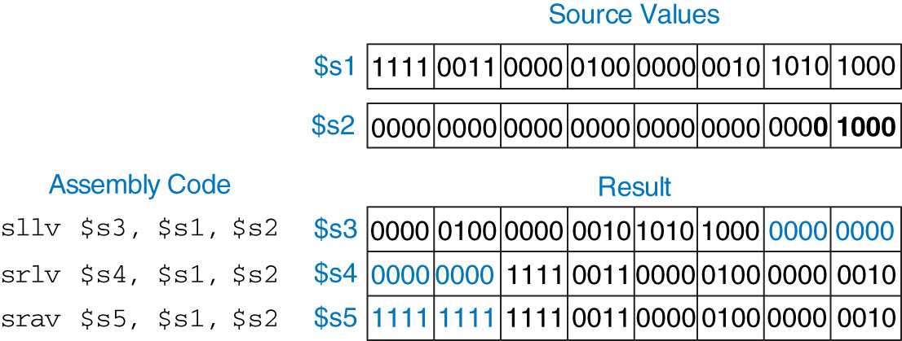
Figure 6.19 Variable-shift operations
Copyright © 2013 Elsevier Inc. All rights reserved.

Slide 21
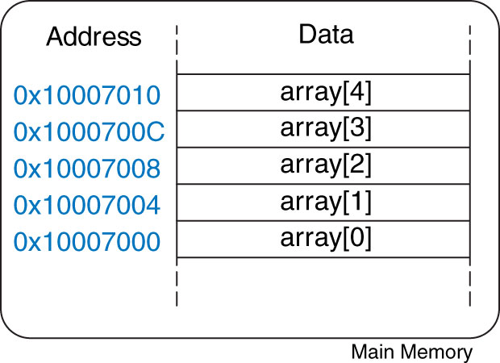
Figure 6.20 Five-entry array with base address of 0x10007000
Copyright © 2013 Elsevier Inc. All rights reserved.

Slide 22
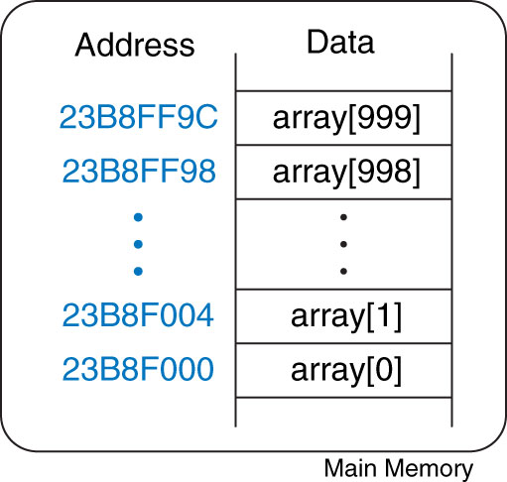
Figure 6.21 Memory holding array[1000] starting at base address 0x23B8F000
Copyright © 2013 Elsevier Inc. All rights reserved.

Slide 23
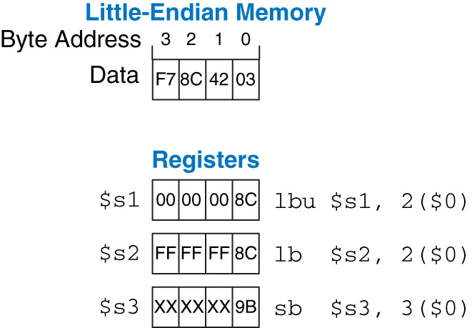
Figure 6.22 Instructions for loading and storing bytes
Copyright © 2013 Elsevier Inc. All rights reserved.

Slide 24
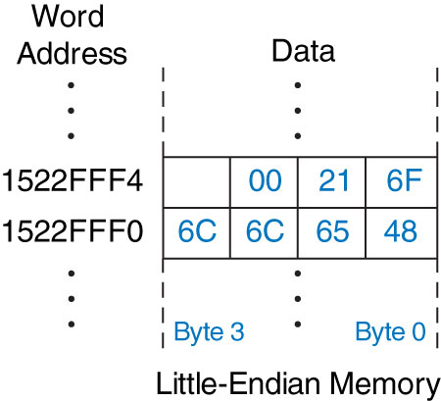
Figure 6.23 The string “Hello!” stored in memory
Copyright © 2013 Elsevier Inc. All rights reserved.

Slide 25
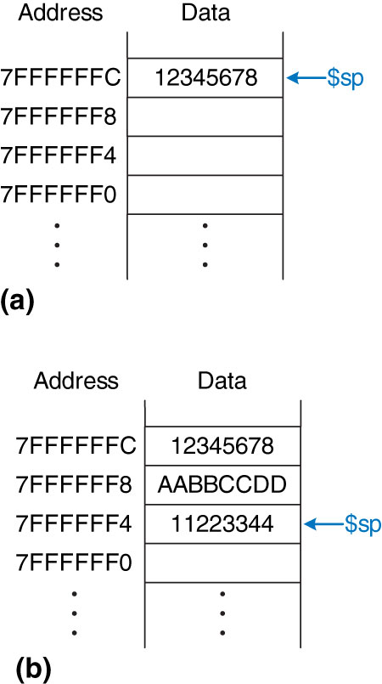
Figure 6.24 The stack
Copyright © 2013 Elsevier Inc. All rights reserved.

Slide 26
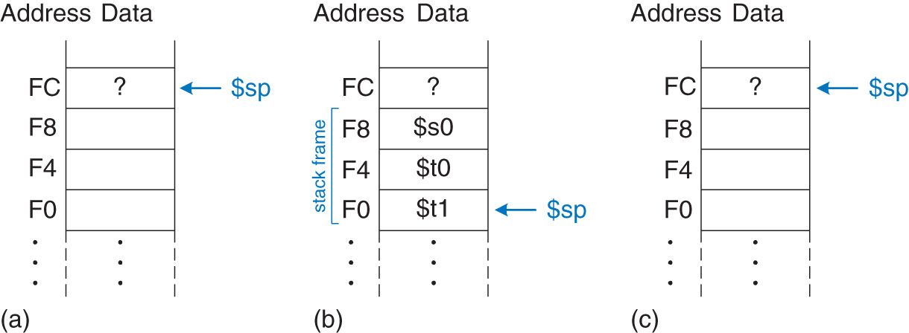
Figure 6.25 The stack (a) before, (b) during, and (c) after diffofsums function call
Copyright © 2013 Elsevier Inc. All rights reserved.

Slide 27
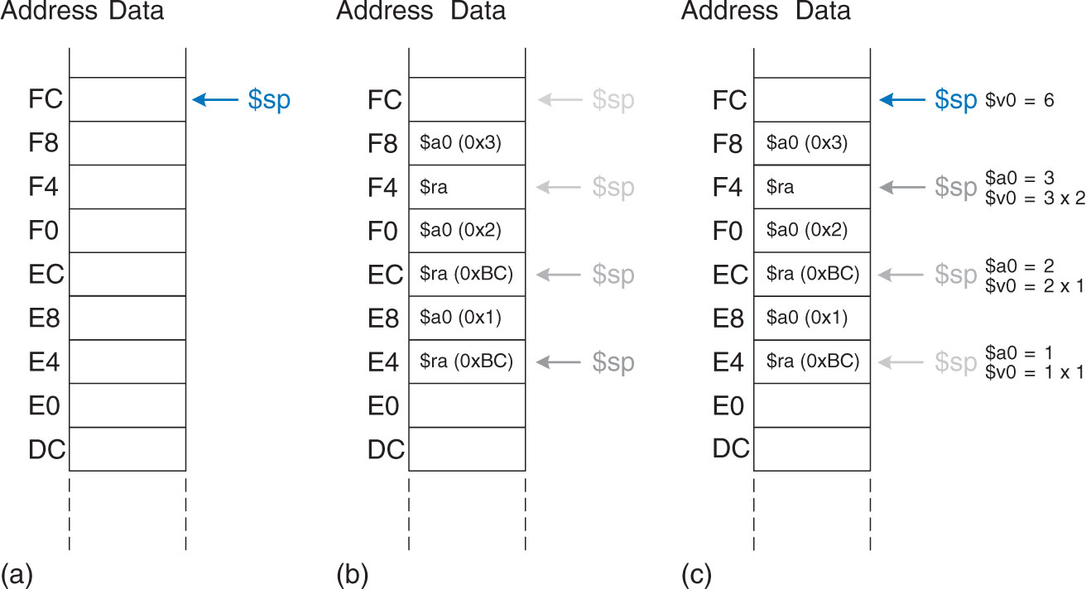
Figure 6.26 Stack during factorial function call when n = 3: (a) before call, (b) after last recursive call, (c) after return
Copyright © 2013 Elsevier Inc. All rights reserved.

Slide 28
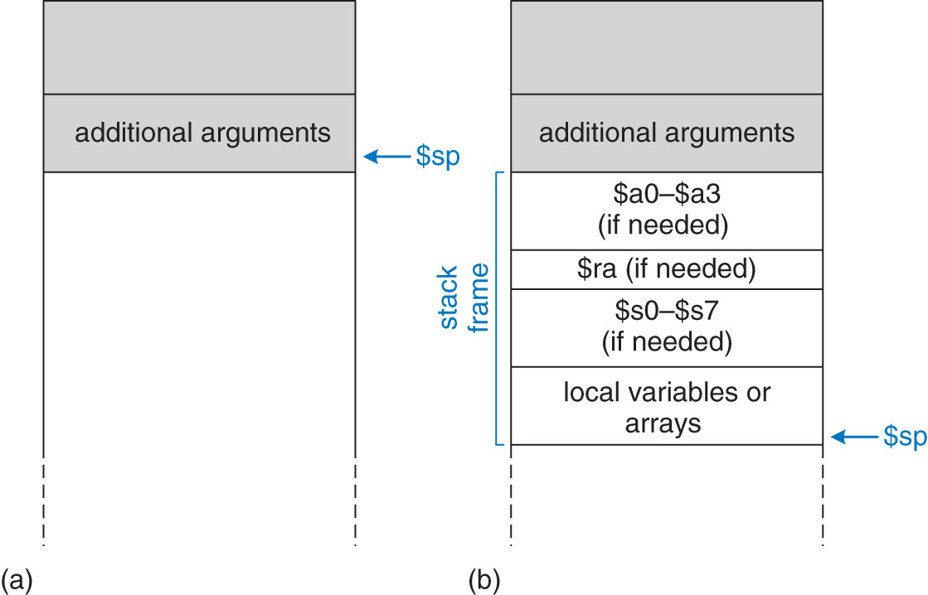
Figure 6.27 Stack usage: (a) before call, (b) after call
Copyright © 2013 Elsevier Inc. All rights reserved.

Slide 29
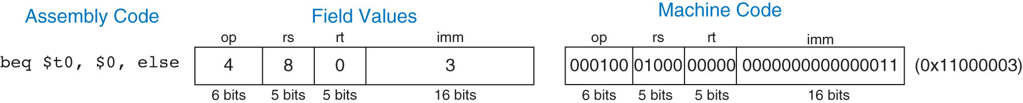
Figure 6.28 Machine code for beq
Copyright © 2013 Elsevier Inc. All rights reserved.

Slide 30
Figure 6.29 bne machine code
Copyright © 2013 Elsevier Inc. All rights reserved.

Slide 31
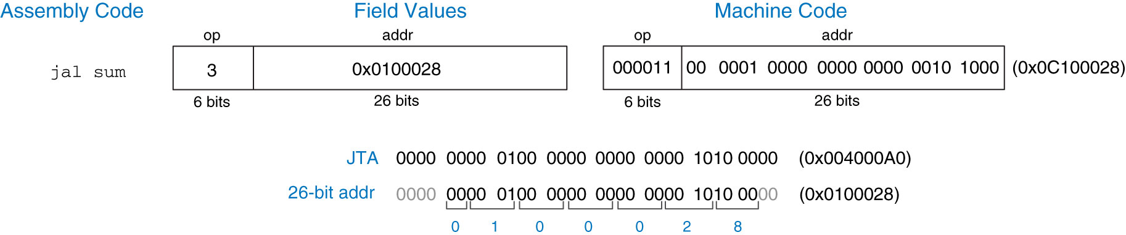
Figure 6.30 jal machine code
Copyright © 2013 Elsevier Inc. All rights reserved.

Slide 32
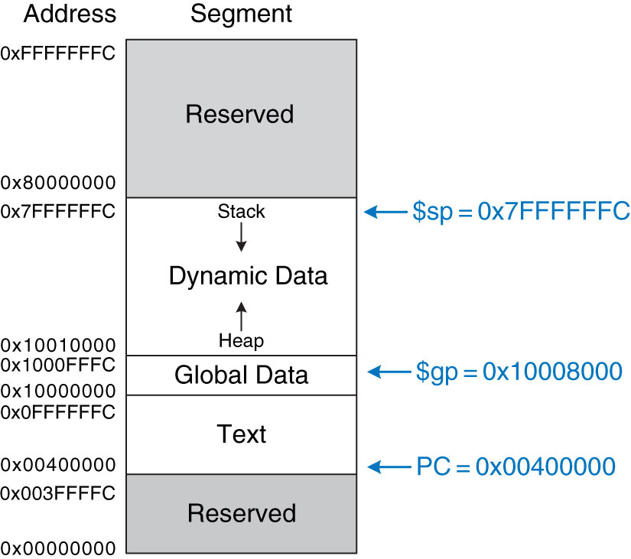
Figure 6.31 MIPS memory map
Copyright © 2013 Elsevier Inc. All rights reserved.

Slide 33
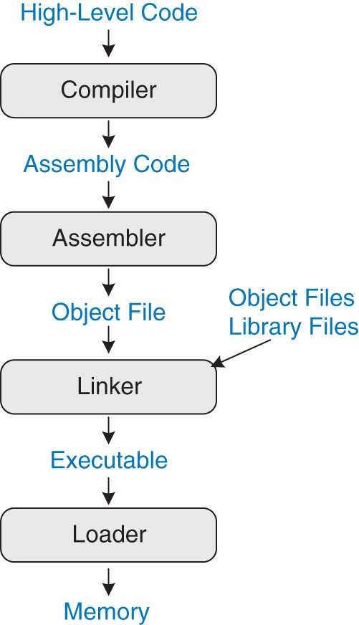
Figure 6.32 Steps for translating and starting a program
Copyright © 2013 Elsevier Inc. All rights reserved.

Slide 34
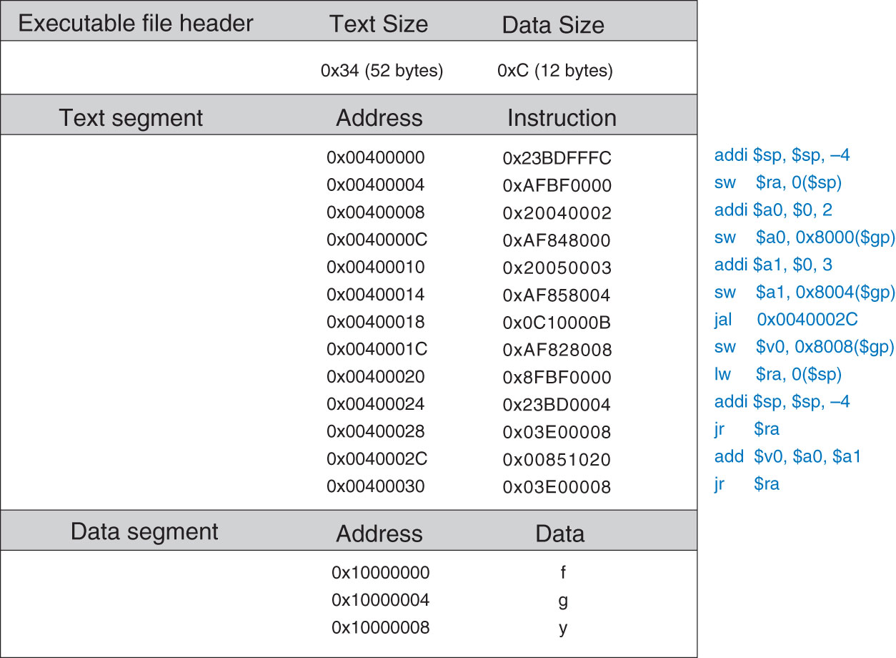
Figure 6.33 Executable
Copyright © 2013 Elsevier Inc. All rights reserved.

Slide 35
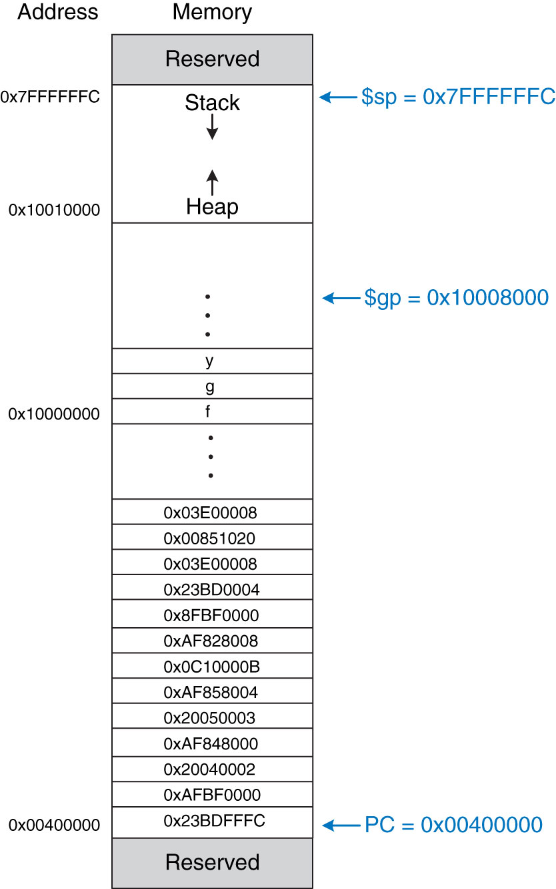
Figure 6.34 Executable loaded in memory
Copyright © 2013 Elsevier Inc. All rights reserved.

Slide 36
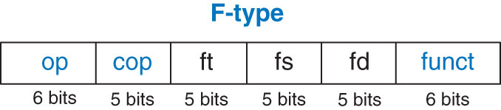
Figure 6.35 F-type machine instruction format
Copyright © 2013 Elsevier Inc. All rights reserved.

Slide 37
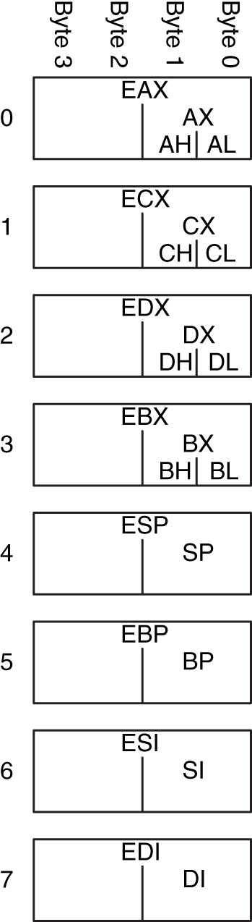
Figure 6.36 x86 registers
Copyright © 2013 Elsevier Inc. All rights reserved.

Slide 38
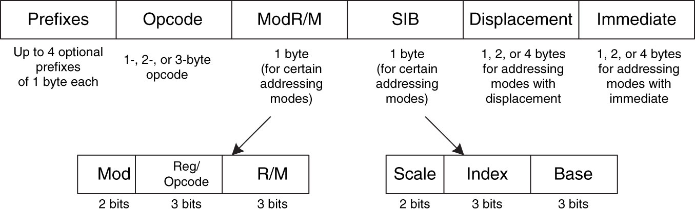
Figure 6.37 x86 instruction encodings
Copyright © 2013 Elsevier Inc. All rights reserved.

Slide 39

Figure M 01
Copyright © 2013 Elsevier Inc. All rights reserved.

Slide 40
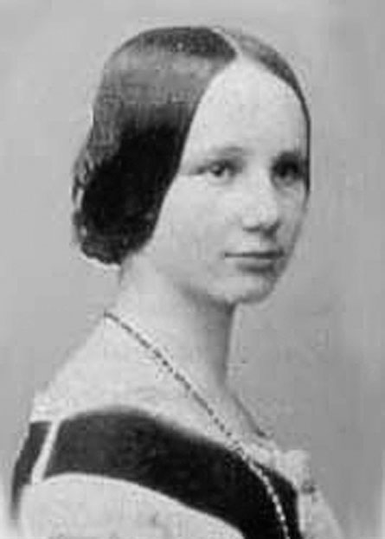
Figure M 02
Copyright © 2013 Elsevier Inc. All rights reserved.

Slide 41
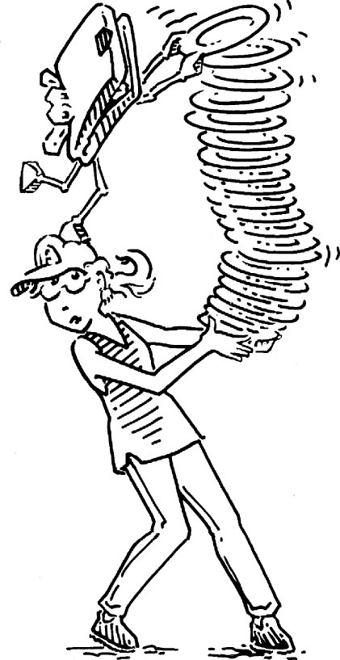
Figure M 03
Copyright © 2013 Elsevier Inc. All rights reserved.

Slide 42
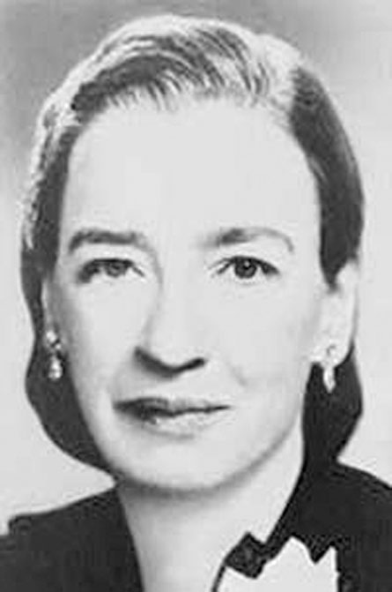
Figure M 04
Copyright © 2013 Elsevier Inc. All rights reserved.

Slide 43
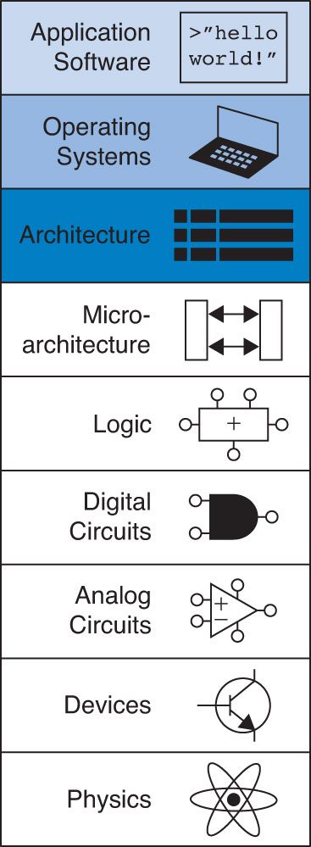
UNN Figure 1
Copyright © 2013 Elsevier Inc. All rights reserved.

