Slide 1
Chapter 1
From Zero to One
Copyright © 2013 Elsevier Inc. All rights reserved.

Slide 2
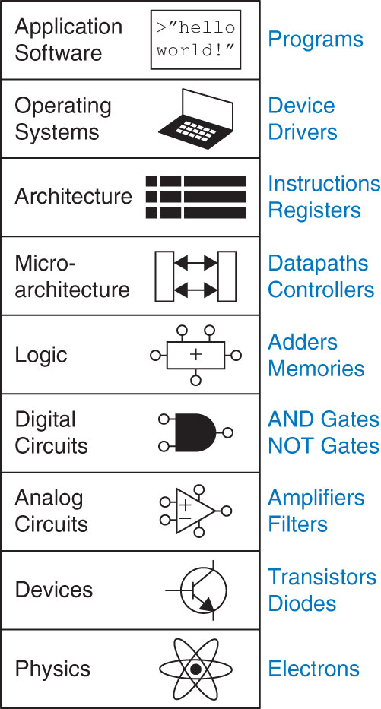
Figure 1.1 Levels of abstraction for an electronic computing system
(Image by Euroarms Italia. www.euroarms.net  2006.)
Copyright © 2013 Elsevier Inc. All rights reserved.

Slide 3
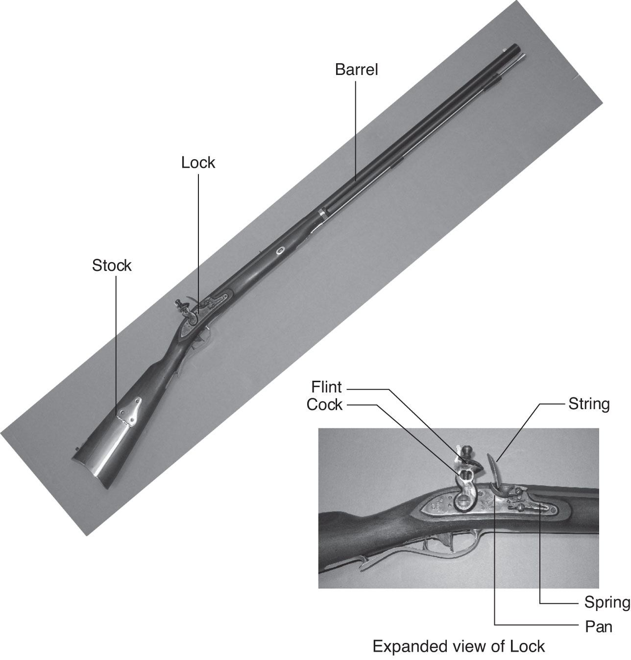
Figure 1.2 Flintlock rifle with a close-up view of the lock
Copyright © 2013 Elsevier Inc. All rights reserved.

Slide 4
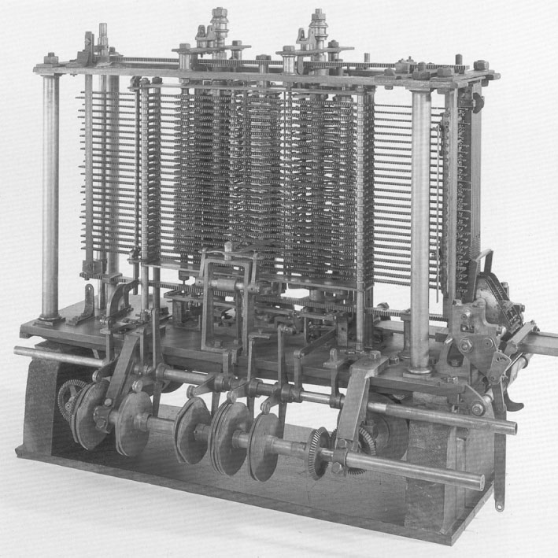
Figure 1.3 Babbage’s Analytical Engine, under construction at the time of his death in 1871
(image courtesy of Science Museum/Science and Society Picture Library)
Copyright © 2013 Elsevier Inc. All rights reserved.

Slide 5
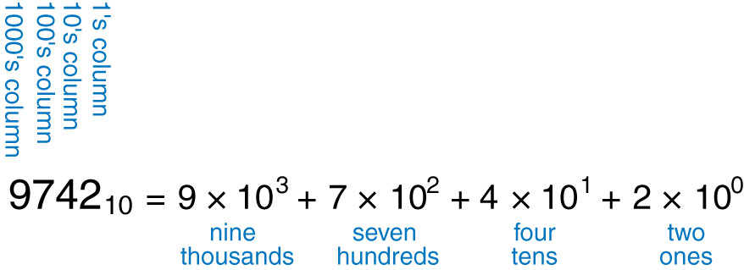
Figure 1.4 Representation of a decimal number
Copyright © 2013 Elsevier Inc. All rights reserved.

Slide 6
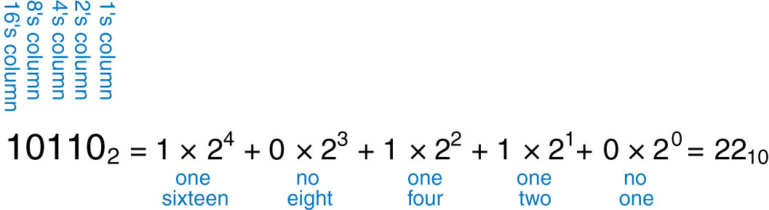
Figure 1.5 Conversion of a binary number to decimal
Copyright © 2013 Elsevier Inc. All rights reserved.

Slide 7
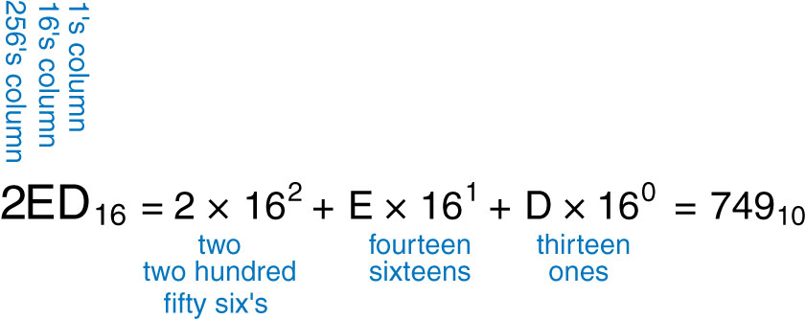
Figure 1.6 Conversion of a hexadecimal number to decimal
Copyright © 2013 Elsevier Inc. All rights reserved.

Slide 8
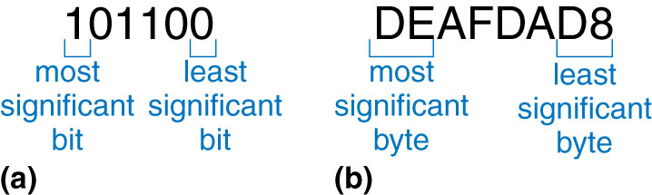
Figure 1.7 Least and most significant bits and bytes
Copyright © 2013 Elsevier Inc. All rights reserved.

Slide 9
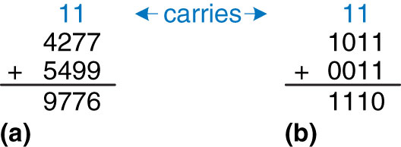
Figure 1.8 Addition examples showing carries: (a) decimal (b) binary
Copyright © 2013 Elsevier Inc. All rights reserved.

Slide 10
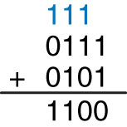
Figure 1.9 Binary addition example
Copyright © 2013 Elsevier Inc. All rights reserved.

Slide 11
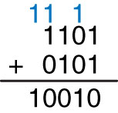
Figure 1.10 Binary addition example with overflow
Copyright © 2013 Elsevier Inc. All rights reserved.

Slide 12
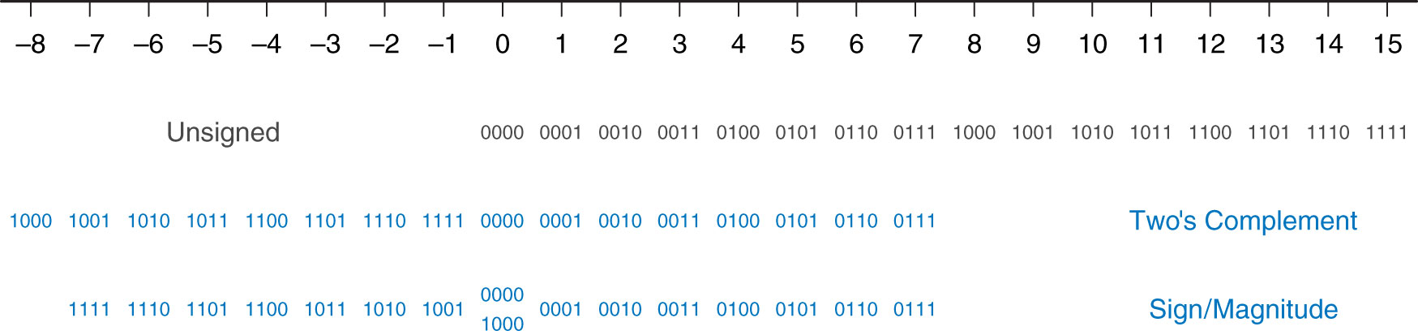
Figure 1.11 Number line and 4-bit binary encodings
Copyright © 2013 Elsevier Inc. All rights reserved.

Slide 13
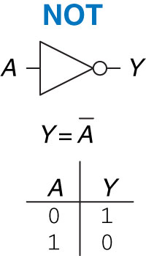
Figure 1.12 NOT gate
Copyright © 2013 Elsevier Inc. All rights reserved.

Slide 14
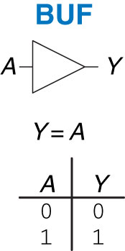
Figure 1.13 Buffer
Copyright © 2013 Elsevier Inc. All rights reserved.

Slide 15
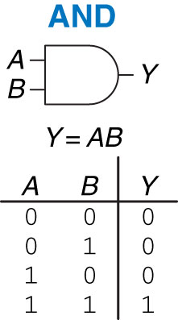
Figure 1.14 AND gate
Copyright © 2013 Elsevier Inc. All rights reserved.

Slide 16
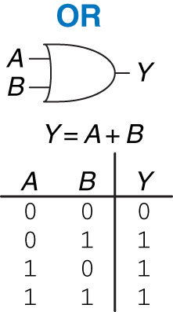
Figure 1.15 OR gate
Copyright © 2013 Elsevier Inc. All rights reserved.

Slide 17
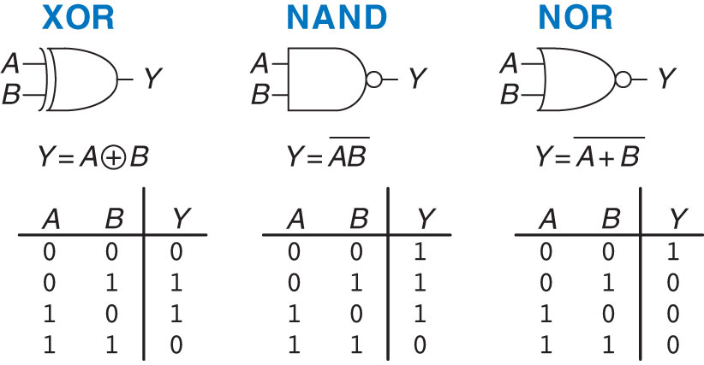
Figure 1.16 More two-input logic gates
Copyright © 2013 Elsevier Inc. All rights reserved.

Slide 18
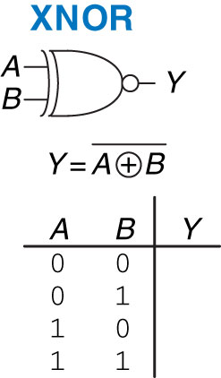
Figure 1.17 XNOR gate
Copyright © 2013 Elsevier Inc. All rights reserved.

Slide 19
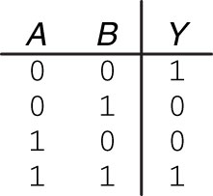
Figure 1.18 XNOR truth table
Copyright © 2013 Elsevier Inc. All rights reserved.

Slide 20
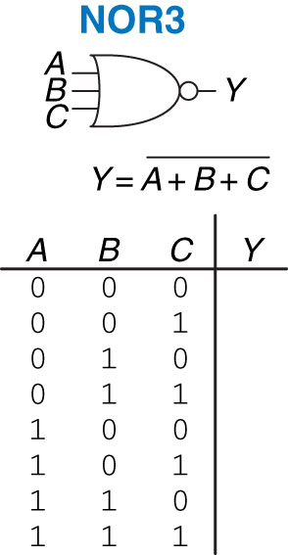
Figure 1.19 Three-input NOR gate
Copyright © 2013 Elsevier Inc. All rights reserved.

Slide 21
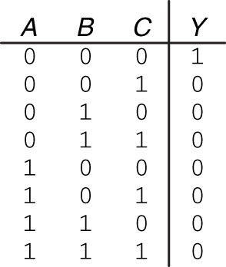
Figure 1.20 Three-input NOR truth table
Copyright © 2013 Elsevier Inc. All rights reserved.

Slide 22
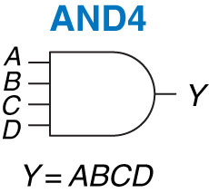
Figure 1.21 Four-input AND gate
Copyright © 2013 Elsevier Inc. All rights reserved.

Slide 23
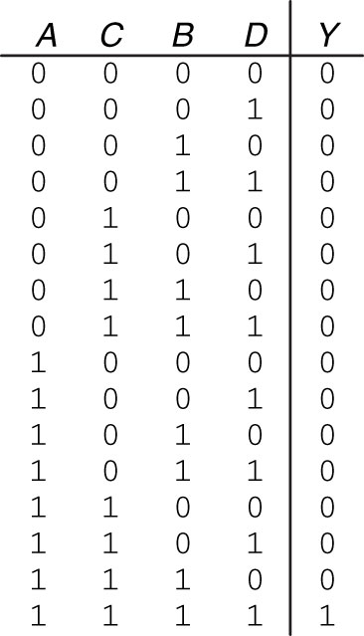
Figure 1.22 Four-input AND truth table
Copyright © 2013 Elsevier Inc. All rights reserved.

Slide 24
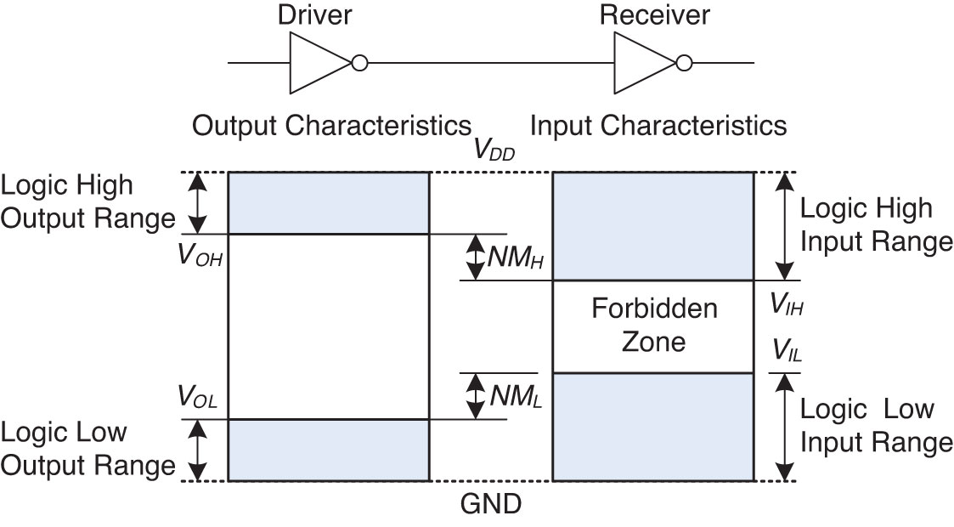
Figure 1.23 Logic levels and noise margins
Copyright © 2013 Elsevier Inc. All rights reserved.

Slide 25
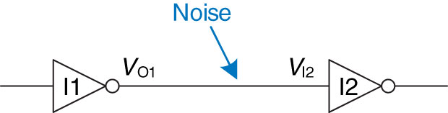
Figure 1.24 Inverter circuit
Copyright © 2013 Elsevier Inc. All rights reserved.

Slide 26
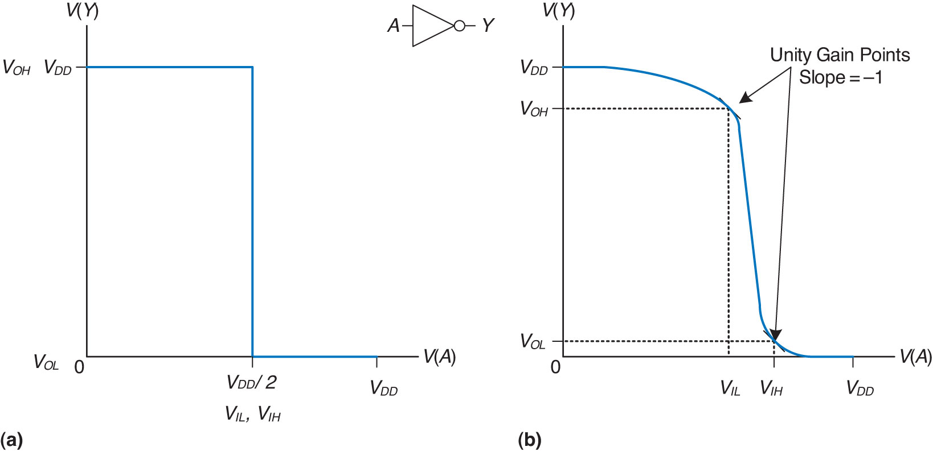
Figure 1.25 DC transfer characteristics and logic levels
Copyright © 2013 Elsevier Inc. All rights reserved.

Slide 27
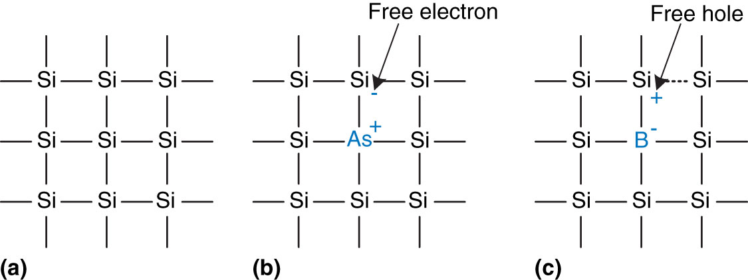
Figure 1.26 Silicon lattice and dopant atoms
Copyright © 2013 Elsevier Inc. All rights reserved.

Slide 28
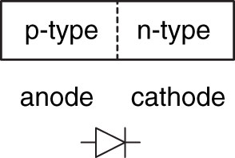
Figure 1.27 The p-n junction diode structure and symbol
Copyright © 2013 Elsevier Inc. All rights reserved.

Slide 29
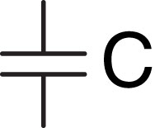
Figure 1.28 Capacitor symbol
Copyright © 2013 Elsevier Inc. All rights reserved.

Slide 30
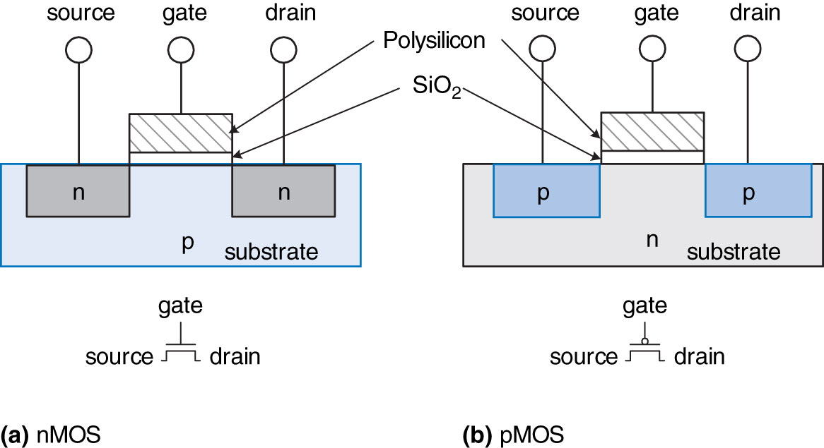
Figure 1.29 nMOS and pMOS transistors
Copyright © 2013 Elsevier Inc. All rights reserved.

Slide 31
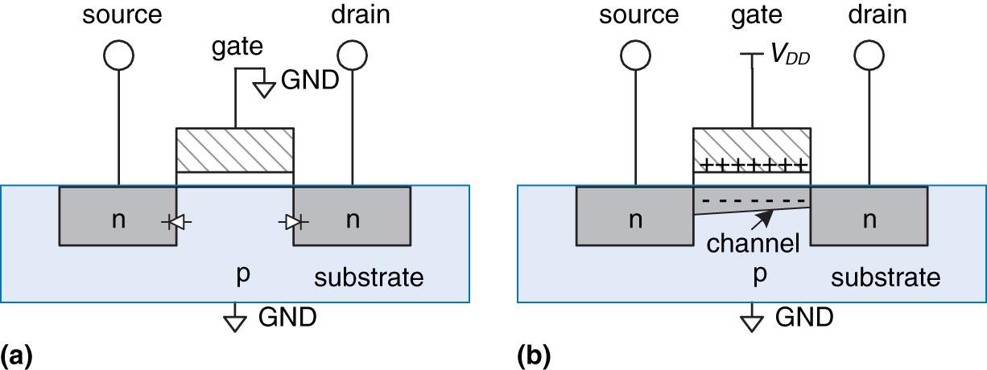
Figure 1.30 nMOS transistor operation
Copyright © 2013 Elsevier Inc. All rights reserved.

Slide 32
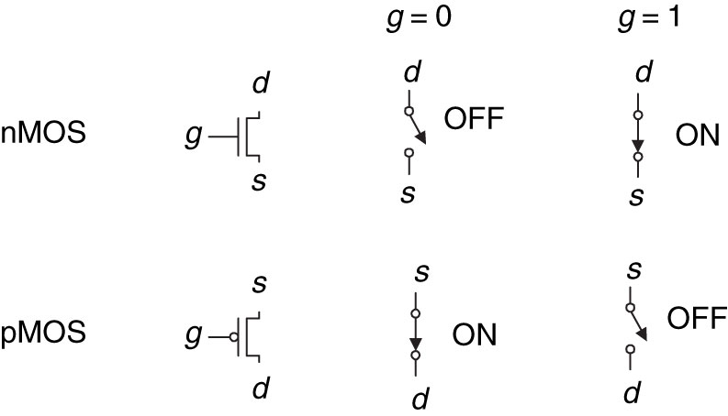
Figure 1.31 Switch models of MOSFETs
Copyright © 2013 Elsevier Inc. All rights reserved.

Slide 33
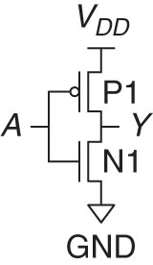
Figure 1.32 NOT gate schematic
Copyright © 2013 Elsevier Inc. All rights reserved.

Slide 34
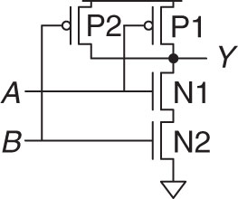
Figure 1.33 Two-input NAND gate schematic
Copyright © 2013 Elsevier Inc. All rights reserved.

Slide 35
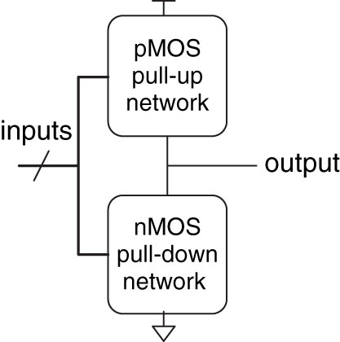
Figure 1.34 General form of an inverting logic gate
Copyright © 2013 Elsevier Inc. All rights reserved.

Slide 36
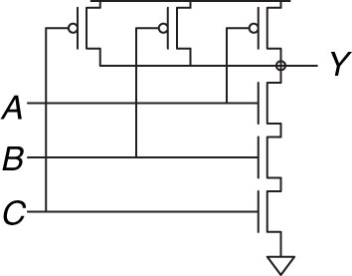
Figure 1.35 Three-input NAND gate schematic
Copyright © 2013 Elsevier Inc. All rights reserved.

Slide 37
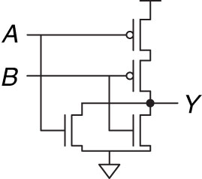
Figure 1.36 Two-input NOR gate schematic
Copyright © 2013 Elsevier Inc. All rights reserved.

Slide 38

Figure 1.37 Two-input AND gate schematic
Copyright © 2013 Elsevier Inc. All rights reserved.

Slide 39
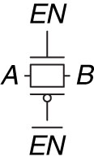
Figure 1.38 Transmission gate
Copyright © 2013 Elsevier Inc. All rights reserved.

Slide 40
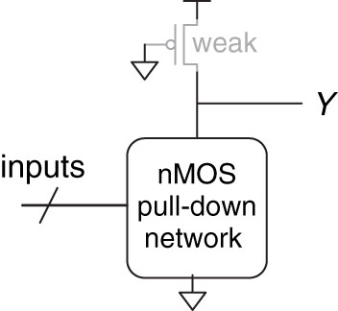
Figure 1.39 Generic pseudo-nMOS gate
Copyright © 2013 Elsevier Inc. All rights reserved.

Slide 41
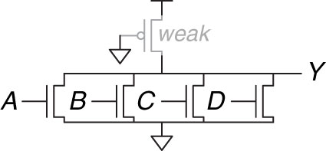
Figure 1.40 Pseudo-nMOS four-input NOR gate
Copyright © 2013 Elsevier Inc. All rights reserved.

Slide 42
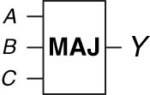
Figure 1.41 Three-input majority gate
Copyright © 2013 Elsevier Inc. All rights reserved.

Slide 43
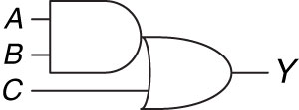
Figure 1.42 Three-input AND-OR gate
Copyright © 2013 Elsevier Inc. All rights reserved.

Slide 44
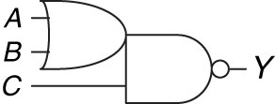
Figure 1.43 Three-input OR-AND-INVERT gate
Copyright © 2013 Elsevier Inc. All rights reserved.

Slide 45
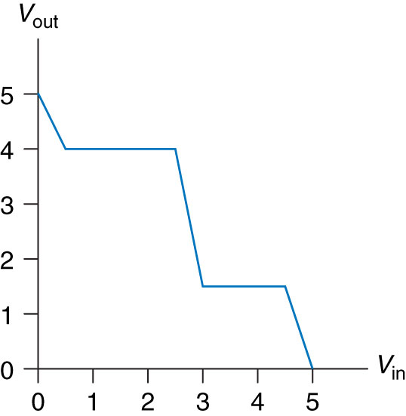
Figure 1.44 DC transfer characteristics
Copyright © 2013 Elsevier Inc. All rights reserved.

Slide 46
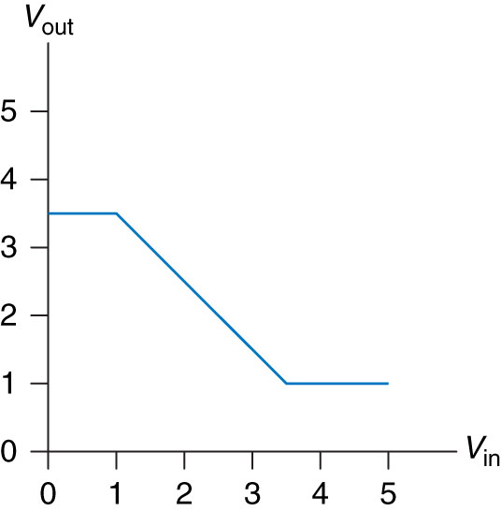
Figure 1.45 DC transfer characteristics
Copyright © 2013 Elsevier Inc. All rights reserved.

Slide 47
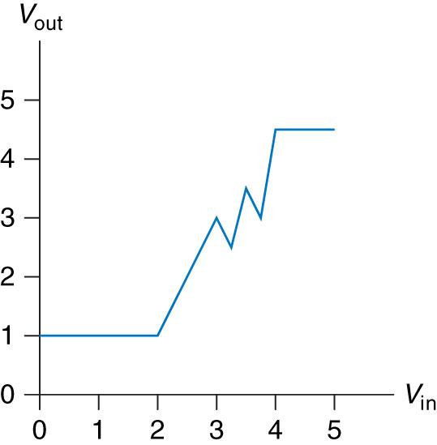
Figure 1.46 DC transfer characteristics
Copyright © 2013 Elsevier Inc. All rights reserved.

Slide 48
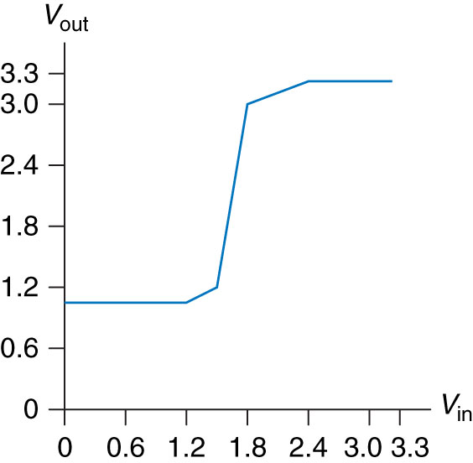
Figure 1.47 Ben’s buffer DC transfer characteristics
Copyright © 2013 Elsevier Inc. All rights reserved.

Slide 49
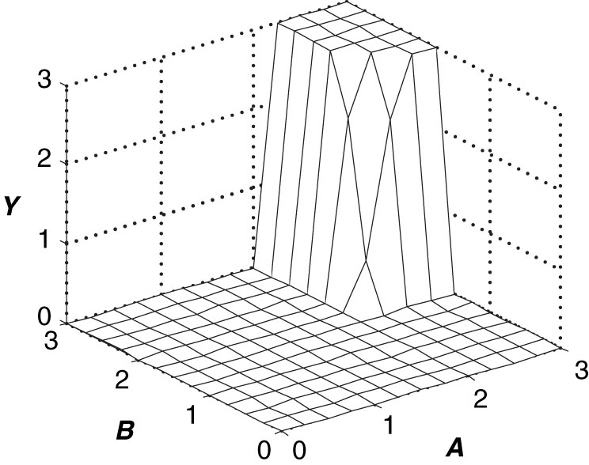
Figure 1.48 Two-input DC transfer characteristics
Copyright © 2013 Elsevier Inc. All rights reserved.

Slide 50
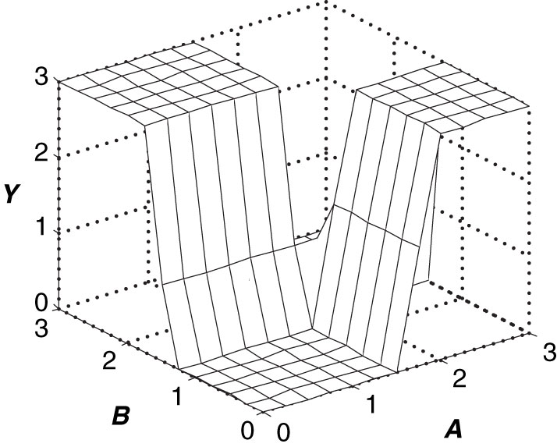
Figure 1.49 Two-input DC transfer characteristics
Copyright © 2013 Elsevier Inc. All rights reserved.

Slide 51
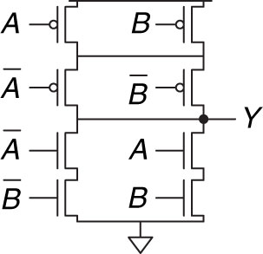
Figure 1.50 Mystery schematic
Copyright © 2013 Elsevier Inc. All rights reserved.

Slide 52
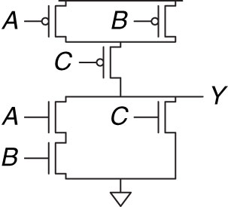
Figure 1.51 Mystery schematic
Copyright © 2013 Elsevier Inc. All rights reserved.

Slide 53

Figure 1.52 RTL NOT gate
Copyright © 2013 Elsevier Inc. All rights reserved.

Slide 54

Figure M 01
Copyright © 2013 Elsevier Inc. All rights reserved.

Slide 55

Figure M 02
Copyright © 2013 Elsevier Inc. All rights reserved.

Slide 56

Figure M 03a
Copyright © 2013 Elsevier Inc. All rights reserved.

Slide 57

Figure M 03b
Copyright © 2013 Elsevier Inc. All rights reserved.

Slide 58

Figure M 04
Copyright © 2013 Elsevier Inc. All rights reserved.

Slide 59

Figure M 05
Copyright © 2013 Elsevier Inc. All rights reserved.

Slide 60

Figure M 06
Copyright © 2013 Elsevier Inc. All rights reserved.

Slide 61

Figure M 07
Copyright © 2013 Elsevier Inc. All rights reserved.

Slide 62

Figure M 08
Copyright © 2013 Elsevier Inc. All rights reserved.

Slide 63

Figure M 10
Copyright © 2013 Elsevier Inc. All rights reserved.

Slide 64

UNN Figure 1
Copyright © 2013 Elsevier Inc. All rights reserved.

