Slide 1
Chapter 3
Sequential Logic Design
Copyright © 2013 Elsevier Inc. All rights reserved.

Slide 2
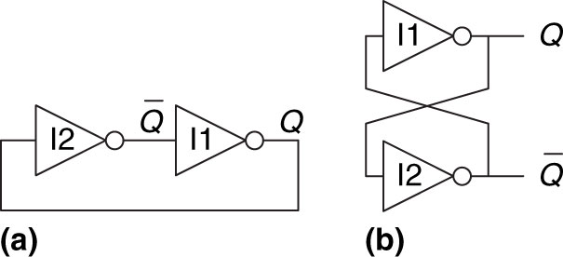
Figure 3.1 Cross-coupled inverter pair
Copyright © 2013 Elsevier Inc. All rights reserved.

Slide 3
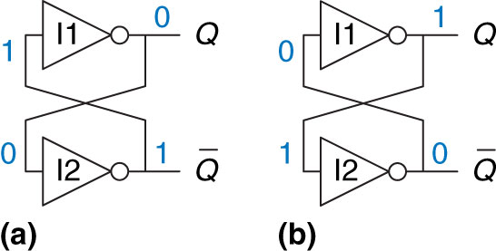
Figure 3.2 Bistable operation of cross-coupled inverters
Copyright © 2013 Elsevier Inc. All rights reserved.

Slide 4
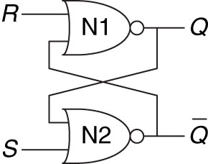
Figure 3.3 SR latch schematic
Copyright © 2013 Elsevier Inc. All rights reserved.

Slide 5
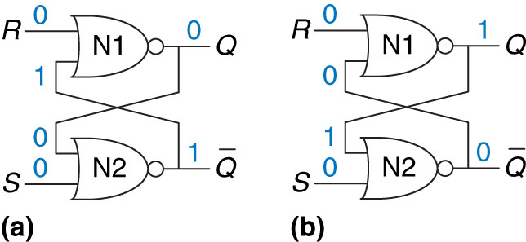
Figure 3.4 Bistable states of SR latch
Copyright © 2013 Elsevier Inc. All rights reserved.

Slide 6
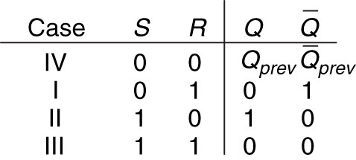
Figure 3.5 SR latch truth table
Copyright © 2013 Elsevier Inc. All rights reserved.

Slide 7
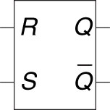
Figure 3.6 SR latch symbol
Copyright © 2013 Elsevier Inc. All rights reserved.

Slide 8
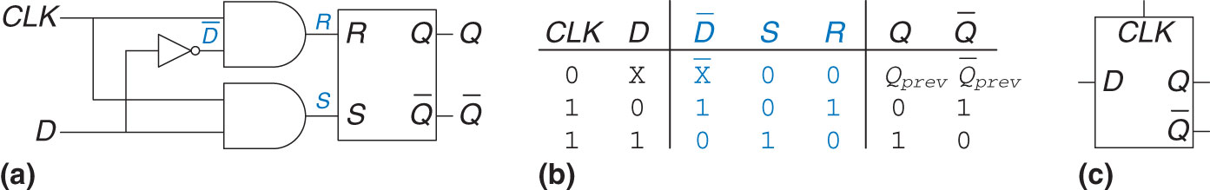
Figure 3.7 D latch: (a) schematic, (b) truth table, (c) symbol
Copyright © 2013 Elsevier Inc. All rights reserved.

Slide 9
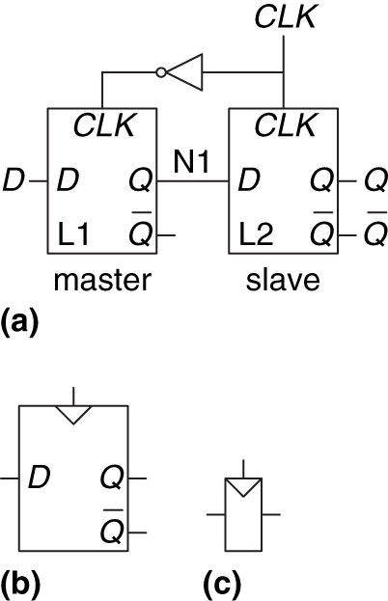
Figure 3.8 D flip-flop: (a) schematic, (b) symbol, (c) condensed symbol
Copyright © 2013 Elsevier Inc. All rights reserved.

Slide 10
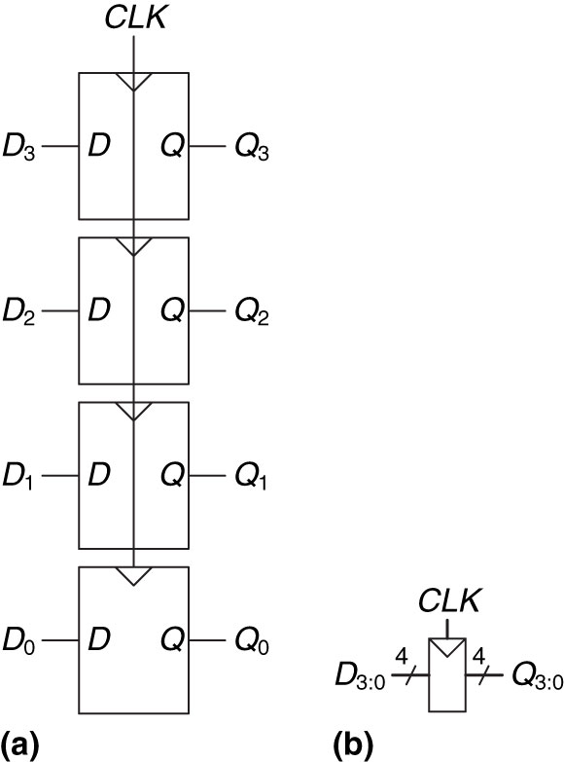
Figure 3.9 A 4-bit register: (a) schematic and (b) symbol
Copyright © 2013 Elsevier Inc. All rights reserved.

Slide 11
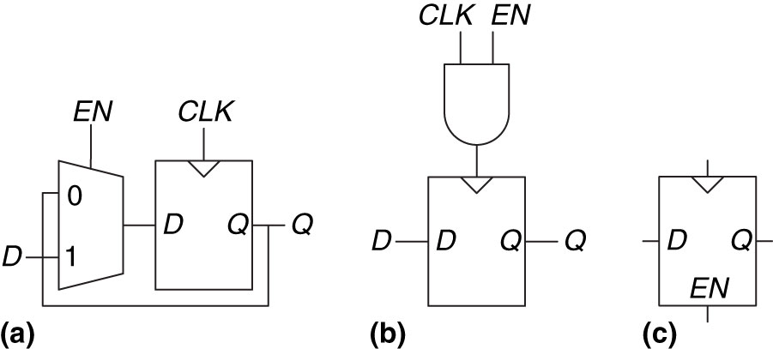
Figure 3.10 Enabled flip-flop: (a, b) schematics, (c) symbol
Copyright © 2013 Elsevier Inc. All rights reserved.

Slide 12
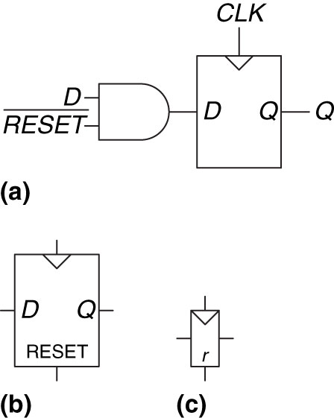
Figure 3.11 Synchronously resettable flip-flop: (a) schematic, (b, c) symbols
Copyright © 2013 Elsevier Inc. All rights reserved.

Slide 13
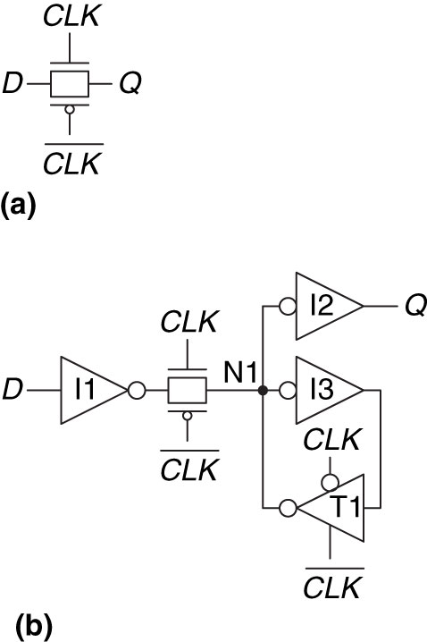
Figure 3.12 D latch schematic
Copyright © 2013 Elsevier Inc. All rights reserved.

Slide 14
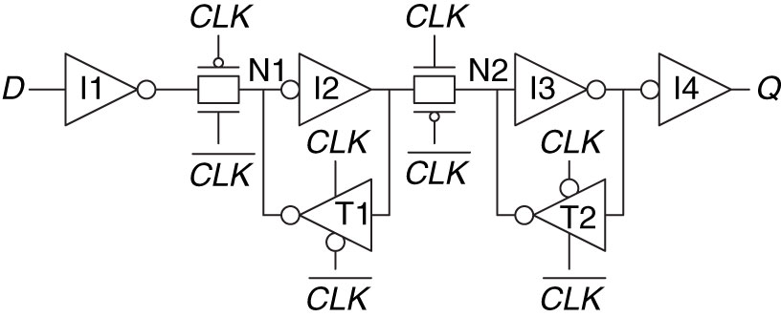
Figure 3.13 D flip-flop schematic
Copyright © 2013 Elsevier Inc. All rights reserved.

Slide 15
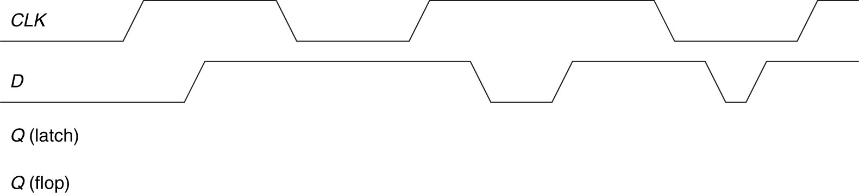
Figure 3.14 Example waveforms
Copyright © 2013 Elsevier Inc. All rights reserved.

Slide 16
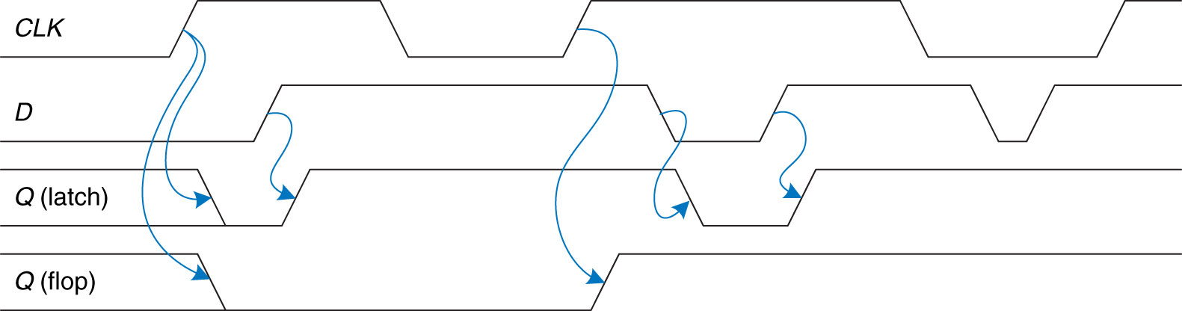
Figure 3.15 Solution waveforms
Copyright © 2013 Elsevier Inc. All rights reserved.

Slide 17
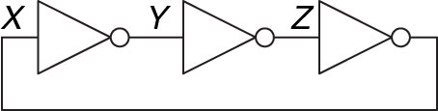
Figure 3.16 Three-inverter loop
Copyright © 2013 Elsevier Inc. All rights reserved.

Slide 18
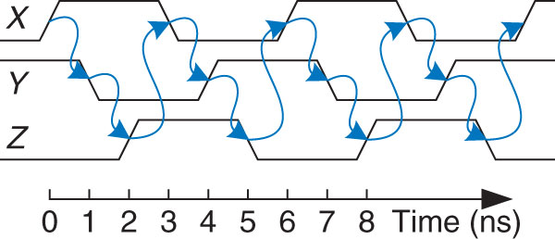
Figure 3.17 Ring oscillator waveforms
Copyright © 2013 Elsevier Inc. All rights reserved.

Slide 19
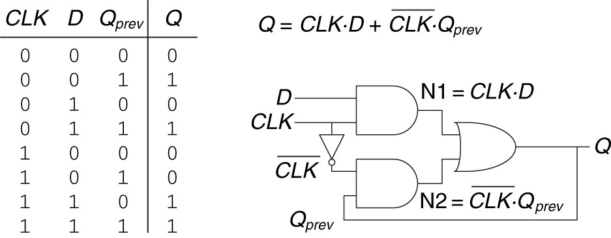
Figure 3.18 An improved (?) D latch
Copyright © 2013 Elsevier Inc. All rights reserved.

Slide 20
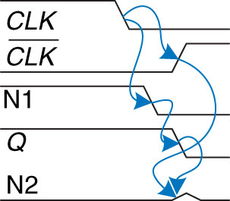
Figure 3.19 Latch waveforms illustrating race condition
Copyright © 2013 Elsevier Inc. All rights reserved.

Slide 21
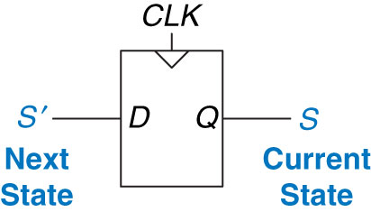
Figure 3.20 Flip-flop current state and next state
Copyright © 2013 Elsevier Inc. All rights reserved.

Slide 22
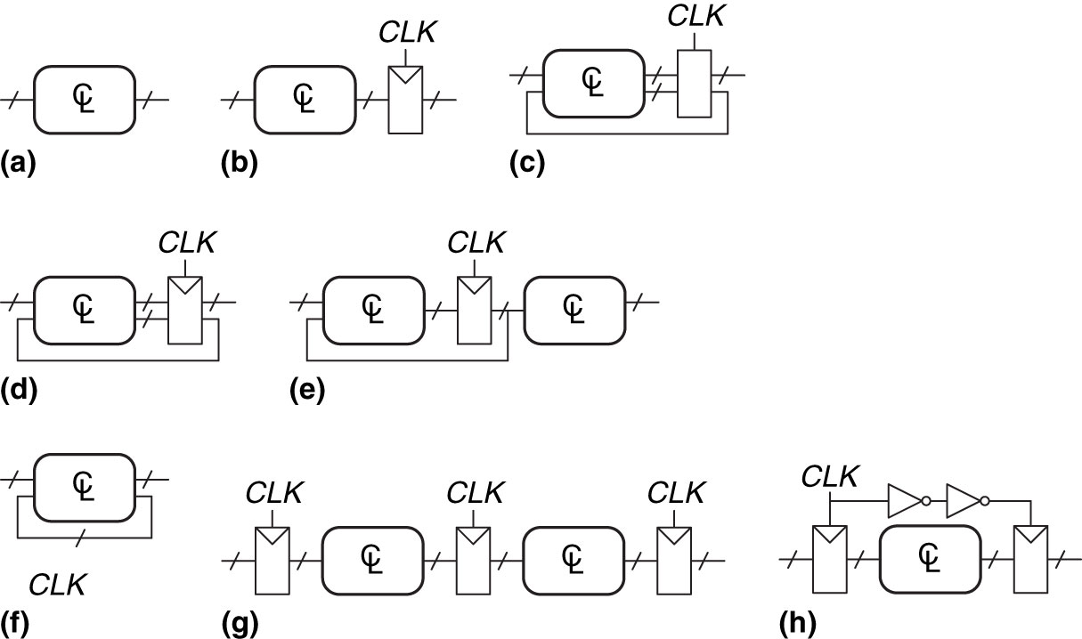
Figure 3.21 Example circuits
Copyright © 2013 Elsevier Inc. All rights reserved.

Slide 23
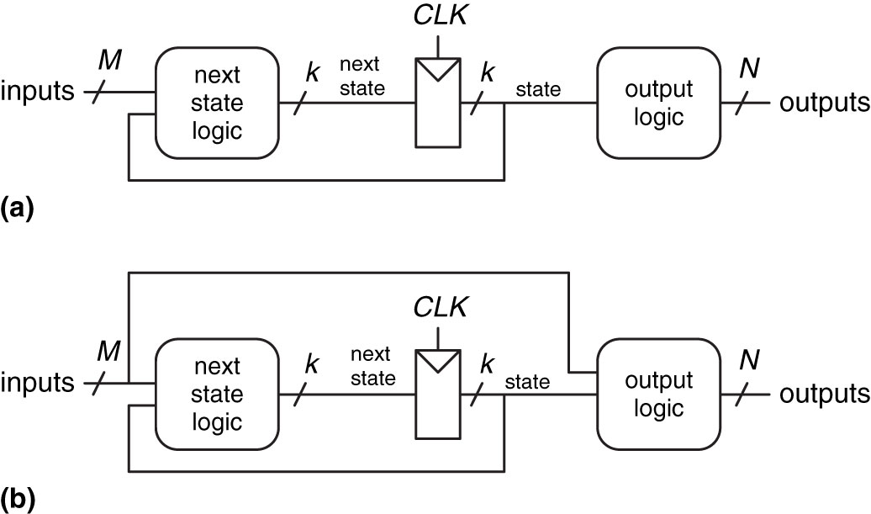
Figure 3.22 Finite state machines: (a) Moore machine, (b) Mealy machine
Copyright © 2013 Elsevier Inc. All rights reserved.

Slide 24
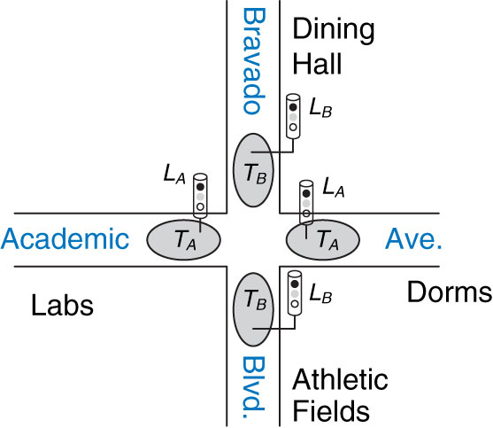
Figure 3.23 Campus map
Copyright © 2013 Elsevier Inc. All rights reserved.

Slide 25
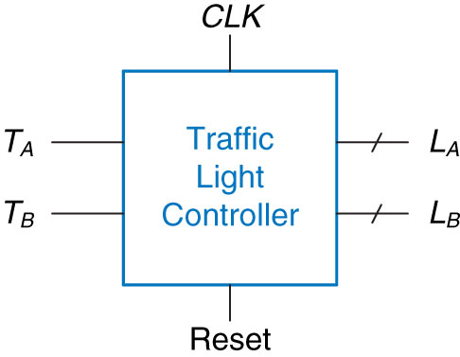
Figure 3.24 Black box view of finite state machine
Copyright © 2013 Elsevier Inc. All rights reserved.

Slide 26
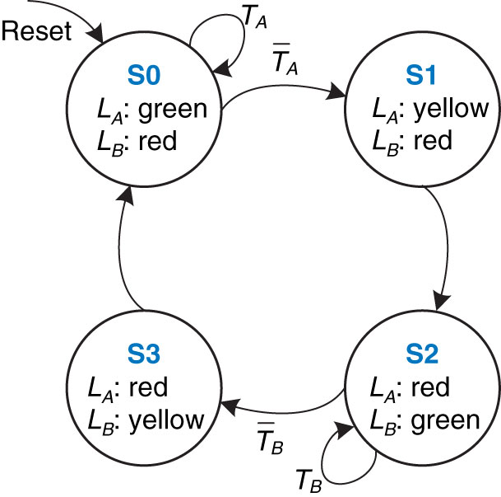
Figure 3.25 State transition diagram
Copyright © 2013 Elsevier Inc. All rights reserved.

Slide 27
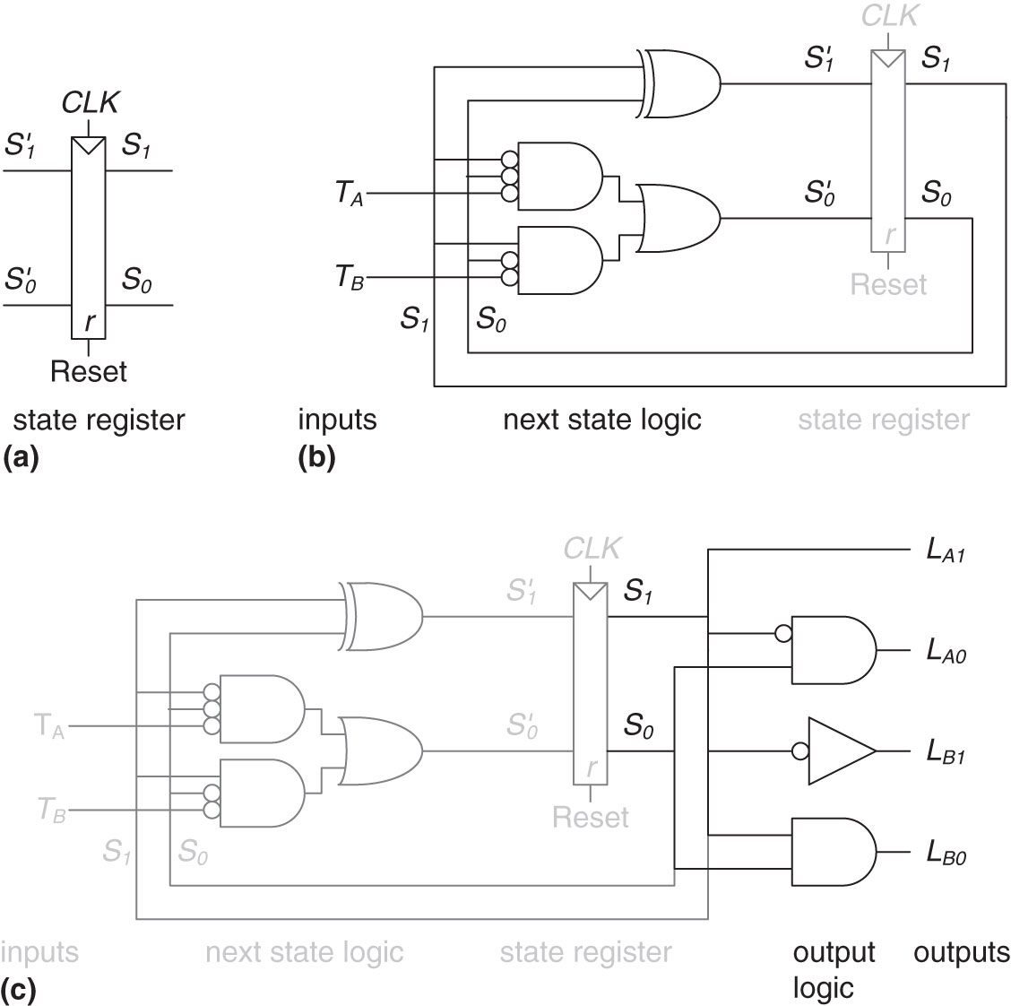
Figure 3.26 State machine circuit for traffic light controller
Copyright © 2013 Elsevier Inc. All rights reserved.

Slide 28
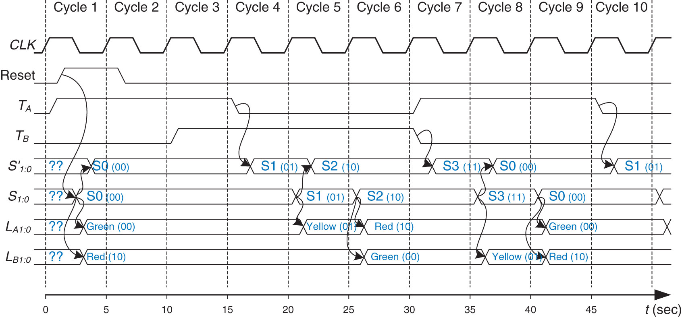
Figure 3.27 Timing diagram for traffic light controller
Copyright © 2013 Elsevier Inc. All rights reserved.

Slide 29
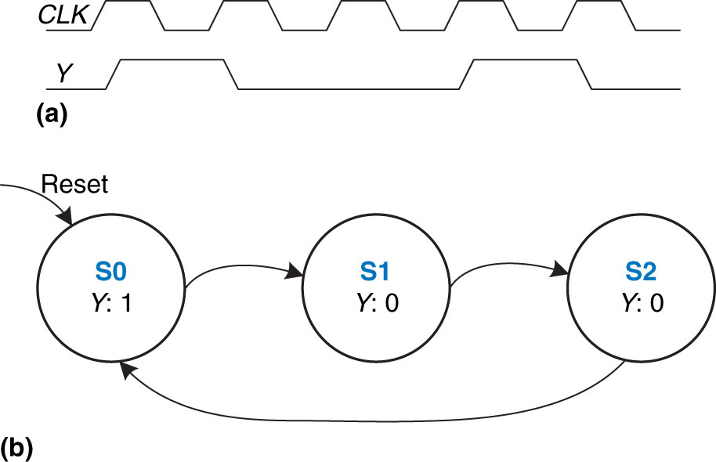
Figure 3.28 Divide-by-3 counter (a) waveform and (b) state transition diagram
Copyright © 2013 Elsevier Inc. All rights reserved.

Slide 30
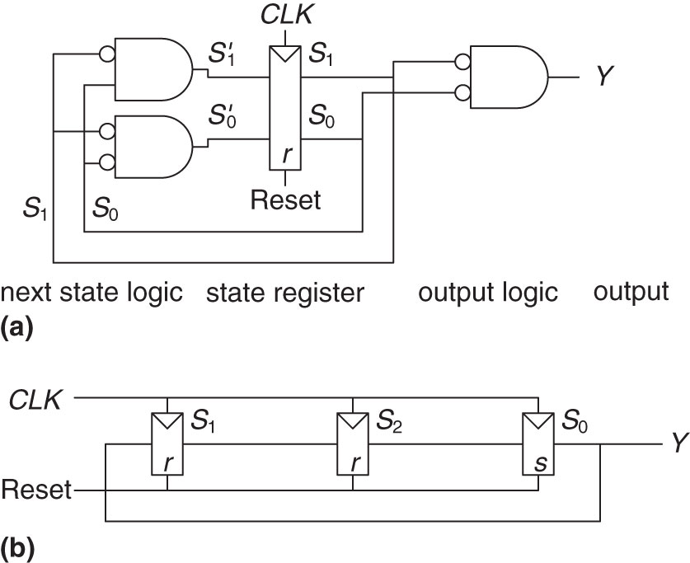
Figure 3.29 Divide-by-3 circuits for (a) binary and (b) one-hot encodings
Copyright © 2013 Elsevier Inc. All rights reserved.

Slide 31
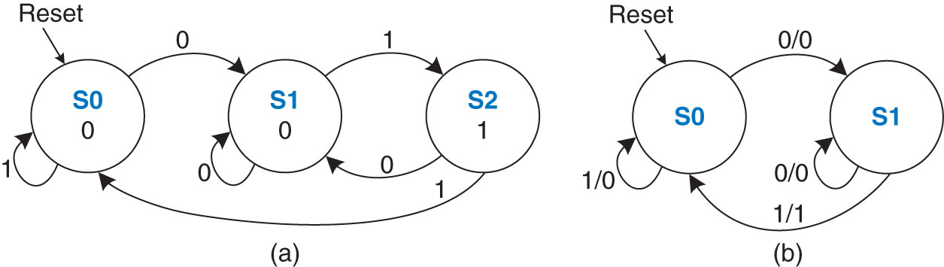
Figure 3.30 FSM state transition diagrams: (a) Moore machine, (b) Mealy machine
Copyright © 2013 Elsevier Inc. All rights reserved.

Slide 32
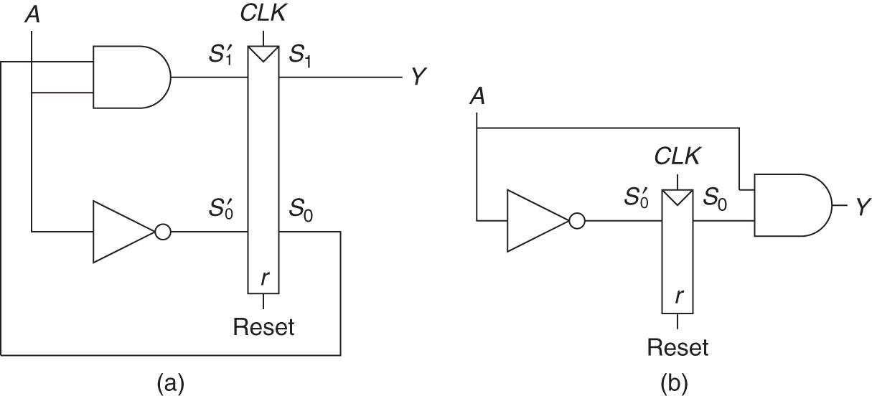
Figure 3.31 FSM schematics for (a) Moore and (b) Mealy machines
Copyright © 2013 Elsevier Inc. All rights reserved.

Slide 33
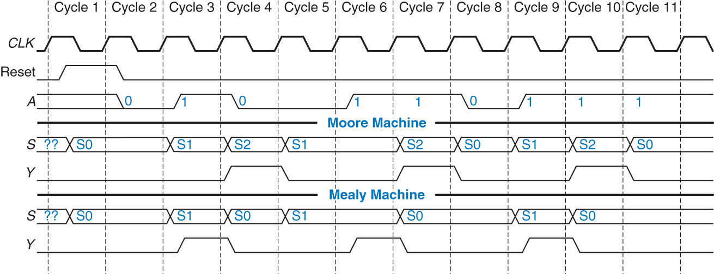
Figure 3.32 Timing diagrams for Moore and Mealy machines
Copyright © 2013 Elsevier Inc. All rights reserved.

Slide 34
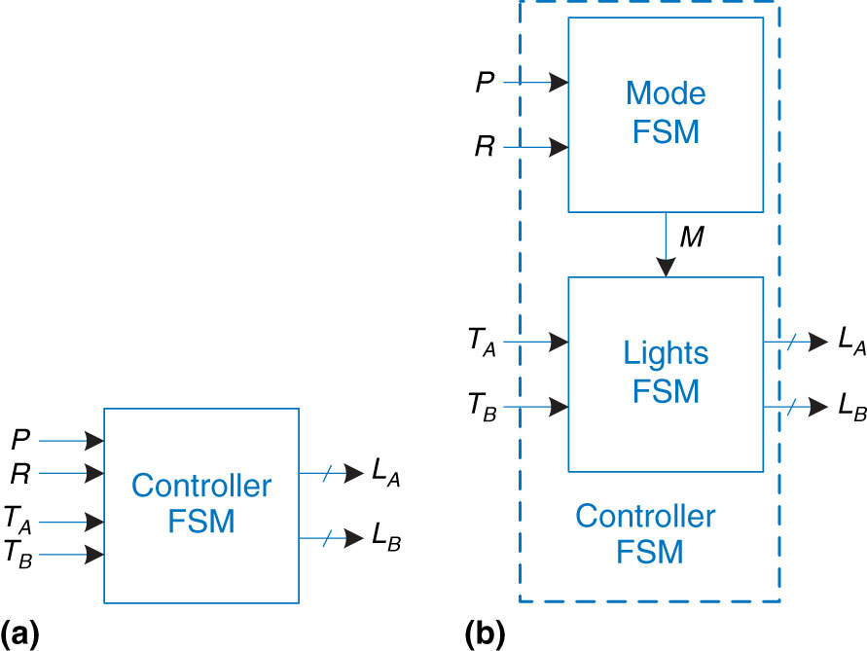
Figure 3.33 (a) single and (b) factored designs for modified traffic light controller FSM
Copyright © 2013 Elsevier Inc. All rights reserved.

Slide 35
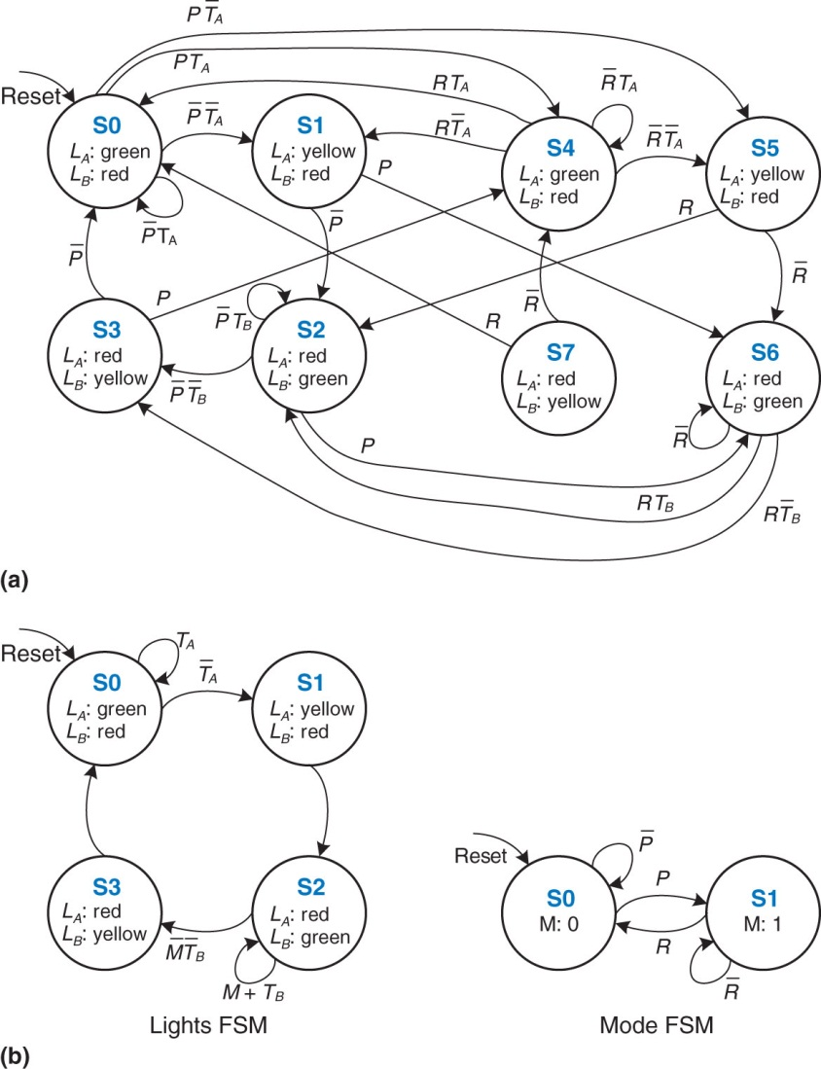
Figure 3.34 State transition diagrams: (a) unfactored, (b) factored
Copyright © 2013 Elsevier Inc. All rights reserved.

Slide 36
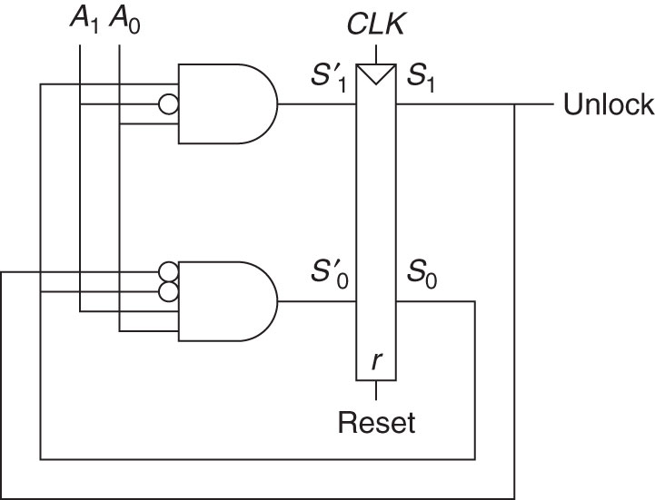
Figure 3.35 Circuit of found FSM for Example 3.9
Copyright © 2013 Elsevier Inc. All rights reserved.

Slide 37
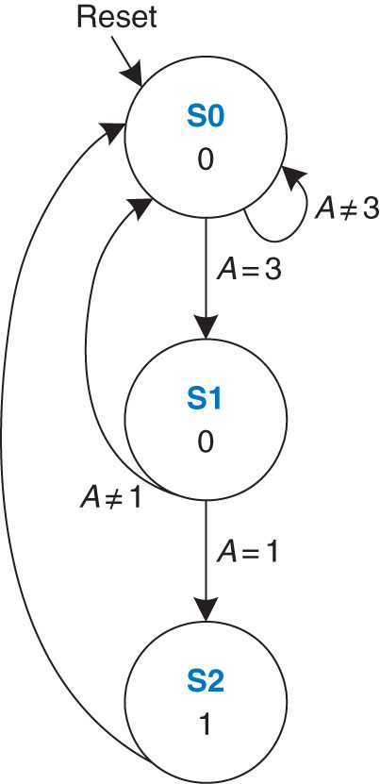
Figure 3.36 State transition diagram of found FSM from Example 3.9
Copyright © 2013 Elsevier Inc. All rights reserved.

Slide 38
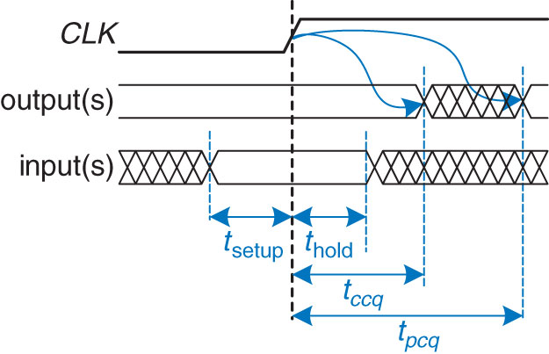
Figure 3.37 Timing specification for synchronous sequential circuit
Copyright © 2013 Elsevier Inc. All rights reserved.

Slide 39
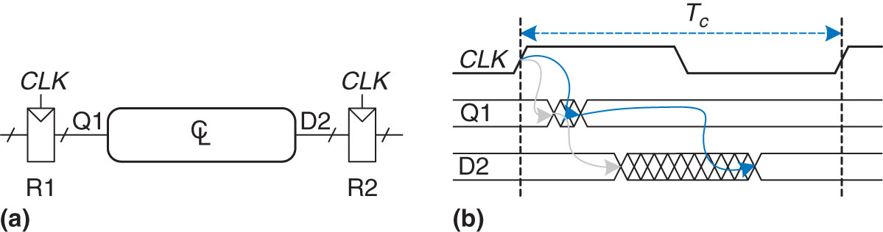
Figure 3.38 Path between registers and timing diagram
Copyright © 2013 Elsevier Inc. All rights reserved.

Slide 40
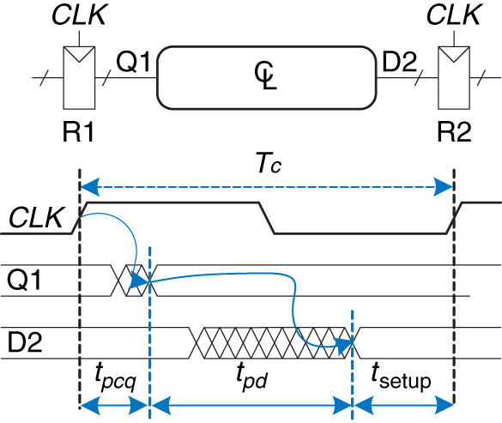
Figure 3.39 Maximum delay for setup time constraint
Copyright © 2013 Elsevier Inc. All rights reserved.

Slide 41
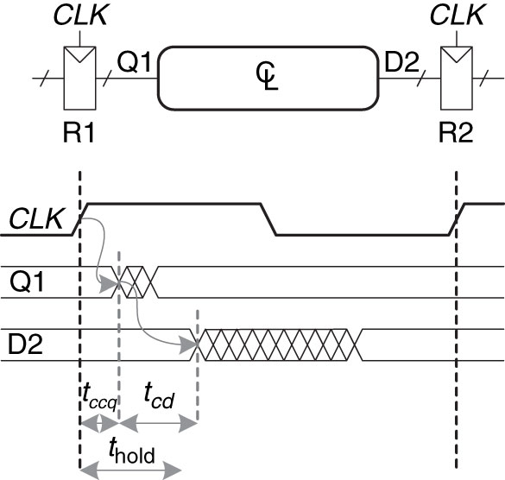
Figure 3.40 Minimum delay for hold time constraint
Copyright © 2013 Elsevier Inc. All rights reserved.

Slide 42
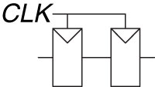
Figure 3.41 Back-to-back flip-flops
Copyright © 2013 Elsevier Inc. All rights reserved.

Slide 43
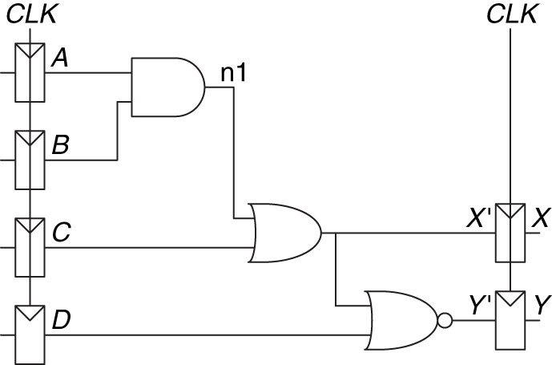
Figure 3.42 Sample circuit for timing analysis
Copyright © 2013 Elsevier Inc. All rights reserved.

Slide 44
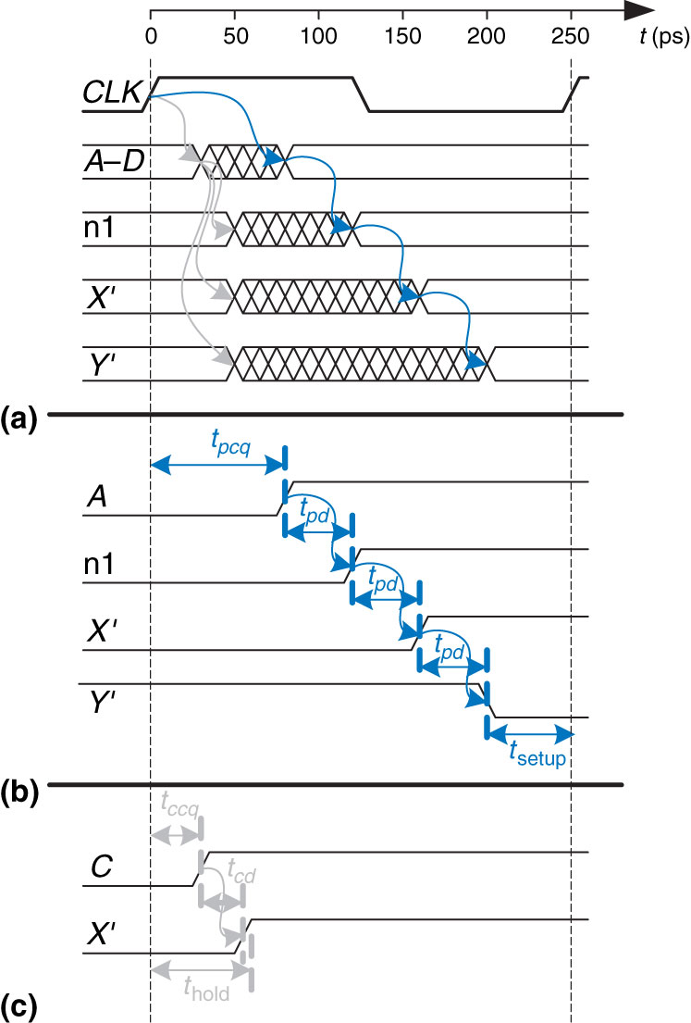
Figure 3.43 Timing diagram: (a) general case, (b) critical path, (c) short path
Copyright © 2013 Elsevier Inc. All rights reserved.

Slide 45
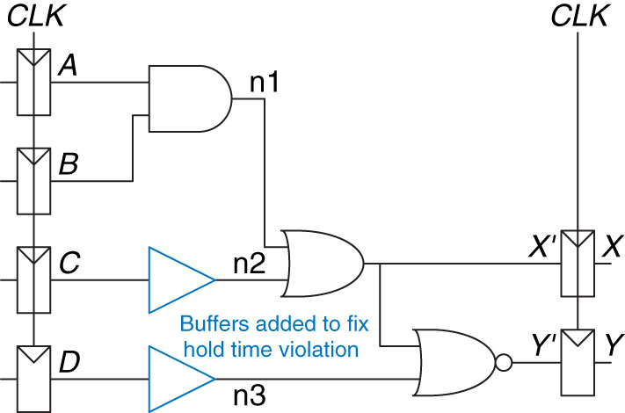
Figure 3.44 Corrected circuit to fix hold time problem
Copyright © 2013 Elsevier Inc. All rights reserved.

Slide 46
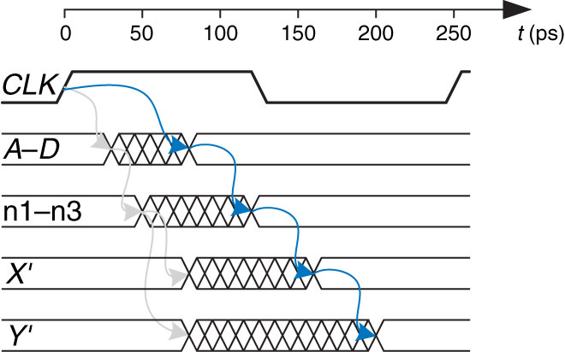
Figure 3.45 Timing diagram with buffers to fix hold time problem
Copyright © 2013 Elsevier Inc. All rights reserved.

Slide 47
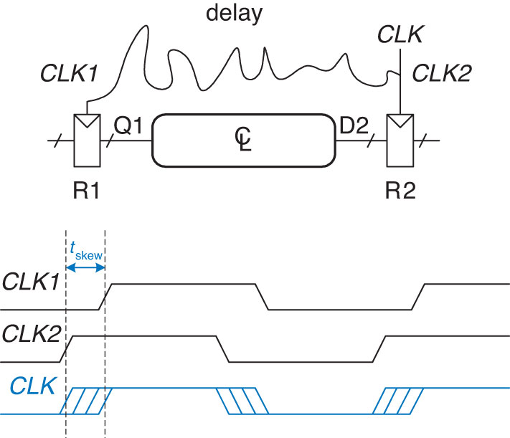
Figure 3.46 Clock skew caused by wire delay
Copyright © 2013 Elsevier Inc. All rights reserved.

Slide 48
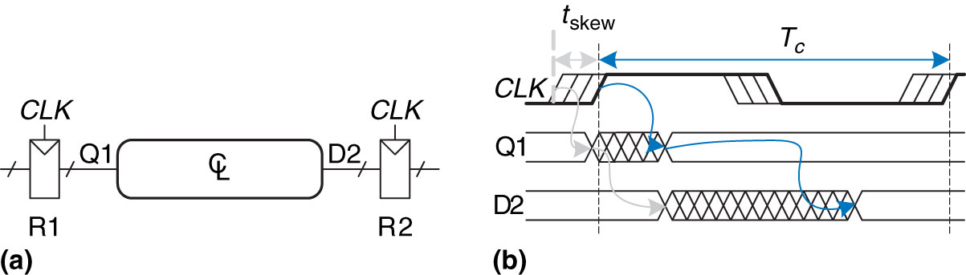
Figure 3.47 Timing diagram with clock skew
Copyright © 2013 Elsevier Inc. All rights reserved.

Slide 49
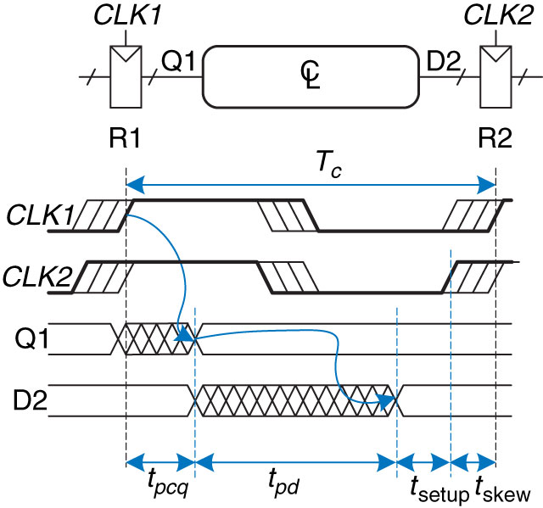
Figure 3.48 Setup time constraint with clock skew
Copyright © 2013 Elsevier Inc. All rights reserved.

Slide 50
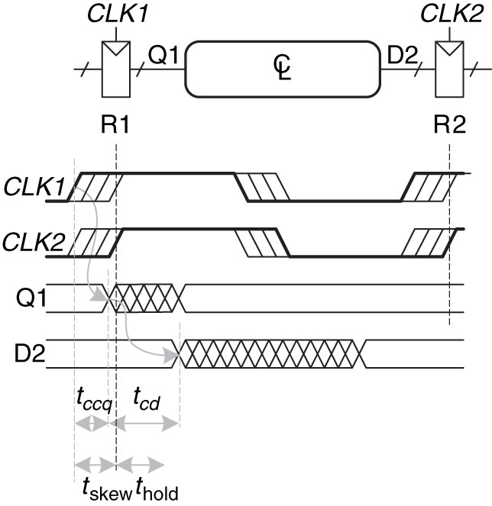
Figure 3.49 Hold time constraint with clock skew
Copyright © 2013 Elsevier Inc. All rights reserved.

Slide 51
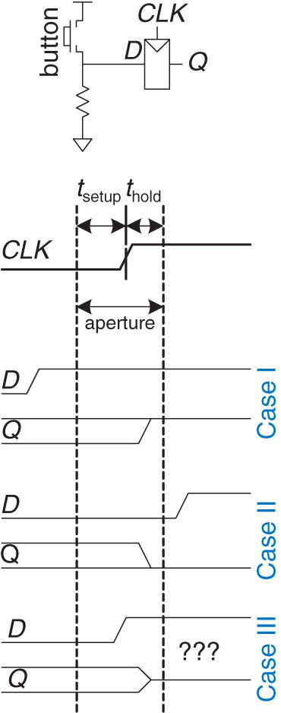
Figure 3.50 Input changing before, after, or during aperture
Copyright © 2013 Elsevier Inc. All rights reserved.

Slide 52

Figure 3.51 Stable and metastable states
Copyright © 2013 Elsevier Inc. All rights reserved.

Slide 53

Figure 3.52 Synchronizer symbol
Copyright © 2013 Elsevier Inc. All rights reserved.

Slide 54

Figure 3.53 Simple synchronizer
Copyright © 2013 Elsevier Inc. All rights reserved.

Slide 55

Figure 3.54 Input timing
Copyright © 2013 Elsevier Inc. All rights reserved.

Slide 56

Figure 3.55 Circuit model of bistable device
Copyright © 2013 Elsevier Inc. All rights reserved.

Slide 57

Figure 3.56 Resolution trajectories
Copyright © 2013 Elsevier Inc. All rights reserved.

Slide 58

Figure 3.57 Spatial and temporal parallelism in the cookie kitchen
Copyright © 2013 Elsevier Inc. All rights reserved.

Slide 59

Figure 3.58 Circuit with no pipelining
Copyright © 2013 Elsevier Inc. All rights reserved.

Slide 60

Figure 3.59 Circuit with two-stage pipeline
Copyright © 2013 Elsevier Inc. All rights reserved.

Slide 61

Figure 3.60 Circuit with three-stage pipeline
Copyright © 2013 Elsevier Inc. All rights reserved.

Slide 62

Figure 3.61 Input waveforms of SR latch for Exercise 3.1
Copyright © 2013 Elsevier Inc. All rights reserved.

Slide 63

Figure 3.62 Input waveforms of SR latch for Exercise 3.2
Copyright © 2013 Elsevier Inc. All rights reserved.

Slide 64

Figure 3.63 Input waveforms of D latch or flip-flop for Exercises 3.3 and 3.5
Copyright © 2013 Elsevier Inc. All rights reserved.

Slide 65

Figure 3.64 Input waveforms of D latch or flip-flop for Exercises 3.4 and 3.6
Copyright © 2013 Elsevier Inc. All rights reserved.

Slide 66

Figure 3.65 Mystery circuit
Copyright © 2013 Elsevier Inc. All rights reserved.

Slide 67

Figure 3.66 Mystery circuit
Copyright © 2013 Elsevier Inc. All rights reserved.

Slide 68

Figure 3.67 Muller C-element
Copyright © 2013 Elsevier Inc. All rights reserved.

Slide 69

Figure 3.68 Circuits
Copyright © 2013 Elsevier Inc. All rights reserved.

Slide 70

Figure 3.69 State transition diagram
Copyright © 2013 Elsevier Inc. All rights reserved.

Slide 71

Figure 3.70 State transition diagram
Copyright © 2013 Elsevier Inc. All rights reserved.

Slide 72

Figure 3.71 FSM input waveforms
Copyright © 2013 Elsevier Inc. All rights reserved.

Slide 73

Figure 3.72 FSM schematic
Copyright © 2013 Elsevier Inc. All rights reserved.

Slide 74

Figure 3.73 FSM schematic
Copyright © 2013 Elsevier Inc. All rights reserved.

Slide 75

Figure 3.74 Registered four-input XOR circuit
Copyright © 2013 Elsevier Inc. All rights reserved.

Slide 76

Figure 3.75 2-bit adder schematic
Copyright © 2013 Elsevier Inc. All rights reserved.

Slide 77

Figure 3.76 New and improved synchronizer
Copyright © 2013 Elsevier Inc. All rights reserved.

Slide 78
Figure 3.77 Signal waveforms
Copyright © 2013 Elsevier Inc. All rights reserved.

Slide 79

Figure M 01
Copyright © 2013 Elsevier Inc. All rights reserved.

Slide 80

Figure M 02
Copyright © 2013 Elsevier Inc. All rights reserved.

Slide 81

Figure M 03
Copyright © 2013 Elsevier Inc. All rights reserved.

Slide 82

Figure M 04
Copyright © 2013 Elsevier Inc. All rights reserved.

Slide 83

Figure M 05
Copyright © 2013 Elsevier Inc. All rights reserved.

Slide 84

UNN Figure 1
Copyright © 2013 Elsevier Inc. All rights reserved.

