Slide 1
Chapter 5
Digital Building Blocks
Copyright © 2013 Elsevier Inc. All rights reserved.

Slide 2
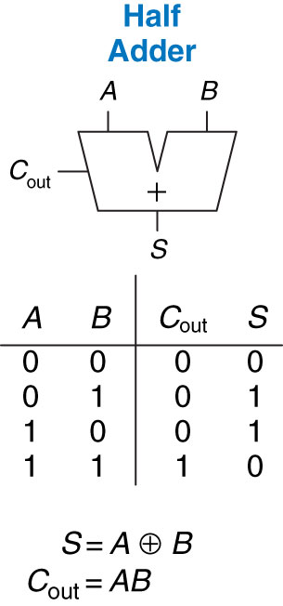
Figure 5.1 1-bit half adder
Copyright © 2013 Elsevier Inc. All rights reserved.

Slide 3
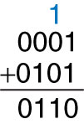
Figure 5.2 Carry bit
Copyright © 2013 Elsevier Inc. All rights reserved.

Slide 4
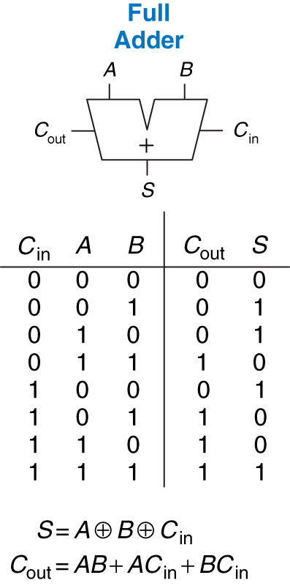
Figure 5.3 1-bit full adder
Copyright © 2013 Elsevier Inc. All rights reserved.

Slide 5
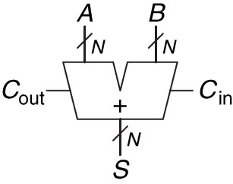
Figure 5.4 Carry propagate adder
Copyright © 2013 Elsevier Inc. All rights reserved.

Slide 6
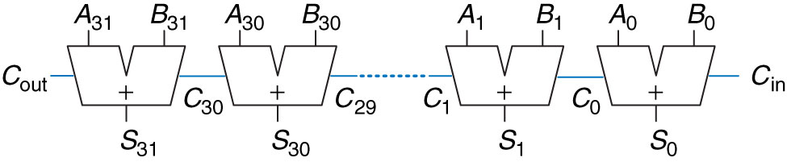
Figure 5.5 32-bit ripple-carry adder
Copyright © 2013 Elsevier Inc. All rights reserved.

Slide 7
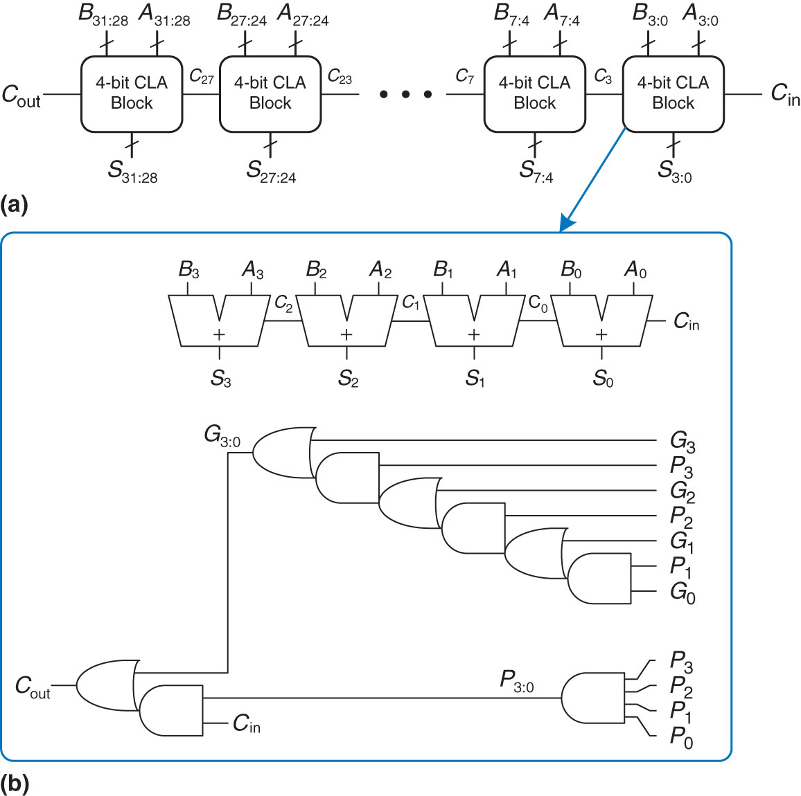
Figure 5.6 (a) 32-bit carry-lookahead adder (CLA), (b) 4-bit CLA block
Copyright © 2013 Elsevier Inc. All rights reserved.

Slide 8
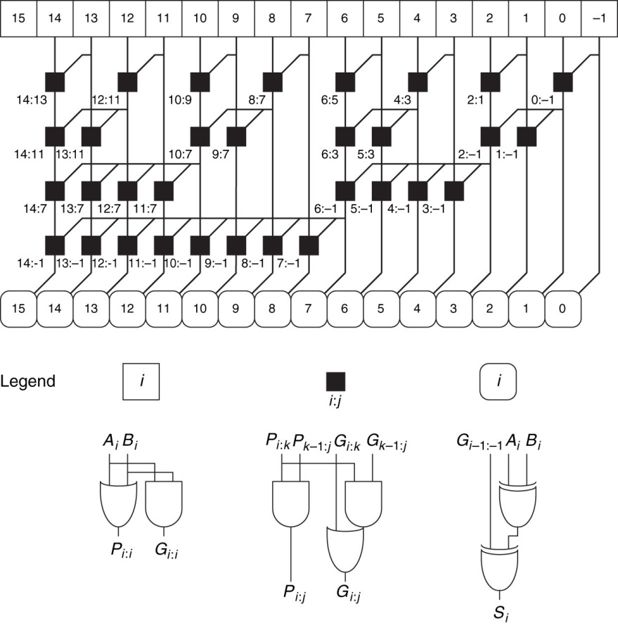
Figure 5.7 16-bit prefix adder
Copyright © 2013 Elsevier Inc. All rights reserved.

Slide 9
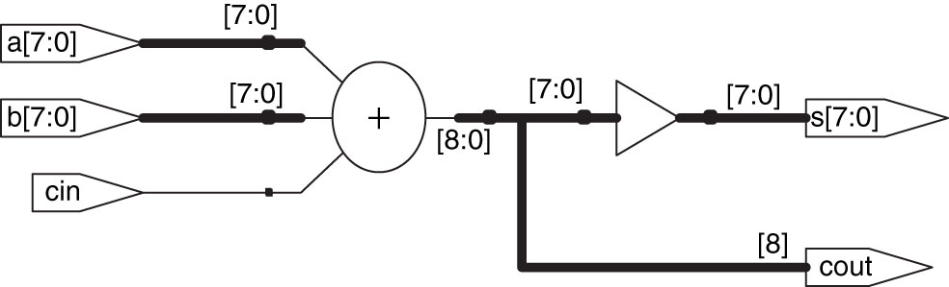
Figure 5.8 Synthesized adder
Copyright © 2013 Elsevier Inc. All rights reserved.

Slide 10
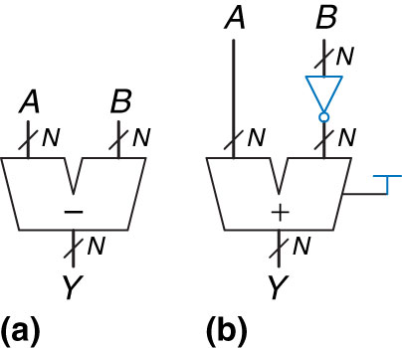
Figure 5.9 Subtractor: (a) symbol, (b) implementation
Copyright © 2013 Elsevier Inc. All rights reserved.

Slide 11
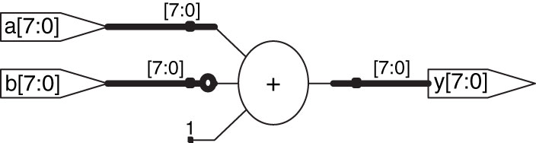
Figure 5.10 Synthesized subtractor
Copyright © 2013 Elsevier Inc. All rights reserved.

Slide 12
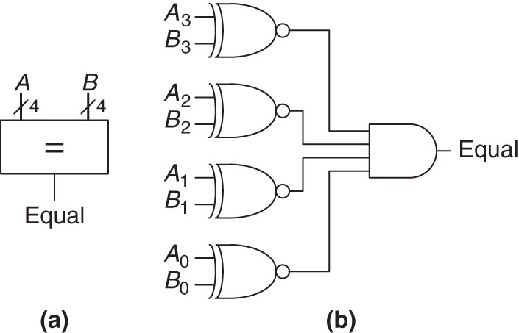
Figure 5.11 4-bit equality comparator: (a) symbol, (b) implementation
Copyright © 2013 Elsevier Inc. All rights reserved.

Slide 13
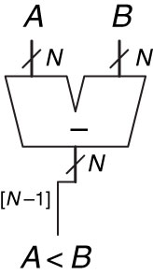
Figure 5.12 N-bit magnitude comparator
Copyright © 2013 Elsevier Inc. All rights reserved.

Slide 14
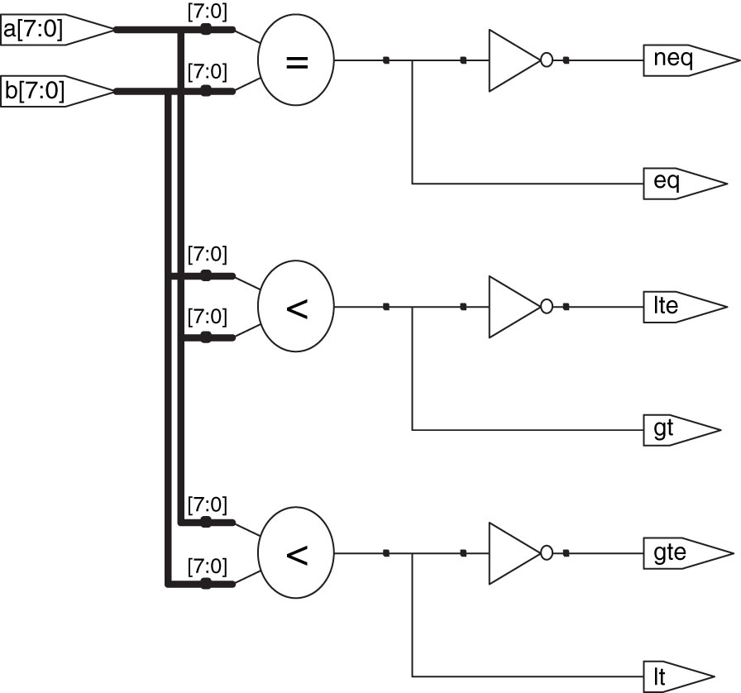
Figure 5.13 Synthesized comparators
Copyright © 2013 Elsevier Inc. All rights reserved.

Slide 15
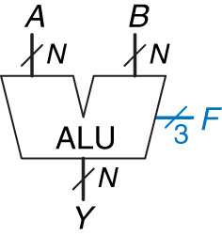
Figure 5.14 ALU symbol
Copyright © 2013 Elsevier Inc. All rights reserved.

Slide 16
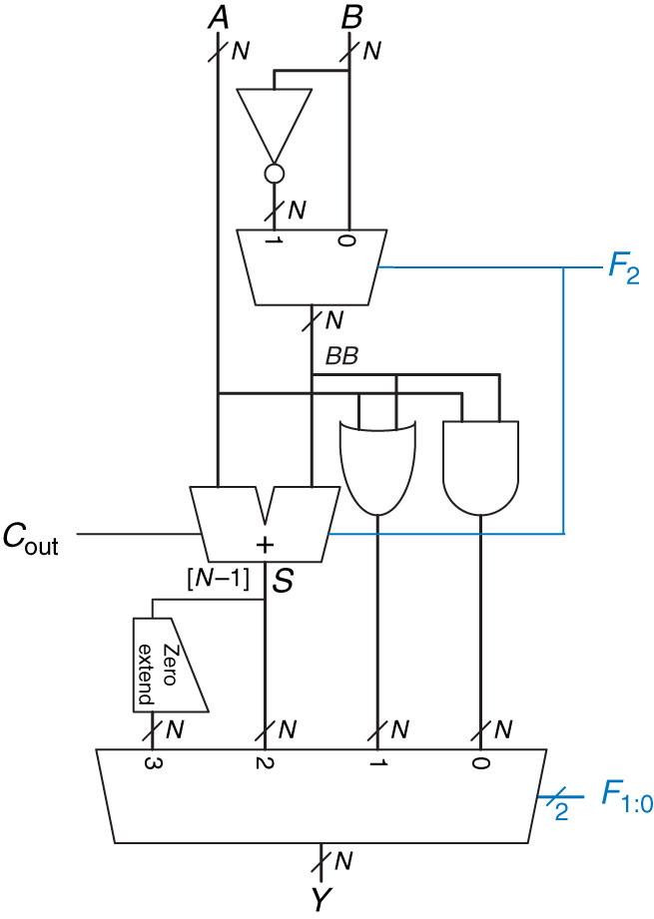
Figure 5.15 N-bit ALU
Copyright © 2013 Elsevier Inc. All rights reserved.

Slide 17
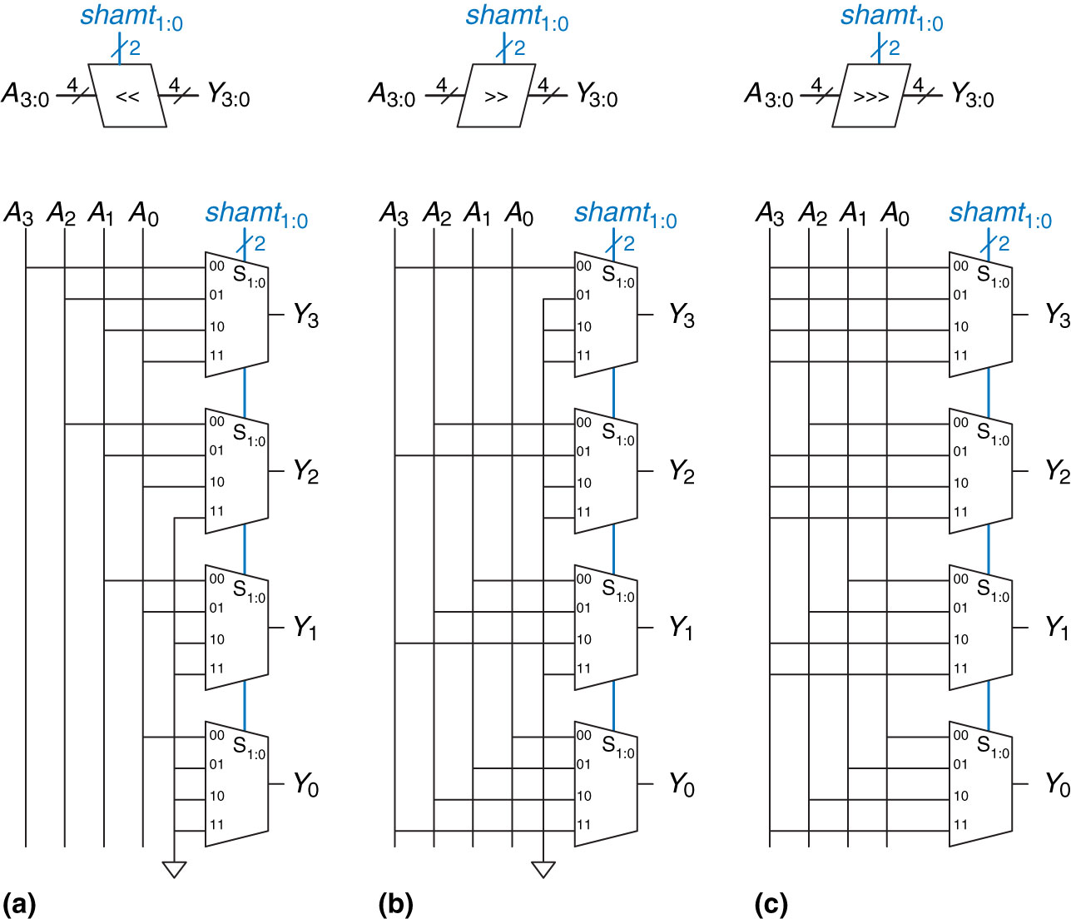
Figure 5.16 4-bit shifters: (a) shift left, (b) logical shift right, (c) arithmetic shift right
Copyright © 2013 Elsevier Inc. All rights reserved.

Slide 18
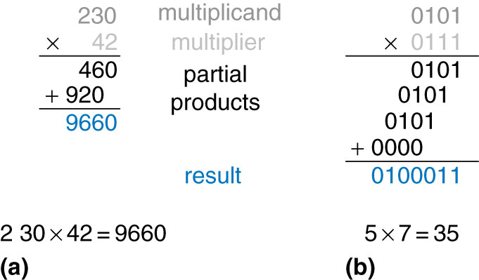
Figure 5.17 Multiplication: (a) decimal, (b) binary
Copyright © 2013 Elsevier Inc. All rights reserved.

Slide 19
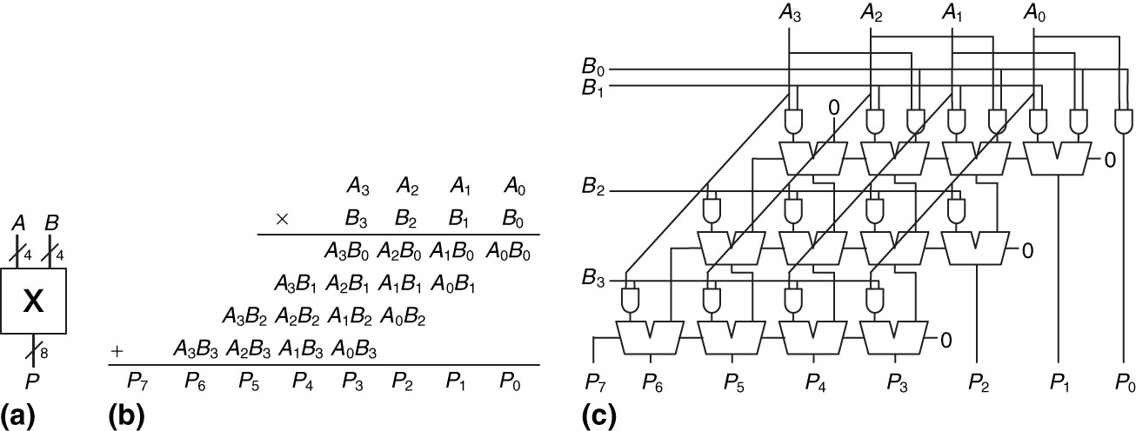
Figure 5.18 4  4 multiplier: (a) symbol, (b) function, (c) implementation
Copyright © 2013 Elsevier Inc. All rights reserved.

Slide 20
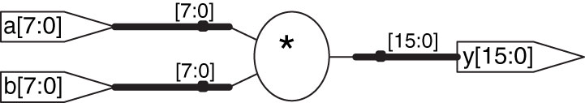
Figure 5.19 Synthesized multiplier
Copyright © 2013 Elsevier Inc. All rights reserved.

Slide 21
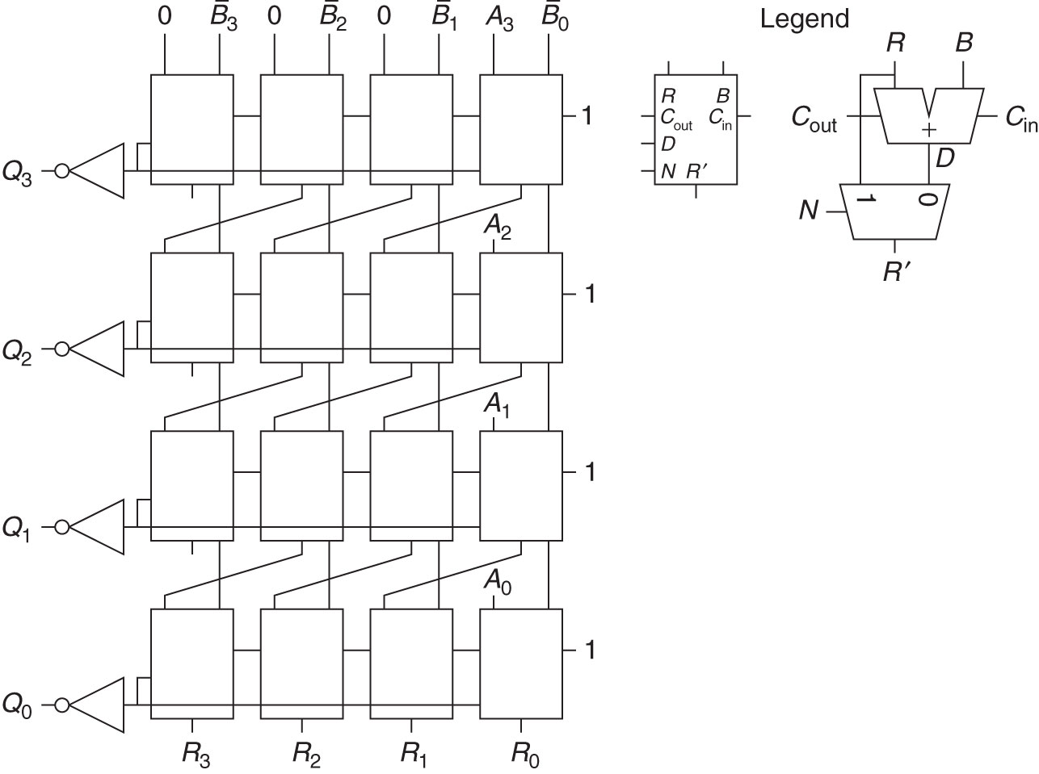
Figure 5.20 Array divider
Copyright © 2013 Elsevier Inc. All rights reserved.

Slide 22
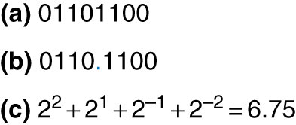
Figure 5.21 Fixed-point notation of 6.75 with four integer bits and four fraction bits
Copyright © 2013 Elsevier Inc. All rights reserved.

Slide 23
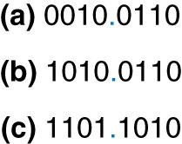
Figure 5.22 Fixed-point representation of 2.375: (a) absolute value, (b) sign and magnitude, (c) two’s complement
Copyright © 2013 Elsevier Inc. All rights reserved.

Slide 24
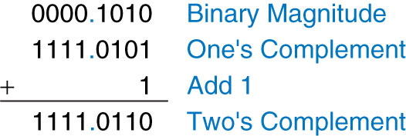
Figure 5.23 Fixed-point two’s complement conversion
Copyright © 2013 Elsevier Inc. All rights reserved.

Slide 25
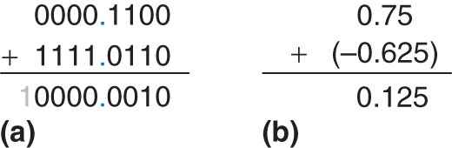
Figure 5.24 Addition: (a) binary fixed-point, (b) decimal equivalent
Copyright © 2013 Elsevier Inc. All rights reserved.

Slide 26

Figure 5.25 Floating-point numbers
Copyright © 2013 Elsevier Inc. All rights reserved.

Slide 27
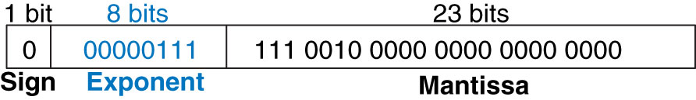
Figure 5.26 32-bit floating-point version 1
Copyright © 2013 Elsevier Inc. All rights reserved.

Slide 28
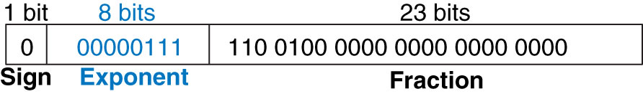
Figure 5.27 Floating-point version 2
Copyright © 2013 Elsevier Inc. All rights reserved.

Slide 29
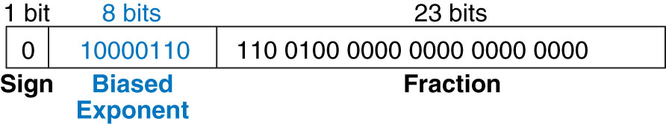
Figure 5.28 IEEE 754 floating-point notation
Copyright © 2013 Elsevier Inc. All rights reserved.

Slide 30
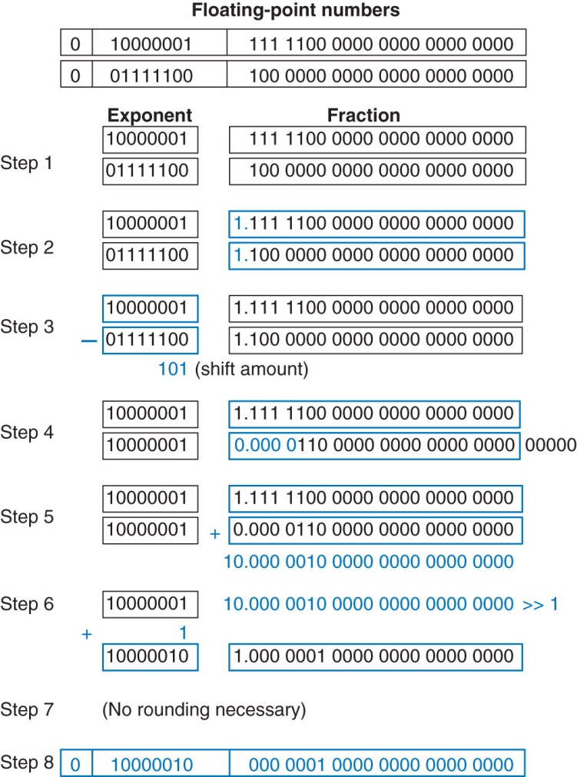
Figure 5.29 Floating-point addition
Copyright © 2013 Elsevier Inc. All rights reserved.

Slide 31
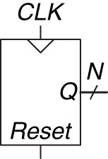
Figure 5.30 Counter symbol
Copyright © 2013 Elsevier Inc. All rights reserved.

Slide 32
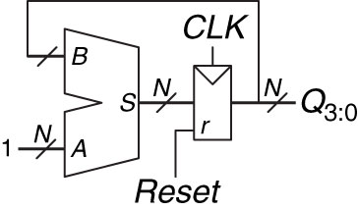
Figure 5.31 N-bit counter
Copyright © 2013 Elsevier Inc. All rights reserved.

Slide 33
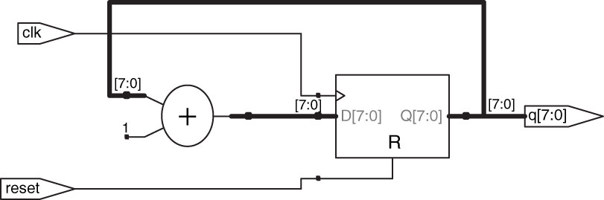
Figure 5.32 Synthesized counter
Copyright © 2013 Elsevier Inc. All rights reserved.

Slide 34
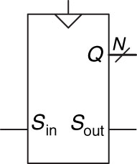
Figure 5.33 Shift register symbol
Copyright © 2013 Elsevier Inc. All rights reserved.

Slide 35
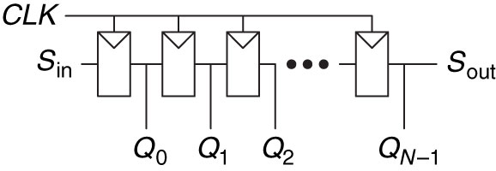
Figure 5.34 Shift register schematic
Copyright © 2013 Elsevier Inc. All rights reserved.

Slide 36
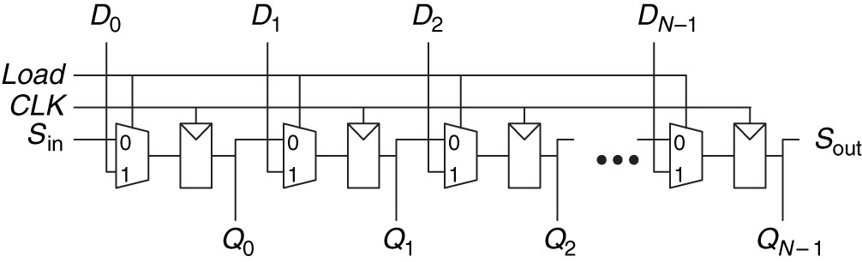
Figure 5.35 Shift register with parallel load
Copyright © 2013 Elsevier Inc. All rights reserved.

Slide 37
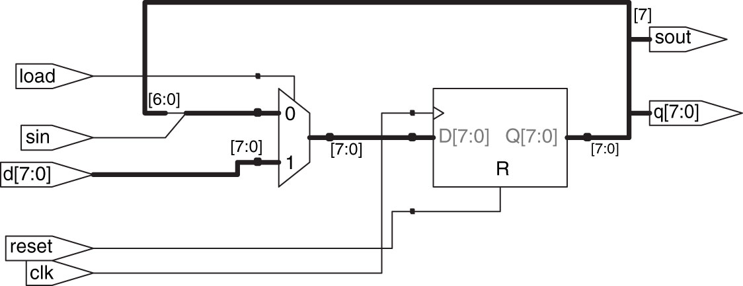
Figure 5.36 Synthesized shiftreg
Copyright © 2013 Elsevier Inc. All rights reserved.

Slide 38
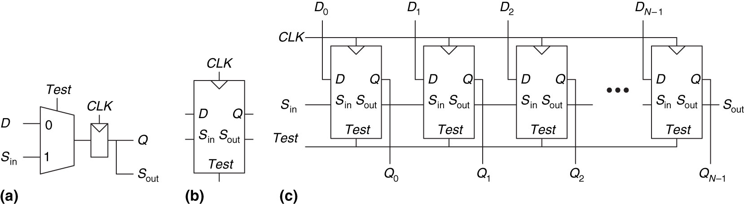
Figure 5.37 Scannable flip-flop: (a) schematic, (b) symbol, and (c) N-bit scannable register
Copyright © 2013 Elsevier Inc. All rights reserved.

Slide 39
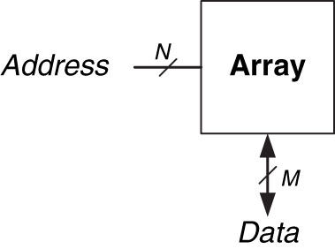
Figure 5.38 Generic memory array symbol
Copyright © 2013 Elsevier Inc. All rights reserved.

Slide 40
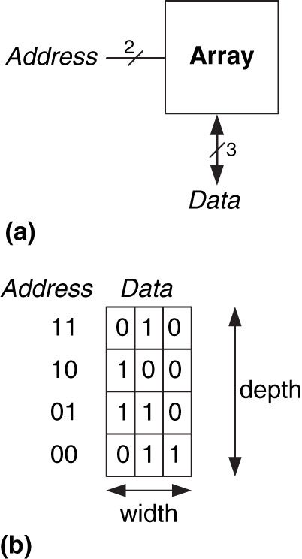
Figure 5.39 4  3 memory array: (a) symbol, (b) function
Copyright © 2013 Elsevier Inc. All rights reserved.

Slide 41
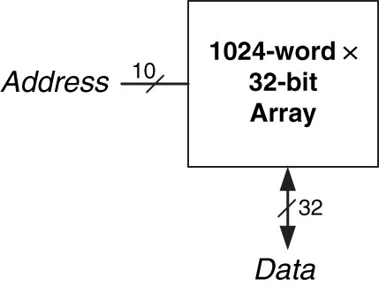
Figure 5.40 32 Kb array: depth = 2¹⁰ = 1024 words, width = 32 bits
Copyright © 2013 Elsevier Inc. All rights reserved.

Slide 42
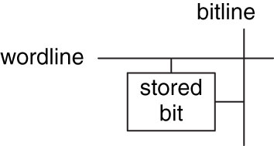
Figure 5.41 Bit cell
Copyright © 2013 Elsevier Inc. All rights reserved.

Slide 43
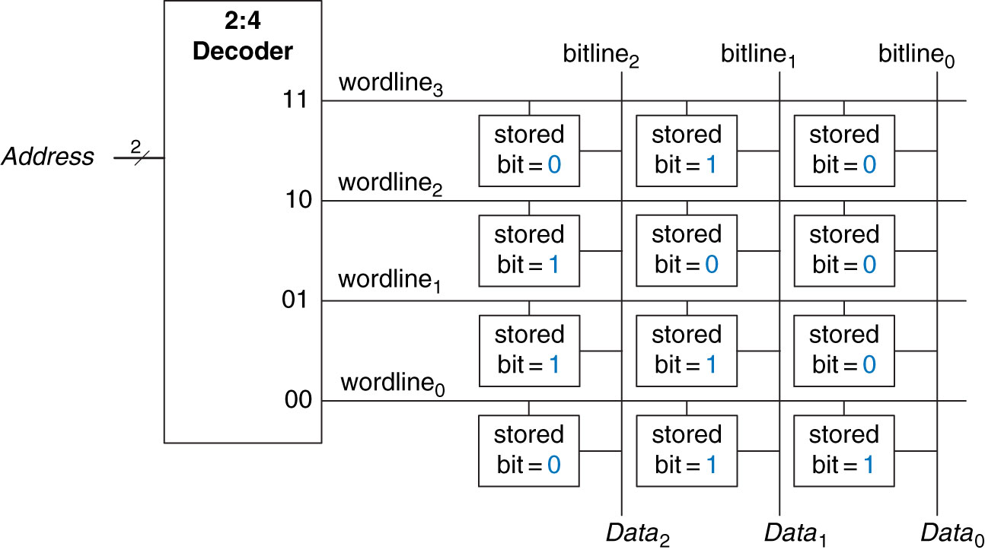
Figure 5.42 4  3 memory array
Copyright © 2013 Elsevier Inc. All rights reserved.

Slide 44
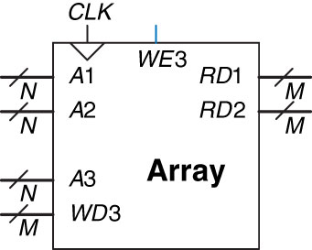
Figure 5.43 Three-ported memory
Copyright © 2013 Elsevier Inc. All rights reserved.

Slide 45
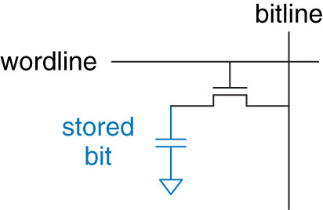
Figure 5.44 DRAM bit cell
Copyright © 2013 Elsevier Inc. All rights reserved.

Slide 46
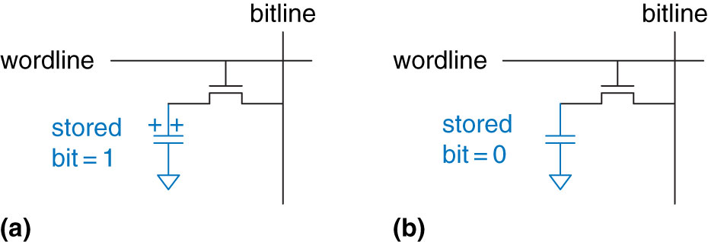
Figure 5.45 DRAM stored values
Copyright © 2013 Elsevier Inc. All rights reserved.

Slide 47
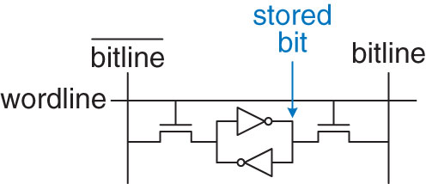
Figure 5.46 SRAM bit cell
Copyright © 2013 Elsevier Inc. All rights reserved.

Slide 48
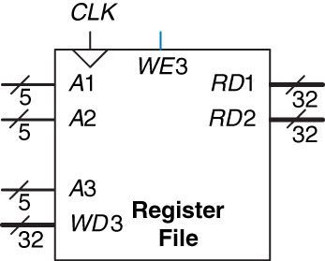
Figure 5.47 32  32 register file with two read ports and one write port
Copyright © 2013 Elsevier Inc. All rights reserved.

Slide 49
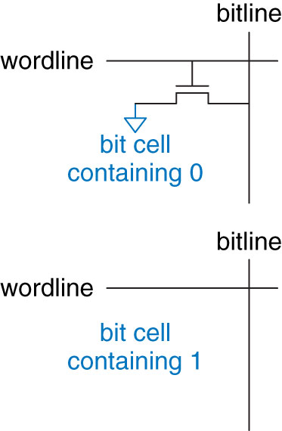
Figure 5.48 ROM bit cells containing 0 and 1
Copyright © 2013 Elsevier Inc. All rights reserved.

Slide 50
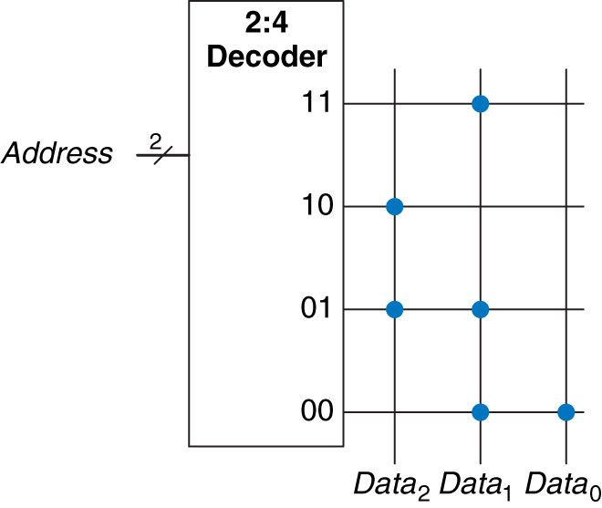
Figure 5.49 4  3 ROM: dot notation
Copyright © 2013 Elsevier Inc. All rights reserved.

Slide 51
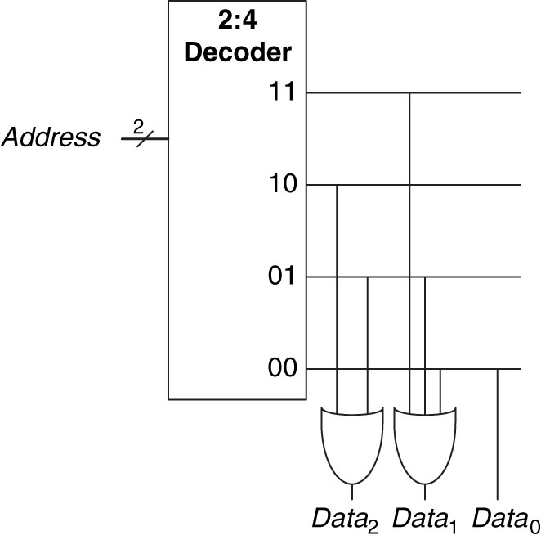
Figure 5.50 4  3 ROM implementation using gates
Copyright © 2013 Elsevier Inc. All rights reserved.

Slide 52
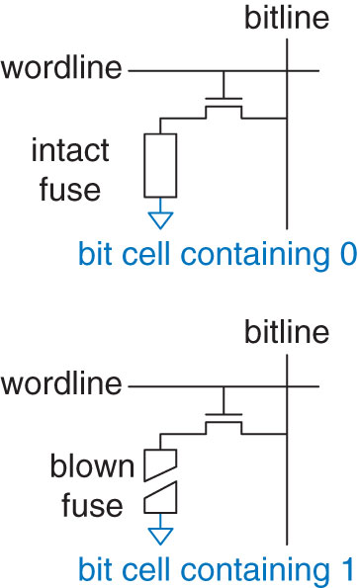
Figure 5.51 Fuse-programmable ROM bit cell
Copyright © 2013 Elsevier Inc. All rights reserved.

Slide 53

Figure 5.52 4-word  1-bit memory array used as a lookup table
Copyright © 2013 Elsevier Inc. All rights reserved.

Slide 54

Figure 5.53 Synthesized ram
Copyright © 2013 Elsevier Inc. All rights reserved.

Slide 55

Figure 5.54 M  N  P-bit PLA
Copyright © 2013 Elsevier Inc. All rights reserved.

Slide 56

Figure 5.55 3  3  2-bit PLA: dot notation
Copyright © 2013 Elsevier Inc. All rights reserved.

Slide 57

Figure 5.56 3  3  2-bit PLA using two-level logic
Copyright © 2013 Elsevier Inc. All rights reserved.

Slide 58

Figure 5.57 General FPGA layout
Copyright © 2013 Elsevier Inc. All rights reserved.

Slide 59

Figure 5.58 Cyclone IV Logic Element (LE)
(Reproduced with permission from the Altera Cyclone IV Handbook  2010 Altera Corporation.)
Copyright © 2013 Elsevier Inc. All rights reserved.

Slide 60

Figure 5.59 LE configuration for two functions of up to four inputs each
Copyright © 2013 Elsevier Inc. All rights reserved.

Slide 61

Figure 5.60 LE configuration for one function of more than four inputs
Copyright © 2013 Elsevier Inc. All rights reserved.

Slide 62

Figure 5.61 LE configuration for FSM with two bits of state
Copyright © 2013 Elsevier Inc. All rights reserved.

Slide 63

Figure 5.62 ROM implementation: (a) dot notation, (b) pseudo-nMOS circuit
Copyright © 2013 Elsevier Inc. All rights reserved.

Slide 64

Figure 5.63 3  3  2-bit PLA using pseudo-nMOS circuits
Copyright © 2013 Elsevier Inc. All rights reserved.

Slide 65

Figure 5.64 Funnel shifter
Copyright © 2013 Elsevier Inc. All rights reserved.

Slide 66

Figure 5.65 ROM circuits
Copyright © 2013 Elsevier Inc. All rights reserved.

Slide 67

Figure M 01
Copyright © 2013 Elsevier Inc. All rights reserved.

Slide 68

Figure M 02
Copyright © 2013 Elsevier Inc. All rights reserved.

Slide 69

Figure M 03
Copyright © 2013 Elsevier Inc. All rights reserved.

Slide 70

Figure M 04
Copyright © 2013 Elsevier Inc. All rights reserved.

Slide 71

Figure M 05
Copyright © 2013 Elsevier Inc. All rights reserved.

Slide 72

Figure M 06
Copyright © 2013 Elsevier Inc. All rights reserved.

Slide 73

UNN Figure 1
Copyright © 2013 Elsevier Inc. All rights reserved.

