Slide 1
Chapter 4
Hardware Description Languages
Copyright © 2013 Elsevier Inc. All rights reserved.

Slide 2
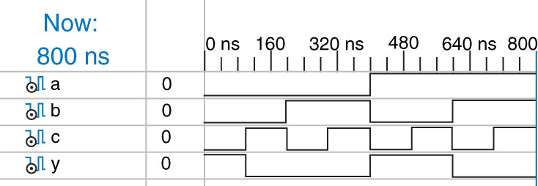
Figure 4.1 Simulation waveforms
Copyright © 2013 Elsevier Inc. All rights reserved.

Slide 3
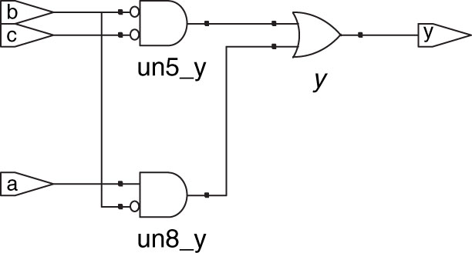
Figure 4.2 Synthesized circuit
Copyright © 2013 Elsevier Inc. All rights reserved.

Slide 4
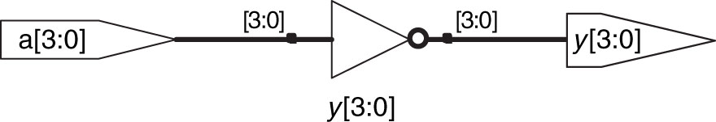
Figure 4.3 inv synthesized circuit
Copyright © 2013 Elsevier Inc. All rights reserved.

Slide 5
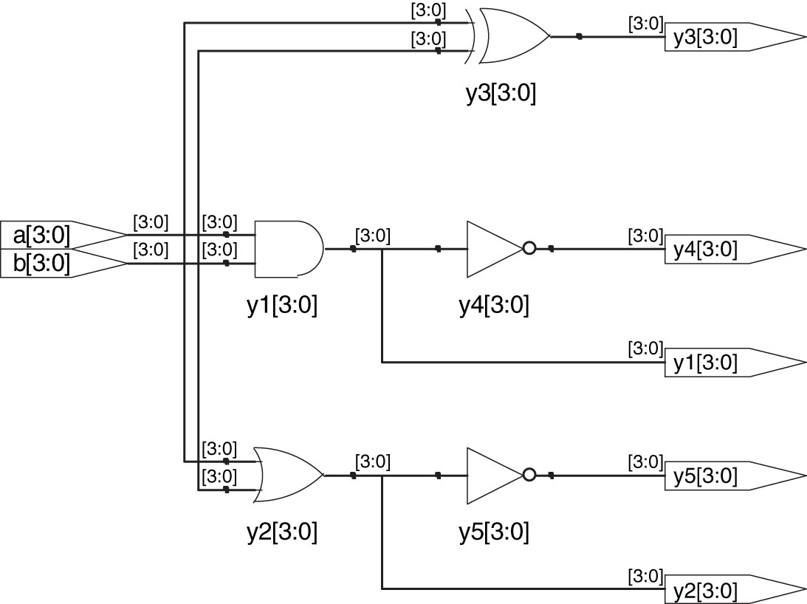
Figure 4.4 gates synthesized circuit
Copyright © 2013 Elsevier Inc. All rights reserved.

Slide 6
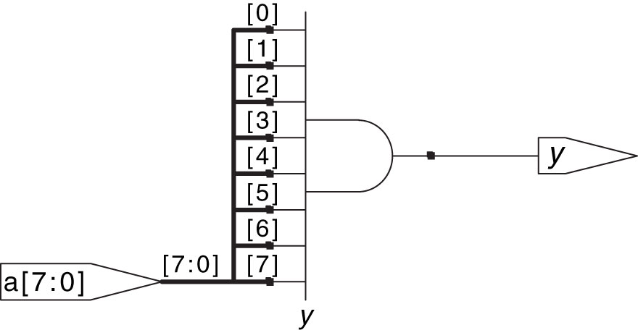
Figure 4.5 and8 synthesized circuit
Copyright © 2013 Elsevier Inc. All rights reserved.

Slide 7
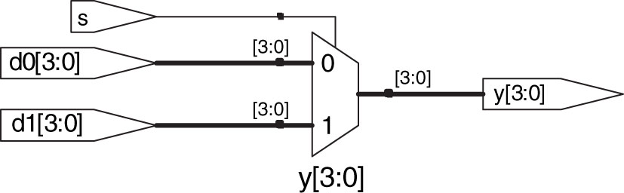
Figure 4.6 mux2 synthesized circuit
Copyright © 2013 Elsevier Inc. All rights reserved.

Slide 8
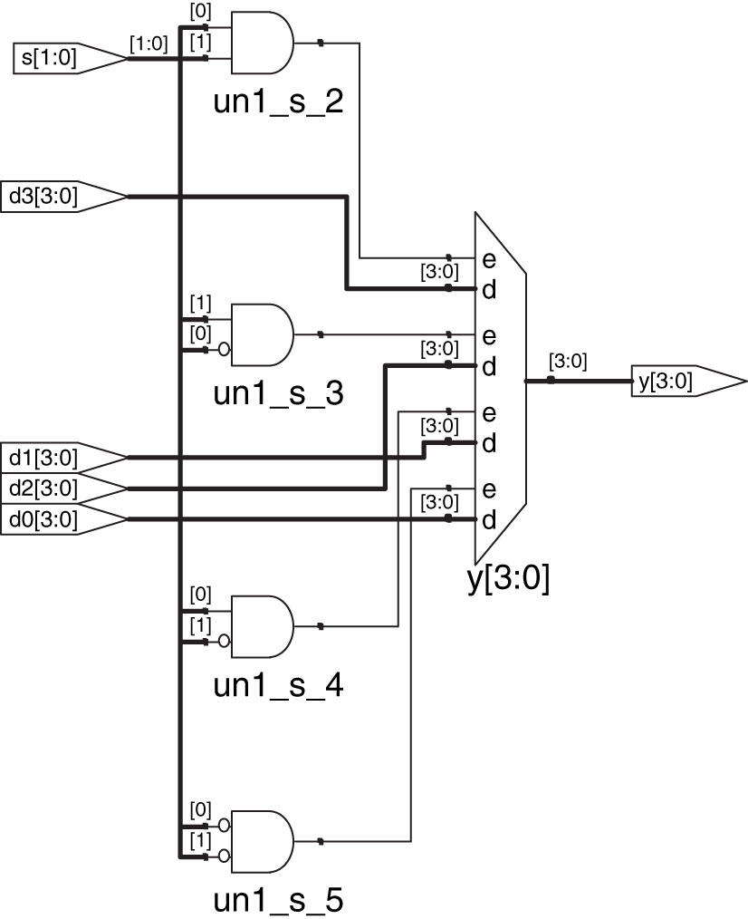
Figure 4.7 mux4 synthesized circuit
Copyright © 2013 Elsevier Inc. All rights reserved.

Slide 9
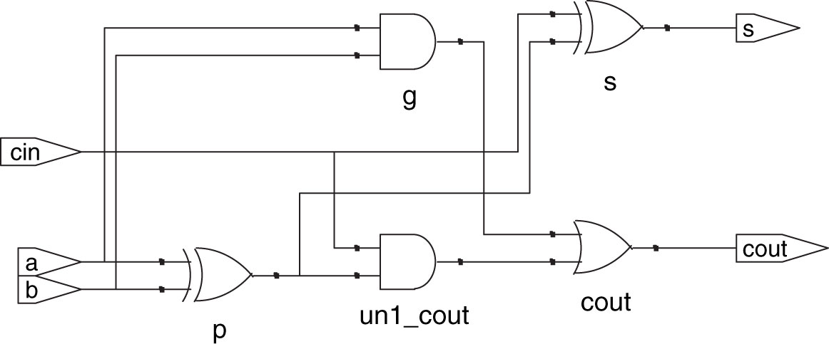
Figure 4.8 fulladder synthesized circuit
Copyright © 2013 Elsevier Inc. All rights reserved.

Slide 10
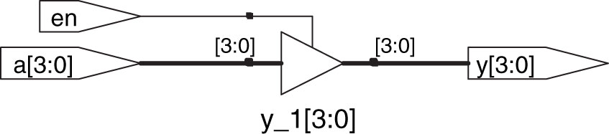
Figure 4.9 tristate synthesized circuit
Copyright © 2013 Elsevier Inc. All rights reserved.

Slide 11
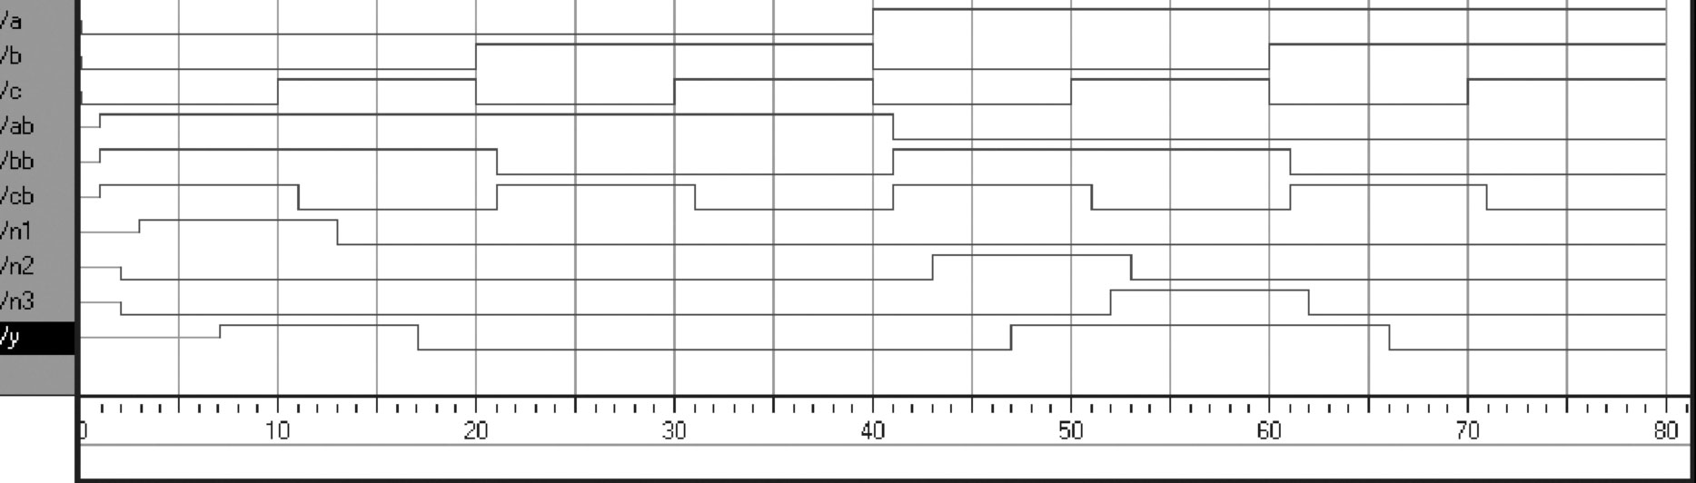
Figure 4.10 Example simulation waveforms with delays (from the ModelSim simulator)
Copyright © 2013 Elsevier Inc. All rights reserved.

Slide 12
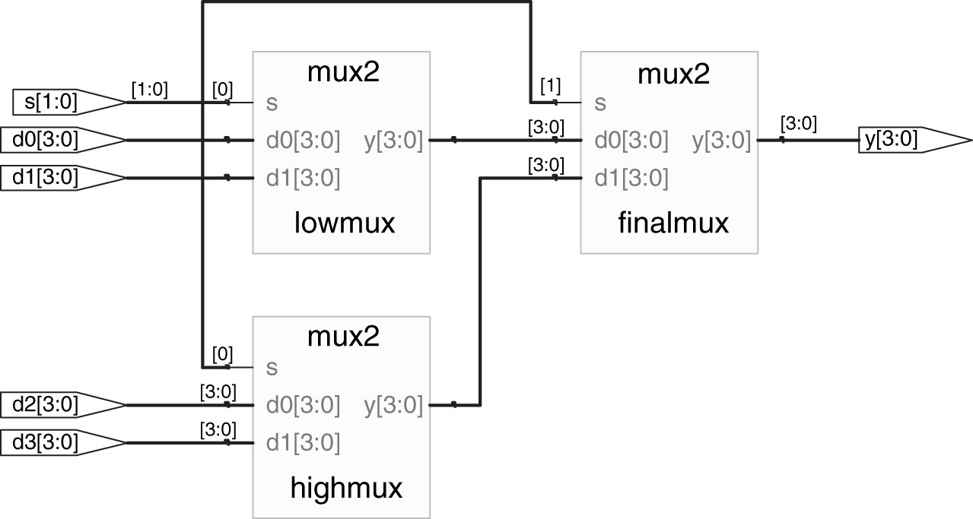
Figure 4.11 mux4 synthesized circuit
Copyright © 2013 Elsevier Inc. All rights reserved.

Slide 13
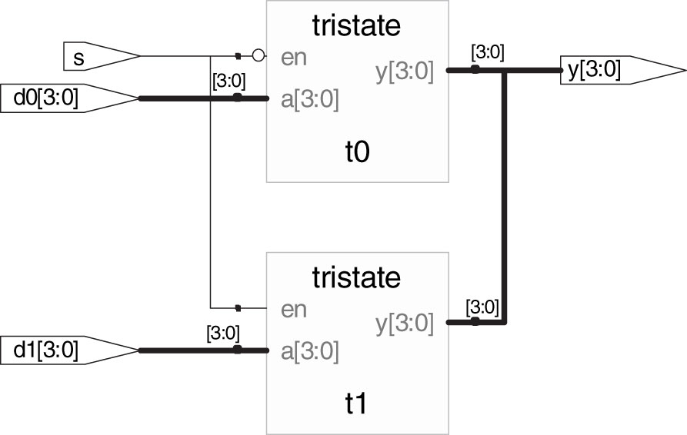
Figure 4.12 mux2 synthesized circuit
Copyright © 2013 Elsevier Inc. All rights reserved.

Slide 14
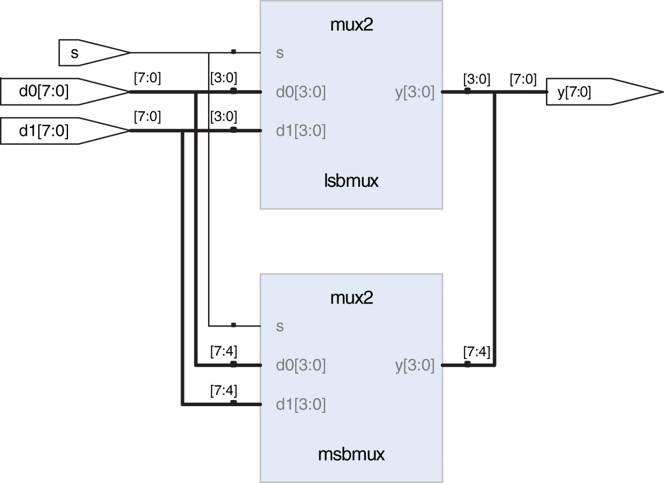
Figure 4.13 mux2_8 synthesized circuit
Copyright © 2013 Elsevier Inc. All rights reserved.

Slide 15
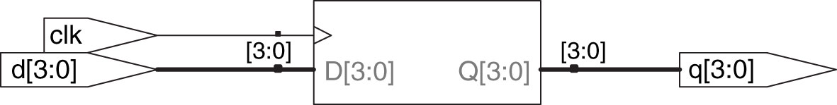
Figure 4.14 flop synthesized circuit
Copyright © 2013 Elsevier Inc. All rights reserved.

Slide 16
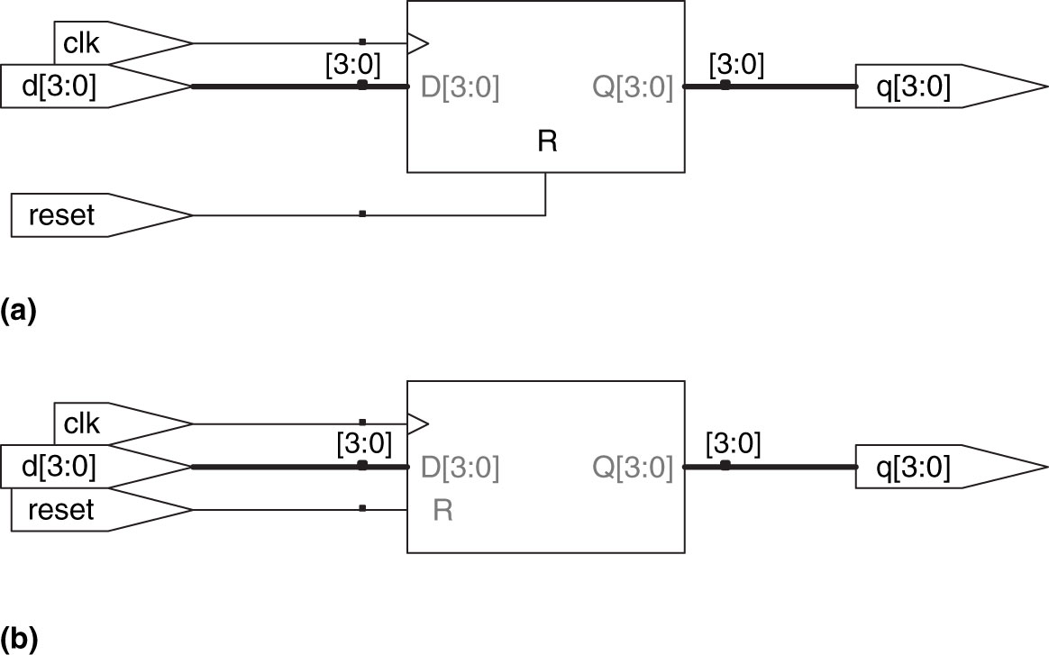
Figure 4.15 flopr synthesized circuit (a) asynchronous reset, (b) synchronous reset
Copyright © 2013 Elsevier Inc. All rights reserved.

Slide 17
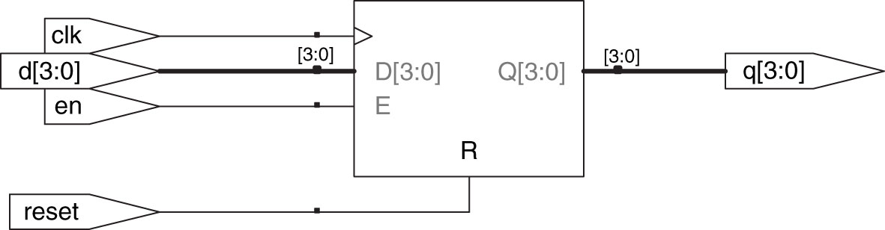
Figure 4.16 flopenr synthesized circuit
Copyright © 2013 Elsevier Inc. All rights reserved.

Slide 18
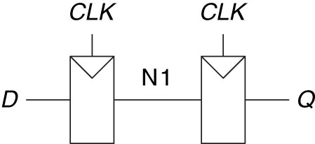
Figure 4.17 Synchronizer circuit
Copyright © 2013 Elsevier Inc. All rights reserved.

Slide 19
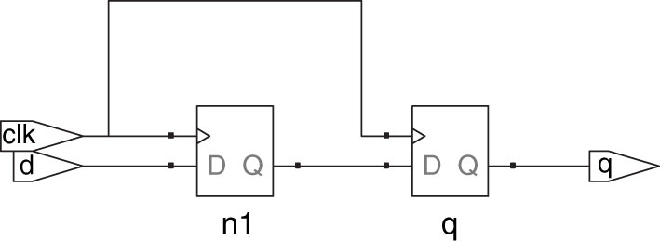
Figure 4.18 sync synthesized circuit
Copyright © 2013 Elsevier Inc. All rights reserved.

Slide 20
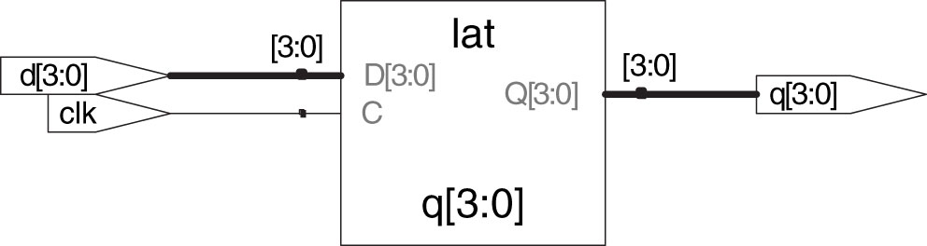
Figure 4.19 latch synthesized circuit
Copyright © 2013 Elsevier Inc. All rights reserved.

Slide 21
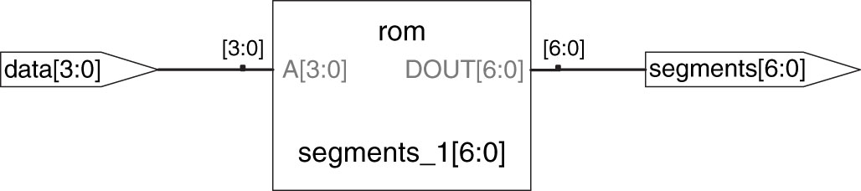
Figure 4.20 sevenseg synthesized circuit
Copyright © 2013 Elsevier Inc. All rights reserved.

Slide 22
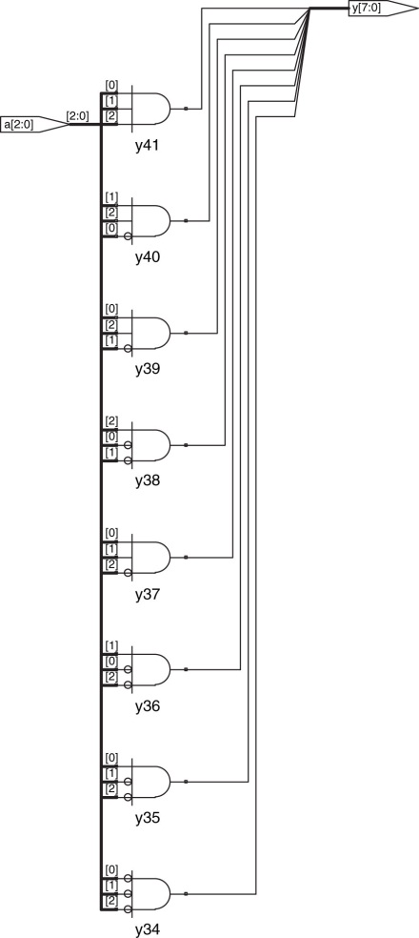
Figure 4.21 decoder3_8 synthesized circuit
Copyright © 2013 Elsevier Inc. All rights reserved.

Slide 23
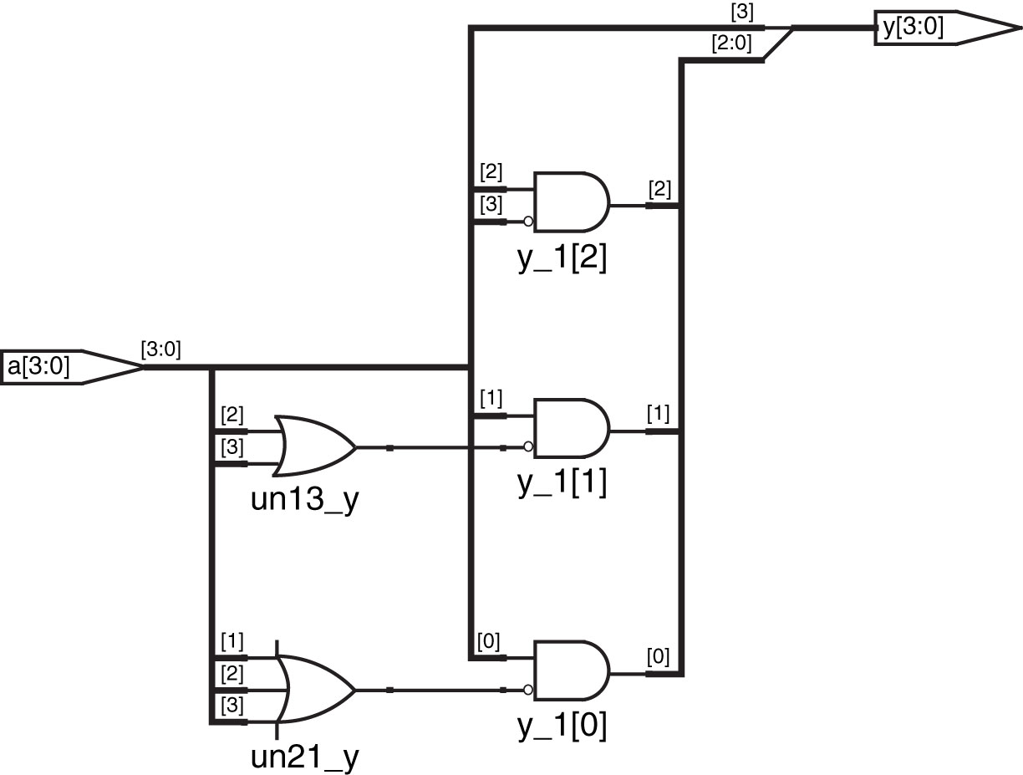
Figure 4.22 priorityckt synthesized circuit
Copyright © 2013 Elsevier Inc. All rights reserved.

Slide 24
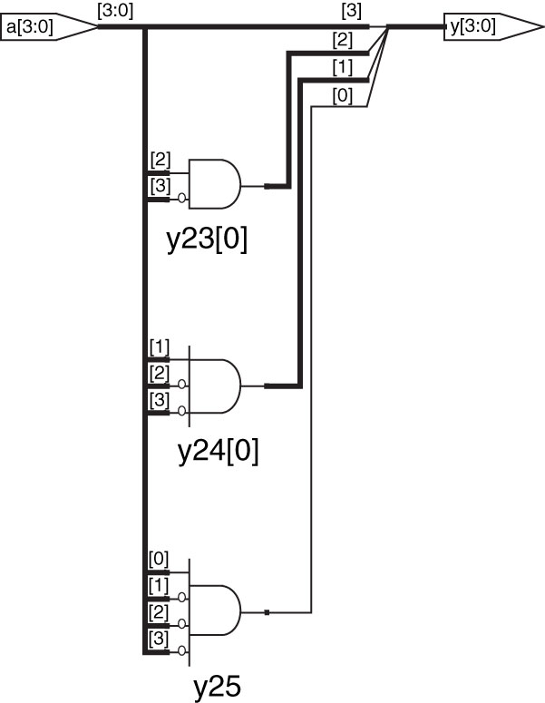
Figure 4.23 priority_casez synthesized circuit
Copyright © 2013 Elsevier Inc. All rights reserved.

Slide 25
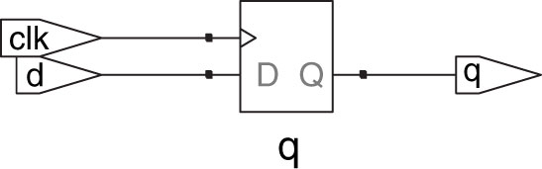
Figure 4.24 syncbad synthesized circuit
Copyright © 2013 Elsevier Inc. All rights reserved.

Slide 26
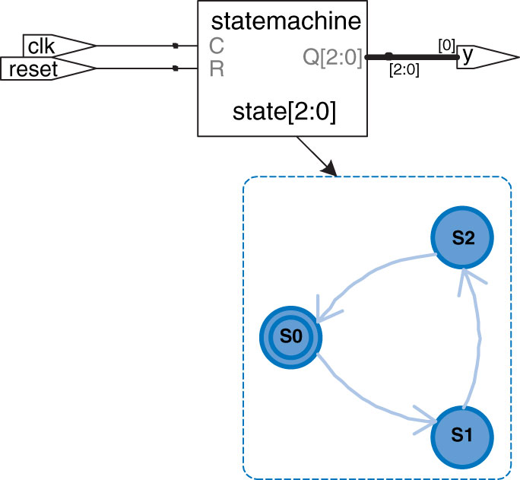
Figure 4.25 priority_casez synthesized circuit
Copyright © 2013 Elsevier Inc. All rights reserved.

Slide 27
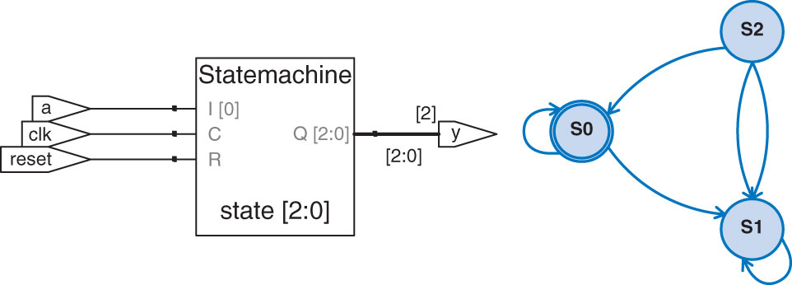
Figure 4.26 patternMoore synthesized circuit
Copyright © 2013 Elsevier Inc. All rights reserved.

Slide 28
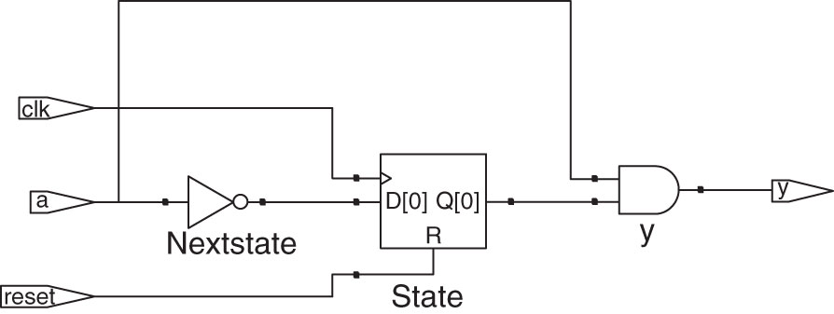
Figure 4.27 patternMealy synthesized circuit
Copyright © 2013 Elsevier Inc. All rights reserved.

Slide 29
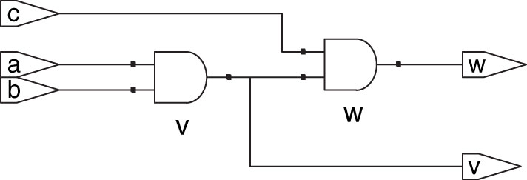
Figure 4.28 and23 synthesized circuit
Copyright © 2013 Elsevier Inc. All rights reserved.

Slide 30
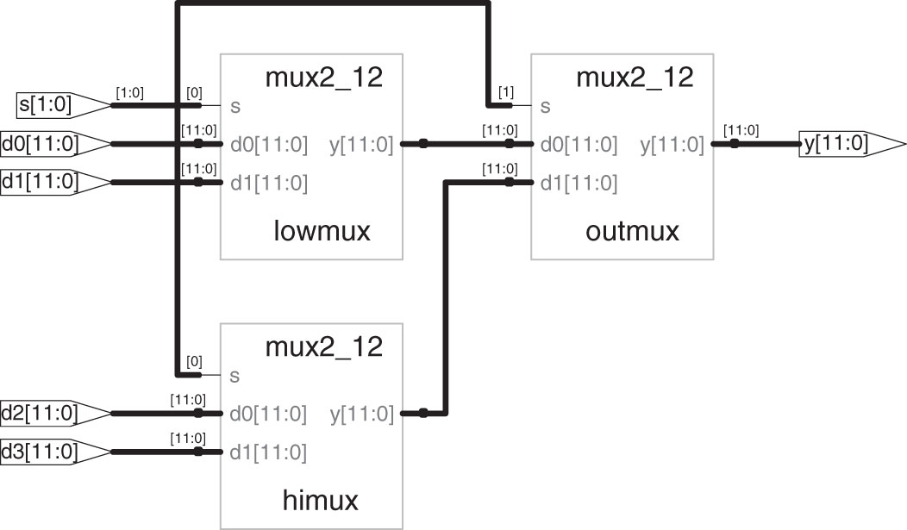
Figure 4.29 mux4_12 synthesized circuit
Copyright © 2013 Elsevier Inc. All rights reserved.

Slide 31
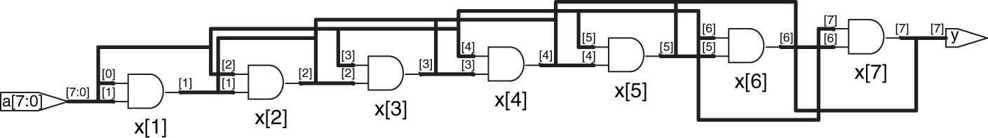
Figure 4.30 andN synthesized circuit
Copyright © 2013 Elsevier Inc. All rights reserved.

Slide 32
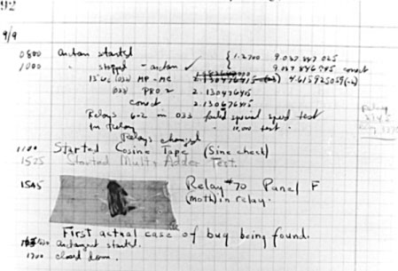
Figure M 01
Copyright © 2013 Elsevier Inc. All rights reserved.

Slide 33
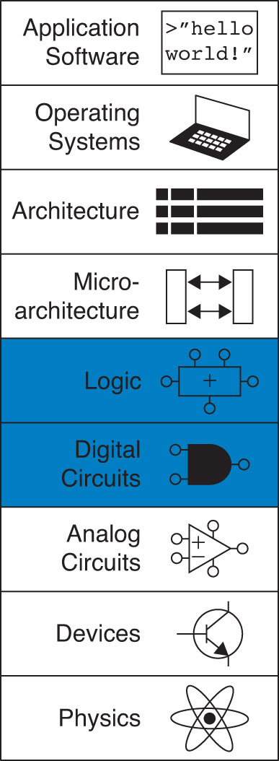
UNN Figure 1
Copyright © 2013 Elsevier Inc. All rights reserved.

