Slide 1


cuRadiomics: A GPU-based Radiomics Feature Extraction Toolkit
Yining Jiao¹, Oihane Mayo Ijurra¹, Lichi Zhang¹,
Dinggang Shen², Qian Wang¹
¹Institute for Medical Imaging Technology, School of Biomedical Engineering, Shanghai Jiao Tong University, China
²Department of Radiology and Biomedical Research Imaging Center (BRIC),
University of North Carolina at Chapel Hill, USA

Slide 2
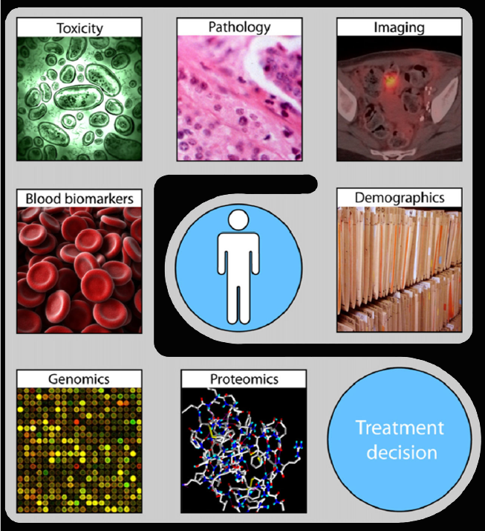


Background
Radiomics
• High-throughput, quantitative features
• Convert images into mineable data
• Diagnosis/prognosis, treatment decision
Shape Features
Texture Features
1 | 0 | 4 | 3
3 | 5 | 2 | 2
2 | 0 | 3 | 5
1 | 3 | 1 | 2
1 | 0 | 7 | 3
0 | 1 | 3 | 2
2 | 9 | 3 | 5
1 | 3 | 1 | 2
Input
Images
Filters-Based Features
Treatment
Decision
First-Order Features
Notes:
Radiomics is an advanced way of extracting high-throughput and quantitative features.
It can transform various kinds of images into mineable data, such as pathology images, MRI, and CT images.
Radiomics features are increasingly used in clinical decision-making tasks for their strong predictive power and promising interpretability, such as the diagnosis/prognosis of different diseases and the design of personalized treatments.

Slide 3
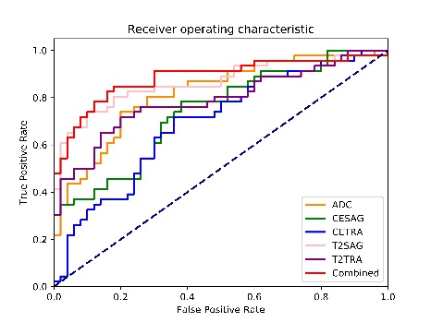
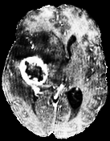
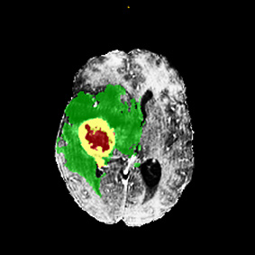
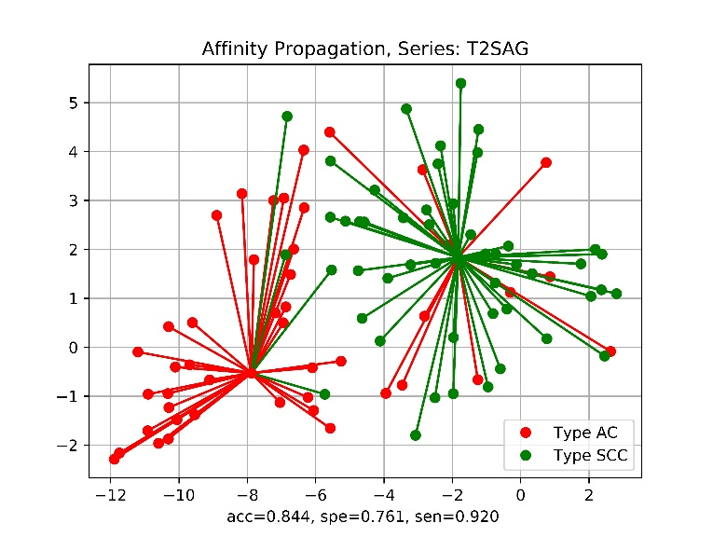
Background
Input Image
Segmentation
Feature Extraction
Analysis
Notes:
Generally, the pipeline of medical image analysis involves the following major steps: (1) collect medical images satisfying certain recruiting criterion; (2) outline re-gions of interest (ROIs) manually or automatically; (3) extract quantitative radiomics features within the ROIs; (4) construct classifiers or regressors to explore data patterns

Slide 4
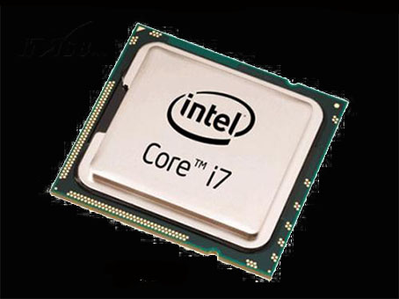
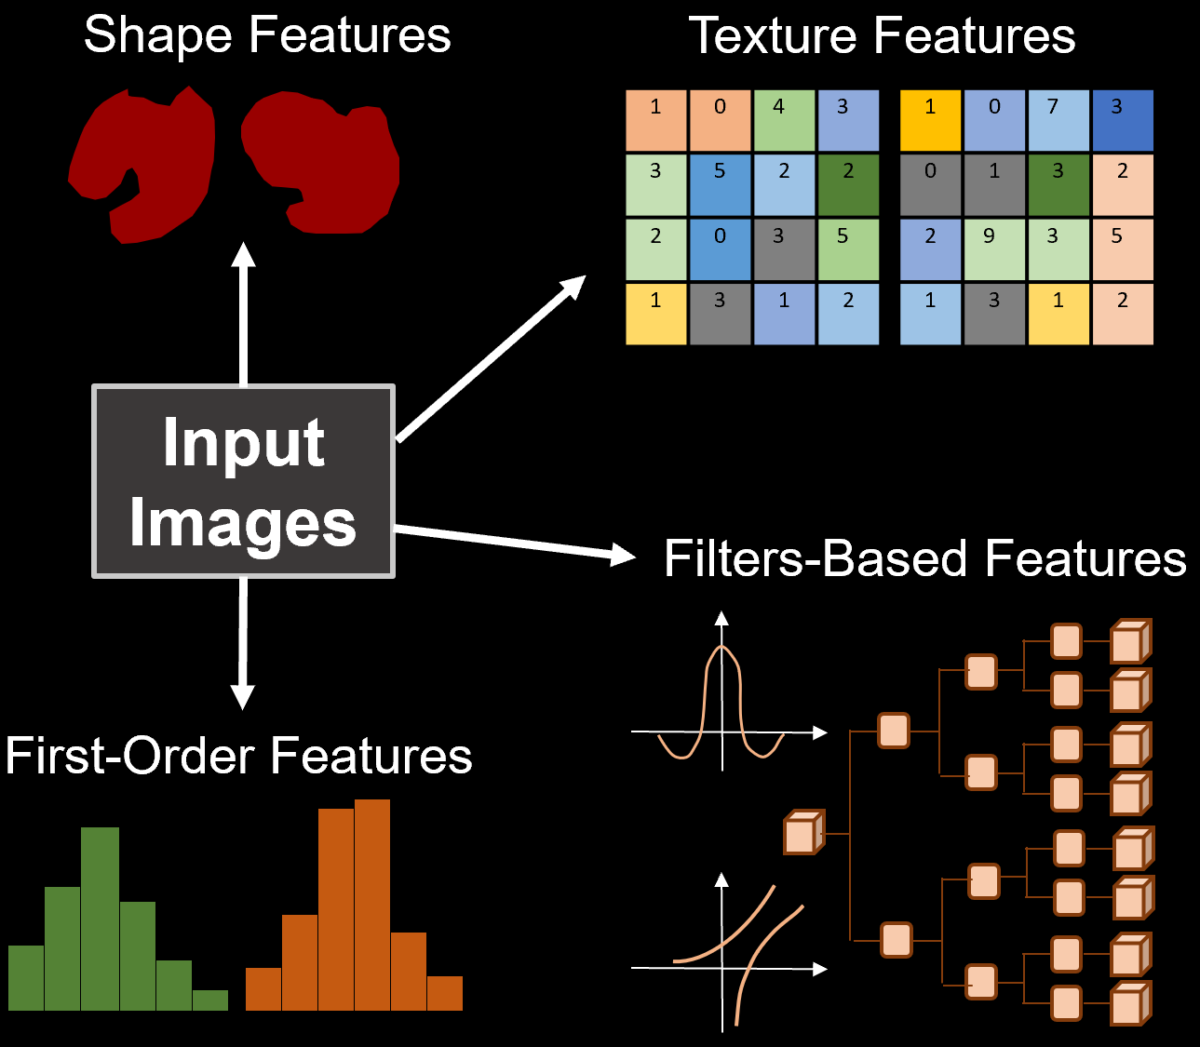
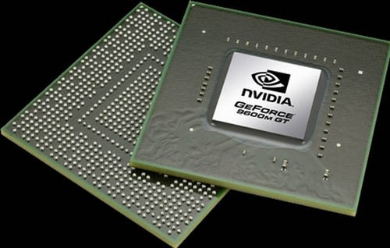
Background
Feature Extraction
Limitation
→ Time-consuming
1) Serialized manner: images are read and analyzed one by one
2) Matrices (GLCM): largely run on CPU
Motivation
1) Images are processed in a batch manner
2) Matrices’ values like GLCM in radiomics features can be calculated as simultaneously as possible
Notes:
There are many toolkits are developed to extract these radiomics features. And now, these tools can only be run with CPU support.
(Limitation): Thus, current feature extraction methods are very time consuming and inconvenient, exacerbating the complexity of many clinical verifications especially when involving large datasets. This is because:
These algorithms are usually designed in a serialized manner, in which the images are read and analyzed one by one.
2) The calculation of the intermediate matrices such as GLCM, consisting in reading and processing voxels in images subsequently, is largely run on CPU.
(Motivation): To address these issues in current feature extraction methods, in this paper we develop a GPU-based radiomics feature extraction toolkit, called cuRadiomics using the CUDA computation platform. The cuRadiomics provides several advantages when compared with conventional CPU-based implementation.
1) Radiomics features are batch-processed
2) Each value of matrices like GLCM and the radiomics features can be calculated simultaneously.

Slide 5
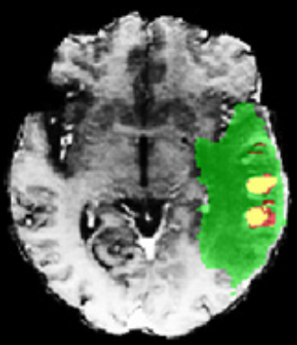
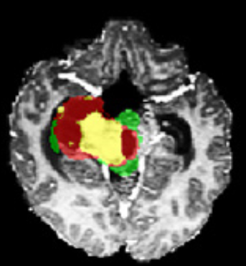




Pipeline
B. Histograms
C. Properties of Histograms
D. First-Order Features
A. Image batch as input
Energy
Entropy
Minimum
10thPercentile
90thPercentile
Maximum
Mean
Median
Interquartile Range
Range
MAD
RMAD
Root Mean Squared
Standard Deviation
Skewness
Kurtosis
Variance
Uniformity
E. GLCMs
F. Properties of GLCMs
G. GLCM Features
…
1 | 2 | 0 | 0
3 | 5 | 2 | 3
2 | 1 | 0 | 5
4 | 0 | 1 | 3
1 | 2 | 0 | 0
3 | 5 | 9 | 3
8 | 0 | 0 | 5
4 | 0 | 3 | 2
Autocorrelation
Joint Average
Cluster Prominence
Cluster Shade
Cluster Tendency
Contrast
Correlation
Difference Average
Difference Extropy
Difference Variance
Joint Energy
Joint Entropy
IMC1
IMC2
IDM
IDMN
Inverse Difference
IDN
Inverse Variance
Max Probability
Sum Average
Sum Entropy
Sum of Squares
1 | 0 | 4 | 3
3 | 5 | 2 | 2
2 | 0 | 3 | 5
1 | 3 | 1 | 2
1 | 0 | 7 | 3
0 | 1 | 3 | 2
2 | 9 | 3 | 5
1 | 3 | 1 | 2
Notes:
Different with PyRadiomics, here the images are batched as input.
The feature extraction pipeline is basically divided into three major steps:
calculation of the histograms or feature matrices;
calculation of vectors representing the properties of the obtained matrices;
calculation of the radiomics features using matrices and properties obtained from the above two steps, i.e., (1) 18 first-order features based on the intensity histogram and (2) 23 texture features based on GLCM.

Slide 6
Pipeline
B. Histograms
C. Properties of Histograms
D. First-Order Features
A. Image batch as input
Energy
Entropy
Minimum
10thPercentile
90thPercentile
Maximum
Mean
Median
Interquartile Range
Range
MAD
RMAD
Root Mean Squared
Standard Deviation
Skewness
Kurtosis
Variance
Uniformity
E. GLCMs
F. Properties of GLCMs
G. GLCM Features
…
1 | 2 | 0 | 0
3 | 5 | 2 | 3
2 | 1 | 0 | 5
4 | 0 | 1 | 3
1 | 2 | 0 | 0
3 | 5 | 9 | 3
8 | 0 | 0 | 5
4 | 0 | 3 | 2
Autocorrelation
Joint Average
Cluster Prominence
Cluster Shade
Cluster Tendency
Contrast
Correlation
Difference Average
Difference Extropy
Difference Variance
Joint Energy
Joint Entropy
IMC1
IMC2
IDM
IDMN
Inverse Difference
IDN
Inverse Variance
Max Probability
Sum Average
Sum Entropy
Sum of Squares
1 | 0 | 4 | 3
3 | 5 | 2 | 2
2 | 0 | 3 | 5
1 | 3 | 1 | 2
1 | 0 | 7 | 3
0 | 1 | 3 | 2
2 | 9 | 3 | 5
1 | 3 | 1 | 2
Notes:
B is the calculation of the histogram.
It is optimized by counting voxels of each grayscale simultaneously, whereas, in PyRadiomics, the voxels are accessed one by one and counted according to their grayscales.
Then, C represents the properties of histograms, such as cumulative distribution functions and the numbers of voxels within ROIs. They can also be calculated simultaneously in cuRadiomics.
As a result, 18 first-order features can be calculated for each image, as is list in D.

Slide 7


Pipeline
B. Histograms
C. Properties of Histograms
D. First-Order Features
A. Image batch as input
Energy
Entropy
Minimum
10thPercentile
90thPercentile
Maximum
Mean
Median
Interquartile Range
Range
MAD
RMAD
Root Mean Squared
Standard Deviation
Skewness
Kurtosis
Variance
Uniformity
E. GLCMs
F. Properties of GLCMs
G. GLCM Features
…
1 | 2 | 0 | 0
3 | 5 | 2 | 3
2 | 1 | 0 | 5
4 | 0 | 1 | 3
1 | 2 | 0 | 0
3 | 5 | 9 | 3
8 | 0 | 0 | 5
4 | 0 | 3 | 2
Autocorrelation
Joint Average
Cluster Prominence
Cluster Shade
Cluster Tendency
Contrast
Correlation
Difference Average
Difference Extropy
Difference Variance
Joint Energy
Joint Entropy
IMC1
IMC2
IDM
IDMN
Inverse Difference
IDN
Inverse Variance
Max Probability
Sum Average
Sum Entropy
Sum of Squares
1 | 0 | 4 | 3
3 | 5 | 2 | 2
2 | 0 | 3 | 5
1 | 3 | 1 | 2
1 | 0 | 7 | 3
0 | 1 | 3 | 2
2 | 9 | 3 | 5
1 | 3 | 1 | 2
Notes:
In cuRadiomics, since the voxels within ROIs can be accessed simultaneously, each element of GLCM can be calculated simultaneously.
F represents the intermediate variables when calculating GLCM features.
The properties of GLCM are more complicated than those of histogram, therefore we classify them according to their dependence on each other.
The calculation is accelerated by arranging four steps as shown in Fig. 1(F).
Each intermediate variable within one step can be calculated simultaneously.
Then, the 23 GLCM texture features can be computed.

Slide 8
Experiments
Goal
cuRadiomics vs. PyRadiomics
Hardware
CPU: Intel i7-7700K Processor
GPU: NVidia GeForce GTX 1080Ti
Dataset
2018 Multimodal Brain Tumor Segmentation(BraTS2018)
285 subjects with FLAIR, T1, T2, and T1CE modalities
Size of each slice: 240x240
Three types of segmented ROIs
2019 Kidney Tumor Segmentation(KiTS2019)
210 subjects with CT images
Size of each slice: 512x512
Two types of segmented ROIs
Notes:
This is the setting of our experiment.
The comparison method is PyRadiomics, a widely used one based on CPU.
The CPU version is intel i7-7700K.
The GPU version is NVIDIA 1080Ti.
。。。。

Slide 9
Experiment
ROI Preparation
New ROIs based on different combinations of original segmented ROIs.
The whole image is also considered as one ROI.
ROI1
ROI2
ROI3
ROI4
ROI5
ROI6
ROI7
ROI8

Slide 10
Results: BraTS2018
Notes:
①This figure shows the time used by cuRadiomics and PyRadiomics on Brats Dataset when extracting different types of features.
These red bars represents the time used by PyRadiomics.
Green bars represents the time used by our proposed cuRadiomics.
Different brightness of red or green represents different configuration of feature extraction.
The horizonal ordinate means different kinds of ROIs. a is the whole image, b is combined by c and d, as illustrated in the ROI preparation.
A presents the largest ROI and and h represents the smallest ROI.
From this figure, we can see,
One strength provided by cuRadiomics is the robustness when dealing with different sizes of ROIs.
For example, the time consumption of feature extraction process in the whole image (i.e. a) being greatly larger than in smaller ROIs.
This strength enables cuRadiomics suitable for high-resolution images and large datasets.
②The table below represents the ratio of the time used by PyRadiomics and cuRadiomics.
Larger value means more time can be saved by cuRadiomics.
From this table, we can see,
The larger the ROI is, the more time can be saved by cuRaiomics.
1) For example, the values in the red box, means then we use the whole brain as ROI, we can save the most time than other kinds of ROIs.
2) And, the values in the yellow and green boxes, means cuRadiomics for the bigger ROIs, which are in the yellow box, can save more time than the smaller ROIs, which are in the green box.

Slide 11
Results: KiTS2019
Notes:
This figure shows the time used by cuRadiomics and PyRadiomics on KITS Dataset when extracting different classes of features.
We can also find the two aforementioned advantages of cuRadiomics from this result.

Slide 12
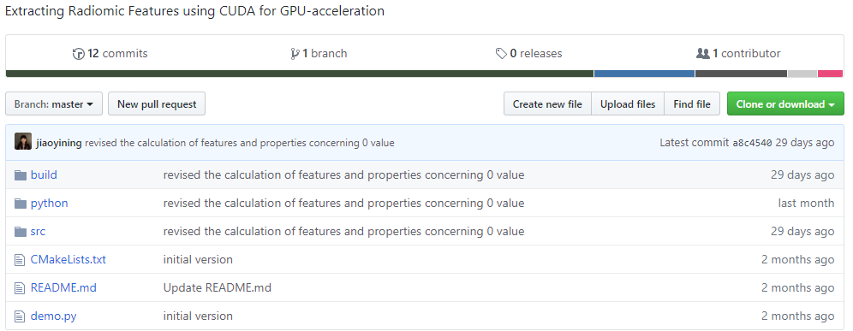
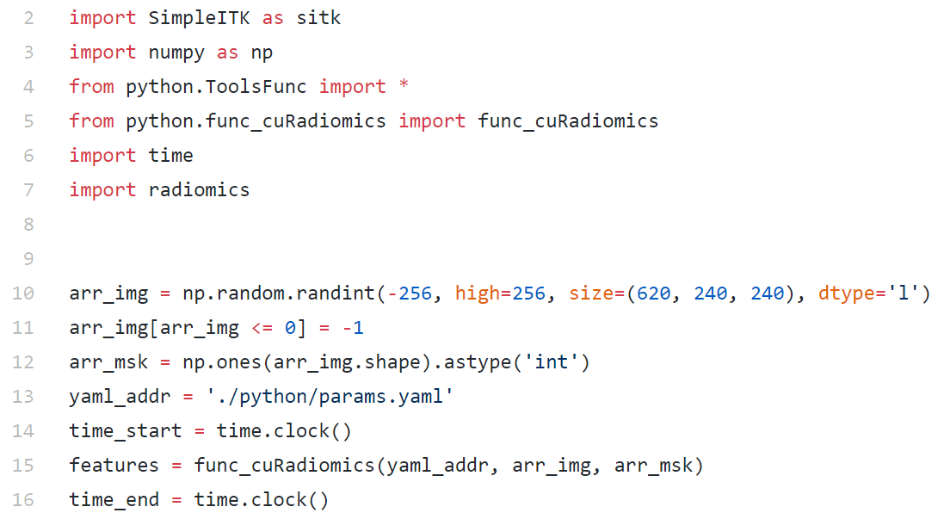
Online Resource
Github
https://github.com/jiaoyining/cuRadiomics
Function Usage
func_cuRadiomics(yaml_addr, arr_img, arr_msk)
arr_img: image batch
arr_msk: mask batch
yaml file: extraction setting
• params.yaml
>> First Order: 1
>> GLCM: 1
(1 --- enable, 0 --- disable)
>> Label: 1 (label number)
Notes:
Here is a brief introduction of how to use cuRadiomics.
Our code can be downloaded at github.
The CUDA code is packaged into a dynamic link library. We can call it on Python platform.
The input is a yaml file, image batch and mask batch.
Here we show an example of yaml file.

Slide 13
Thanks for attention!
Email: jiaoyining@sjtu.edu.cn
Website: jiaoyining.github.io

