Slide 1
LIVA
A Lite Version of Java
Shanqi Lu, Jiafei Song, Zihan Jiao, Yanan Zhang, Hyoyoon Kate Kim

Slide 2
Introduction
What we are looking for from LIVA
Simple
It is designed to let programmers, who are familiar with class-based languages, to feel comfortable with developing common algorithms like GCD. It is lite in the sense that it maintains some but not all features in Java.
Object-Oriented
It has a Java-like syntax and supports object-oriented paradigm and inheritance.
Portable
LIVA is a portable language and compiled down to LLVM.

Slide 3




Tools
01
02
03
04
GitHub
VMware
Ubuntu
OS X
Version Control
Make Development Consistent
Operating System
Operating System

Slide 4
Project Schedule
36 Days’ Project !!!
Proposal
Hello World Milestone
Brain storm for proposed language design
milestone with main function call and print feature
July 6 - July 11
July 12- July 20
July 21- Aug 1
Aug 2- Aug 11
Language Reference Manual
Final Work
Syntax and scope determined
All features and test suite completed

Slide 5
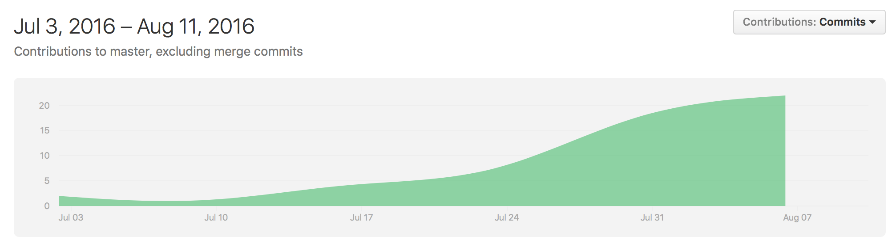
GitHub History

Slide 6
Features
LIVA
Types
Operators
Functions
Classes
Inheritance
cv
Arrays
Loops
cv
If-Else
cv
Standard Library

Slide 7
Syntax
LIVA
Type
Operators
Comments
int a = 1; float b = 2.2; char c = '3'; boolean d = true;
int[] x = new int[10]; float[] y = new float[10]; y[1] = 1.0;
| '+' { PLUS }
| '-' { MINUS }
| '*' { TIMES }
| '/' { DIVIDE }
| '%' { MODULO }
| '=' { ASSIGN }
| "==" { EQ }
| "!=" { NEQ }
| '<' { LT }
| "<=" { LEQ }
| ">" { GT }
| ">=" { GEQ }
| "&" { AND }
| "|" { OR }
| "!" { NOT }
/*This is a Liva comment!*/

Slide 8
Syntax
Control Flow
Class
Object
int i; for (i=0; i<10; i=i+1){ print(i); } while (i > 0){ print(i); i = i - 1; } if (true){ print(42); } else { print(8); }
class myclass{ int calc (int x, int y){ int z; z = x + y; return (z); } } class subcls extends myclass{ int b; constructor(int a){ this.b = a; } int calc (int x, int y){ int z; z = x - y; return (z); } }
class test { void main(){ int x = 9; int y = 6; int z; class myclass obj = new myclass(); z = obj.calc(x, y); print ("z=",z); } }

Slide 9
Architecture
Source Code
.liva file
LLVM
Scanner
Parser
AST
SAST
Code
Generation
AST

Slide 10
AST
PROGRAM
Classes
Fields
Methods
Constructors
SUCCESS
Constructors
Expressions
Statements

Slide 11
SAST
PROGRAM
Classes
Main
Reserved
Functions
Fields
Name
Function
SUCCESS
Return Type
Function Type
Formals
Body
Name

Slide 12
Testing
Test procedure
Compile and run test-if1.liva
Compare the output with test-if1.out
If they are the same, done! Otherwise, find out the problems.
120 test files
All passed!
Testall.sh
Based on the test script of MicroC
Test all files in a single command

Slide 13
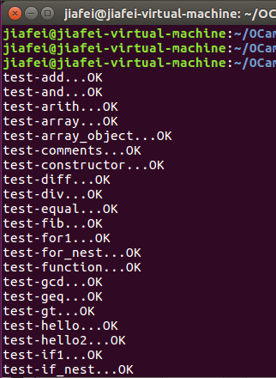
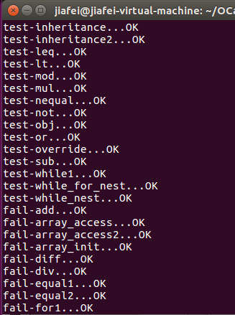
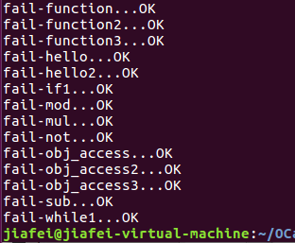
Testing

Slide 14





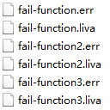
Testing
Unit Test
Successful & Unsuccessful
Small pieces

Slide 15



Testing
Integration Test
Small tests integated into larger one

Slide 16
Lessons Learned
Time Management
Start the project early
Cooperation
Teamwork and integration
Communication
Avoid doing the same work
Software Tools
Efficiency improvement

Slide 17
DEMO

