Slide 1
QWGCN · MANUSCRIPT AND EXPERIMENT AUDIT
10 SEP 2026
Project Review
Projects 1–8
Generated figures, runtime evidence, reproducibility,
and final manuscript verification
Physics sign consistency · Figures 1 / 2 / 4 / 6 · Table II · Final compile
Notes:
QWGCN Project Review deck. Scope: Projects 1–8 and their generated local evidence images.

Slide 2
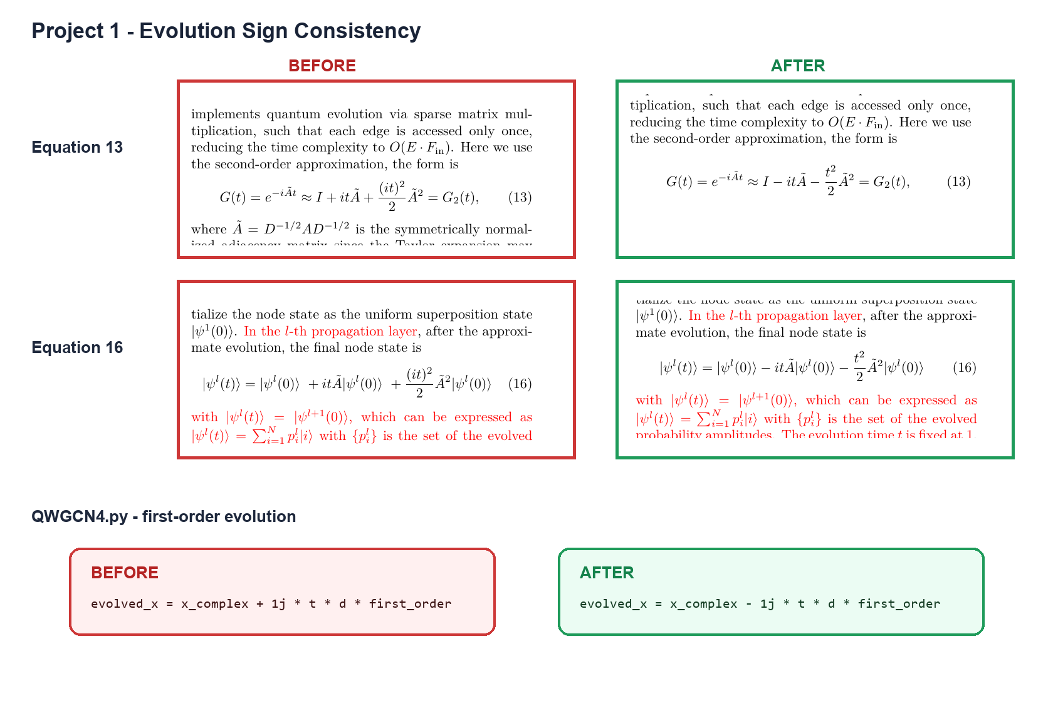
Evolution sign consistency
PROJECT 1
Corrected exp(-iAt) and the second-order Taylor sign across code and manuscript
2
Notes:
Source: project1_before_after.png. Evidence compares the old positive first-order sign with the corrected negative first-order sign in Eq. 13, Eq. 16, and QWGCN4.py.

Slide 3
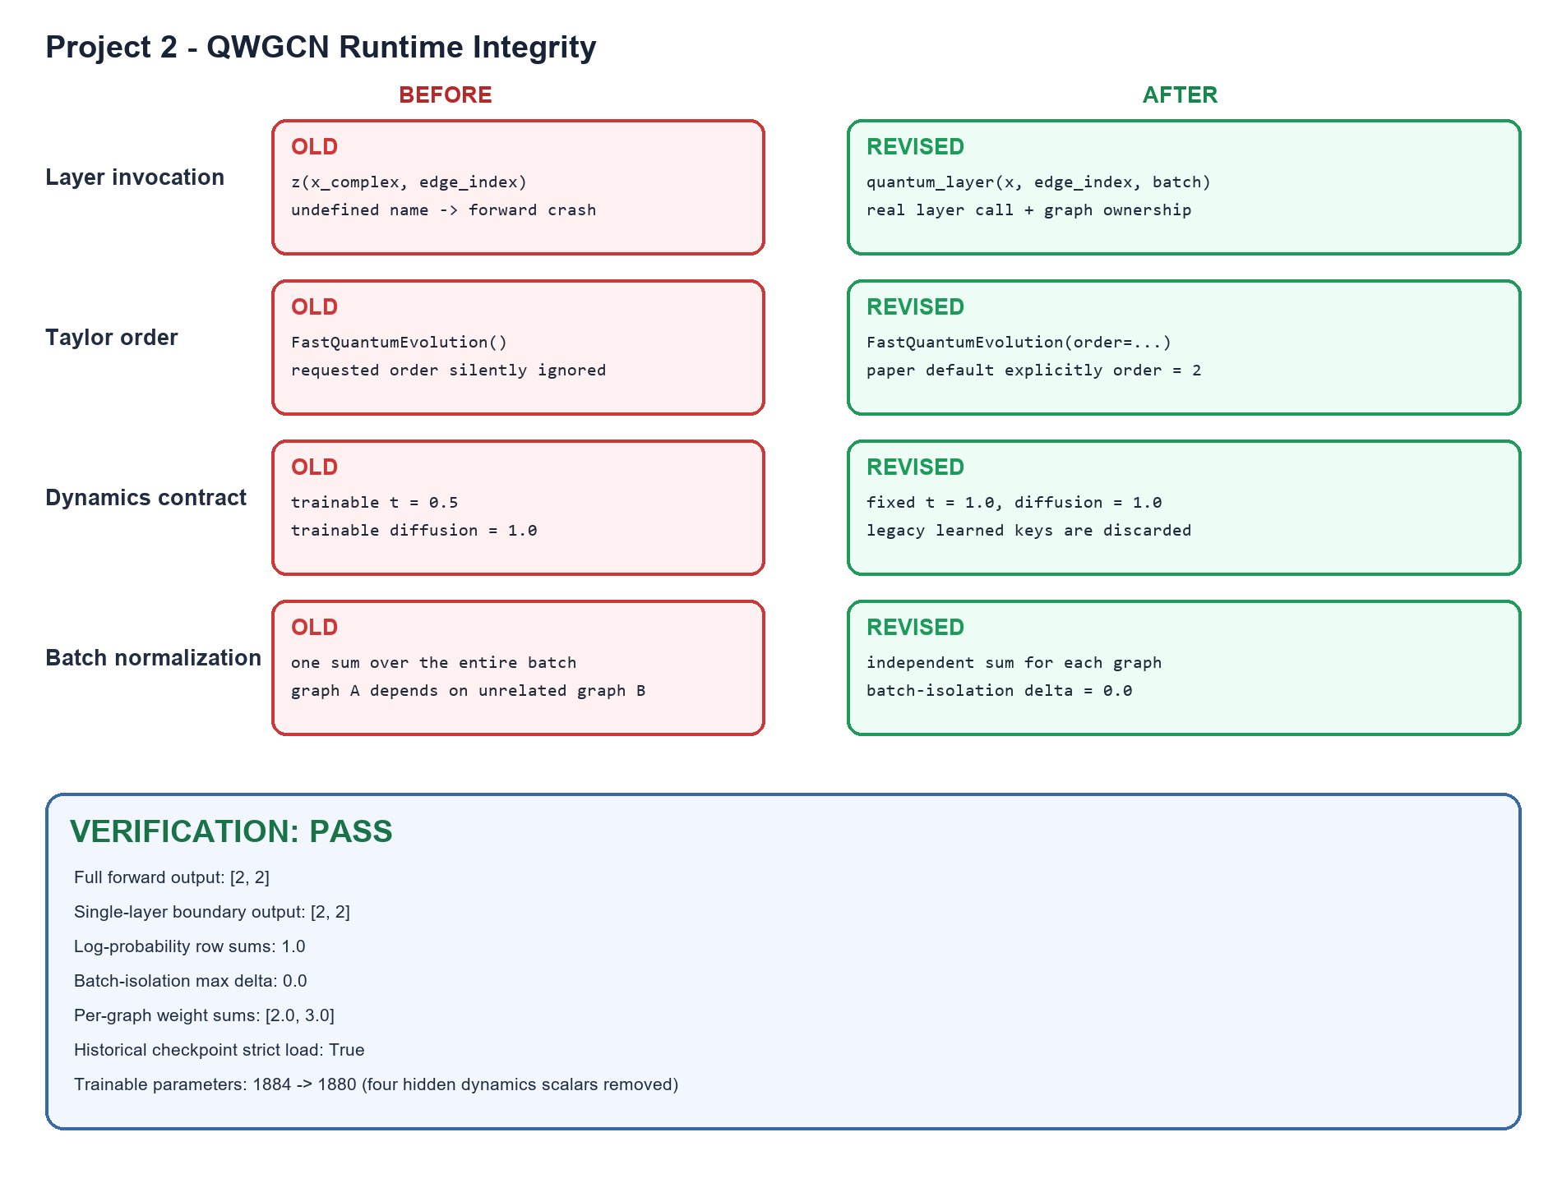
Runtime integrity
PROJECT 2
Executable, order-aware propagation with shared batch scaling and trainable time
3
Notes:
Source: project2_runtime_integrity_comparison.png. Summary of the runtime-integrity repairs and validation status.

Slide 4
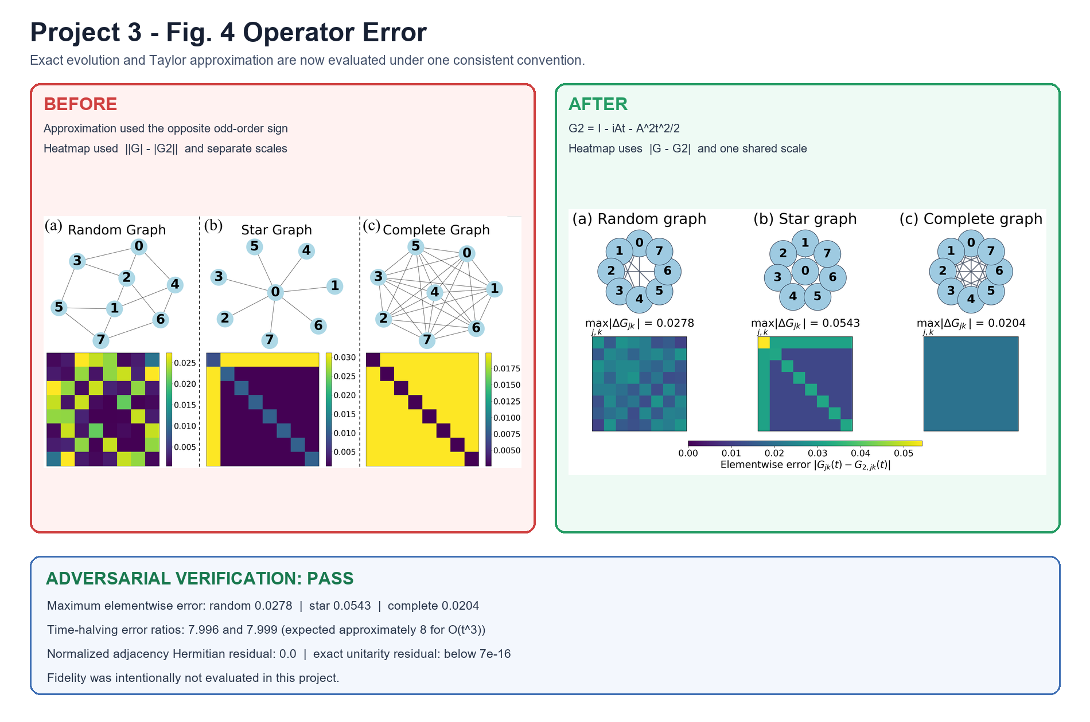
Figure 4 operator error
PROJECT 3
Sign-consistent approximation errors shown on a shared vertical scale
4
Notes:
Source: project3_fig4_before_after.png. The repaired comparison applies the corrected sign convention and a common scale across topologies.

Slide 5
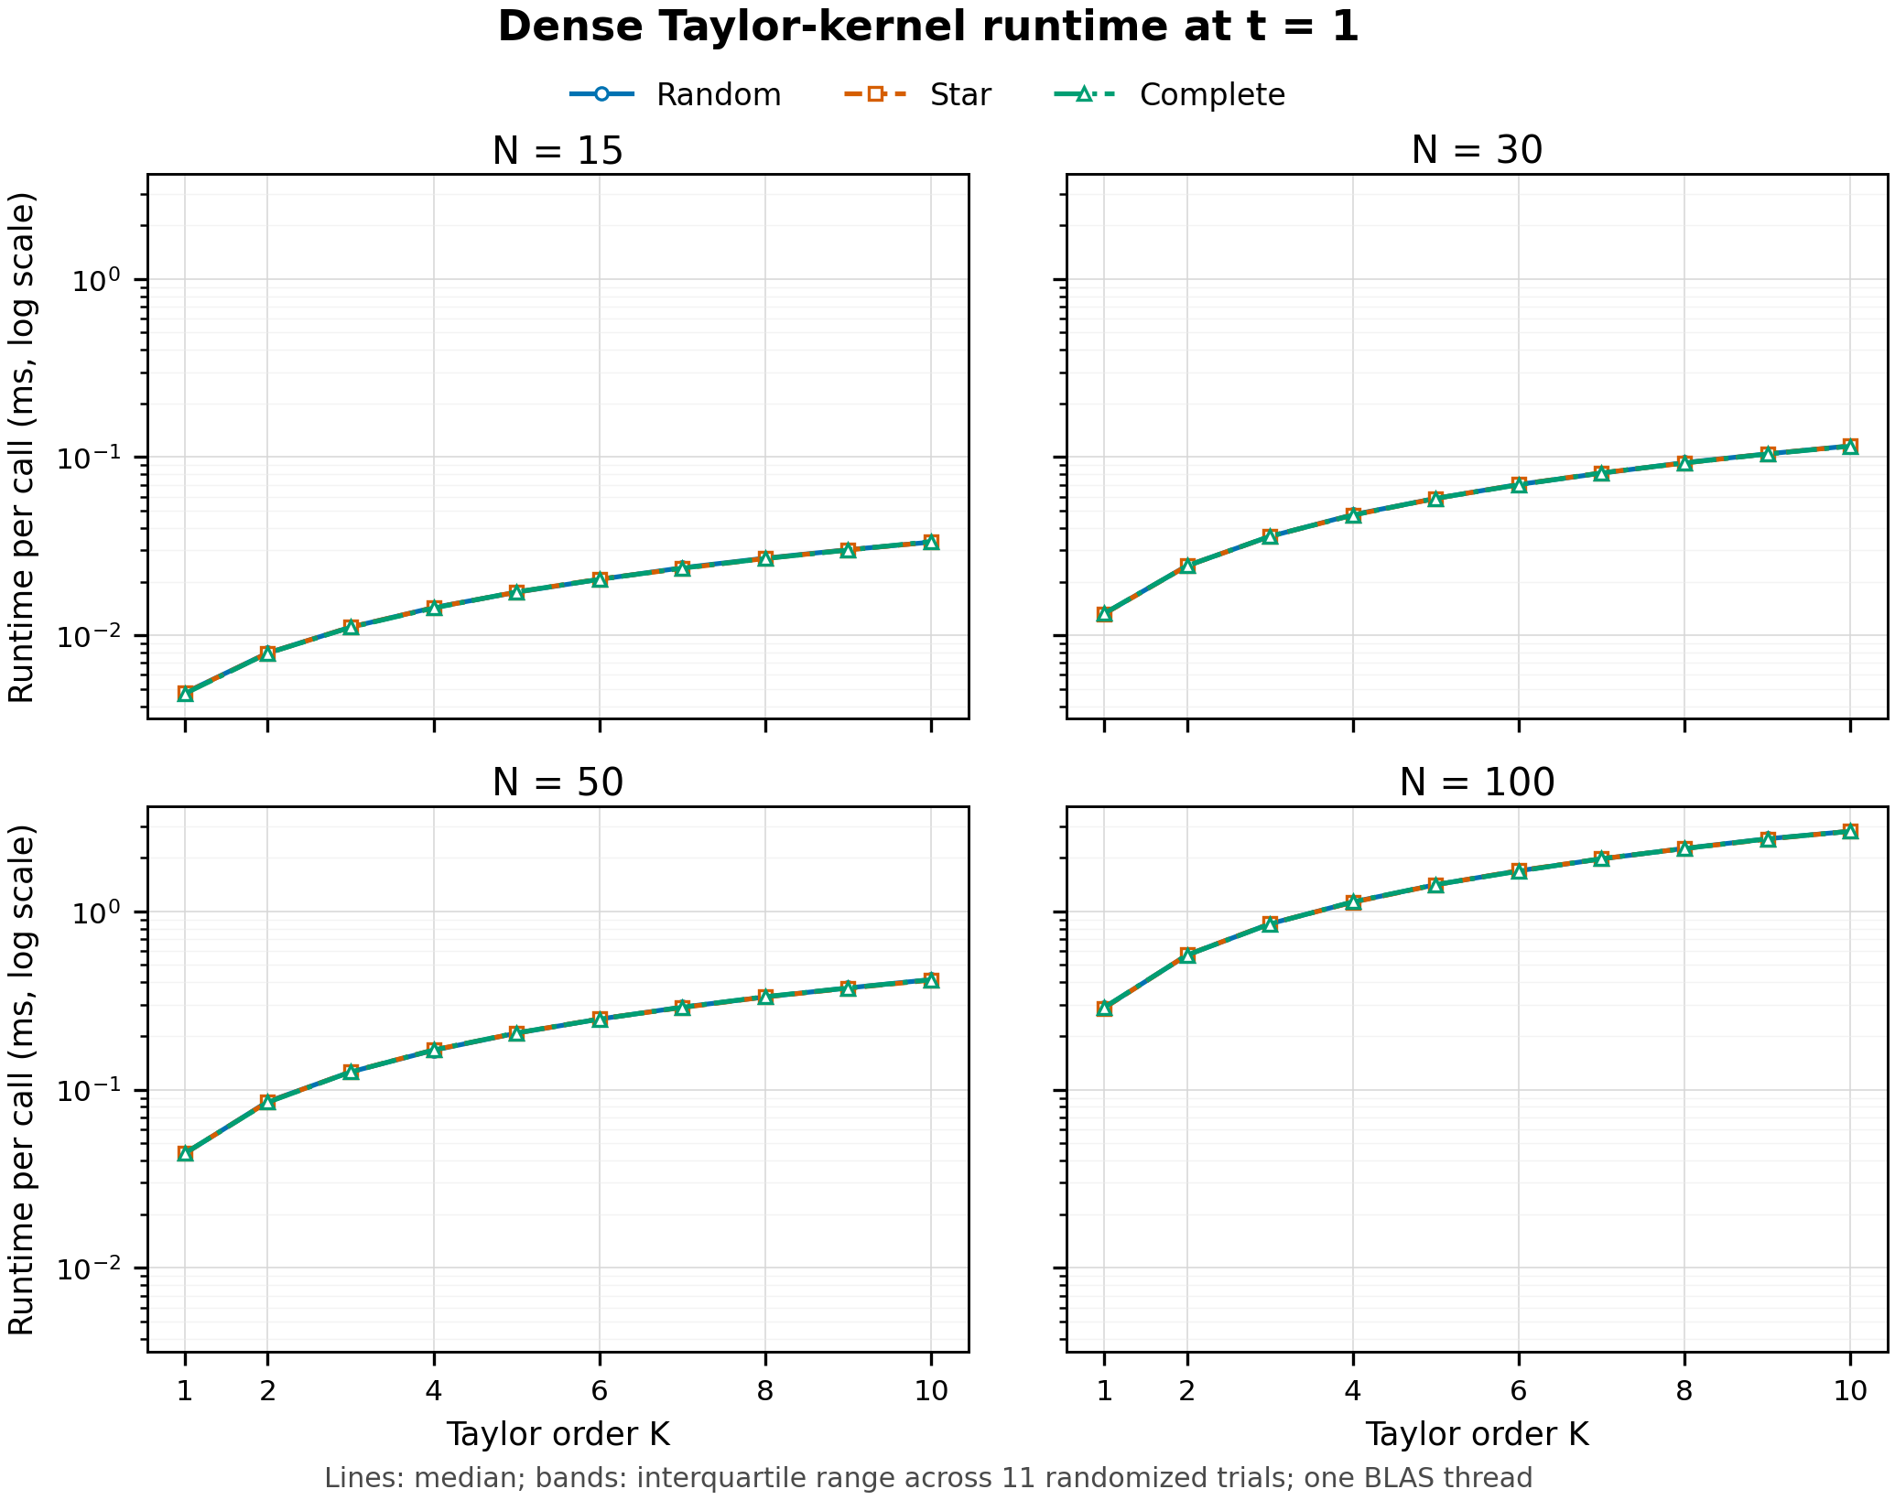
Figure 6 runtime benchmark
PROJECT 4
Measured dense Taylor-kernel runtime at t = 1 for graph sizes N = 15, 30, 50, and 100
5
Notes:
Source: node_time_1.png. This is a dense reference-kernel benchmark, not end-to-end training time and not a sparse QWGCN benchmark.

Slide 6
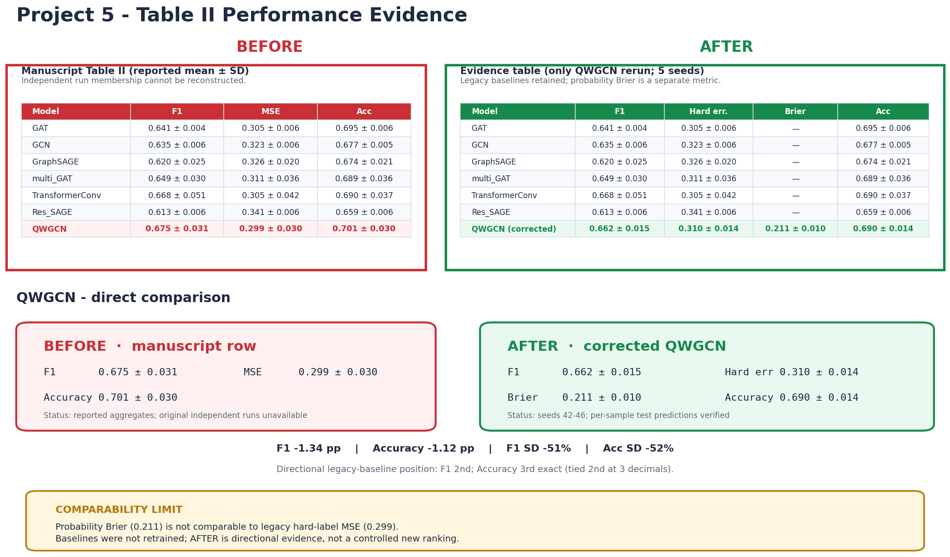
Table II reproducibility
PROJECT 5 · A
Corrected QWGCN rerun evidence for seeds 42–46, with comparability limits retained
6
Notes:
Source: project5_table2_before_after.png. Only the corrected QWGCN was rerun; baseline models were not retrained under a newly controlled protocol.

Slide 7
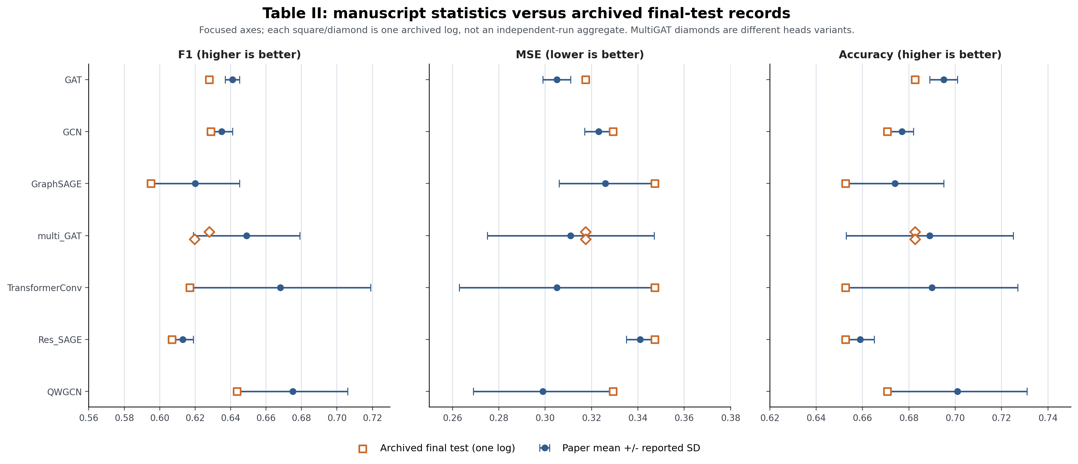
Table II performance comparison
PROJECT 5 · B
Manuscript statistics compared with archived final-test records
7
Notes:
Source: table2_performance_comparison.png. Archived snapshots are not treated as independent-run aggregates.

Slide 8
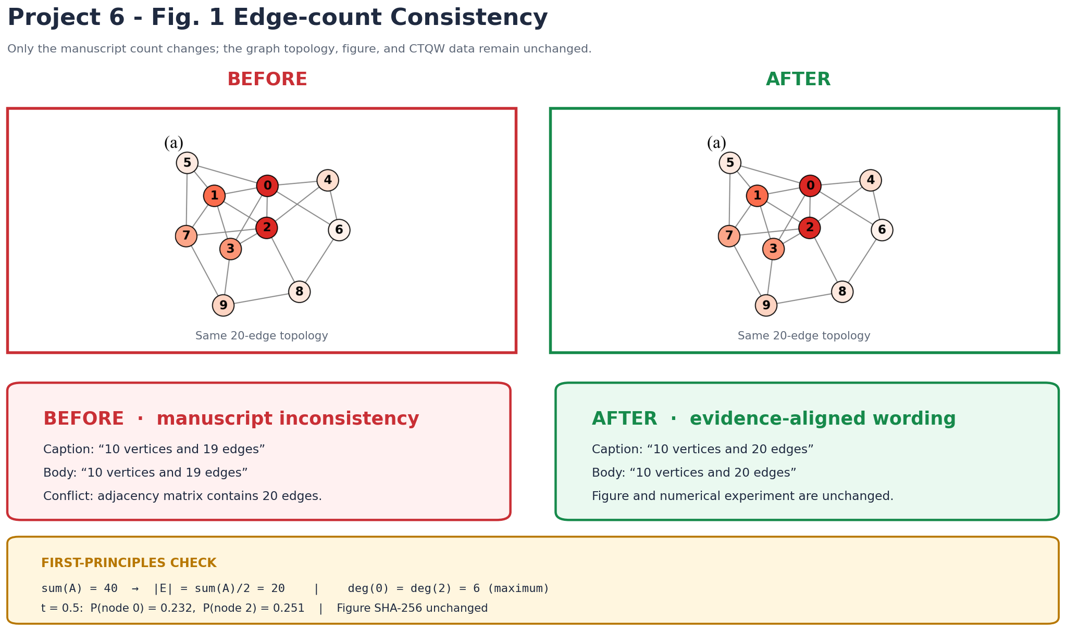
Figure 1 edge count
PROJECT 6
Topology audit confirms the corrected undirected edge count |E| = 20
8
Notes:
Source: project6_fig1_before_after.png. The topology and rendered figure remain unchanged; only the reported edge count is corrected.

Slide 9
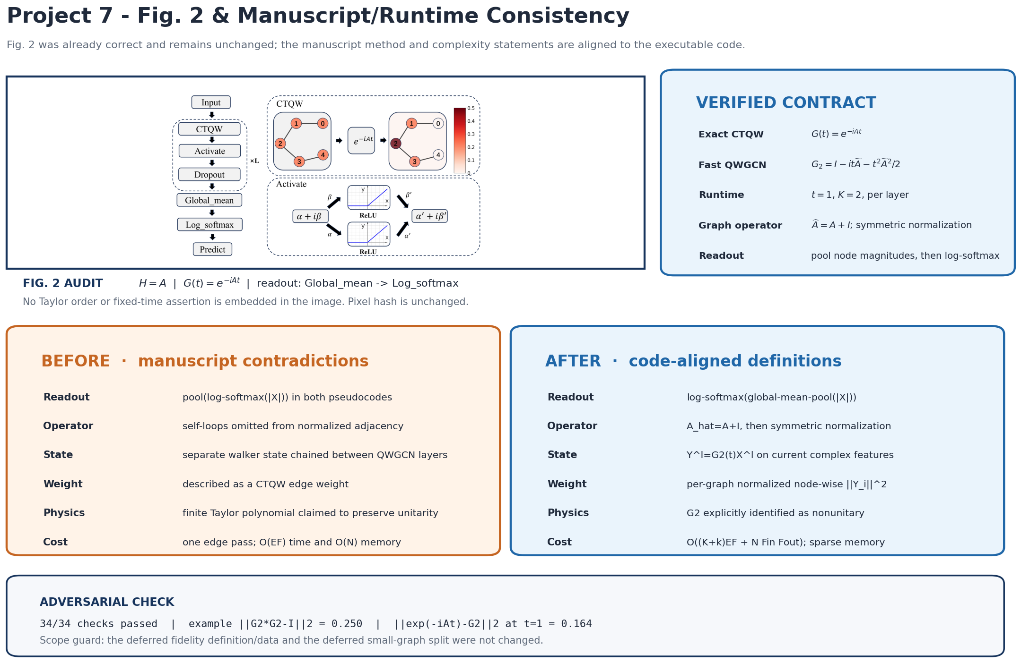
Figure 2 text consistency
PROJECT 7
Exact CTQW evolution and nonunitary order-2 QWGCN approximation are distinguished
9
Notes:
Source: project7_fig2_before_after.png. The audit verifies the figure was already consistent with the corrected manuscript and runtime definitions.

Slide 10
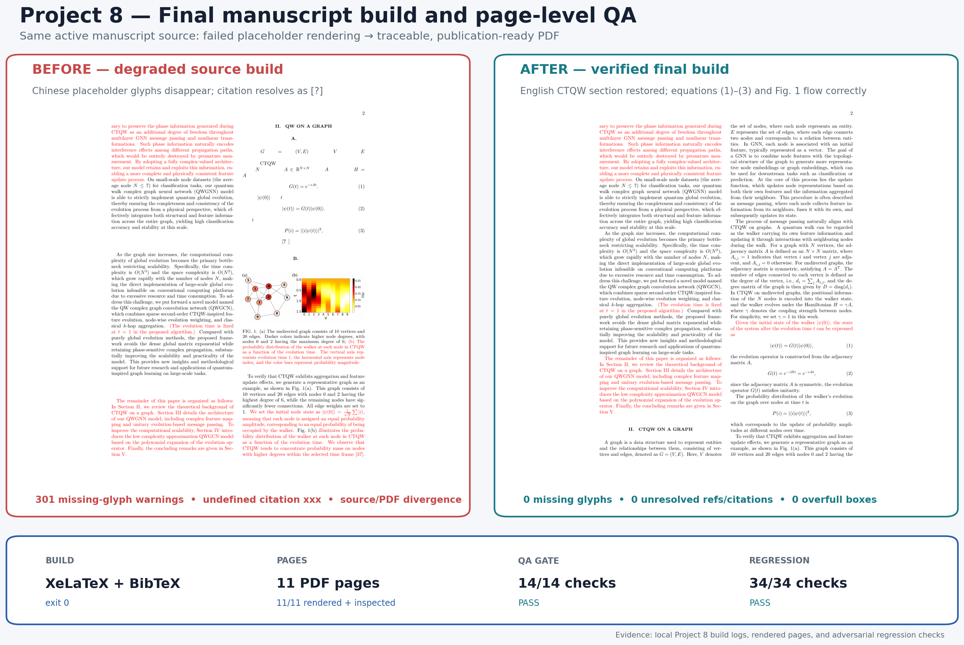
Final manuscript compile
PROJECT 8
Clean English CTQW build with glyph, reference, overflow, and page-count checks passed
10
Notes:
Source: project8_final_compile_before_after.png. Final compile audit reports 0 missing glyphs, 0 unresolved references, and 0 overfull boxes.

