Slide 1
Palmprint Verification on Mobile Phones
June 2022

Slide 2
Pipeline
Use YOLO-v4-tiny to detect Double Finger Gap and Palm Center
Construct a local coordinate system and extract the ROI
Resize the ROI to 224 X 224 and feed the resized ROI to the MobileFaceNet to extract a 512-dimensional feature vector
Compute the dot product of the features
Major Work
Train the YOLO-v4-tiny model using the D dataset in Generation
Prepare training set and test set for MobileFaceNet and train the model
Evaluate the MobileFaceNet on test set and determine the threshold
Implement the verification system in an Android application (totally local)
Perform some experiments on Mobile ViT

Slide 3
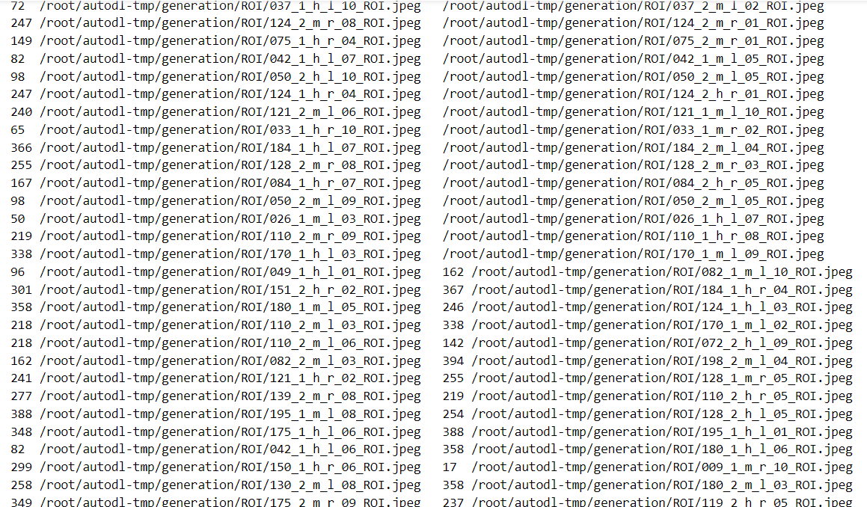
Training Set and Test Set
The MPD ROI dataset contains 16,000 images from 400 hands of 200 persons (40 images for each hand)
Palmprint ROI images from 160 subjects were selected as the training set, and ROI images from the remaining 40 subjects formed the test set.
Data augmentation is performed on the training set RandomResizedCrop: scale and ratio are both [0.75, 1.25] ColorJintter: brightness is 0.25, the rest of parameters are all 0.1
All images in the training set are flipped horizontally and labelled as a new class (So there are 160 x 2 x 2 = 640 classes in the training set)
We prepared the test set with reference to LFW datasets. Our testing set contains 8000 pairs of images (4000 pairs from the same hand and 4000 pairs from two different people but of the same side)
The test set is divided into 10 folds for cross validation (each fold contains 400 pairs from the same hand and 400 pairs from two different people but of the same side)

Slide 4
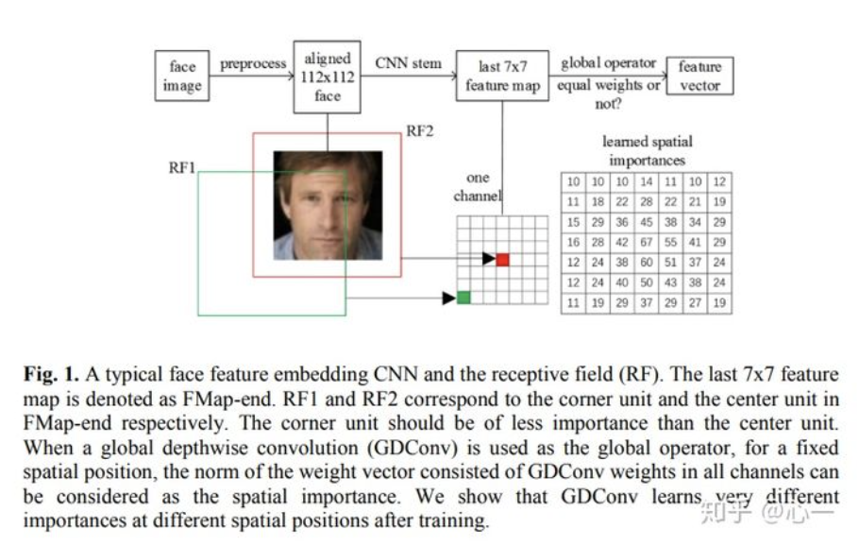
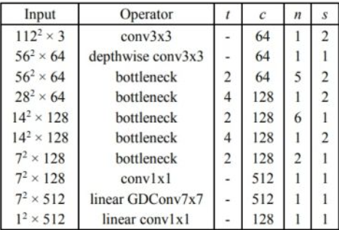
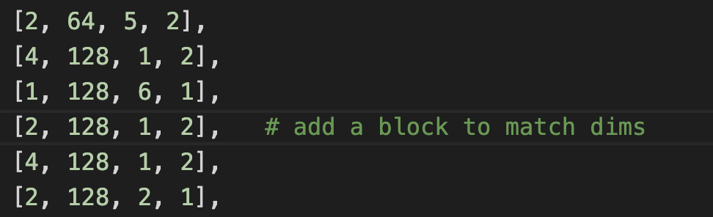
MobileFaceNet
Resize ROI to 224 x 224
After removing the linear layer, use ArcMargin instead
Change the parameter of the block to match the size of input images

Slide 5
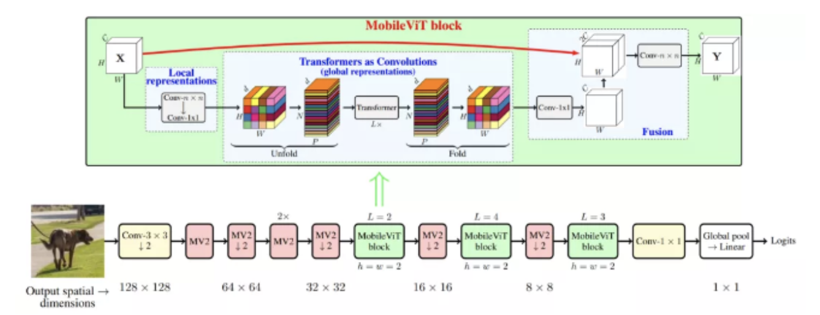
MobileViT
The computational cost of ordinary convolutional layers is high
Deeply separable convolution is widely used in state-of-the-art lightweight CNN mobile vision tasks, including MobileNets, ShuffleNetv2.
However, they are spatially localized. MobileVit exploits the advantages of convolution and Transformer to build lightweight ViT models.
Notes:
CNN的基本构建层是标准的卷积层。由于这一层的计算成本很高，人们提出了几种基于因子分解的方法，使其变得轻量化以方便移动设备的部署。
其中，深度可分离卷积引起了人们的兴趣，并被广泛应用于最先进的轻量级CNN移动视觉任务，包括MobileNets、ShuffleNetv2、ESPNetv2、MixNet和MNASNet。这些轻量级CNN是多功能的，易于训练。
例如，这些网络可以很容易地取代现有特定任务模型(如DeepLabv3)中的heavyweight backbones(如ResNet)，以减少网络规模并降低延迟。尽管有这些好处，但这些方法的一个主要缺点是它们在空间上是局部的。
这项工作将Transformer视为卷积;允许利用卷积和Transformer(例如，全局处理)的优点来构建轻量级和通用ViT模型。

Slide 6
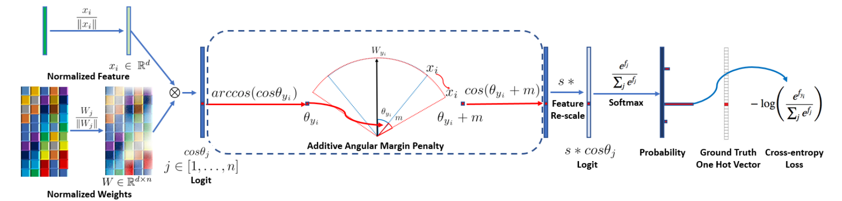
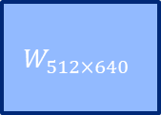
Training and Validation
$$W_{512×640}$$
MobileFaceNet
Multiply
ArcMargin
224x224x3
ROI
512-d
feature
640-d
raw logits
640-d
logits
Train the network using ArgFace Framework
Perform 10-fold validation on test set (use 9 folds to determine the threshold which maximize the accuracy and test the threshold on the remaining 1 fold)
Perform Top-1 test: for each palm, randomly select an image as the registration image, take the rest of the images as input, and compare the selected image with the registration images one by one to find the palm from which the input image is taken

Slide 7
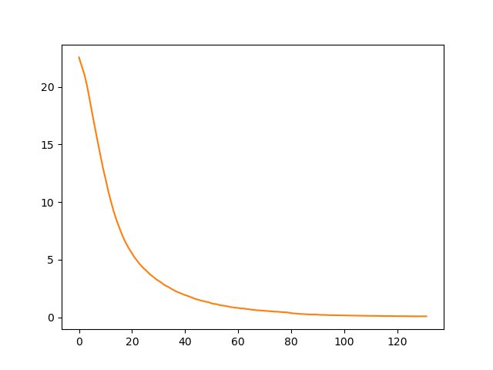
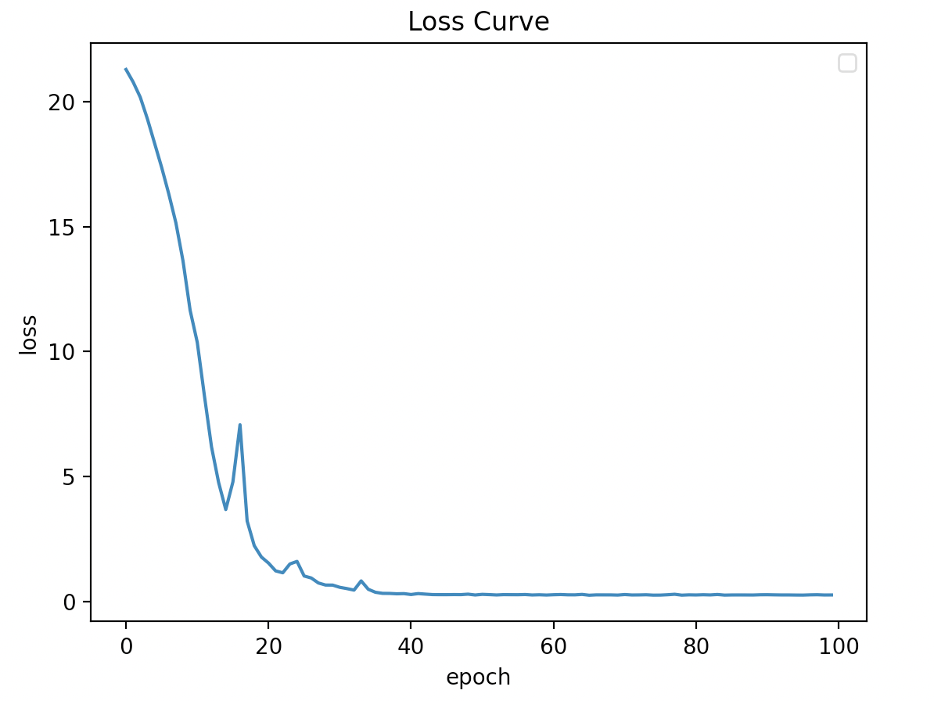
MobileFaceNet and MobileVit
Loss Curve MobileFaceNet MobileVit
Flops
Params
Extraction time
10-fold validation accuracy
Top-1 accuracy
2.8G
0.7M
0.8s
98.86%
97.70%
(98.06% on original paper)
0.7G
0.9M
0.65s
93.5%
81.3%
Notes:
FLOPS：floating point operations per second,每秒浮点数运算，即“吞吐量”，衡量速度，一般与硬件相关。越大越好。
FLOPs：floating point operations,浮点数运算，指计算量，越小越好。

Slide 8
Determine the Threshold
We determine the threshold of dot product based on the False Acceptance Rate (FAR)
The table shows the thresholds and corresponding True Positive Rates (TPR) when FAR takes different values
For the sake of security, we chose the threshold corresponding to FAR=1e-4 as the final threshold to build a smartphone palmprint verification application. (threshold = 0.432)
FAR | Threshold | TPR
1e-1 | 0.1726 | 0.998
1e-2 | 0.2979 | 0.986
1e-3 | 0.4222 | 0.921
1e-4 | 0.4320 | 0.914
Notes:
FLOPS：floating point operations per second,每秒浮点数运算，即“吞吐量”，衡量速度，一般与硬件相关。越大越好。
FLOPs：floating point operations,浮点数运算，指计算量，越小越好。

Slide 9
Demo Android Application
Notes:
FLOPS：floating point operations per second,每秒浮点数运算，即“吞吐量”，衡量速度，一般与硬件相关。越大越好。
FLOPs：floating point operations,浮点数运算，指计算量，越小越好。

