Slide 1
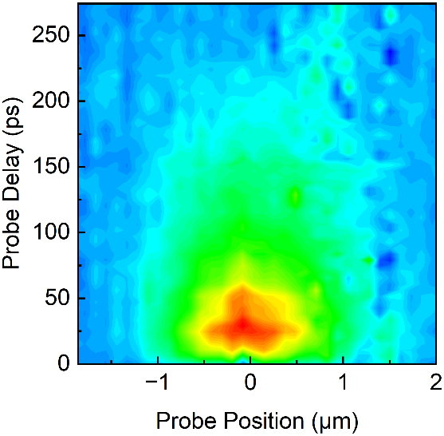
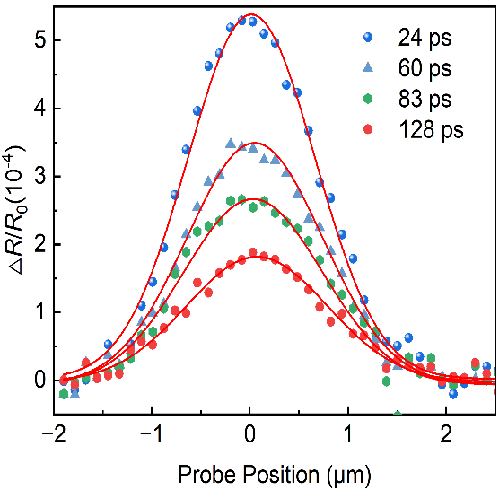
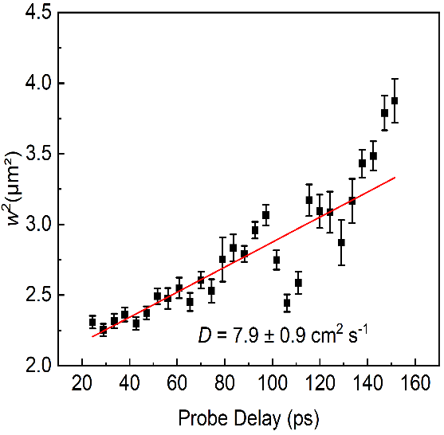

(a)
△R/R₀ (10⁻⁴)
(b)
(c)
5.6
3.1
0.0

