Slide 1
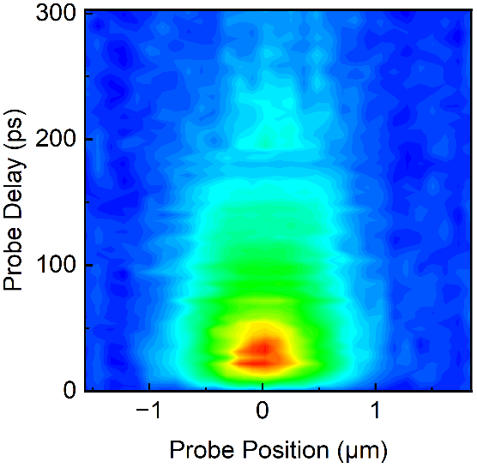
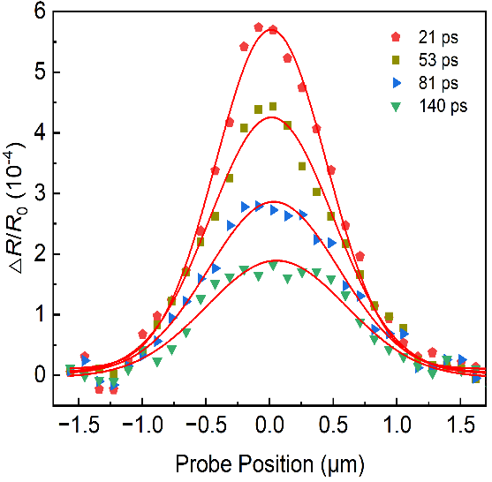
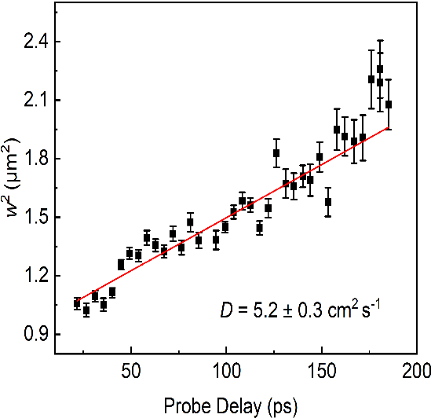

(a)
(b)
(c)
△R/R₀ (10⁻⁴)
5.9
3.6
0.0

