Slide 1
生产计划体系

Slide 2
7. 生产计划的优化模型
生产计划体系
7.1 问题建模要素分析
7.2 基本生产规划优化模型
7.3 单级能力约束的生产计划优化模型
7.4 多级能力约束的生产计划优化模型

Slide 3
7.1 问题建模要素分析
生产计划体系
生产启动结构
(Setup Structure)
计划层级
(Number of Levels)
物料衰退性
(Deterioration)
能力
(Capacity constraints)
需求
(Demand)
对象数量
(Number of Products)
计划展望期
(Planning Horizon)
t

Slide 4
7.1 问题建模要素分析
生产计划体系
建模要素 | 要素分类
计划展望期 | Finite / Infinite
计划层级 | Single-level / Multi-level
对象数量 | Single-item / Multi-item
需求 | Static demand / Dynamic demand Deterministic / Probabilistic Independent / Dependent
能力 | Uncapacitated / Capacitated
物料衰退性 | No / Yes
生产启动结构 | Simple setup / Complex setup

Slide 5
7.2 基本生产规划优化模型
生产计划体系
回顾：扩展的生产规划模型：
输入
资源 (Resources) | 劳力(Workforce) 设施(Facilities)
需求预测(Demand Forecast)
政策 (Policy Statement) | 外包(Outsourcing) 加班(Overtime) 退货(Back orders) 库存水平(Inventory Levels)
成本 (Costs) | 持有成本(Inventory carrying) 退货成本(Back orders) 聘用/解聘成本(Hiring/firing) 加班费用(Overtime) 库存变化(Inventory changes) 分包成本(Subcontracting)
输出
总成本
预期水平 | 库存(Inventory) 产出(Output) 雇佣(Employment) 分包(Subcontracting) 退货(Backordering)
生产规划
参数
(Parameters)
决策
(Decisions)

Slide 6
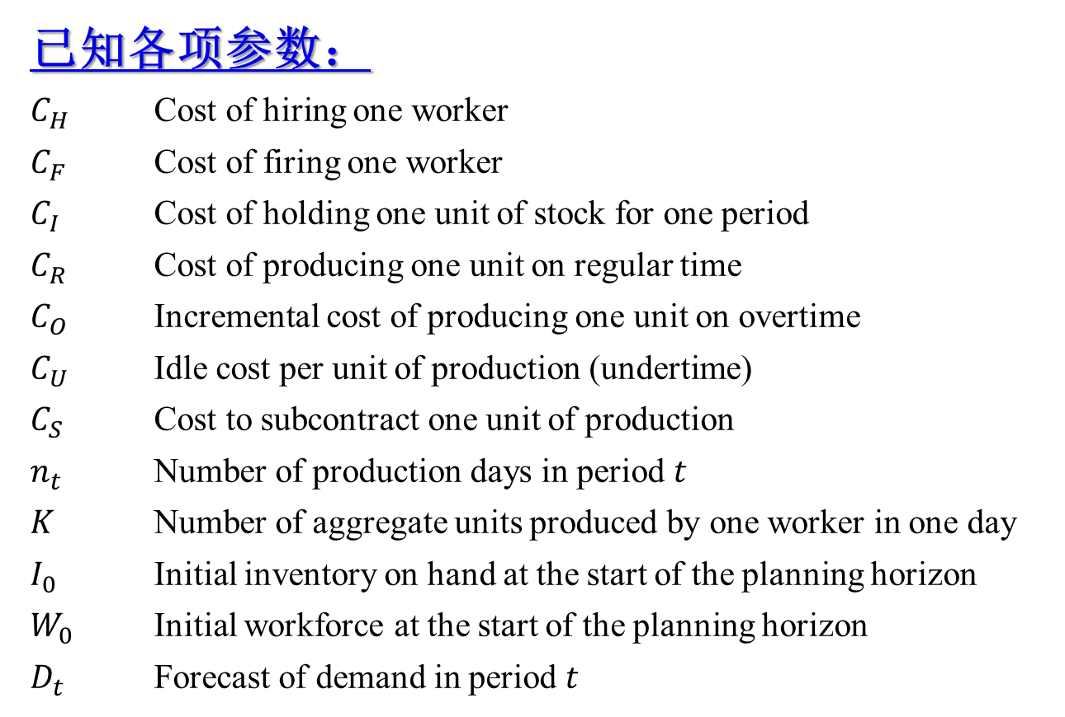
7.2 基本生产规划优化模型
生产计划体系
已知各项参数：
$C_{H}$ Cost of hiring one worker
$C_{F}$ Cost of firing one worker
$C_{I}$ Cost of holding one unit of stock for one period
$C_{R}$ Cost of producing one unit on regular time
$C_{O}$ Incremental cost of producing one unit on overtime
$C_{U}$ Idle cost per unit of production (undertime)
$C_{S}$ Cost to subcontract one unit of production
$n_{t}$ Number of production days in period $t$
$K$ Number of aggregate units produced by one worker in one day
$I_{0}$ Initial inventory on hand at the start of the planning horizon
$W_{0}$ Initial workforce at the start of the planning horizon
$D_{t}$ Forecast of demand in period $t$

Slide 7
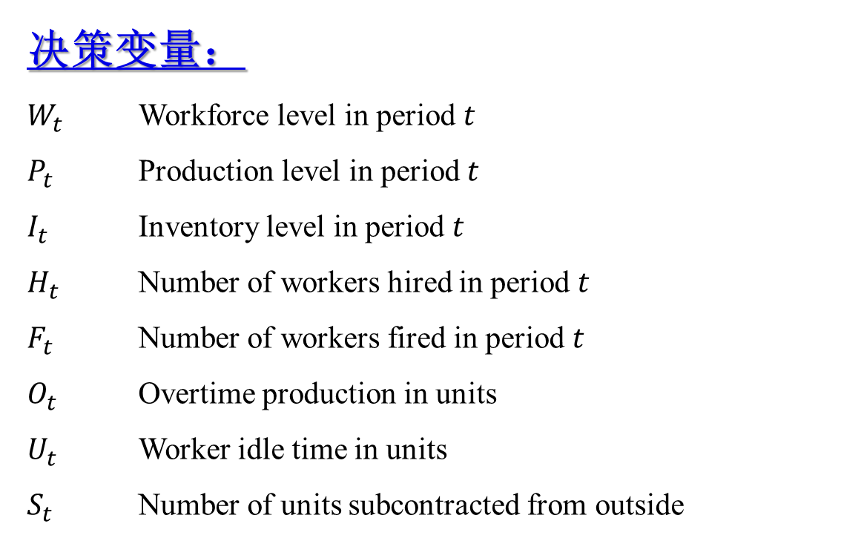
7.2 基本生产规划优化模型
生产计划体系
决策变量：
$W_{t}$ Workforce level in period $t$
$P_{t}$ Production level in period $t$
$I_{t}$ Inventory level in period $t$
$H_{t}$ Number of workers hired in period $t$
$F_{t}$ Number of workers fired in period $t$
$O_{t}$ Overtime production in units
$U_{t}$ Worker idle time in units
$S_{t}$ Number of units subcontracted from outside

Slide 8
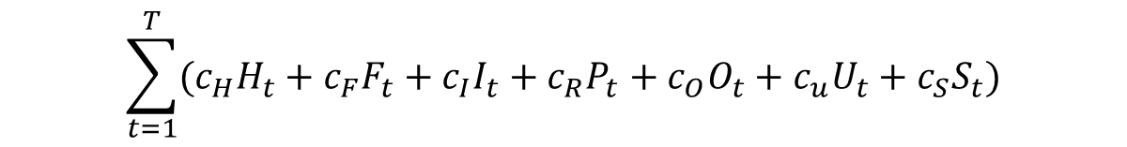
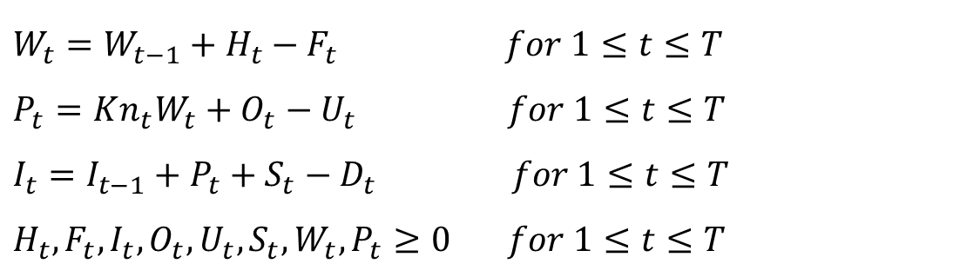
7.2 基本生产规划优化模型
生产计划体系
问题数学模型：
min
s.t.
$$\sum_{t=1}^{T}{(c_{H}H_{t}+c_{F}F_{t}+c_{I}I_{t}+c_{R}P_{t}+c_{O}O_{t}+c_{u}U_{t}+c_{S}S_{t})}$$
$W_{t}=W_{t−1}+H_{t}−F_{t} for 1≤t≤T$
$P_{t}=Kn_{t}W_{t}+O_{t}−U_{t} for 1≤t≤T$
$I_{t}=I_{t−1}+P_{t}+S_{t}−D_{t} for 1≤t≤T$
$H_{t},F_{t},I_{t},O_{t},U_{t},S_{t},W_{t},P_{t}≥0$ $for 1≤t≤T$
Reference: Nahmias S. Production and Operations Analysis (7th Edition). 北京: 清华大学出版社, 2018

Slide 9
7.3 单级能力约束的生产计划优化模型
生产计划体系
Capacitated Lot Sizing Problem (CLSP)
能力约束批量优化问题
能力
(Capacity constraints)
需求
(Demand)
计划展望期
(Planning Horizon)
t

Slide 10

7.3 单级能力约束的生产计划优化模型
生产计划体系
问题符号（参数与变量）：
$T$ number of periods in the planning horizon
$P_{it}$ production (lot size) of item $i$ in period $t$
$I_{it}$ inventory of item $i$ at the end of period $t$
($I_{i1}=I_{iT}=0$,without loss of generality)
$Y_{it}$ a binary variable that assumes value $1$
if item $i$ is produced in period $t$ and $0$, otherwise
$R_{t}$ available capacity in period $t$
$d_{it}$ demand for item $i$ in period $t$
$C_{it}$ unit production cost of item $i$ produced in period $t$
$S_{it}$ setup cost incurred if item $i$ is produced in period $t$
$M_{it}=\sum_{k=t}^{T}{d_{it}}$ upper bound on the production of item $i$ in period $t$
$a_{i}$ unit resource consumption for item $i$
$h_{it}$ unit holding cost of item $i$ at the end of period $t$

Slide 11


7.3 单级能力约束的生产计划优化模型
生产计划体系
问题数学模型：
min
s.t.
$$Z=\sum_{i=1}^{n}{\sum_{t=1}^{T}{\left(S_{it}Y_{it}+C_{it}P_{it}+h_{it}I_{it}\right)}}$$
$$\sum_{i=1}{a_{i}P_{it}≤R_{t}} \left(t=1,…,T\right),$$
$P_{it}+I_{i,t−1}−I_{it}=d_{it} \left(i=1,…,n;t=1,…,T\right)$,
$$P_{it}≤M_{it}Y_{it} \left(i=1,…,n;t=1,…,T\right),$$
$$Y_{it}∈\left\{0,1\right\} \left(i=1,…,n;t=1,…,T\right),$$
$$P_{it}≥0 \left(i=1,…,n;t=1,…,T\right),$$
$$I_{it}≥0 \left(i=1,…,n;t=1,…,T\right).$$
Reference: Karimi B., Fatemi Ghomi S.M.T., Wilson J.M. The capacitated lot sizing problem: a review of models and algorithms. Omega, 2003, 31(5): 365-378

Slide 12
7.4 多级能力约束的生产计划优化模型
生产计划体系
Multi-level Capacitated Lot Sizing Problem (MLCLSP)
多级能力约束批量优化问题
能力
(Capacity constraints)
需求
(Demand)
计划展望期
(Planning Horizon)
t

Slide 13
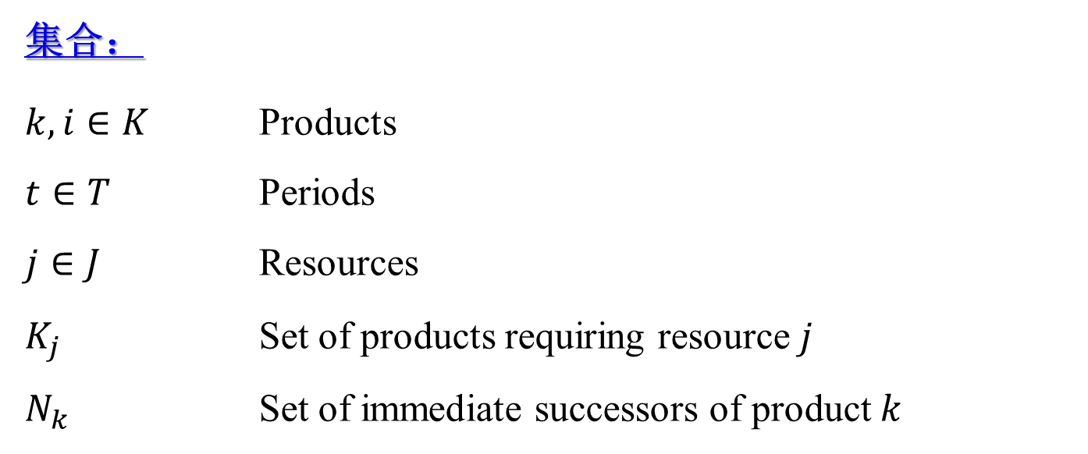
7.4 多级能力约束的生产计划优化模型
生产计划体系
Multi-level Capacitated Lot Sizing Problem (MLCLSP)
多级能力约束批量优化问题
集合：
$k,i∈K$ Products
$t∈T$ Periods
$j∈J$ Resources
$K_{j}$ Set of products requiring resource $j$
$N_{k}$ Set of immediate successors of product $k$

Slide 14
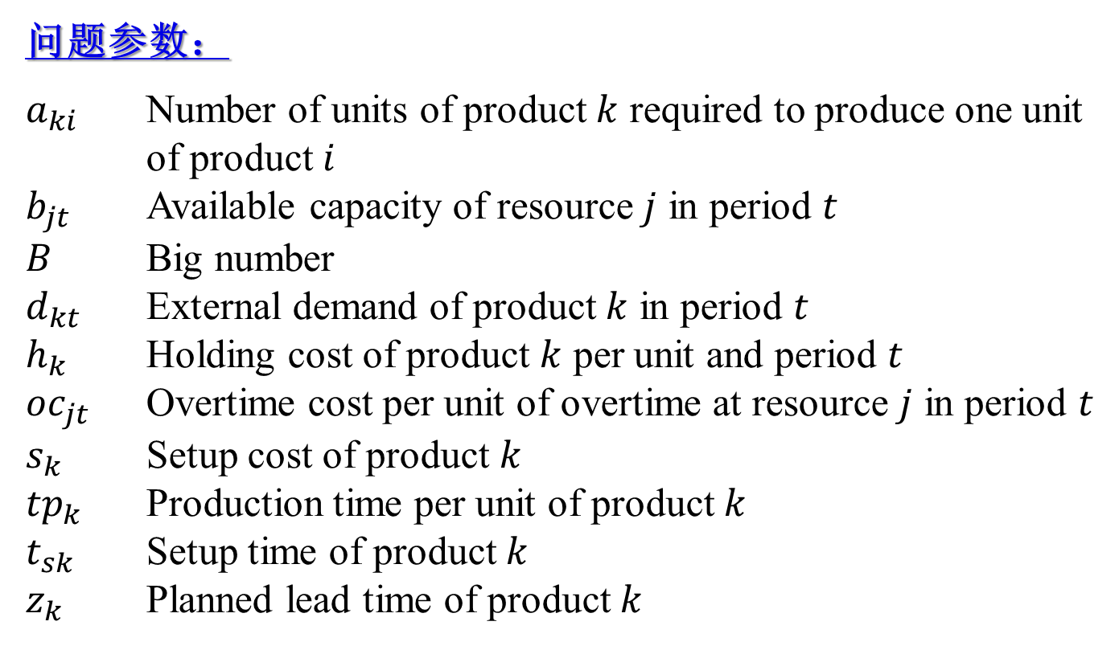
7.4 多级能力约束的生产计划优化模型
生产计划体系
问题参数：
$a_{ki}$ Number of units of product $k$ required to produce one unit of product $i$
$b_{jt}$ Available capacity of resource $j$ in period $t$
$B$ Big number
$d_{kt}$ External demand of product $k$ in period $t$
$h_{k}$ Holding cost of product $k$ per unit and period $t$
${oc}_{jt}$ Overtime cost per unit of overtime at resource $j$ in period $t$
$s_{k}$ Setup cost of product $k$
${tp}_{k}$ Production time per unit of product $k$
$t_{sk}$ Setup time of product $k$
$z_{k}$ Planned lead time of product $k$

Slide 15
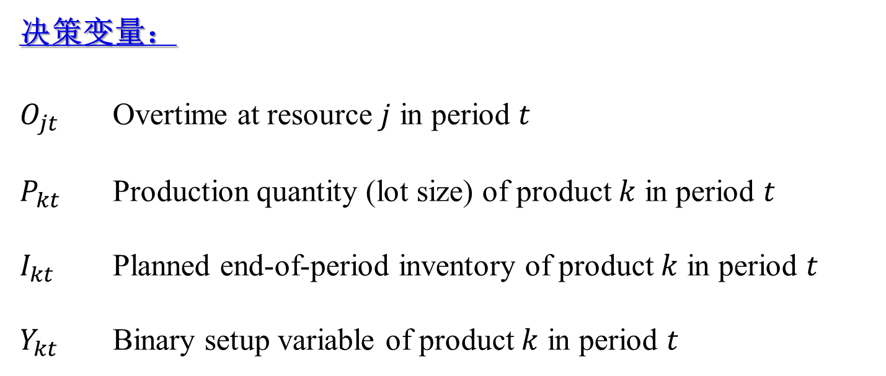
7.4 多级能力约束的生产计划优化模型
生产计划体系
决策变量：
$O_{jt}$ Overtime at resource $j$ in period $t$
$P_{kt}$ Production quantity (lot size) of product $k$ in period $t$
$I_{kt}$ Planned end-of-period inventory of product $k$ in period $t$
$Y_{kt}$ Binary setup variable of product $k$ in period $t$

Slide 16
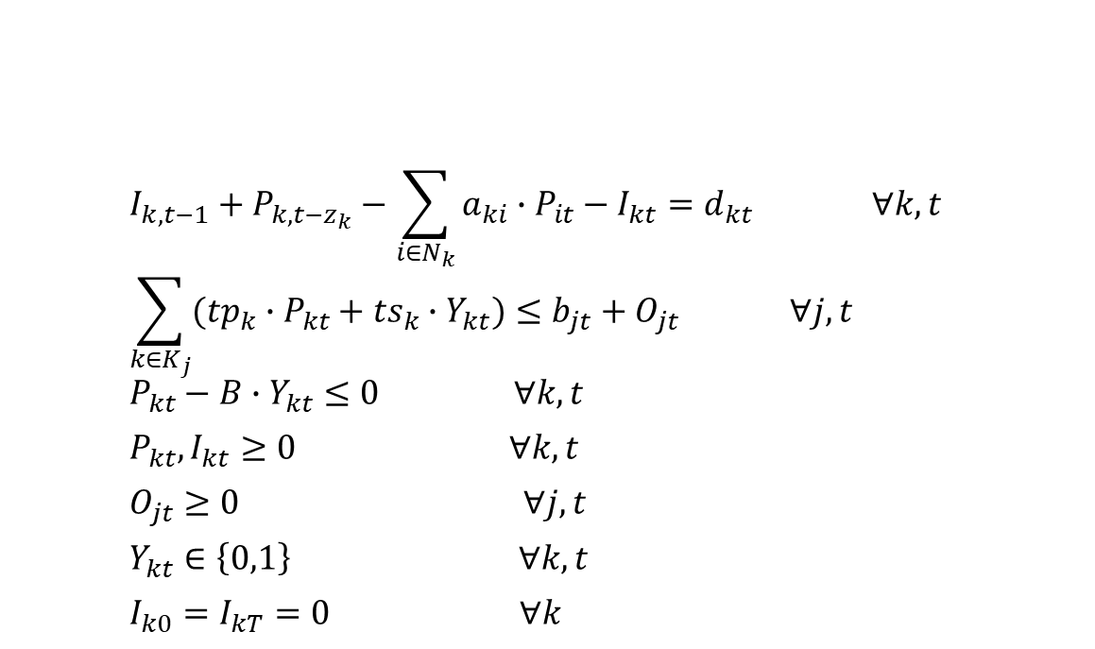
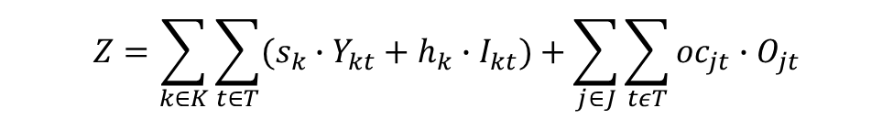
7.4 多级能力约束的生产计划优化模型
生产计划体系
问题数学模型：
min
s.t.
$$Z=\sum_{k∈K}{\sum_{t∈T}{(s_{k}∙Y_{kt}+h_{k}∙I_{kt})}}+\sum_{j∈J}{\sum_{tεT}{{oc}_{jt}∙O_{jt}}}$$
$$I_{k,t−1}+P_{k,t−z_{k}}−\sum_{i∈N_{k}}{a_{ki}∙P_{it}}−I_{kt}=d_{kt} ∀k,t$$
$$\sum_{k∈K_{j}}{({tp}_{k}∙P_{kt}+{ts}_{k}∙Y_{kt})}≤b_{jt}+O_{jt} ∀j,t$$
$$P_{kt}−B∙Y_{kt}≤0 ∀k,t$$
$$P_{kt},I_{kt}≥0 ∀k,t$$
$$O_{jt}≥0 ∀j,t$$
$$Y_{kt}∈\left\{0,1\right\} ∀k,t$$
$$I_{k0}=I_{kT}=0 ∀k$$
Reference: Helber S., Sahling F. A fix-and-optimize approach for the multi-level capacitated lot sizing problem. International Journal of Production Economics, 2010, 123(2): 247-256

Slide 17
生产计划体系
小结

