Slide 1
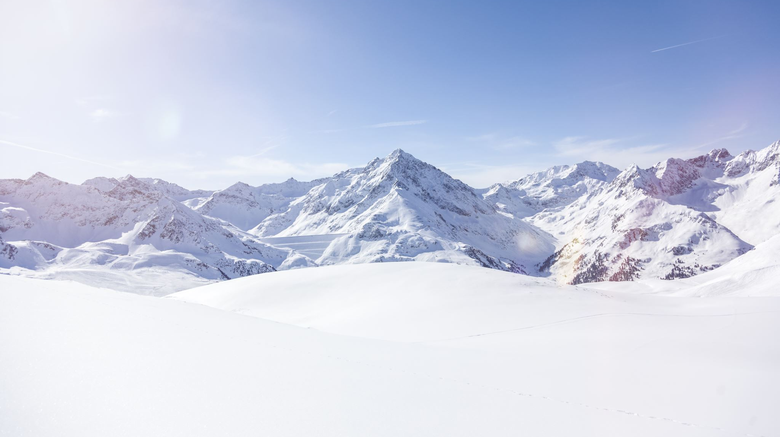
Big Mountain Resort
Data Science Group

Slide 2
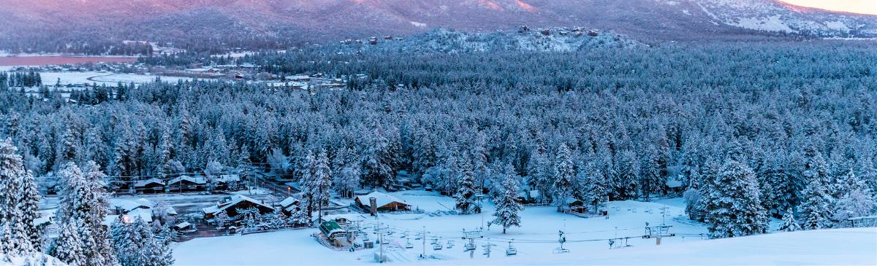
Problem Identification
Background
Northwestern Montana
350,000 people ski/year
$1.54 million additional chair list
Question
What opportunities exist for Big Mountain Resort to increase the income at least 1.54 million to maintain 9.2% margin profit through operational improvements?

Slide 3
Recommendation and Key Findings
To increase weekend lift ticket price, the operational department can increase
Days open last year
Vertical change in elevation from the summit to the base in feet
Cost of adult weekday chairlift ticket
Number of runs in the resort

Slide 4

Modeling Results and Analysis
Data Pre-processing
Filling missing with mean:
Filling missing with zero:
Not take too much care about outliers since the small data size
Remove “base_elev” since collinearity
K-mean clustering patterns in the data
Remove state since it is not for management

Slide 5
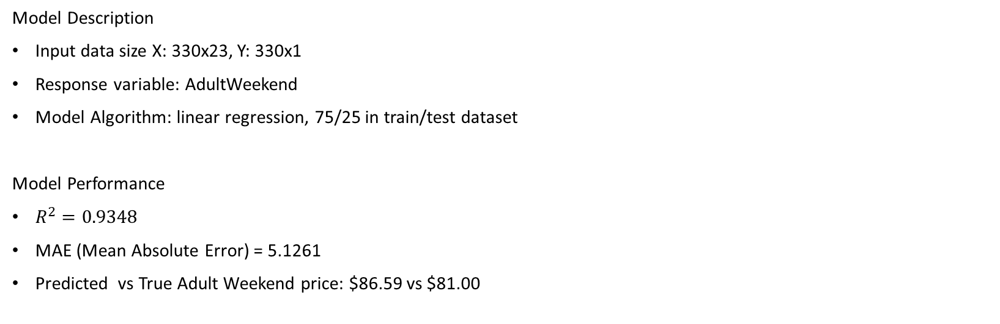
Modeling Results and Analysis
Model Description
Input data size X: 330x23, Y: 330x1
Response variable: AdultWeekend
Model Algorithm: linear regression, 75/25 in train/test dataset
Model Performance
$R^{2}=0.9348$
MAE (Mean Absolute Error) = 5.1261
Predicted vs True Adult Weekend price: $86.59 vs $81.00

Slide 6
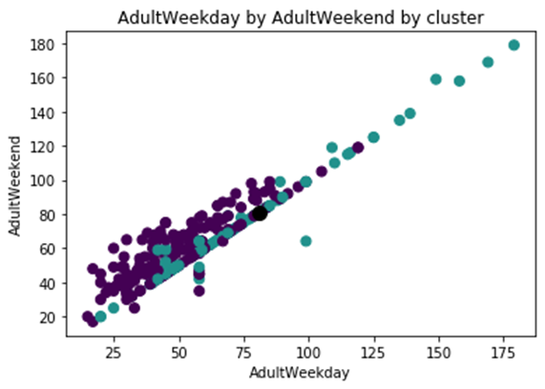
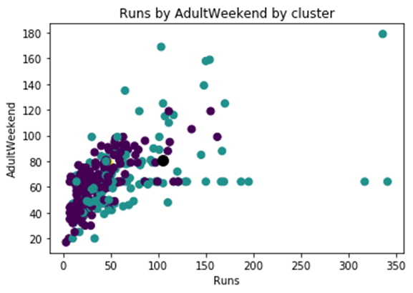
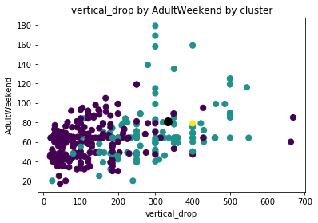

Modeling Results and Analysis

Slide 7

Summary and Conclusion
In this project we did:
Build a model to predict cost of adult weekend chair lift ticket
Give recommendations to increase adult weekend price to overcome $1.54 million additional chair list
Future work:
Get a larger dataset
Use other machine learning models (KNN, NB, Ridge Regression, Neural Network)

