Slide 1
Trajectory Learning for Pedestrian Tracking
by
Regression Methods
Jiaren Zhou, B.Eng.
E-Mail: iuk.zhou@gmail.com
Betreuer: Florian Particke M.Sc.
Prof. Dr.-Ing. Jörn Thielecke
Professur für Informationstechnik
Schwerpunkt Navigation und Ortsbestimmung
Telefon: +49 9131 8525-118
Fax: +49 9131 8525-102
E-Mail: joern.thielecke@fau.de

Slide 2
Inhalt
Algorithmen vorstellen
Algorithmen testen
Neue Idee für Entwicklung der Algorithmen

Slide 3
Inhalt
Algorithmen vorstellen
Algorithmen testen
Neue Idee für Entwicklung der Algorithmen

Slide 4
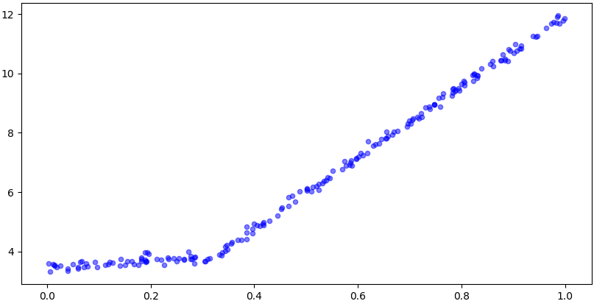
Algorithmen
Regression Tree
Model Tree
Neural Network

Slide 5
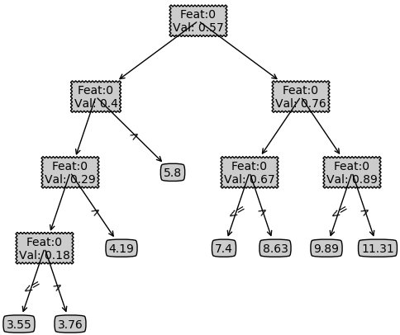
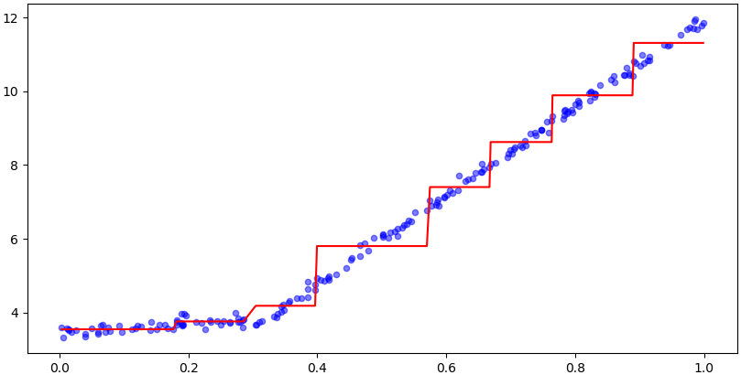
Algorithmen
Regression Tree
Model Tree
Neural Network
Hyperparameter:
Mind. error reduction: 1
Mind. data instances: 20

Slide 6
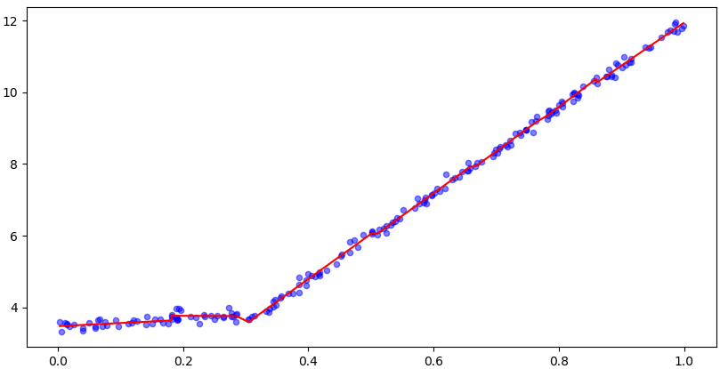
Algorithmen
Regression Tree
Model Tree
Neural Network
Hyperparameter:
Mind. error reduction: 1
Mind. data instances: 20
Feat: 0
Val: 0.28
W 1
W 2
Prediction = X * W

Slide 7

Algorithmen
Regression Tree
Model Tree
Neural Network
Hyperparameter:
Layer dimension: [1, 5, 5, 1]
Learning rate: 10; Iteration: 1000
Activation: “relu”

Slide 8
Inhalt
Algorithmen vorstellen
Algorithmen testen
Neue Idee für Entwicklung der Algorithmen

Slide 9
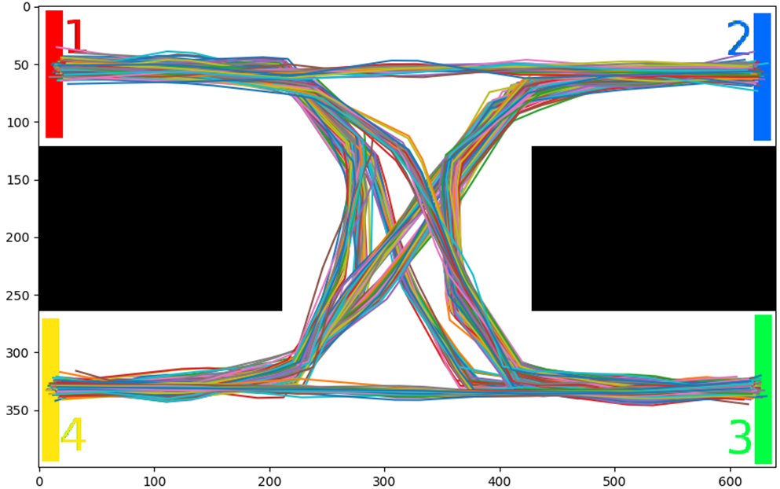
Simulation: training set

Slide 10
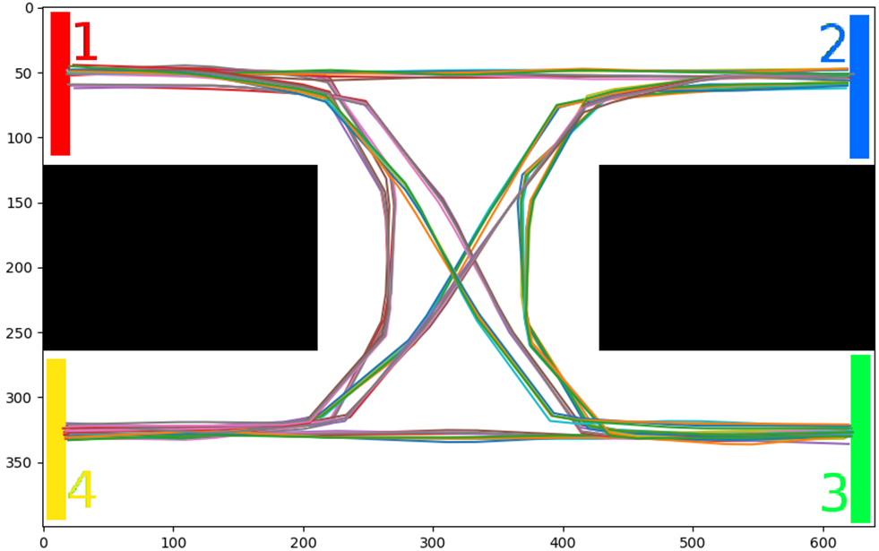
Simulation: test set

Slide 11
Evaluation
Algorithmen | Regression Tree |  |  | Neural Network
Mind. Error Reduction | 0 | 0 | 0
Mind. Instances | 5 | 10 | 15
Network dim. |  |  |  | 4, 20, 30, 10, 1 | 4, 20, 30, 10, 1 | 4, 20, 30, 10, 1
Learning Rate |  |  |  | 1000 | 1000 | 1000
Iteration |  |  |  | 1000 | 2000 | 3000
Corr. Coef (train_X) | 0.976 | 0.960 | 0.953 | 0.794 | 0.880 | 0.904
Corr. Coef (train_Y) | 0.985 | 0.977 | 0.971 | 0.837 | 0.901 | 0.937
Corr. Coef (test_X) | 0.608 | 0.595 | 0.591 | 0.734 | 0.710 | 0.705
Corr. Coef (test_Y) | 0.876 | 0.847 | 0.837 | 0.825 | 0.850 | 0.877

Slide 12
Algorithmen testen
Problems of Model Tree method:
Trainging takes long time for many samples (more than 10000)
The matrix inverse may not exist
Solution:
check the inversability of matrix
try some other pseudo inverse functions

Slide 13
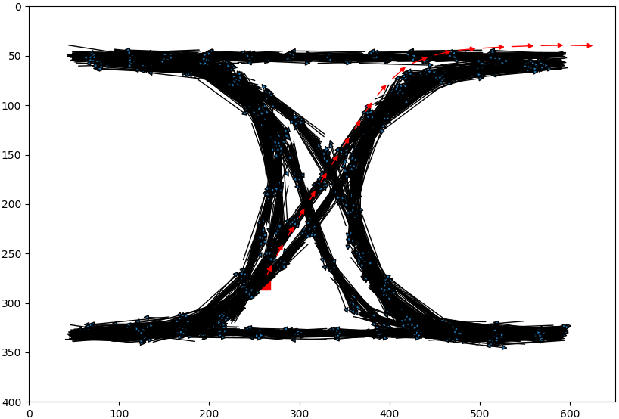
Inhalt

Slide 14
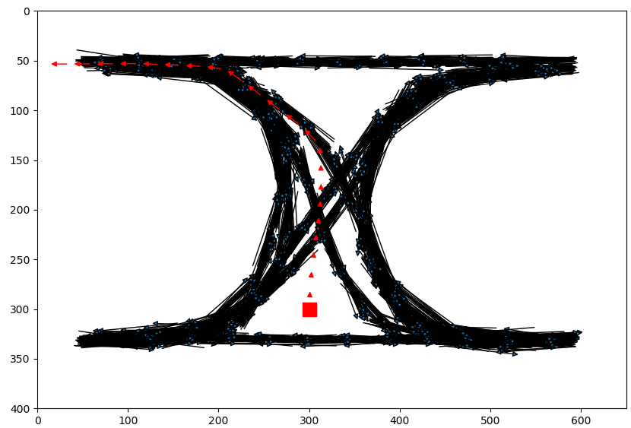
Inhalt

Slide 15
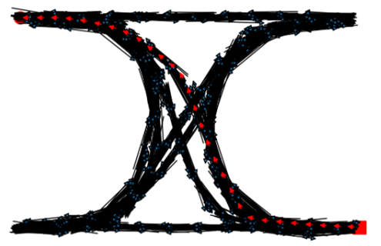
Inhalt

Slide 16
Inhalt
Algorithmen vorstellen
Algorithmen testen
Neue Idee für Entwicklung der Algorithmen

Slide 17
Aktuelle Datenstruktur
Features für 1 Pixel
Targets
Pos_ x | Pos_ y | Speed_x | Speed_y | Acc_ x | Acc_ y
122 | 127 | 19 | 24 | -34 | -10
107 | 141 | -15 | 14 | 33 | 6
125 | 161 | 18 | 20 | -12 | -6
… | …. | …. | …. | … | …
… | …. | …. | …. | … | …
… | …. | …. | …. | … | …

Slide 18
Erweiterte Datenstruktur
Features für n Pixels
Targets
Pos_ x | Pos_ y | … | … | … | … | Speed_x | Speed_y | Acc_ x | Acc_ y
… | … | … | … | 122 | 127 | 19 | 24 | -34 | -10
… | … | … | … | 107 | 141 | -15 | 14 | 33 | 6
… | … | … | … | 125 | 161 | 18 | 20 | -12 | -6
… | … | … | … | … | …. | …. | …. | … | …
… | … | … | … | … | …. | …. | …. | … | …
… | … | … | … | … | …. | …. | …. | … | …

Slide 19

Hmmmm…

