Slide 1
Regression
Jiaren Zhou, B.Eng.
E-Mail: iuk.zhou@gmail.com
Betreuer: Florian Particke M.Sc.
Prof. Dr.-Ing. Jörn Thielecke
Professur für Informationstechnik
Schwerpunkt Navigation und Ortsbestimmung
Telefon: +49 9131 8525-118
Fax: +49 9131 8525-102
E-Mail: joern.thielecke@fau.de

Slide 2
Contents
Regression vs. Classification
Linear Regression
Locally Weighted Linear Regression
Tree-based Regression
Linear Regression vs. Tree Regression
Summary

Slide 3
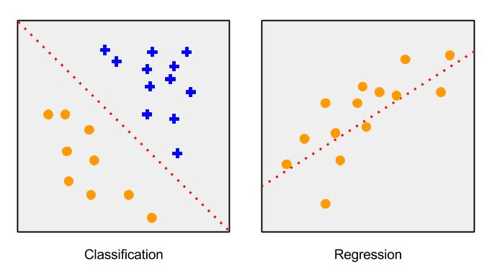
I. Regression vs. Classification
"Classification" is the task of predicting a discrete class label.
"Regression" is the task of predicting a continuous quantity.

Slide 4
II. Linear Regression
Task: House Price
Equation:
HousePrice = ω1 ∗ HouseSize + ω2 ∗ AgeofHouse
Input: HouseSize, AgeofHouse
Weights: ω1, ω2

Slide 5

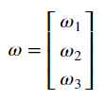

II. Linear Regression
Let's assume that our input and output data are matrix X and Y:
and we put regression weights into a vector:
then we could predict the value y1 for the given dataset x1

Slide 6



II. Linear Regression
The next step is to find the weights with the given training datasets by minimizing the squared error between actual and predicted value.
The corresponding expression in matrix is
After the derivation, we get
Setting this to zero and solve for ω to get the following equation

Slide 7
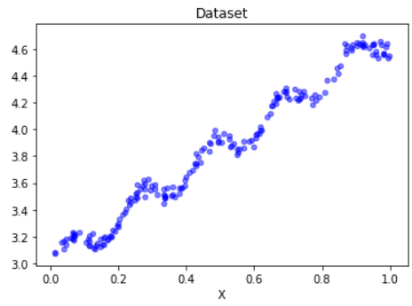
II. Linear Regression
weights:
[[3.00774324] [1.69532264]]

Slide 8
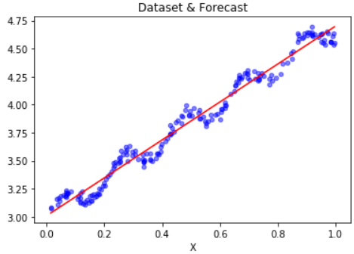
II. Linear Regression
Y_pred = X * weights
weights:
[[3.00774324] [1.69532264]]

Slide 9
II. Linear Regression
But how far do they differ from each other?
numpy.corrcoef(pred, actual):
array([[1. , 0.98647356],
[0.98647356, 1. ]])
underfitting problem?

Slide 10


III. Locally Weighted Linear Regression
More weights are given to those data points which are close to the data point of interest, then the least-squares regression similar to the linear regression will be carried out.
W is a matrix and will be generated by a kernel function, which shall give nearby points more weights than other points. The mostly used kernel is Gaussian and assigns the weights by

Slide 11
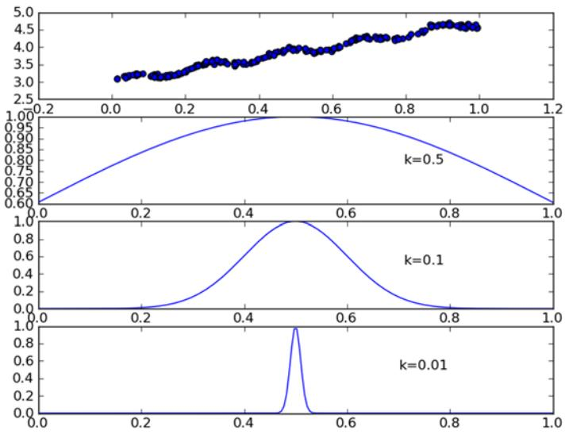
III. Locally Weighted Linear Regression

Slide 12
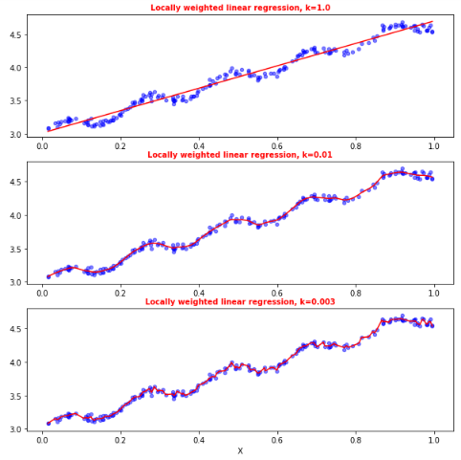
III. Locally Weighted Linear Regression

Slide 13
III. Locally Weighted Linear Regression
overfitting!

Slide 14
Example: predicting the age of an abalone
Testdata: abalone.txt
Feature_X:
[[ 1. 0.455 0.365 0.095 0.514 0.2245 0.101 0.15 ]
[ 1. 0.35 0.265 0.09 0.225 0.0995 0.048 0.07 ]
[ -1. 0.53 0.42 0.135 0.677 0.2565 0.141 0.21 ]
[ … … ]
[ 0. 0.33 0.255 0.08 0.205 0.0895 0.039 0.05]]
Age_Y:
[[15.]
[ 7.]
[ 9.]
[10.]
[ 7.]]
Training set and test set are identical:
k=0.1, the Error: 56.82523568972884
k=1.0, the Error: 429.8905618700651
k=10, the Error: 549.1181708826451

Slide 15
Example: predicting the age of an abalone
Training set and test set are identical:
k=0.1, the Error: 56.82523568972884
k=1.0, the Error: 429.8905618700651
k=10, the Error: 549.1181708826451
Training set and test set are different:
k=0.1, the Error: 41317.161723642595
k=1.0, the Error: 573.526144189767
k=10, the Error: 517.5711905387598

Slide 16
Example: predicting the age of an abalone
Training set and test set are different,
Linear regression vs. Locally weighted linear regression
lwlr with k=1: the Error: 573.526144189767
Linear regression: the Error: 518.6363153249638
Simple linear regression works almost as well as the locally weighted linear regression. This demonstration illustrates one fact: in order to find the best model, we have to see how the model works on unknown data.

Slide 17
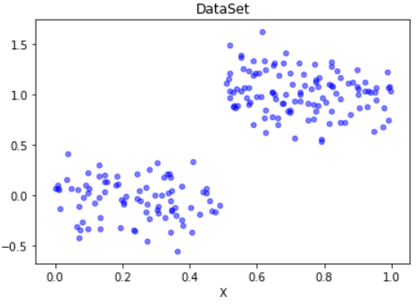
IV: Tree-based Regression
How to deal with the nonlinearities in real life?

Slide 18
IV: Tree-based Regression
How to deal with the nonlinearities in real life?
Tree Regression

Slide 19
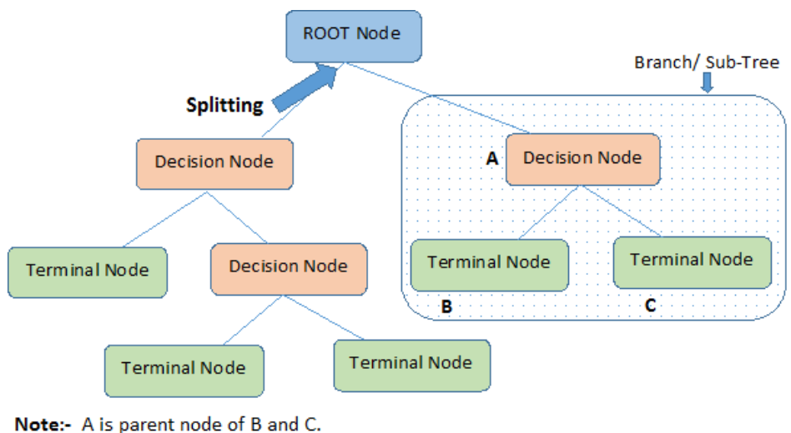
IV: Tree-based Regression
Tree structure

Slide 20
IV: Tree-based Regression
Tree structure
How ?

Slide 21
IV: Tree-based Regression
How to deal with the nonlinearities in real life?
Tree regression:
It implements a new algorithm called CART (Classification And Regression Trees). It is well-known and well-documented tree-building algorithm that makes binary splits to handle continuous variables.
By doing this we choose a feature and make values greater than the desired go on the right side of the tree and all the other values go on the left side.

Slide 22
Example: binary split in the tree regression
Let’s split it by the value of the second feature, threshold value: 0.5
matrix([[1., 0., 0., 0.],
[0., 1., 0., 0.],
[0., 0., 1., 0.],
[0., 0., 0., 1.]])
Left: [[1. 0. 0. 0.]
[0. 0. 1. 0.]
[0. 0. 0. 1.]]
Right: [[0. 1. 0. 0.]]

Slide 23


IV: Tree-based Regression
How to make a binary split?
We need to select: splitting feature ‘xj’ and a splitting point ‘s’
so that we can divide data into two regions R1 and R2:
Then we calculate the average value for each generated region by
Goal: find such (ĉ 1, ĉ 2) which gives the minimum of total squared error as follows

Slide 24
Pseudo-code of choosing a best split
How to make a binary split?
For every unique value: Split the dataset into two Measure the error of these two splits If the error is less than bestError, then bestSplit to this
split and update bestError Return bestSplit feature and threshold

Slide 25
Pseudo-code of choosing a best split
How to make a binary split?
For every unique value: Split the dataset into two Measure the error of these two splits If the error is less than bestError, then bestSplit to this
split and update bestError Return bestSplit feature and threshold
Stop Conditions: min. error-reduction & min. data instances
If (actual error – best error < error reduction) or
(left_matrix.numInstance < min.Inst) or
(right_matrix.numInstance < min.Inst) → split stops!

Slide 26
IV: Tree-based Regression
User-defined parameter:
Error reduction: 1
Min.data instances: 4
Result:
Splitting feature: 0 (here only the feature from x-data)
Splitting point: 0.48813 (x-value)

Slide 27
Pseudo-code of creating a regression tree
How to make a regression tree?
Find the best feature to split on: If we can’t split the data, this node becomes a leaf node Make a binary split of the data Call createTree() on the right split of the data Call createTree() on the left split of the data

Slide 28
IV: Tree-based Regression
User-defined parameter:
Mind. error eduction: 1
Mind. data instances: 4

Slide 29
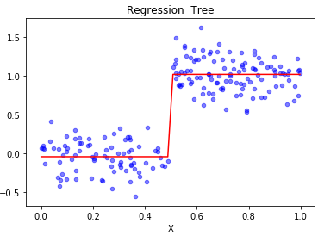
IV: Tree-based Regression
User-defined parameter:
Mind. error eduction: 1
Mind. data instances: 4
print(createTree(data_mat))
{'spInd': 0,
'spVal': 0.48813,
'left': -0.04465028571428572,
'right': 1.0180967672413792 }

Slide 30
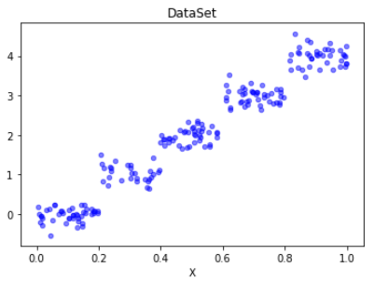
IV: Tree-based Regression
User-defined parameter:
Mind. error eduction: 1
Mind. data instances: 4

Slide 31
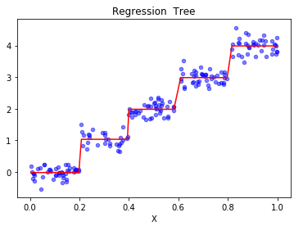
IV: Tree-based Regression
User-defined parameter:
Mind. error eduction: 1
Mind. data instances: 4
{'spInd': 1, 'spVal': 0.39435, 'left': {'spInd': 1, 'spVal': 0.197834, 'left': -0.023838155555555553, 'right': 1.0289583666666666}, 'right': {'spInd': 1, 'spVal': 0.582002, 'left': 1.980035071428571, 'right': {'spInd': 1, 'spVal': 0.797583, 'left': 2.9836209534883724, 'right': 3.9871632}}}

Slide 32
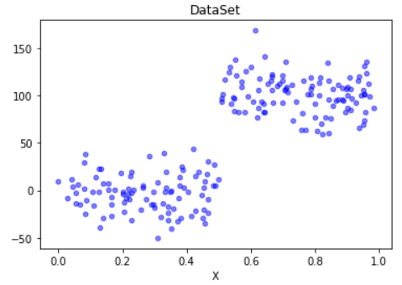
IV: Tree-based Regression
User-defined parameter:
Mind. error eduction: 1
Mind. data instances: 4

Slide 33
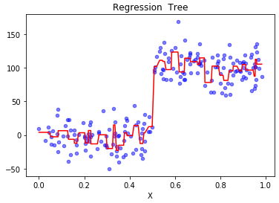
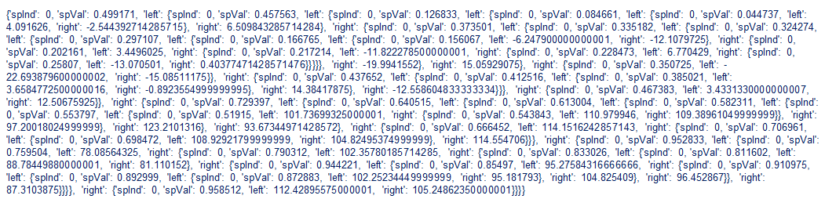
IV: Tree-based Regression
User-defined parameter:
Mind. error eduction: 1
Mind. data instances: 4

Slide 34
IV: Tree-based Regression
User-defined parameter:
Mind. error eduction: 1
Mind. data instances: 4
Too many nodes !!
Overfitting problem !!

Slide 35
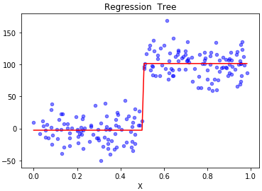
IV: Tree-based Regression
User-defined parameter:
Mind. error eduction: 1 10000
Mind. data instances: 4

Slide 36
IV: Tree-based Regression
User-defined parameter:
Mind. error eduction: 1 10000
Mind. data instances: 4
Is there any better method without user intervention?
→ Postpruning

Slide 37
Postpruning
How to implement the postpruning?
Make the regression tree to a large depth
Start at the bottom and combine every two leaf nodes(left and right) into a new terminal node, if such error after merge is smaller than the original one

Slide 38
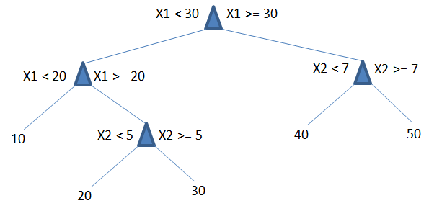
Postpruning
How to implement the postpruning?
Make the regression tree to a large depth
Start at the bottom and combine every two leaf nodes(left and right) into a new terminal node, if such error after merge is smaller than the original one

Slide 39
Postpruning
How to implement the postpruning?
Make the regression tree to a large depth
Start at the bottom and combine every two leaf nodes(left and right) into a new terminal node, if such error after merge is smaller than the original one
Calculate Merge-Error with 45
Calculate Orig.-Error with 40 and 50

Slide 40
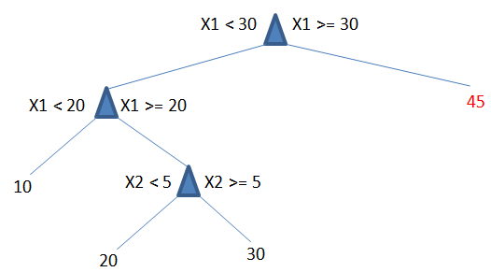
Postpruning
How to implement the postpruning?
Make the regression tree to a large depth
Start at the bottom and combine every two leaf nodes(left and right) into a new terminal node, if such error after merge is smaller than the original one
If Merge-Error < Orig.-Error
then merge

Slide 41
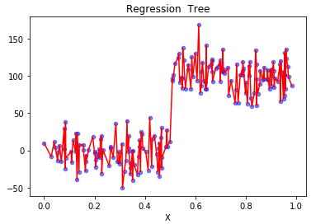
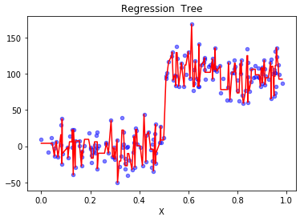
Prepruning vs. Postpruning
Prepruning (stop conditions)
Error reduction: 0
Min.data instances: 1
Postpruning

Slide 42
Prepruning vs. Postpruning
A large number of nodes were pruned off the tree, but it wasn’t reduced to two nodes as we had hoped. It turns out that postpruning isn’t as effective as prepruning.
We can employ both to give the best possible model.

Slide 43
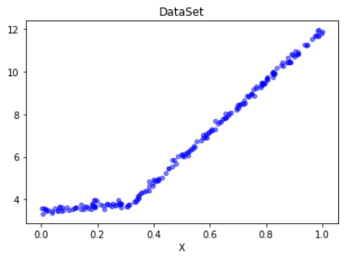
IV: Tree-based Regression
Would it be better to model this dataset as
a bunch of constant values (many leaf nodes) or
two straight lines (1: from 0.0 to 0.3; 2: from 0.3 to 1.0)

Slide 44
IV: Tree-based Regression
Model Tree:
A way to model dataset as a piecewise linear model at each leaf node. Piecewise linear means that the model consists of multiple linear segments

Slide 45
IV: Tree-based Regression
How to make the model tree?
Use the tree-generating algorithm to break up the data into segment
Use the linear regression to generate the linear model at the leaf nodes
Use the least-squares method to determine the best weight

Slide 46
IV: Tree-based Regression
Result:
{'spInd': 0, 'spVal': 0.285477,
'left': matrix([[3.46877936], [1.18521743]]),
'right': matrix([[1.69855694e-03], [1.19647739e+01]])}

Slide 47
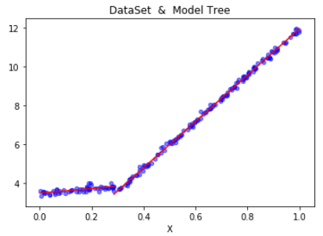
IV: Tree-based Regression
Result:
{'spInd': 0, 'spVal': 0.285477,
'left': matrix([[3.46877936], [1.18521743]]),
'right': matrix([[1.69855694e-03], [1.19647739e+01]])}

Slide 48
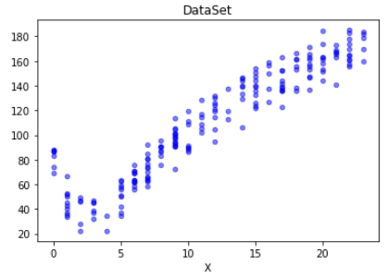
V: Compare Linear Regression and Tree Regression
Regression methods:
Linear Regression(LR)
Regression Tree (RT)
Model Tree (MT)
Evaluation method:
Numpy.corrcoef()
Correlation coefficients:
LR: 0.94346842356
RT: 0.96408523182
MT: 0.97604121913

Slide 49
VI: Summary
Regression is the process of predicting a target value, which makes it become one of the most useful tools in statistics.
Linear methods:
Linear regression: does a good job, when the dataset is simple and linear.
Locally weighted linear regression: the forecast would be more precise. Overfitting problem should be avoided.
Non-linear methods:
Regression tree: breaks up the predicted value into piecewise constant segments.
Model Tree: implements the linear regression equations at each leaf node.
Pre- and Postpruning: can effectively reduce the complexity of tree and help avoid the overfitting problem.

Slide 50
Reference
Harrington, Peter. 2012. Machine Learning in Action. Shelter Island (N.Y.): Manning Publications Co.
Li Hang. 2012. Statistic Learning Methods. Tsinghua University Publications Co.
Analytics Vidhya: A Complete Tutorial on Tree Based Modeling from Scratch. APRIL 12, 2016 https://www.analyticsvidhya.com/blog/2016/04/complete-tutorial-tree-based-modeling-scratch-in-python

