Slide 1
Regression
Jiaren Zhou, B.Eng.
E-Mail: iuk.zhou@gmail.com
Betreuer: Florian Particke M.Sc.
Prof. Dr.-Ing. Jörn Thielecke
Professur für Informationstechnik
Schwerpunkt Navigation und Ortsbestimmung
Telefon: +49 9131 8525-118
Fax: +49 9131 8525-102
E-Mail: joern.thielecke@fau.de

Slide 2
Contents
Regression vs. Classification
Linear Regression
Locally Weighted Linear Regression
Tree-based Regression
Linear Regression vs. Tree Regression
Summary

Slide 3
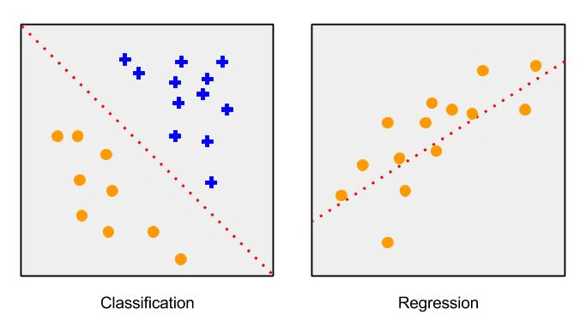
I. Regression vs. Classification
"Classification" is the task of predicting a discrete class label.
"Regression" is the task of predicting a continuous quantity.

Slide 4
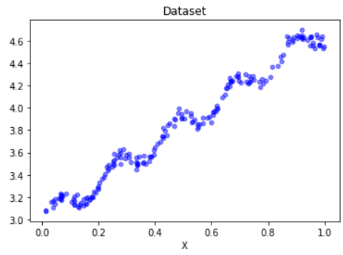
II. Linear Regression

Slide 5
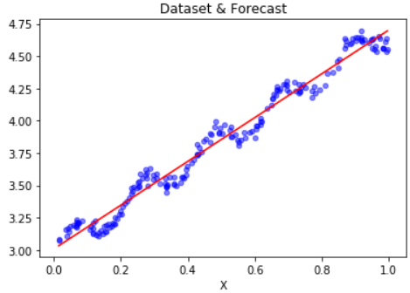
II. Linear Regression
y = ω_1 * x + ω_0
ω_1 : 1.7
ω_0 : 3.0

Slide 6
II. Linear Regression
y = ω_1 * x + ω_0
ω_1 : 1.7
ω_0 : 3.0
how to find the best weight ?

Slide 7



II. Linear Regression
How to find the best weight:
find the least squared error
The expression in matrix is
After the derivation with respect to ω, we get
Setting this to zero and solve for ω to get the following equation

Slide 8
II. Linear Regression
Y = w_1 * X + w_0
w_0 : 3.0
w_1 : 1.7
weights: [[3.00774324]
[1.69532264]]

Slide 9
II. Linear Regression
But how far do they differ from each other?
numpy.corrcoef(pred, actual):
array([[1. , 0.98647356],
[0.98647356, 1. ]])

Slide 10
II. Linear Regression
But how far do they differ from each other?
numpy.corrcoef(pred, actual):
array([[1. , 0.98647356],
[0.98647356, 1. ]])
More precise ?

Slide 11
II. Linear Regression
But how far do they differ from each other?
numpy.corrcoef(pred, actual):
array([[1. , 0.98647356],
[0.98647356, 1. ]])
More precise ?

Slide 12
II. Linear Regression
But how far do they differ from each other?
numpy.corrcoef(pred, actual):
array([[1. , 0.98647356],
[0.98647356, 1. ]])
More precise ?

Slide 13
II. Linear Regression
But how far do they differ from each other?
numpy.corrcoef(pred, actual):
array([[1. , 0.98647356],
[0.98647356, 1. ]])
More precise ?

Slide 14


III. Locally Weighted Linear Regression
More weights are given to those data points which are close to the data point of interest, then the least-squares regression similar to the linear regression will be carried out.
W is a matrix and will be generated by a kernel function, which shall give nearby points more weights than other points. The mostly used kernel is Gaussian and assigns the weights by

Slide 15
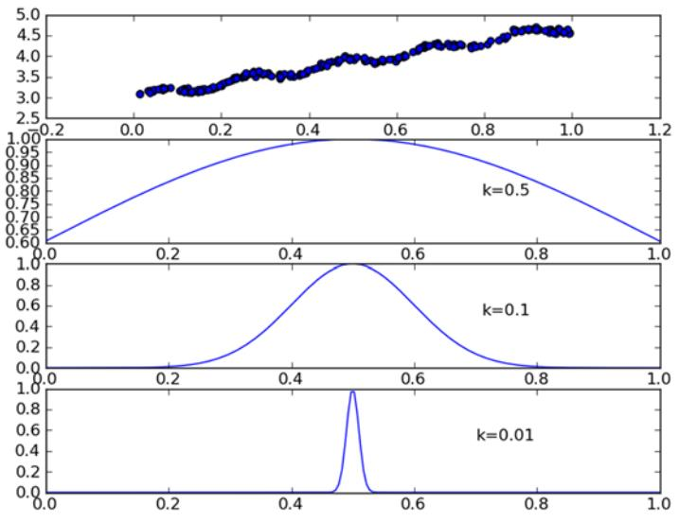
III. Locally Weighted Linear Regression

Slide 16
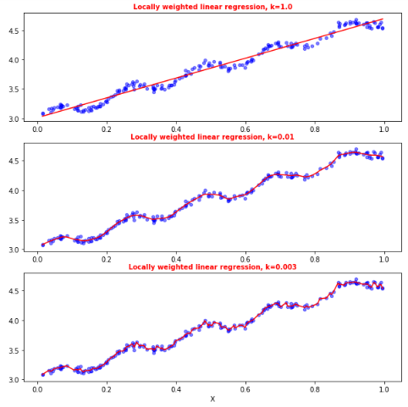
III. Locally Weighted Linear Regression

Slide 17
III. Locally Weighted Linear Regression
overfitting!

Slide 18
Example: predicting the age of an abalone
Testdata: abalone.txt
Feature_X:
[[ 1. 0.455 0.365 0.095 0.514 0.2245 0.101 0.15 ]
[ 1. 0.35 0.265 0.09 0.225 0.0995 0.048 0.07 ]
[ -1. 0.53 0.42 0.135 0.677 0.2565 0.141 0.21 ]
[ … … … … … … … … ]
[ 0. 0.33 0.255 0.08 0.205 0.0895 0.039 0.05 ]]
Age_Y:
[[15.]
[ 7.]
[ 9.]
[10.]
[ 7.]]
Training set and test set are identical:
k=0.1, squared error : 56.82523568972884
k=1.0, squared error : 429.8905618700651
k=10, squared error : 549.1181708826451

Slide 19
Example: predicting the age of an abalone
Training set and test set are identical:
k=0.1, squared error : 56.82523568972884
k=1.0, squared error : 429.8905618700651
k=10, squared error : 549.1181708826451
Training set and test set are different:
k=0.1, squared error : 41317.161723642595
k=1.0, squared error : 573.526144189767
k=10, squared error : 517.5711905387598
Linear regression: squared error : 518.6363153249638

Slide 20
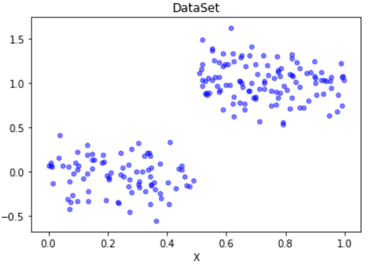
IV: Tree-based Regression
How to deal with the nonlinearities in real life?

Slide 21
IV: Tree-based Regression
How to deal with the nonlinearities in real life?
Tree Regression

Slide 22
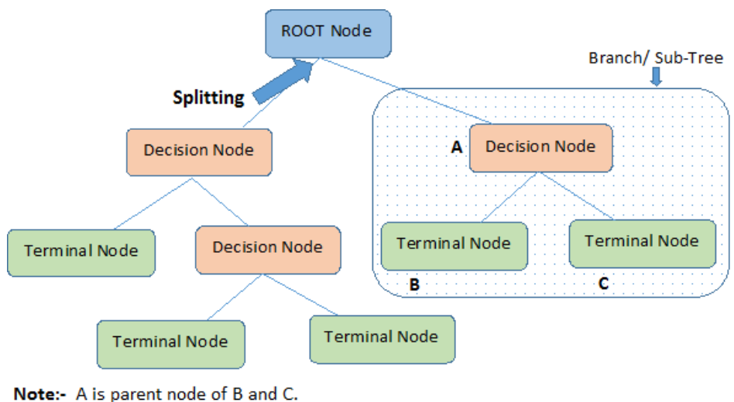
IV: Tree-based Regression
Tree structure

Slide 23
IV: Tree-based Regression
Feature Index: 0
Threshold value: 0.5
Leaf node value: 0.0 or 1.0
Number of Samples: 100
X0 <= 0.5 ?
Y = 0.0
Y = 1.0
100
100

Slide 24
IV: Tree-based Regression
How to find the splitting feature
and splitting point ?
Feature Index: 0
Threshold value: 0.5
Leaf node value: 0.0 or 1.0
Number of Samples: 100
X0 <= 0.5 ?
Y = 0.0
Y = 1.0
100
100

Slide 25
IV: Tree-based Regression
How to deal with the nonlinearities in real life?
Tree regression:
It implements a new algorithm called CART (Classification And Regression Trees). It is well-known and well-documented tree-building algorithm that makes binary splits to handle continuous variables.
By doing this we choose a feature and make values greater than the desired go on the right side of the tree and all the other values go on the left side.

Slide 26


IV: Tree-based Regression
How to make a binary split?
We need to select: splitting feature ‘xj’ and a splitting point ‘s’
so that we can divide data into two regions R1 and R2:
Then we calculate the average value for each generated region by
Goal: find such (ĉ 1, ĉ 2) which gives the minimum of total squared error as follows

Slide 27
Example: binary split in the tree regression
Let’s split it by the value of the second feature, threshold value: 0.5
matrix([[1., 0., 0., 0.],
[0., 1., 0., 0.],
[0., 0., 1., 0.],
[0., 0., 0., 1.]])
Left: [[1. 0. 0. 0.]
[0. 0. 1. 0.]
[0. 0. 0. 1.]]
Right: [[0. 1. 0. 0.]]

Slide 28
IV: Tree-based Regression
Stop Conditions:
Mind. error reduction: 1
Mind. data instances: 4

Slide 29
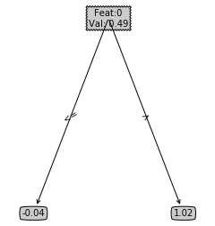
IV: Tree-based Regression
Stop Conditions:
Mind. error reduction: 1
Mind. data instances: 4
print(createTree(data_mat))
{'spInd': 0,
'spVal': 0.48813,
'left': -0.04465028571428572,
'right': 1.0180967672413792 }

Slide 30
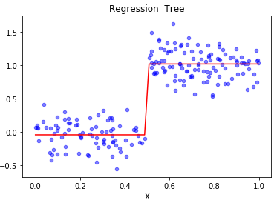
IV: Tree-based Regression
Stop Conditions:
Mind. error reduction: 1
Mind. data instances: 4

Slide 31
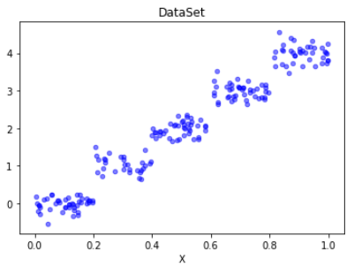
IV: Tree-based Regression
Stop Conditions:
Mind. error reduction: 1
Mind. data instances: 4

Slide 32
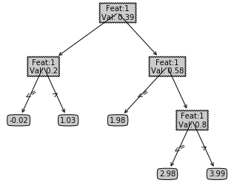
IV: Tree-based Regression
Stop Conditions:
Mind. error reduction: 1
Mind. data instances: 4

Slide 33
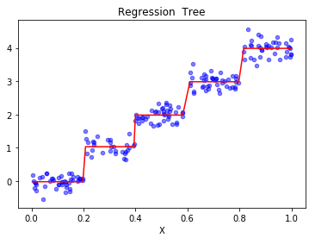
IV: Tree-based Regression
Stop Conditions:
Mind. error reduction: 1
Mind. data instances: 4

Slide 34
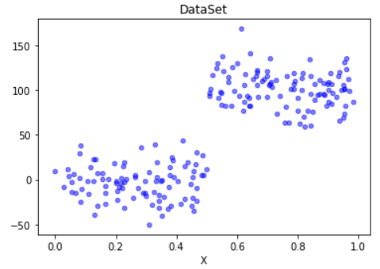
IV: Tree-based Regression
Stop Conditions:
Mind. error reduction: 1
Mind. data instances: 4

Slide 35
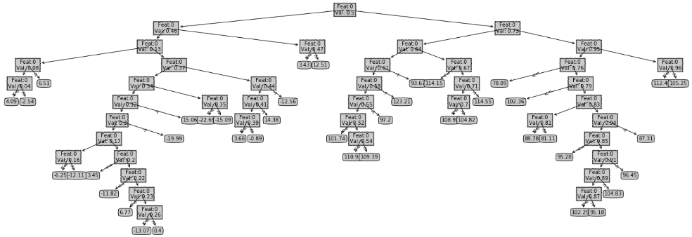
IV: Tree-based Regression
Stop Conditions:
Mind. error reduction: 1
Mind. data instances: 4

Slide 36
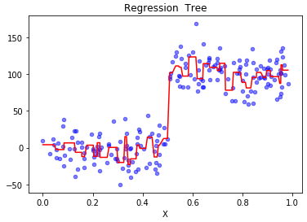
IV: Tree-based Regression
Stop Conditions:
Mind. error reduction: 1
Mind. data instances: 4

Slide 37
IV: Tree-based Regression
Stop Conditions:
Mind. error reduction: 1
Mind. data instances: 4
Too many nodes !!
Overfitting problem !!

Slide 38
IV: Tree-based Regression
Stop Conditions:
Mind. error reduction: 1 10000
Mind. data instances: 4

Slide 39
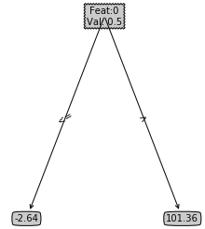
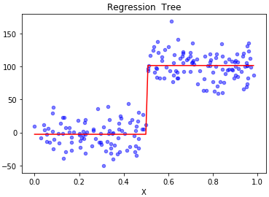
IV: Tree-based Regression
Stop Conditions:
Mind. error reduction: 1 10000
Mind. data instances: 4

Slide 40

IV: Tree-based Regression
Stop Conditions:
Mind. error reduction: 1 10000
Mind. data instances: 4
Is there any solution without user intervention?
→ Postpruning

Slide 41
Postpruning
How to implement the postpruning?
Make the regression tree to a large depth
Start at the bottom and combine every two leaf nodes(left and right) into a new terminal node, if such error after merge is smaller than the original one

Slide 42
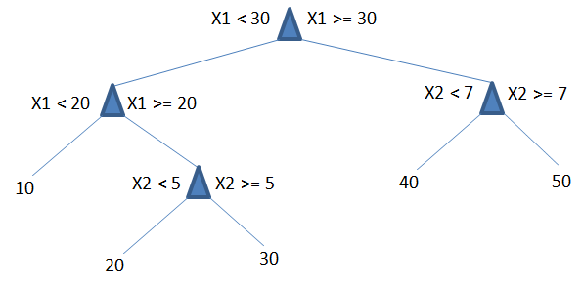
Postpruning
How to implement the postpruning?
Make the regression tree to a large depth
Start at the bottom and combine every two leaf nodes(left and right) into a new terminal node, if such error after merge is smaller than the original one

Slide 43

Postpruning
How to implement the postpruning?
Make the regression tree to a large depth
Start at the bottom and combine every two leaf nodes(left and right) into a new terminal node, if such error after merge is smaller than the original one
Test_data
Calculate Merge-Error with 45
Calculate Orig.-Error with 40 and 50

Slide 44
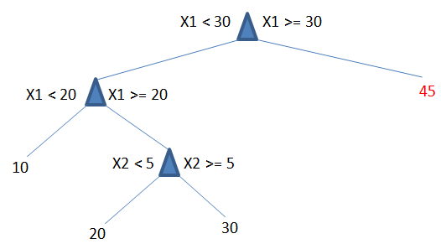
Postpruning
How to implement the postpruning?
Make the regression tree to a large depth
Start at the bottom and combine every two leaf nodes(left and right) into a new terminal node, if such error after merge is smaller than the original one
If Merge-Error < Orig.-Error
then merge

Slide 45
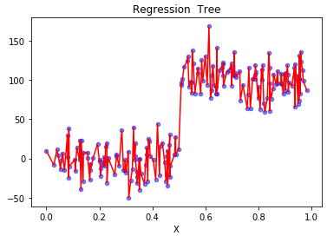
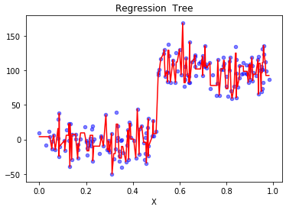
Prepruning vs. Postpruning
Prepruning
Sum of leaf nodes: 200
tree depth: 25
Postpruning
Sum of leaf nodes: 141
tree depth: 23

Slide 46
Prepruning vs. Postpruning
Some nodes were pruned off the tree, but it wasn’t reduced to two nodes as we had hoped. It turns out that postpruning isn’t as effective as prepruning.
We can employ both to give the best possible model.

Slide 47
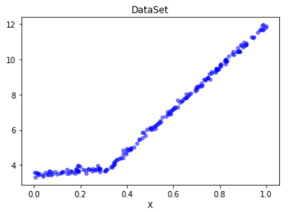
IV: Tree-based Regression
Would it be better to model this dataset as
a bunch of constant values (many leaf nodes) or
two straight lines (1: from 0.0 to 0.3; 2: from 0.3 to 1.0)

Slide 48
IV: Tree-based Regression
Model Tree = Tree + Linear regression
A way to model dataset as a piecewise linear model at each leaf node. Piecewise linear means that the model consists of multiple linear segments

Slide 49
IV: Tree-based Regression
Result:
{'spInd': 0, 'spVal': 0.285477,
'left': matrix([[3.46877936], [1.18521743]]),
'right': matrix([[1.69855694e-03], [1.19647739e+01]])}

Slide 50
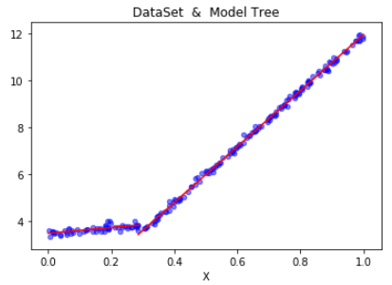
IV: Tree-based Regression
Result:
{'spInd': 0, 'spVal': 0.285477,
'left': matrix([[3.46877936], [1.18521743]]),
'right': matrix([[1.69855694e-03], [1.19647739e+01]])}

Slide 51
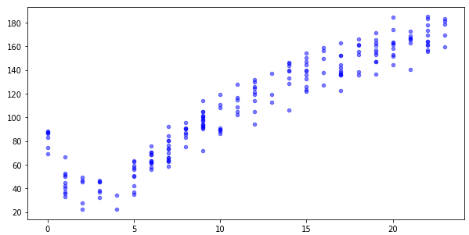
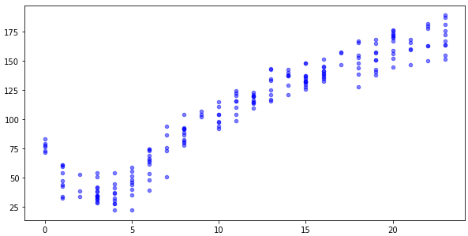
V: Linear Regression vs. Tree Regression
Training-data
Testing-data
Evaluation method:
Correlation coefficients
Regression methods:
Linear Regression(LR)
Regression Tree (RT)
Model Tree (MT)

Slide 52
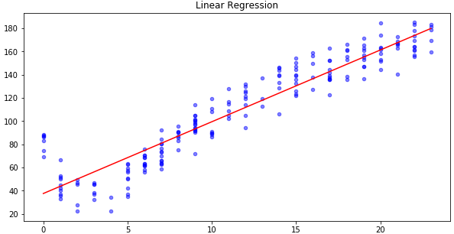
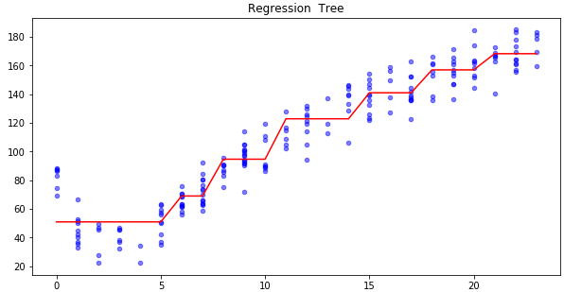
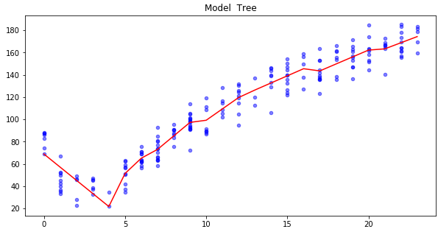
V: Linear Regression vs. Tree Regression
Correlation coefficients:
LR: 0.94346842356
RT: 0.96408523182
MT: 0.97604121913

Slide 53
VI: Summary
Regression is the process of predicting a target value, which makes it become one of the most useful tools in statistics.
Linear methods:
Linear regression: does a good job, when the dataset is simple and linear.
Locally weighted linear regression: the forecast would be more precise. Overfitting problem should be avoided.
Non-linear methods:
Regression tree: breaks up the predicted value into piecewise constant segments.
Model Tree: implements the linear regression equations at each leaf node.
Pre- and Postpruning: can effectively reduce the complexity of tree and help avoid the overfitting problem.

Slide 54
Reference
Harrington, Peter. 2012. Machine Learning in Action. Shelter Island (N.Y.): Manning Publications Co.
Li Hang. 2012. Statistic Learning Methods. Tsinghua University Publications Co.
Analytics Vidhya: A Complete Tutorial on Tree Based Modeling from Scratch. APRIL 12, 2016 https://www.analyticsvidhya.com/blog/2016/04/complete-tutorial-tree-based-modeling-scratch-in-python

