Slide 1



Runtime Programmable Switches
Jiarong Xing, Kuo-Feng Hsu, Matty Kadosh, Alan Lo, Yonatan Piasetzky, Arvind Krishnamurthy, Ang Chen

Slide 2





Background: Programmable switches
Routing
Telemetry
p4c compiler
“Fixed” function
p4c compiler
Security
…
P4 switch
P4 switch
P4 switch
Switches become fixed after the program is deployed.
Operators compile and reflash the data plane w/ a new program
However, reflashing can cause downtime and packet loss
To avoid downtime, traffic drain/undrain is necessary
Changes must be infrequent and operator driven

Slide 3


From compile-time to runtime programmability
Runtime reconfiguration
Program updates
Runtime programmable switch
The key features of runtime programmability:
Runtime: Live upgrade at runtime
Seamless: Zero downtime and packet loss
Partial: Upgrade the program partially
Atomic: Reprogram with strong consistency guarantees

Slide 4

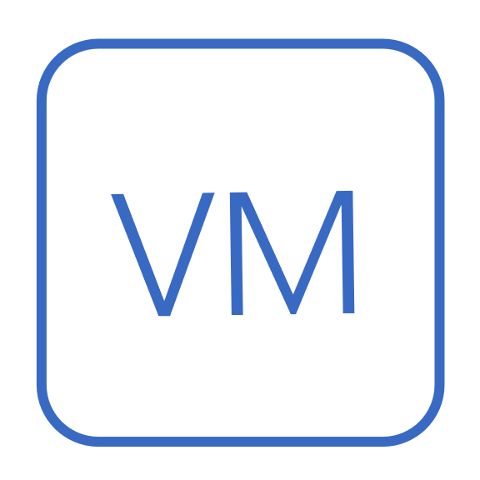








Benefits of runtime programmability
Performance monitoring
Dynamic optimization
Real-time attack mitigation
JIT optimization
Tenant-specific extension
Example benefits of runtime programmability
Real-time attack mitigation
Just-in-time network optimization
Tenant-specific network extension

Slide 5







FlexCore: A whole-stack design
Multi-level consistency
delta
Atomic changes
Partial reconfig primitives
current.p4
new.p4
Switch hardware
Switch hardware design
The FlexCore ecosystem
An ecosystem that supports live program upgrades with strong consistency and no downtime.
FlexCore

Slide 6
Challenge #1: Flexible switch architecture
Match
Match
Match
pkt
pkt
pkt
pkt
…
pkt
pkt
Action
Action
Action
Memory
Stage 1
Stage 2
Stage n
The RMT architecture is inflexible for runtime changes
Compute and memory are tightly coupled in stages.
Packets can only move forward to the next stage.
Memory of one stage cannot be used by other stages.

Slide 7

Solution: Disaggregated RMT architecture
MA processor1
MA processor2
MA processorN
Match
PDTab
Match
PDTab
Match
PDTab
Action
Action
…
Action
Load-balanced crossbar
Disaggregated, sharded access
…
Memory bank 1
Memory bank t
Enhanced disaggregated RMT (dRMT) architecture
Compute and memory are disaggregated
Memory is sharded, and accesses are load-balanced
MA processors handle packets in parallel in a run-to-completion manner

Slide 8
Partial reconfiguration with indirection
Start
。。。
parser {
...
}
control ingress{
ipv4.apply();
+ acl.apply();
route.apply();
}
Match key
Key type
Mem pointer
Next table pointer
ipv4
④
…
route
③
acl
①
…
②
Program description table (PDTab)
Memory banks
P4 program
FlexCore adopts a pointer-based indirection mechanism
Program description table (PDTab)
Each PDTab entry records the information of a MA table
PDTab entries are chained together by “next table pointers”
Pointers can be changed at runtime atomically.

Slide 9
More partial reconfiguration primitives
Match
PDTab
if (condition) { tab.apply();
}
Action
AllocTab(T)
SetPtr(T, T’)
ModTab(T, T’)
AllocCond(B, Pred, Br1, Br2)
DeallocCond(B)
SetCondPtr(B, N1, N2)
AllocState(S)
AllocTrans(S1, S2)
AllocEx(R)
* Each allocation primitive has its respective deallocation primitive
FlexCore provides a set of atomic reconfiguration primitives
FlexCore transforms program diff into these primitives

Slide 10
Challenge #2: Atomic changes
r
r
A
x
Reused node
A
B
C
x
New node
B
C
D
New edge
D
E
F
E
x
Pointer change
s
s
A program-level update
Undesired intermediate states
A program-level update may involve multiple discrete changes
Non-atomic changes lead to undesired intermediate states

Slide 11
Solution: Version control with FlexEdge
r
r
r
Check on version number
A
A
A
0
Current version
B
C
B
C
B
C
i
1
D
D
D
i
0
i
i
i
i
i
1
New version
i
1
i
i
1
0
0
E
F
E
F
s
s
s
FlexEdge
Control with FlexEdge
Current version
New version
FlexEdge: A version control mechanism
Check on a global version metadata
Can be inserted/deleted one by one atomically

Slide 12
Challenge #3: Finer-grained partial updates
r
Headroom
r
Headroom
A
A
Released by D
Success
Failure
To delete
B
C
To add
B
C
D
E
D
E
A P4 program with two independent branches
Peak transient overhead
Do this first, it will release resources from table D
Peak transient overhead
One tx still requires preparing all the differences together
Could fail if the switch has insufficient headroom
First completed can release resources for later updates
We need multi-step transactions

Slide 13
Solution: Multi-level consistency for multi-step TXs
Tx 1
Tx 1
Tx 2
Tx 1
Tx 2
Tx 3
B
C
B
C
D
B
C
D
D
F
F
F
E
E
E
E
s
s
s
s
s
s
Program consistency
Element consistency
Execution consistency
Weaker consistency, lower transient overhead
FlexCore supports multi-level consistency
Definitions and algorithms are in the paper!

Slide 14


Implementation and setup
Commercial switch hardware
NVIDIA/Mellanox Spectrum-2 silicon
As fast as 12.8Tbps
BMv2 emulator
Reconfiguration primitives in P4Runtime
Three consistency levels
Available at https://github.com/jiarong0907/FlexCore
Case study setup
Accelerated multicast
A spectrum-2 switch connected with one sender and several subscribers
The sender sends the same data to its subscribers

Slide 15
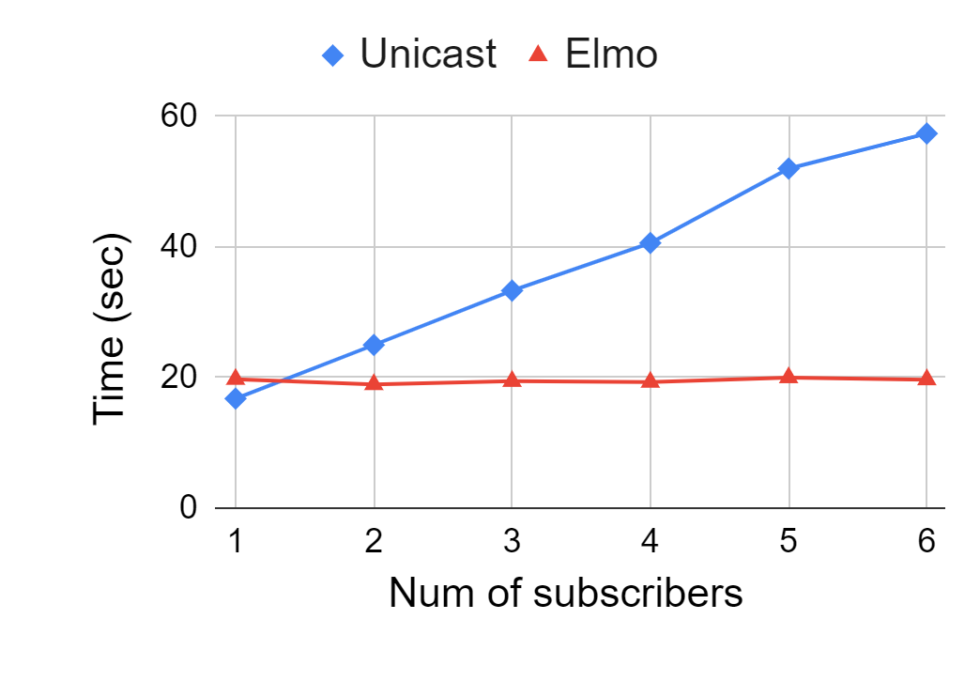
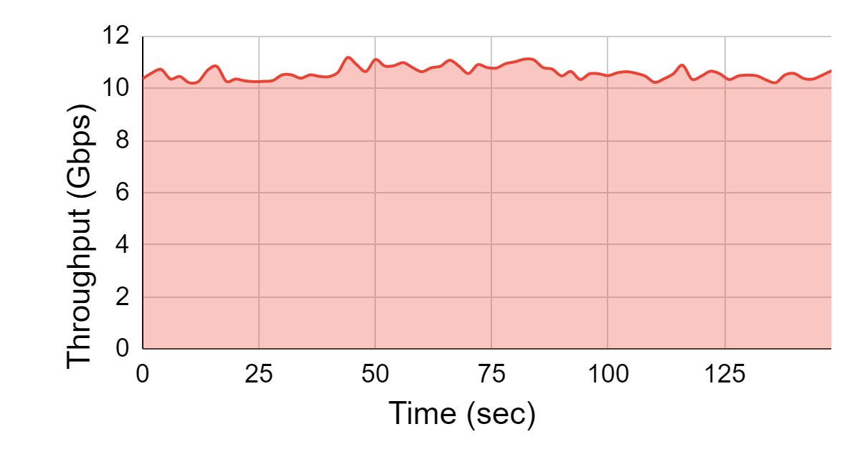
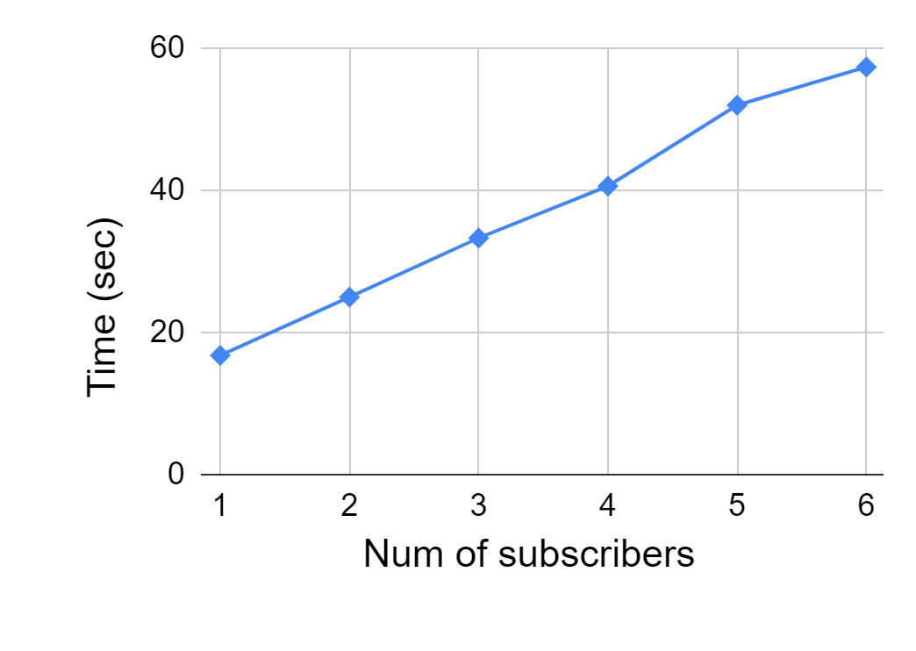
Case study: Accelerated multicast
Traffic throughput
Zero packet loss
20ns reduced
Job completion time
Time
Unicast
Insert multicast
Insert telemetry
Remove multicast
Remove telemetry
Runtime switch function upgrade with FlexCore has no downtime
Runtime network optimization greatly improves performance

Slide 16



More results in the paper
In-place application upgrade
Real-time attack mitigation
Tenant-specific network extensions
Use cases
Scalability of real-world P4 programs
Large-scale synthetic program simulation
Multi-level consistency
Hardware overhead
Reconfiguration transient overhead
System overhead

Slide 17
Summary
Today’s switches are only programmable at compile time
FlexCore: An ecosystem for runtime programmability
Live switch program upgrades
Zero packet loss, no downtime
Support partial upgrades with multi-level consistency guarantees
Implementation:
12.8Tbps Spectrum-2 switch silicon
BMv2 emulator: https://github.com/jiarong0907/FlexCore
Use cases:
Runtime accelerated multicast, real-time attack mitigation, …
Ultimate vision:
End-to-end runtime programmable networks
See our vision paper at HotNets’21: A Vision for Runtime Programmable Networks

