Slide 1
2014北京微电子国际研讨会
Semiconductor Technology Trends & SMIC’s R&D to Supply Manufacturing Technologies
Dr. Shiuh-Wuu Lee 李序武博士
Executive VP, Technology R & D, SMIC
Oct 23th, 2014

Slide 2
Safe Harbor Statements
Under the Private Securities Litigation Reform Act of 1995
This document contains, in addition to historical information, “forward-looking statements” within the meaning of the “safe harbor” provisions of the U.S. Private Securities Litigation Reform Act of 1995. These forward-looking statements are based on SMIC’s current assumptions, expectations and projections about future events. SMIC uses words like “believe,” “anticipate,” “intend,” “estimate,” “expect,” “project” and similar expressions to identify forward looking statements, although not all forward-looking statements contain these words. These forward-looking statements are necessarily estimates reflecting the best judgment of SMIC’s senior management and involve significant risks, both known and unknown, uncertainties and other factors that may cause SMIC’s actual performance, financial condition or results of operations to be materially different from those suggested by the forward-looking statements including, among others, risks associated with cyclicality and market conditions in the semiconductor industry, intense competition, timely wafer acceptance by SMIC’s customers, timely introduction of new technologies, SMIC’s ability to ramp new products into volume, supply and demand for semiconductor foundry services, industry overcapacity, shortages in equipment, components and raw materials, availability of manufacturing capacity, financial stability in end markets and intensive intellectual property litigation in high tech industry.
In addition to the information contained in this document, you should also consider the information contained in our other filings with the SEC, including our annual report on Form 20-F filed with the SEC on April 14, 2014, especially in the “Risk Factors” section and such other documents that we may file with the SEC or SEHK from time to time, including on Form 6-K. Other unknown or unpredictable factors also could have material adverse effects on our future results, performance or achievements. In light of these risks, uncertainties, assumptions and factors, the forward-looking events discussed in this document may not occur. You are cautioned not to place undue reliance on these forward-looking statements, which speak only as of the date stated or, if no date is stated, as of the date of this document.

Slide 3
Outline
Major Technology Challenges
SMIC’s Technology R&D Strategies and Plans
  Continue to build & enhance high quality and innovative R&D at SMIC
  Place significant focus on leading-edge differentiation technologies
  Strengthen R&D on advanced CMOS technology
  Enrich design IP to actively support design houses for faster TTM
  Actively drive the growth in domestic IC industry chain
3. Concluding Remarks

Slide 4
国际主流逻辑技术路线图
Foundry
2H12
1H13
2H13
1H14
2H14
1H15
2H15
1H16
2H16
1H17
2H17
T
20nm Planar
16nm FF
10nm FinFET
7nm FinFET
GF
20nm Planar
10nm FinFET
14nm FF
7nm FinFET
Manufacture Technologies
U
Skip 20nm Planar
14nm FF
Speculated
Pre-manufacture Technologies
Samsung
14nm FF
10nm FinFET
7nm FinFET
(Intel)
22nm FF
14nm FF
10nm FinFET
7nm FinFET
14nm FF
国际主流公司未来五年逻辑技术路线图，各公司均加快了科研进度，多数公司在未来五年均拟推出3代或3代以上技术产品。
Trial/NTO
MP

Slide 5
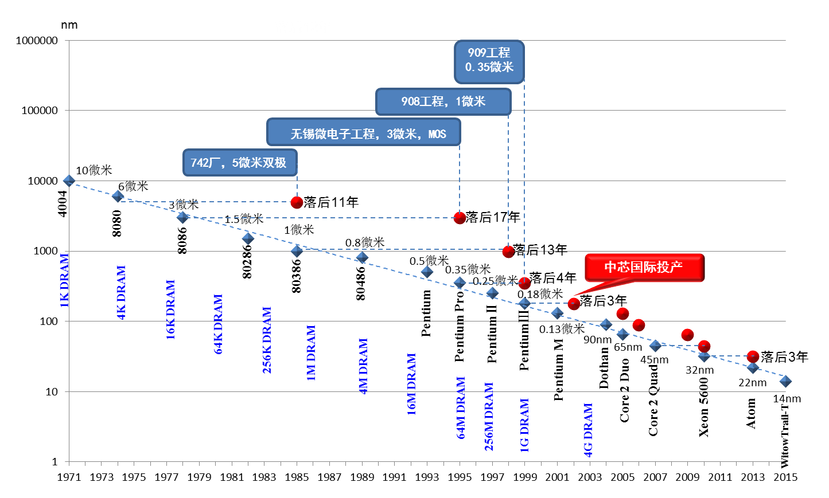
摘自：北京大学王阳元, 2012
落后2-3年

Slide 6
芯片制造技术中的五大技术挑战
光刻技术
新材料
工艺误差
新结构
工艺集成

Slide 7
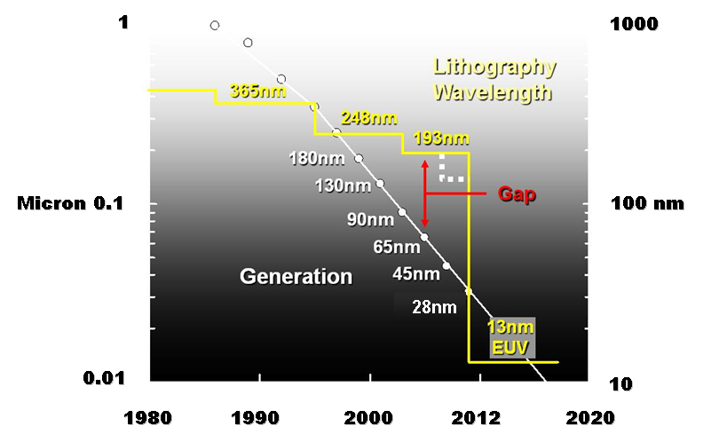
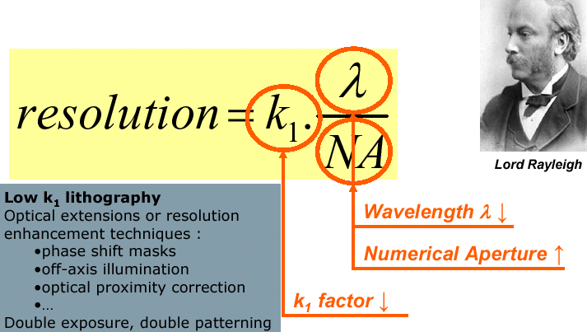
技术挑战-1: 精密图形转换
如何用193纳米波长光源形成65-20纳米特征长度的图形?
?
1.光学修正(OPC),相移掩膜(Phase Shift Mask)
2.浸没式光刻(Immersion Litho)
3.多重曝光和刻蚀(Multiple Patterning)

Slide 8
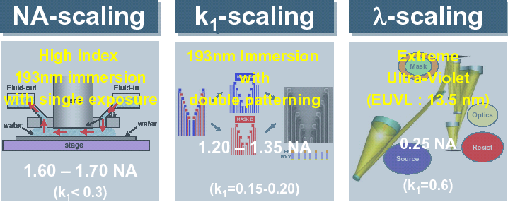
光刻技术的瓶颈三因素
Phase Shift Mask
Off-axis illumination
…….

Slide 9
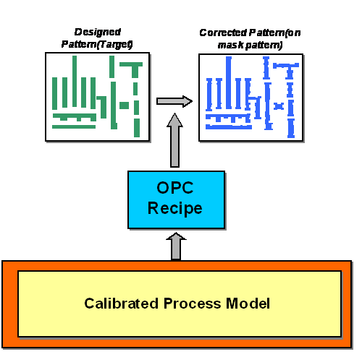
光学修正技术使得图形比波长短
光掩模
图形
光掩模
图形

Slide 10
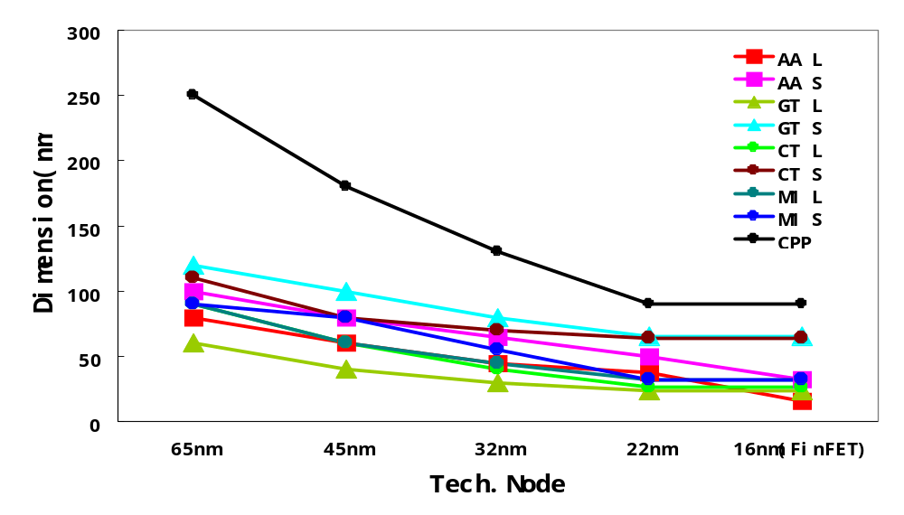
193纳米光刻技术支撑CMOS发展65-14nm
Design Rule of Critical Layers
193nm 光刻的瓶颈
193nm Happy Days
Contact PL Pitch
Fin

Slide 11
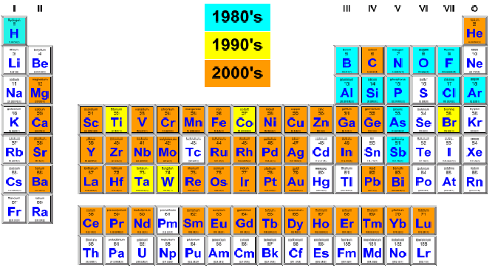
技术挑战-2: 新材料新工艺
新材料在CMOS中的应用
本世纪来:
47种新材料进入
集成电路制造.
共计64种材料.
12
5
47

Slide 12
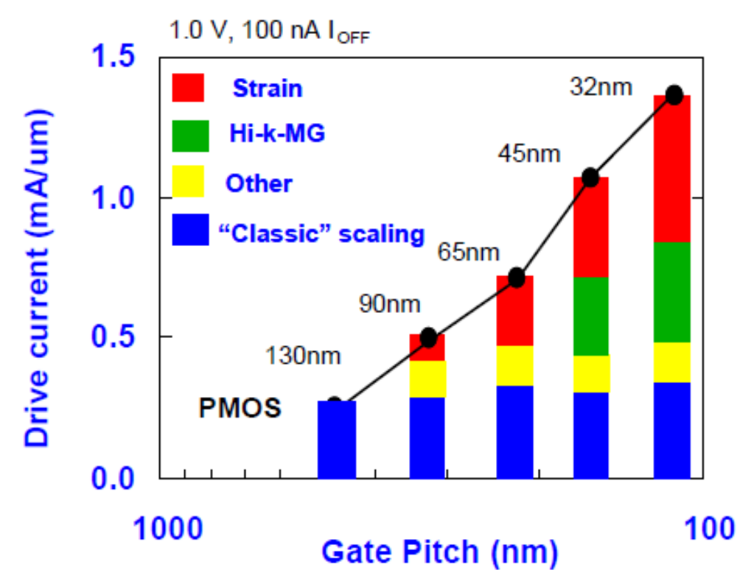
新材料技术带来的器件性能提高
0.13um 90nm 65nm 45nm 32nm

Slide 13
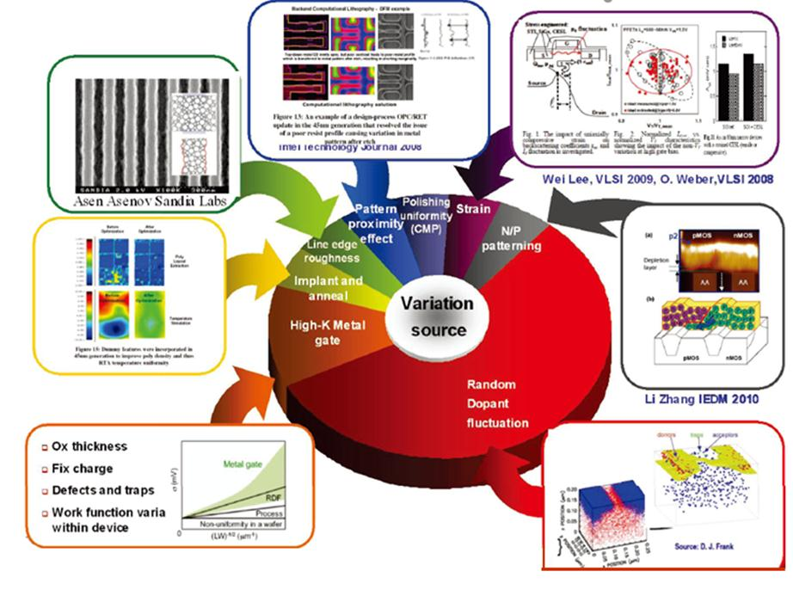
技术挑战-3: 工艺误差
产品技术杀手: 工艺随机误差
Direct impact:
SRAM yield
Circuit performance and design margin
Indirect impact:
Reliability
Mobility
Manufacturing control
DFM： 研究工艺误差带来的器件产品性能变化，并提出解决方案。
APC: 及时发现工艺异常.

Slide 14
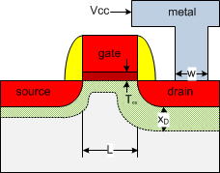
技术挑战-4: 新结构
体硅平面工艺似乎走到尽头?
动态功耗
栅泄漏电流
短沟效应
迁移率退化
寄生电阻
波动性
功耗：
P=αC_{g}V_{dd}²f+I_{leakage}V_{dd}
驱动能力：
I_{DSat}=C_{g}v_{inj}~C_{g}(V_{dd}-V_{t})^{α}μ_{eff}
速度：
τ_{g}=C_{g}V_{dd}/I_{DSat}
挑战：在低电压下获得高电流和少泄漏
即在低电源电压情况下（低电压可以获得好的功耗指标），要设法获得更大的驱动能力和更小的晶体管延时（提高性能）。显然，在传统的体硅平面器件上，已很难实现上述要求。
来源：北京大学黎明研究员

Slide 15
3维晶体管FinFET
新器件的设计问题
  新一代FinFET器件的结构优化
  应力分布模拟、迁移率提取、输运机制、可靠性与涨落特性
  器件结构参数和工艺参数对电路性能的影响
可制造性问题
  栅泄漏电流，功函数调节，源漏串联电阻及接触电阻等关键问题
  材料体系与工艺技术的稳定性可靠性问题
大生产平台上工艺集成问题
  自对准多次曝光技术，纳米级Fin和Gate的光刻和刻蚀，节距的缩小带来的原子水平的间隙填充，低介电常数侧墙，超低K铜互连等。
功函数
接触电阻
沟道材料
电路模型
源漏电阻
高K材料

Slide 16
技术挑战-5:工艺集成技术
65-14纳米CMOS工艺流程复杂度
>1600
>1400
>1200
~1000
~800
45nm
32nm
20nm
14nm
65nm
每一代新技术需要约20%以上的工艺设备添置和更新
几乎每步工艺需要实验,关键工艺需要数百次

Slide 17
Outline
Major Technology Challenges
SMIC’s Technology R&D Strategies and Plans
  Continue to build & enhance high quality and innovative R&D at SMIC
  Place significant focus on leading-edge differentiation technologies
  Strengthen R&D on advanced CMOS technology
  Enrich design IP to actively support design houses for faster TTM
  Actively drive the growth in domestic IC industry chain
3. Concluding Remarks

Slide 18












SMIC’s Two-Pronged Technology Strategy
14nm
28nm
RF/MS
28nm
40nm
55nm
65nm
90nm
0.13µm
0.18µm
Flash
(ETOX)
38nm
45nm
65nm
90nm
0.13µm
0.18µm
0.25µm
e-Flash
55nm
90nm
0.11µm
0.13µm
0.18µm
40nm
65/55nm
90nm
0.11µm
0.13µm
0.15µm
0.18µm
0.25µm
0.35µm
Logic
Baseline
EEPROM
0.11µm
0.13µm
0.18µm
0.35µm
HV
0.13µm
0.16µm
0.20µm
0.25µm
0.35µm
Imager
55nm BSI
90nm FSI/BSI
0.11µm BSI
0.13µm FSI
0.15µm FSI
0.18µm FSI
LCOS
0.13µm
0.18µm
0.25µm
0.35µm
MEMS
0.13µm
0.18µm
PMIC
0.13µm
0.18µm
0.35µm
SOC platforms
SOC platforms

Slide 19
28nm Readiness and MPW Milestones
Y14 NTO Year
Y14 – MPW
4 Shuttles: 28PS, 28HK
Apr, Jun, Aug, Dec
28nm
Milestone
4Q13
On Time Delivery!
Process
Qualification
PDK
MPW
Process
Freeze
28PS & 28HK Q4/2014-Q1/2015
1st SMIC
28nm MPW Dec/2013
28PS & 28HK
V0.5 V0.5
Nov/2013 Jan/2014
28PS & 28HK
Dec/2013
Notes:
28PS & 28HK were Process Forzen on time at the end of 4Q13.
The first 28nm MPW including 28PS & 28HKMG is readiness by the end of 4Q13.
28nm PS & HK will achieve qualification in 2Q14.
28nm HKL will be process frozen in 1Q14 and reach qualification in 3Q14.
28nm MPW schedule launched on schedule at the end of 4Q13. Three more MPW for 28PS/HK/HPL are planned for Y14.

Slide 20

MTE Device Structure
Device Structure : 2x gate density
Advantages
  50% reduction in transistor pitch from 0.79um to0.39um by SA/SB shrunk.
  1/3 parasitic S/D junction capacitance compare to conventional structure.
Actual Performance
  Standard Cell library : >37 % area shrunk in avg. compared to 13LL
  SRAM : 50% bitcell size (1.05um2) vs 13LL (2.03um2) with 2pA/cell Istdby
  SRAM : Smallest bitcell (0.74um2) 10M yield 67%
0.13 BL
0.13 MTE
0.06
0.11
0.13
0.16
0.16
0.04
0.13
0.13
CT
CT
CT
Poly2
GT
GT
N+
N+
N+
N+
PW
PW

Slide 21
MTE Merits –High Performance
Junction capacitor table from SPICE model
0.13 MTE
Parameter | unit | 013MTE* | 013LL | MTE vs. LL
W | um | 100 | 100 | N/A
SA/SA | um | 0.13 | 0.38 | N/A
Cj0_total_n15 | fF | 14.05 | 28.994 | -51.5%
Cgd0_total_n15 | fF | 42 | 38.9 | 8.0%
S/D_CV_total_n15 | fF | 56.05 | 67.894 | -17.4%
Cj0_total_p15 | fF | 11.18 | 47.31 | -76.4%
Cgd0_total_p15 | fF | 43.9 | 36.1 | 21.6%
S/D_CV_total_p15 | fF | 55.08 | 83.41 | -34.0%
0.13
Cgd
=
CT
GT
N+
N+
=
Cj
PW
As high as 70% reduction in S/D parasitic capacitance was obtained in latest lot.
Device fine tuning needed to further reduce parasitic junction capacitance.

Slide 22
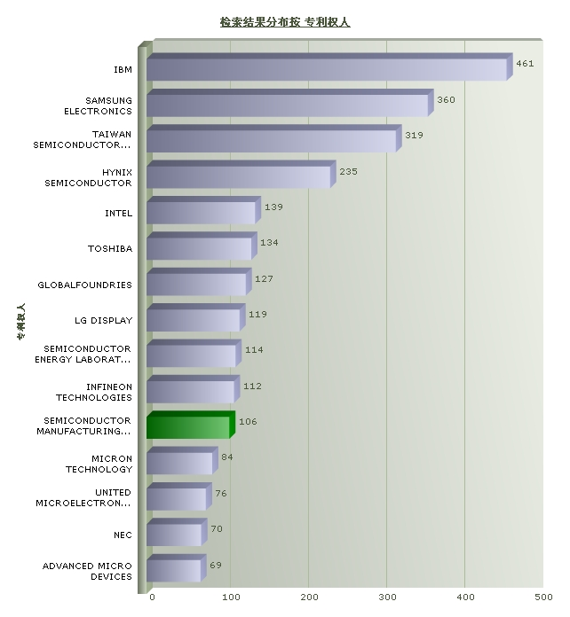
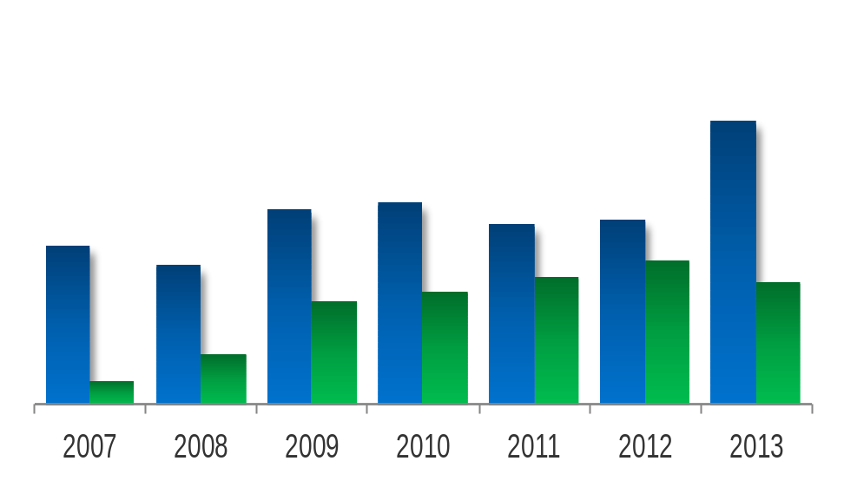

Driving Technology R&D with Innovation
SMIC is amongst the
Top 5 companies in China
in numbers of patents granted
Filed patents
Issued patents
16纳米节点关键技术FinFET
世界前十一名
中国第1位
Patents filed: 9,088 total
Patents granted: 4,174 total
Source: Corp. Legal, data as of July. 29, 2014

Slide 23
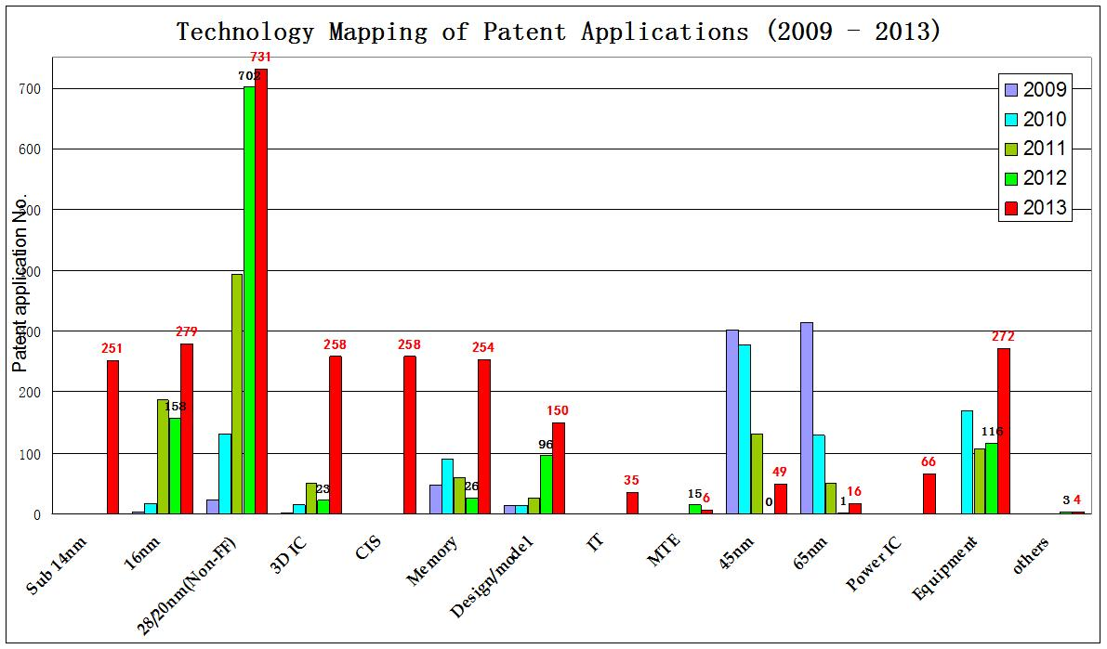
Grow Competitive Portfolio for Mobile Internet
4G R&D Completed
3G Production
Technologies
Current focuses: 28nm, 20nm, 16nm, 14nm , 3D IC, IP design, MEMS and new memory
Source: SMIC dada

Slide 24
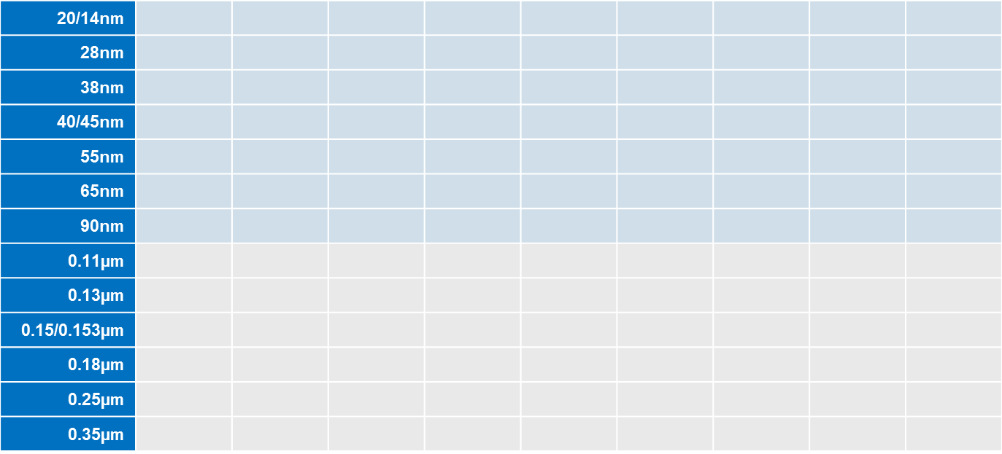
SMIC’s Technology Portfolio
Power Mgmt
Wireline Comm.
Image & Display
MCU
Wireless
Connectivity
Smart Card
Mobile Computing
NOR/NAND/
Memory
Digital Home
In Production
Major Focus (close to or in early production)
Future Plan
Notes:
SMIC’s offers various technology nodes across 9 different product segments, such as Power Management, Wireline Comm., Image & Display, MCU, Wireless Connectivity, Smart Card, Mobile Computing, NOR/NAND/Memory, and Digital Home.
Blue dot shows that SMIC already has a technology node in production for an application.
Orange dot shows that SMIC either has a technology node in early production or close to production for an application.
Orange circle shows that SMIC has plans to have a technology node for an application.

Slide 25






















中芯国际多元差异化器件和互连与3D系统集成技术全貌
多元差异化核心器件及芯片技术
先进逻辑
互连及3D系统集成
20/14nm
28nm
45/40nm
2D片上互连
3D系统集成
Wide I/O
65/55nm
90nm
0.13/0.11um
TSV转接板及2.5D系统集成
0.18/0.15um
0.25um
3D芯片
0.35um
CMOS
MEMS
CIS
PMIC
Emb-
NVM
Mass
Storage
NVM
RF
SOI
RF
CMOS
Logic
Al
BEOL
Cu LK
& ELK
TSI
SiP
CMOS
e-TSV
I/O
3D
WtW
Stack

Slide 26
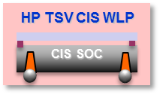
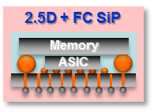
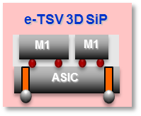


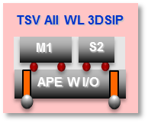
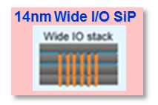
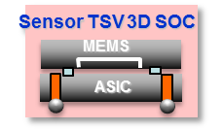
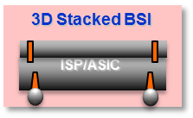
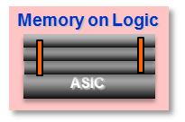
中芯国际TSV与3D芯片及系统集成技术产业化进程表
产业化
基于TSV的
2.1/2.5D
系统集成
工艺定型
客户设计
工艺定型
客户设计
TSV BS GRD
High density I/O
WL Fan-Out
WL integration
Low cost
Low profile
HP RF & PMIC
基于TSV的
3D芯片级
系统芯片
集成
构架及模块技术开发
工艺定型
客户设计
构架及模块技术开发
工艺定型
客户设计
基于TSV的
3D晶圆级
系统芯片
堆叠集成
工艺定型
65~14nmLG
65~20nm NVM
HP MCU
KGD resolved
Low cost
客户设计
工艺定型
客户设计
国家02
产业化项目
构架及模块技术开发
工艺定型
客户设计

Slide 27
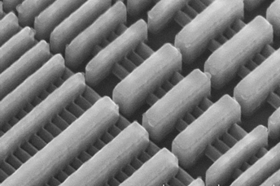
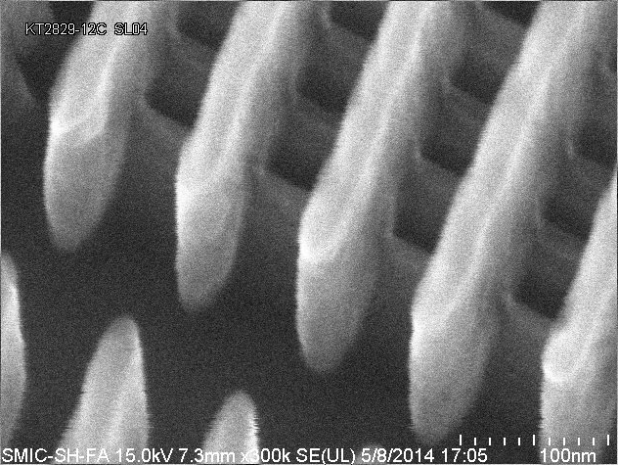
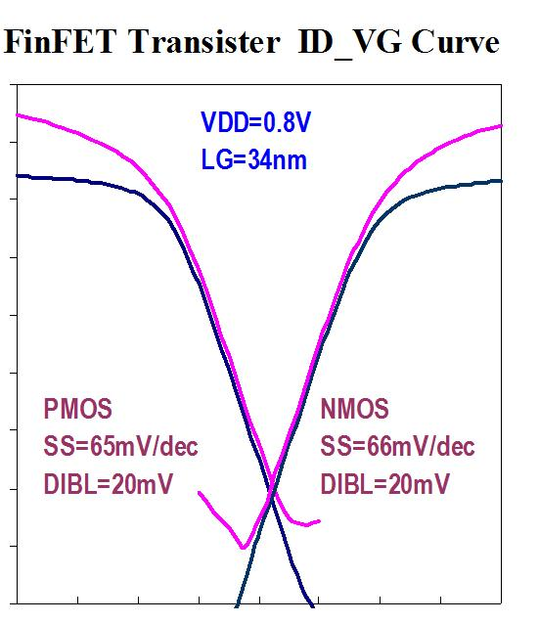
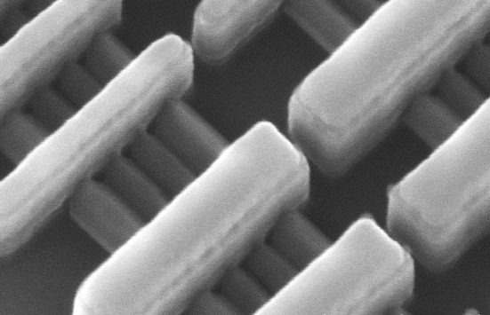
14nm先导技术研究进展：FinFET工艺结果
FinFET Features demo-ed:
  3D fin based
  All-last RMG
  Local interconnect MOL
  64nm BEOL metal pitch with double patterning
  Functional transistors with excellent electrostatic performance!
Fin
Raised EPI
Features in working
  pFET epi SiGe on fin
  nFET epi Si/SiC on fin
  Self-aligned local inter-connect contact (SAC)
Gate Poly
ID (A/um)
STI
VG(V)
Source: SMIC dada
Notes:
3D FinFET transistors with 14nm dimension are successfully demonstrated.
Key technology features have been implemented are under “FinFET Features demo-ed”
Technology features still yet to be electrically demo-ed are under “Features in working”
Tilted SEM image on upper-right shows well-constructed 3D FinFET device structure. On the image, silicon fins and poly lines are shown.
The Id-Vg curves on lower-right shows excellent sub-threshold slopes (~65mV/dec vs typical 28nm SSLP of ~90mV/dec) and DIBL (only 20mV vs. typical 28nm DIBL of >100mV).
The excellent (but expected from FinFET) indicated good 3D HKMG on fin transistor integrity. Good SSLP and DIBL shows the potential of substantial Vdd reduction.
Drive current is still not the best due to high parasitic resistance from lacking epi-S/D on fin. (this comment is optional)

Slide 28
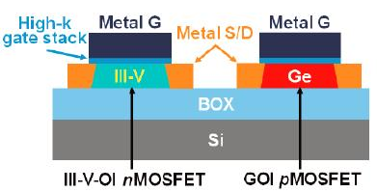
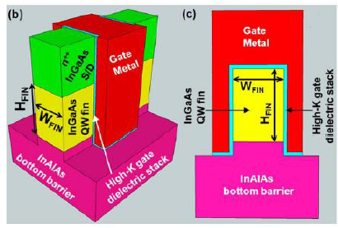
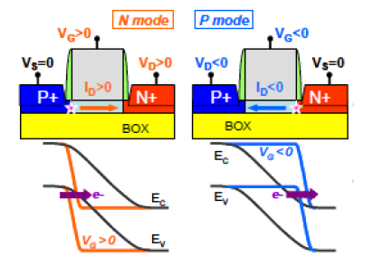
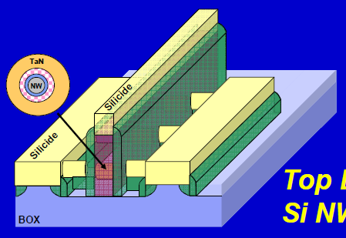
Devices Beyond FinFET
High-mobility
Channel FinFET
High-mobility Channel FET
[Yokoyama, VLSI 2011]
Radosavljevic, IEDM 2010
Gate-All-Around Nanowire FET
[Bangsaruntip, IEDM 2009]
TFET (Tunnel FET) [Villalon, VLSI 2012]
for ultra-low-power application

Slide 29
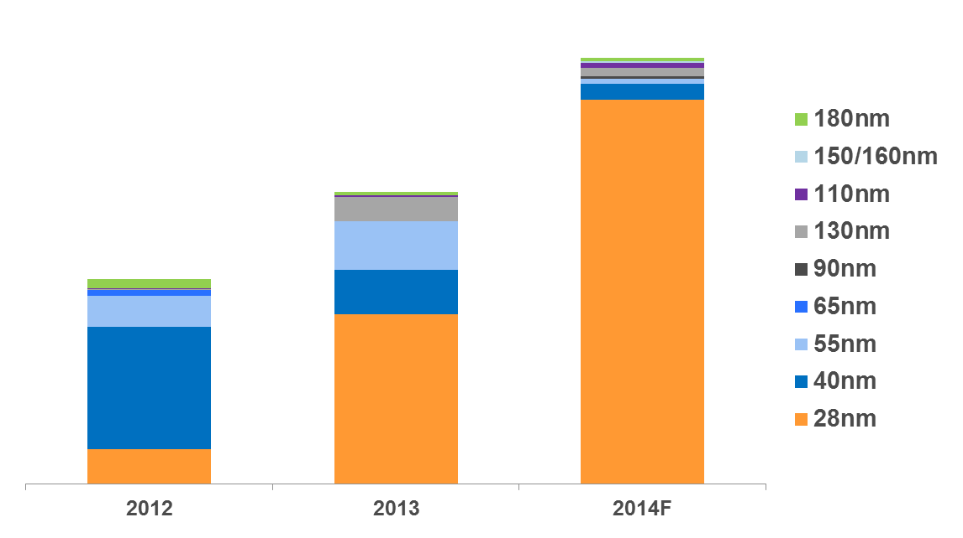
Continue to Strengthen IP Investments
Continuously focusing on investing advanced technology
Driving 28nm IP Investment to meet customers’ needs
Single user-friendly interface to access all technical information
with accuracy and consistency
SMIC Historical Third Party IP Investment
2.2X
1.5X
1
All actual engaged or forecast IP investment are “Booking” based
Notes:
SMIC IP strategy:
Continue to strengthen SMIC IP warehouse(encourage internal paten development program )
Offer application oriented IP platform.
Focus on shorten customer product development time through providing design solutions.
Started from 2010, investment on IP has doubled, especially on advanced technologies such as 40nm and 28nm.
It is an important part of our strategy to have the IP investment timely and readily to couple with our technology development.

Slide 30








Manufacturing Excellence
Quality, Service, Technology Customer Oriented
1st Time
Success
Customer Satisfaction
Production
Yield
Excellence
Lowest
Cost
Production
Stability
Defect
Density
Delivery
Cycle
Notes:
半导体集成电路大生产主要的运营指标有七个：第一是“一次做对率”，要达到100%。无论是一个新的技术平台，一台新型设备的采购，还是一个新产品的导入，都要一次成功，否则就会推迟甚至丧失进入市场的机会，造成客户流失和产能空置。第二是生产线的成品率，要保持在99.5%以上。如果下线了一万产品片，最后只有九千五百片合格地交货给客户，那这个生产效率就太低了。第三是生产线的稳定性，就是发生突发事件的几率，在每10 万片交货中要少于1 次。第四是交货周期要快过理论值。交货周期与你投资设定的产能与设备合理性有关系。如果购买的设备产能多达2 万片，而你每月的订单只有1 万片，你的交货周期自然就会很短；但如果你建成的产线是3 万片，而每一步都在不多不少3 万片产能瓶颈，而你又要每月投片3 万片以上，那你就做不快，很可能无法准时交货。在国际上，客户除了对产品的质量非常关心以外，对交货周期也非常重视。我们必须在同等的投资情况下，实现交货周期最短。第五是工艺缺陷的密度，取决于工艺设定的合理性和设备维护的质量，是一代生产技术成熟程度的标志，到达本征密度的时间被称为“学习周期”。第二梯队的第一名要用最短的时间完成“学习”。第六是最低的生产成本。我们身处中国，在生产运营成本上比较有竞争性，除了人力资源上的优势外，国内还有许多生产设备和材料的企业在02 专项的大力支持下发展得很好，为我们取得了很大的本地优势和竞争力。第七是客户放心度。要通过“说到做到、周到厚道”留给客户最放心的体验。作为一个集成电路生产厂要做到有信誉，负责任，这是说到做到；提前替客户把问题解决掉，出了问题不推卸，责任永远留给自己，这是周到厚道。我们的目标应该是把这种敞开胸怀的文化传达给客户，成为客户最喜欢的生产厂。

Slide 31
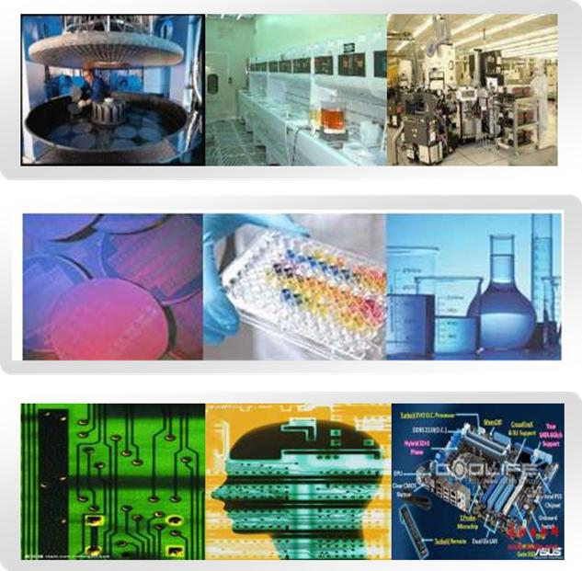
Strong Partnership with Domestic IC Industry Chain
Equipment
Foundry
Material
Design house

Slide 32


12” Bumping – JV with JCET
Building China’s Domestic IC Supply Chain
Front-end
Middle-end
Back-end
SMIC’s advanced 40nm & 28nm process technology
12" Bumping production line jointly built with JCET
JCET’s Package production line
at nearby Middle-end facility
Will strengthen the co-operation in the 3D wafer level packaging field
Notes:
By establishing Bumping and nearby advanced flip-chip packaging capabilities, along with SMIC’s front-end 28nm process technology offerings, the first complete 12“ advanced IC manufacturing local supply chain in China will be formed. This supply chain can greatly reduce the cycle time between FEOL (Front-end of Line) and MEOL (Middle-end of Line) / BEOL (Back-end of Line), and effectively control the intermediate costs. More importantly, it is closer to the end market in China, therefore it can shorten the time to market for fabless customers while focusing on China’s mobile market.
Using this as a foundation, both sides will also strengthen the co-operation in the 3D wafer level packaging field.

Slide 33
Collaboration with Universities and Research Institutes
Market Driven
7nm
Advanced Technology
28-20nm
14-10nm
Pre-Manufacture Technology
Manufacture Technology
  Original Innovation
  原始创新
  New architecture New material & process
  新结构,新材料,新工艺
  Scientist lead innovation
  充分发挥科研院所/高校的创新精神
  Marketing oriented 企业引导、瞄准市场
  Academic Effect
  具有较高学术影响
  Application adopted 先导性成果争取获得企业应用
  Know-How Dominated
  技术细节为主体
  Efficiency and cost
  快、赶、省，企业发展路线图
  Theoretic support from Univ.
  科研院所/高校提供理论支持
Innovation Driven

Slide 34
Outline
Major Technology Challenges
SMIC’s Technology R&D Strategies and Plans
  Continue to build & enhance high quality and innovative R&D at SMIC
  Place significant focus on leading-edge differentiation technologies
  Strengthen R&D on advanced CMOS technology
  Enrich design IP to actively support design houses for faster TTM
  Actively drive the growth in domestic IC industry chain
3. Concluding Remarks

Slide 35
小 结
我国的集成电芯片制造距离世界先进水平技术差距3年。
工艺技术发展中的五大挑战（光刻、材料、随机误差、 结构、工艺集成），其中光刻瓶颈尤为明显。
先进工艺步伐趋缓，但是世界龙头在20-14纳米（及以下）产业化技术发展加快。
中芯国际发挥中国市场的主场优势，保持技术发展步伐，实行差异化发展。
设计IP的建设正在得到更多的重视。
产业链需要加强产业联盟的建设,促进产学研协同创新。

Slide 36

Thank You
谢谢

Slide 37
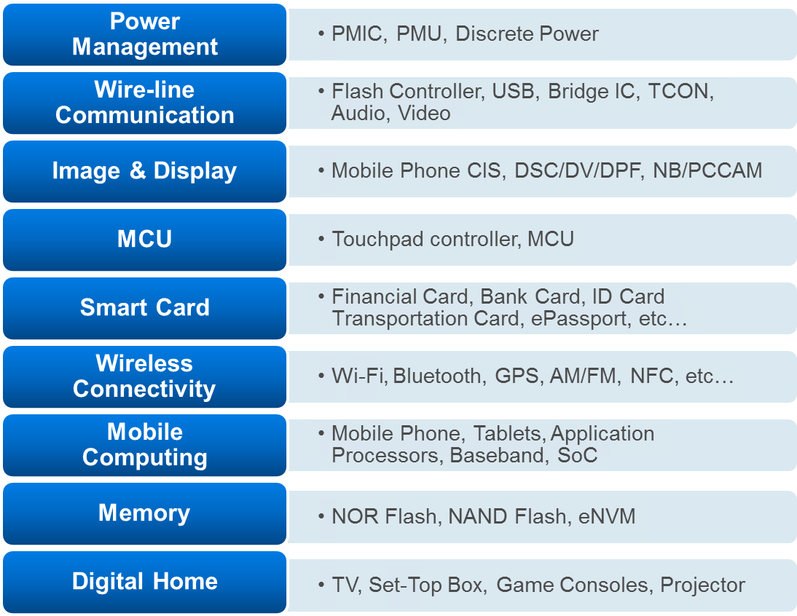









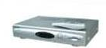
Diversified Technologies for Various Applications
Notes:
From application point of view, SMIC’s technology offering currently covers these areas.
Throughout the years, SMIC has been building solid foundation and experiences many areas
For instance, Power, CIS, Wireless, AP/BB/SoC needed for Mobile and Consumers productions, which are the key growth drivers in today’s electronics economy.
Going forward, SMIC will continue to explore new growing area such as IoT/Cloud, Automotive, Industrial, and Medical related applications.

Slide 38
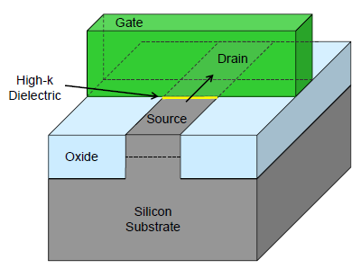
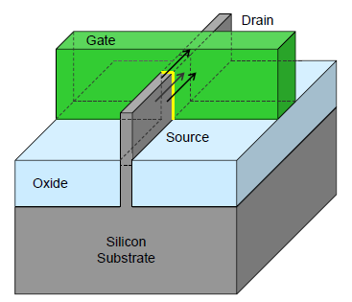

14纳米以下的研究发展趋势(863项目)
单栅控制
短沟道效应
涨落
迁移率退化
多栅控制
全耗尽沟道
3D集成度
传统平面晶体管
三栅FinFET
2012
2014
2016
2018
技术细节未明
技术方案不确定

Slide 39
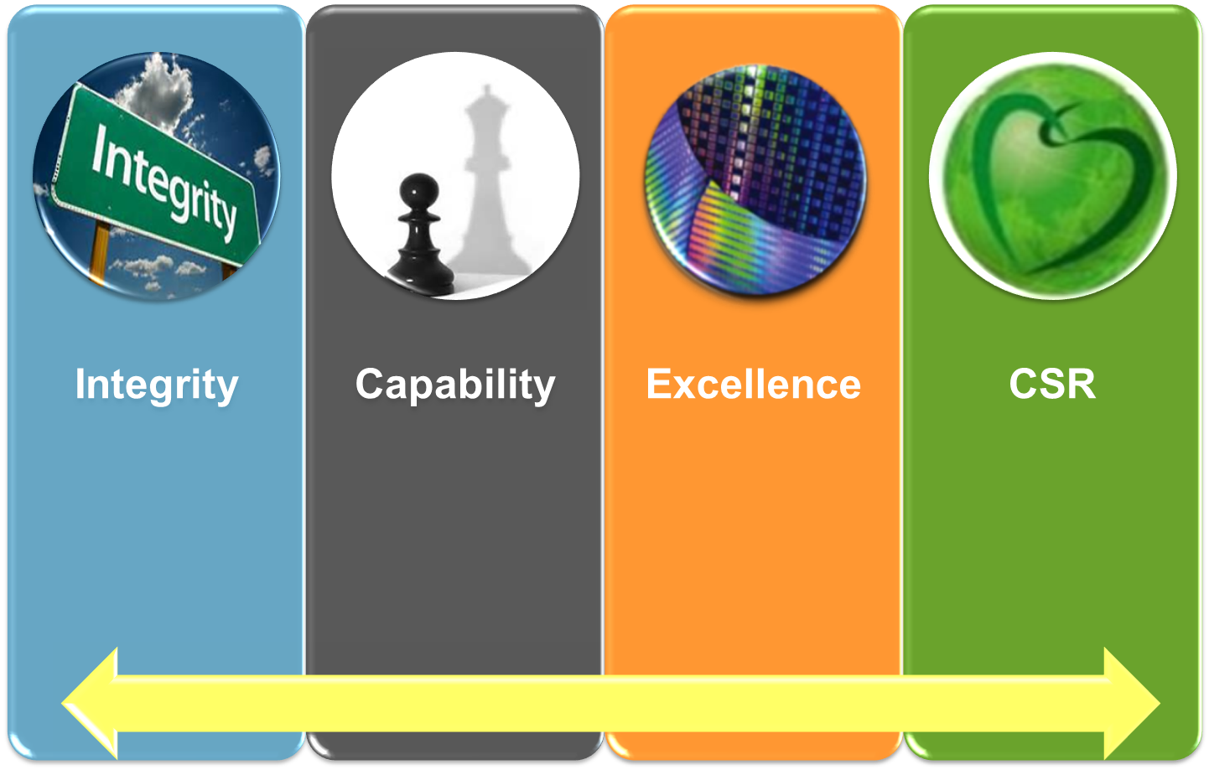
Your Trusted Foundry Partner in China
Building Long Term Partnerships for Mutual Success
Protect Customers’
Interests & IPs
Steady Growth with Confidence & Competence
Building Technology Roadmap & Service Offerings
Discipline & Manufacturing Excellence
Innovation, Quality & Safety
Achievements in EHS, Environmental Protections
Social Responsibility
Charity Program on
Liver Transplant
Building Customers’ Trusts & Success

Slide 40
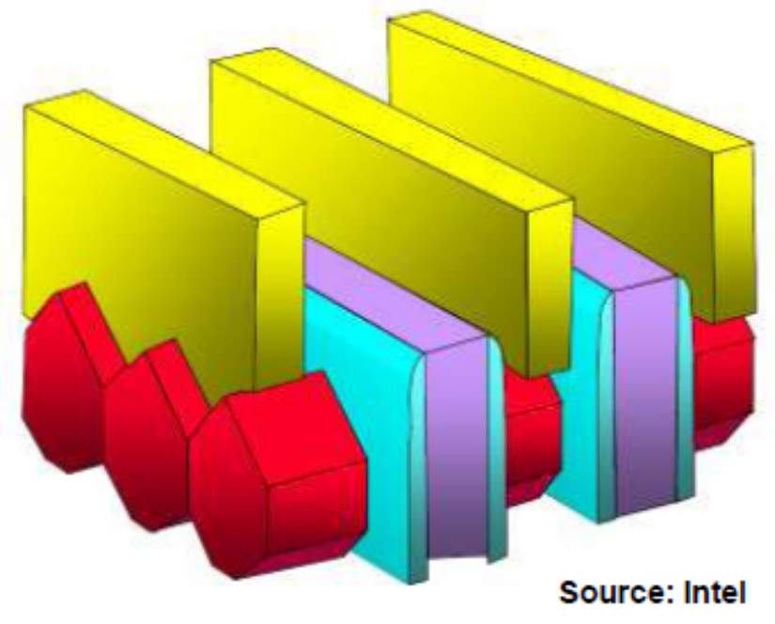
3D结构器件：14纳米FinFET
用3D晶体管替代平面晶体管
Fin
Raised EPI
Gate Poly
STI
Source: SMIC dada

