Slide 1
PAPER TALK · REAL-TIME MULTIMODAL MODELS · 2026
MOSS-VL
Technical Report
An open VLM stack designed to keep perceiving while it speaks - from architecture and training to runtime.
OpenMOSS Team
Fudan University · Shanghai Innovation Institute · MOSI Intelligence
01
Notes:
Open with the strict definition: real-time means perceiving during generation, not merely accepting streaming input between replies.
[Sources]
- /Users/xnnxax/projects/jerexjs-blog/local-papers/MOSS-VL-2608.pdf, p. 1, title and abstract, accessed 2026-08-20
[/Sources]

Slide 2
PROBLEM
Streaming input is not real-time interaction
L1
L2
L3
L4
L5
offline
streaming input
deliberate silence
persistent query
perceive while speaking
L2-L4 can receive frames continuously - yet remain blind for the duration of every reply.
L5 lets new visual evidence revise or stop an answer already in progress.
Paper Table 1, §1 · pp. 1-3
02
Notes:
Use the capability ladder to isolate the paper's object. The public benchmarks later quantify L2-L4; L5 is the higher bar.
[Sources]
- /Users/xnnxax/projects/jerexjs-blog/local-papers/MOSS-VL-2608.pdf, pp. 1-3, §1 and Table 1, accessed 2026-08-20
[/Sources]

Slide 3
CORE INSIGHT
Real-time behavior is a cross-stack contract
ARCHITECTURE
DATA
OBJECTIVE
RUNTIME
append visual KV
→
streaming interactions
→
speak / wait / revise
→
concurrent frame ingest
No single component creates L5. The interface only works when all four stages reproduce the same frame-decision rhythm.
Paper §1, §7
03
Notes:
Frame the paper as co-design. Architecture enables concurrency; data and loss install response timing; runtime preserves the same alternating contract.
[Sources]
- /Users/xnnxax/projects/jerexjs-blog/local-papers/MOSS-VL-2608.pdf, pp. 1-3, §1, accessed 2026-08-20
- /Users/xnnxax/projects/jerexjs-blog/local-papers/MOSS-VL-2608.pdf, pp. 14-15, §7, accessed 2026-08-20
[/Sources]

Slide 4
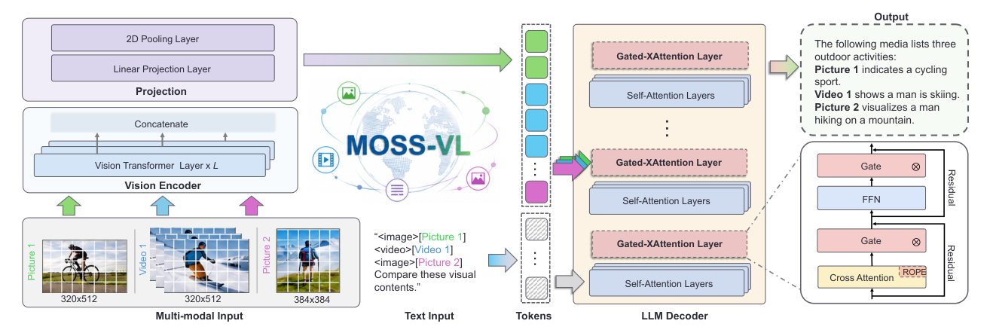
ARCHITECTURE
Visual tokens stay outside the decoded sequence
11.3B
12
New frame → encode once → append cross-attention KV
The language decoding state stays intact.
total parameters
gated X-attention layers
Paper Fig. 2 · p. 4
04
Notes:
The language decoder never self-attends over visual patch tokens. New frames append KV to 12 gated cross-attention layers, allowing vision to update without rebuilding the decoded sequence.
[Sources]
- /Users/xnnxax/projects/jerexjs-blog/local-papers/MOSS-VL-2608.pdf, p. 4, Figure 2 and §2.1-§2.2, accessed 2026-08-20
[/Sources]

Slide 5
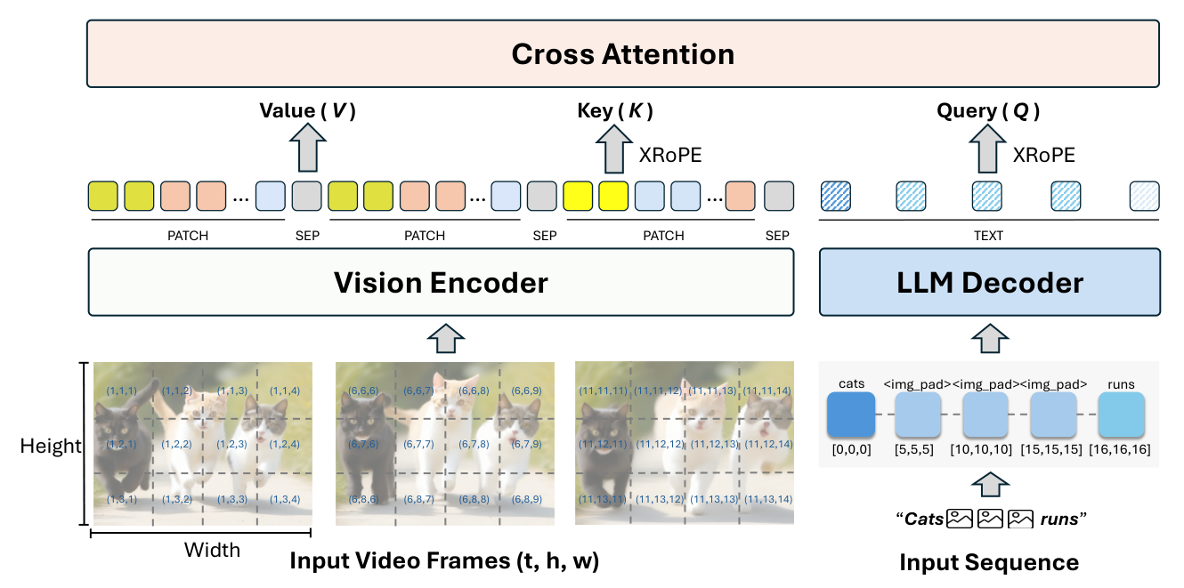
TEMPORAL INTERFACE
XRoPE aligns order; timestamps encode time
XRoPE
Shared (t, h, w) coordinates align text queries with visual keys.
Timestamps
Explicit seconds preserve wall-clock time under motion-adaptive 1-16 fps sampling.
Paper Fig. 3 · p. 5
05
Notes:
Keep logical sequence and physical time separate. XRoPE provides cross-modal order; timestamp tokens provide seconds, which positions alone cannot encode under variable frame rates.
[Sources]
- /Users/xnnxax/projects/jerexjs-blog/local-papers/MOSS-VL-2608.pdf, p. 5, Figure 3 and §2.3-§2.4, accessed 2026-08-20
[/Sources]

Slide 6
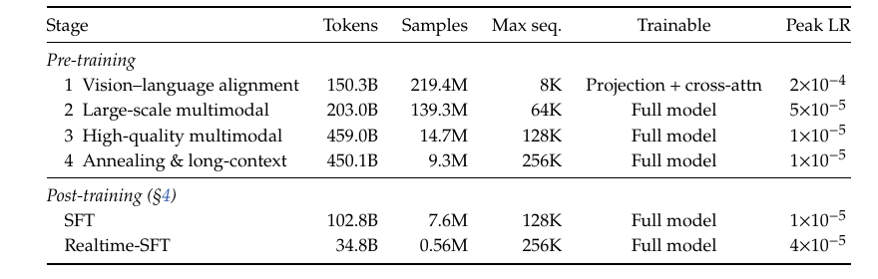
TRAINING
Realtime-SFT is late in a 1.4T-token curriculum
1.4T
tokens across all six stages
34.8B
Realtime-SFT tokens
2.49%
A light final stage is small in proportion - not in absolute cost.
of the full token budget
Paper Table 4 · p. 6
06
Notes:
Realtime-SFT concentrates all interaction-specific choices in the final stage. It is only 2.49% of total tokens, but 34.8B tokens and 0.56M samples are still substantial.
[Sources]
- /Users/xnnxax/projects/jerexjs-blog/local-papers/MOSS-VL-2608.pdf, p. 6, Table 4, accessed 2026-08-20
- /Users/xnnxax/projects/jerexjs-blog/local-papers/MOSS-VL-2608.pdf, pp. 8-9, §4.2-§4.3, accessed 2026-08-20
[/Sources]

Slide 7
BEHAVIOR OBJECTIVE
Every frame becomes a decision point
STREAMING TRAINING SEQUENCE
frame 1
frame 2
frame 3
frame 4
frame 5
<|silence|>
<|silence|>
<|response|>
continue
revise
Status tokens make waiting an explicit action - not an accidental lack of output.
Class reweighting and focal loss prevent the model from learning to stay silent forever.
Paper §4.2-§4.3 · pp. 8-9
07
Notes:
Each frame creates a decision slot. Realtime-SFT unfolds responses across slots and reweights rare speaking states, directly supervising timing and mid-response updates.
[Sources]
- /Users/xnnxax/projects/jerexjs-blog/local-papers/MOSS-VL-2608.pdf, pp. 8-9, §4.2-§4.3 and Eq. (2), accessed 2026-08-20
[/Sources]

Slide 8
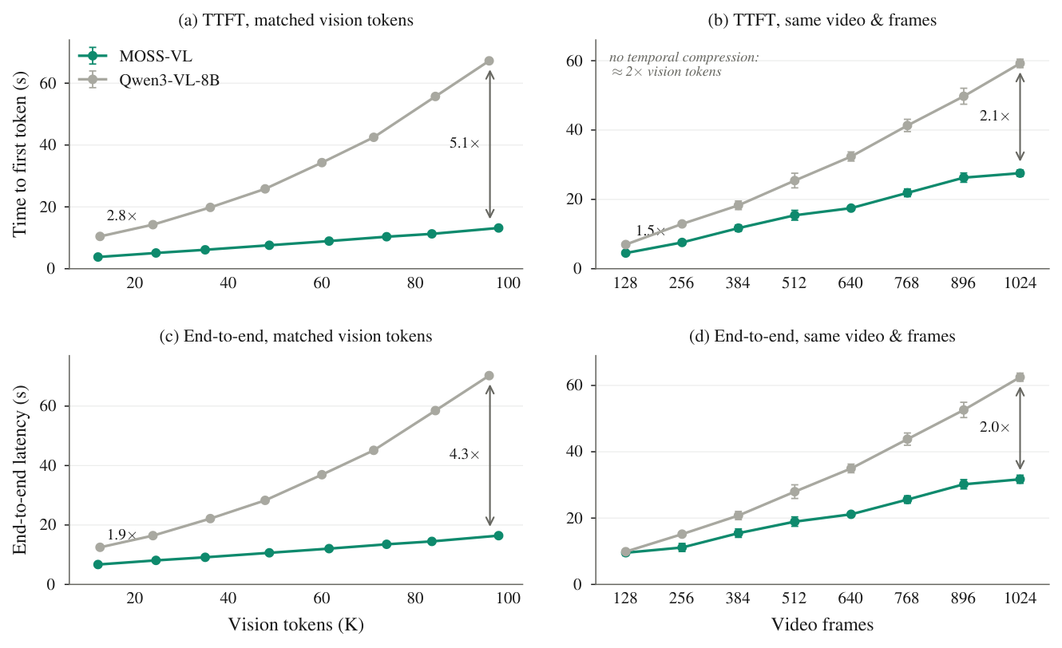
SYSTEMS EVIDENCE
Append-only vision reduces long-context cost
2.8 → 5.1x
TTFT advantage as matched visual context grows
1.9 → 4.3x
end-to-end advantage
Single H200 · TP=1 · BF16 · same SGLang version · five cold starts
Paper Fig. 4 · p. 13
08
Notes:
This controlled comparison shares the Qwen3-8B language backbone and serving stack. The widening gap is consistent with moving visual tokens outside the decoded sequence.
[Sources]
- /Users/xnnxax/projects/jerexjs-blog/local-papers/MOSS-VL-2608.pdf, p. 13, Figure 4 and §6.3, accessed 2026-08-20
[/Sources]

Slide 9
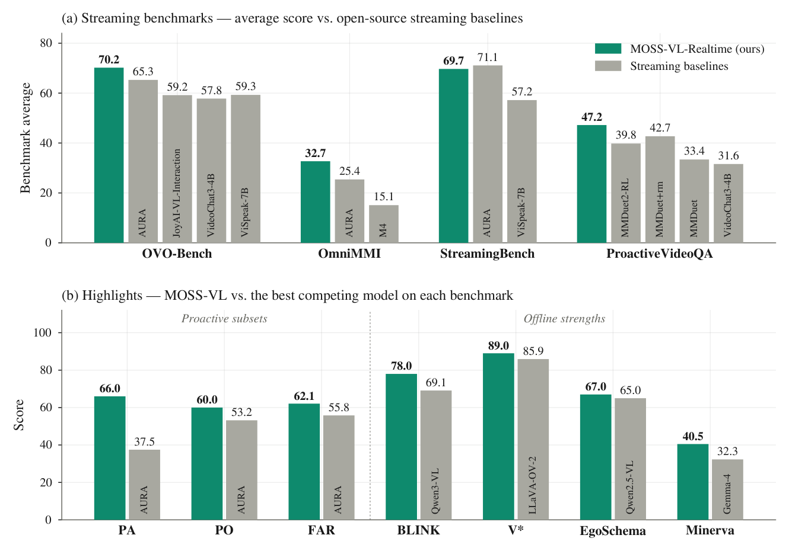
BEHAVIOR EVIDENCE
Wins concentrate on response timing
66.0
OmniMMI proactive alerting
vs. 37.5
62.1
OVO-Bench active responding
vs. 55.8
Three benchmark averages rank first; the fourth ranks second.
60.0
Protocols follow each baseline's own streaming setup - this is convergent evidence, not an equal-budget causal comparison.
StreamingBench proactive output
vs. 53.2
Paper Fig. 1, Table 6 · pp. 2, 12-13
09
Notes:
The subset pattern matters more than a single average: proactive alerting, proactive output, and forward active responding all improve. Comparisons still inherit different model protocols and budgets.
[Sources]
- /Users/xnnxax/projects/jerexjs-blog/local-papers/MOSS-VL-2608.pdf, p. 2, Figure 1, accessed 2026-08-20
- /Users/xnnxax/projects/jerexjs-blog/local-papers/MOSS-VL-2608.pdf, pp. 12-13, Table 6 and §6.2, accessed 2026-08-20
[/Sources]

Slide 10
EVIDENCE BOUNDARY
Public benchmarks stop before L5
L2
streaming input
QUANTIFIED
L3
deliberate silence
QUANTIFIED
L4
persistent query
QUANTIFIED
L5
perceive during generation
DEMO ONLY
Missing: revision latency, correct interruption rate, false interruptions, and stale-token count after evidence changes.
Paper §6.2, §7 · pp. 12-15
10
Notes:
Do not promote architecture capability into validated behavior. Existing public suites cover L2-L4. The paper explicitly treats L5 as qualitative because no benchmark measures perception during generation.
[Sources]
- /Users/xnnxax/projects/jerexjs-blog/local-papers/MOSS-VL-2608.pdf, pp. 12-13, §6.2, accessed 2026-08-20
- /Users/xnnxax/projects/jerexjs-blog/local-papers/MOSS-VL-2608.pdf, pp. 14-15, §7, accessed 2026-08-20
[/Sources]

Slide 11
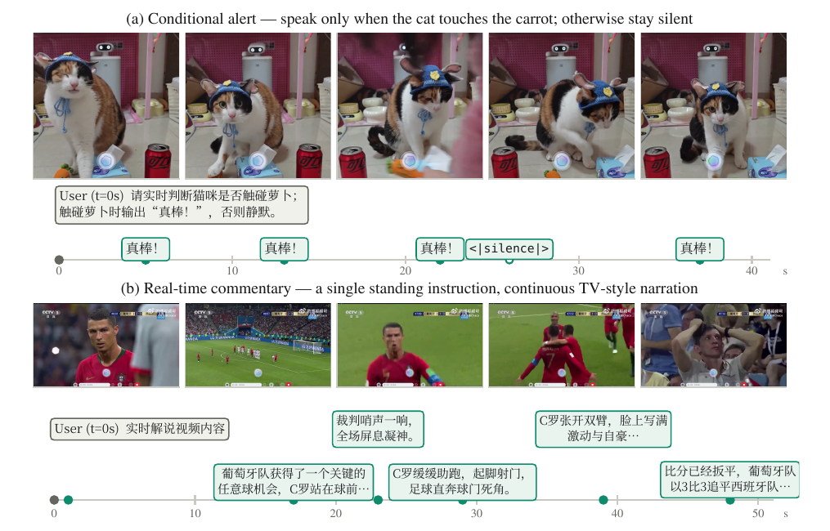
QUALITATIVE L5
The demos show L5 behavior - not its reliability
OBSERVED
Conditional alerts fire at target contacts.
Commentary follows a live sequence as it unfolds.
NOT MEASURED
How often the model misses, interrupts incorrectly, or revises too late.
Paper Fig. 5 · p. 14
11
Notes:
Use the two released sessions as evidence of intended behavior only. They do not estimate reliability, revision latency, or failure frequency.
[Sources]
- /Users/xnnxax/projects/jerexjs-blog/local-papers/MOSS-VL-2608.pdf, p. 14, Figure 5 and §6.4, accessed 2026-08-20
[/Sources]

Slide 12
TAKEAWAYS
Real-time interaction is an interface contract
01
Architecture changes the state boundary.
Visual history grows in cross-attention KV, while the autoregressive language sequence remains stable.
02
Realtime-SFT installs timing behavior.
A small fraction of the curriculum is enough to concentrate the speak-wait-revise objective - but not at trivial absolute cost.
03
The strongest claim still needs its benchmark.
Inject evidence changes during long answers and measure revision latency, stale tokens, correct stops, and false stops.
DISCUSSION
Does MOSS-VL learn a genuinely concurrent policy - or mainly gain from an append-only visual input pipeline?
MOSS-VL · paper synthesis
12
Notes:
Close with the decisive experiment: compare blind generation, buffered restart, and true concurrent visual KV under matched frame and language budgets.
[Sources]
- /Users/xnnxax/projects/jerexjs-blog/local-papers/MOSS-VL-2608.pdf, p. 1, abstract, accessed 2026-08-20
- /Users/xnnxax/projects/jerexjs-blog/local-papers/MOSS-VL-2608.pdf, pp. 14-15, §7, accessed 2026-08-20
[/Sources]

