Slide 1
PAPER TALK · VIDEO WORLD MODELS · 2026
MiniWorld
Democratizing the Training of Video World Models from Scratch
A reproducible causal-video recipe that aligns training with streaming deployment - and keeps online DiT compute bounded.
Yian Zhao · Ruochong Zheng · Hongcan Guo · Yu Yan · Jian Zhang · Jie Chen
Peking University · arXiv:2608.01127
01
Notes:
Open with the systems thesis: the paper optimizes for accessibility and train-deploy consistency, not frontier visual quality.
[Sources]
- /Users/xnnxax/projects/jerexjs-blog/local-papers/MiniWorld-2608.pdf, p. 1, title and abstract, accessed 2026-08-20
[/Sources]

Slide 2
PROBLEM
Bidirectional video diffusion breaks in streaming
TRAINING
STREAMING DEPLOYMENT
Clean history
Predicted history
all frames jointly available
clean
committed
active
noise
Bidirectional denoising sees ground-truth context and a fixed window.
Errors accumulate; old observations leave the window; asynchronous chunks sit at different noise levels.
The mismatch is structural - not a decoding hyperparameter.
Paper §1, §3.1
02
Notes:
Contrast what training supplies with what autoregressive streaming actually produces. This motivates an aligned architecture and corruption process.
[Sources]
- /Users/xnnxax/projects/jerexjs-blog/local-papers/MiniWorld-2608.pdf, pp. 2-4, §1 and §3.1, accessed 2026-08-20
[/Sources]

Slide 3
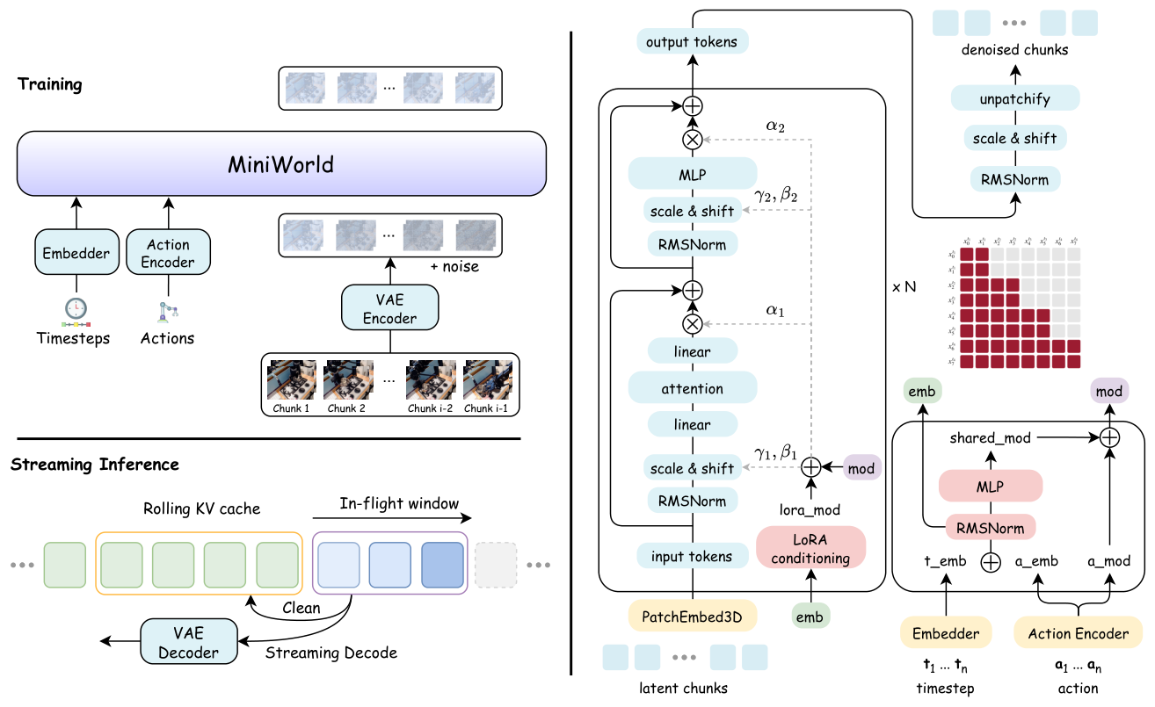
CORE INSIGHT
A single contract aligns training and streaming
Block causality
CoPP noise order
Two-stage continuation
Rolling KV + pipeline
Paper Fig. 1 · p. 4
03
Notes:
Treat the method as one integrated contract. The evidence supports the recipe as a whole more strongly than isolated causal credit for every component.
[Sources]
- /Users/xnnxax/projects/jerexjs-blog/local-papers/MiniWorld-2608.pdf, p. 4, Figure 1, accessed 2026-08-20
- /Users/xnnxax/projects/jerexjs-blog/local-papers/MiniWorld-2608.pdf, pp. 5-9, §3.2-§3.5, accessed 2026-08-20
[/Sources]

Slide 4
MECHANISM 1
Block causality preserves local context
keys / values →
Within a chunk: bidirectional attention preserves local spatiotemporal modeling.
chunk 1
chunk 2
Across chunks: strict causality turns video generation into next-state prediction.
chunk 3
chunk 4
The architecture gives up future-chunk access, not rich context inside the current unit.
Paper §3.2 · pp. 5-6
04
Notes:
Explain the attention mask: each query chunk can attend to itself and all past chunks, never future chunks. This is the architecture-side alignment.
[Sources]
- /Users/xnnxax/projects/jerexjs-blog/local-papers/MiniWorld-2608.pdf, pp. 5-6, §3.2, accessed 2026-08-20
[/Sources]

Slide 5
MECHANISM 2
CoPP matches inference-time noise states
A non-decreasing chunk schedule matches the partially denoised frontier seen during asynchronous generation.
history
committed
active
future
≤
≤
≤
τ₁ = 0.00
τ₂ = 0.15
τ₃ = 0.55
τ₄ = 0.90
Training now covers clean past, partially denoised present, and noisy future in one sample.
Paper §3.3, Eq. (4) · pp. 6-7
05
Notes:
CoPP constrains chunk noise levels to be non-decreasing. The important idea is exposure to asynchronous intermediate states, not the illustrative values shown on the slide.
[Sources]
- /Users/xnnxax/projects/jerexjs-blog/local-papers/MiniWorld-2608.pdf, pp. 6-7, §3.3 and Eq. (4), accessed 2026-08-20
[/Sources]

Slide 6
STREAMING ENGINE
Denoise only the active window
ROLLING STATE
sink
cached
cached
cached
active
active
active
noise
online DiT compute
Finished chunks are frozen and reused.
Only a bounded in-flight window keeps denoising.
RoPE re-shifting keeps retained keys inside the trained position range after eviction.
Paper §3.5 · pp. 8-9
06
Notes:
Walk from left to right: a resident sink, FIFO cached history, active chunks, and future noise. Completed chunks no longer pay repeated DiT compute.
[Sources]
- /Users/xnnxax/projects/jerexjs-blog/local-papers/MiniWorld-2608.pdf, pp. 8-9, §3.5, accessed 2026-08-20
[/Sources]

Slide 7
EVALUATION
Test action and camera-conditioned dynamics
DROID
REALESTATE10K
Robot manipulation
Camera-controlled scenes
7-D end-effector + gripper control
Single observed frame
253-frame streaming rollout
Pose rays as spatial conditioning
Single observed frame
Same streaming architecture
Does geometry and action consistency survive autoregression?
Does the recipe transfer beyond robot interaction?
Main comparison: fixed 29-frame bidirectional sliding-window baseline, normalized to 1.
Paper §4.1 · pp. 9-10
07
Notes:
Emphasize the evaluation contract: one observed frame, 50 held-out videos, relative scores against one fixed-window baseline. The domains are complementary, but the protocol is narrow.
[Sources]
- /Users/xnnxax/projects/jerexjs-blog/local-papers/MiniWorld-2608.pdf, pp. 9-10, §4.1 and Table 1, accessed 2026-08-20
[/Sources]

Slide 8
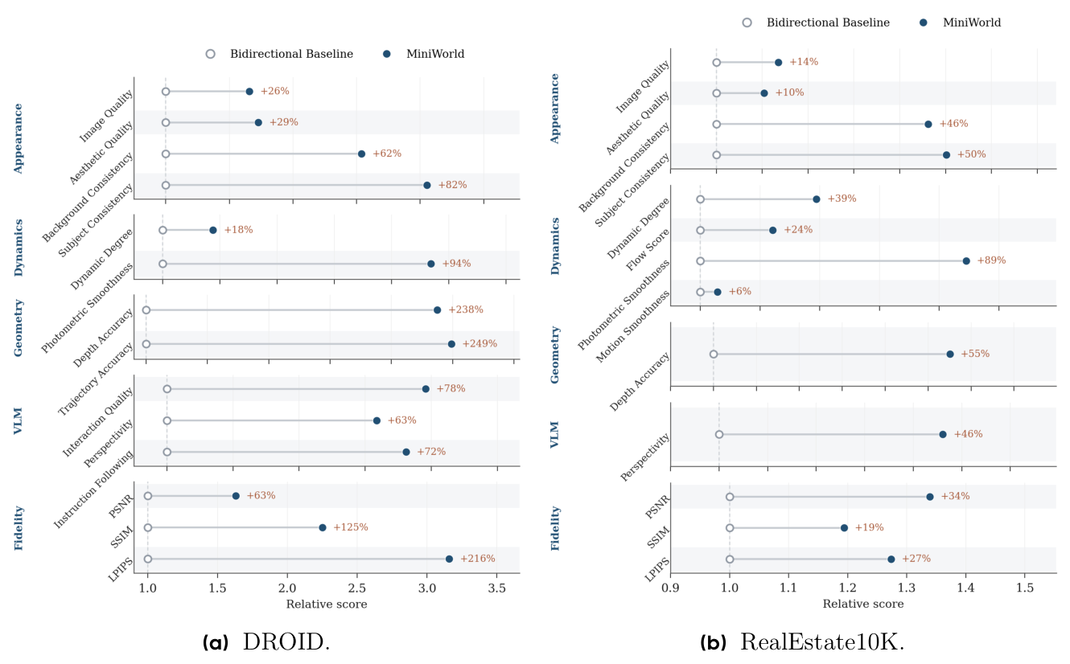
EVIDENCE
Quality gains transfer across control domains
All values are relative; the bidirectional 29-frame baseline is 1.0, and error ratios are inverted.
Paper Fig. 2 · p. 11
08
Notes:
The broad direction is consistent across DROID and RE10K. Do not read these as absolute quality scores: the baseline is normalized, errors are inverted, and uncertainty is not shown.
[Sources]
- /Users/xnnxax/projects/jerexjs-blog/local-papers/MiniWorld-2608.pdf, p. 11, Figure 2, accessed 2026-08-20
- /Users/xnnxax/projects/jerexjs-blog/local-papers/MiniWorld-2608.pdf, pp. 10-11, §4.2, accessed 2026-08-20
[/Sources]

Slide 9
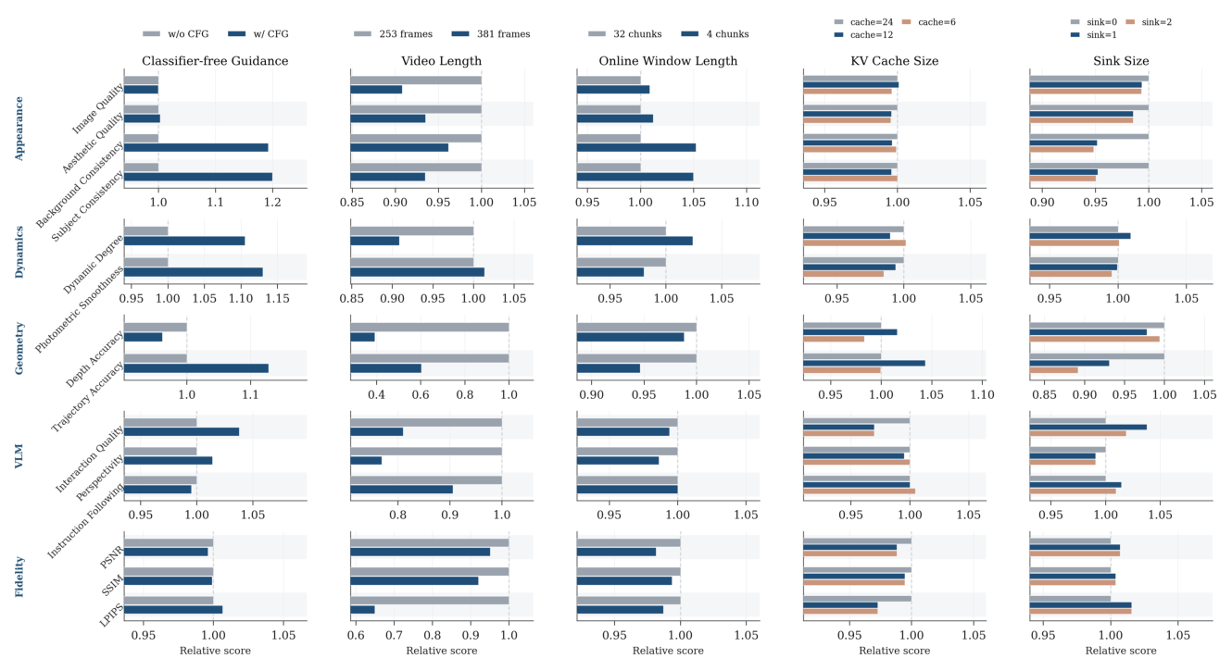
ABLATION
Eight active chunks keep quality nearly flat
32 → 8 active chunks
24 → 12 cached chunks
quality stays within a few percent
nearly indistinguishable at this horizon
Paper Fig. 3 · p. 12
09
Notes:
The small active window is the key system ablation. Shorter retained history also appears flat at this horizon, but that does not prove early state is recoverable hundreds of frames later.
[Sources]
- /Users/xnnxax/projects/jerexjs-blog/local-papers/MiniWorld-2608.pdf, p. 12, Figure 3, accessed 2026-08-20
- /Users/xnnxax/projects/jerexjs-blog/local-papers/MiniWorld-2608.pdf, pp. 11-12, §4.3, accessed 2026-08-20
[/Sources]

Slide 10
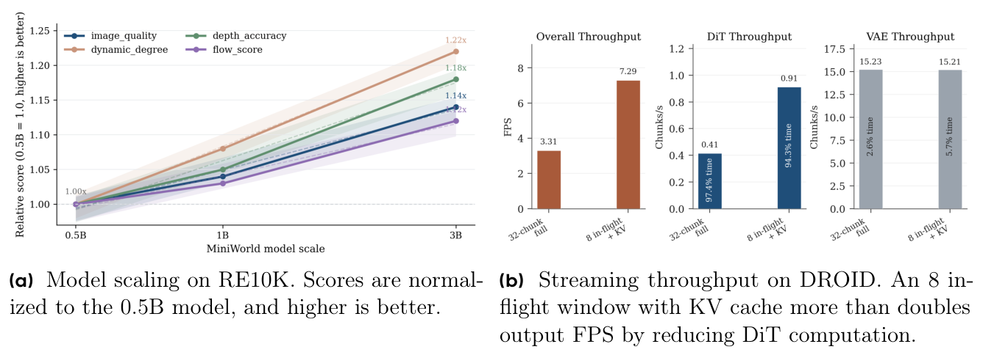
SYSTEMS RESULT
KV caching doubles FPS and cuts latency 15.2x
7.29
output FPS
vs. 3.31 full-window
4.86 s
first chunk
vs. 74.0 s
1B model · DROID · cfg=1 · 3 warmups + 20 timed clips
The gain comes from bounding DiT recomputation - VAE is not the bottleneck.
Paper Fig. 4b · p. 13
10
Notes:
This is the paper's cleanest direct result. The cache improves steady throughput 2.20x and first-chunk latency 15.2x under the stated cfg=1 DROID benchmark.
[Sources]
- /Users/xnnxax/projects/jerexjs-blog/local-papers/MiniWorld-2608.pdf, p. 13, Figure 4b, accessed 2026-08-20
- /Users/xnnxax/projects/jerexjs-blog/local-papers/MiniWorld-2608.pdf, pp. 12-13, §4.4, accessed 2026-08-20
[/Sources]

Slide 11
LIMITS
Bounded compute is not persistent memory
ESTABLISHED
Online DiT work can remain bounded while preserving current benchmark quality.
SUGGESTIVE
A shorter cache is sufficient for the tested 253-381 frame regime.
OPEN
Can the model recover an early object state after hundreds of frames and interventions?
Missing: absolute scores, uncertainty, compute-matched causal baselines, GPU-hours, and a long-term recall test.
Paper §5 · pp. 13-14
11
Notes:
Separate bounded online compute from long-term memory. The evaluation does not require explicit recall of an early state after a long delay, so memory persistence remains open.
[Sources]
- /Users/xnnxax/projects/jerexjs-blog/local-papers/MiniWorld-2608.pdf, pp. 13-14, §5, accessed 2026-08-20
- /Users/xnnxax/projects/jerexjs-blog/local-papers/MiniWorld-2608.pdf, p. 12, Figure 3, accessed 2026-08-20
[/Sources]

Slide 12
TAKEAWAYS
An open baseline - not a performance ceiling
01
The contribution is the contract.
Block causality, CoPP, continuation, and rolling inference align what the model trains on with what it will deploy.
02
The strongest evidence is systems evidence.
The rolling cache attacks the actual DiT bottleneck and improves both steady FPS and first response.
03
The right next test is state recall.
Vary cache length on tasks that require recovering an early object property after long interaction, not only visual continuity.
DISCUSSION
What is the smallest memory mechanism that changes the long-horizon failure curve - without breaking the open training budget?
MiniWorld · paper synthesis
12
Notes:
Close on the research value: MiniWorld is useful because it is open, causal, and measurable. The next contribution should isolate memory rather than only scale the same recipe.
[Sources]
- /Users/xnnxax/projects/jerexjs-blog/local-papers/MiniWorld-2608.pdf, p. 1, abstract, accessed 2026-08-20
- /Users/xnnxax/projects/jerexjs-blog/local-papers/MiniWorld-2608.pdf, pp. 13-14, §5, accessed 2026-08-20
[/Sources]

