Slide 1
PAPER TALK · VARIATIONAL INFERENCE · 2013
Auto-Encoding
Variational Bayes
VAE is an inference algorithm before it is an architecture.
Reparameterized gradients make the ELBO trainable;
amortization makes posterior inference scalable.
Diederik P. Kingma · Max Welling
arXiv:1312.6114
01
Notes:
Open by separating the durable estimator and amortization contribution from the later architectural shorthand.
[Sources]
- /Users/xnnxax/projects/jerexjs-blog/local-papers/VAE-1312.pdf, p. 1, title and abstract, accessed 2026-08-22
[/Sources]

Slide 2
PROBLEM
Latent-variable learning breaks at the posterior
MARGINAL LIKELIHOOD
TRUE POSTERIOR
pθ(x) = ∫ pθ(z)pθ(x|z) dz
pθ(z|x) = pθ(x|z)pθ(z) / pθ(x)
Often intractable to evaluate or differentiate.
Unavailable when the denominator is unavailable.
N ≫ 1
per x
nonlinear
batch optimization is too costly
MCMC / iterative VI is too slow
mean-field expectations may also be intractable
Paper §2.1 · p. 2
02
Notes:
The target regime combines intractable integrals, large datasets, and nonlinear likelihoods. A useful solution must support minibatches and avoid local iterative inference.
[Sources]
- /Users/xnnxax/projects/jerexjs-blog/local-papers/VAE-1312.pdf, p. 2, §2.1, accessed 2026-08-22
[/Sources]

Slide 3
OBJECTIVE
The ELBO separates fit from posterior mismatch
log pθ(x)
=
ELBO 𝓛(θ, φ; x)
+
KL(qφ || pθ)
what we can optimize
posterior approximation gap
TRAINING VIEW
− KL(qφ(z|x) || p(z))
+
Eqφ [ log pθ(x|z) ]
regularize the approximate posterior
expected reconstruction log-likelihood
The objective is clear. Its gradient with respect to φ is still the hard part.
Paper Eq. (1)-(3) · p. 3
03
Notes:
Eq. (1) is a diagnostic decomposition; Eq. (3) gives the familiar prior-match plus reconstruction view.
[Sources]
- /Users/xnnxax/projects/jerexjs-blog/local-papers/VAE-1312.pdf, p. 3, Eq. (1)-(3), accessed 2026-08-22
[/Sources]

Slide 4
CORE INSIGHT
Reparameterization exposes a differentiable path
FIXED NOISE
DIFFERENTIABLE MAP
MODEL OBJECTIVE
→
→
ε ~ p(ε)
z = gφ(ε, x)
f(z)
Gaussian case: z = μ(x) + σ(x) ⊙ ε, ε ~ 𝒩(0, I)
Sampling remains stochastic. The sampled computation becomes differentiable in φ.
Paper Eq. (4)-(5) · pp. 3-5
04
Notes:
Randomness is isolated in exogenous noise. Once epsilon is fixed, the sample path is differentiable in the variational parameters.
[Sources]
- /Users/xnnxax/projects/jerexjs-blog/local-papers/VAE-1312.pdf, pp. 3-5, Eq. (4)-(5) and §2.4, accessed 2026-08-22
[/Sources]

Slide 5
ESTIMATOR
SGVB makes the bound minibatch-trainable
GENERIC ESTIMATOR
L̃A(x) = 1/L Σₗ [ log pθ(x, zₗ) − log qφ(zₗ|x) ]
LOWER-VARIANCE FORM
L̃B(x) = − KL(qφ(z|x)||p(z)) + 1/L Σₗ log pθ(x|zₗ)
L = 1
M = 100
N / M
sample per datapoint in the experiments
minibatch size
rescales the minibatch bound
Paper Eq. (6)-(8), Algorithm 1 · pp. 3-4
05
Notes:
When the KL is analytic, only reconstruction is sampled. The experiments use one latent sample per datapoint and rely on minibatch averaging.
[Sources]
- /Users/xnnxax/projects/jerexjs-blog/local-papers/VAE-1312.pdf, pp. 3-4, Eq. (6)-(8) and Algorithm 1, accessed 2026-08-22
[/Sources]

Slide 6
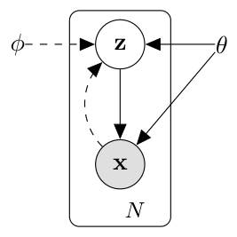
AMORTIZATION
Amortization replaces per-example inference
PER-DATAPOINT VI
xᵢ → optimize local parameters → qᵢ(z)
Repeat an iterative inference procedure for every new observation.
AMORTIZED VI
xᵢ → encoderφ(xᵢ) → (μᵢ, σᵢ)
Shared parameters learn how to infer across the entire dataset.
Inference becomes a forward pass.
Paper Fig. 1, §2.2 · pp. 2-3
06
Notes:
The dashed recognition edge is the amortization mechanism: local variational parameters become outputs of a shared network.
[Sources]
- /Users/xnnxax/projects/jerexjs-blog/local-papers/VAE-1312.pdf, p. 2, Figure 1, accessed 2026-08-22
- /Users/xnnxax/projects/jerexjs-blog/local-papers/VAE-1312.pdf, p. 3, §2.2, accessed 2026-08-22
[/Sources]

Slide 7
VAE SPECIAL CASE
The canonical VAE is a Gaussian special case
ENCODER
maximize
qφ(z|x) = 𝒩( μ(x), diag σ²(x) )
− KL
prior match
PRIOR
+
E log pθ(x|z)
p(z) = 𝒩(0, I)
reconstruction likelihood
DECODER
pθ(x|z): Bernoulli or Gaussian MLP
Architecture is replaceable; the inference recipe is the invariant.
Paper §3, Eq. (9)-(10) · p. 5
07
Notes:
The diagonal Gaussian posterior and simple MLPs are simplifying choices. They produce the canonical VAE objective but are not the full contribution.
[Sources]
- /Users/xnnxax/projects/jerexjs-blog/local-papers/VAE-1312.pdf, p. 5, §3 and Eq. (9)-(10), accessed 2026-08-22
[/Sources]

Slide 8
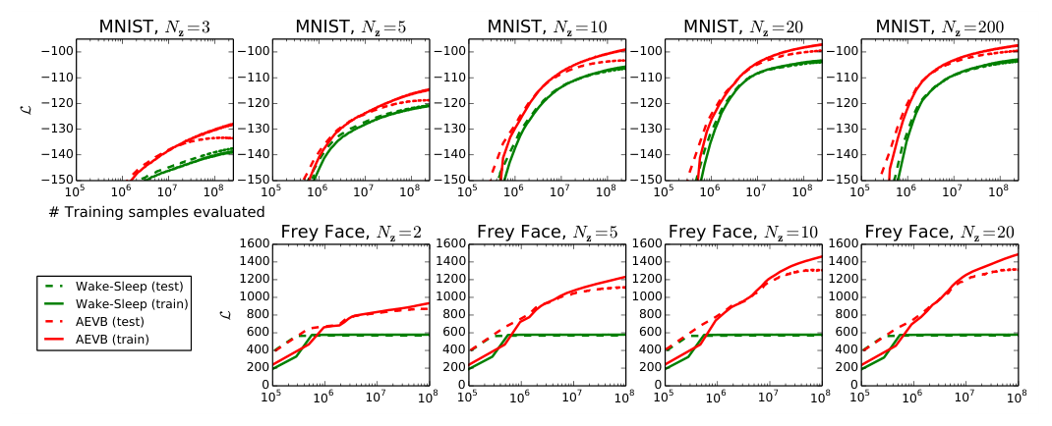
OPTIMIZATION EVIDENCE
AEVB outpaces Wake-Sleep in these MLP tests
MNIST: 500 hidden units · Frey Face: 200 · M=100 · L=1 · no error bands
Paper Fig. 2 · p. 7
08
Notes:
Across several latent dimensions, AEVB rises faster and finishes above Wake-Sleep. The evidence is consistent, small-scale, and lacks uncertainty bands.
[Sources]
- /Users/xnnxax/projects/jerexjs-blog/local-papers/VAE-1312.pdf, p. 7, Figure 2 and §5, accessed 2026-08-22
[/Sources]

Slide 9
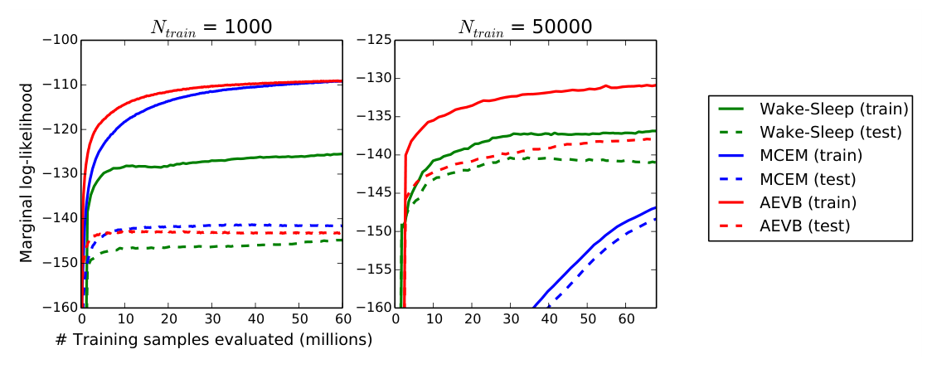
LIKELIHOOD EVIDENCE
Likelihood favors AEVB in a low-dimensional test
z = 3
latent dimensions
50
HMC posterior samples
per datapoint
1,000
train/test points used
for estimation
The paper reports that estimates become unreliable in higher dimensions.
Paper Fig. 3, Appendix D-E · pp. 8, 11-12
09
Notes:
AEVB converges fastest for both training-set sizes. Appendix D explicitly limits the estimator to low-dimensional sampled spaces.
[Sources]
- /Users/xnnxax/projects/jerexjs-blog/local-papers/VAE-1312.pdf, p. 8, Figure 3, accessed 2026-08-22
- /Users/xnnxax/projects/jerexjs-blog/local-papers/VAE-1312.pdf, pp. 11-12, Appendix D-E, accessed 2026-08-22
[/Sources]

Slide 10
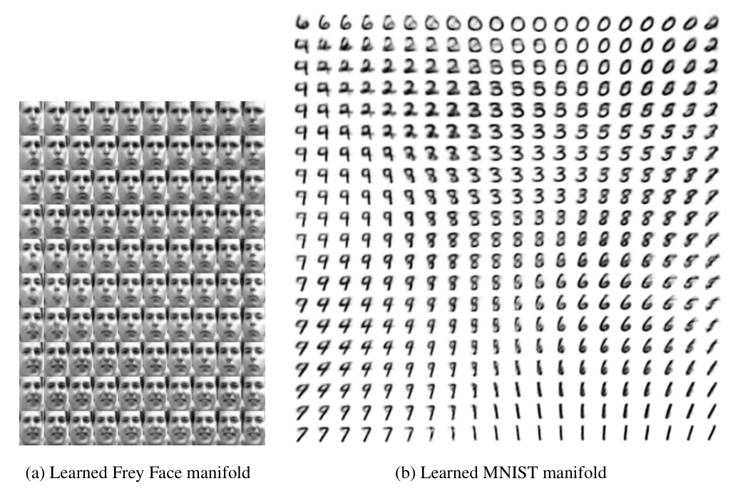
REPRESENTATION
Smooth manifolds are not disentanglement proof
A 2-D latent grid produces smooth changes in identity, pose, and digit shape.
QUALITATIVE
Paper Fig. 4 · p. 10
10
Notes:
The appendix visualizations make interpolation tangible. They do not establish independent semantic factors or harder-data representation quality.
[Sources]
- /Users/xnnxax/projects/jerexjs-blog/local-papers/VAE-1312.pdf, p. 10, Figure 4 and Appendix A, accessed 2026-08-22
[/Sources]

Slide 11
EVIDENCE BOUNDARY
A gradient recipe—not a universal model
ESTABLISHED
Pathwise gradients make a reparameterizable ELBO differentiable.
SUPPORTED
Amortized inference trains efficiently on the reported MLP models.
SUGGESTIVE
Smooth latent manifolds indicate useful local structure.
UNTESTED
Modern sample quality, multimodal posteriors, and high-dimensional exact likelihood.
A loose ELBO can reflect model error, posterior-family error, or amortization error.
Paper §6-7, Appendices · pp. 8-14
11
Notes:
The derivation is general within the reparameterizable continuous setting; the empirical evidence is deliberately narrow.
[Sources]
- /Users/xnnxax/projects/jerexjs-blog/local-papers/VAE-1312.pdf, p. 8, §6-7, accessed 2026-08-22
- /Users/xnnxax/projects/jerexjs-blog/local-papers/VAE-1312.pdf, pp. 10-14, Appendices B-F, accessed 2026-08-22
[/Sources]

Slide 12
TAKEAWAYS
Three ideas survived the original architecture
01
Pathwise gradients
Write randomness as fixed noise plus a differentiable transform, then backpropagate through the sampled path.
02
Amortized inference
Learn one qφ(z|x) across datapoints instead of optimizing every posterior from scratch.
03
ELBO training
Jointly fit the generative and inference models while keeping posterior mismatch explicit.
DISCUSSION
Which failure in a modern VAE comes from the decoder, the posterior family, or amortization?
Auto-Encoding Variational Bayes · synthesis
12
Notes:
Modern variants mostly change the posterior, likelihood, prior, or estimator while preserving this interface.
[Sources]
- /Users/xnnxax/projects/jerexjs-blog/local-papers/VAE-1312.pdf, p. 1, abstract, accessed 2026-08-22
- /Users/xnnxax/projects/jerexjs-blog/local-papers/VAE-1312.pdf, p. 3, Eq. (1)-(3), accessed 2026-08-22
- /Users/xnnxax/projects/jerexjs-blog/local-papers/VAE-1312.pdf, p. 8, §6, accessed 2026-08-22
[/Sources]

