Slide 1
PAPER TALK · DISCRETE REPRESENTATIONS · NIPS 2017
Neural Discrete
Representation Learning
VQ-VAE made neural representations discrete without high-variance estimators.
Nearest-neighbor codes, a straight-through path, and explicit codebook updates create a trainable token interface.
Aaron van den Oord · Oriol Vinyals · Koray Kavukcuoglu
NIPS 2017 · arXiv:1711.00937
01
Notes:
Frame VQ-VAE as an interface between continuous neural features and discrete tokens.
[Sources]
- /Users/xnnxax/projects/jerexjs-blog/local-papers/VQ-VAE-1711.pdf, p. 1, title and abstract, accessed 2026-08-22
[/Sources]

Slide 2
PROBLEM
Powerful decoders can ignore continuous latents
CONTINUOUS VAE + STRONG DECODER
DISCRETE REPRESENTATION
q(z|x) ≈ p(z)
z ∈ {1, …, K}
the decoder models x without using z
a compressed symbol sequence for a learned prior
low variance
hard codes
strong prior
without score-function estimators
without annealing a soft relaxation
over compressed discrete sequences
Paper §1-2 · pp. 1-3
02
Notes:
The motivation combines latent usage under powerful decoders with practical gradients for discrete variables.
[Sources]
- /Users/xnnxax/projects/jerexjs-blog/local-papers/VQ-VAE-1711.pdf, pp. 1-2, §1, accessed 2026-08-22
- /Users/xnnxax/projects/jerexjs-blog/local-papers/VQ-VAE-1711.pdf, pp. 2-3, §2, accessed 2026-08-22
[/Sources]

Slide 3
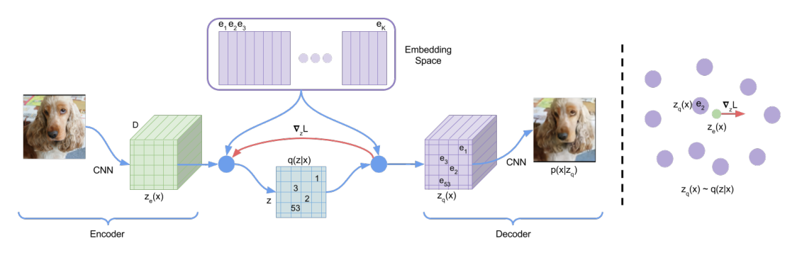
DISCRETE BOTTLENECK
Nearest-neighbor lookup turns features into tokens
zₑ(x) → k = argminⱼ ||zₑ(x) − eⱼ||² → zq(x) = eₖ
Paper Fig. 1, Eq. (1)-(2) · pp. 3-4
03
Notes:
The forward pass is genuinely discrete. The decoder receives only the nearest codebook embedding.
[Sources]
- /Users/xnnxax/projects/jerexjs-blog/local-papers/VQ-VAE-1711.pdf, pp. 3-4, Figure 1 and Eq. (1)-(2), accessed 2026-08-22
[/Sources]

Slide 4
GRADIENT INTERFACE
Straight-through bypasses the discrete assignment
FORWARD
zₑ(x) → nearest code eₖ → decoder → reconstruction
BACKWARD
∇z L is copied directly from zq(x) to zₑ(x)
The gradient is biased: it is not the derivative of nearest-neighbor lookup.
Paper §3.2 · pp. 3-4
04
Notes:
The paper explicitly says no real gradient is defined for the lookup. The straight-through estimator copies the decoder gradient to the encoder.
[Sources]
- /Users/xnnxax/projects/jerexjs-blog/local-papers/VQ-VAE-1711.pdf, pp. 3-4, §3.2, accessed 2026-08-22
[/Sources]

Slide 5
OBJECTIVE
Three losses divide responsibility across the model
RECONSTRUCTION
CODEBOOK
COMMITMENT
− log p(x | zq)
|| sg[zₑ] − e ||²
β || zₑ − sg[e] ||²
updates
updates
updates
decoder + encoder
embeddings only
encoder only
β = 0.25
0.1–2.0
KL = log K
used in every experiment
reported robust range
constant under the uniform prior
Paper Eq. (3) · p. 4
05
Notes:
Stop-gradient determines ownership: reconstruction trains decoder and encoder; dictionary loss trains embeddings; commitment trains encoder.
[Sources]
- /Users/xnnxax/projects/jerexjs-blog/local-papers/VQ-VAE-1711.pdf, p. 4, Eq. (3) and §3.2, accessed 2026-08-22
[/Sources]

Slide 6
TWO-STAGE MODEL
Learn the representation, then learn its prior
STAGE 1 · LEARN THE TOKENIZER
STAGE 2 · LEARN THE PRIOR
x → encoder → discrete z → decoder → x̂
p(z) = PixelCNN or WaveNet
→
uniform prior during VQ-VAE training
ancestral sample z, then decode once
The prior models global structure; the decoder handles local detail.
Joint training is explicitly left as future work.
Paper §3.3 · p. 5
06
Notes:
Sample quality is produced by both stages and should not be attributed to the quantizer alone.
[Sources]
- /Users/xnnxax/projects/jerexjs-blog/local-papers/VQ-VAE-1711.pdf, p. 5, §3.3, accessed 2026-08-22
[/Sources]

Slide 7
QUANTITATIVE EVIDENCE
VQ-VAE approaches continuous-VAE likelihood
4.51
4.67
5.14
continuous VAE
bits / dim
VQ-VAE
bits / dim
VIMCO
bits / dim
lower is better · all values are variational lower bounds
VQ-VAE is 0.16 bits/dim behind the continuous VAE.
It improves 0.47 bits/dim over this VIMCO baseline.
Paper §4.1 · p. 5
07
Notes:
VQ-VAE approaches but does not beat the continuous VAE. The result establishes competitive hard discrete latents under the shared architecture.
[Sources]
- /Users/xnnxax/projects/jerexjs-blog/local-papers/VQ-VAE-1711.pdf, p. 5, §4.1, accessed 2026-08-22
[/Sources]

Slide 8
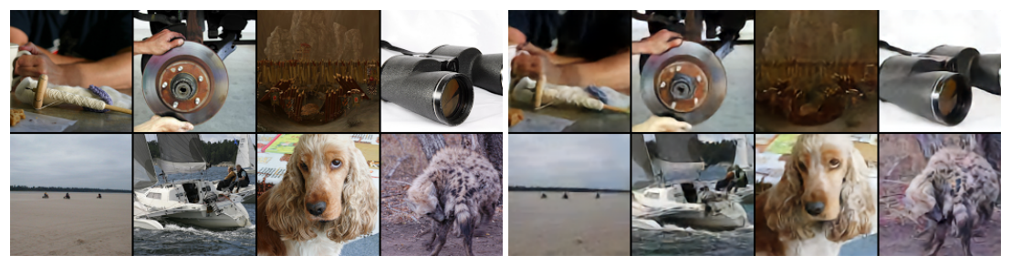
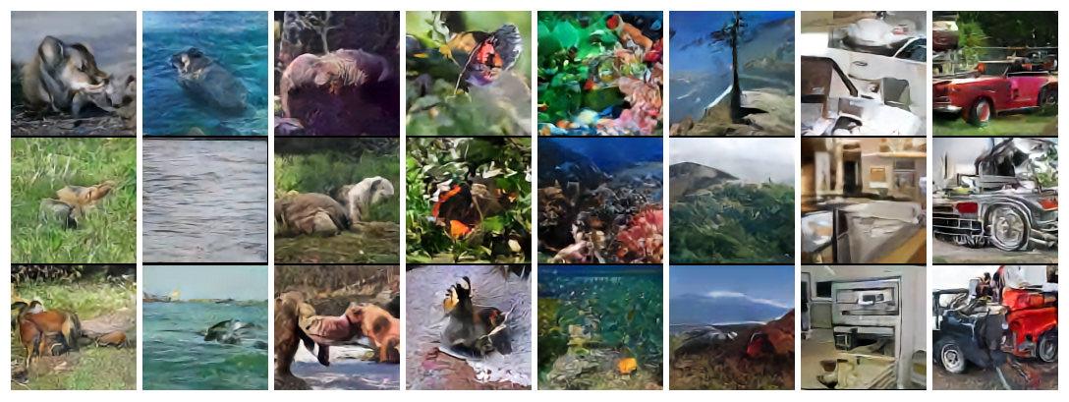
IMAGE EVIDENCE
A compact code grid preserves image structure
RECONSTRUCTION
128×128×3 image
→ 32×32 codes, K=512
≈42.6×
Main objects survive; pixel-level detail becomes visibly blurrier.
raw-bit compression ratio
before entropy coding
Paper Fig. 2-3, §4.2 · pp. 5-6
08
Notes:
The nominal ratio compares raw 8-bit RGB pixels with 9-bit indices. It excludes model size and entropy coding. Evidence is qualitative.
[Sources]
- /Users/xnnxax/projects/jerexjs-blog/local-papers/VQ-VAE-1711.pdf, pp. 5-6, Figure 2-3 and §4.2, accessed 2026-08-22
[/Sources]

Slide 9
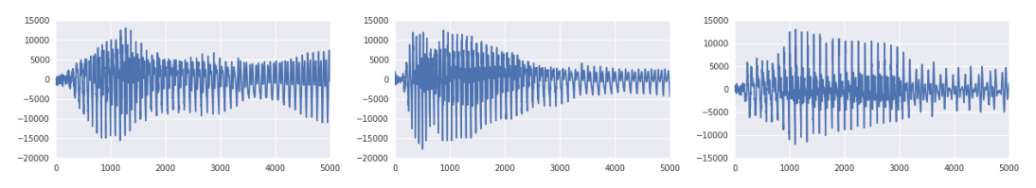
SPEECH EVIDENCE
Speech codes retain content and enable conversion
49.3%
code → phoneme
accuracy
7.2%
VCTK SETUP
majority-phoneme
baseline
109 speakers · 64× downsampling · K=512 · decoder receives speaker ID
Content is retained while speaker identity can be swapped.
Paper Fig. 6, §4.3 · pp. 7-8
09
Notes:
The phoneme probe is unsupervised with respect to VQ-VAE training, but the mapping is simple. Speaker conversion also uses explicit speaker conditioning.
[Sources]
- /Users/xnnxax/projects/jerexjs-blog/local-papers/VQ-VAE-1711.pdf, pp. 7-8, Figure 6 and §4.3, accessed 2026-08-22
[/Sources]

Slide 10
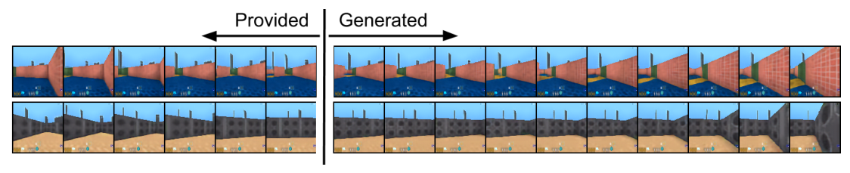
VIDEO EVIDENCE
Short latent rollouts retain local DMLab geometry
6
10
latent first
provided frames
generated frames
generate all z before deterministic pixel decoding
Paper Fig. 7, §4.4 · p. 8
10
Notes:
The rows condition on different actions. The qualitative result shows plausible local geometry for ten generated frames, not quantified long-horizon dynamics.
[Sources]
- /Users/xnnxax/projects/jerexjs-blog/local-papers/VQ-VAE-1711.pdf, p. 8, Figure 7 and §4.4, accessed 2026-08-22
[/Sources]

Slide 11
EVIDENCE BOUNDARY
The method is strong; causal claims remain suggestive
DIRECT
Hard quantization is trainable with straight-through and codebook updates.
DIRECT
Discrete likelihood is competitive in the reported CIFAR-10 setup.
CONVERGENT
Image, speech, and video examples show useful compressed structure.
MISSING
Code usage, dead-code statistics, matched-prior controls, and long-horizon metrics.
A powerful PixelCNN/WaveNet prior shares credit for final sample quality.
Paper §3-5, Appendix A.1 · pp. 3-11
11
Notes:
The optimization interface is established; posterior-collapse and semantic-abstraction claims lack mechanism-isolating controls.
[Sources]
- /Users/xnnxax/projects/jerexjs-blog/local-papers/VQ-VAE-1711.pdf, pp. 3-8, §3-5, accessed 2026-08-22
- /Users/xnnxax/projects/jerexjs-blog/local-papers/VQ-VAE-1711.pdf, p. 11, Appendix A.1, accessed 2026-08-22
[/Sources]

Slide 12
TAKEAWAYS
VQ-VAE is a tokenization interface
01
Forward semantics
Nearest-neighbor lookup commits every encoder feature to a finite learned vocabulary.
02
Backward semantics
Straight-through, codebook, and commitment updates assign a gradient role to every component.
03
Generative semantics
A separate autoregressive prior models token sequences while the decoder reconstructs local detail.
DISCUSSION
When does a discrete bottleneck create semantics—and when does it only create compression?
Neural Discrete Representation Learning · synthesis
12
Notes:
The durable abstraction connects continuous networks to discrete sequence models. The open question is when the interface yields stable semantics.
[Sources]
- /Users/xnnxax/projects/jerexjs-blog/local-papers/VQ-VAE-1711.pdf, p. 1, abstract, accessed 2026-08-22
- /Users/xnnxax/projects/jerexjs-blog/local-papers/VQ-VAE-1711.pdf, pp. 3-5, §3, accessed 2026-08-22
- /Users/xnnxax/projects/jerexjs-blog/local-papers/VQ-VAE-1711.pdf, p. 8, §5, accessed 2026-08-22
[/Sources]

