Slide 1
STAT 430 Project Presentation
-- Wine Data Cluster Analysis
Team members:
Shuyu Jia, Zhehui Chen

Slide 2
Content
1. Introduction and Dataset Info
2. Data Research
3. Exploratory Data Analysis (EDA)
4. Pre-analysis Questions
5. Algorithm Selection Motivation
6. Algorithm Results and Post-analysis Question
K-means
Hierarchical
Fuzzy c-means
7. Analysis Summary

Slide 3
1. Introduction and Dataset

Slide 4
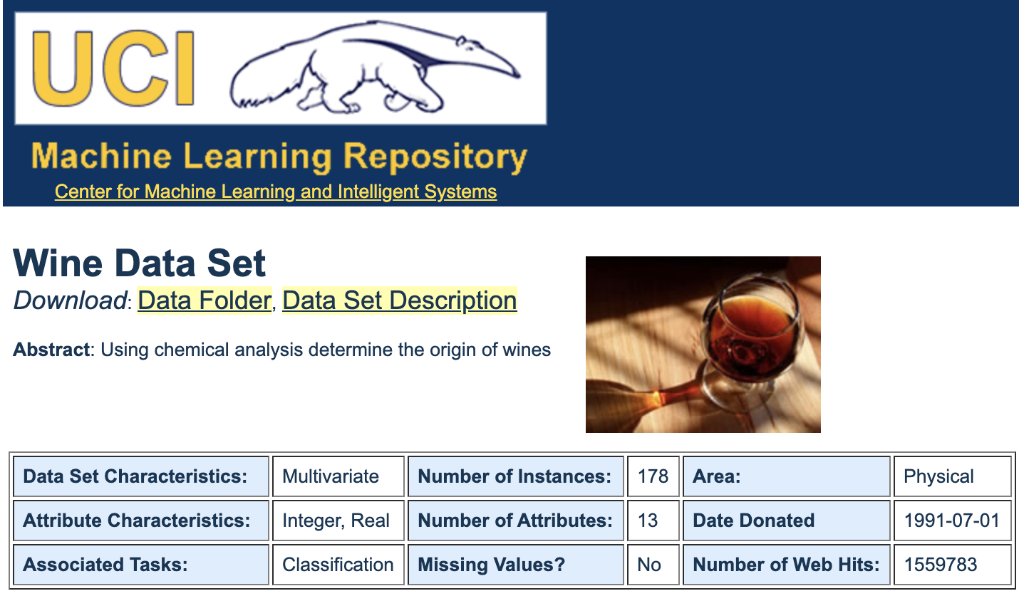
Background
Wine Dataset
Sample size：178
Labels：three different classes
13 variables

Slide 5
2. Data Research

Slide 6
Motivation
✦ visualized the clustering and predicted the classes (supervised)
✦ group similar observations together and determine the number of possible clusters (unsupervised)
✦ a new semi-supervised clustering algorithm
constraint-based methods
distance-function learning methods

Slide 7
3. Exploratory Data Analysis (EDA)

Slide 8
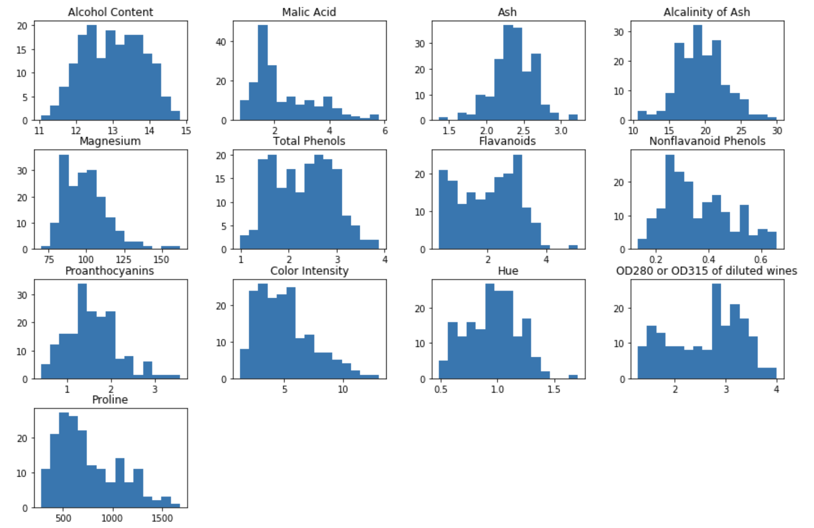
Continuous Features
13 continuous variables
Normally distributed
No significant outliers

Slide 9
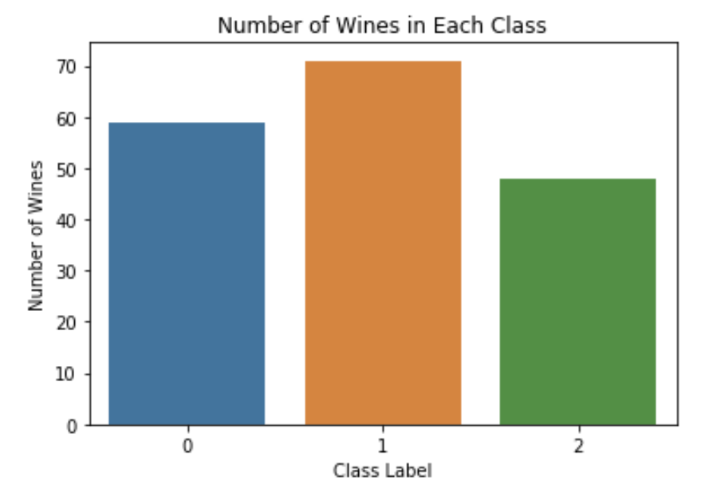
Discrete Outcome
Barplot for the class labels.

Slide 10
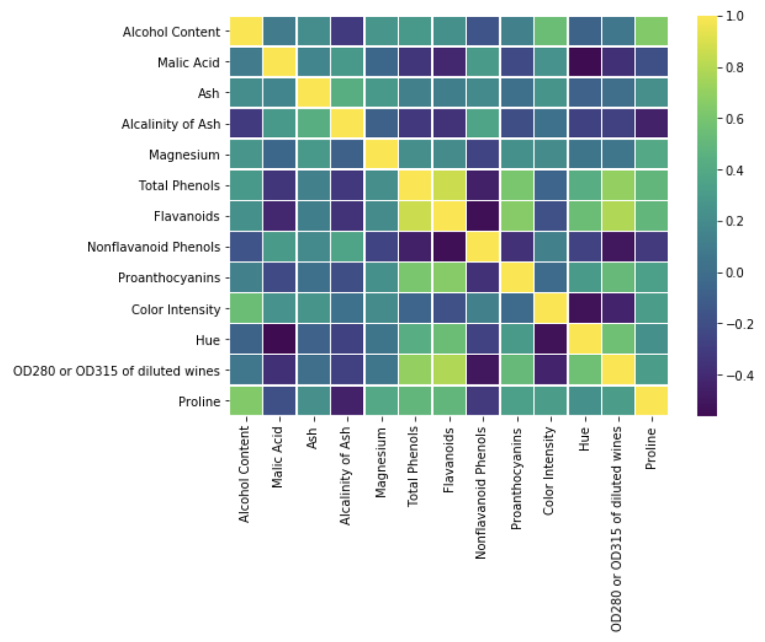
Correlation Analysis
Create heatmap for correlation analysis.
There is no two variables that are strongly correlated to each other.

Slide 11
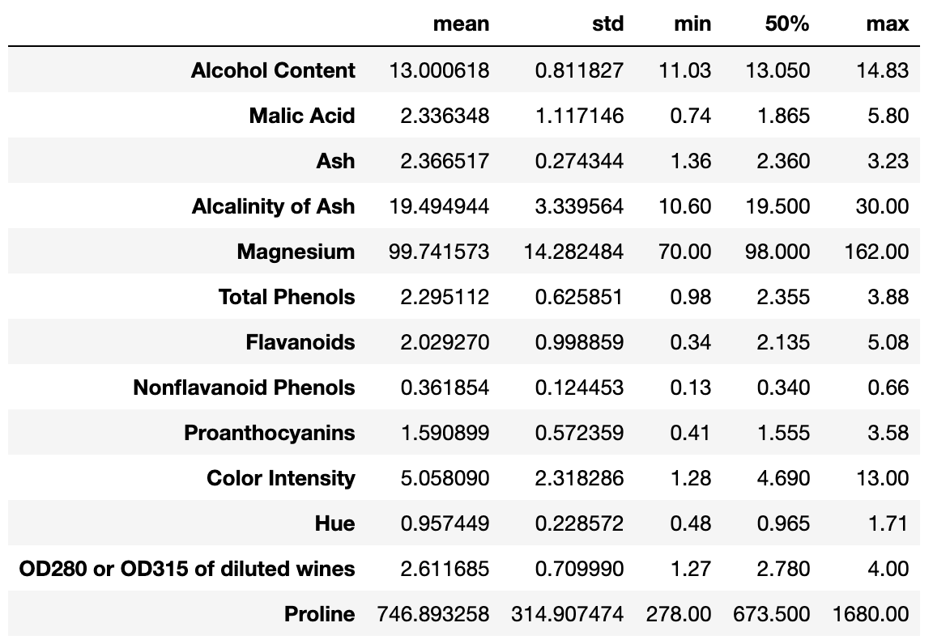
Data Scale
Different Range of values.
Should be normalized

Slide 12
4. Pre-analysis Questions

Slide 13
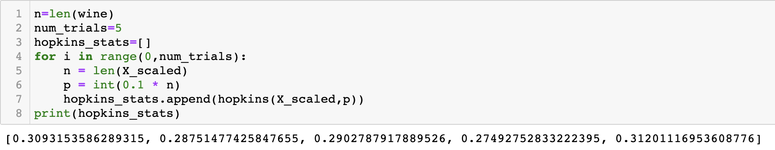
Clusterability
Hopkins statistic

Slide 14
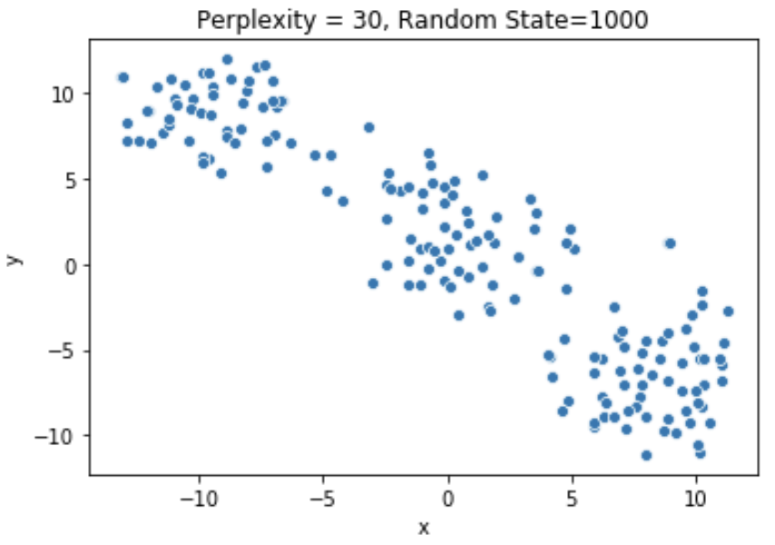
Clusterability
2) t-SNE plot
1) Roughly three point clusters.
2) Each cluster has spherical shape.
3) Clusters have almost the same size.
4) Some overlaps, not well separated.

Slide 15
5. Algorithm Selection Motivation

Slide 16
Motivations
k-means performs well in this dataset
No two variables are strongly correlated with each other.
3 underlying clusters; spherical shape; similar sizes; decently separated
All features are numerical.
No significant outliers.

Slide 17
Algorithm Selection
K-means clustering
Agglomerative hierarchical clustering (“bottom-up” approach)
Fuzzy c-means (membership scores)

Slide 18
6. Algorithm Results and Post-analysis Question

Slide 19
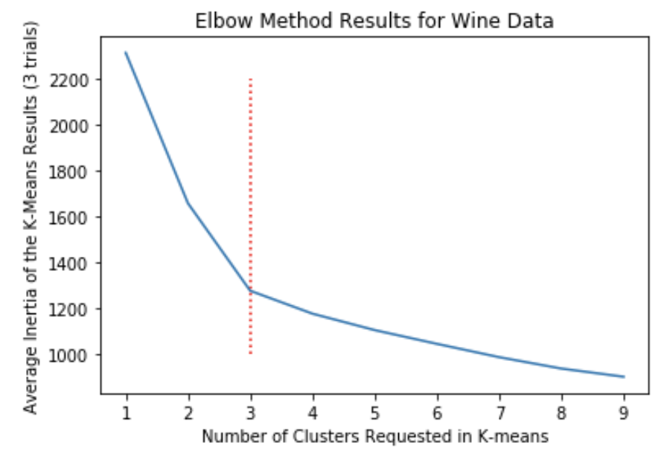
K-Means Algorithm
Parameter Setting (K)
Use the elbow method with the average inertia measurement.
Choose K=3

Slide 20
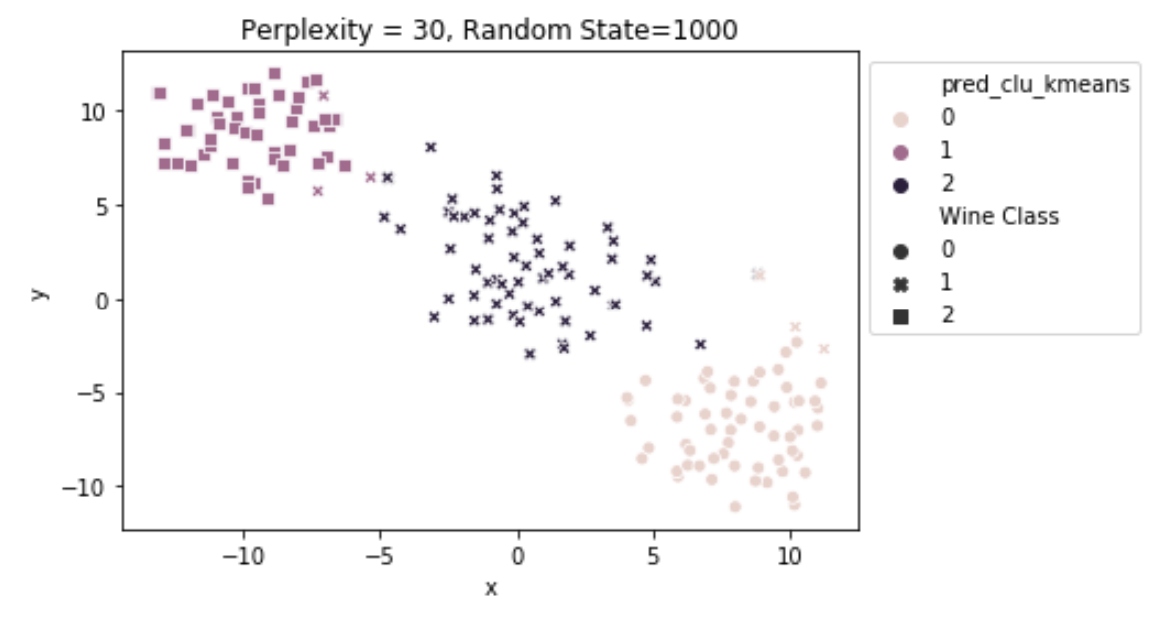
K-Means Algorithm
No strong cohesion
Performance
silhouette_score | 0.285
Adjusted Rand Score | 0.897
Homogeneity Score | 0.879
Completeness Score | 0.873
Good cluster result

Slide 21
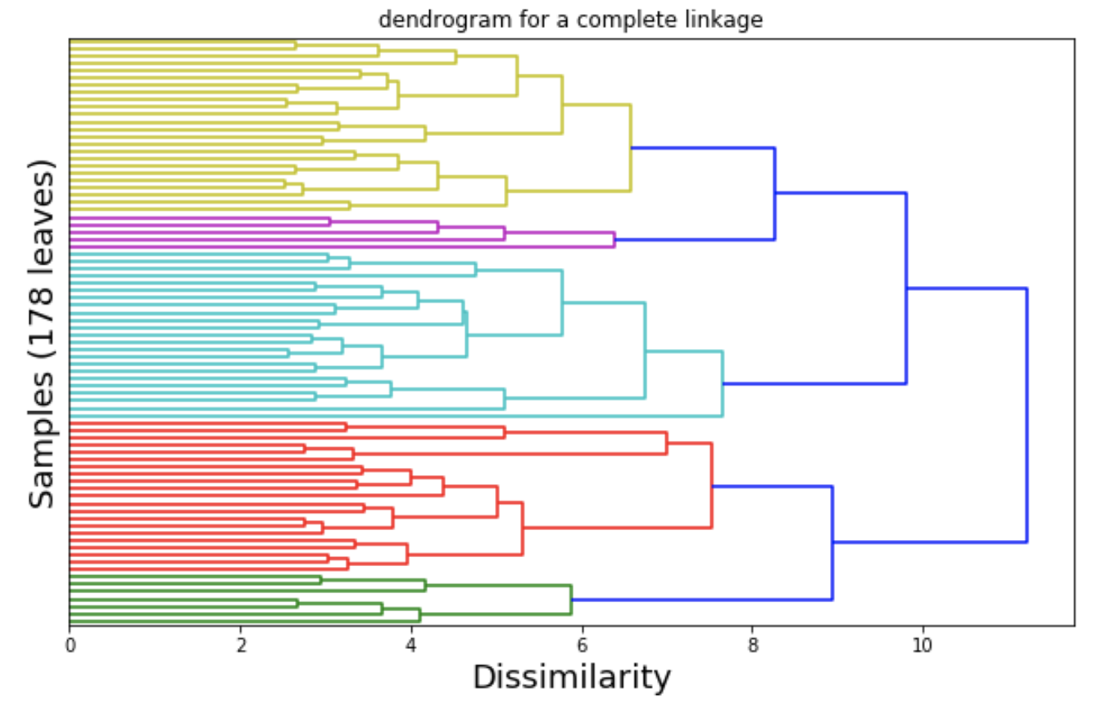
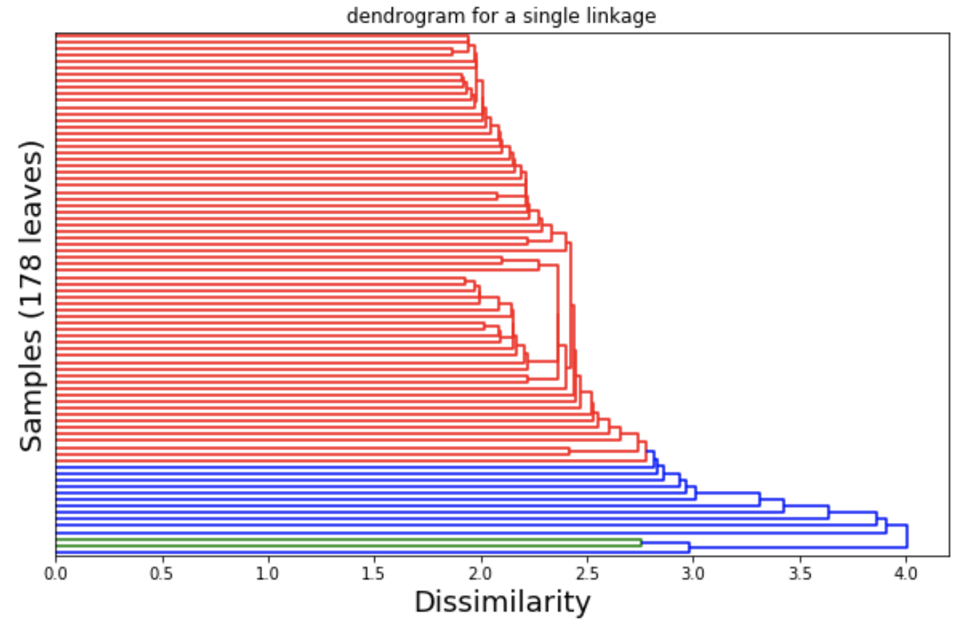
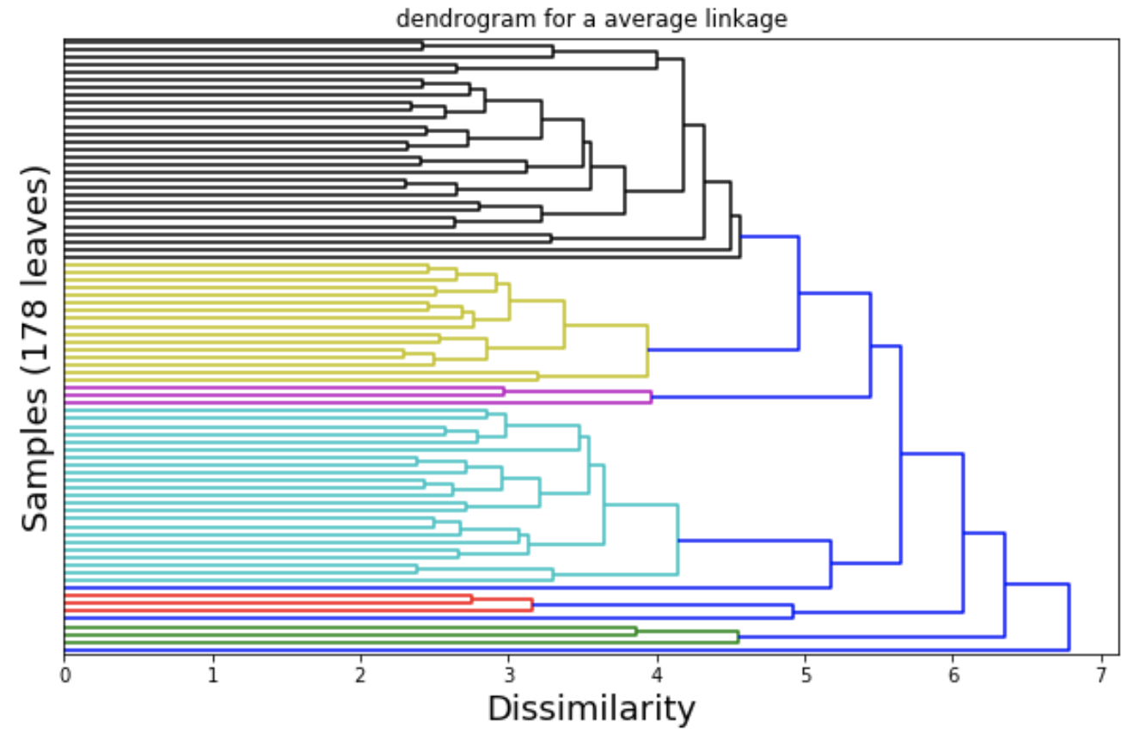
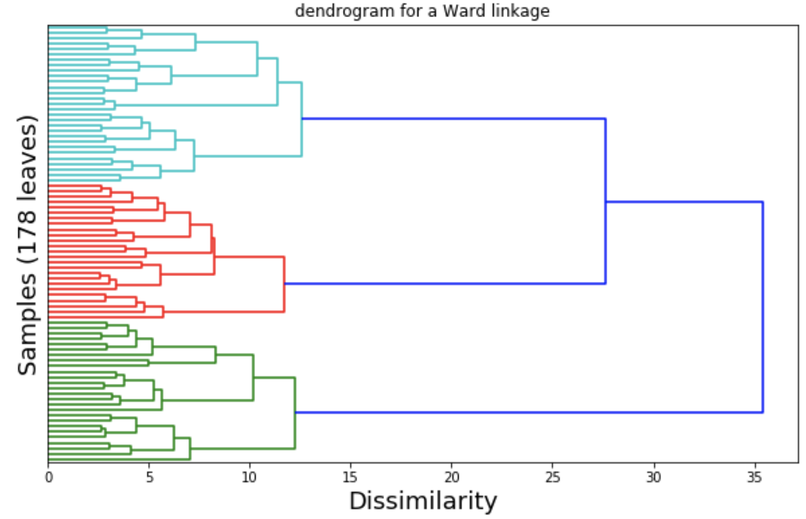
Hierarchical Clustering Algorithm
K=3
Distance between the newly formed clusters (linkage): complete, single, average, Ward
BEST!

Slide 22
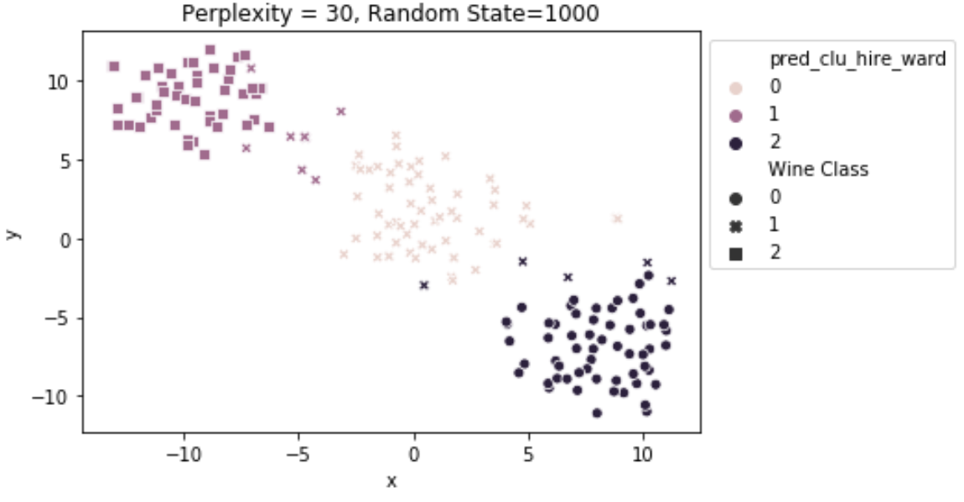
HAC (Ward Linkage)
No strong cohesion
Performance
silhouette_score | 0.277
Adjusted Rand Score | 0.790
Homogeneity Score | 0.790
Completeness Score | 0.783
Worse than K-Means

Slide 23
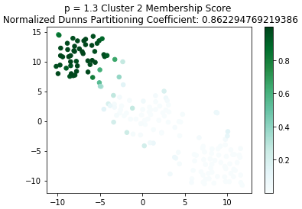
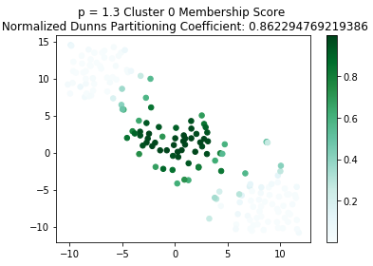
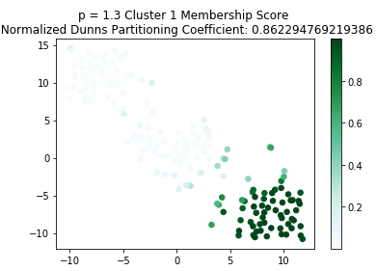
Fuzzy C-Means
Algorithm

Slide 24
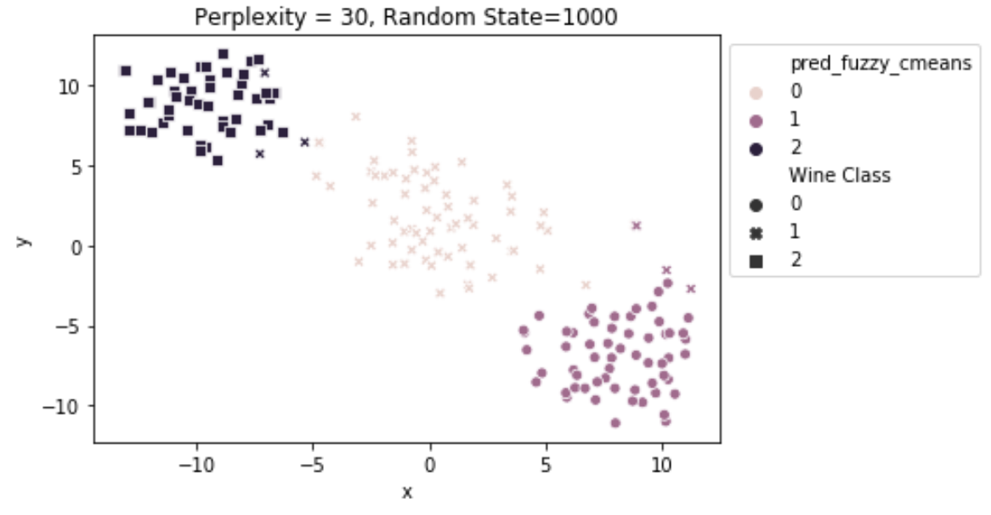
Fuzzy C-Means
No strong cohesion
Performance
silhouette_score | 0.285
Adjusted Rand Score | 0.897
Homogeneity Score | 0.879
Completeness Score | 0.873
Same as K-Means

Slide 25
7. Analysis Summary

Slide 26
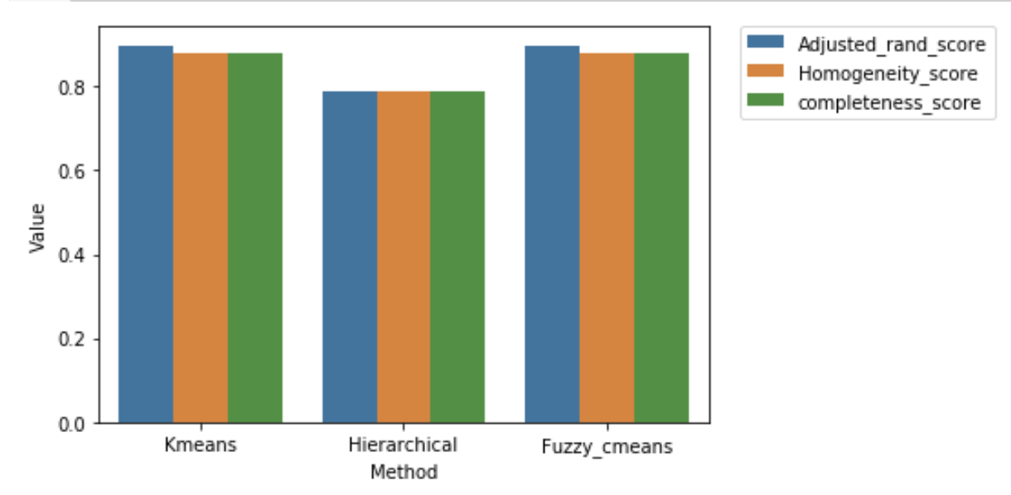
Model Comparison

Slide 27
Insight Summary
Fuzzy C-Means v.s. K-Means
For hierarchical clustering, different linkages will lead to different performance.
K-means clustering centroids lead to future predictions.

Slide 28
References
1] Nath, Ayantika, and Shikha Nema. “Clustering Visualization and Class Prediction Using Flask of Benchmark Dataset for Unsupervised Techniques in Machine Learning.” International Journal of Innovative Technology and Exploring Engineering Regular Issue, vol. 9, no. 7, 2020, pp. 1297–1302., doi:10.35940/ijitee.g5943.059720. (http://www.ijitee.org/wp-content/uploads/papers/v9i7/G5943059720.pdf)
[2] Jankovic, Dina. “K-Means Clustering of Wine Data.” Medium, Towards Data Science, 13 Aug. 2018, towardsdatascience.com/k-means-clustering-of-wine-data-95bac074baae. (https://towardsdatascience.com/k-means-clustering-of-wine-data-95bac074baae)
[3] Bilenko, Mikhail, et al. “Integrating Constraints and Metric Learning in Semi-Supervised Clustering.” Twenty-First International Conference on Machine Learning - ICML '04, 2004, doi:10.1145/1015330.1015360. (https://www.cs.utexas.edu/~ml/papers/semi-icml-04.pdf)

Slide 29
Thanks for watching!

