Slide 1
Geodata Analysis
for Targeting Sales in Illinois
Jing Huang / Yuqi Zhang / Shuyu Jia / Qingxuan Kong

Slide 2
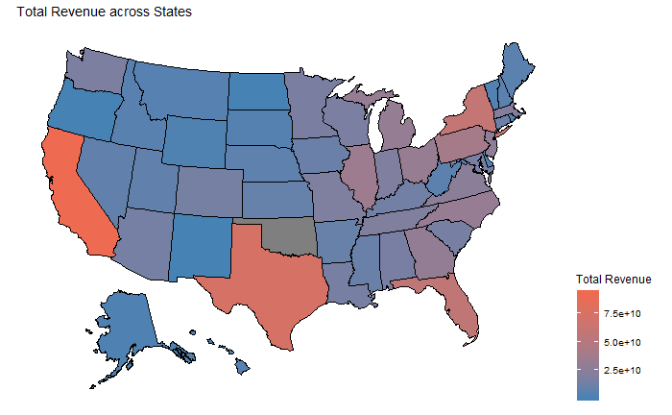
Introduction
Total Revenue across States
(US Nationwide)
Location
Num of Estabs.
Retail Category
Sales Level
(Illinois)
Introduce
New Variables
Which?
Sales Targets
Zip Codes
Random Forest
Undersold Regions
Variable Importance
How?

Slide 3
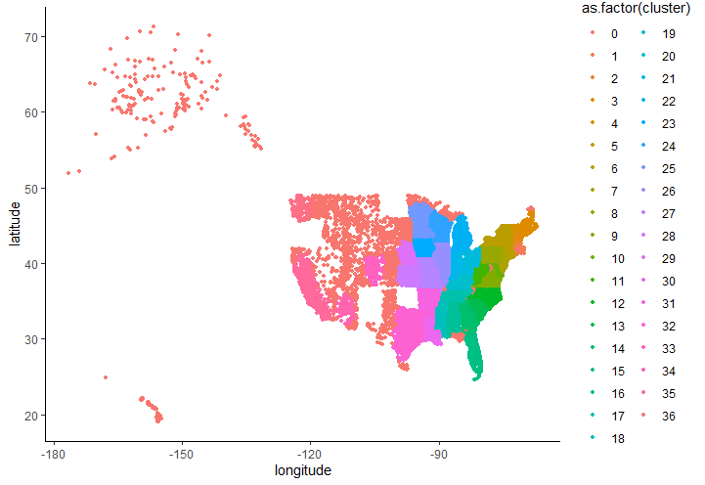


Feature Processing
Original Data
Latitude
+ Longitude
+ State
-> DBSCAN Cluster
Population
/ Number of Establishments
-> Population per Establishment
Linkage:
Zip Code
(Note: this feature is not used in building regression model)
Average
Income
?
?
Population
Coordinates

Slide 4
Regression
IL
Predict expected sales
Find undersold locations
Complete Dataset
Validation Set
Random Forest
Training Set

Slide 5
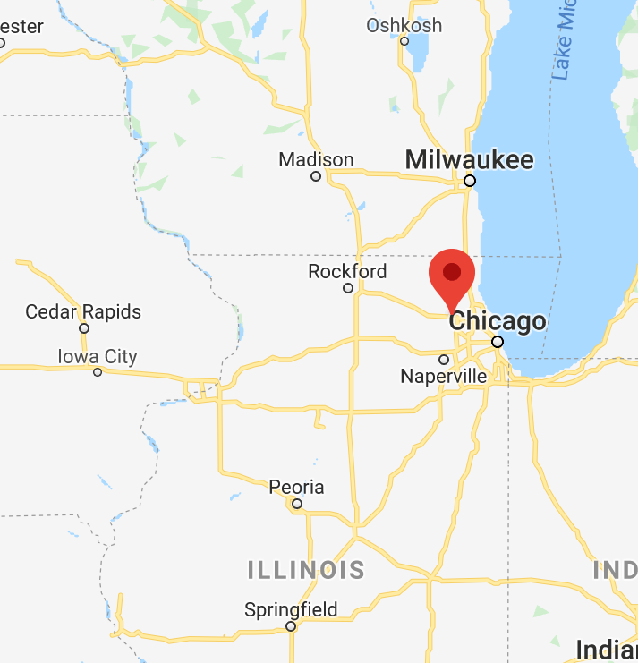
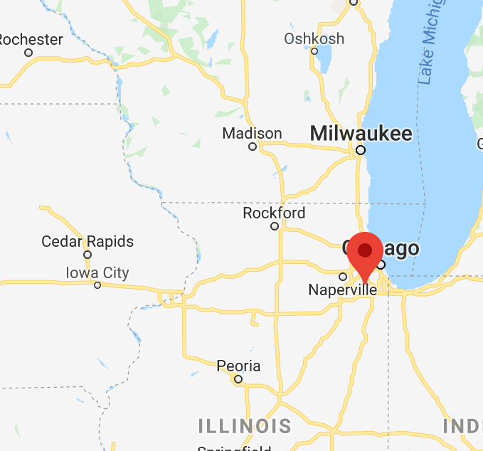
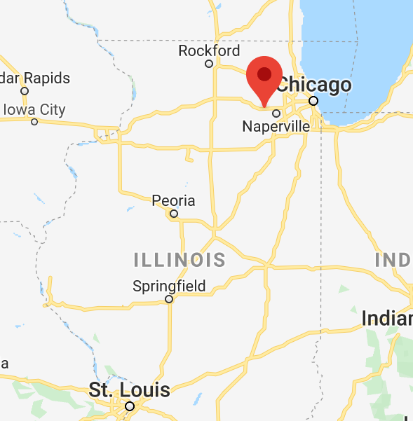
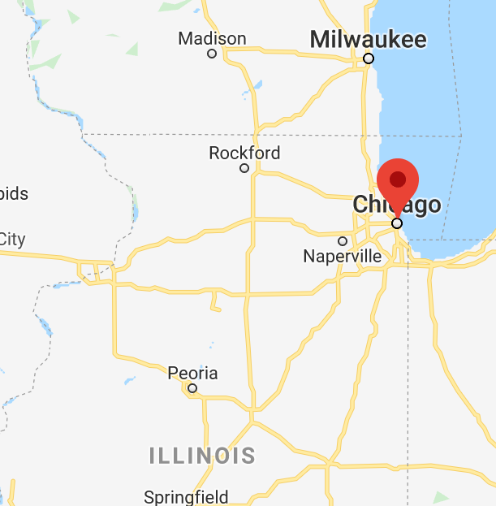
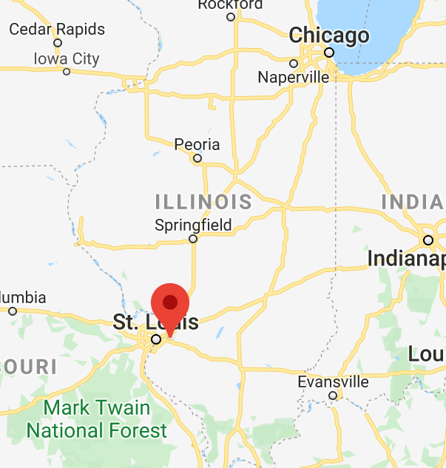
Targets

Slide 6
Drawback
Feature space is too small
We expect (and do get) a large MSE, and we are searching for data whose residual is large
But there comes another problem…

