Slide 1

cd

Slide 2

pwd

Slide 3

cat

Slide 4

ls

Slide 5
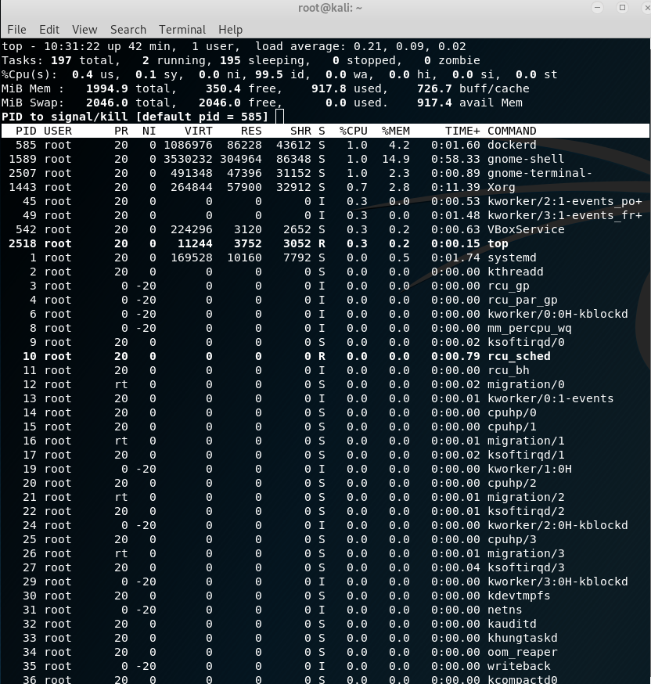
top

Slide 6

ps

Slide 7

ping

