Slide 1

cd

Slide 2

pwd

Slide 3

cat

Slide 4

ls

Slide 5
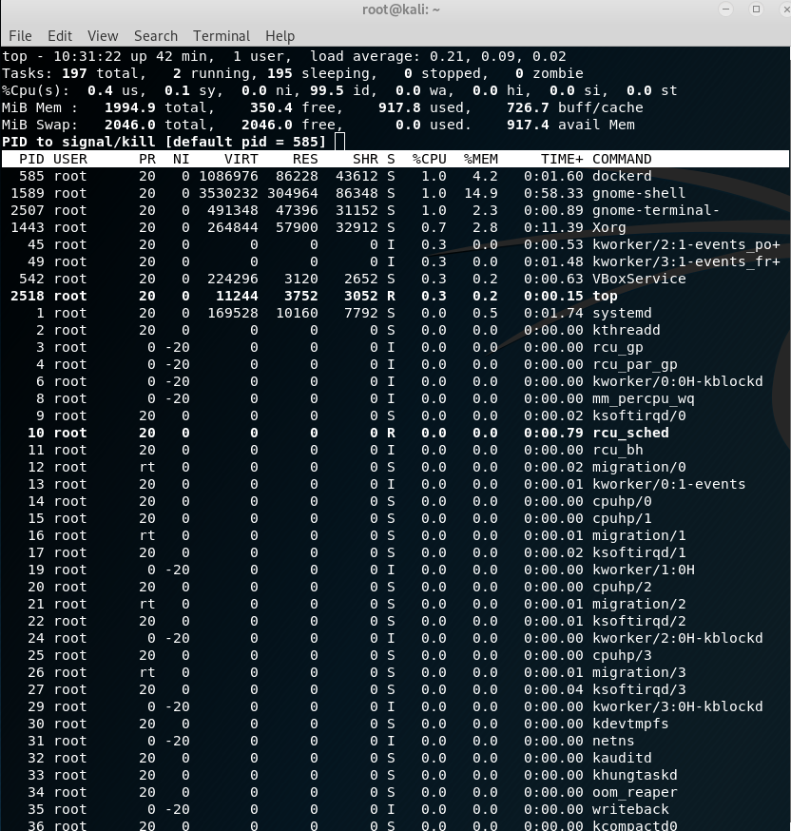
top

Slide 6

ps

Slide 7

ping

Slide 8

mkdir

Slide 9

rmdir

Slide 10

cp

Slide 11

rm

Slide 12

mv

Slide 13

nl

Slide 14

more

Slide 15

less

Slide 16

head

Slide 17

tail

Slide 18

od

Slide 19

touch

Slide 20

umask

Slide 21

chattr

Slide 22
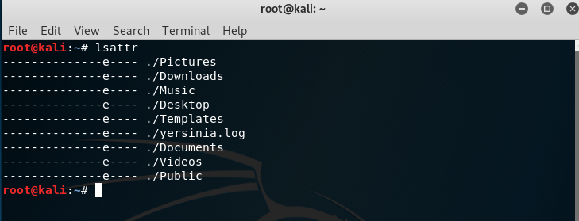
lsattr

Slide 23

SUID

Slide 24

sgid

Slide 25

sbit

Slide 26

file

Slide 27

which

Slide 28

whereis

Slide 29

locate

Slide 30

updatedb

