Slide 1
论文讨论 SchNet: A continuous-filter convolutional neural network for modeling quantum interactions
刘涛
2021-04-28

Slide 2
Main idea
model local correlations without requiring
the data to lie on a grid
Continuous Filter
Convolution
a novel deep learning
architecture modeling quantum interactions in molecules
SchNet
rotationally invariant energy predictions
rotationally equivariant, energy-conserving
force predictions
Basic quantum chemical constrains

Slide 3
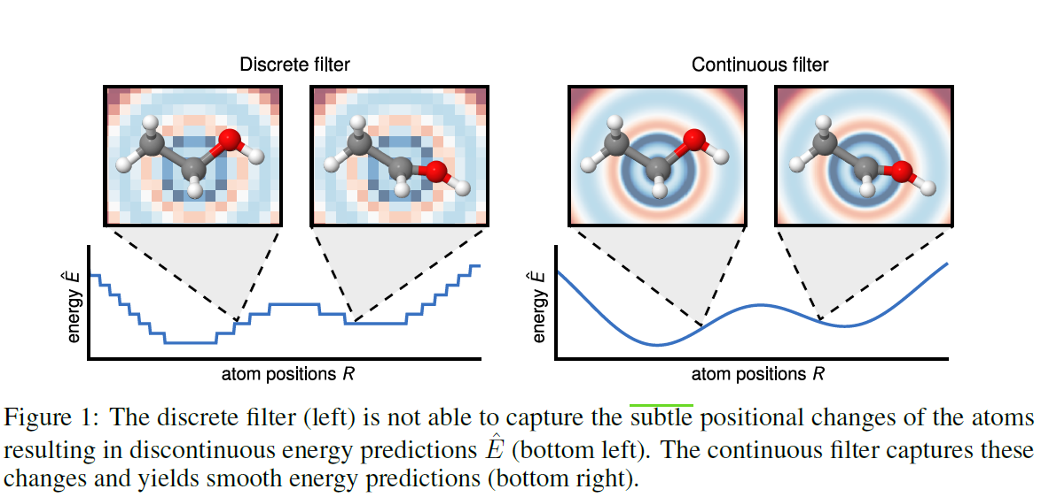
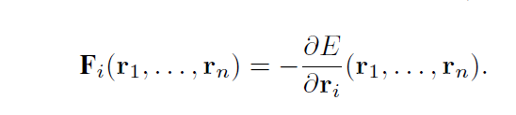
Continuous filter → Continuous energy surface

Slide 4
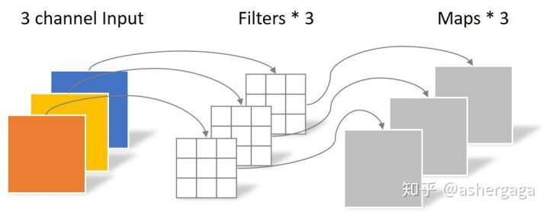
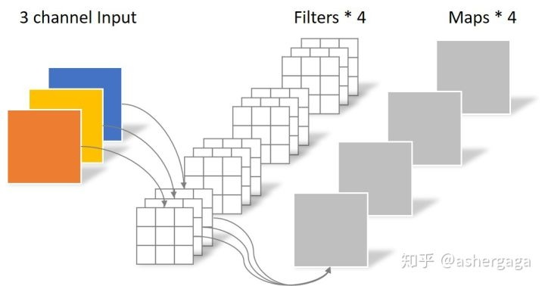
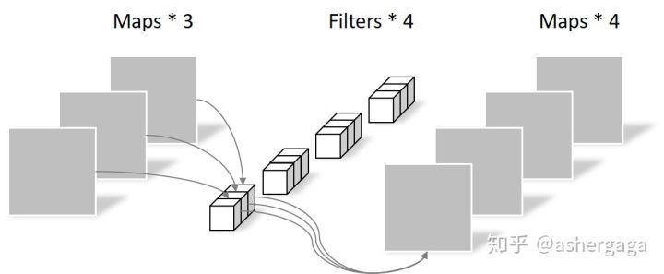
Continuous filter convolution 借鉴——深度可分离卷积
SchNet：区分Feature wise和Point Wise（即Atom wise），但其输入的n个atom并不按二维网格的形式组织

Slide 5
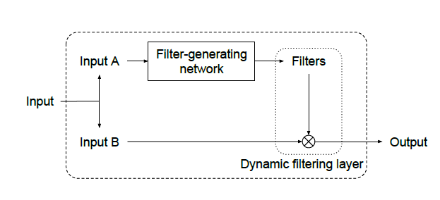
Continuous filter convolution 借鉴——Dynamic Filter Network
InputA和InputB可以相同也可以不同，应用可以视具体情况确定。
由Filter-generating network根据输入生成一组动态的Filter，这组Filter再Apply到输入本身。
区分：生成的动态Filter里的权重参数是Filter-generating network的输出，是随着InputA的变化而变化的；而网络本身的权重参数是在网络训练后就固定的。

Slide 6
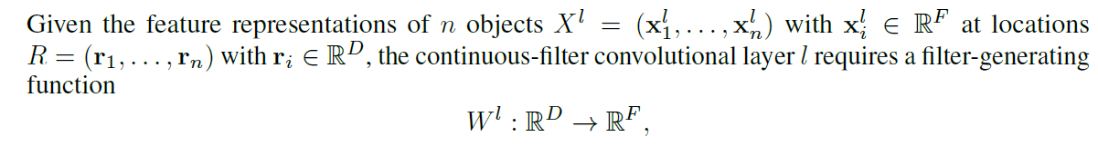
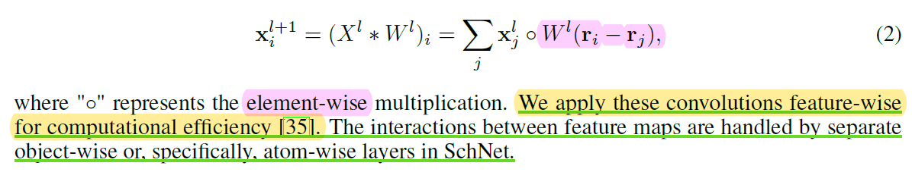
Continuous filter convolution
一维卷积

Slide 7
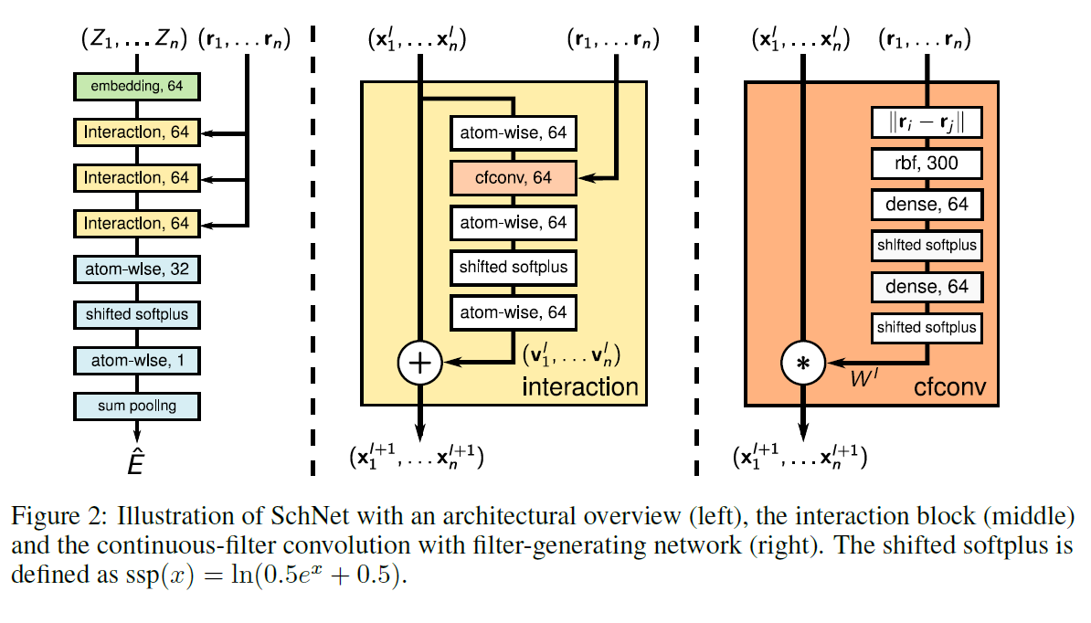
SchNet
第9页
step1
连续的
光滑的
第9页
step2
第9页
step3

Slide 8
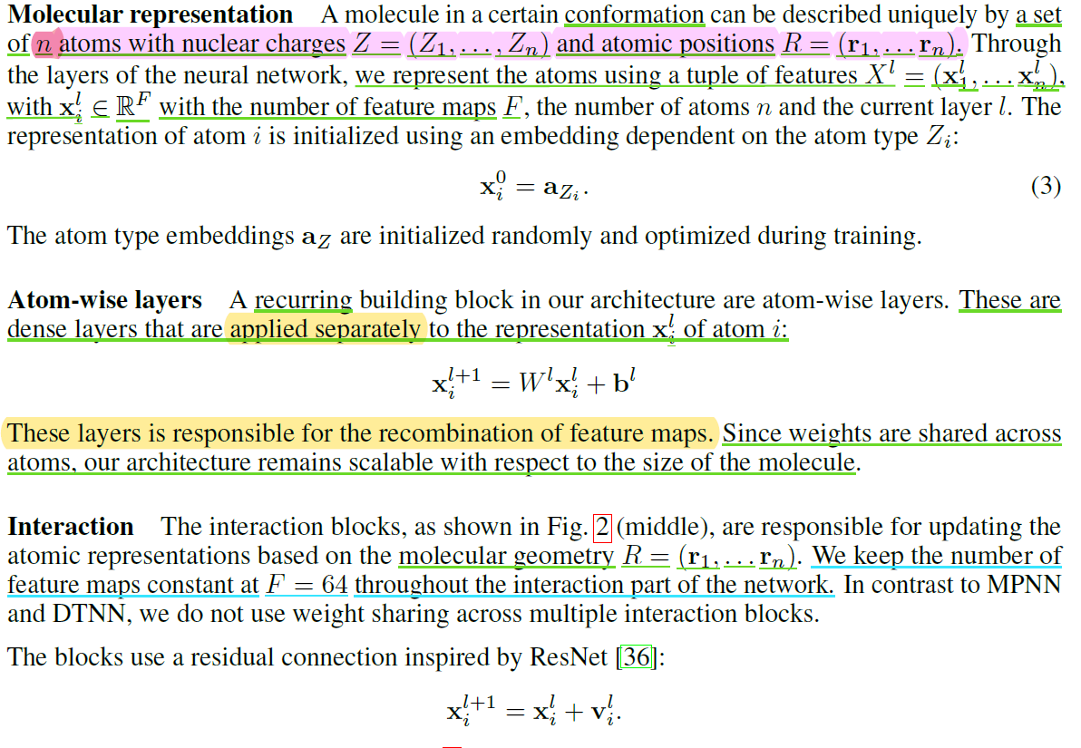
SchNet

Slide 9
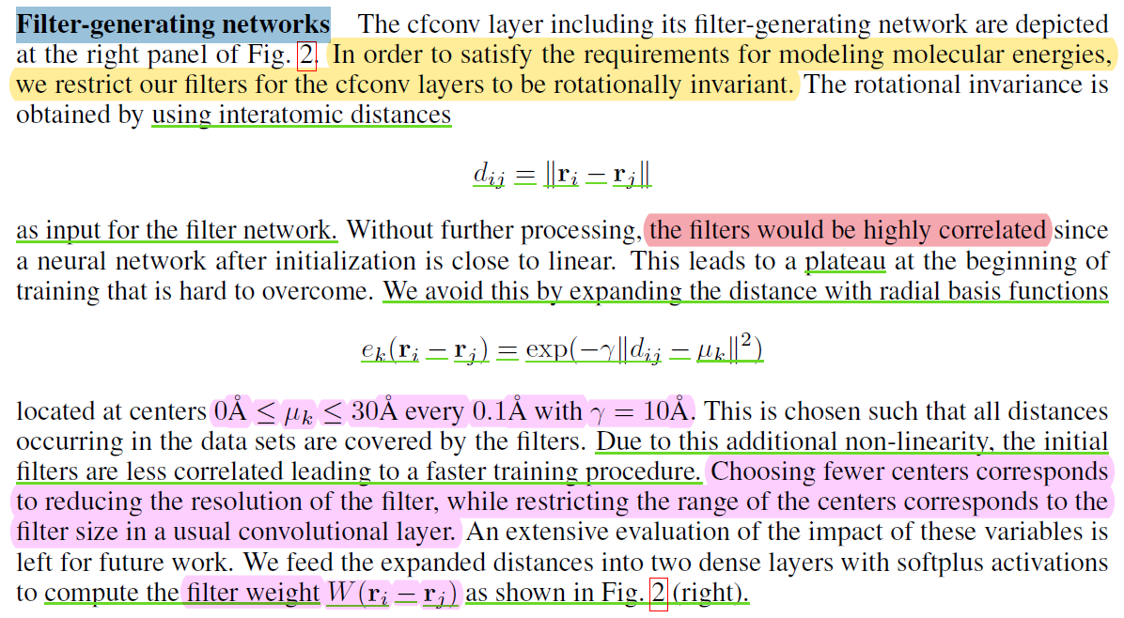
SchNet Filter-generating networks
3：学得动态Filter
（距离-权重函数，见下页）
Continuous filter：如何处理任意位置的原子？
1：计算两两原子间的距离
2：300个高斯RBF核采样

Slide 10
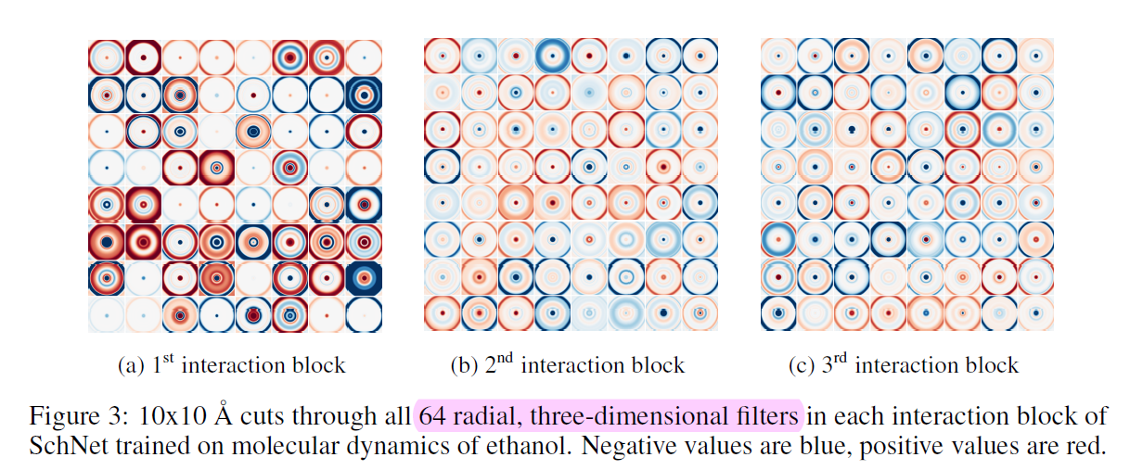
Continuous filters
y
权重
0
x
the filter contains
64 feature channels （F=64）
距离

Slide 11
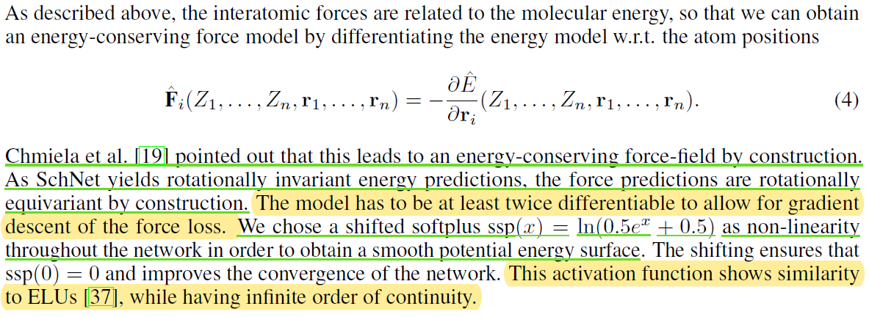
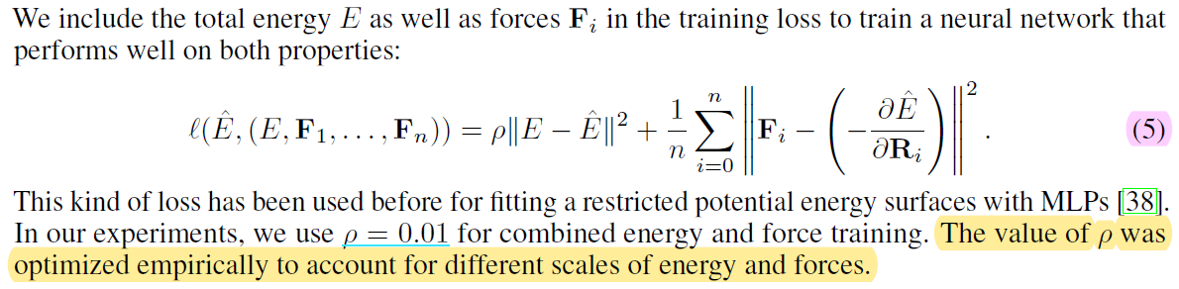
Training with energies and forces

Slide 12
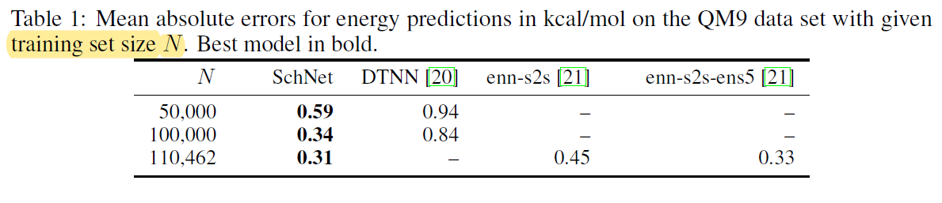
Experiments and results QM9 - chemical degrees of freedom

Slide 13
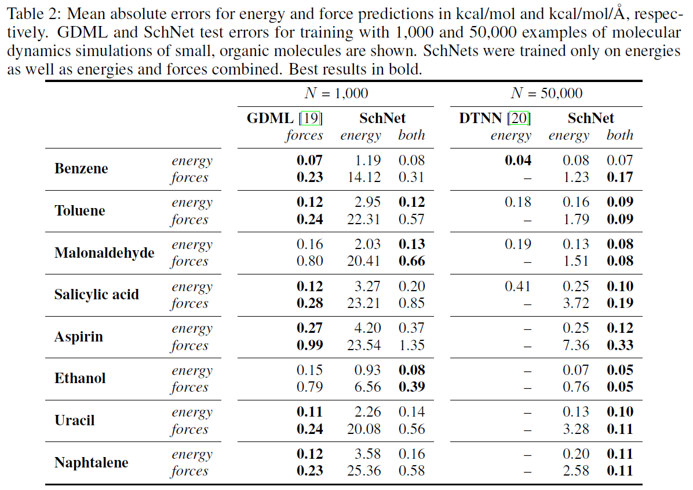
Experiments and results MD17 – conformational degrees of freedom

Slide 14
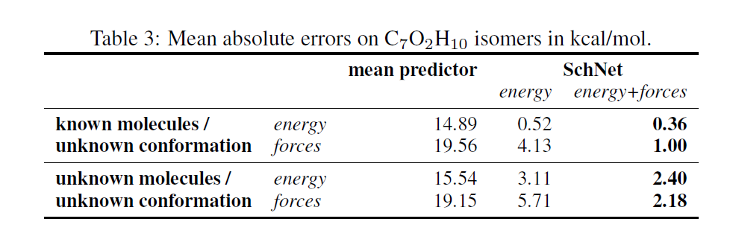
Experiments and results ISO17 – chemical and conformational degrees of freedom

Slide 15
谢谢！

