Slide 1
FOURIER NEURAL OPERATOR FOR PARAMETRIC PARTIAL DIFFERENTIAL EQUATIONS
International Conference on Learning Representations（ICLR）2013~
Zongyi Li et.al
https://github.com/zongyi-li/fourier_neural_operator
https://www.youtube.com/watch?v=IaS72aHrJKE&ab_channel=YannicKilcher

Slide 2

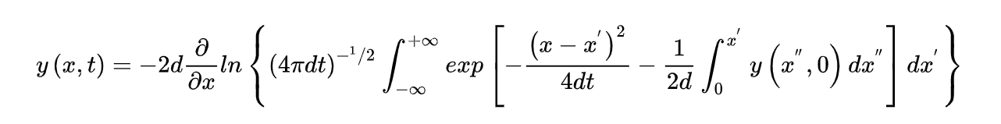
Motivation
Many problems in science and engineering involve solving complex partial differential equation (PDE) systems repeatedly for different values of some parameters.
E.g.,Burgers equation
是一个模拟冲击波的传播和反射的非线性偏微分方程
数值求解
A fast method can make such problems feasible.

Slide 3
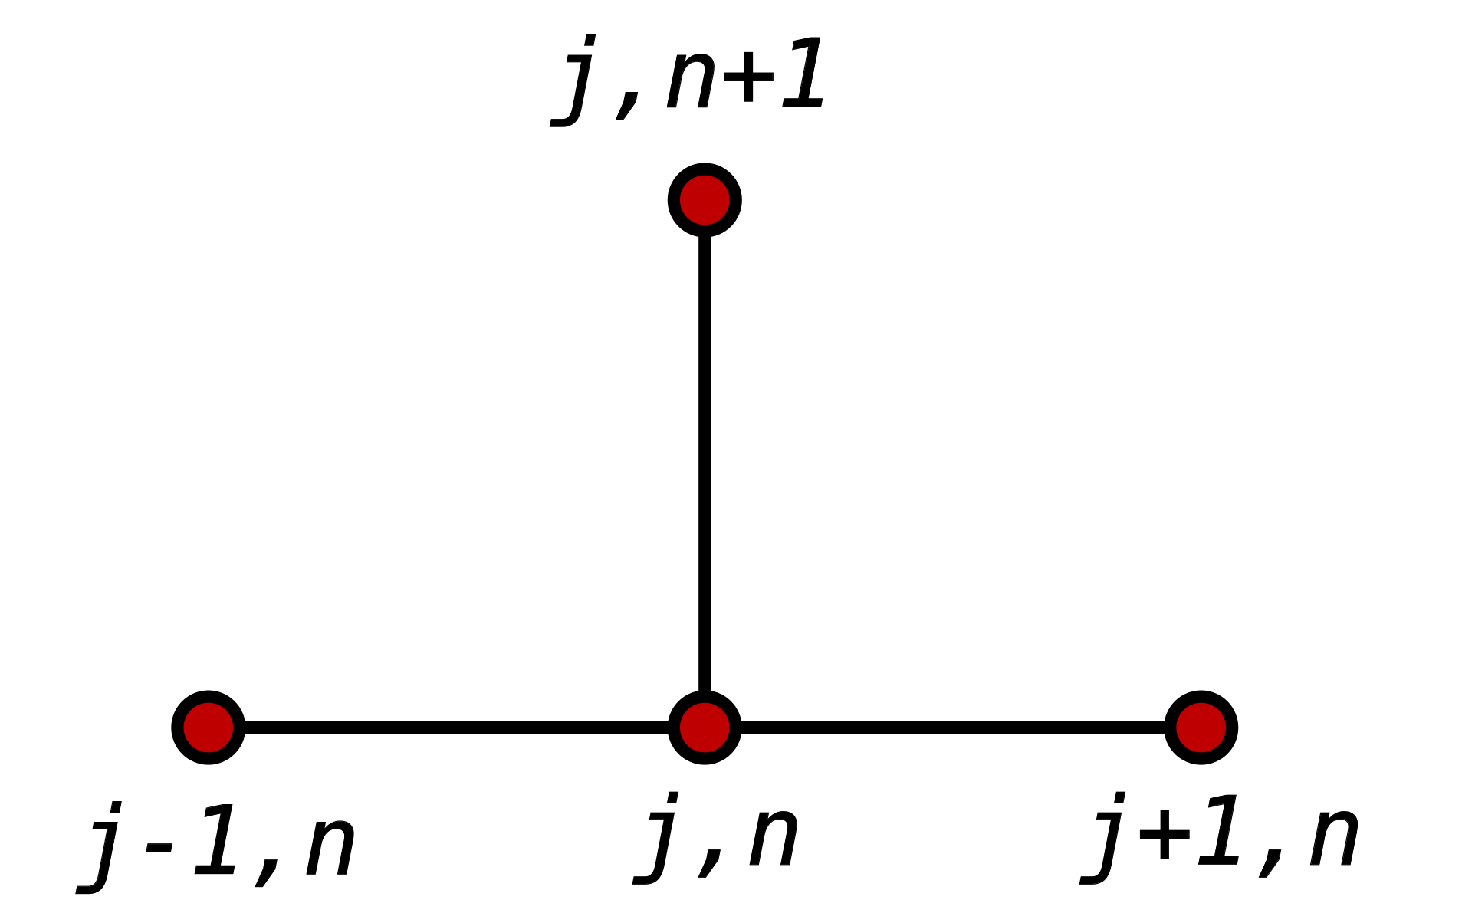
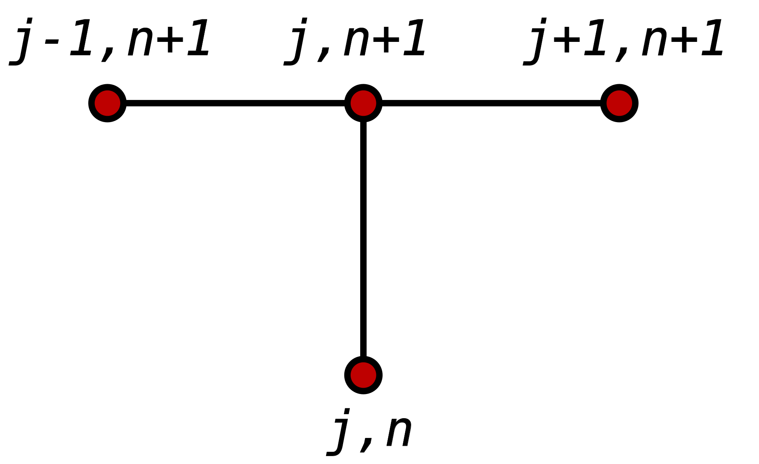
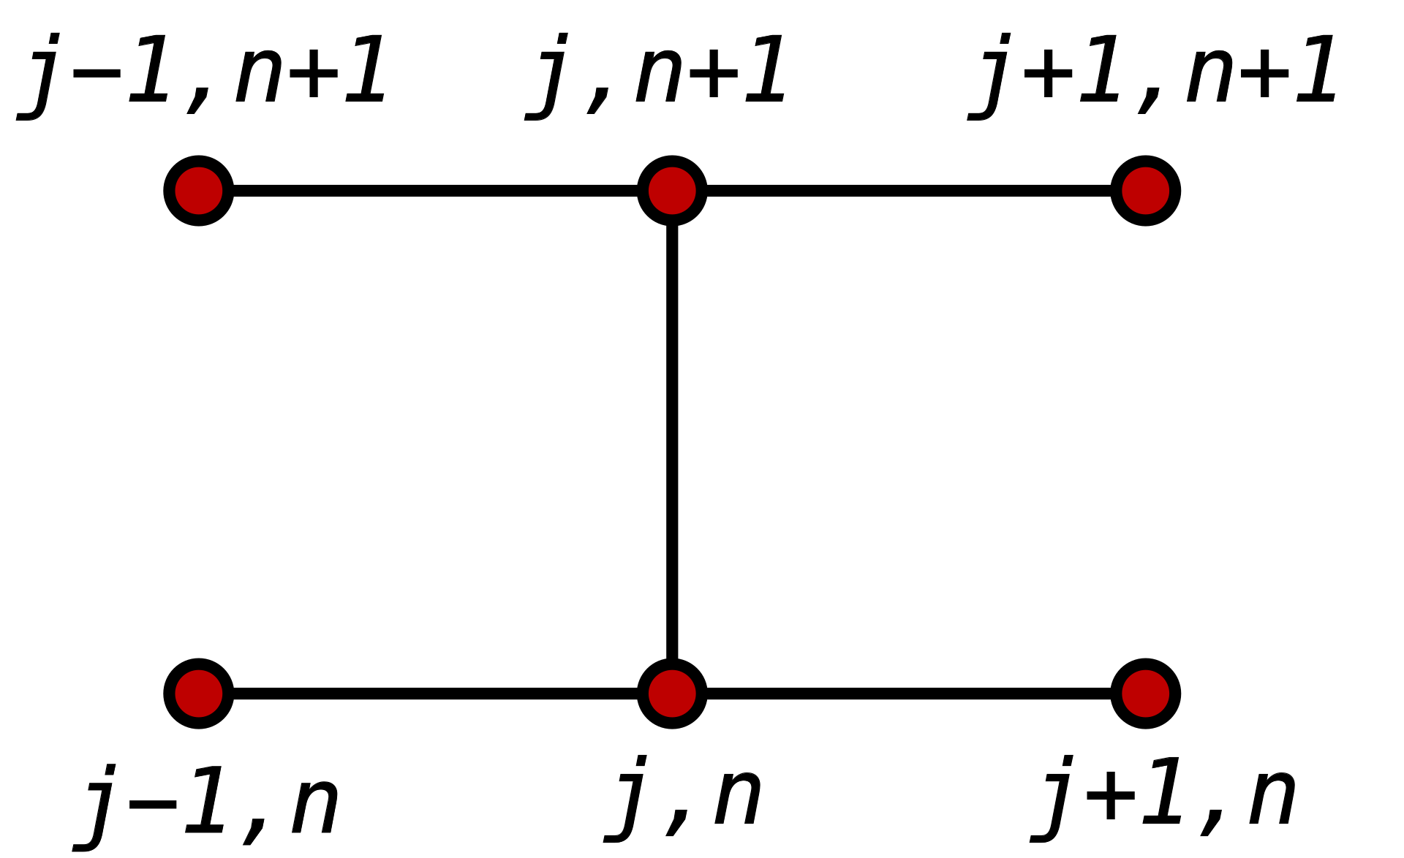
Related work
Conventional solvers
finite element methods(FEM)
finite difference methods(FDE)
Explicit method; implicit method; Crank-Nicolson
require a very fine discretization, and time-consuming
Data-driven methods
Finite-dimensional operators（ a deep convolutional neural network → mesh-dependent and need modifications ）
Neural-FEM(neural network→model one specifific instance, not the solution operator → given new instance→ training a new NN)
Neural Operators(mesh-free, infinite-dim NN, transfer solutions between meshes→ a forward pass→evaluate integral op→ Fourier)
Notes:
有限元：剖分离散（不均匀离散），基函数求解，基函数可以挑选
有限差分: 等距离离散，递推求解

Slide 4
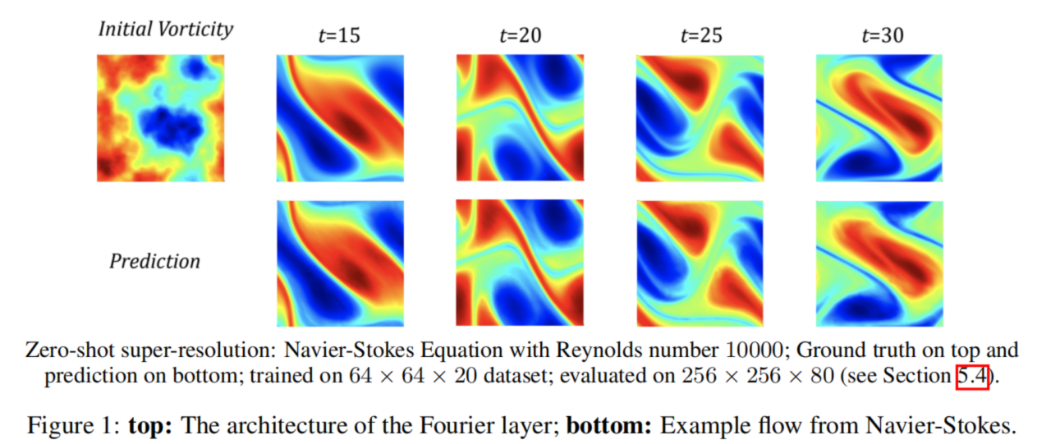
Vorticity example

Slide 5
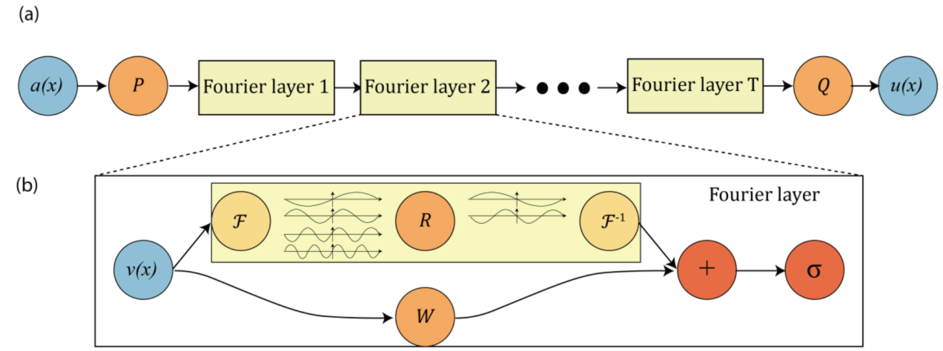
Contributions
It can do zero-shot super-resolution: trained on a lower resolution directly evaluated on a higher resolution
introduce the Fourier neural operator, a novel deep learning architecture able to learn mappings between infinite-dimensional spaces of functions;
proposing a neural operator architecture defined directly in Fourier space with quasi-linear time complexity and state-of-the-art approximation capabilities; pay attention to this part
inference time of only 0.005s compared to the 2.2s of the pseudo-spectral method used to solve Navier-Stokes……faster
It achieves error rates that are 30% lower on Burgers’ Equation…… more accurate

Slide 6

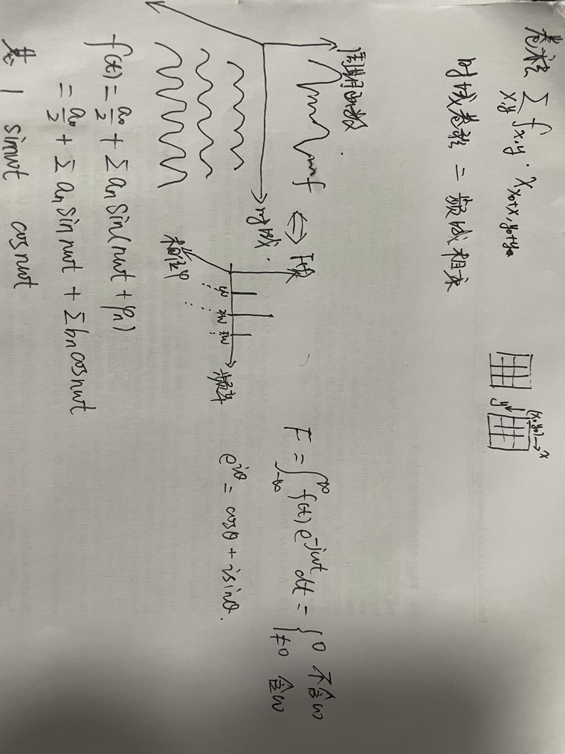
Fourier Transform
Conv→ discrete

Slide 7
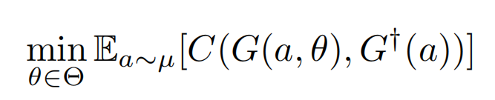

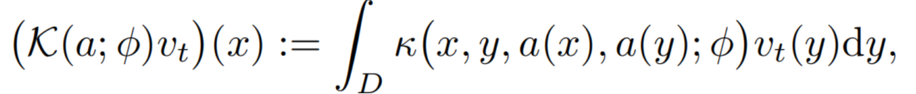
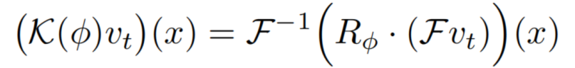
LEARNING OPERATORS
learns a mapping between two infinite dimensional spaces from a finite collection of observed input-output pairs.
Iterative updates
Kernel integral operator K
Fourier integral operator K
Notes:
Theta:参数空间
Min: cost function

Slide 8
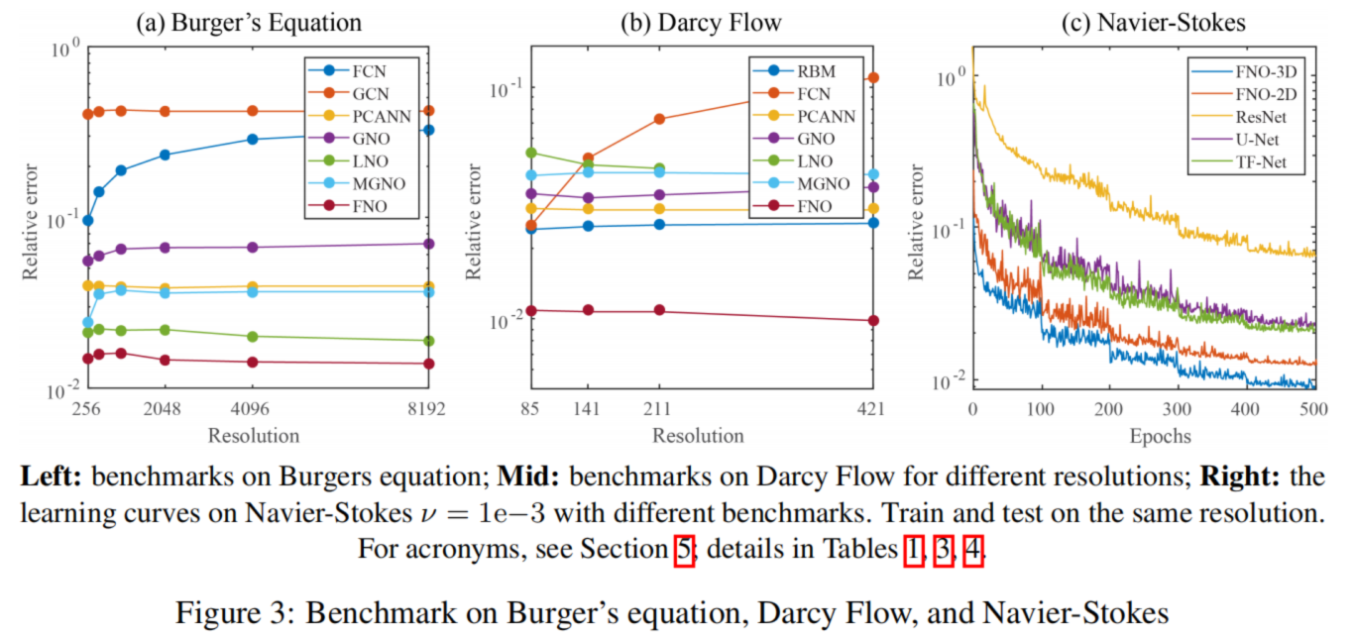
Experiments

Slide 9
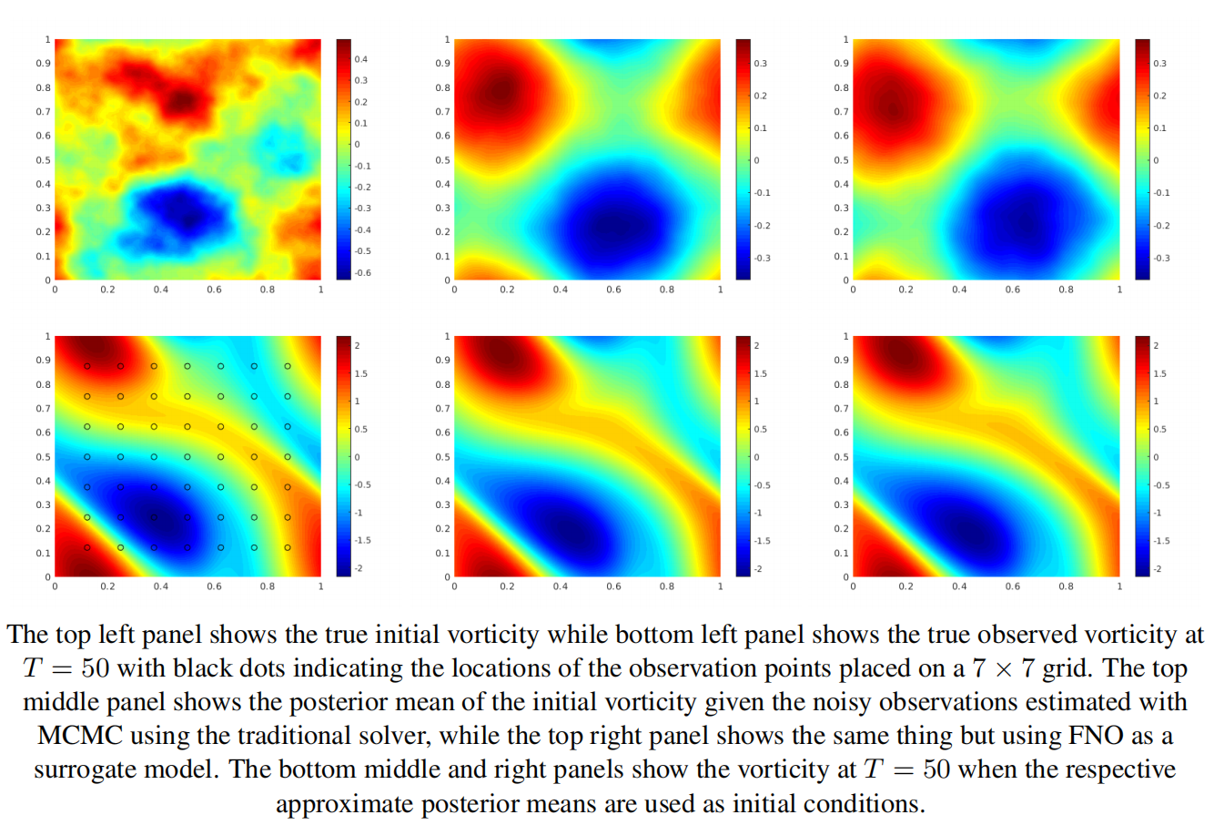
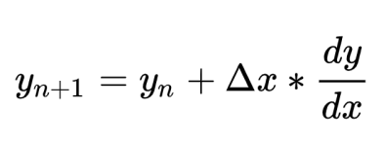



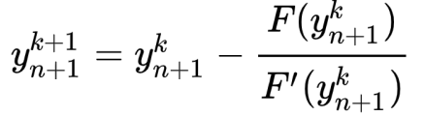
欧拉方法
显示
隐式
牛顿法求解
https://www.zhihu.com/question/34780726
Crank Nicolson:
https://blog.csdn.net/qq_21808415/article/details/89368851

