Slide 1
Enhancing the scalability and load balancing of the parallel selected inversion algorithm via tree-based asynchronous communication
Mathias，Lin Lin

Slide 2

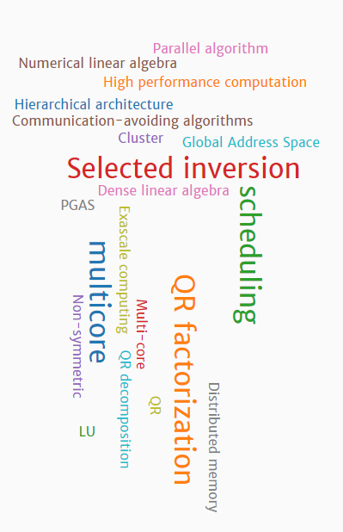
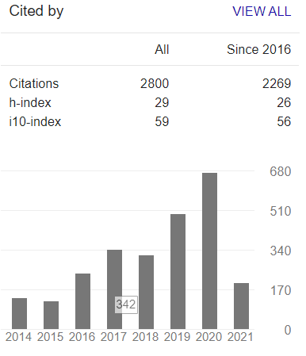

Authors’ info
Mathias Jacquelin
focusing on algorithms and scheduling && how hierarchical memory architectures should be handled
working on communication avoiding algorithms for dense linear algebra
focusing on various sparse linear algebra computations from multicores to large scale platforms
Lin Lin
Applied mathematics && Quantum many-body physics
Quantum chemistry && Scientific machine learning
Quantum computing
Articles 1-162

Slide 3
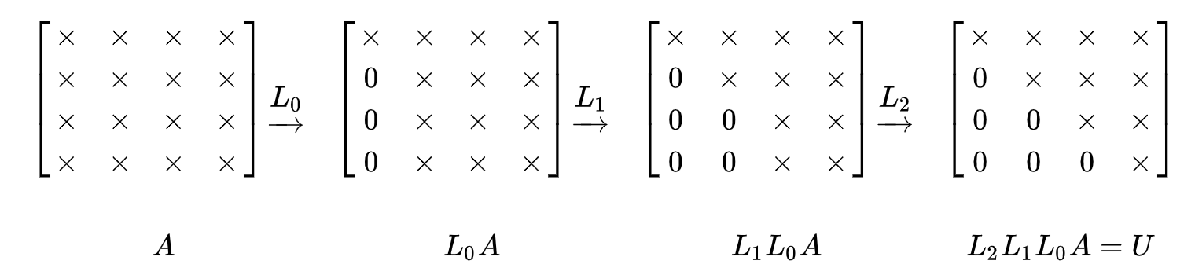

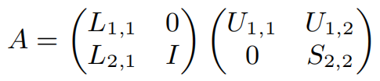

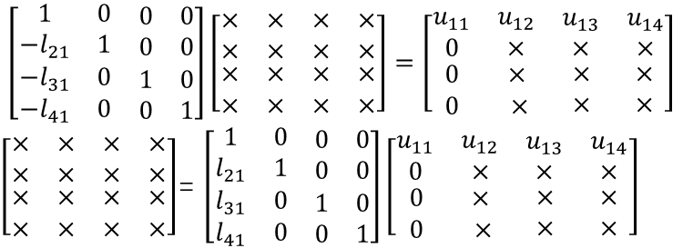
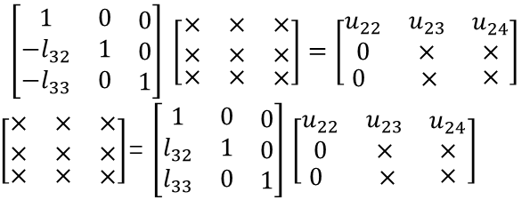
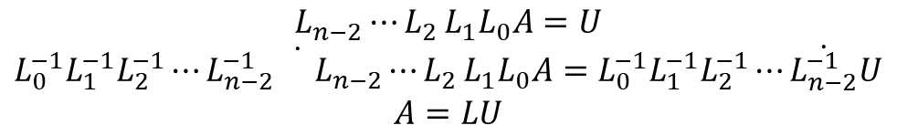
LU分解
LU分解主要应用在数值分析中，用来解线性方程、求反矩阵等，以提高计算效率为目的。
$$L_{n−2}{⋯L}_{2}L_{1}L_{0}A=U$$
$$L_{0}^{−1}L_{1}^{−1}L_{2}^{−1}⋯L_{n−2}^{−1} \dot{}L_{n−2}{⋯L}_{2}L_{1}L_{0}A=L_{0}^{−1}L_{1}^{−1}L_{2}^{−1}⋯\dot{L_{n−2}^{−1}}U$$
$$A=LU$$
$$\left[\begin{matrix}\begin{matrix}1 & 0 \\ −l_{21} & 1\end{matrix} & \begin{matrix}0 & 0 \\ 0 & 0\end{matrix} \\ \begin{matrix}−l_{31} & 0 \\ −l_{41} & 0\end{matrix} & \begin{matrix}1 & 0 \\ 0 & 1\end{matrix}\end{matrix}\right]\left[\begin{matrix}\begin{matrix}× & × \\ × & ×\end{matrix} & \begin{matrix}× & × \\ × & ×\end{matrix} \\ \begin{matrix}× & × \\ × & ×\end{matrix} & \begin{matrix}× & × \\ × & ×\end{matrix}\end{matrix}\right]=\left[\begin{matrix}\begin{matrix}u_{11} & u_{12} \\ 0 & ×\end{matrix} & \begin{matrix}u_{13} & u_{14} \\ × & ×\end{matrix} \\ \begin{matrix}0 & × \\ 0 & ×\end{matrix} & \begin{matrix}× & × \\ × & ×\end{matrix}\end{matrix}\right]$$
$\left[\begin{matrix}\begin{matrix}× & × \\ × & ×\end{matrix} & \begin{matrix}× & × \\ × & ×\end{matrix} \\ \begin{matrix}× & × \\ × & ×\end{matrix} & \begin{matrix}× & × \\ × & ×\end{matrix}\end{matrix}\right]$= $\left[\begin{matrix}\begin{matrix}1 & 0 \\ l_{21} & 1\end{matrix} & \begin{matrix}0 & 0 \\ 0 & 0\end{matrix} \\ \begin{matrix}l_{31} & 0 \\ l_{41} & 0\end{matrix} & \begin{matrix}1 & 0 \\ 0 & 1\end{matrix}\end{matrix}\right]\left[\begin{matrix}\begin{matrix}u_{11} & u_{12} \\ 0 & ×\end{matrix} & \begin{matrix}u_{13} & u_{14} \\ × & ×\end{matrix} \\ \begin{matrix}0 & × \\ 0 & ×\end{matrix} & \begin{matrix}× & × \\ × & ×\end{matrix}\end{matrix}\right]$
$$\left[\begin{matrix}\begin{matrix}1 & 0 \\ −l_{32} & 1\end{matrix} & \begin{matrix}0 \\ 0\end{matrix} \\ \begin{matrix}−l_{33} & 0\end{matrix} & 1\end{matrix}\right] \left[\begin{matrix}\begin{matrix}× & × \\ × & ×\end{matrix} & \begin{matrix}× \\ ×\end{matrix} \\ \begin{matrix}× & ×\end{matrix} & ×\end{matrix}\right]=\left[\begin{matrix}\begin{matrix}u_{22} & u_{23} \\ 0 & ×\end{matrix} & \begin{matrix}u_{24} \\ ×\end{matrix} \\ \begin{matrix}0 & ×\end{matrix} & ×\end{matrix}\right]$$
$\left[\begin{matrix}\begin{matrix}× & × \\ × & ×\end{matrix} & \begin{matrix}× \\ ×\end{matrix} \\ \begin{matrix}× & ×\end{matrix} & ×\end{matrix}\right]$= $\left[\begin{matrix}\begin{matrix}1 & 0 \\ l_{32} & 1\end{matrix} & \begin{matrix}0 \\ 0\end{matrix} \\ \begin{matrix}l_{33} & 0\end{matrix} & 1\end{matrix}\right]$ $\left[\begin{matrix}\begin{matrix}u_{22} & u_{23} \\ 0 & ×\end{matrix} & \begin{matrix}u_{24} \\ ×\end{matrix} \\ \begin{matrix}0 & ×\end{matrix} & ×\end{matrix}\right]$

Slide 4
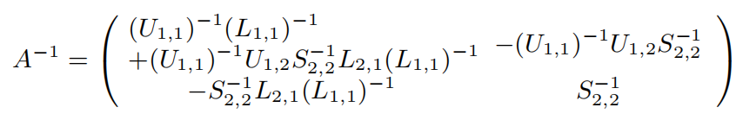

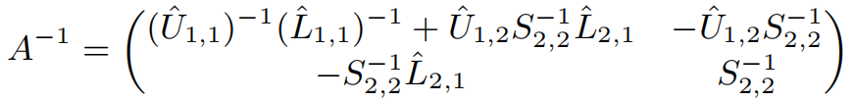
LU分解
$A=LU$ → $A^{−1}=U^{−1}L^{−1}$=${\left(\begin{matrix}U_{11} & U_{12} \\ 0 & S_{22}\end{matrix}\right)}^{−1}{\left(\begin{matrix}L_{11} & 0 \\ L_{21} & I\end{matrix}\right)}^{−1}$= $\left(\begin{matrix}U_{11}^{−1} & {−U_{11}^{−1}U}_{12}S_{22}^{−1} \\ 0 & S_{22}^{−1}\end{matrix}\right)$ $\left(\begin{matrix}L_{11}^{−1} & 0 \\ {−L}_{21}L_{11}^{−1} & I\end{matrix}\right)$

Slide 5
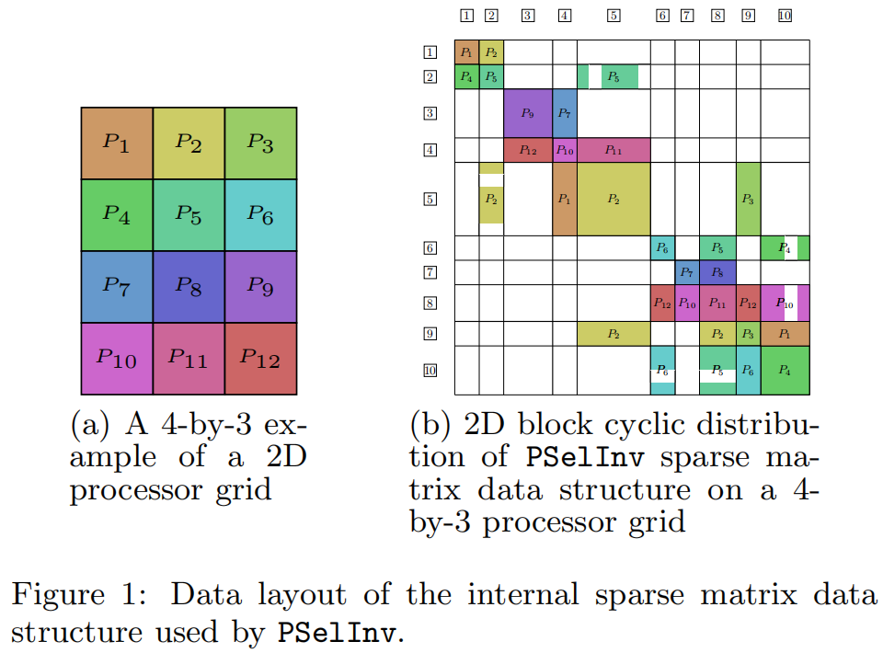

Super node
20*20~80*80

Slide 6
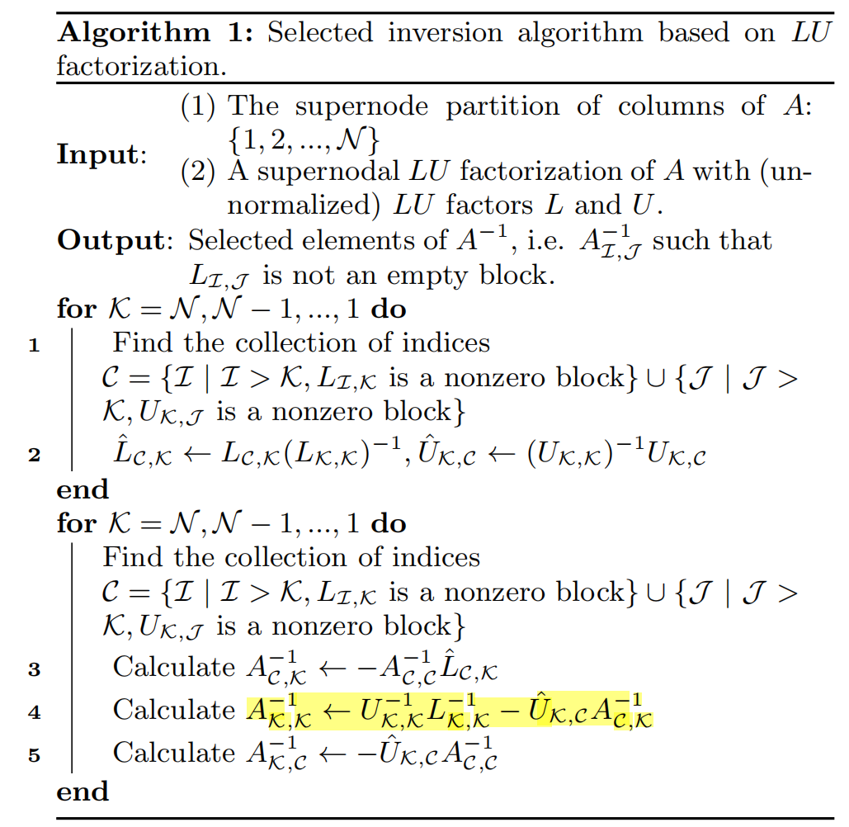
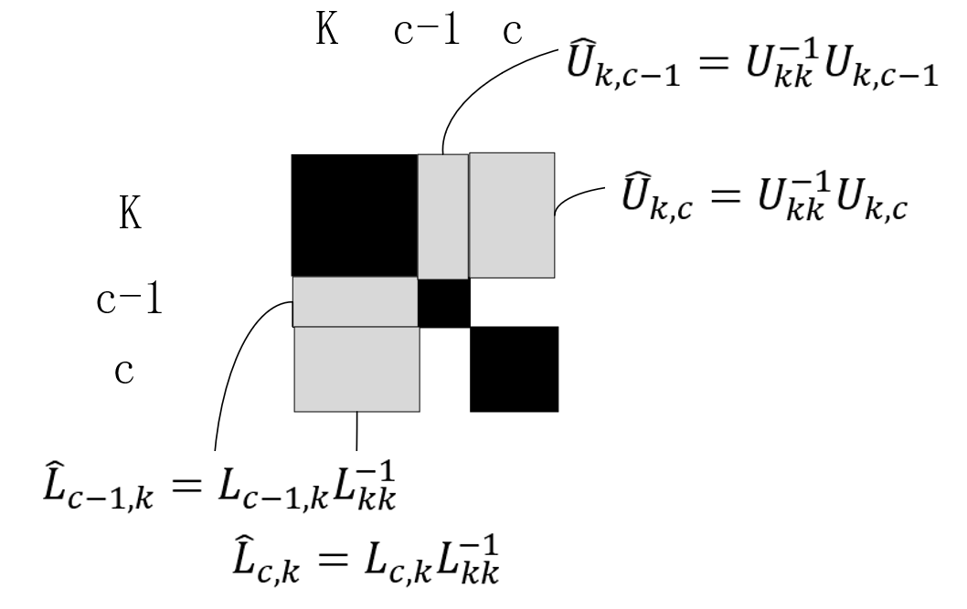
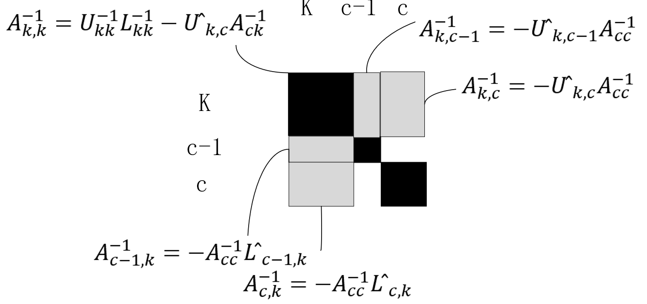
Alg:

Slide 7
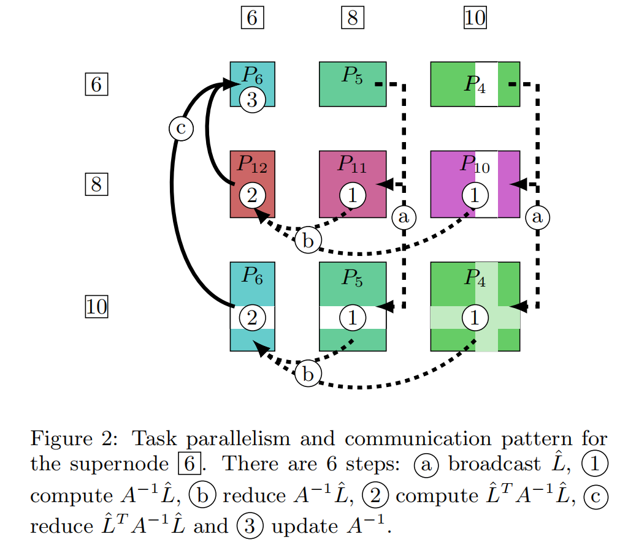
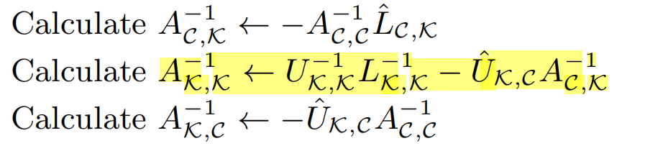
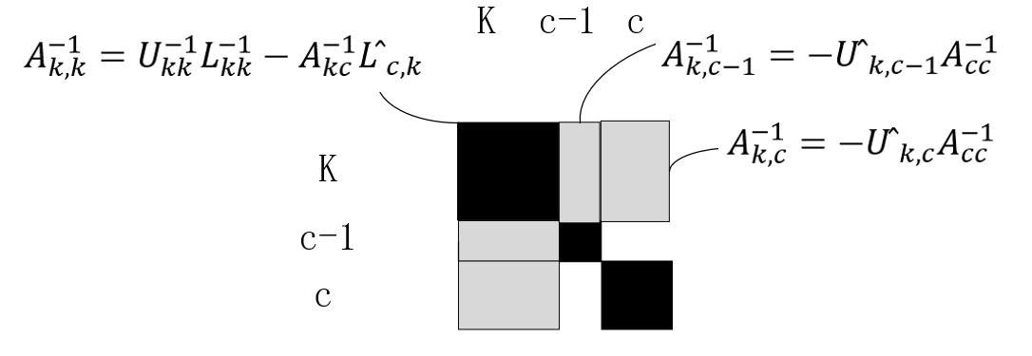
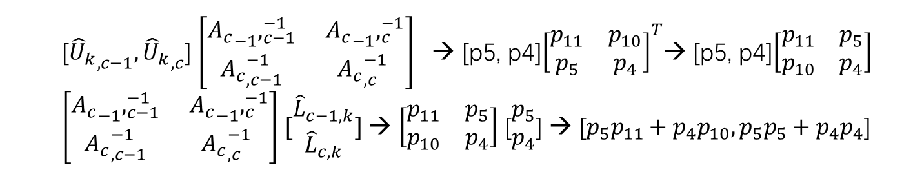
For symmetric matrix
[${{\hat{U}}_{k}}_{,c−1},{{\hat{U}}_{k}}_{,c}$] ${\left[\begin{matrix}{A_{c}}_{−1},_{c−1}^{−1} & {A_{c}}_{−1},_{c}^{−1} \\ {A_{c}}_{,c−1}^{−1} & {A_{c}}_{,c}^{−1} \end{matrix}\right]}^{}$→ [p5, p4]${\left[\begin{matrix}p_{11} & p_{10} \\ p_{5} & p_{4}\end{matrix}\right]}^{T}$→ [p5, p4]$\left[\begin{matrix}p_{11} & p_{5} \\ p_{10} & p_{4}\end{matrix}\right]$
$\left[\begin{matrix}{A_{c}}_{−1},_{c−1}^{−1} & {A_{c}}_{−1},_{c}^{−1} \\ {A_{c}}_{,c−1}^{−1} & {A_{c}}_{,c}^{−1} \end{matrix}\right]$ $[\begin{matrix}{\hat{L}}_{c−1,k} \\ {\hat{L}}_{c,k}\end{matrix}]$→ $\left[\begin{matrix}p_{11} & p_{5} \\ p_{10} & p_{4}\end{matrix}\right]$ [$\begin{matrix}p_{5} \\ p_{4}\end{matrix}$] → [$p_{5}p_{11}+p_{4}p_{10}, p_{5}p_{5}+p_{4}p_{4}$]

Slide 8
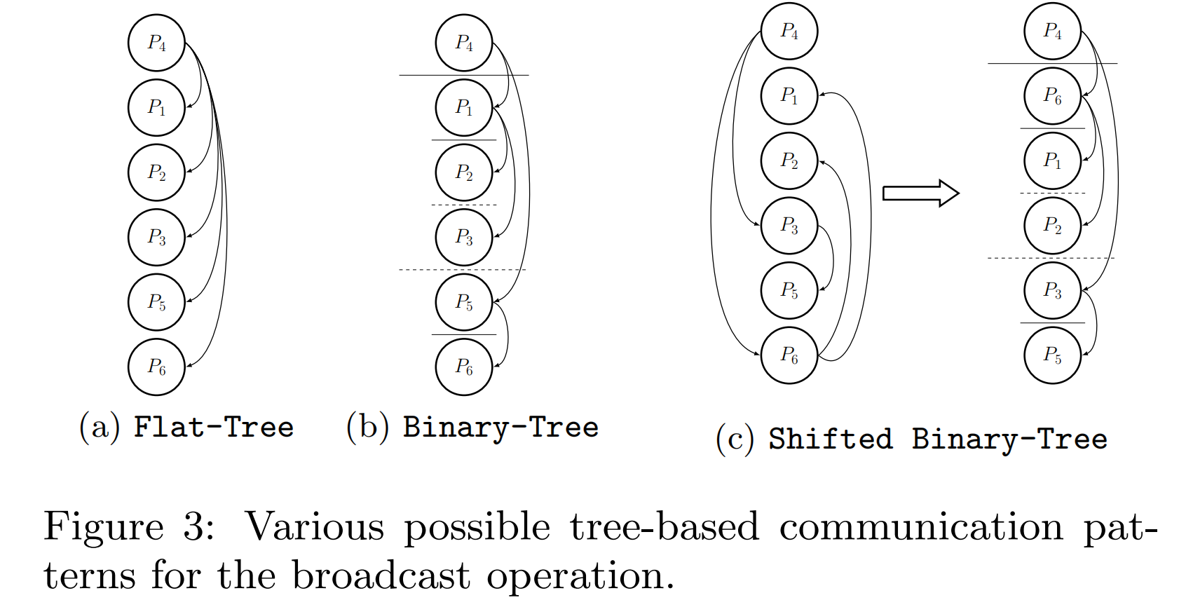
Shifted binary tree(random circular shift)
In most MPI implementations, ranks are assigned so that consecutive ranks first fill up a node, and then fill the closest node physically, and so on.
It is thus very likely that jobs placed on machines ranks that are logically close in MPI_COMM_WORLD are also physically close to each other.
broadcast implementation should be to minimize the amount of data that needs to be transferred at long distance, both logically and physically (avoiding hot spots).

Slide 9
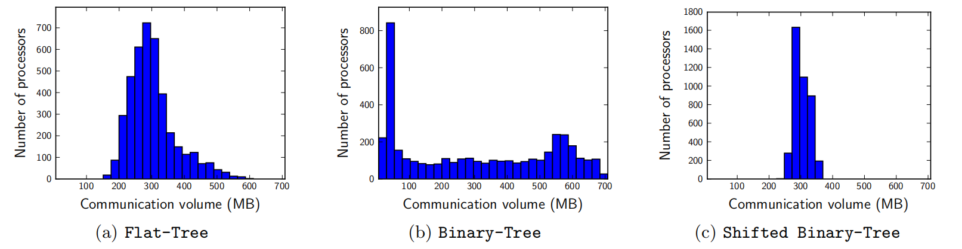
Experiments
By using point-to-point asynchronous communication functions (MPI_Isend and MPI_Irecv), performing parallel selected inversion efficiently on 256 ∼ 1, 024 processors
DG PNF14000 matrix: processors P = 256 , the communication cost is 27%, GEMM routine is 73%
P = 4096 , the communication cost is 89%, GEMM routine is 11%
The matrix size is 512,000, with 0.2% nonzeros

Slide 10
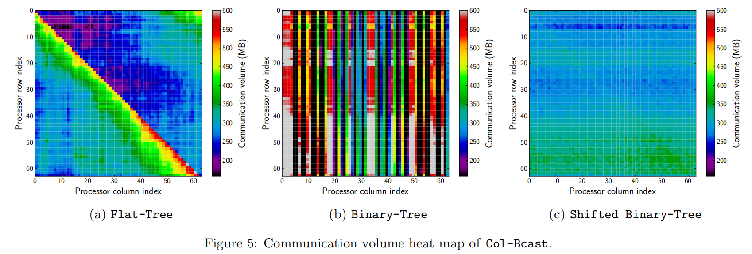
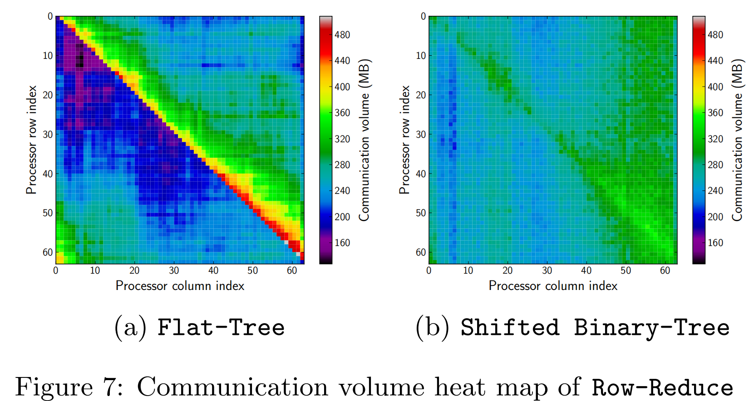
Experiments
Platform：Cray XC30，Each node has 24 cores partitioned among two Intel Ivy Bridge processors. Each 12-core processor runs at 2.4GHz. A single node has 64GB of memory, providing more than 2.6 GB of memory per core.

Slide 11
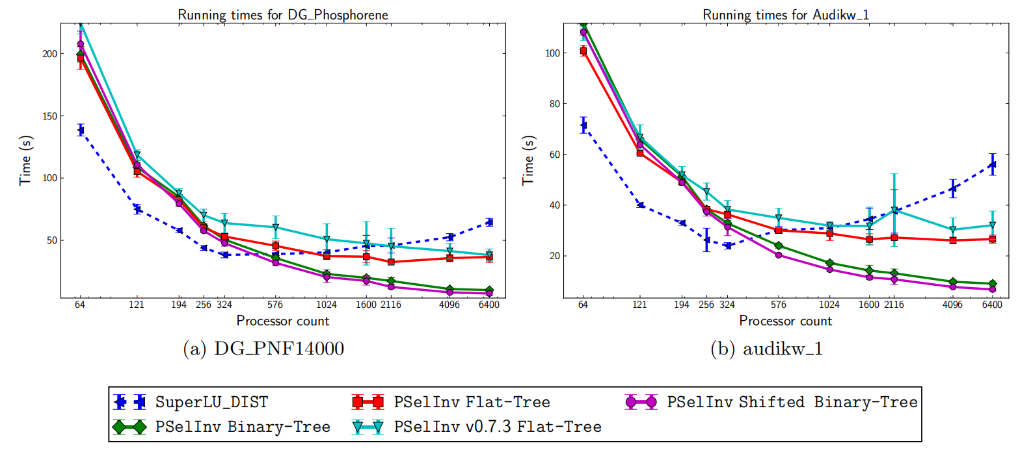
Experiments
scaling

Slide 12
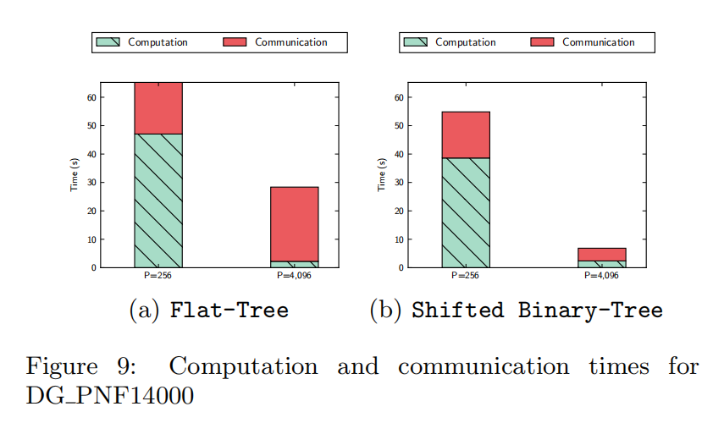
Experiments
Computing time vs communication time

