Slide 1
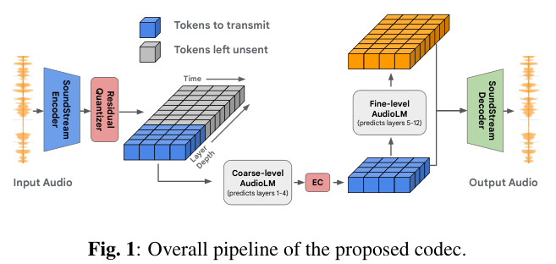
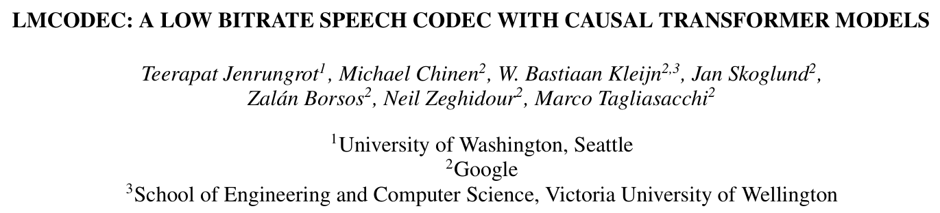
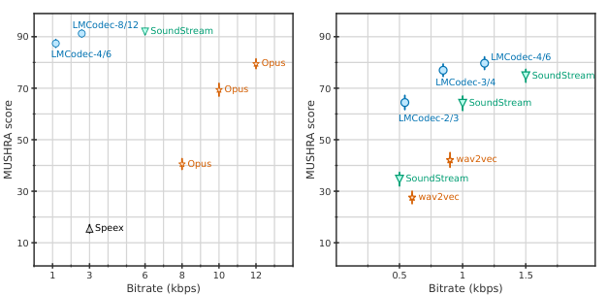
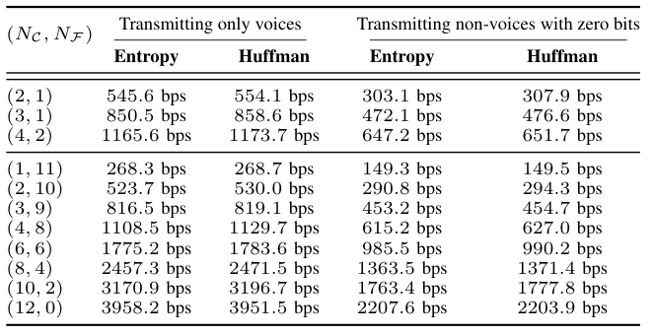
Innovation: LM_coarse for lossless compression
LM_fine for generating fine code from coarse code
Evaluation: 20ms algorithmic delay
compare with SoundStream, opus
VAD

Slide 2
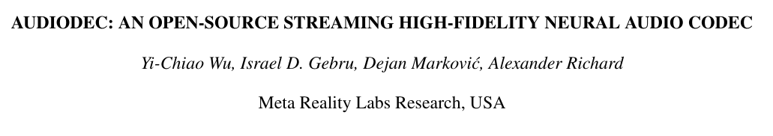
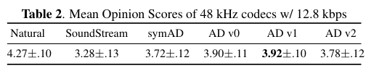
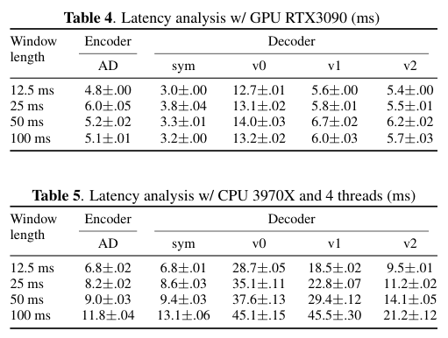
Innovation: Efficient Training Paradigm
modified HiFiGAN generator for real time application
Evaluation: 48kHz@12.8kbps/24kHz@6.4kbps outperforms SoundStream
training speed analysis
latency analysis

Slide 3
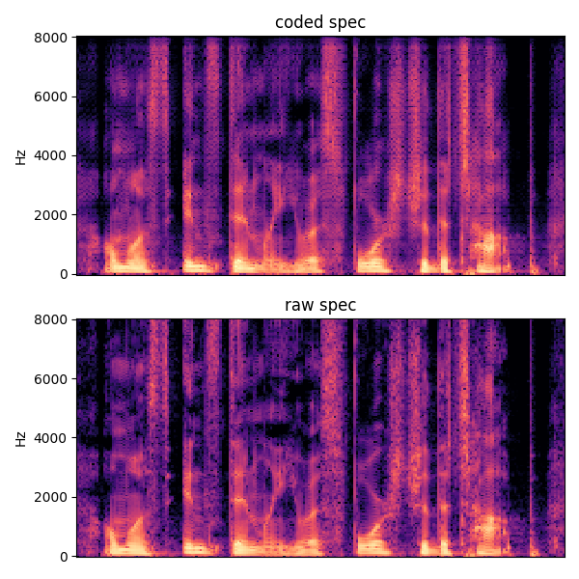
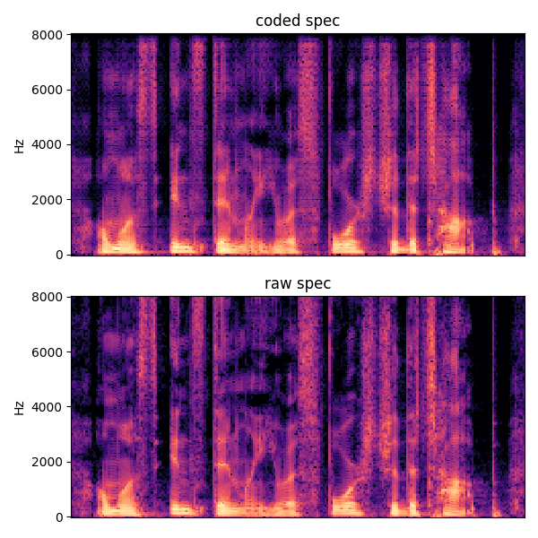
Magri+MelL1
fine tune with adv training
(MPD + MSD)
PESQ: 3.38 -> 3.33
STOI: 0.96 ->0.96

Slide 4
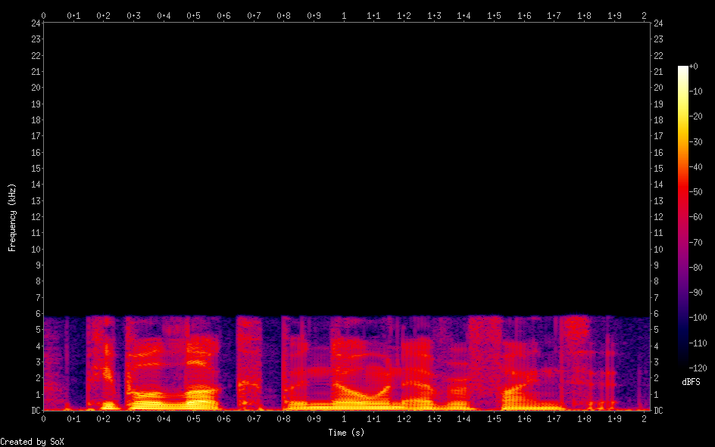
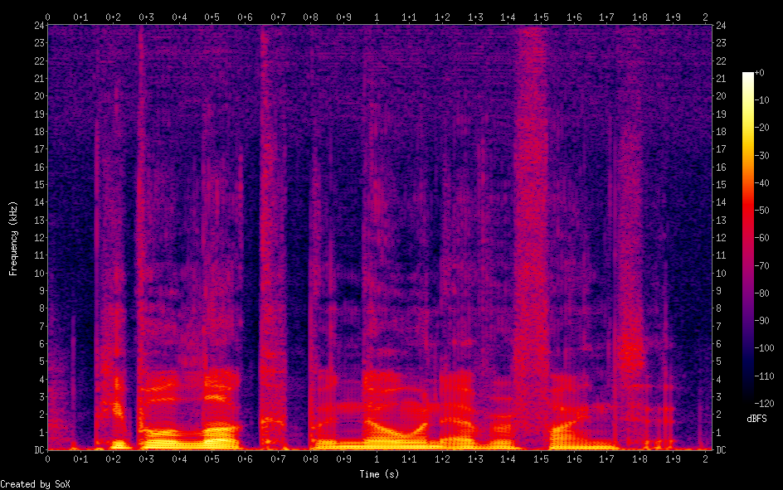
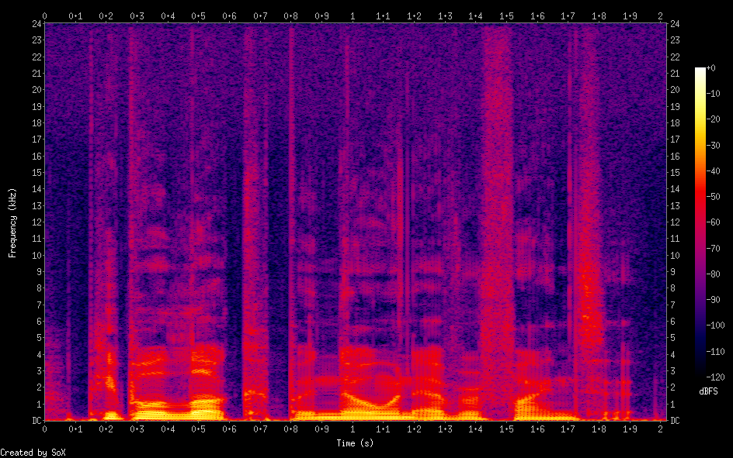
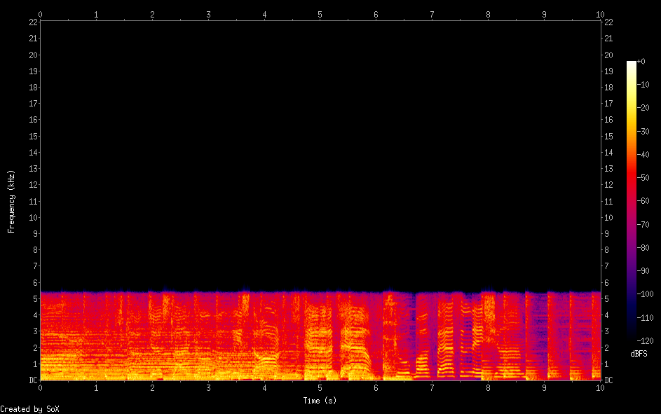
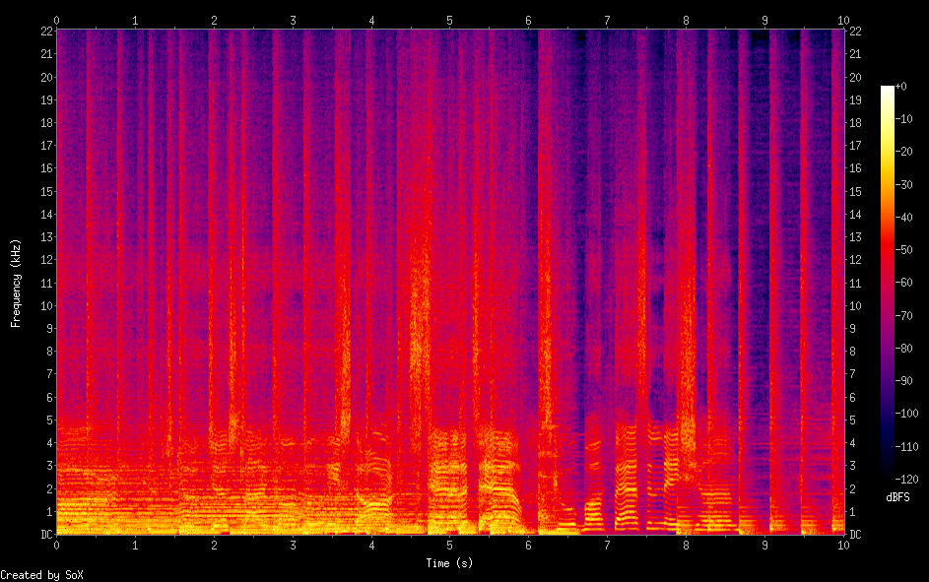
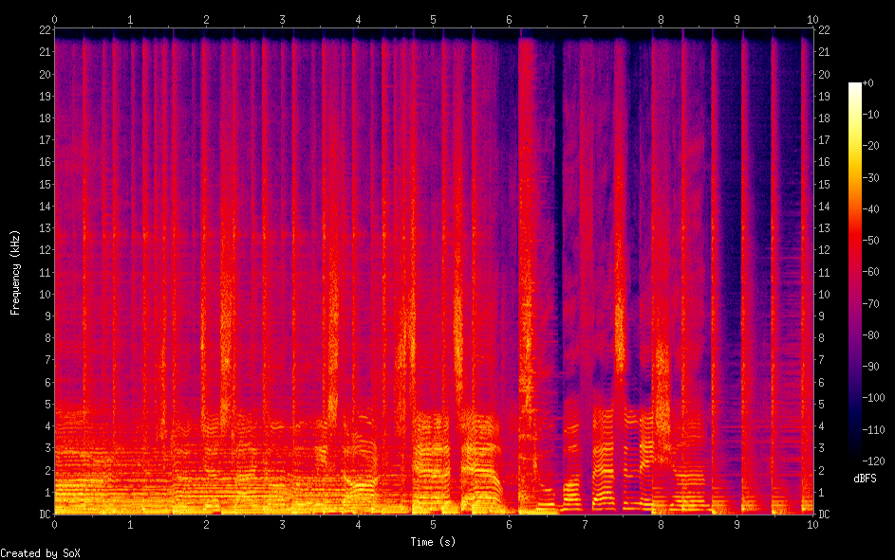
Speech
Audio
LR BWE HR

Slide 5
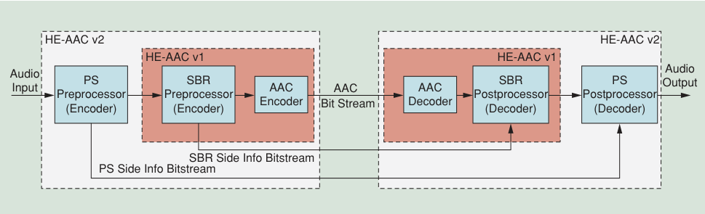
NN-Based SBR side info extractor
NN-Based BWE Model
NN-Based BWE Model

